Slide 1
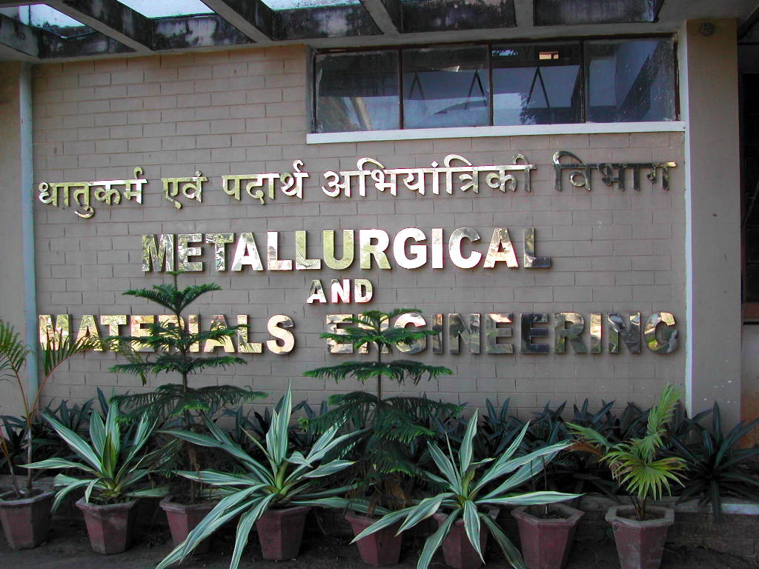

Thermodynamics
Thermodynamic functions
Equilibrium state
Case study: mechanical alloying
Computer calculation: phase diagrams
Thermodynamics - irreversible
Quasichemical models
https://www.phase-trans.msm.cam.ac.uk/teaching.html
H. K. D. H. Bhadeshia

Slide 3
Ideal solution: random distribution of atoms
Regular solution: excess Gibbs energy
Symmetric about x=0.5

Slide 4
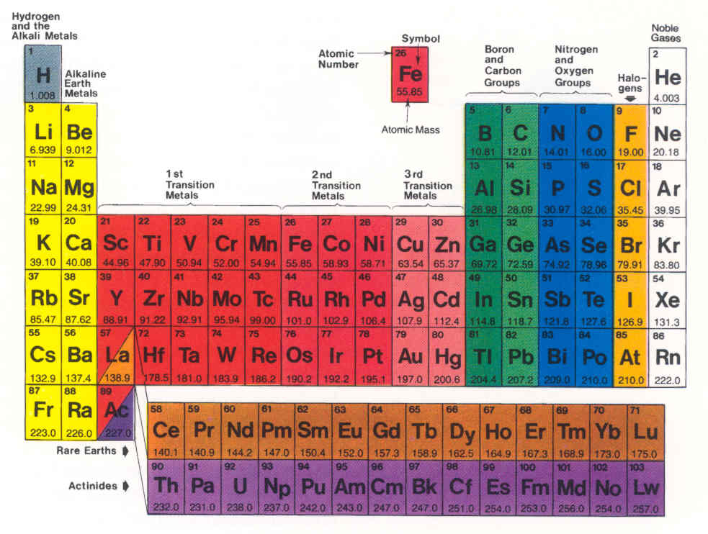

Slide 6
binary solution

Slide 7
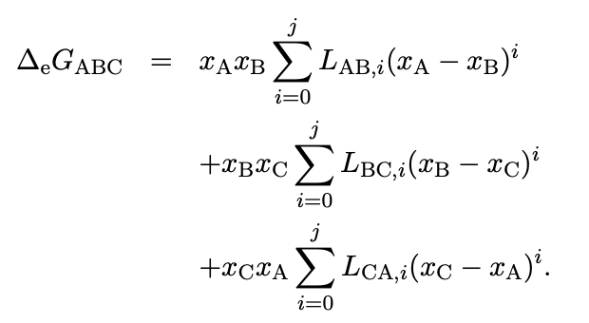
approximate ternary system based on binary data

Slide 8
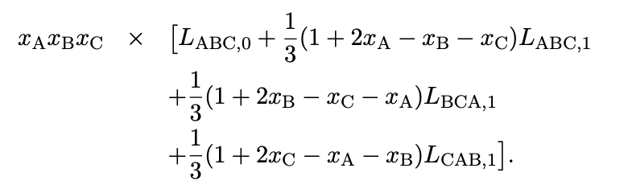
ternary system interactions

Slide 9
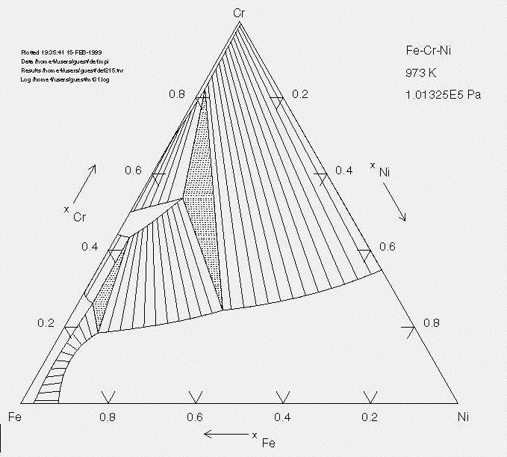

Slide 10
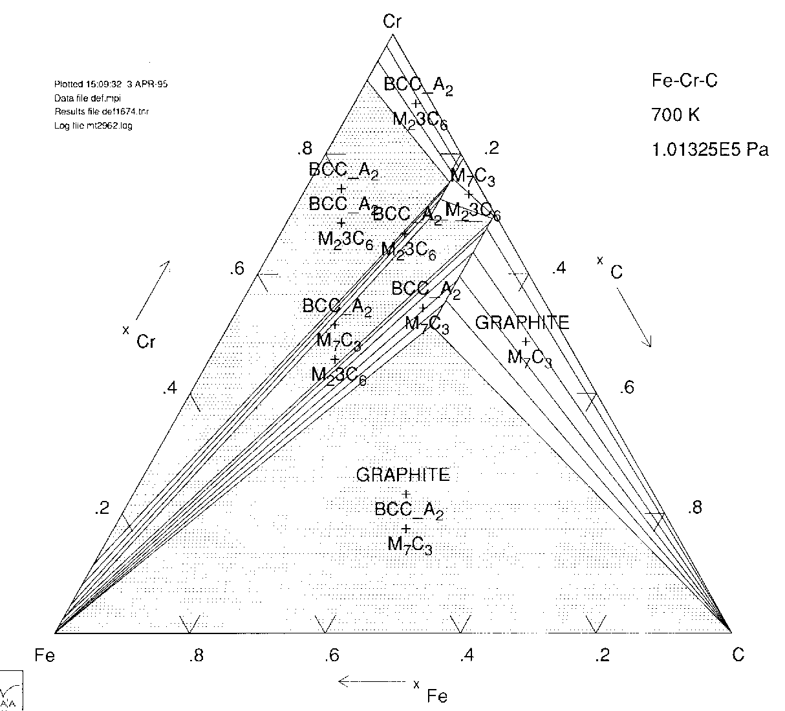

Slide 11
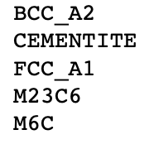
Fe-0.14C-0.25Si-0.35Mn-0.125Ni-0.05Mo-1.45Cr wt%

Slide 12
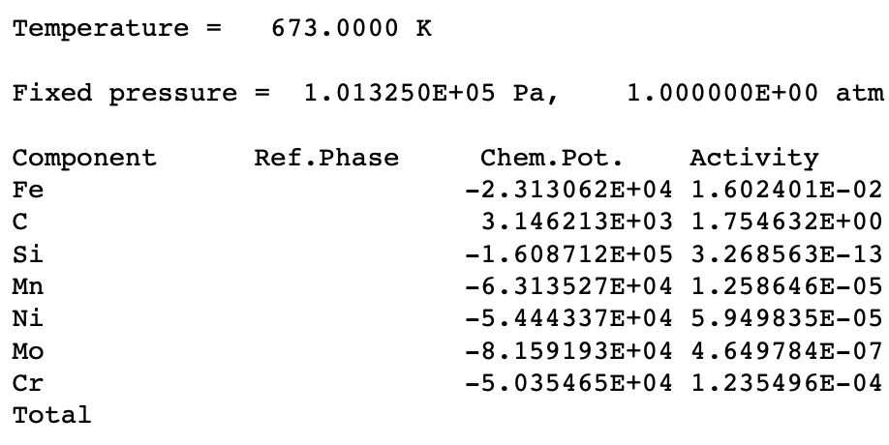

Slide 13
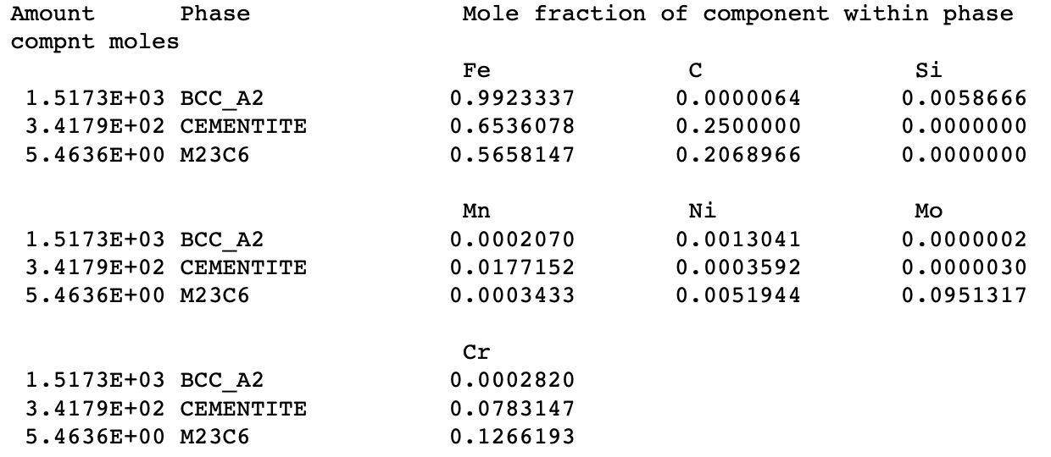

Slide 14

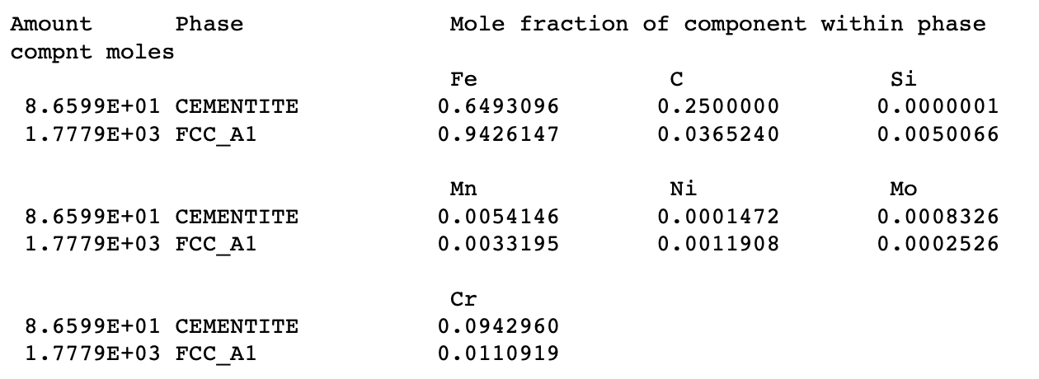

Slide 15
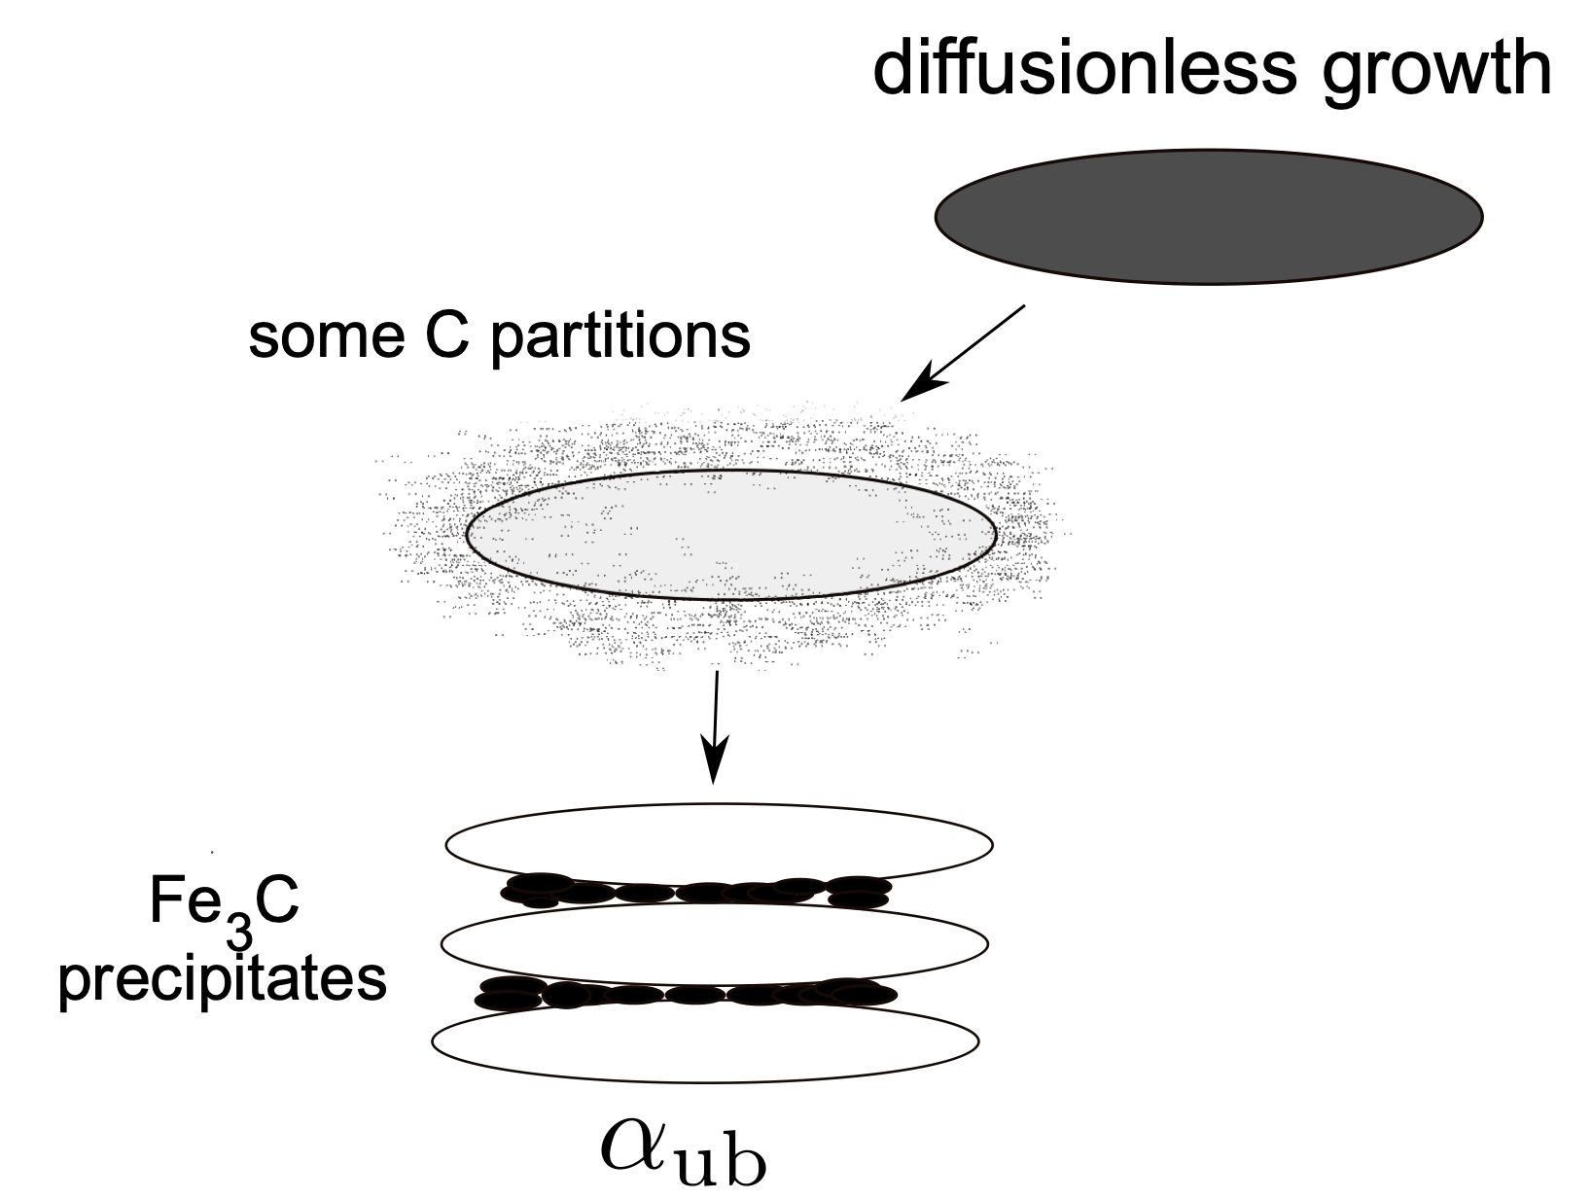
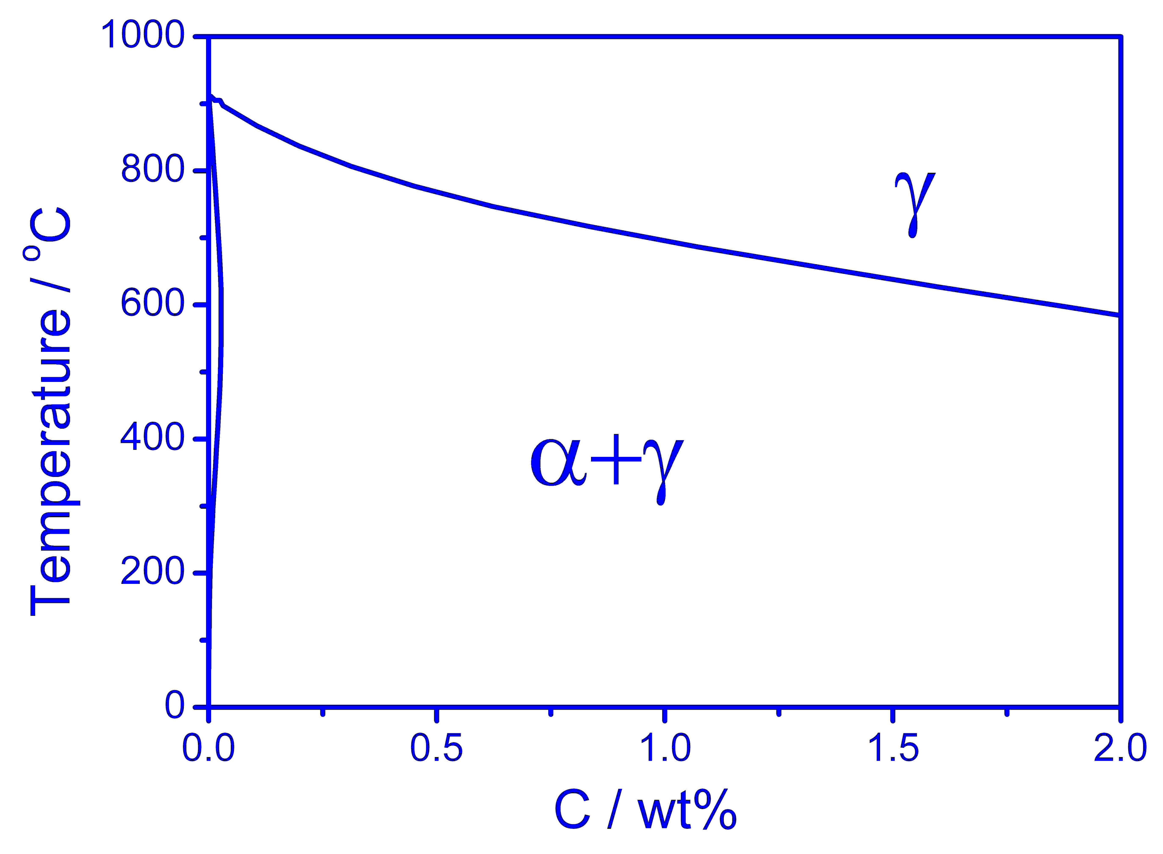
Composition following transformation
Bhadeshia, Met. Sci. (1982)

Slide 16
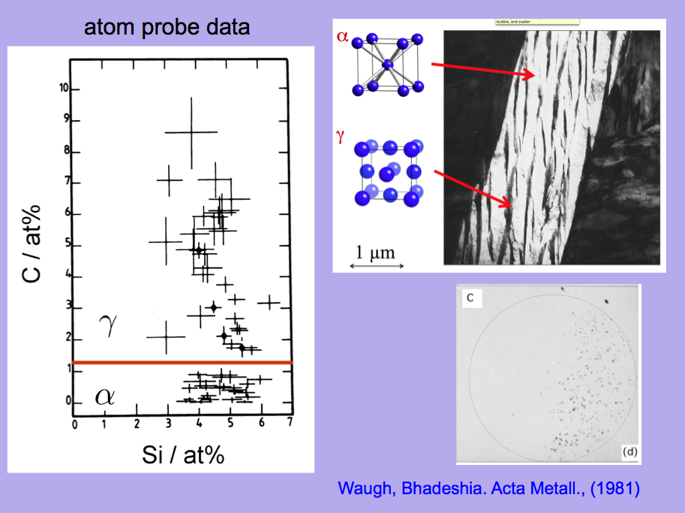

Slide 17
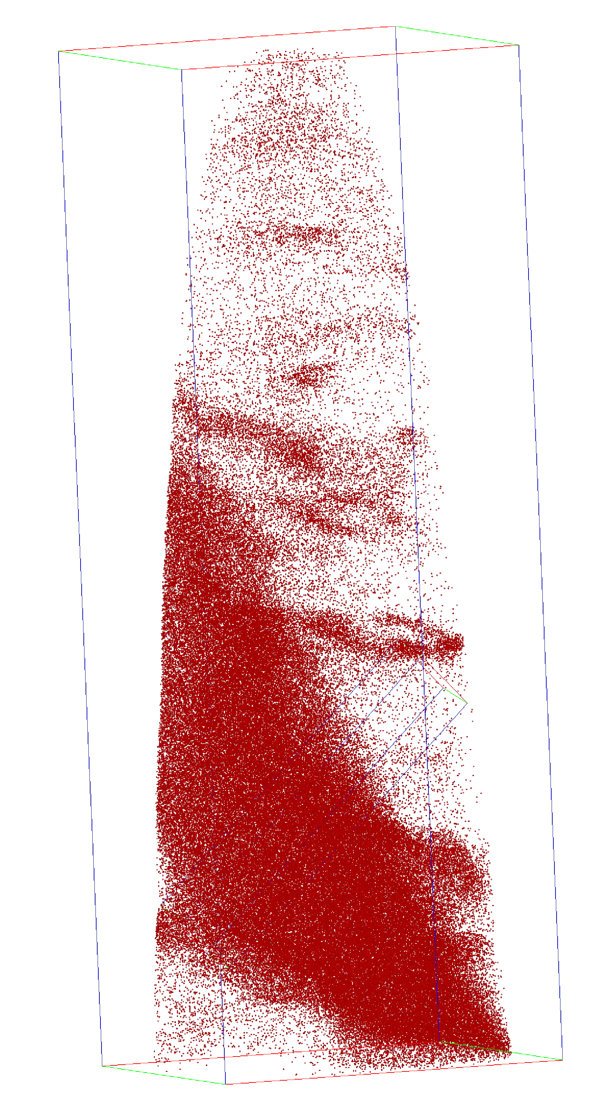
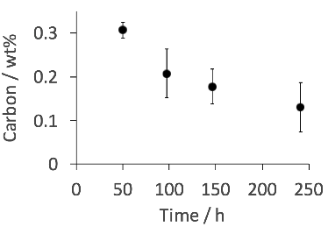
Large carbon concentration in solution in ferrite
Ferrite
Pereloma, Beladi, Zhang, Timokhina,
Metall. Mat. Trans. A 43 (2012) 3958
Caballero, Miller, Mateo, Cornide.
J. Alloys & Compounds 577 (2013) S626
Dislocation
Austenite
Courtesy of Francisca Garcia Caballero

Slide 18
Against all expectations,
huge excess concentration of carbon in ferrite
stays within the ferrite in spite of stimulation by heat treatment
leads to an inversion of hardness

Slide 19
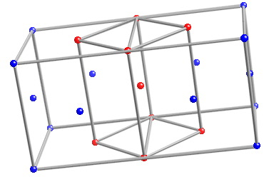
A diffusionless transformation will necessarily lead to a body-centred tetragonal ferrite in steel.

Slide 20
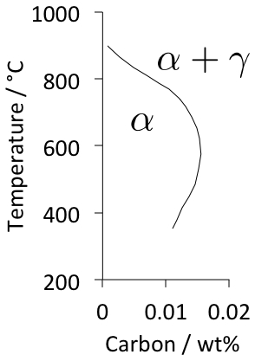
Huge increase in solubility; ferrite with tetragonal symmetry
Jang, Suh, Bhadeshia, Scr. Mat. 68 (2012) 195

Slide 21
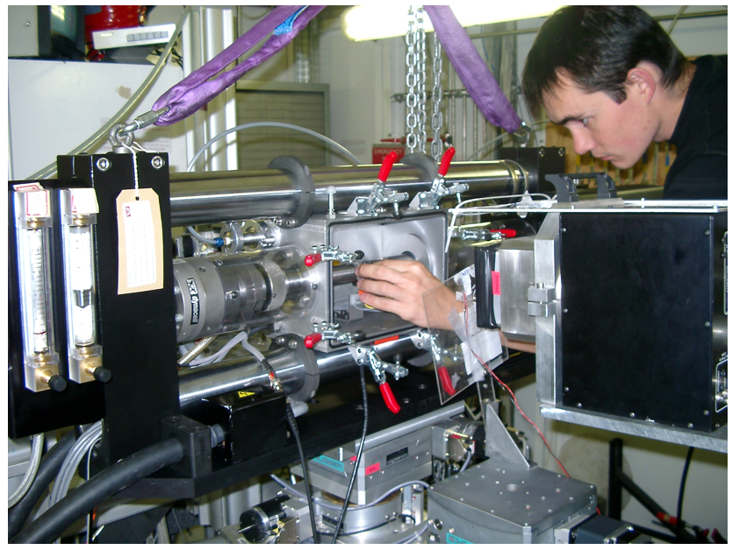
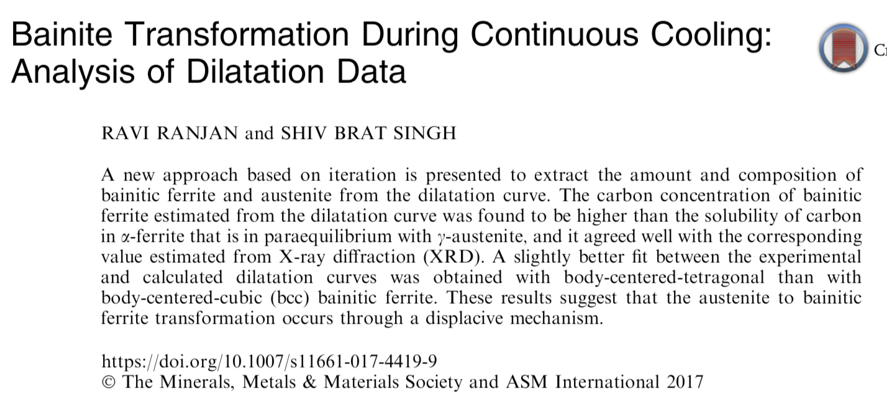
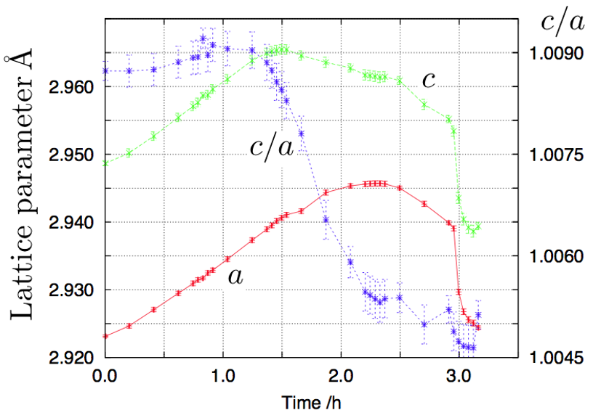

Slide 23
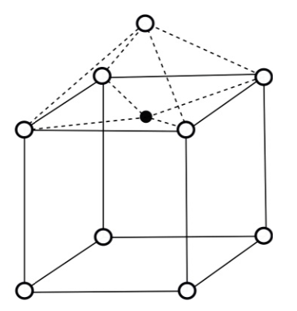

Slide 24

{
McLellan & Wasz 1988

Slide 25
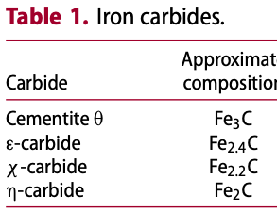

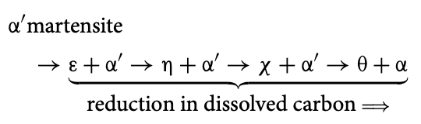
thermodynamic data may sometimes be incorrect

Slide 26
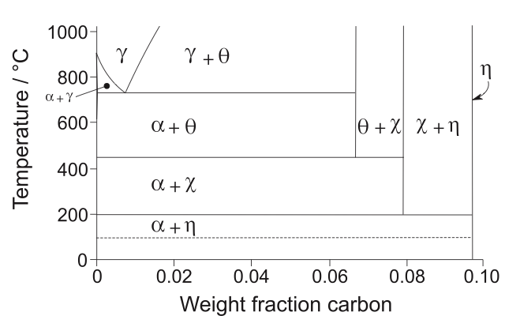
Naraghi et al. Calphad. 2014;46:148–158

Slide 27
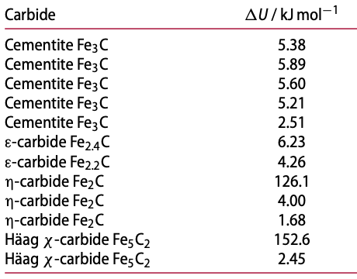

first principles data

Slide 28
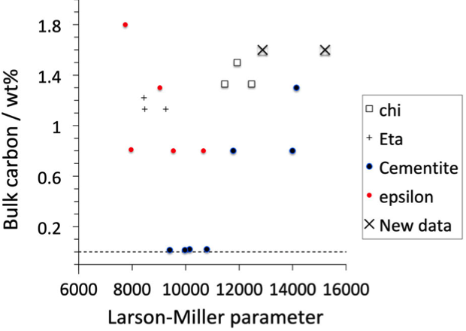
Bhadeshia, Chintha, Lenka, Mat. Sci. Techn. 35 (2019) 1301

Slide 30
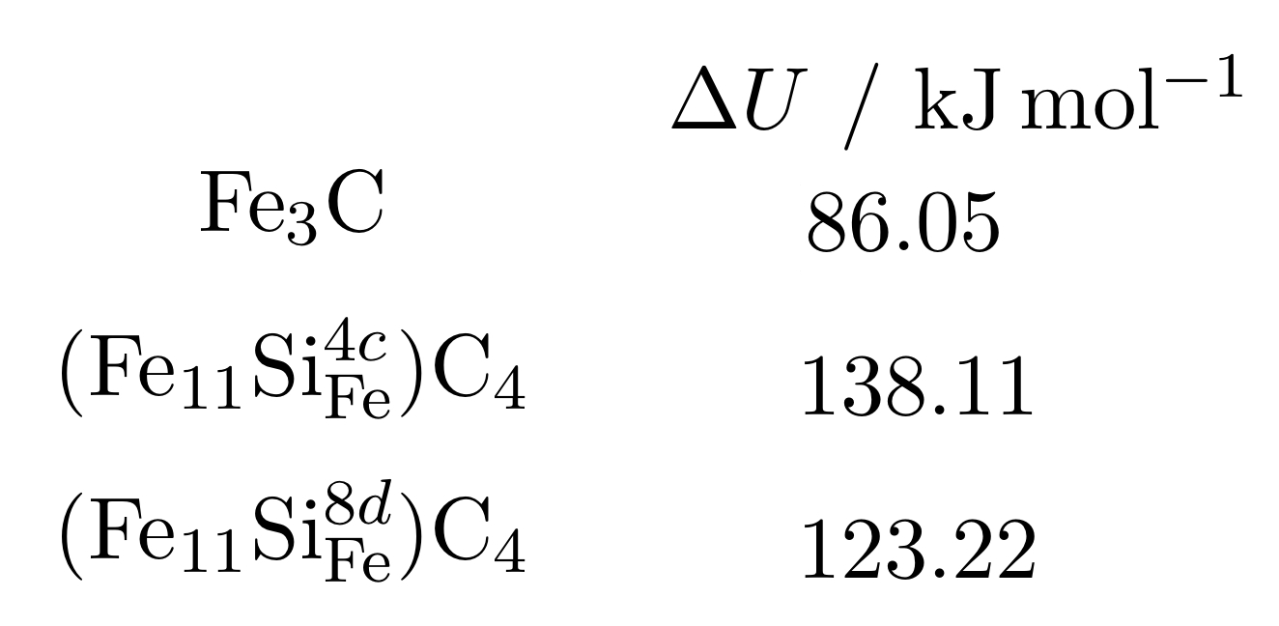
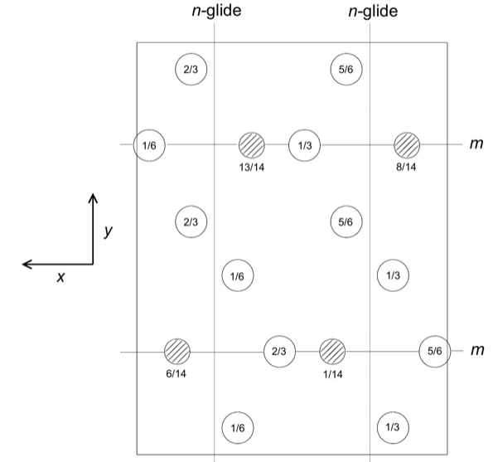
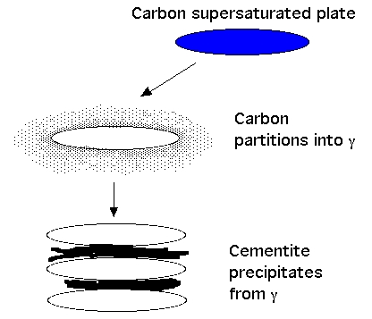
Jang, Kim, Bhadeshia
Notes:
30

Slide 31
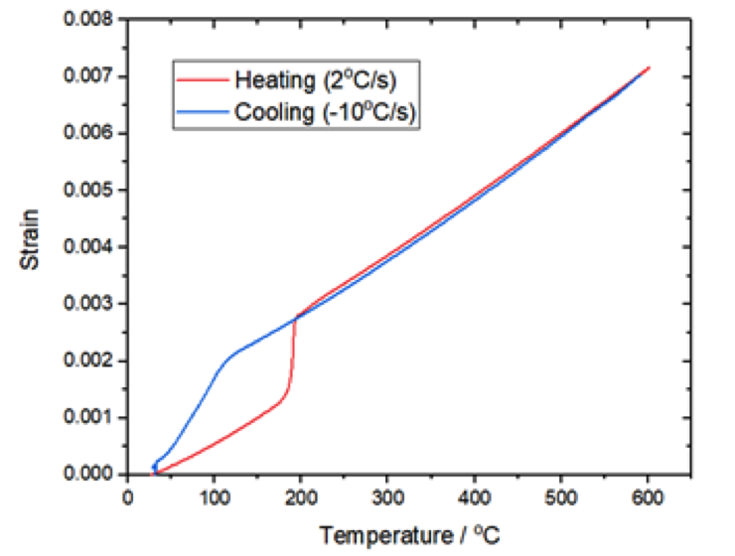
epsilon
martensite
Fe-20 wt% Jang & Bhadeshia, 2020
unsolved problem

Slide 32
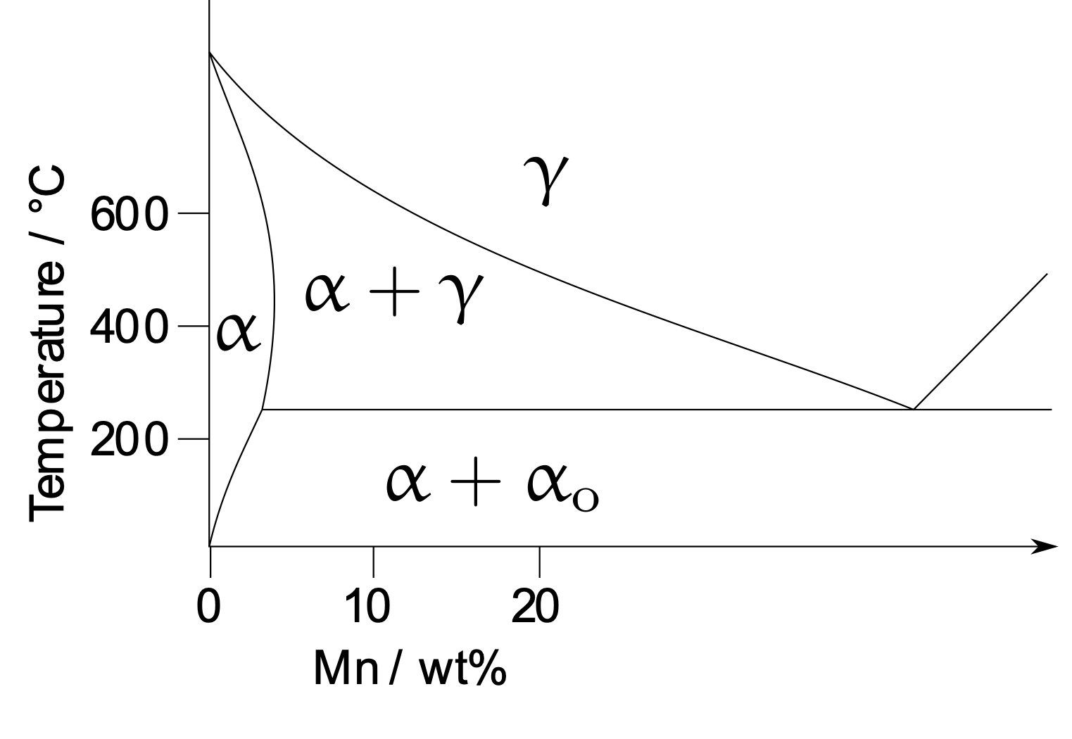

Slide 33
