Slide 1
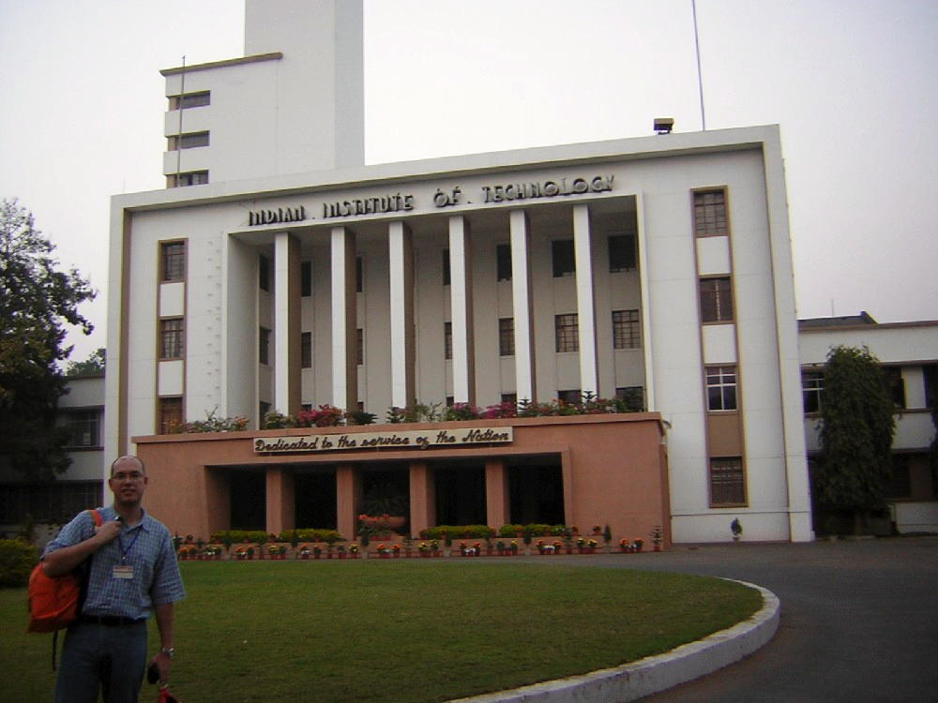

Thermodynamics
Thermodynamic functions
Equilibrium state
Case study: mechanical alloying
Computer calculation: phase diagrams
Thermodynamics - irreversible
Quasichemical models
https://www.phase-trans.msm.cam.ac.uk/teaching.html
H. K. D. H. Bhadeshia

Slide 2
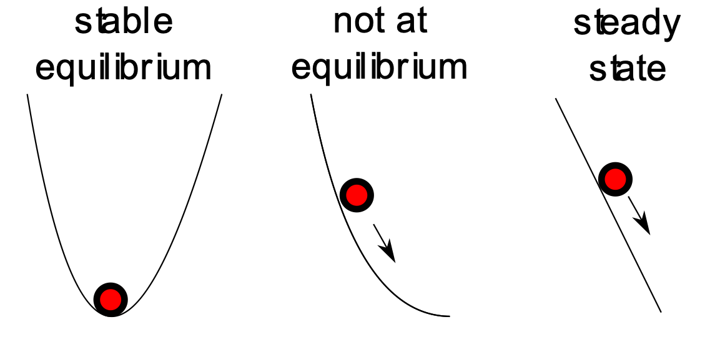
dissipating free energy

Slide 3
reversible
irreversible

Slide 4
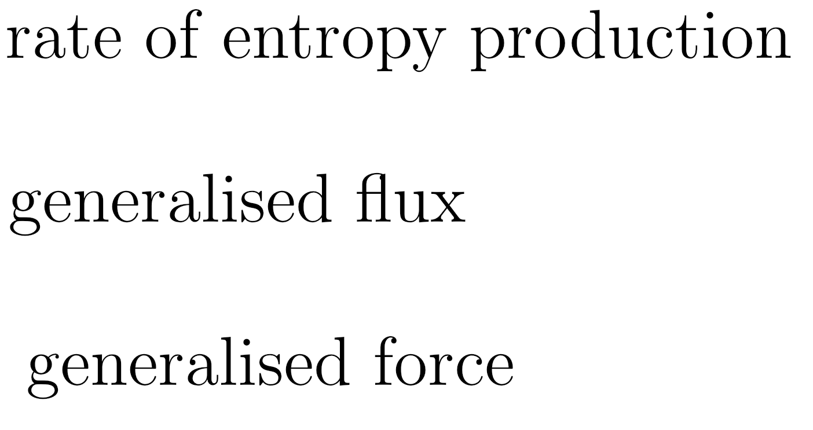
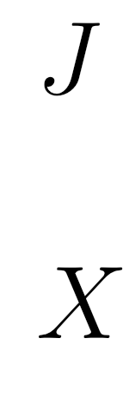

Slide 6
Heat transfer

Slide 7
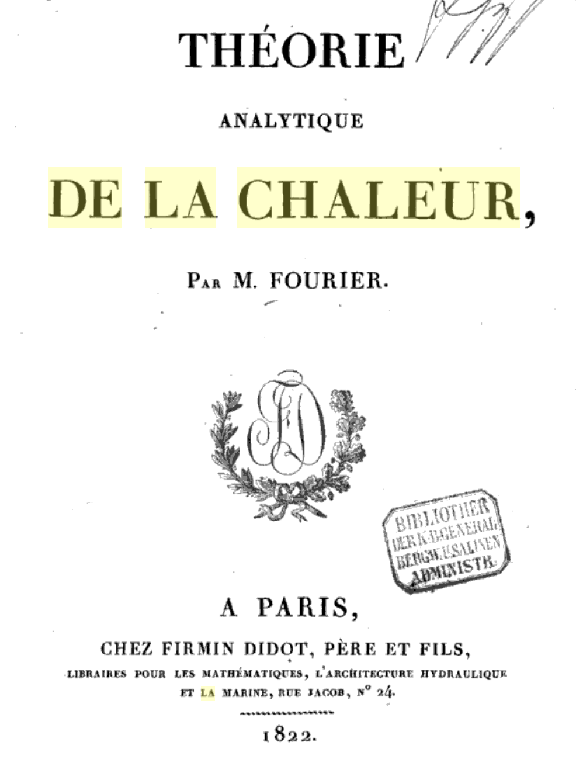

Slide 8
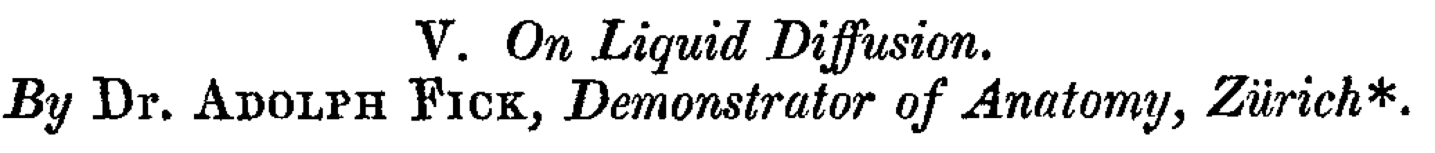
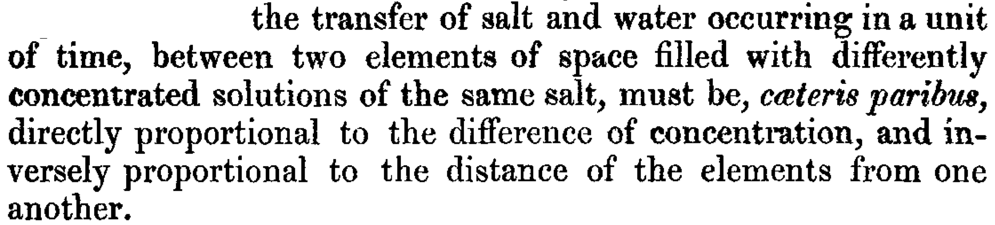
(1855)
}
concentration
gradient
flux
diffusion
coefficient

Slide 9
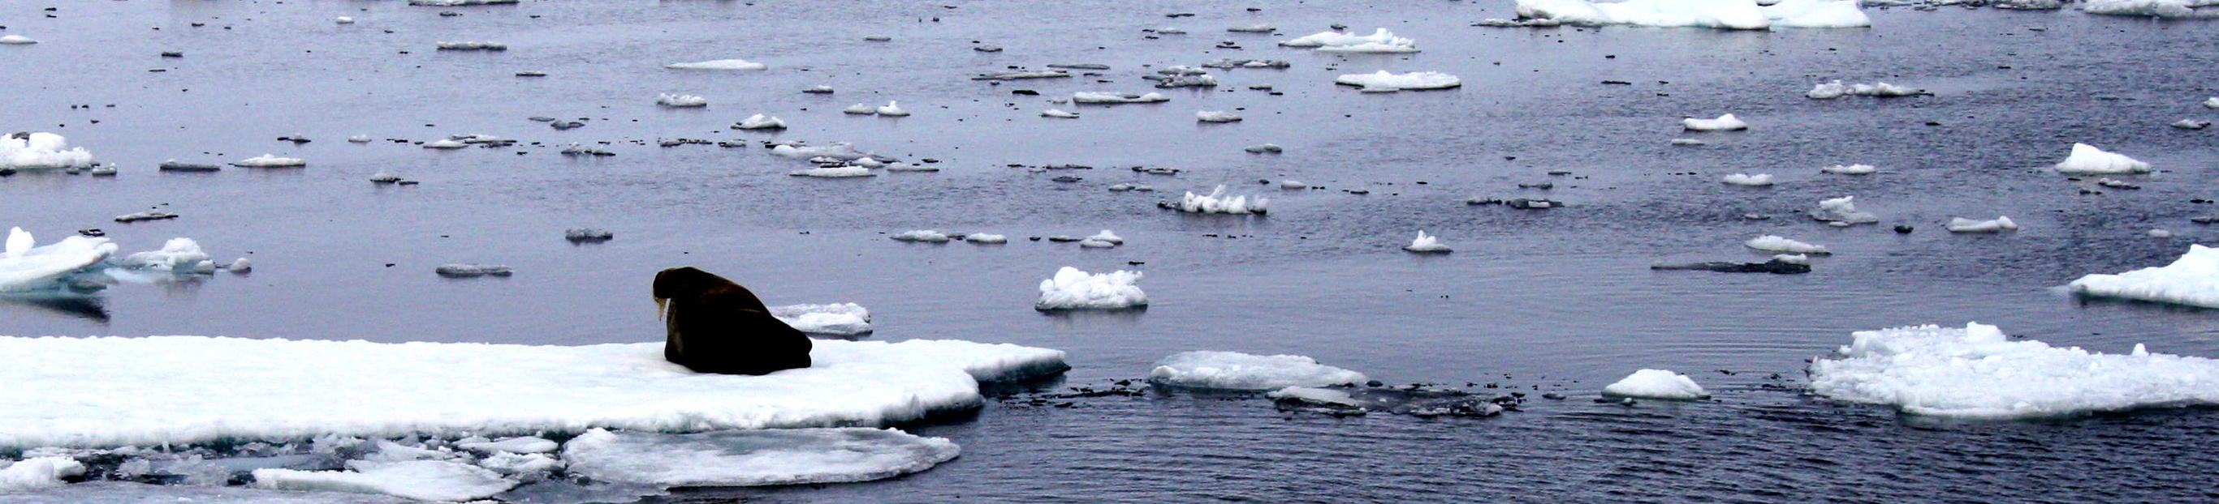

Slide 11
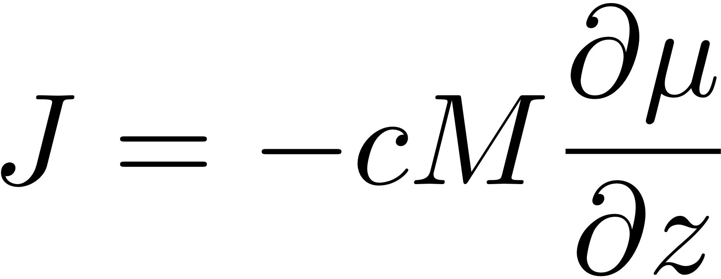

Slide 12
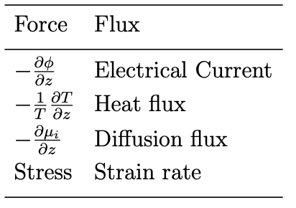
All of these processes driven by free energy gradients.

Slide 13

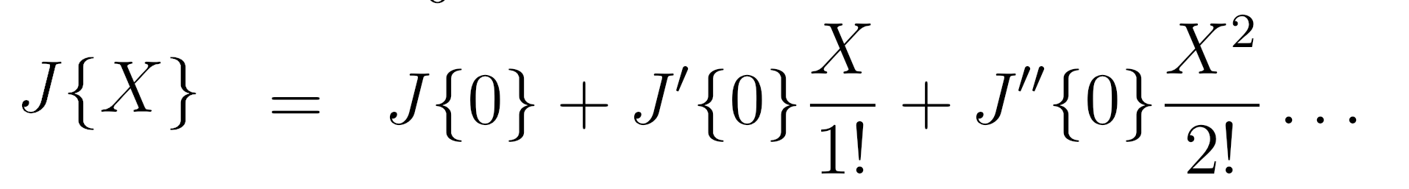
polynomial expansion of flux
as a function of force

Slide 15
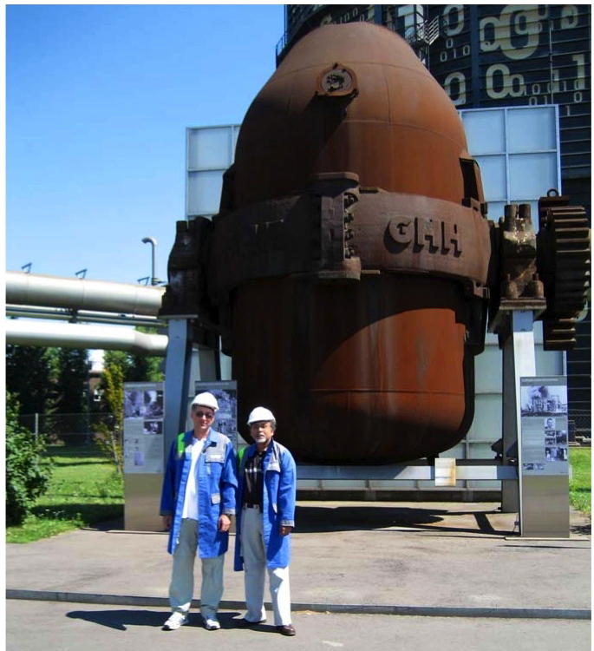
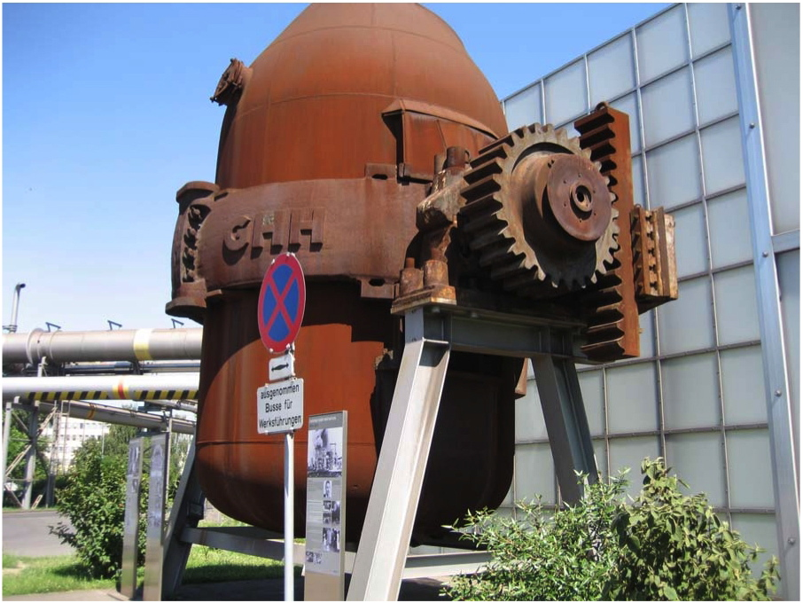
Linz-Donawitz converter, picture courtesy of Professor Nirupam Chakraborti.
High pressure oxygen is blown and a slag of lime and dolomite used, to help remove phosphorus.

Slide 16
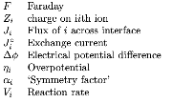
Slag-metal interfacial reactions are electrochemical
W.-K. Lu, ISIJ Int. 11 (1971) 32.

Slide 17
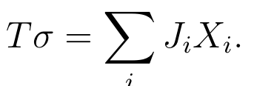



Slide 18
(at equilibrium, any microscopic processes and their reverse must occur at the same average rate)

Slide 19
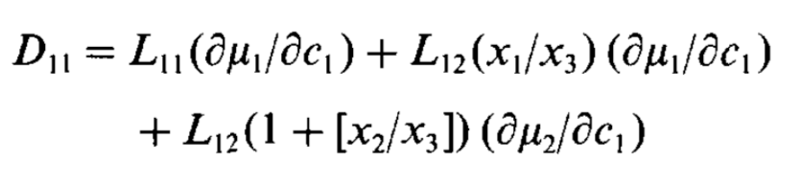
Progress in Materials Science 29 (1985) 336

Slide 20
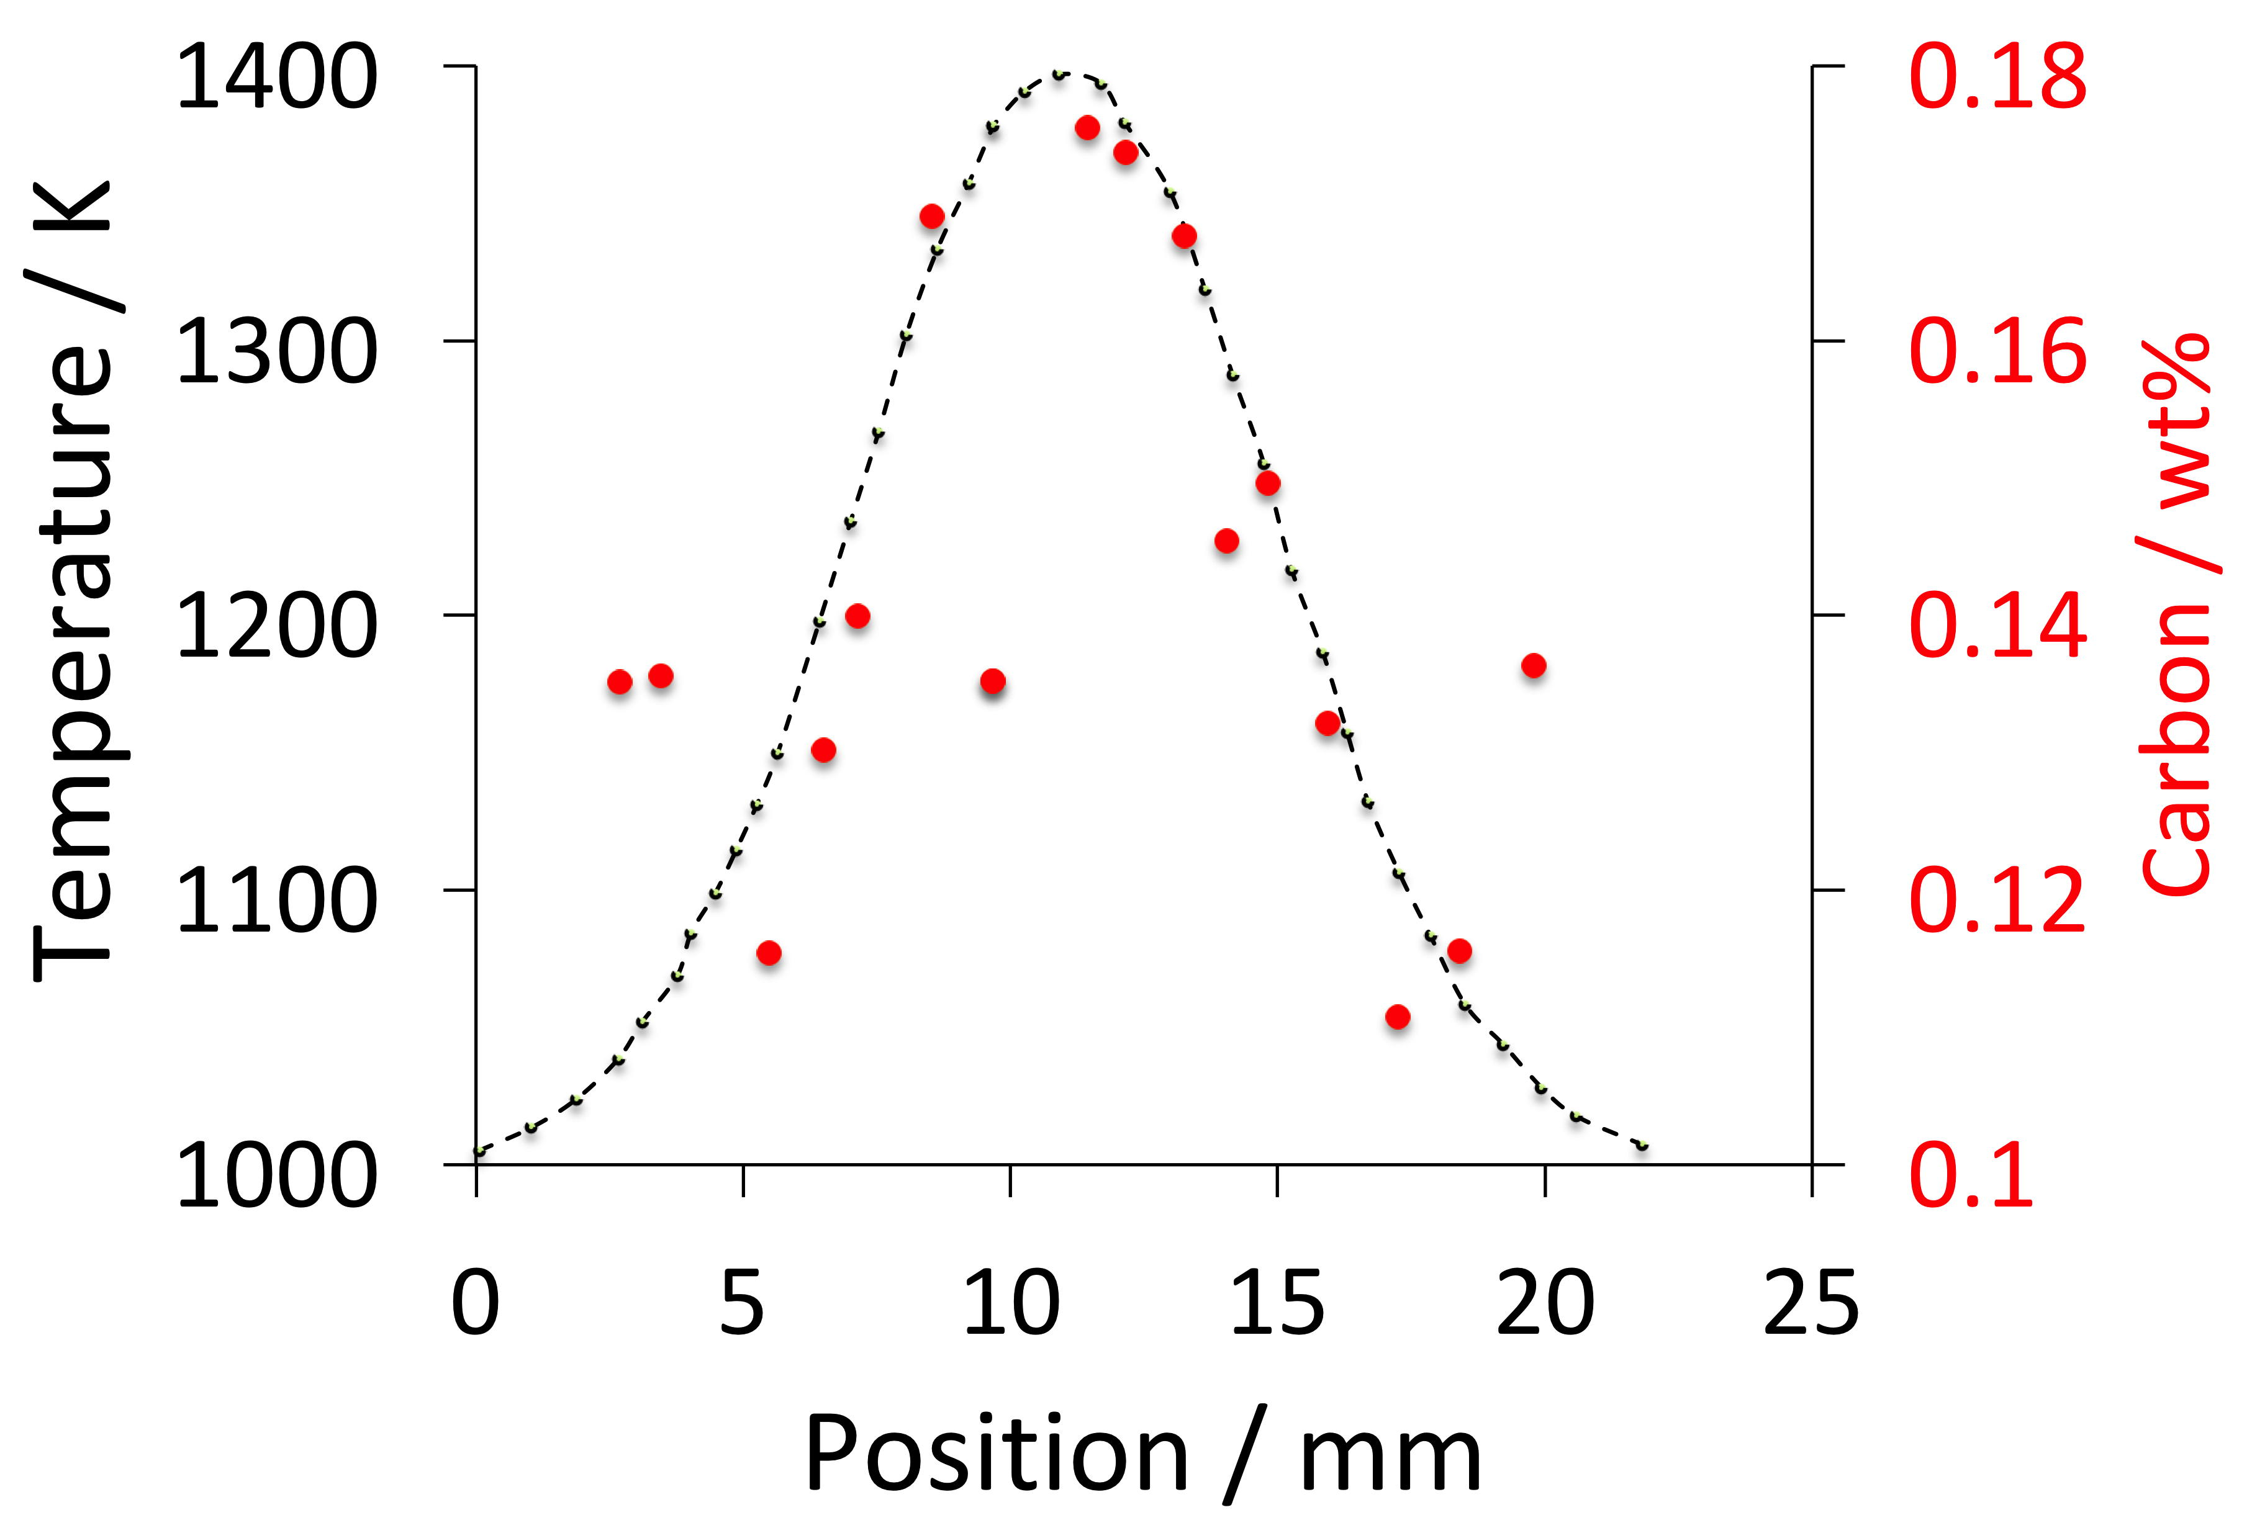
data from Okafor et al. 1982

