Slide 1

Crystallography
H. K. D. H. Bhadeshia
Introduction and point groups
Stereographic projections
Low symmetry systems
Space groups
Deformation and texture
Interfaces, orientation relationships
Martensitic transformations
https://www.phase-trans.msm.cam.ac.uk/teaching.html

Slide 2
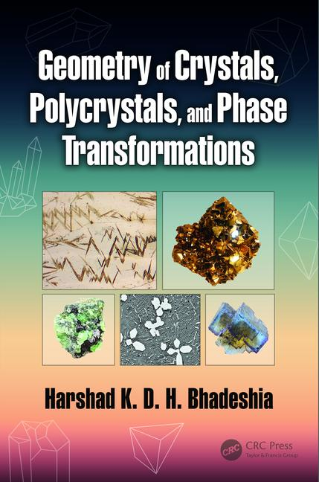
www.phase-trans.msm.cam.ac.uk/2020/Crystallography_book.pdf
(hard copies of both in departmental library)

Slide 3
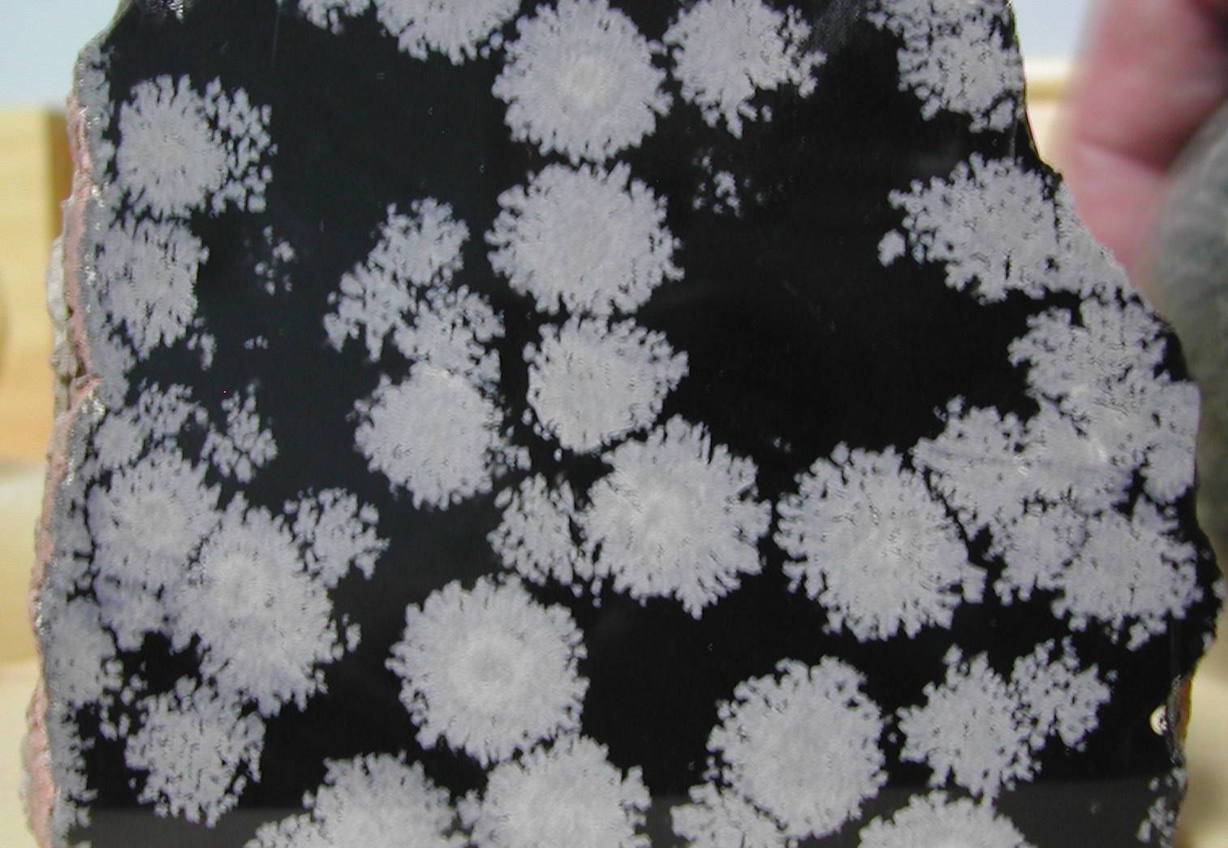
cristobalite from
glassy magma
crystalline
amorphous

Slide 4
anisotropic molecules
liquid crystal,
somewhat ordered
liquid: cannot support
shear stress
solid crystal, ordered

Slide 5
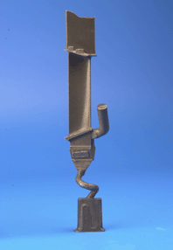
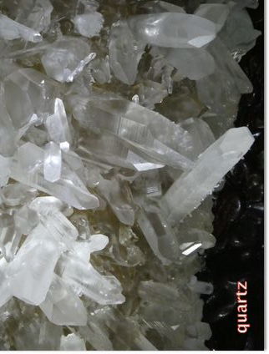
Form

Slide 6
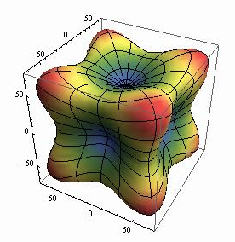
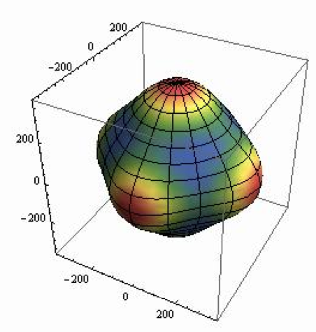
Anisotropy
(elastic modulus, MPa)
Ag
Mo

Slide 7
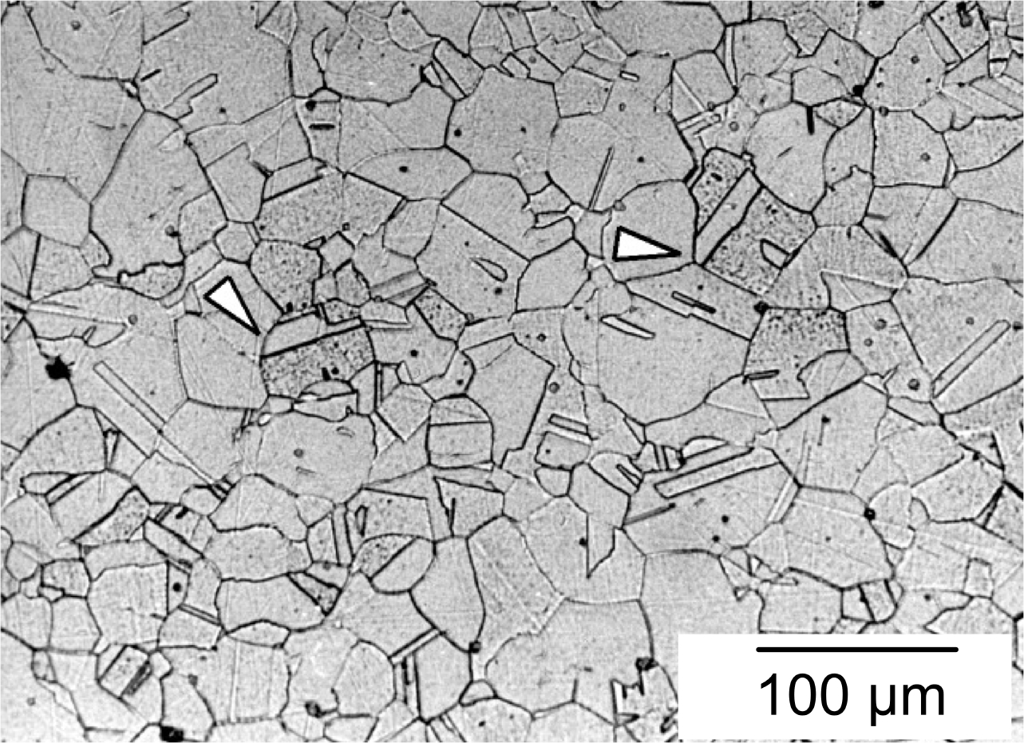
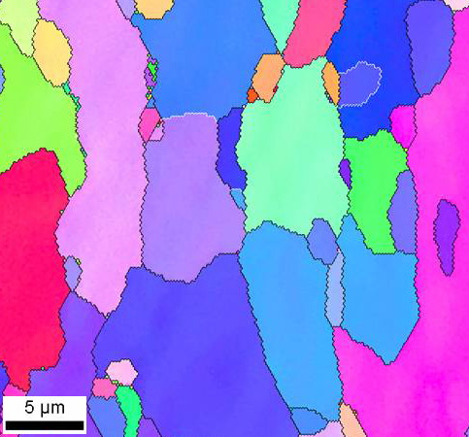
Polycrystals

Slide 8
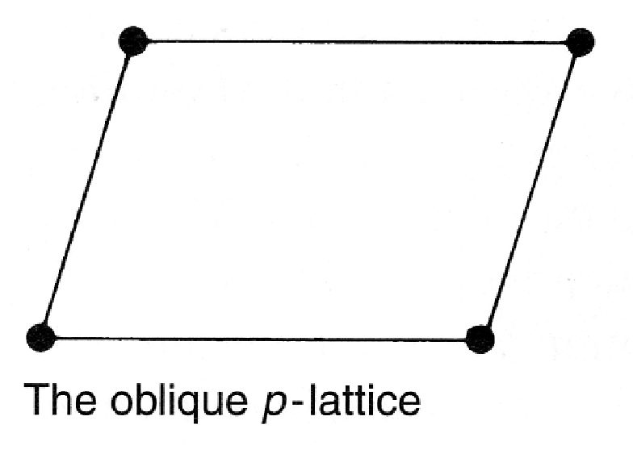
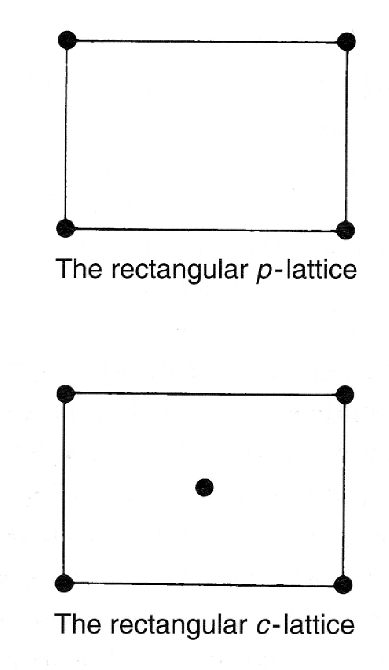
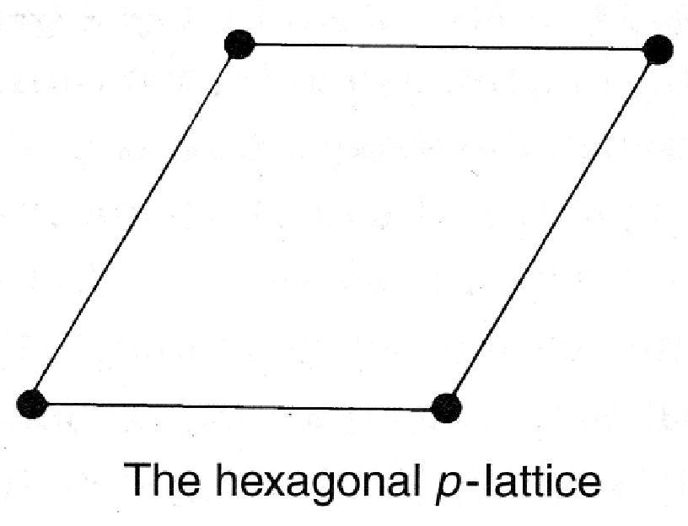
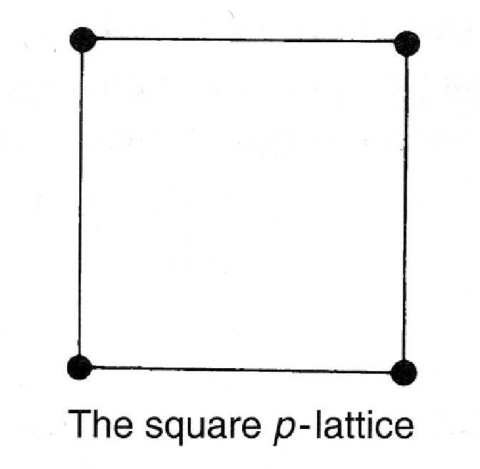
2D lattices

Slide 9
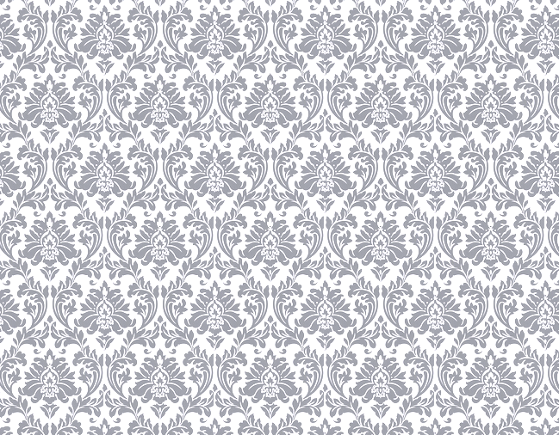

Slide 10
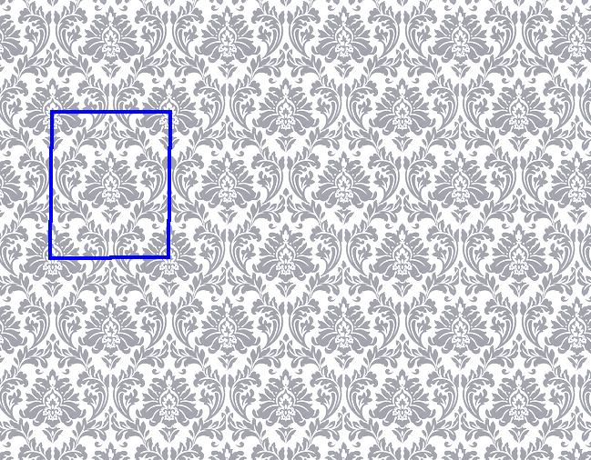

Slide 11
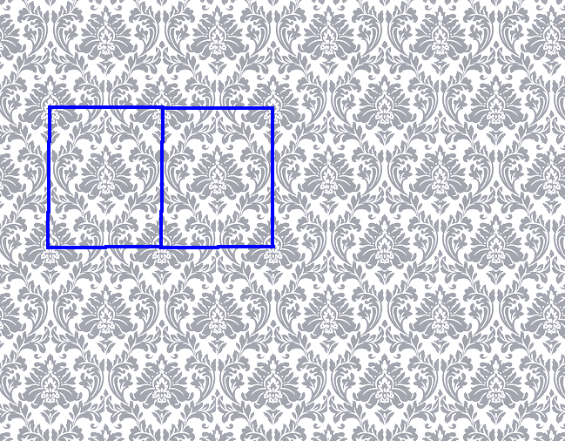

Slide 12
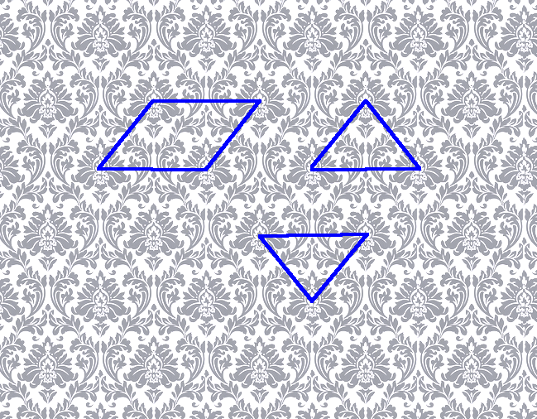

Slide 13
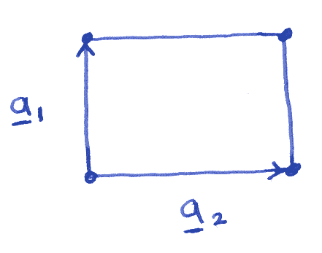
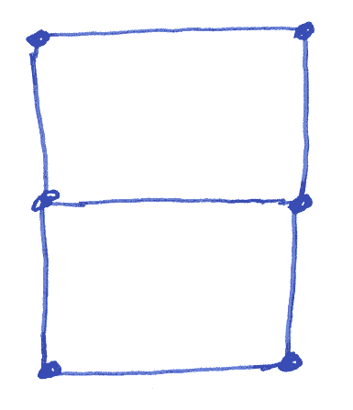
The Lattice

Slide 14
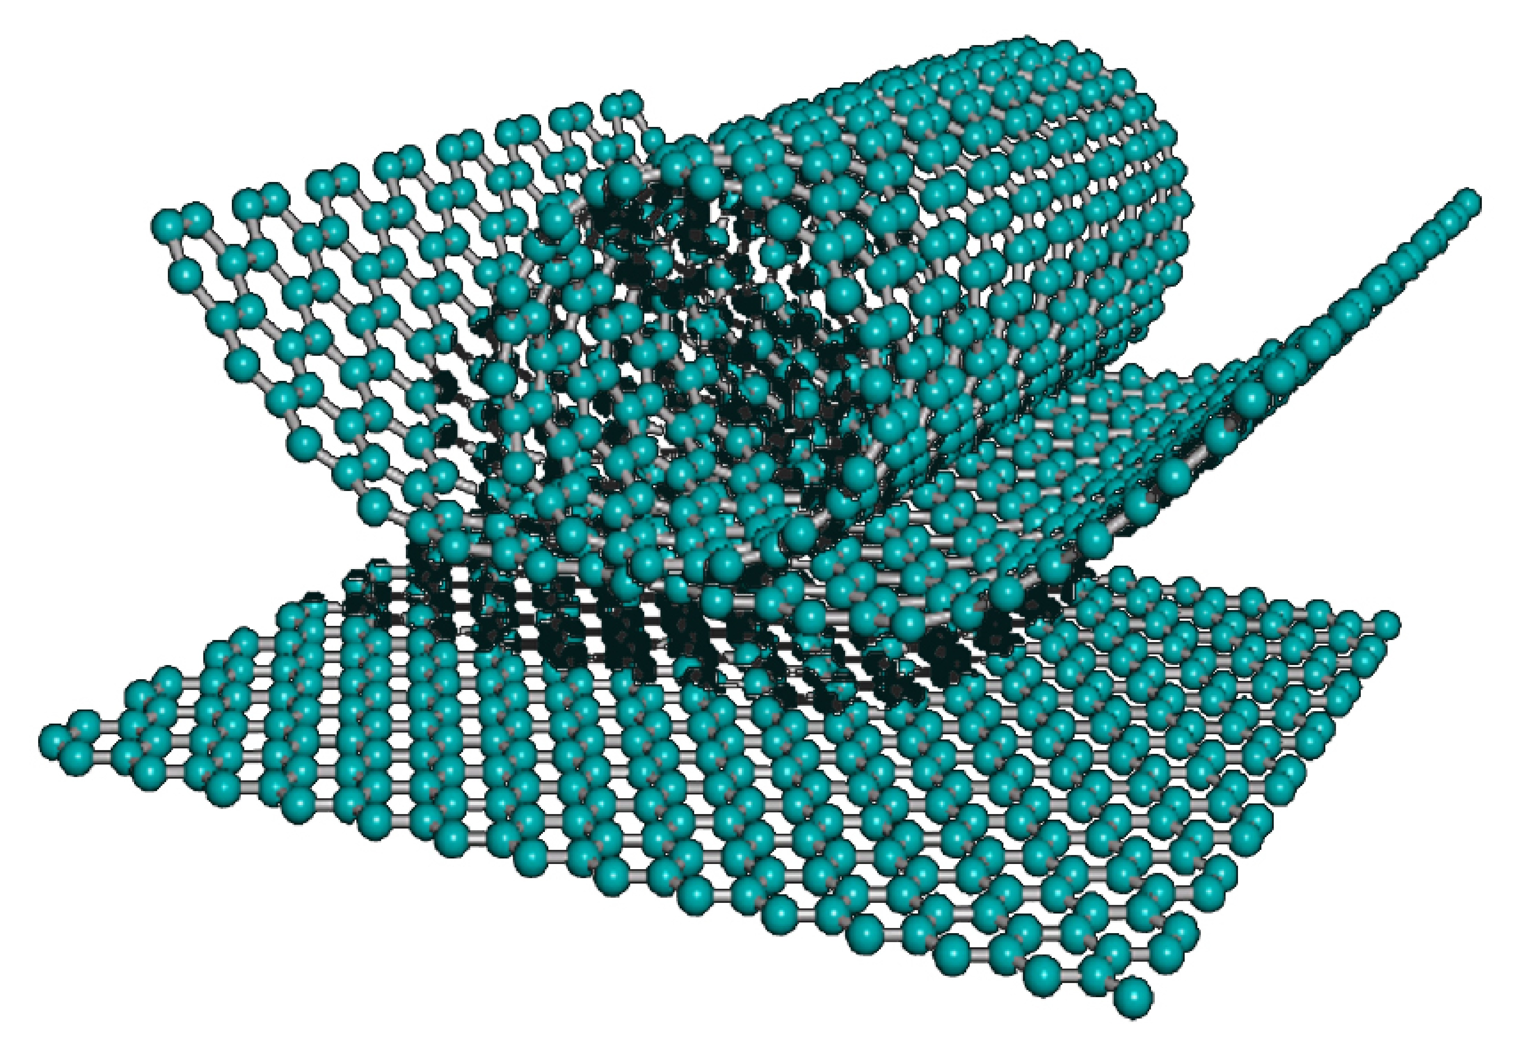
Graphene, nanotubes

Slide 15
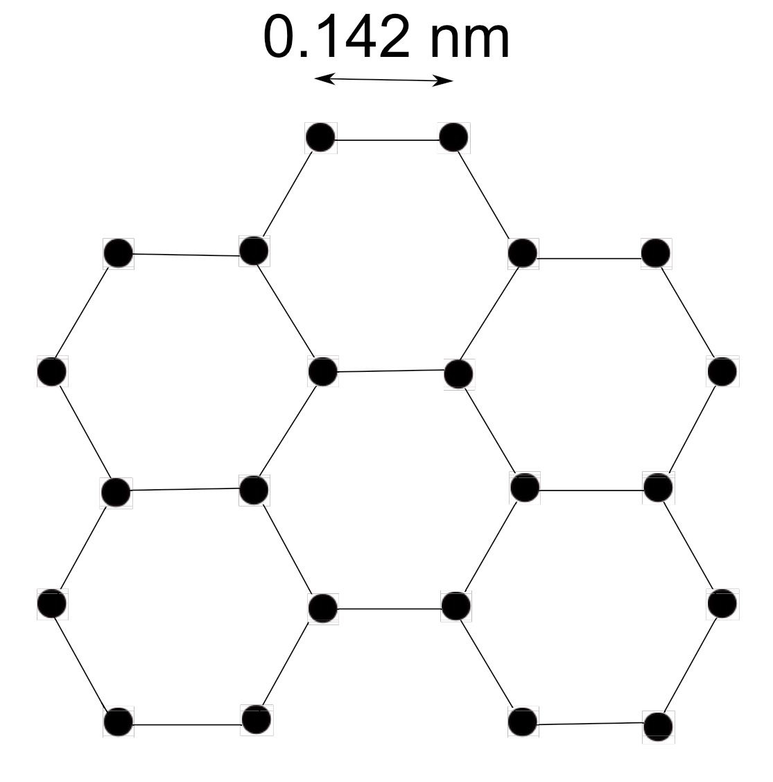
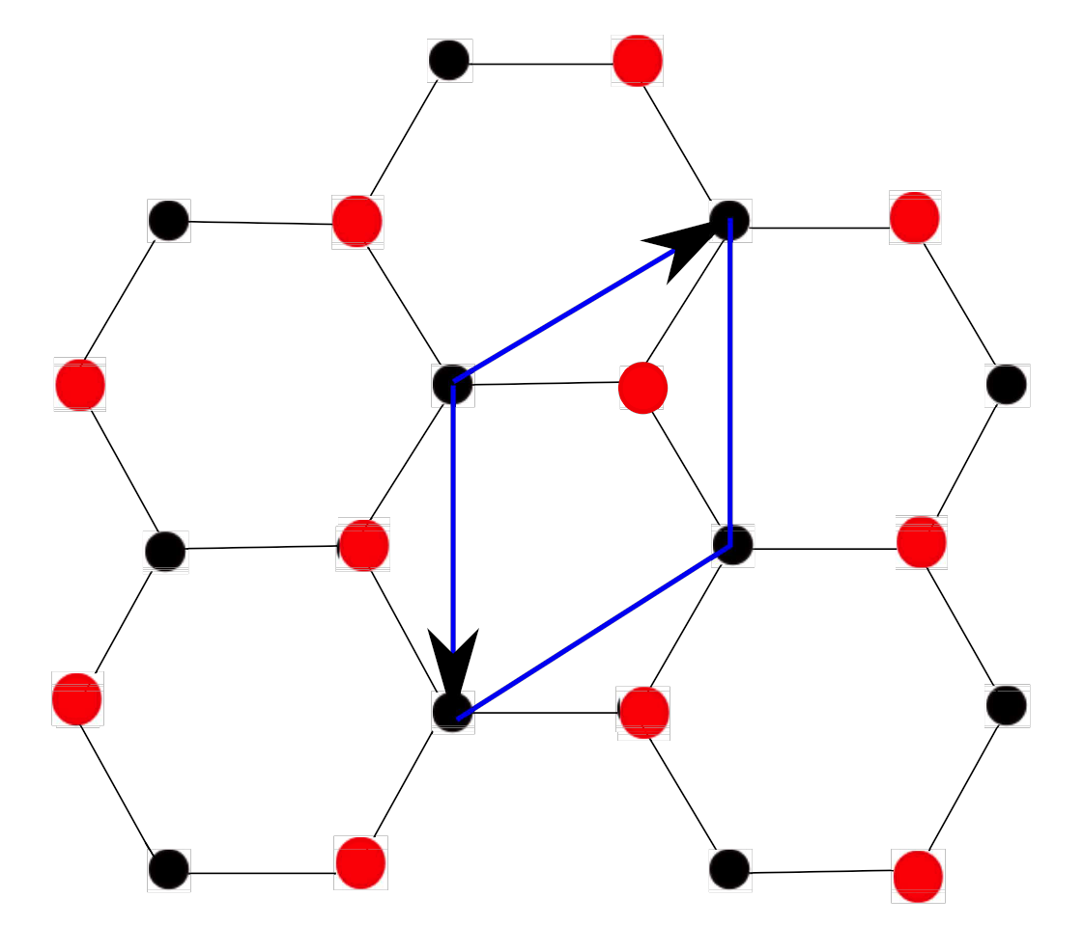

Slide 16
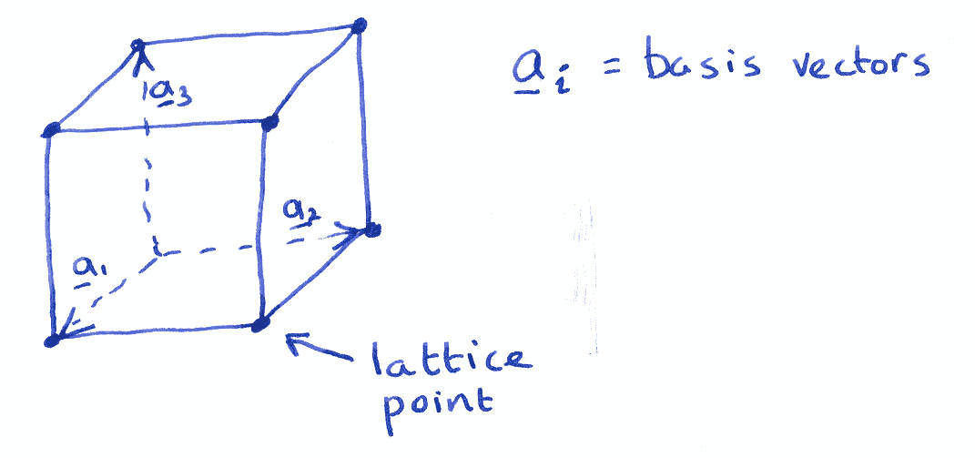

Slide 17
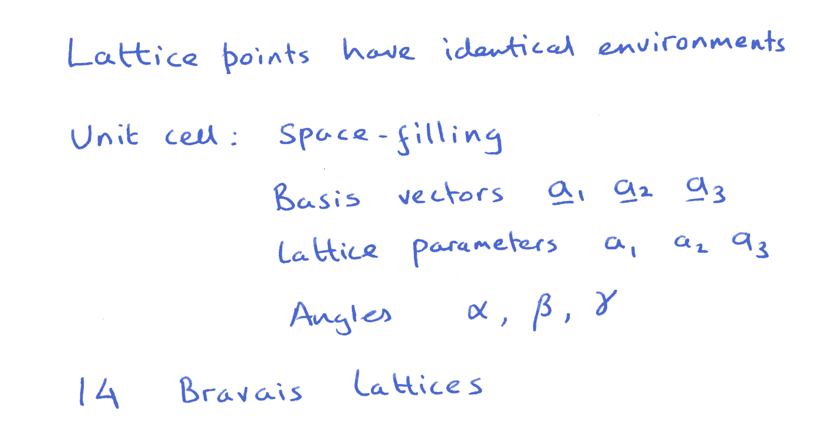

Slide 18
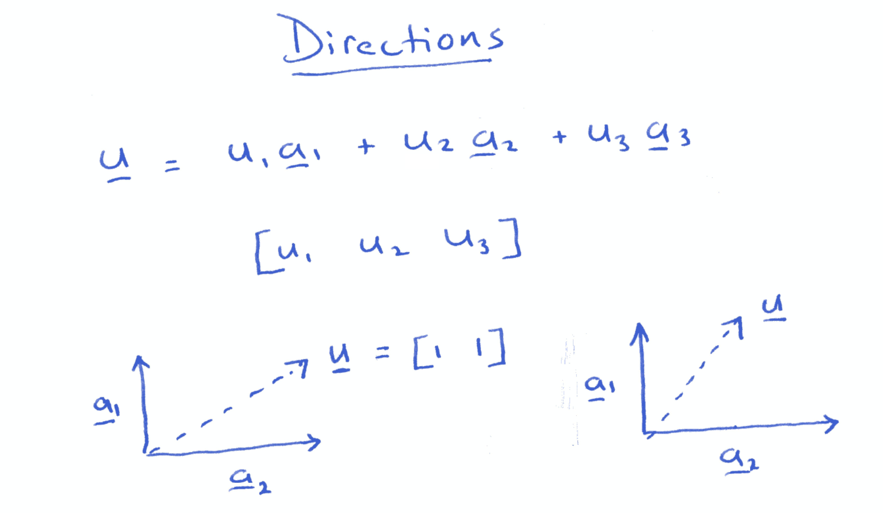

Slide 19
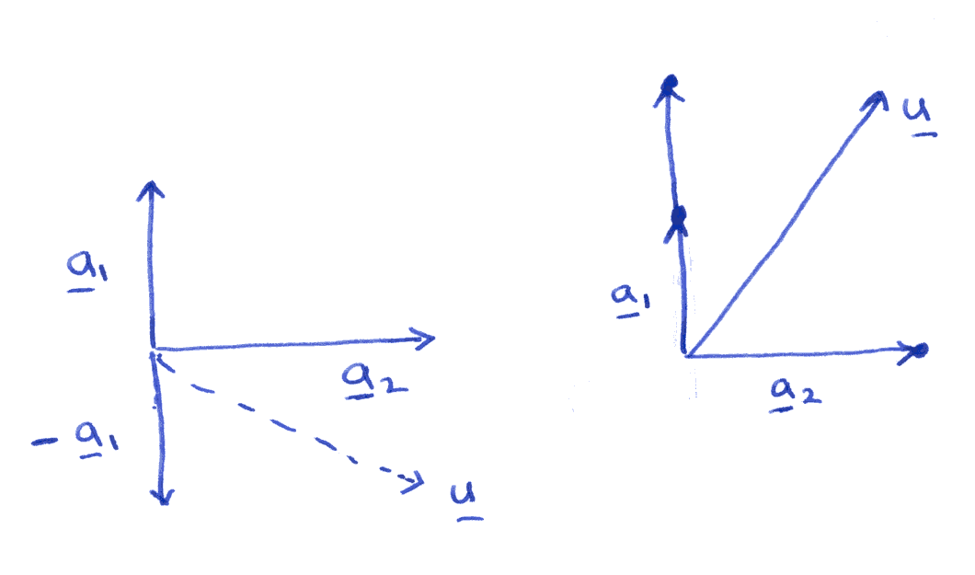

Slide 20
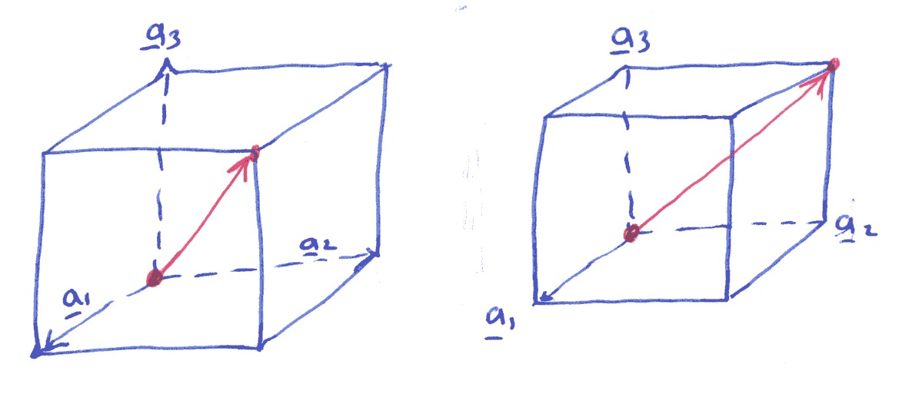

Slide 21
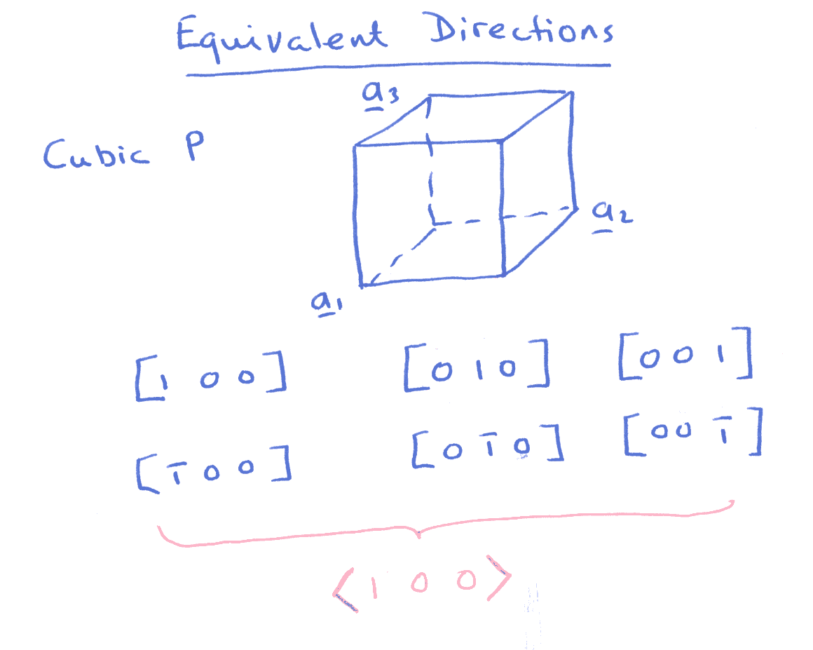

Slide 22
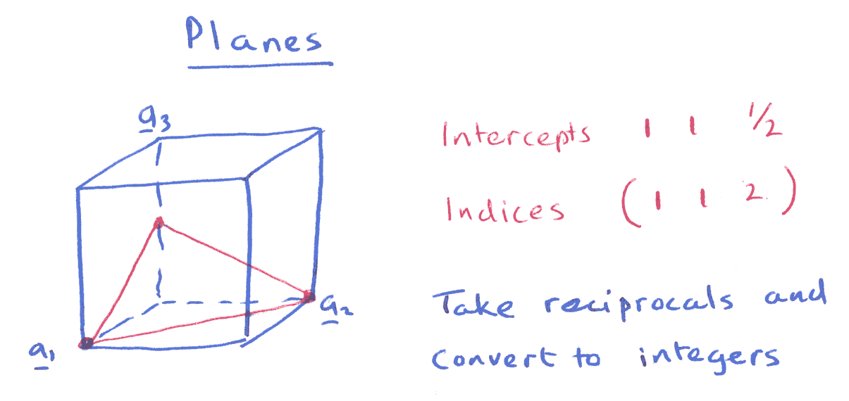

Slide 23
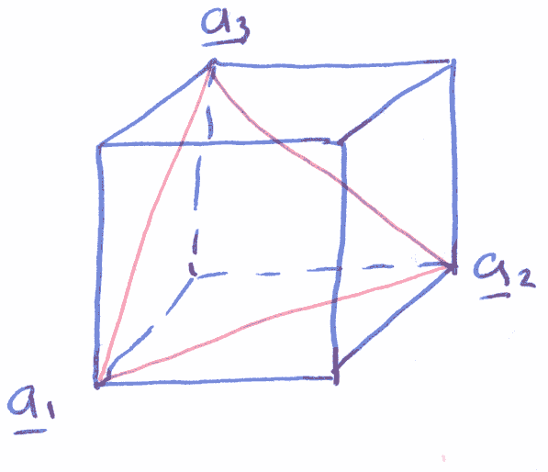
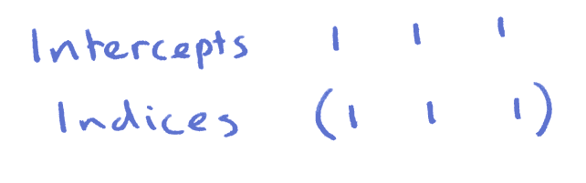

Slide 24
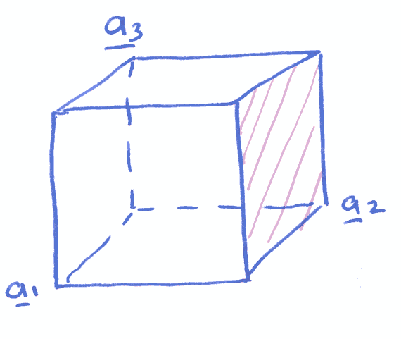
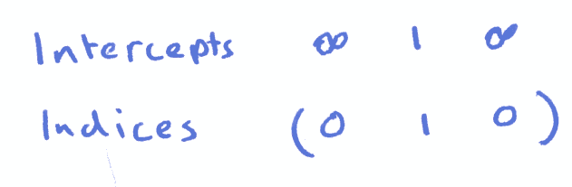

Slide 25
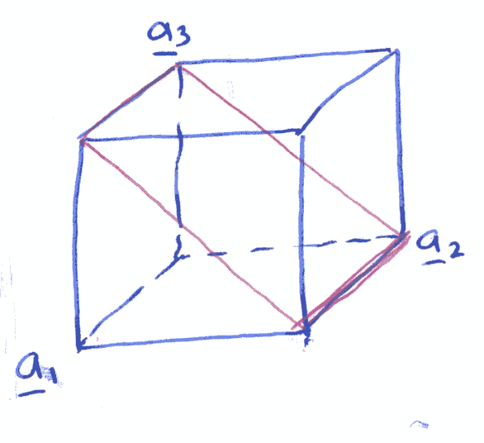
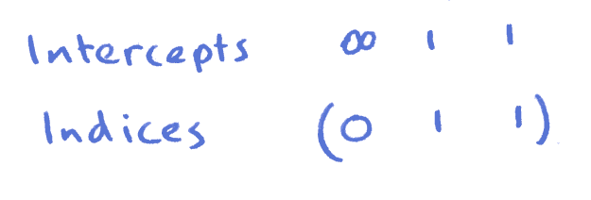

Slide 26
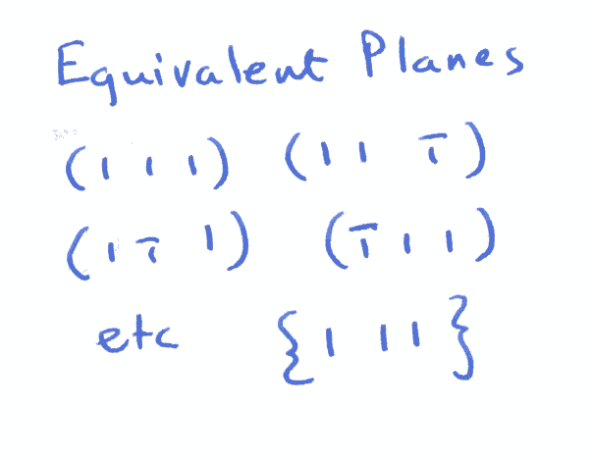

Slide 27
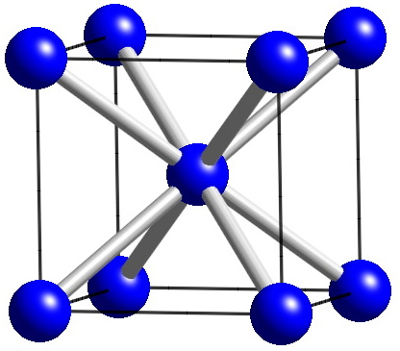
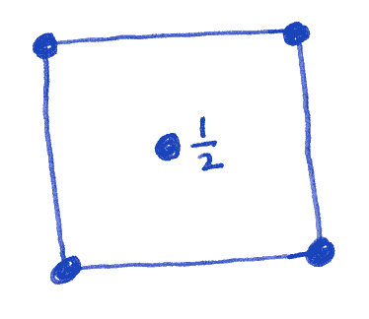

Slide 28
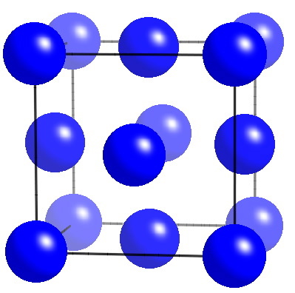
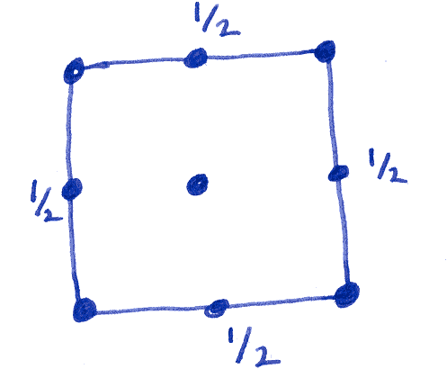

Slide 29
I
P
F

Slide 30
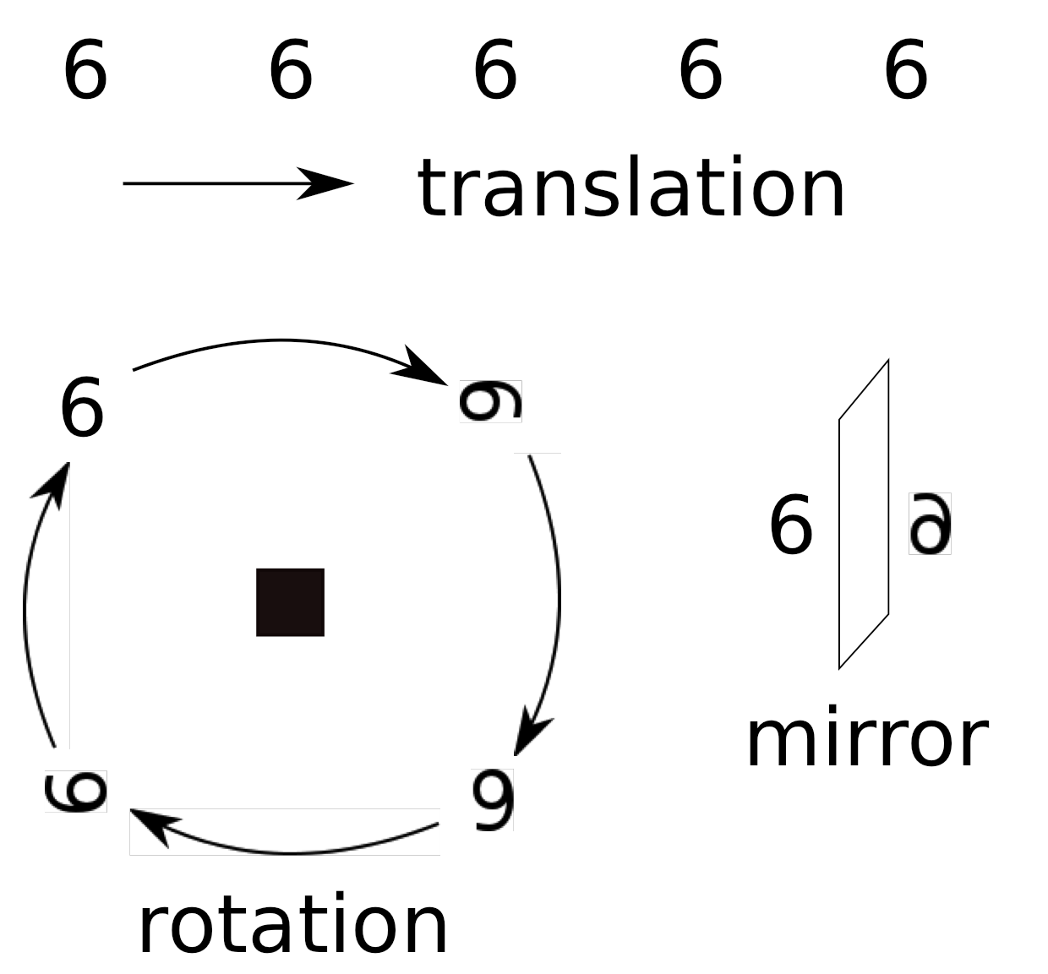
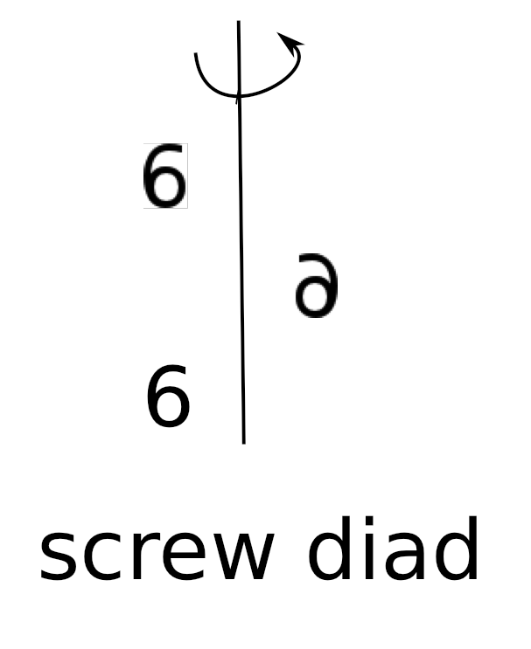
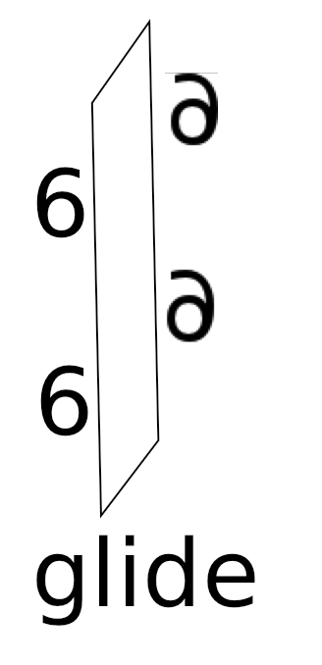

Slide 31
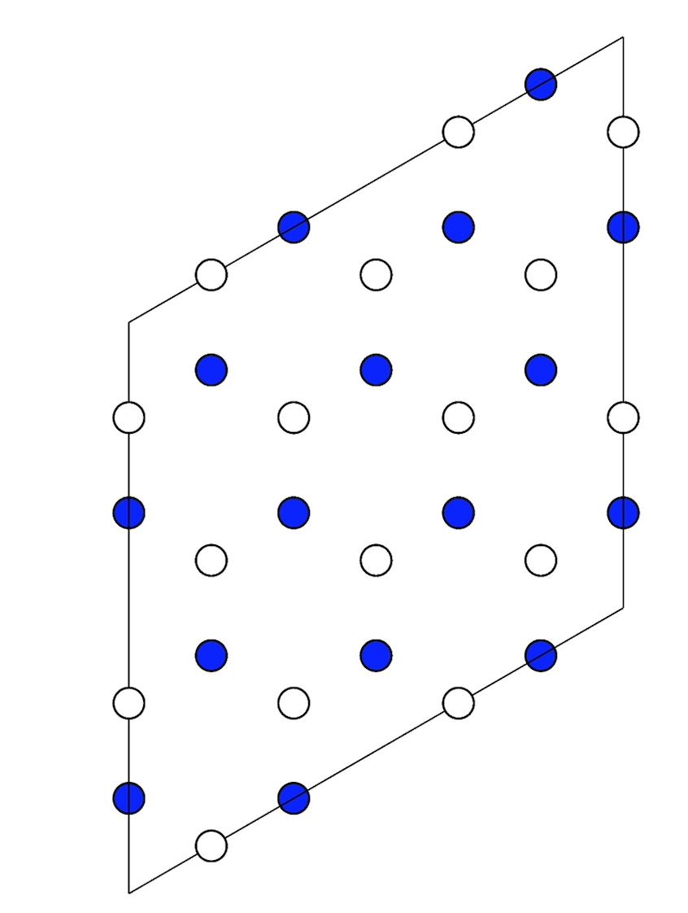
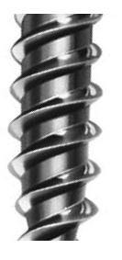
height 1/2
height 0,1
6
3
hcp Fe

Slide 32
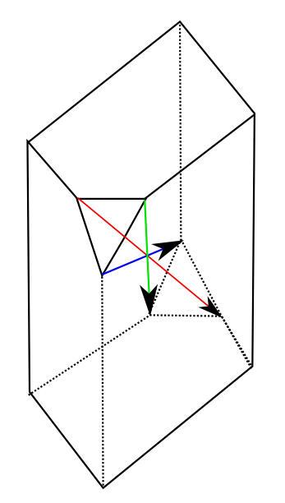
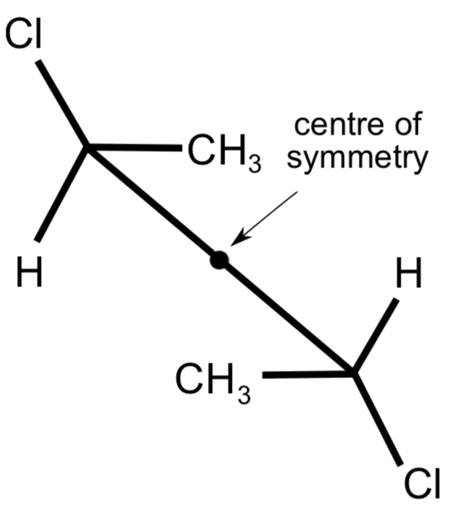
Centre of symmetry and inversion

Slide 33

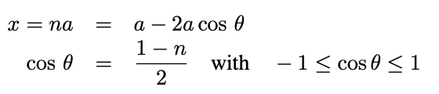

180°120°90°60°

Slide 34
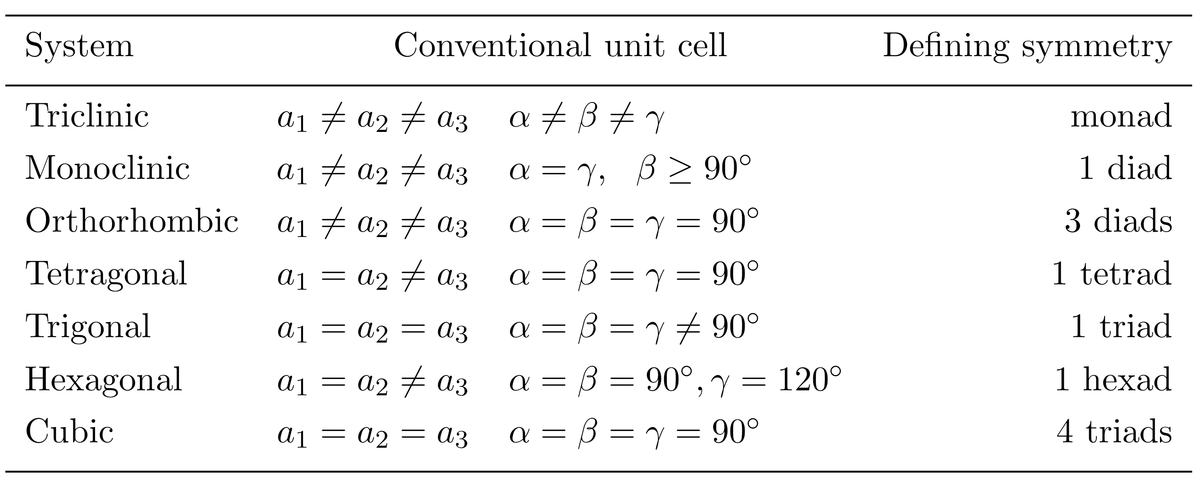

Slide 35
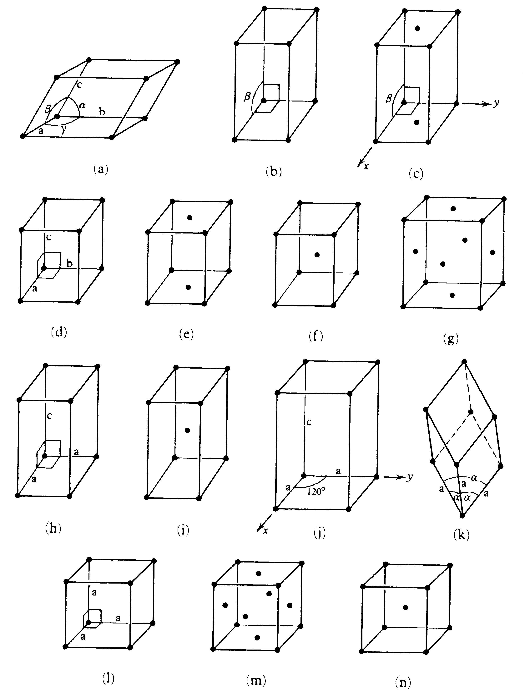
Bravais Lattices
Triclinic P
Monoclinic P & C
Orthorhombic P, C, I & F
Tetragonal P & I
Hexagonal
Trigonal P
Cubic P, F & I

Slide 36
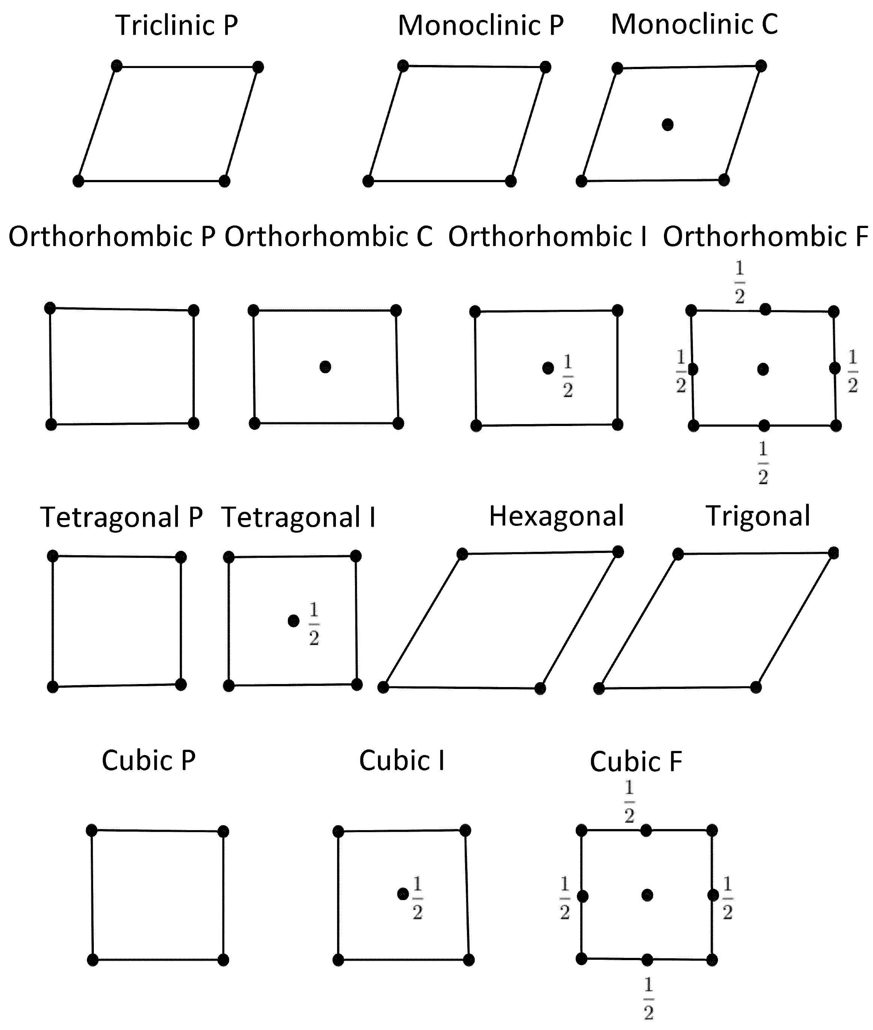
Bravais Lattices

Slide 37

Bundy (1965)
pure iron

Slide 38


Slide 39

Paxton et al. (1990)
Pure iron

Slide 40
Fe
Ru
6d 2s
Os
Hs

Slide 41
Crystallography
H. K. D. H. Bhadeshia
Introduction and point groups
Stereographic projections
Low symmetry systems
Space groups
Deformation and texture
Interfaces, orientation relationships
Martensitic transformations
www.phase-trans.msm.cam.ac.uk/teaching.html

Slide 42

Crystal Structure
1/2
1/2
1/2
1/2

Slide 43


Slide 44
lattice + motif = structure
primitive cubic lattice
motif = Cu at 0,0,0
Zn at 1/2, 1/2, 1/2

Slide 45

1/4
3/4
1/4
3/4
1/4
3/4
1/4
3/4
1/4
Lattice: face-centred cubic
Motif: C at 0,0,0 C at 1/4,1/4,1/4

Slide 46



Slide 47
3/4
1/4
1/4
3/4

Slide 48

x

Slide 49
3/4
1/4
1/4
3/4
Lattice: face-centred cubic
Motif: Zn at 0,0,0 S at 1/4,1/4,1/4

Slide 50


Slide 51


Slide 52

fluorite

Slide 53




Slide 54


Slide 55
Rotation axes
2 diad
3 triad
4 tetrad
6 hexad

Slide 56



Slide 57
CENTRE OF SYMMETRY

Slide 58

Point groups
2m

Slide 59


Slide 60

Sulphur tetraflouride
Water and sulphur tetrafluoride have same point symmetry and hence some identical vibration modes - similar lines in spectra

Slide 61


Gypsum
2/m

Slide 62


Epsomite
222

Slide 63


Slide 64

3m
bishop

Slide 65

4/mmm
castle

Slide 66

1 µm
hexagonal
aluminium
nitride
Courtesy Shaumik Lenka

Slide 67


Slide 68


Slide 69

without high-order axes

Slide 70

with high-order axes

Slide 71


Slide 72

Weiss Law
If a direction [uvw] lies in a plane (hkl) then
uh+vk+wl = 0
[uvw]
(hkl)

Slide 73
z
(110)
y
x
[110]
z
y
x

