Slide 1

Crystallography
H. K. D. H. Bhadeshia
Introduction and point groups
Stereographic projections
Low symmetry systems
Space groups
Deformation and texture
Interfaces, orientation relationships
Martensitic transformations
www.phase-trans.msm.cam.ac.uk/teaching.html

Slide 2
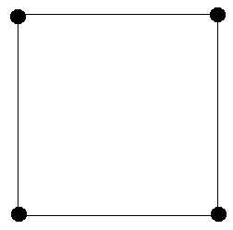
Crystal Structure
1/2
1/2
1/2
1/2

Slide 3
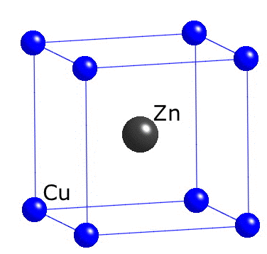

Slide 4
lattice + motif = structure
primitive cubic lattice
motif = Cu at 0,0,0
Zn at 1/2, 1/2, 1/2

Slide 5
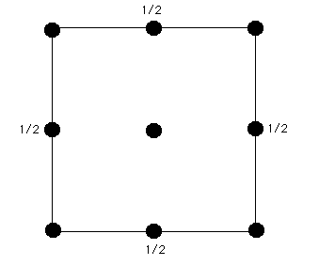
1/4
3/4
1/4
3/4
1/4
3/4
1/4
3/4
1/4
Lattice: face-centred cubic
Motif: C at 0,0,0 C at 1/4,1/4,1/4

Slide 6
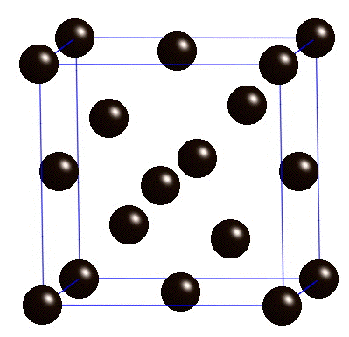
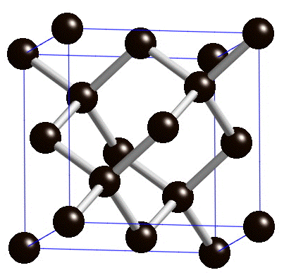

Slide 7
3/4
1/4
1/4
3/4

Slide 8
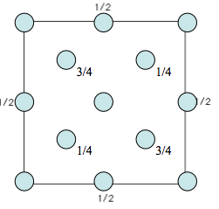
x

Slide 9
3/4
1/4
1/4
3/4
Lattice: face-centred cubic
Motif: Zn at 0,0,0 S at 1/4,1/4,1/4

Slide 10
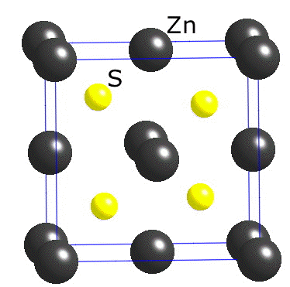
candidate for ultra violet light-emitting diode
could be useful in the purification of water

Slide 11
cubic gallium nitride
has the potential of more efficient green coloured light-emitting diodes than the normal hexagonal version
Lee LY. Cubic zincblende gallium nitride for green-wavelength light-emitting diodes. Materials Science and Technology.
33 (2017) 1570-83.

Slide 12
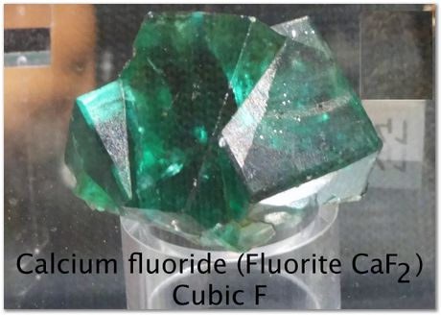
source of flourine,
flux in aluminium smelting

Slide 13
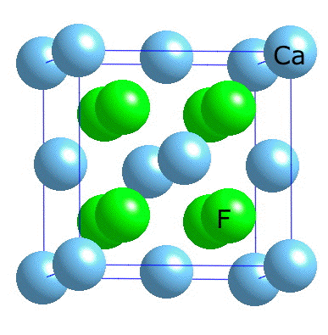
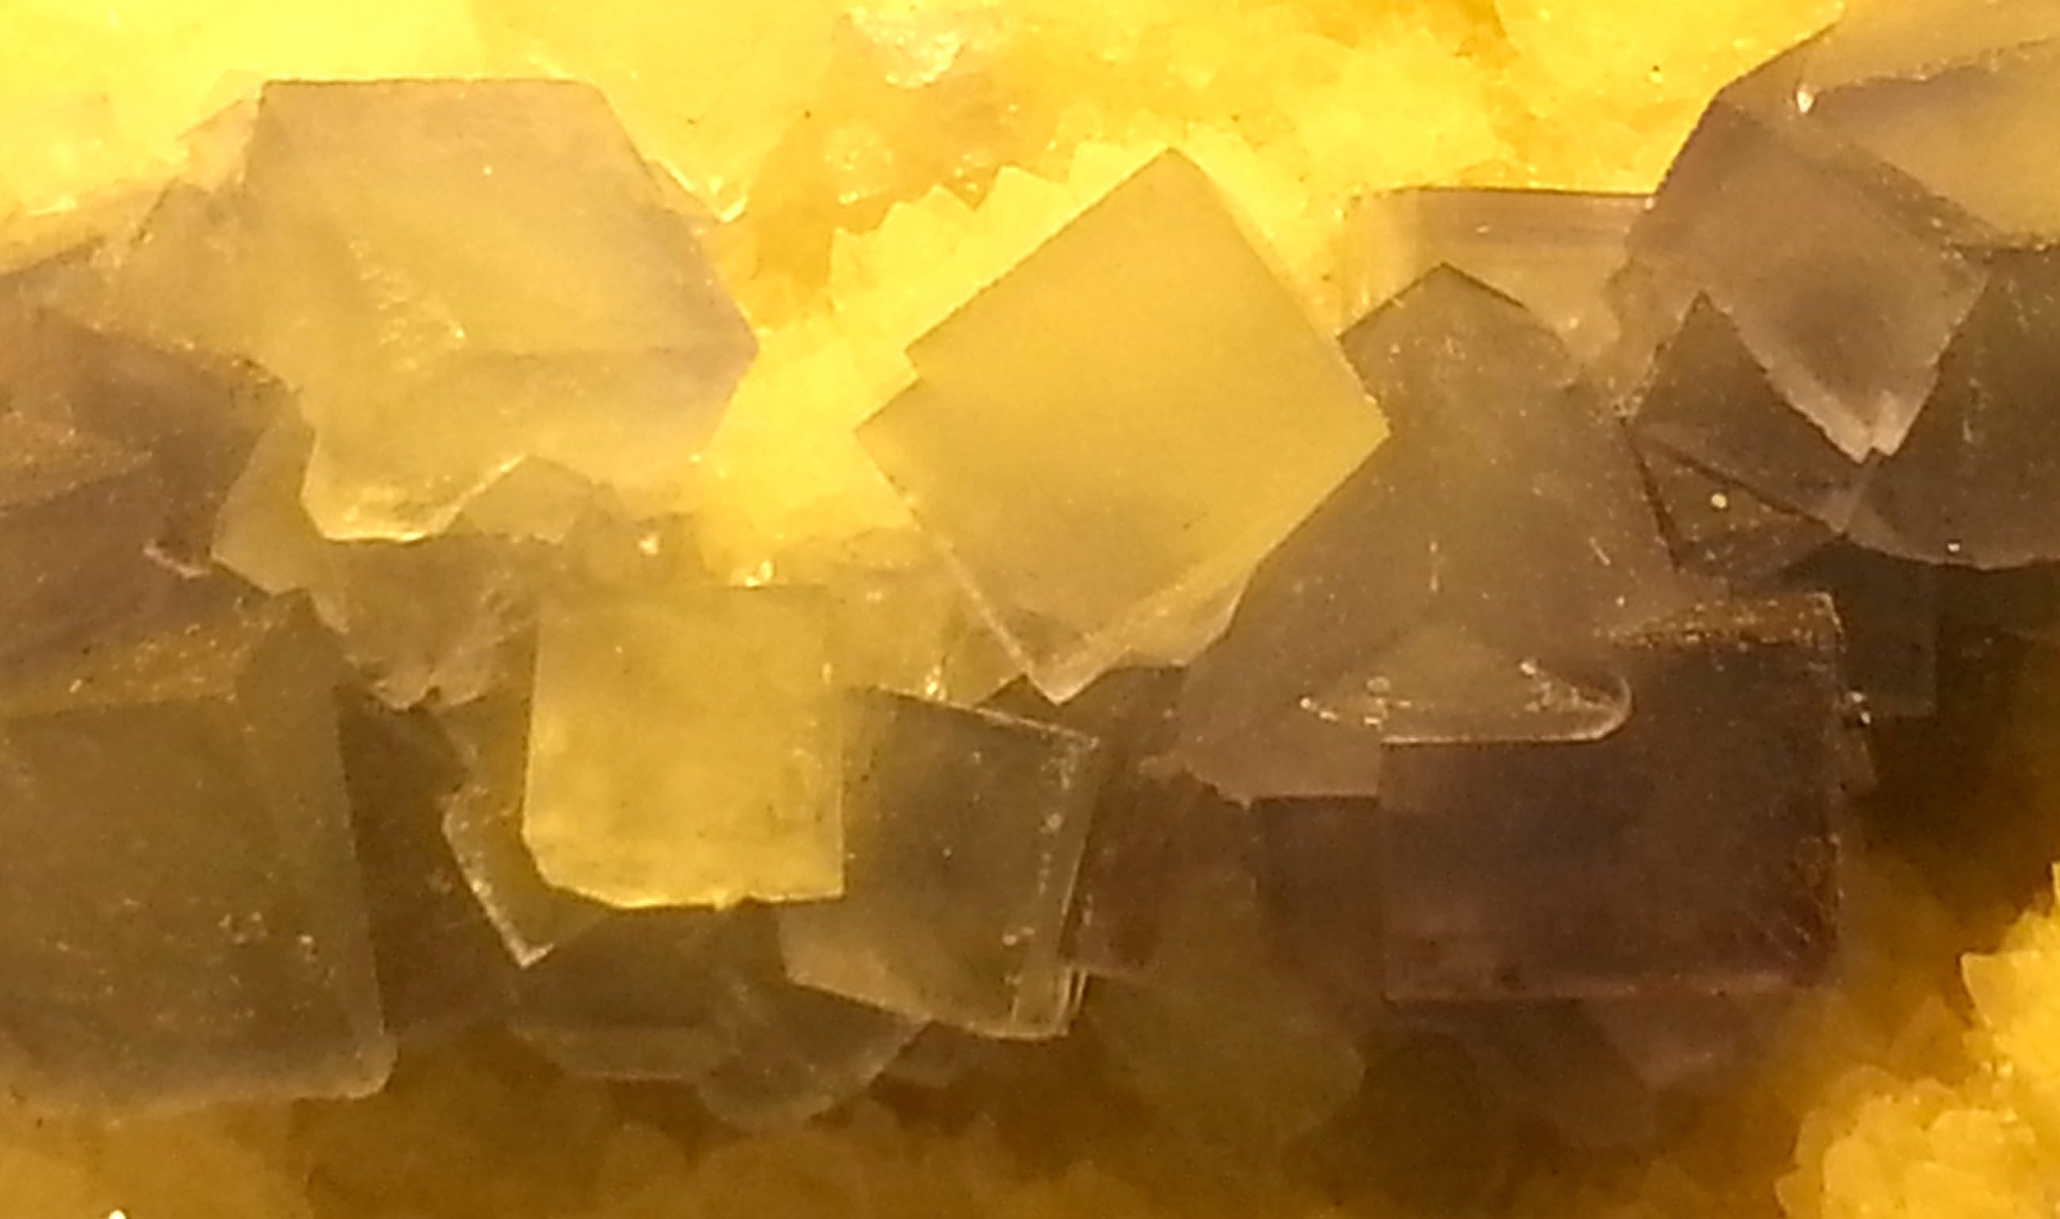

Slide 14
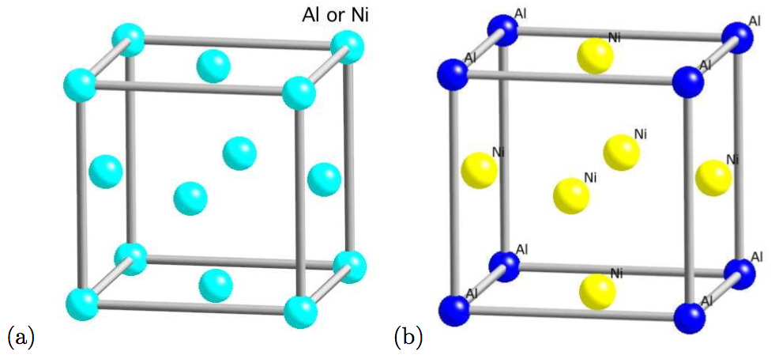

Slide 15
Rotation axes
2 diad
3 triad
4 tetrad
6 hexad

Slide 16
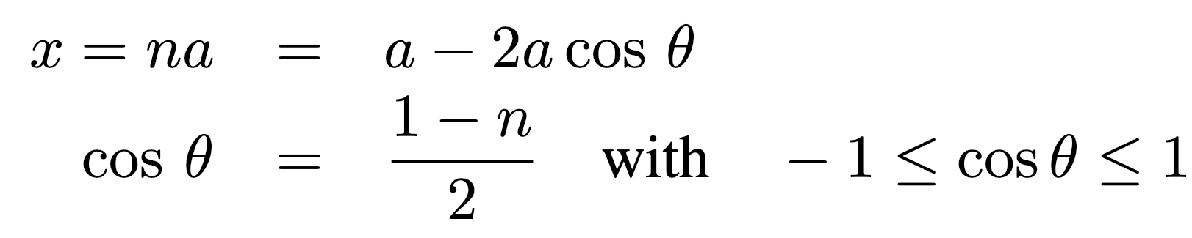
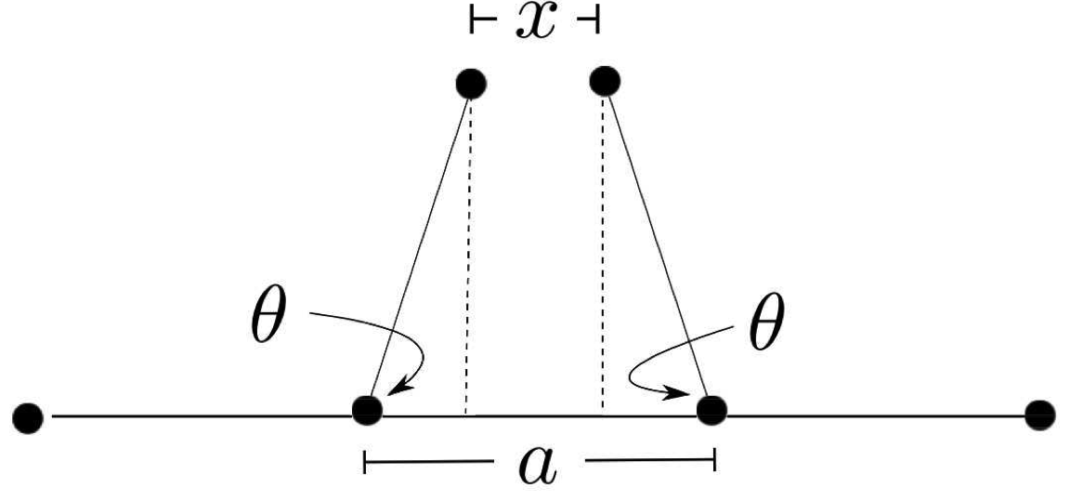

Slide 17
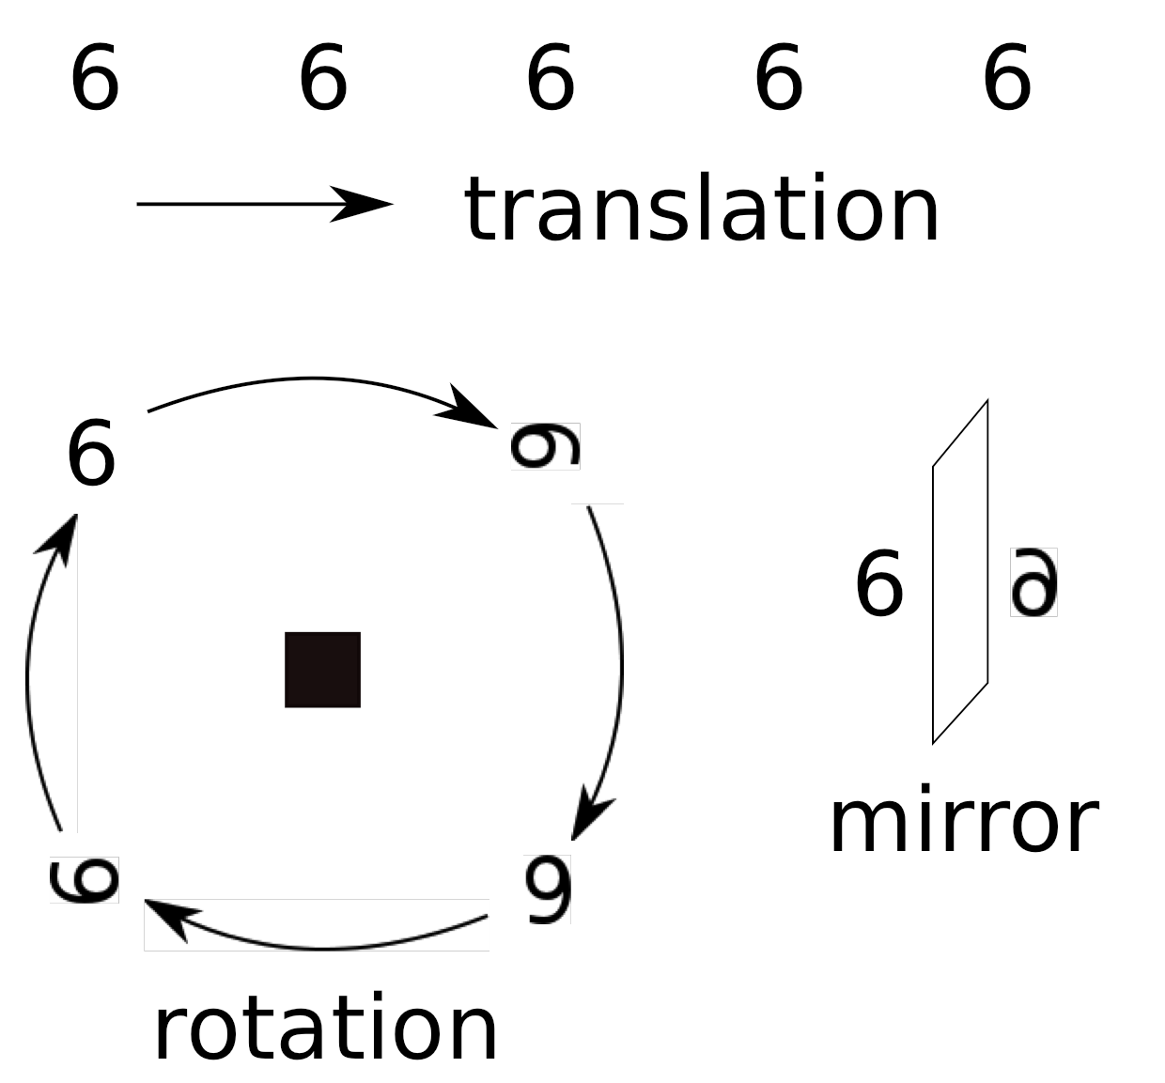
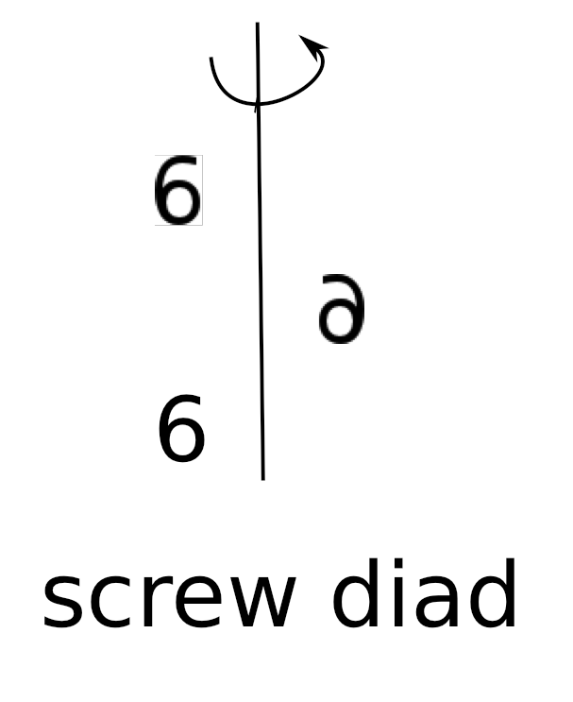
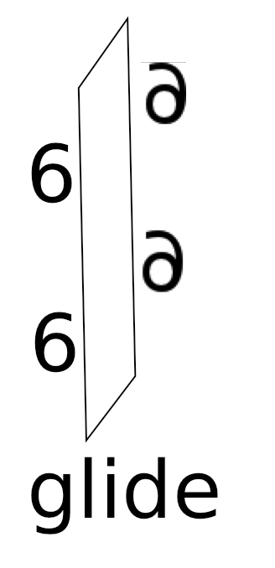
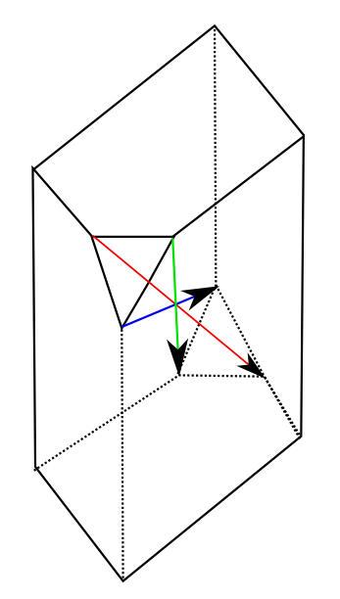
CENTRE OF SYMMETRY

Slide 18
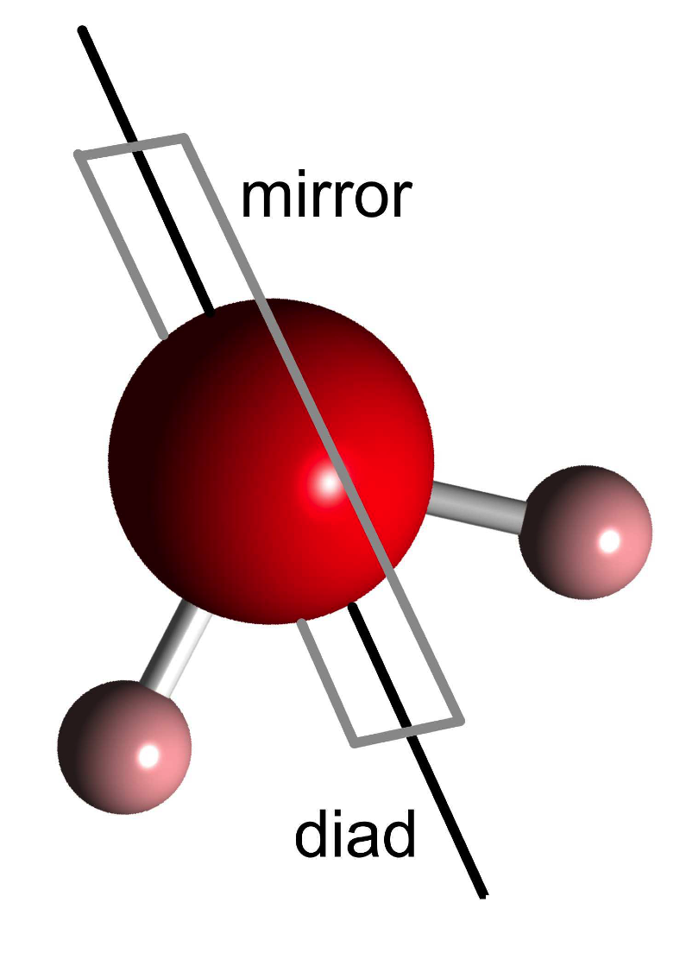
Point groups
2m

Slide 19
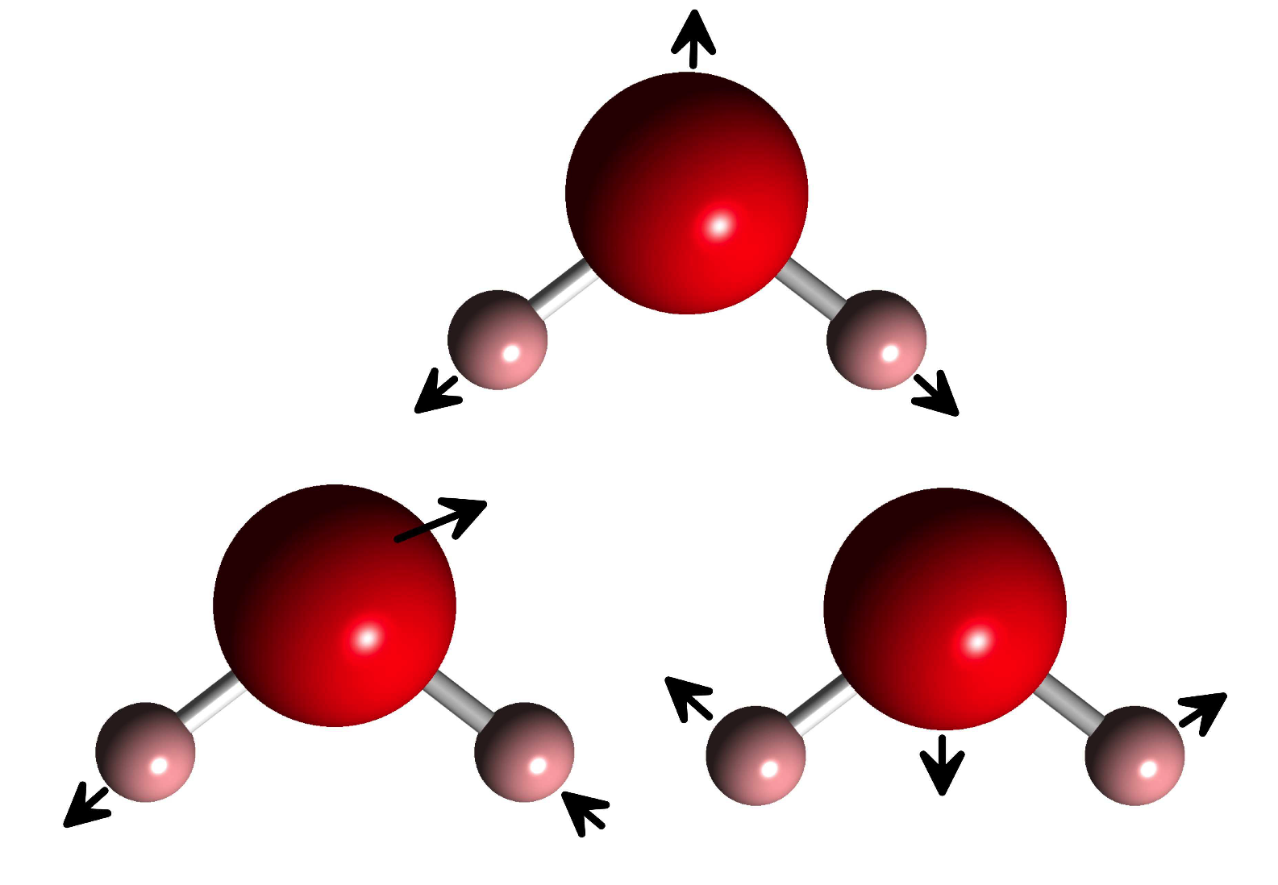

Slide 20
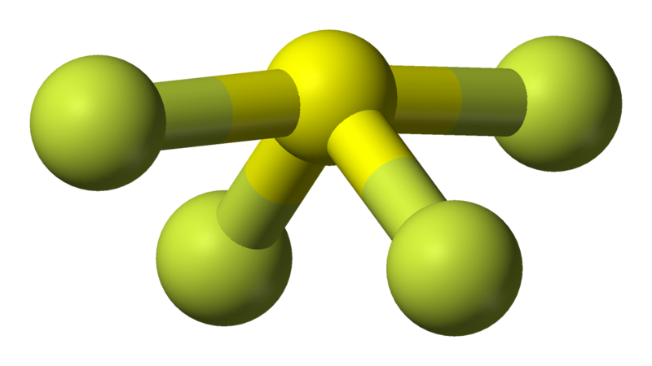
Sulphur tetraflouride
Water and sulphur tetrafluoride have same point symmetry and hence some identical vibration modes - similar lines in spectra

Slide 21
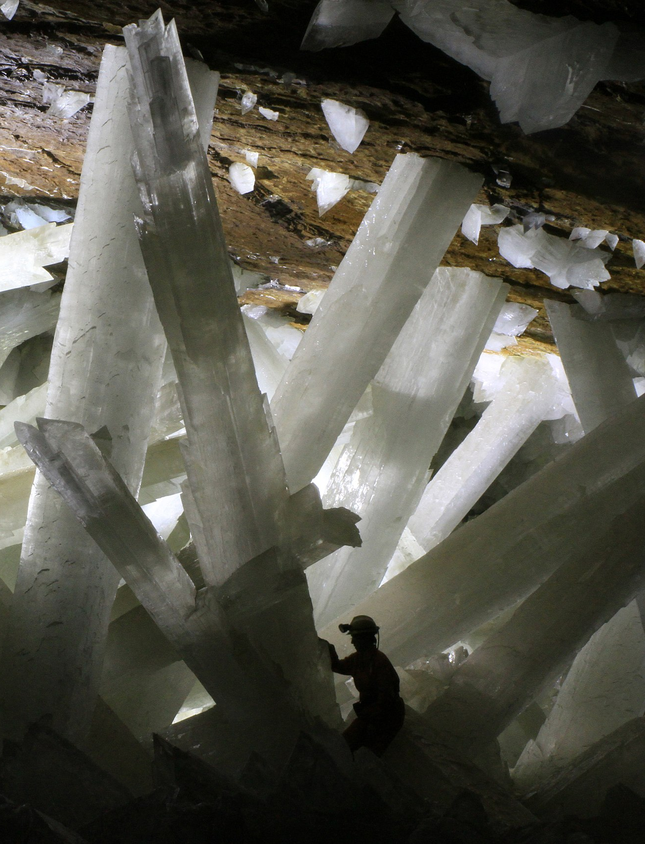
Gigantic gypsum in the cave of crystals,
Naica, Mexico
Alexander Van Driessche / CC BY (https://creativecommons.org/licenses/by/3.0)
Gypsum used in construction materials.

Slide 22
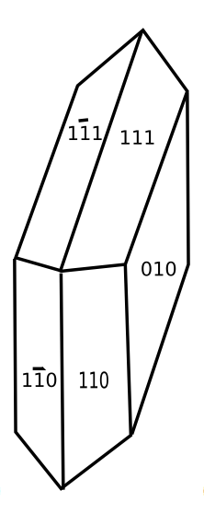
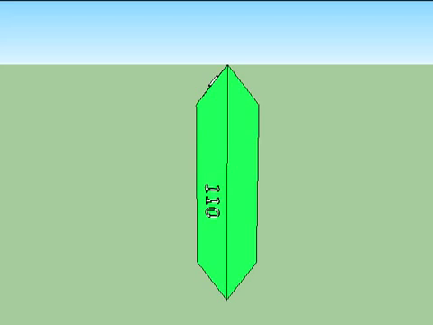
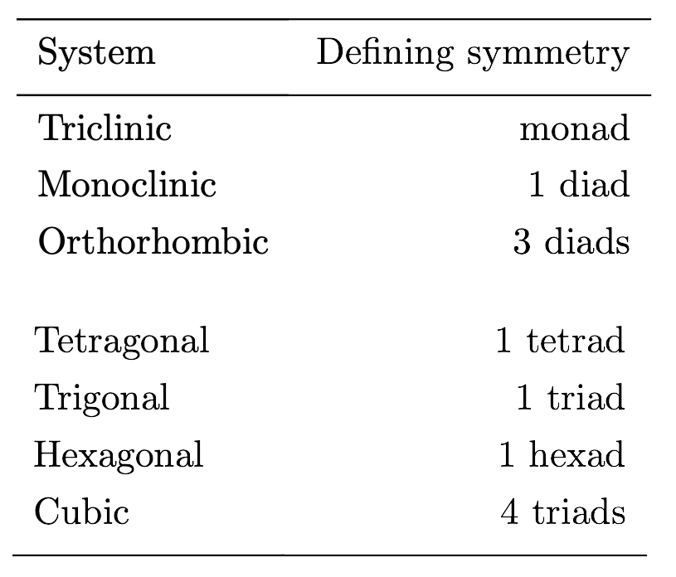
Gypsum
2/m

Slide 23
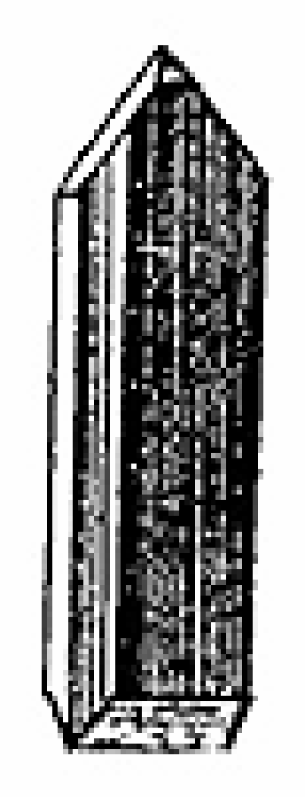
hydrated magnesium sulphate
Martin Lister,
De Fontibus Medicatis Angliae (1682)
Epsom salts, apparently have palliative properties.

Slide 24
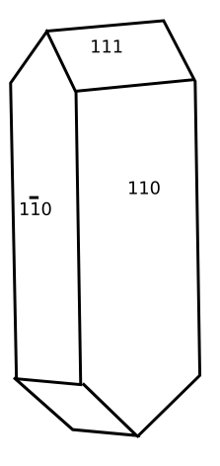

Epsomite
222

Slide 25
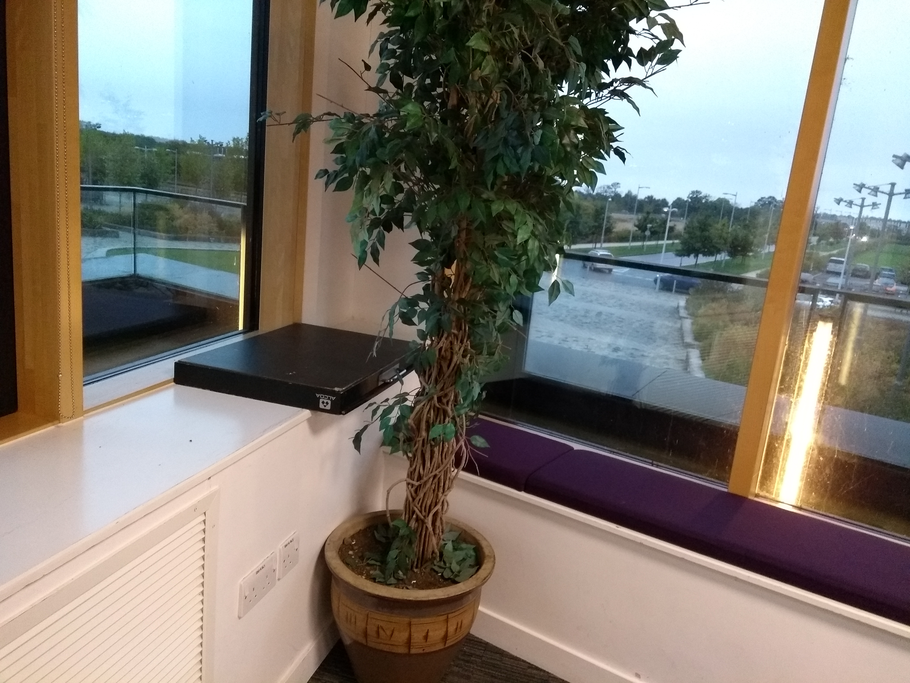

Slide 26
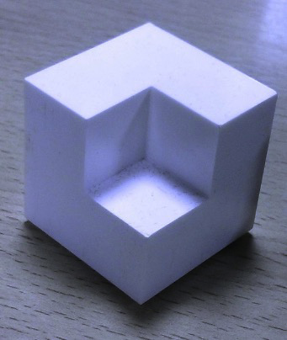
3m
bishop

Slide 27
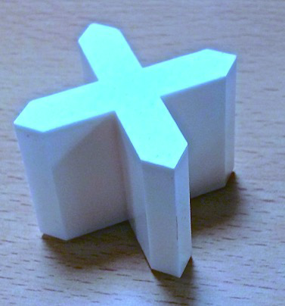
4mm
castle

Slide 28
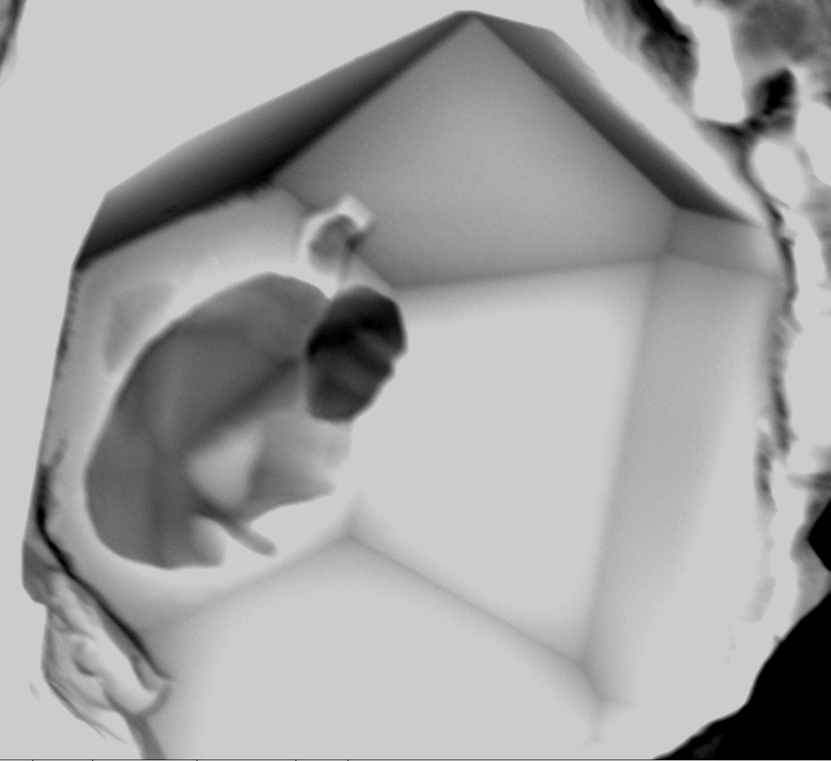
1 µm
hexagonal
aluminium
nitride
Courtesy Shaumik Lenka

Slide 29
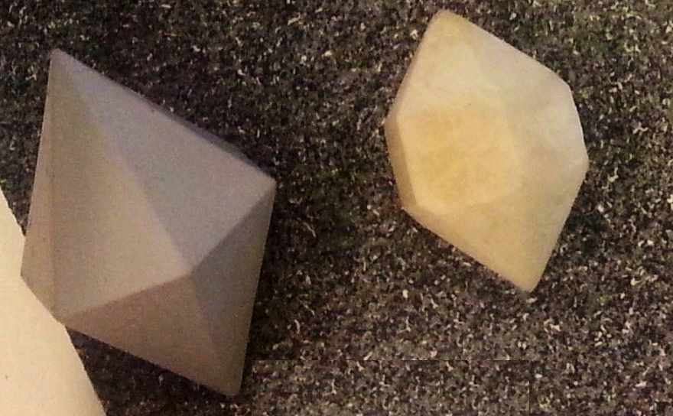

Slide 31
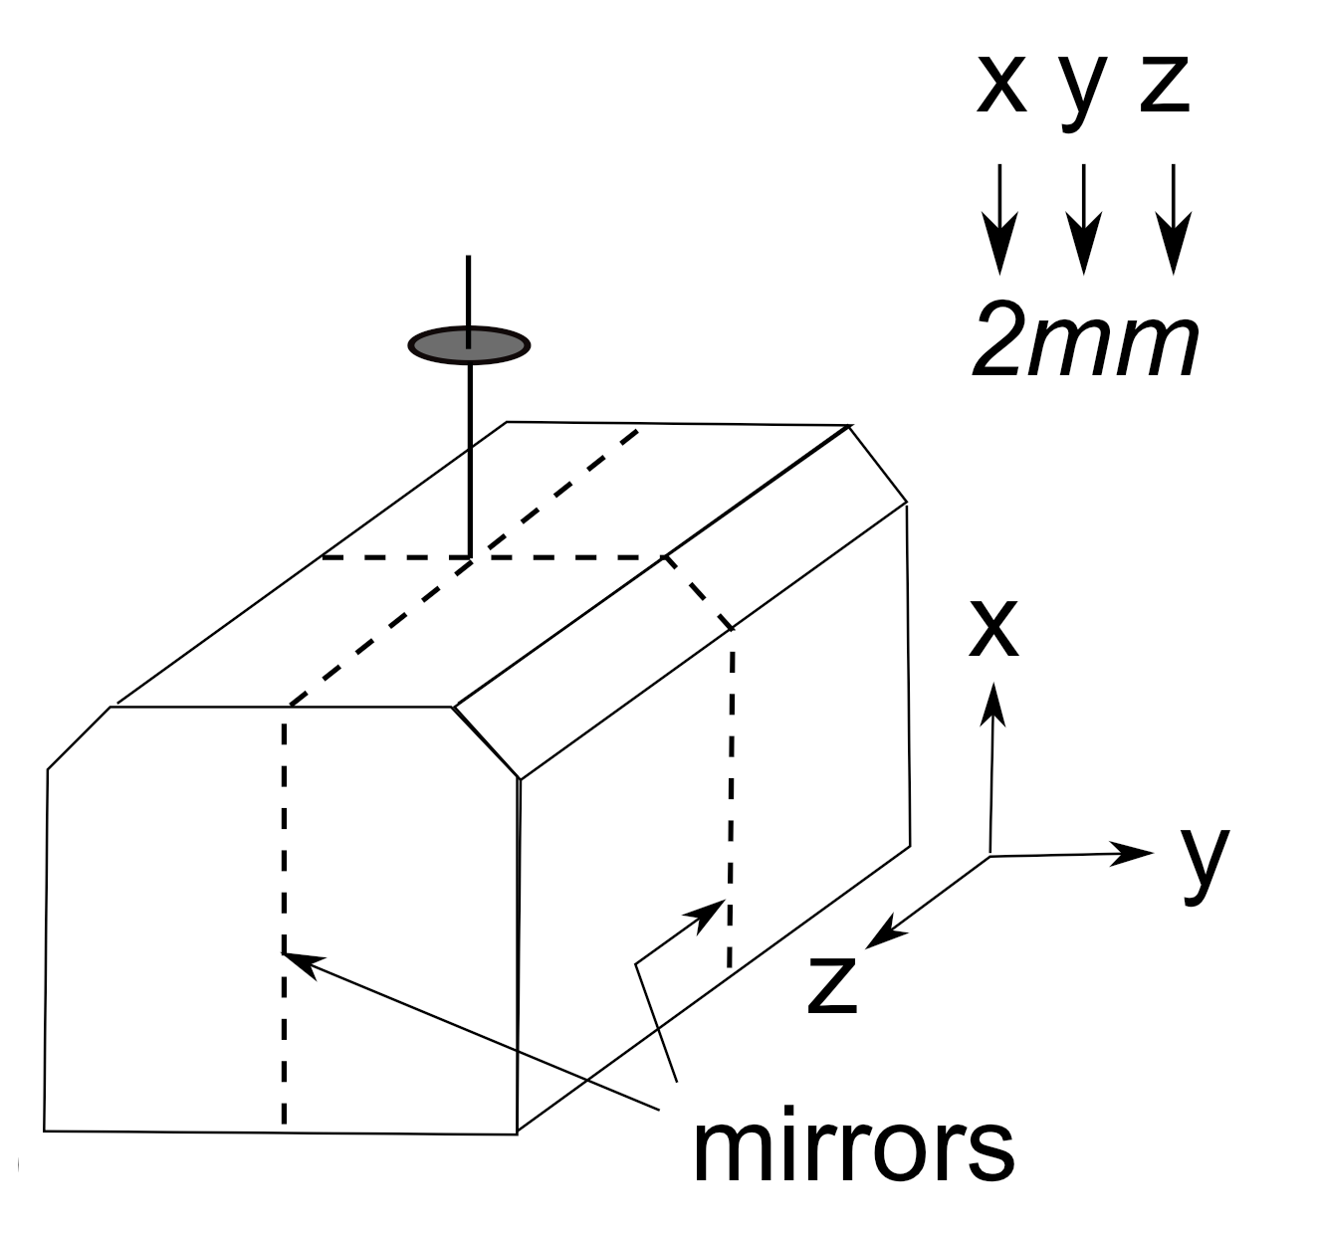
without high-order axes

Slide 32
with high-order axes

Slide 33
