Slide 1

Crystallography
Introduction and point groups
Stereographic projections
Low symmetry systems
Space groups
Deformation and texture
Interfaces, orientation relationships
Martensitic transformations
H. K. D. H. Bhadeshia

Slide 2
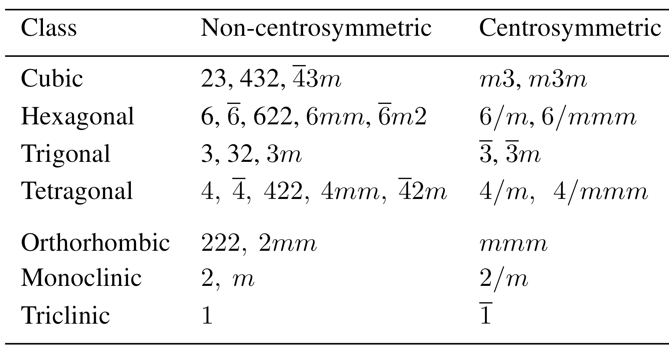

Slide 3
Ga_{0.52}In_{0.48}P
When epitaxially deposited,
undergoes ordering of atoms that leads to a change from a cubic-F (point group 43m) to a trigonal structure (point group 3m)
_
lattice point

Slide 4
3m
trigonal
mirror plane
polar group

Slide 5
6mm
hexagonal
mirror plane
polar group

Slide 6
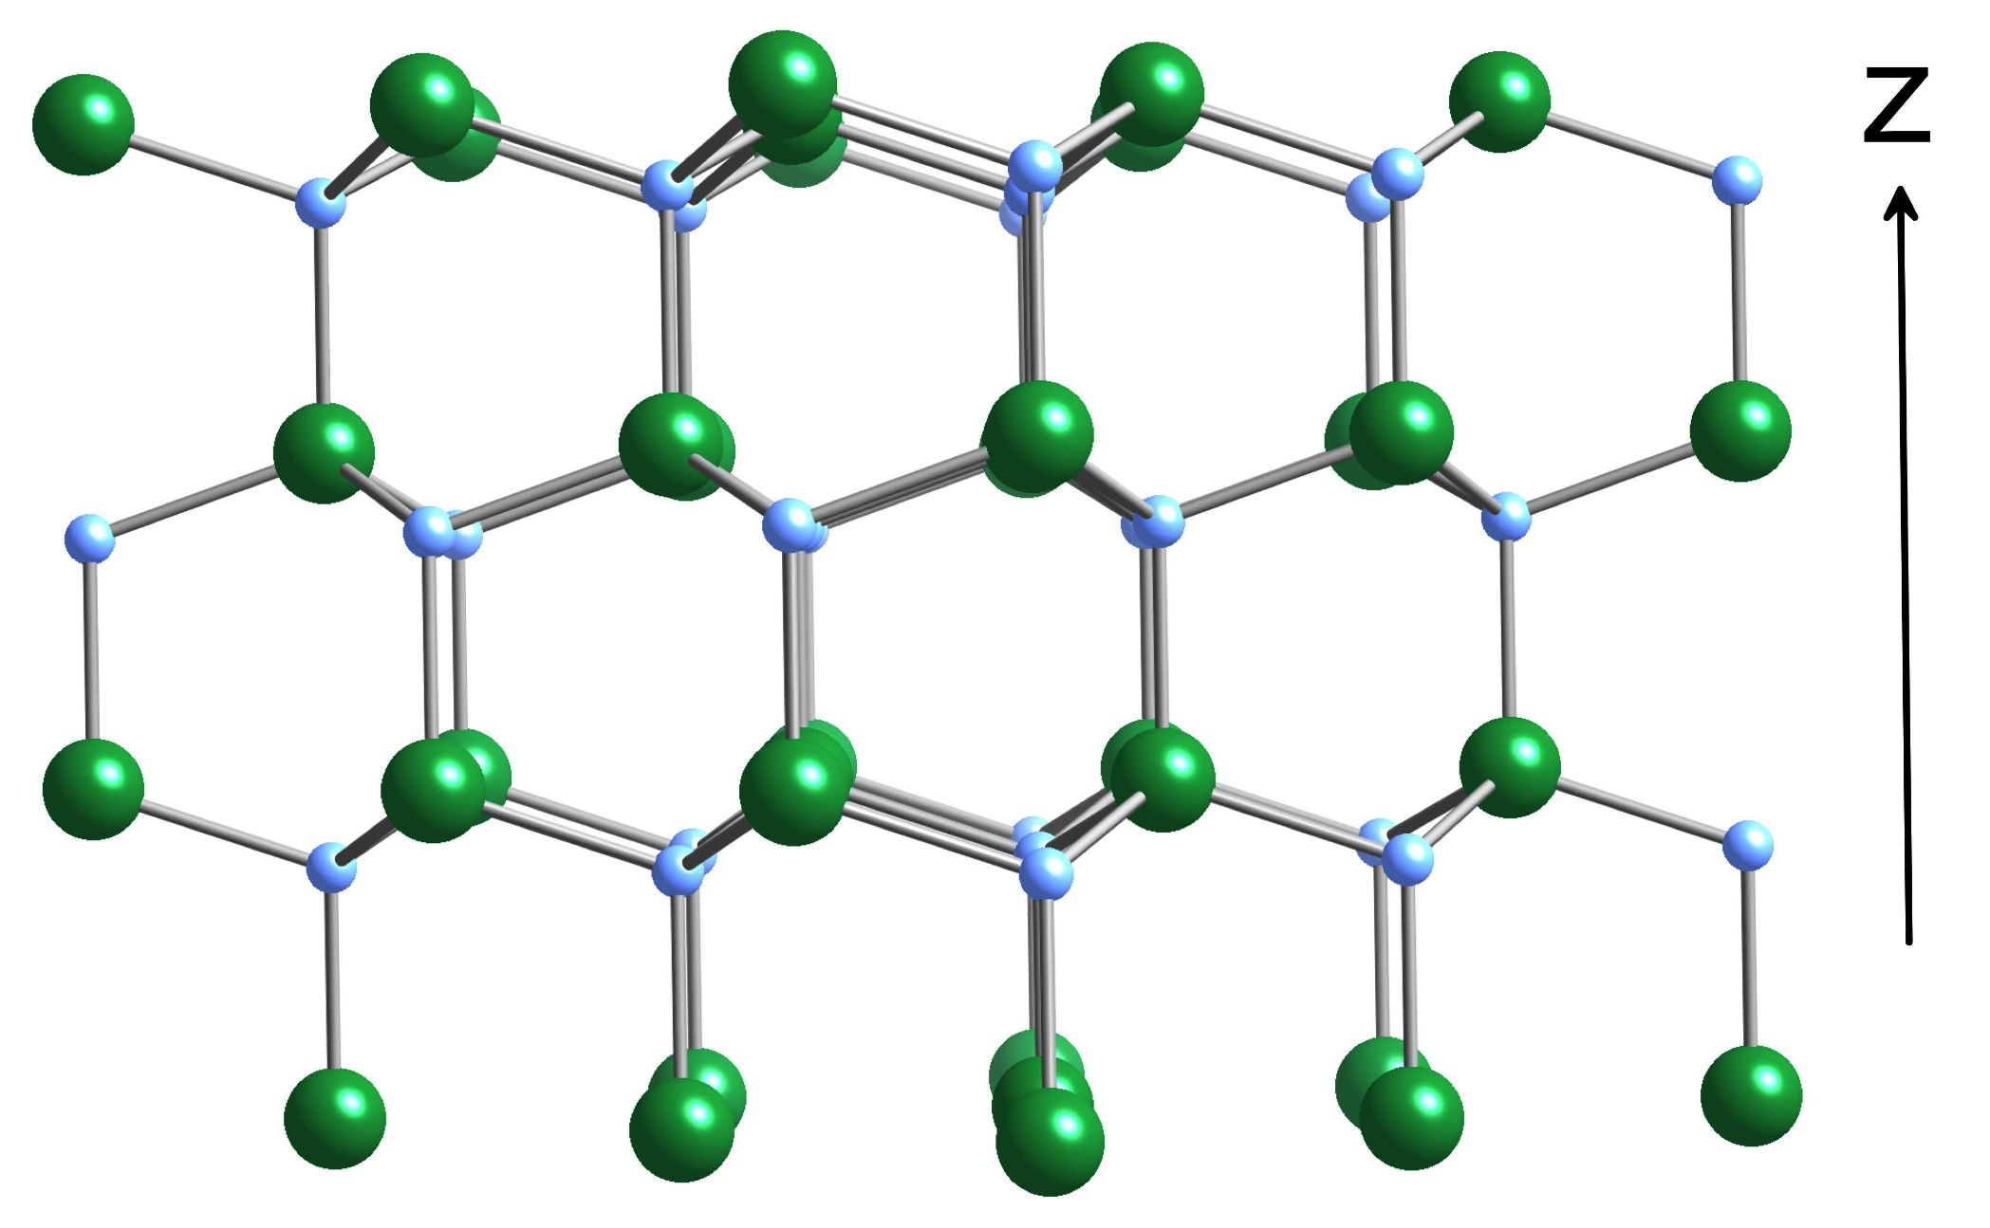
polar group 6mm GaN

Slide 7
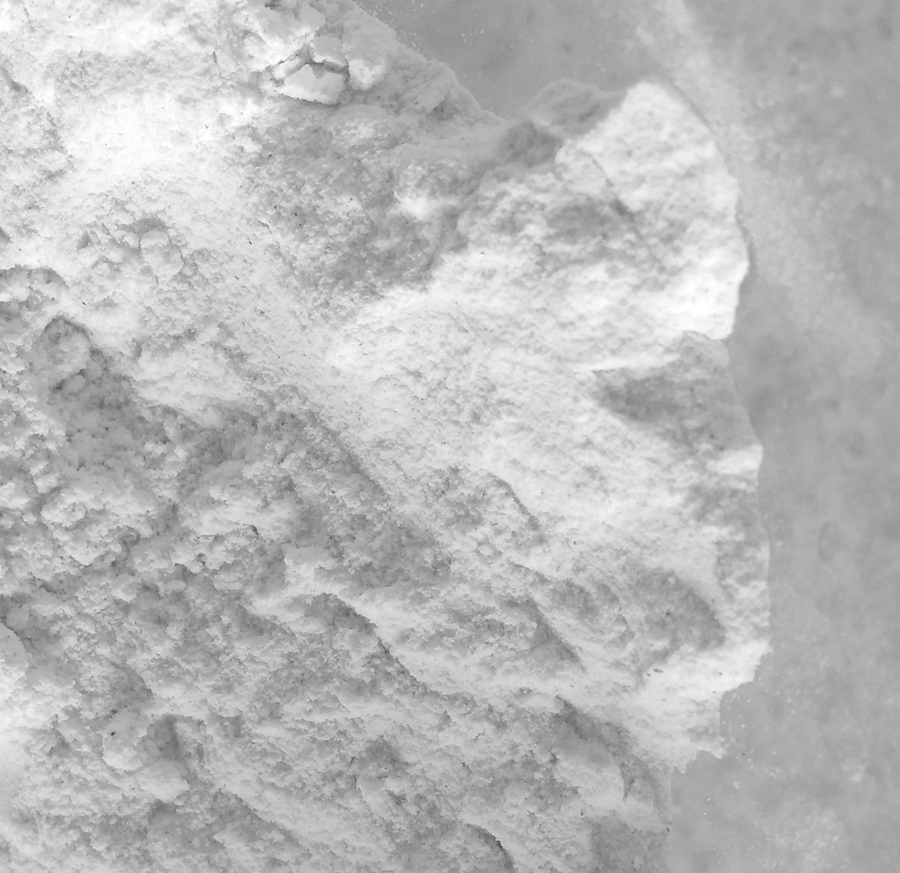
Where are the atoms in the cell?
Experimental data
Chemical formula: TiPbO₃
X-rays: tetragonal lattice
X-rays: cell volume
Density: 1Pb, 1Ti, 3O therefore P-lattice
Valency: Ti⁴⁺, Pb²⁺, O²⁻
Piezoelectric

Slide 8
to locate 3 O ions they would have to be at the face-centres
the titanium and lead would be at equivalent point symmetries
titanium with its greater valency would have a larger number of oxygen ions
in its vicinity than lead

Slide 9
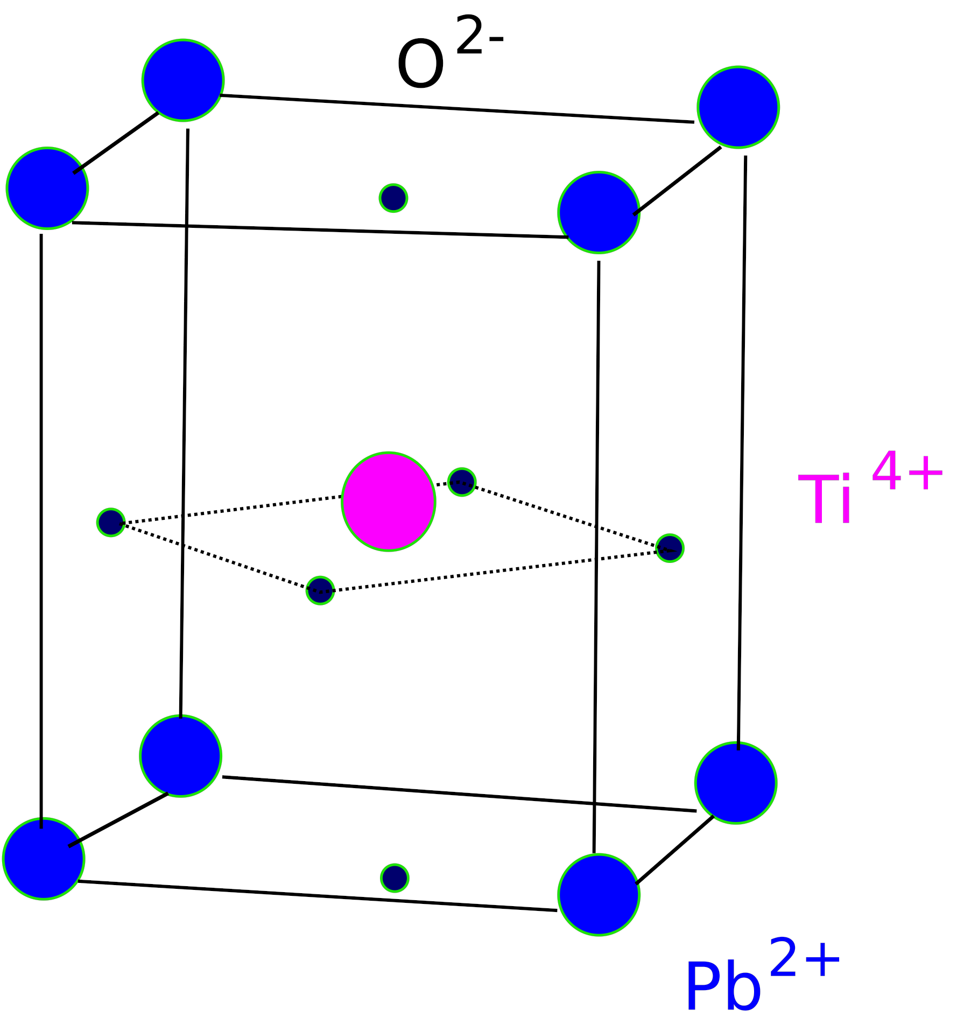



tetragonal

Slide 10
Point group 4mm, tetragonal
a general location x,y,z with a site symmetry 1
would require 8 such atoms in the cell

Slide 11
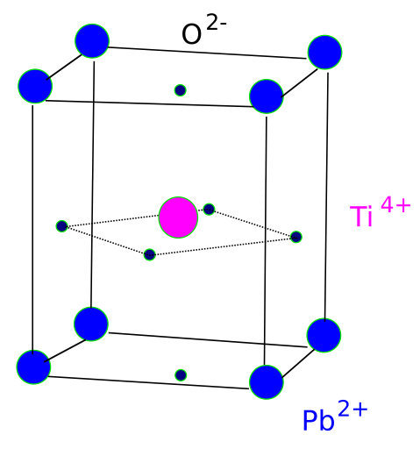
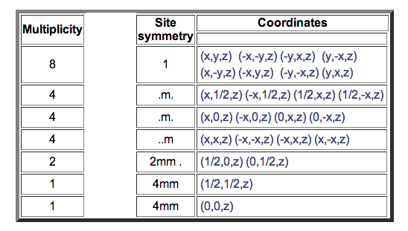
P4mm

Slide 12
4mm
4mm
2mm
site symmetry
4mm

Slide 14
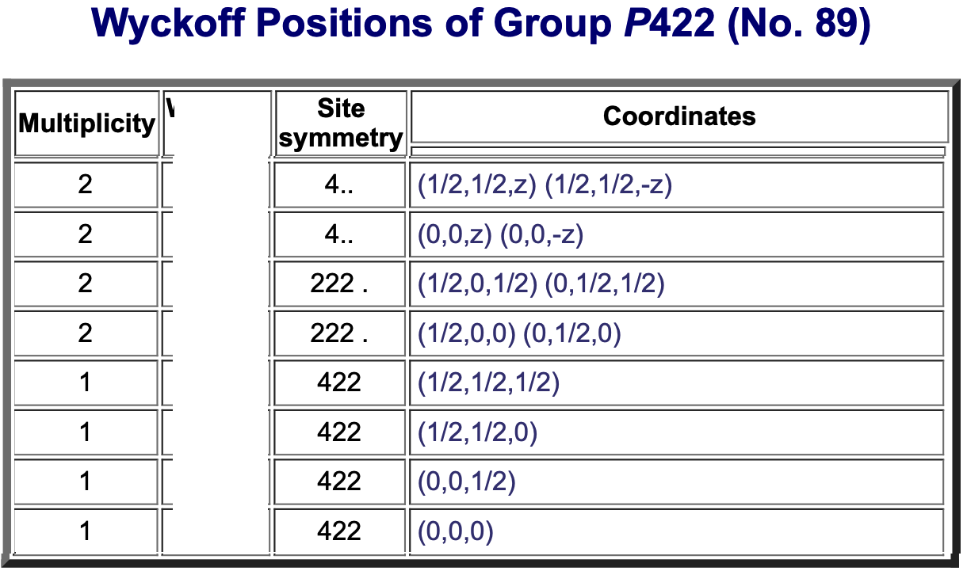
✘
2 oxygens
face centres
✘
1 oxygen
face centre
1 lead
corner

Slide 15
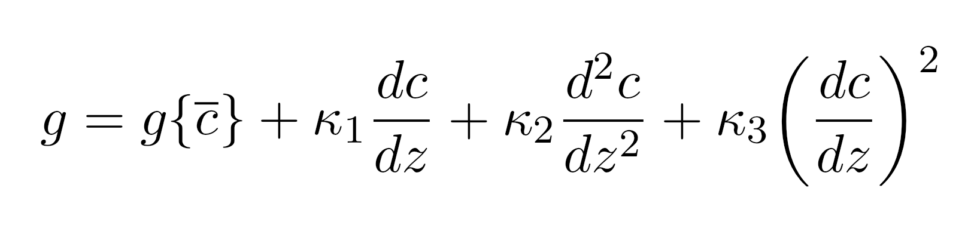
the titanate just discussed has no centre of symmetry,
piezoelectric.
free energy of heterogeneous solution

Slide 16
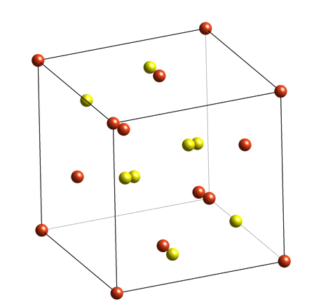
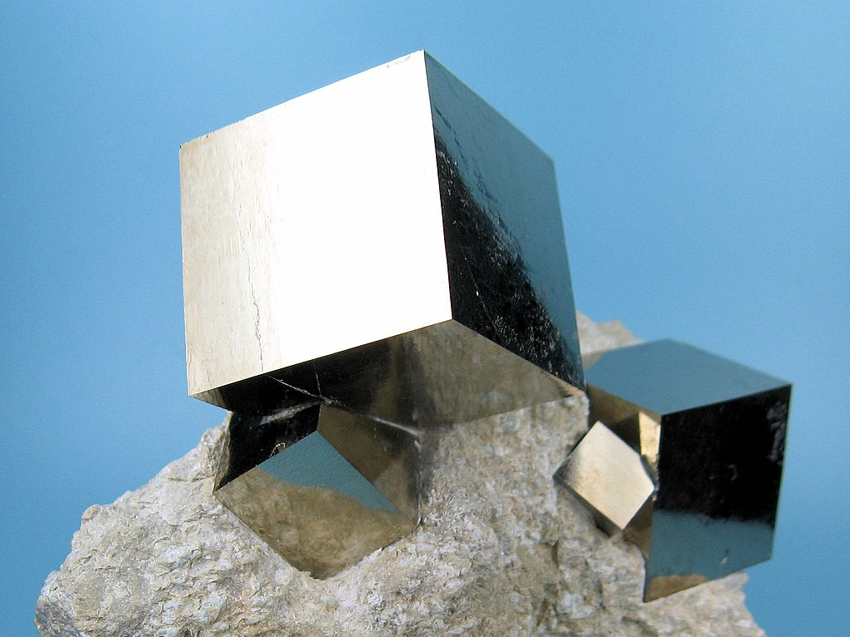
yellow atoms
are sulphur
Carles Millan, Wikimedia, CC BY-SA 3.0

Slide 17
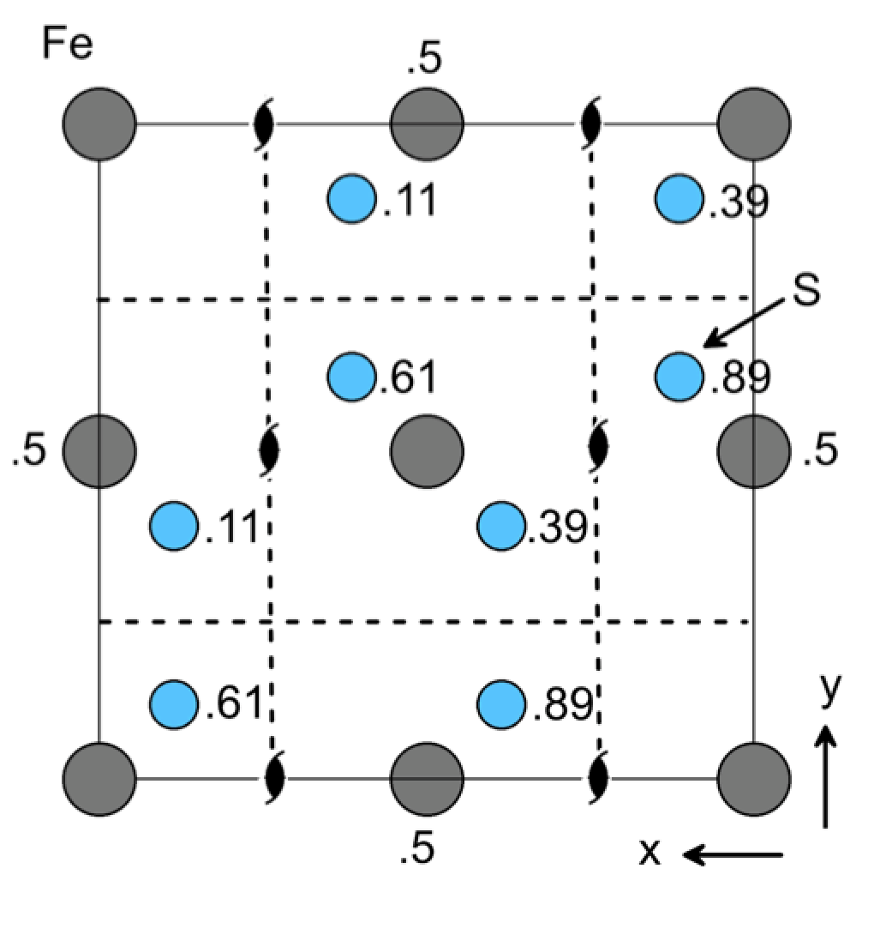
Pyrite m3

Slide 18
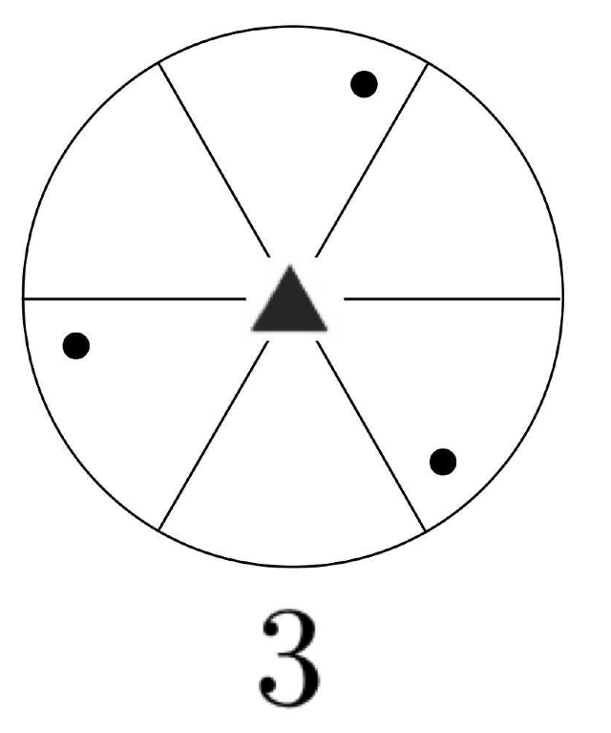
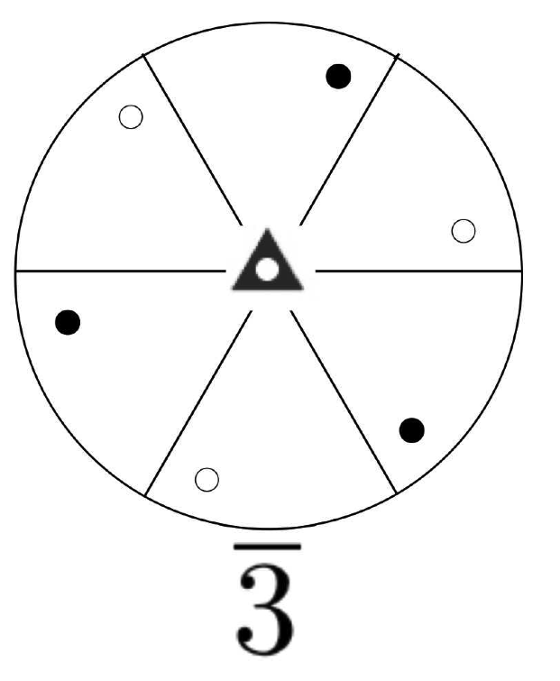

Slide 19
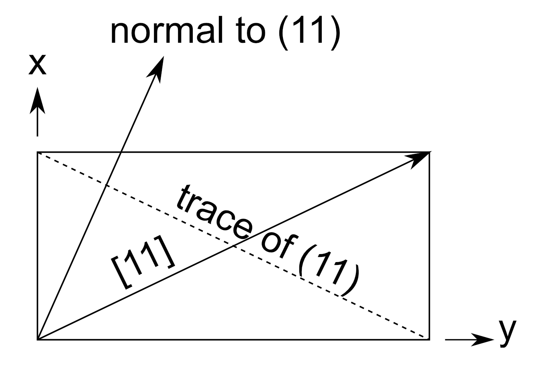
Stereograms for systems of low symmetry

Slide 20
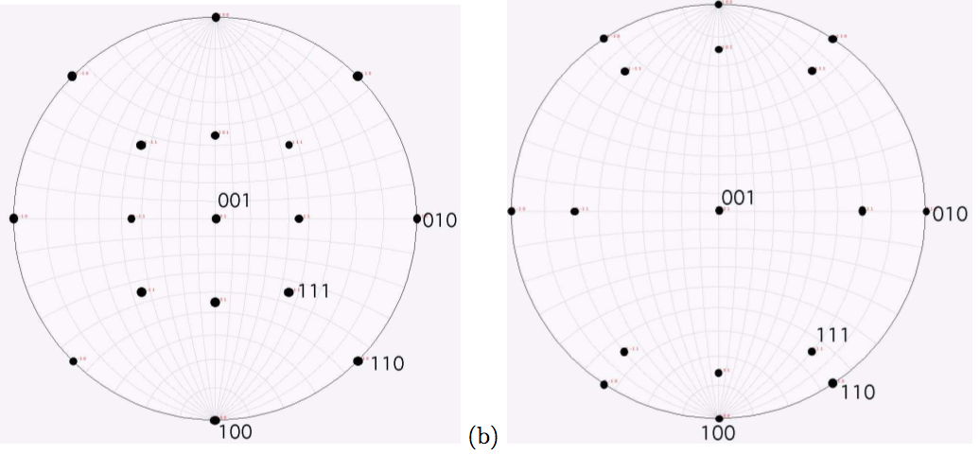
5
2,3,8

Slide 21
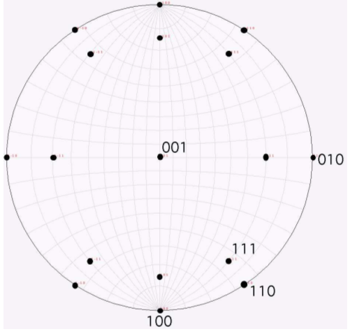
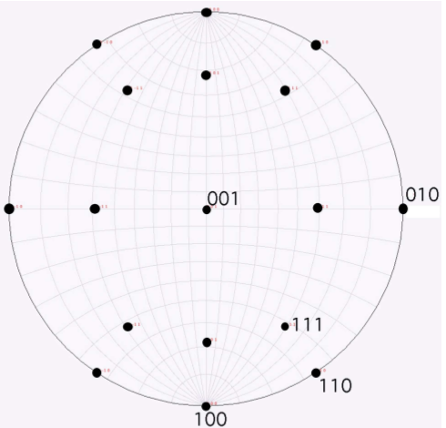
2,3,8 2,3,5

Slide 22
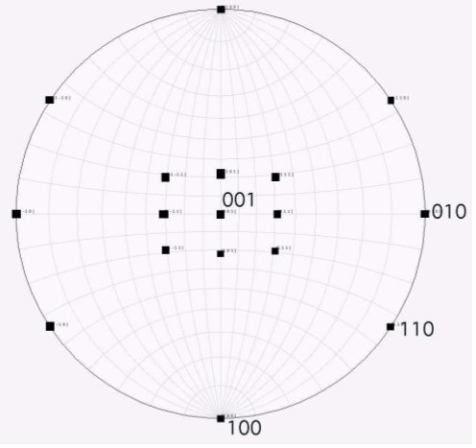
2,3,5
normals directions

Slide 23
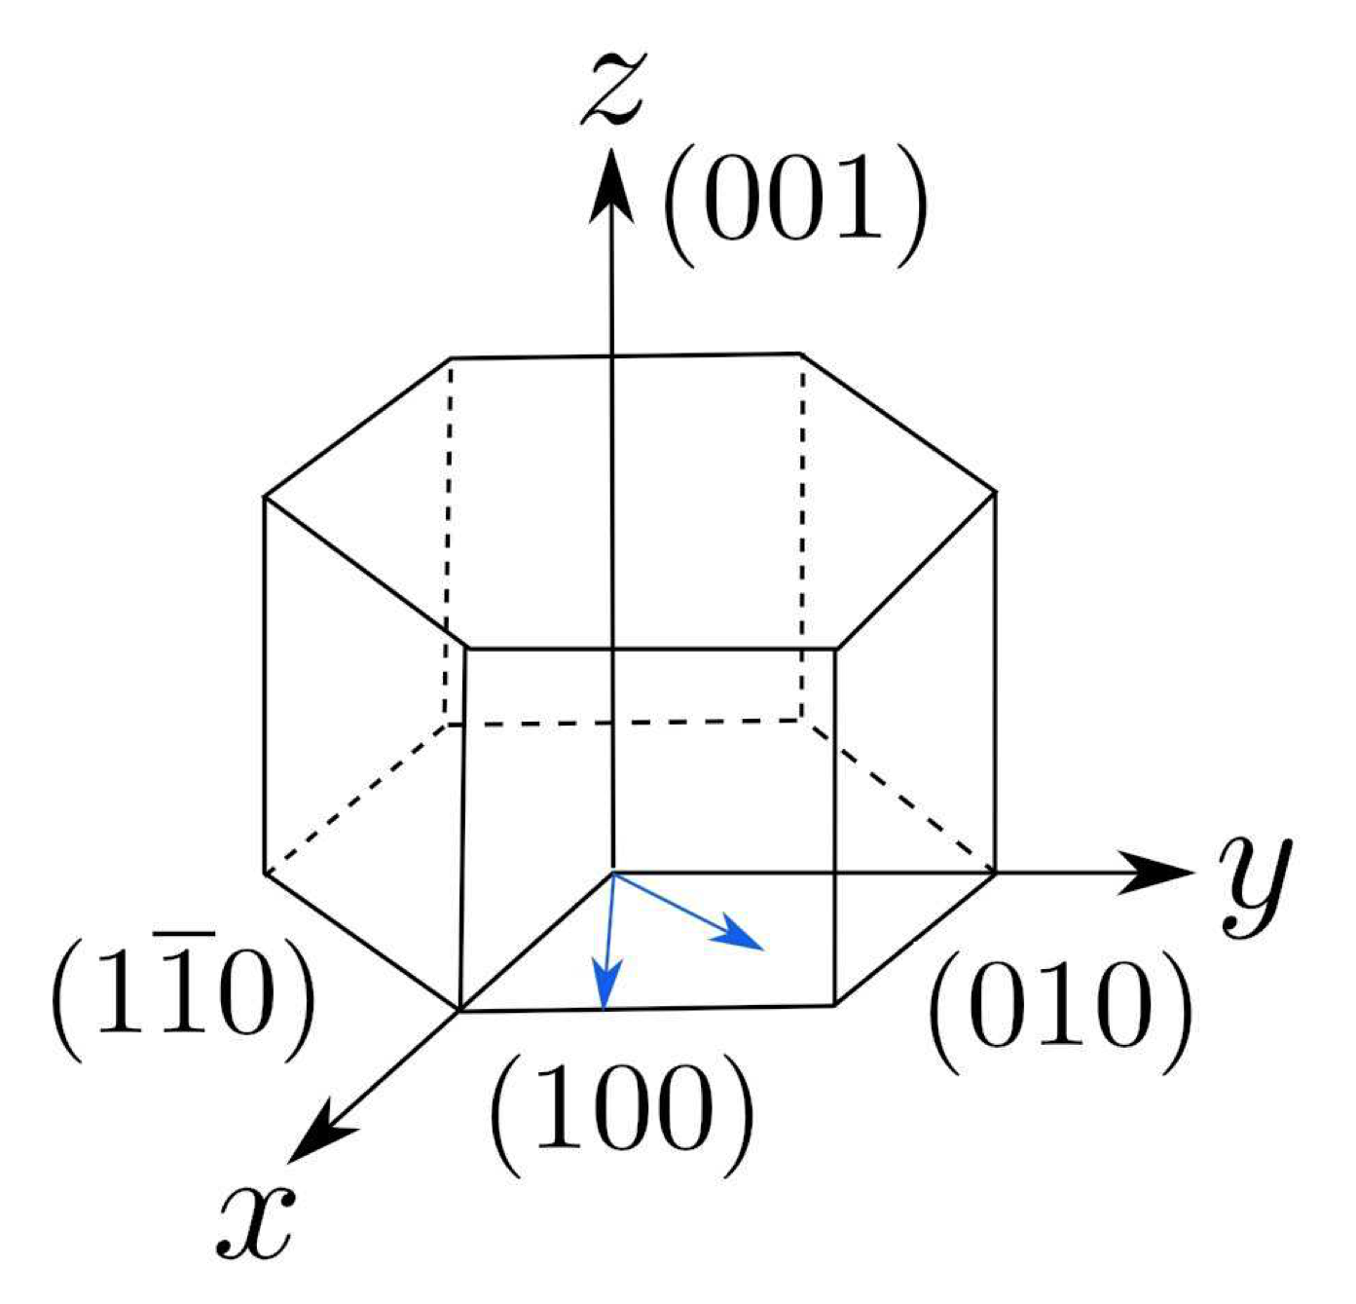
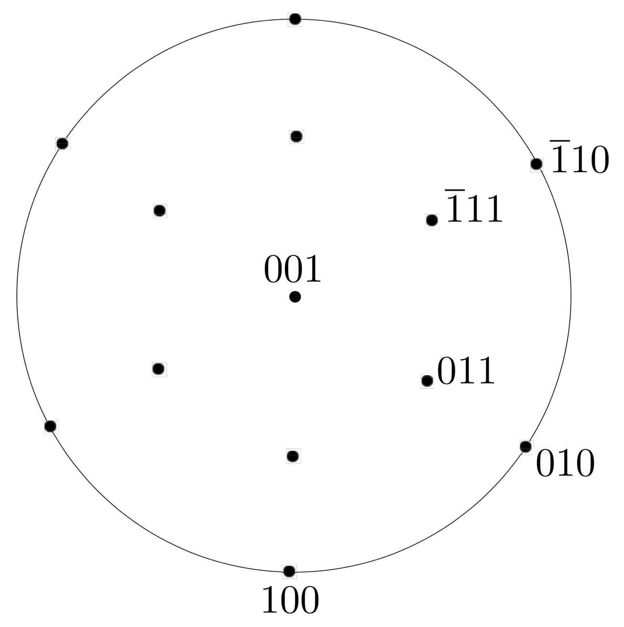
plotting poles, i.e.,
plane normals

Slide 24


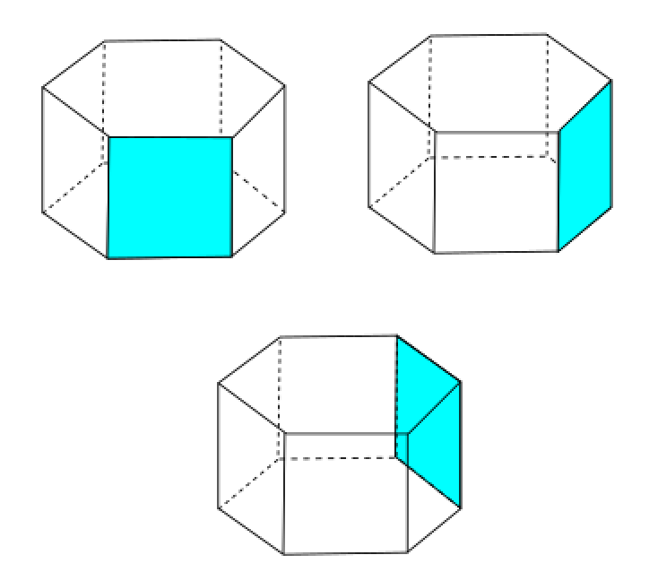

Slide 25


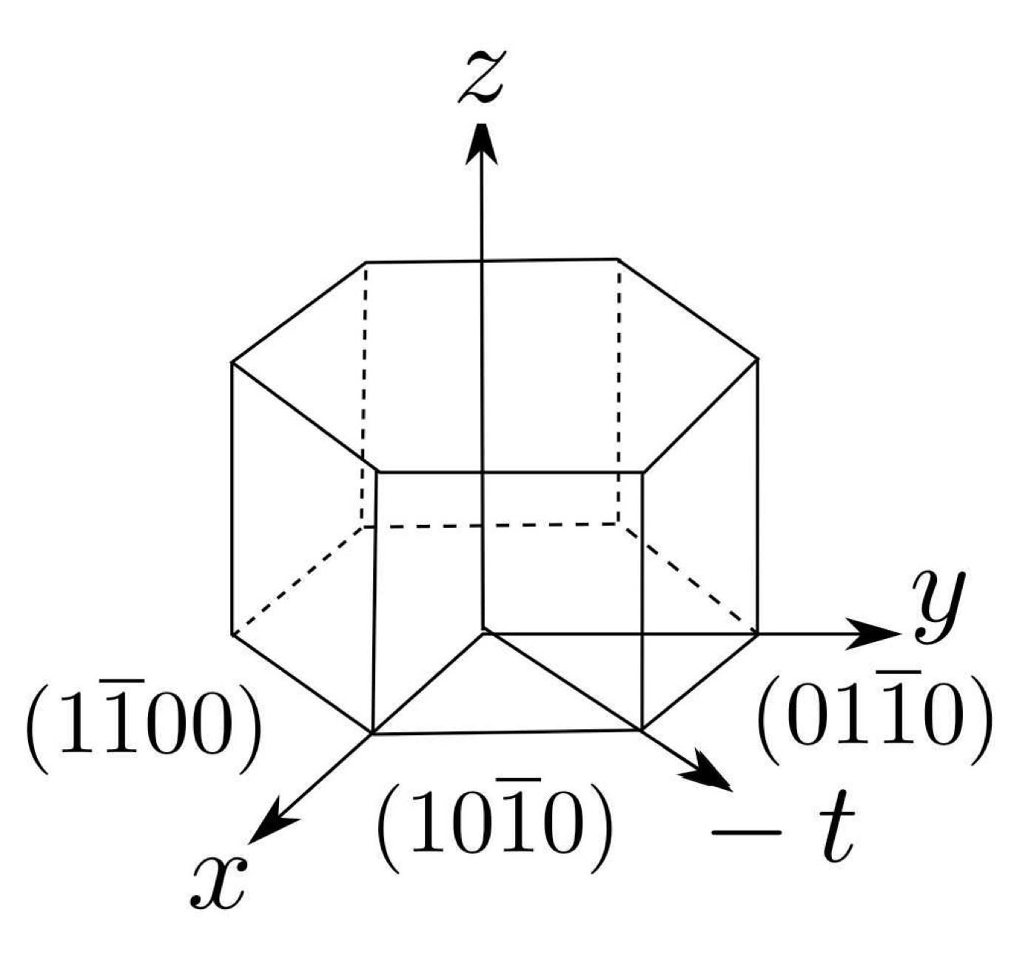



Slide 26
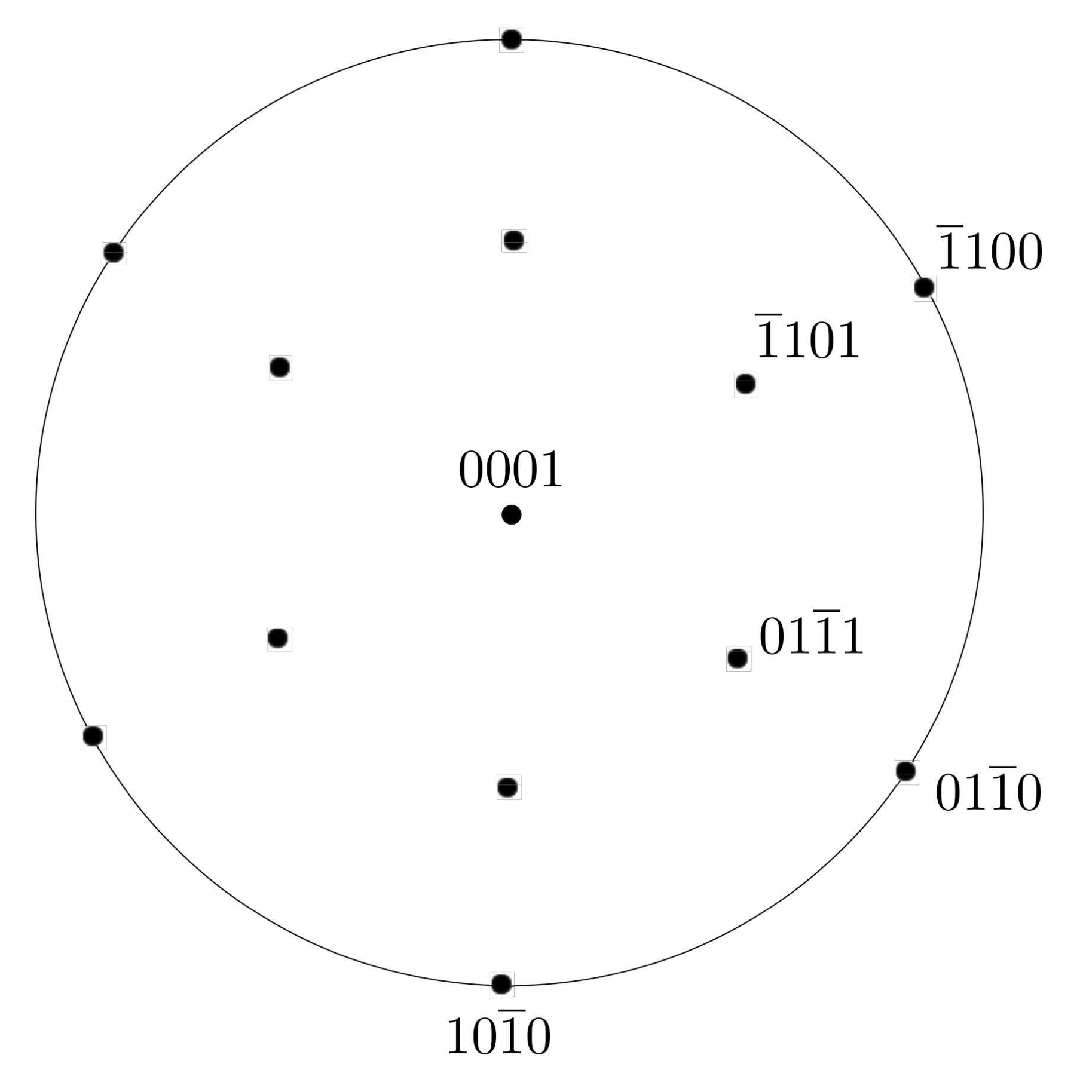

Slide 27
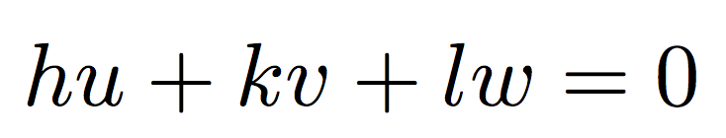


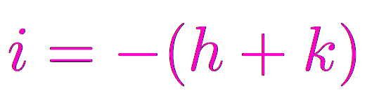

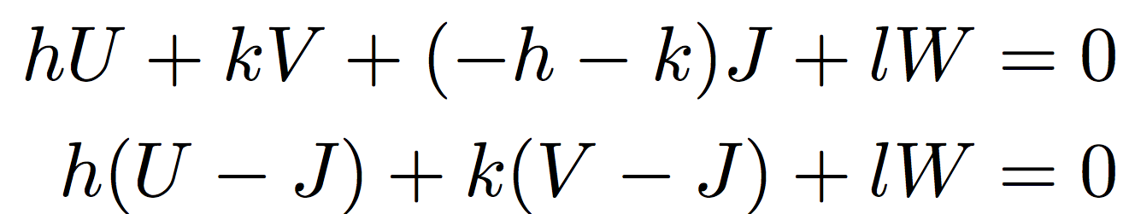

Weiss zone rule

Slide 28
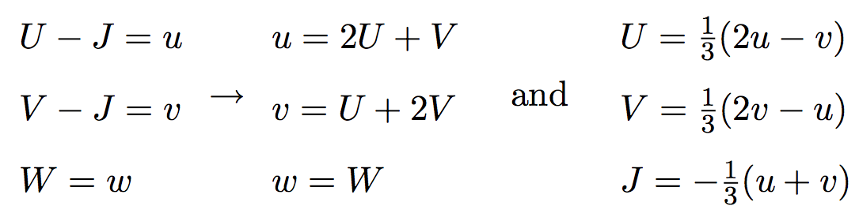

Slide 29
