Slide 1

Crystallography
Introduction and point groups
Stereographic projections
Low symmetry systems
Space groups
Reciprocal Lattice & Diffraction
Deformation and texture
Interfaces, orientation relationships
Martensitic transformations
H. K. D. H. Bhadeshia

Slide 2
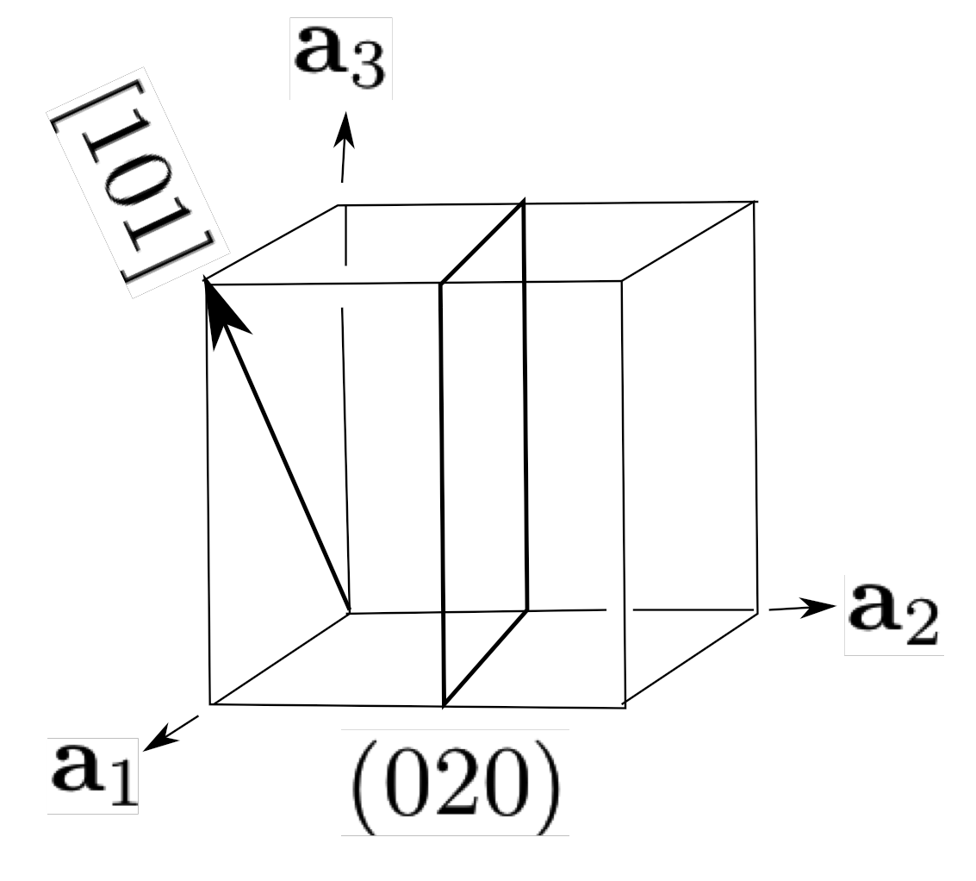


vector has magnitude and direction
u
u

Slide 3
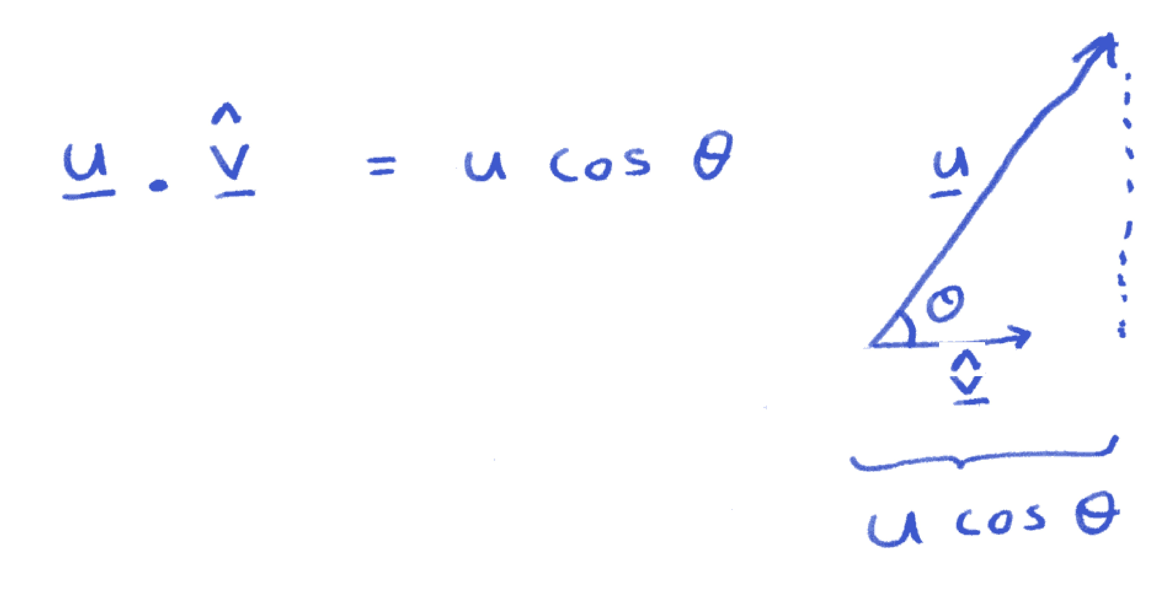

Slide 4
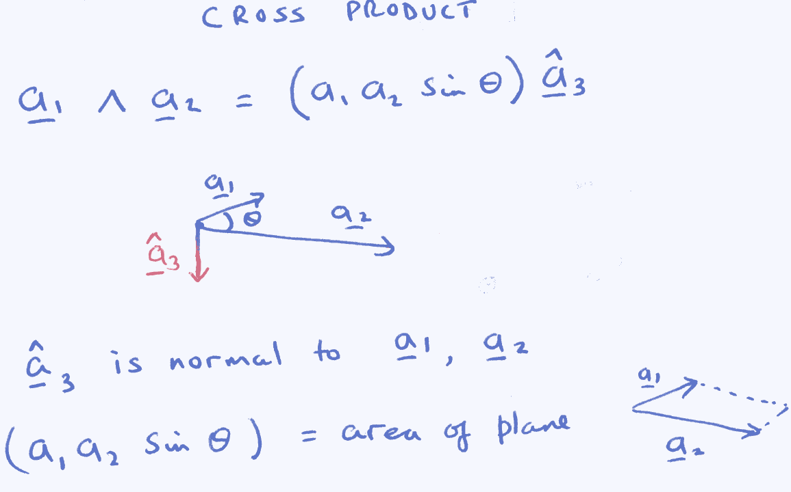

Slide 5
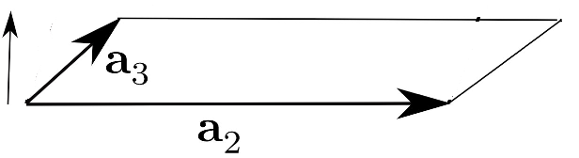

Slide 7
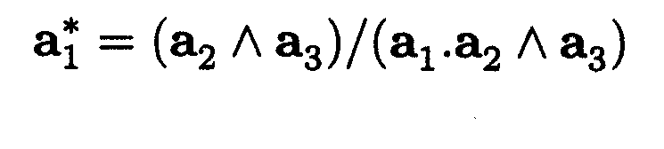
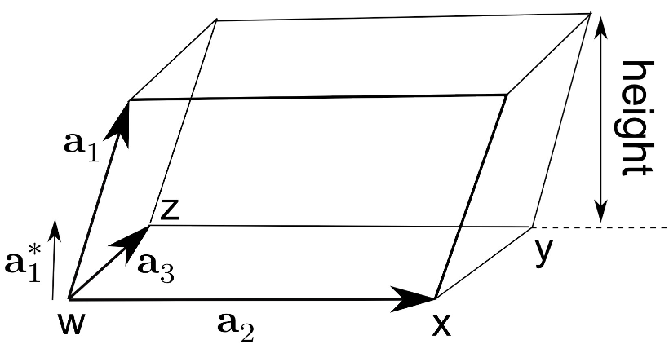

Slide 8
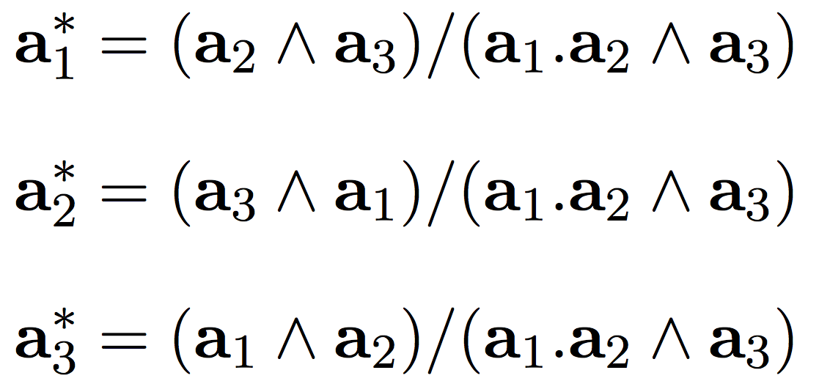

Slide 9
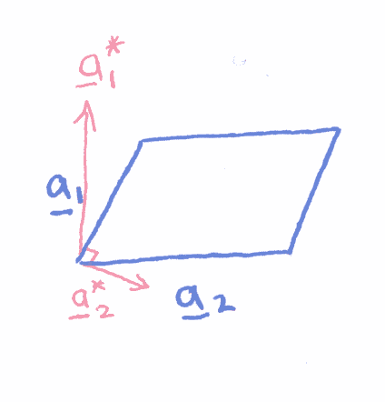
the basis vectors of the reciprocal lattice are not necessarily parallel
to those of the real-space lattice

Slide 10
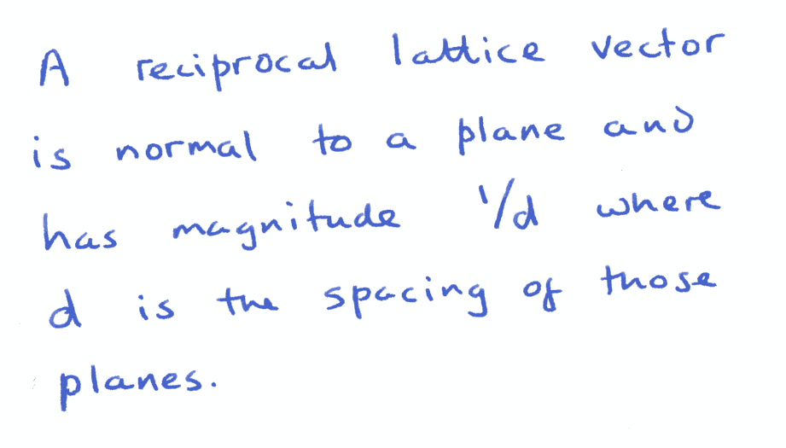

Slide 11
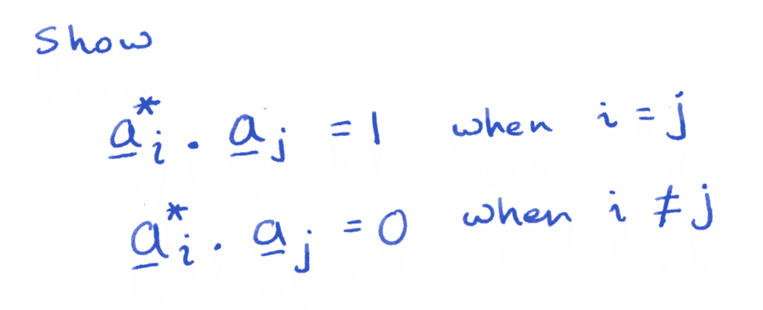

Slide 12
Construct reciprocal
lattice section normal
to [001]

Slide 13
Cubic P, section of reciprocal lattice normal to [001]

Slide 14
Reciprocal lattice
section normal
to [110]

Slide 15
Cubic P, section of reciprocal lattice normal to [110]

Slide 17
Cubic P, section of reciprocal lattice normal to [111]

Slide 18
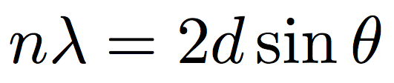
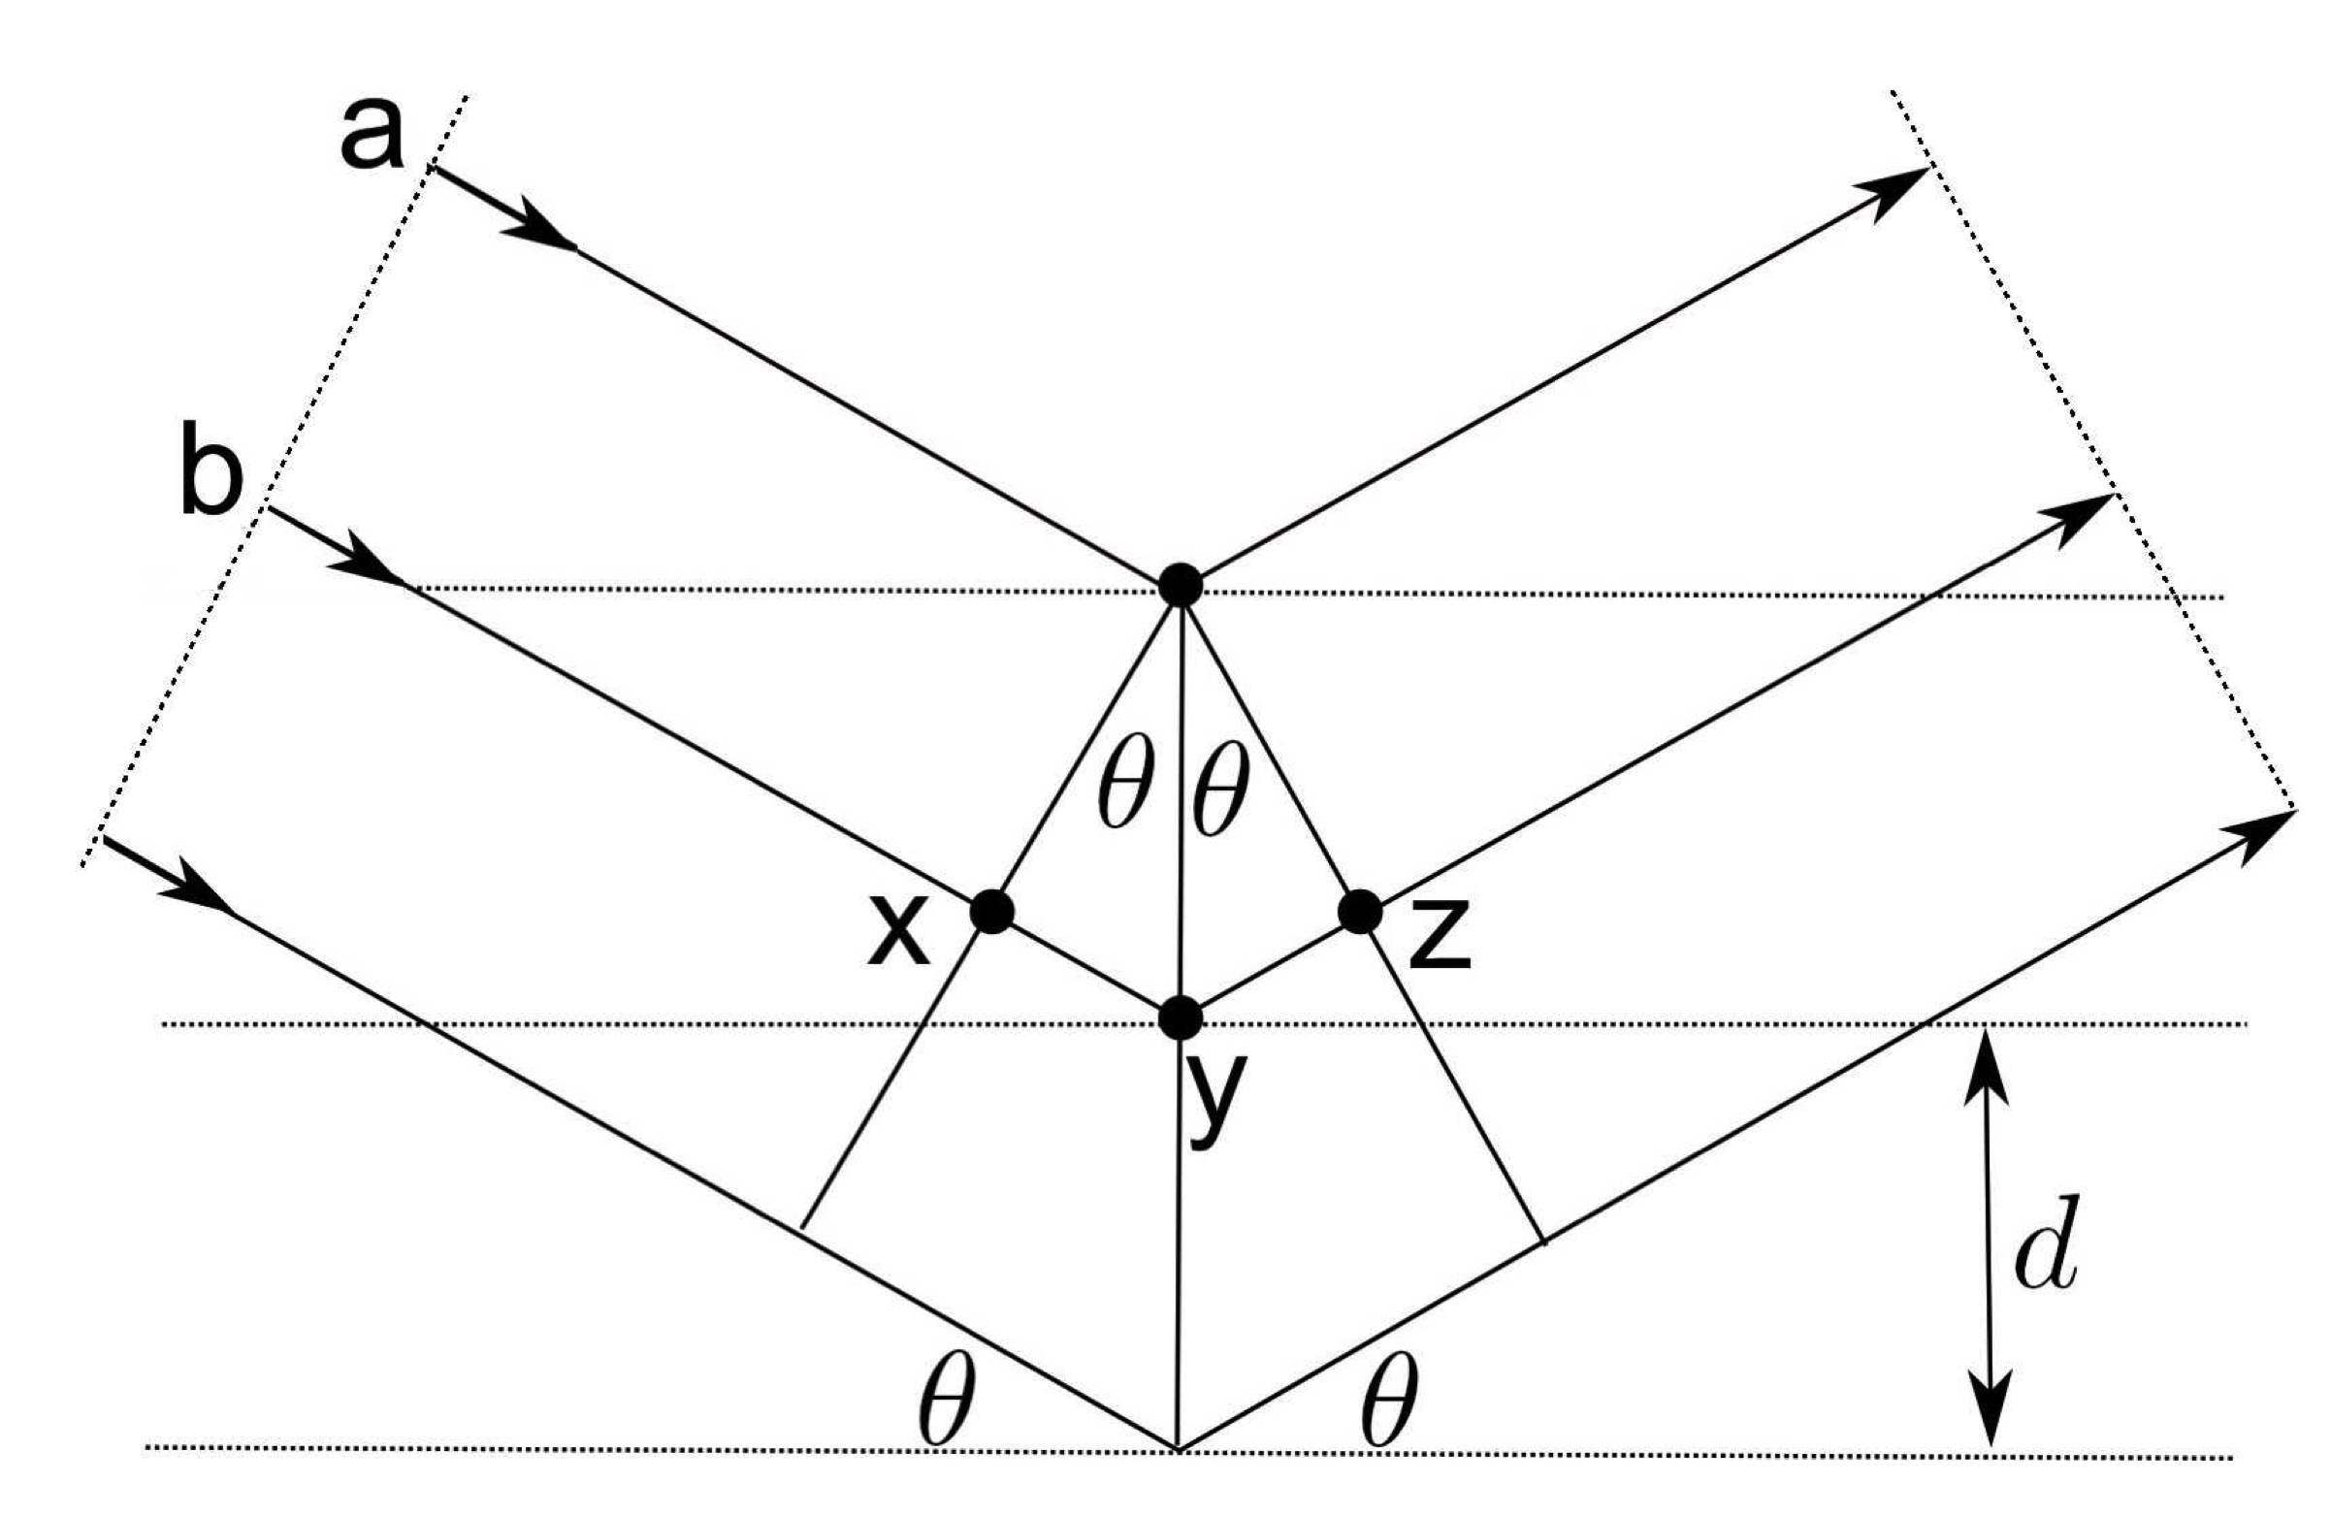
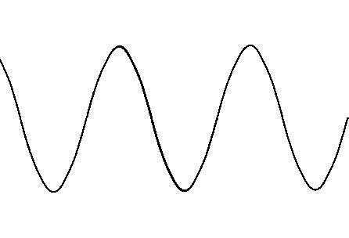

Slide 19
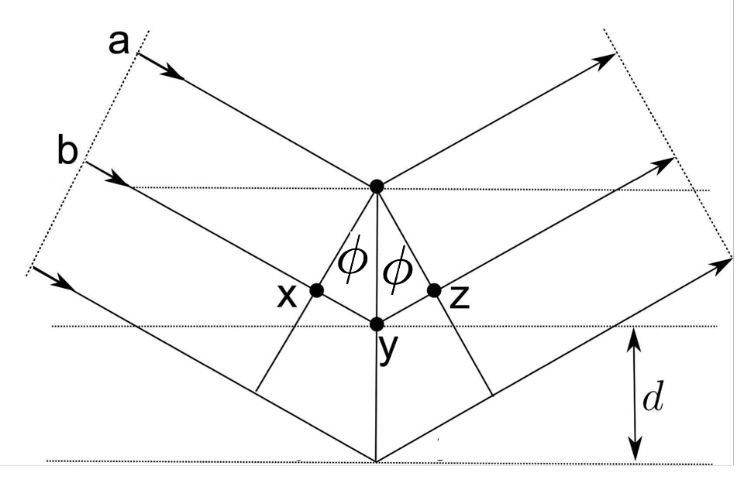

Slide 20
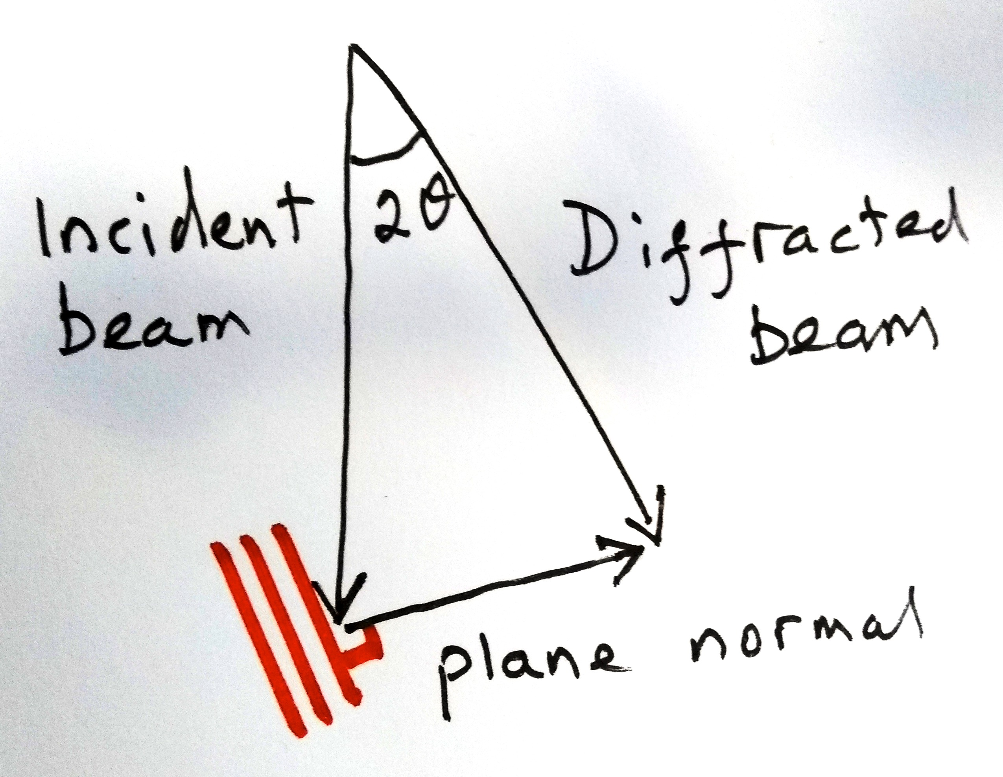

Slide 21
For 100 keV accelerating voltage, the wavelength of electrons is 0.0037 nm.
If the d spacing is 0.2 nm, then the Bragg angle is just 0.5°

Slide 22
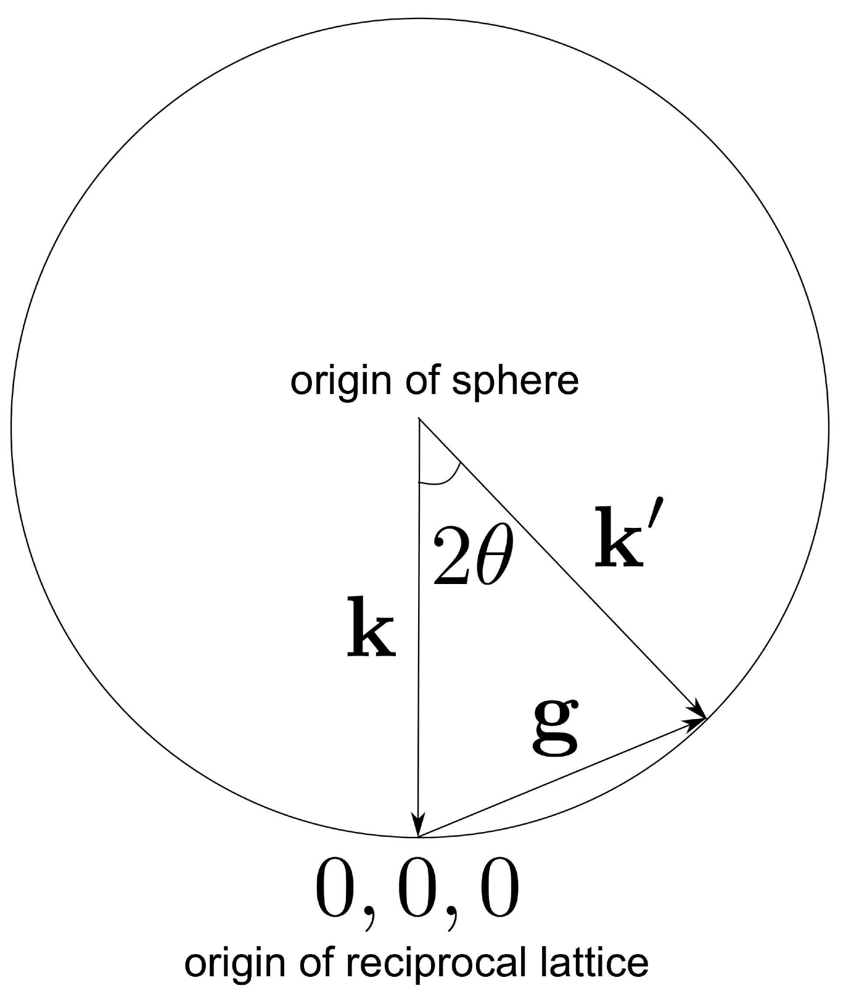
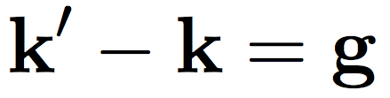


Consider now the Bragg law in reciprocal space

Slide 23
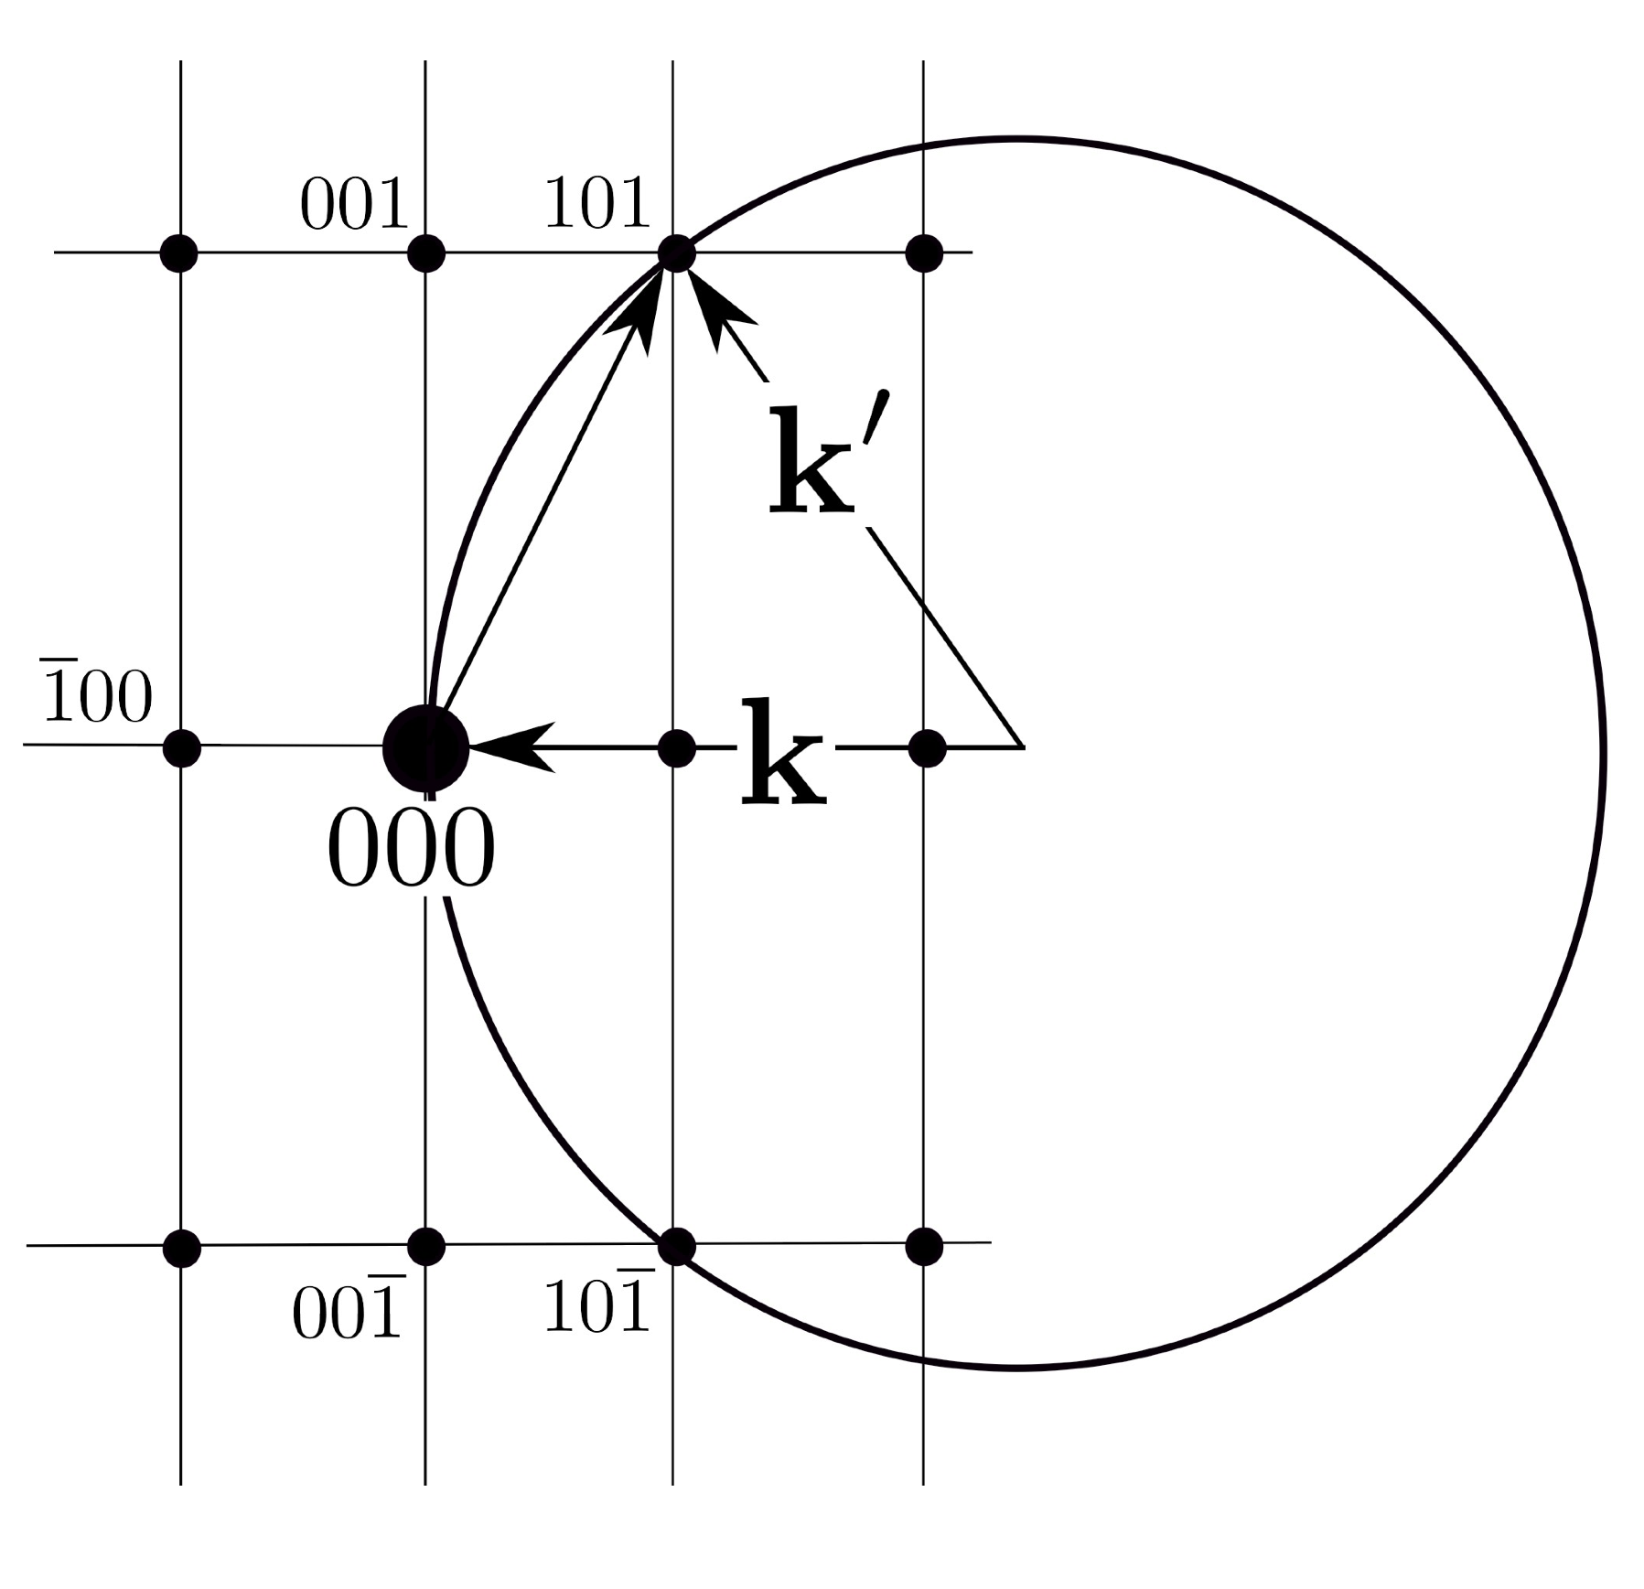

Slide 24
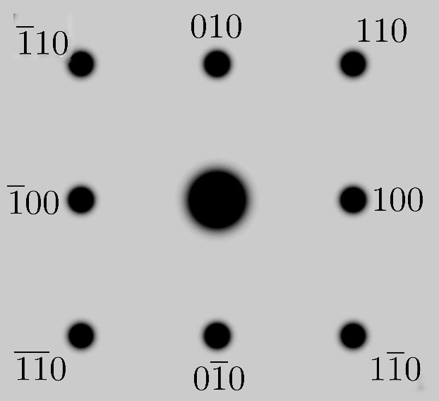
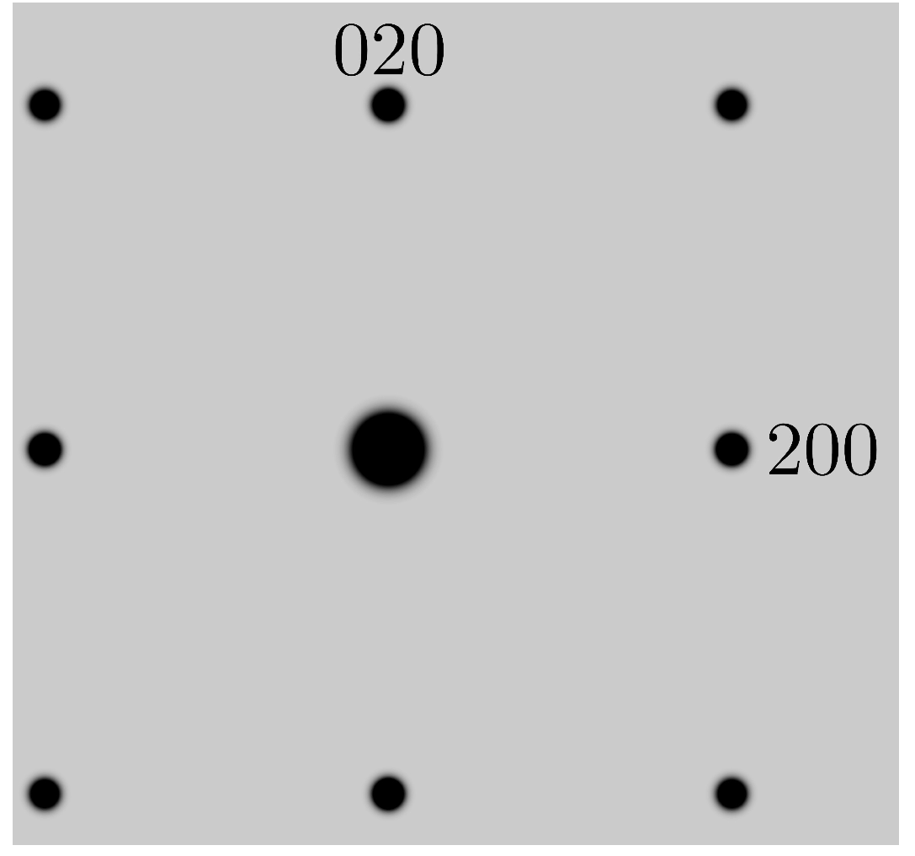
Cubic P
Cubic F

Slide 25
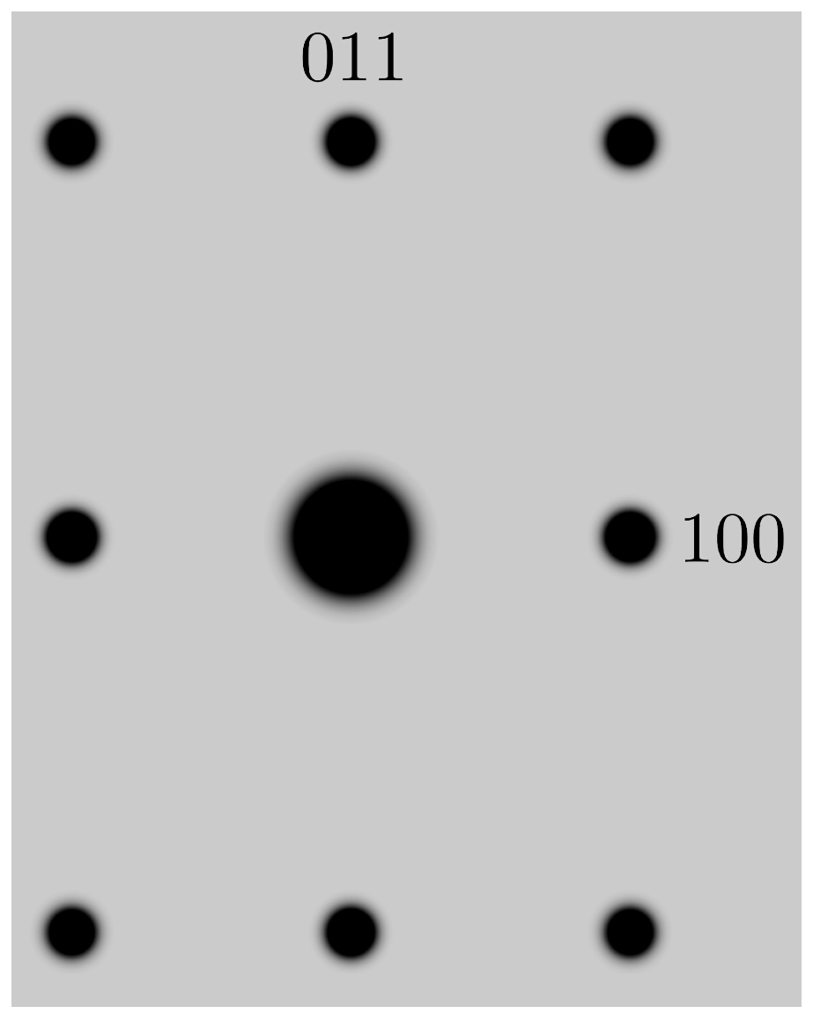
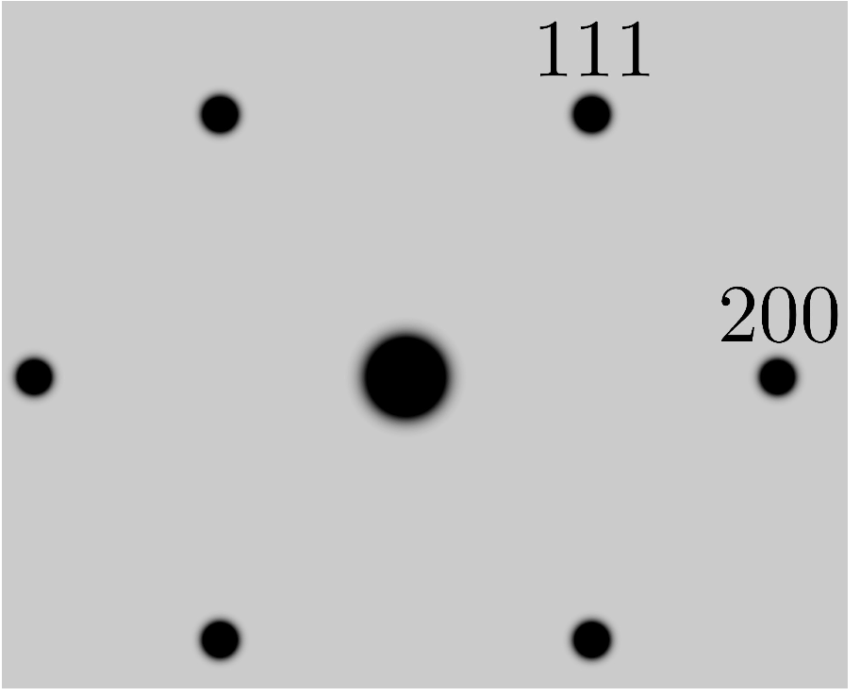
_
Cubic P [011]
Cubic F
111

Slide 26
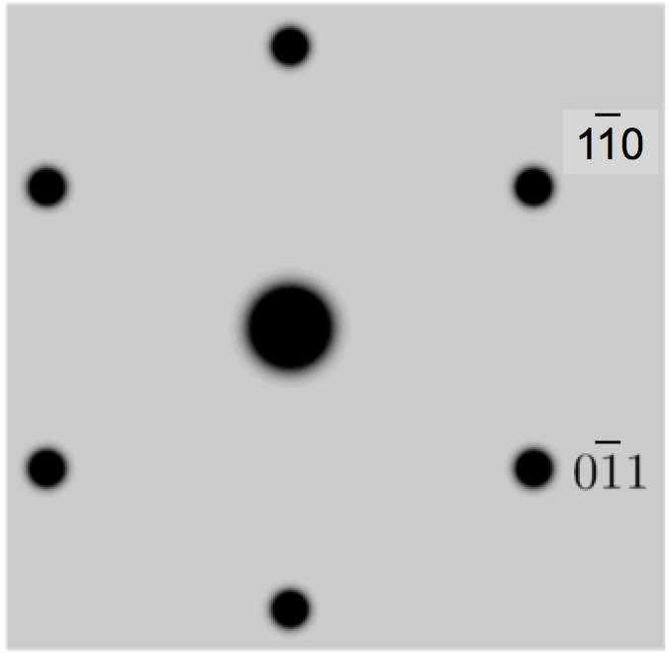
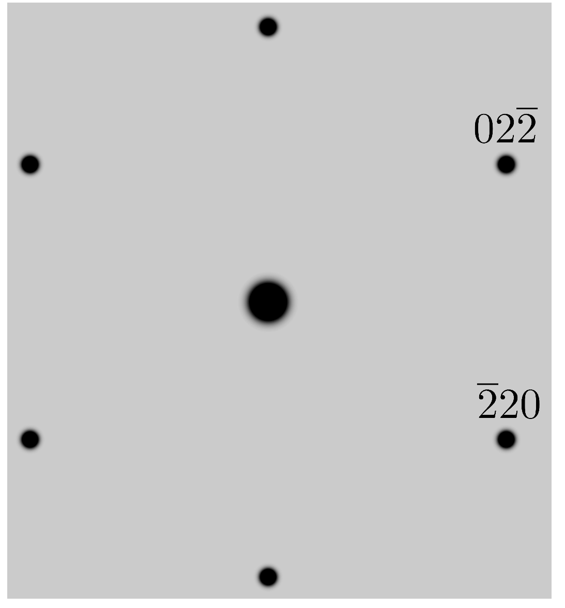
Cubic P [111]
Cubic F
_
220
_
022

Slide 27
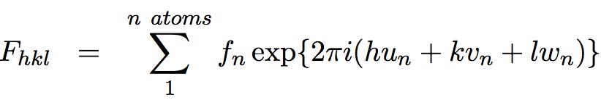


Slide 28
Diffraction from thin crystals

Slide 30
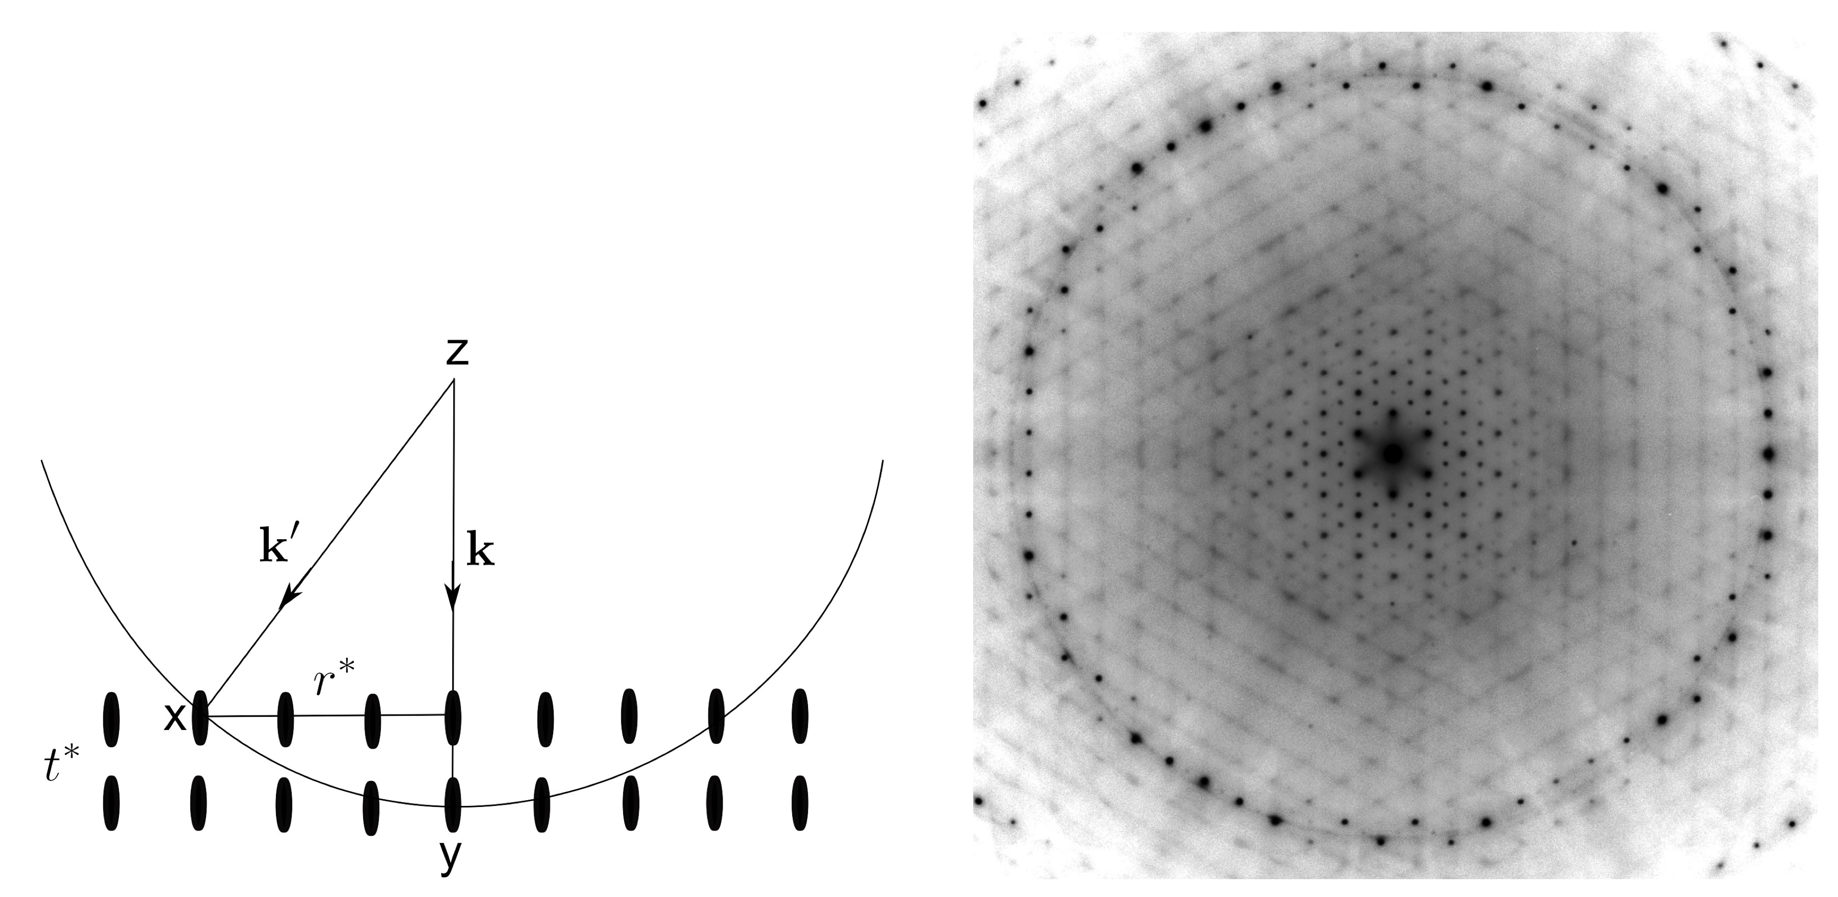

Slide 31
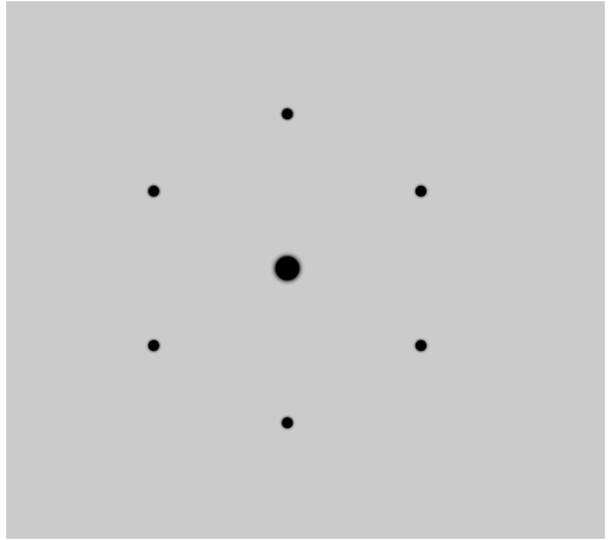
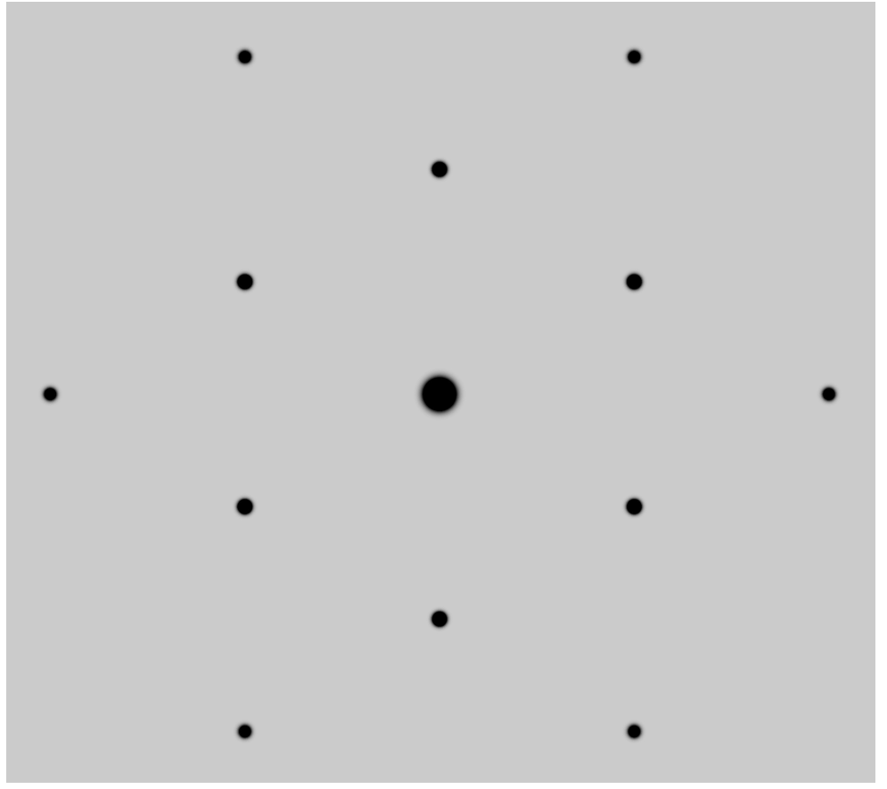
200 nm thick foil
50 nm thick foil

Slide 32
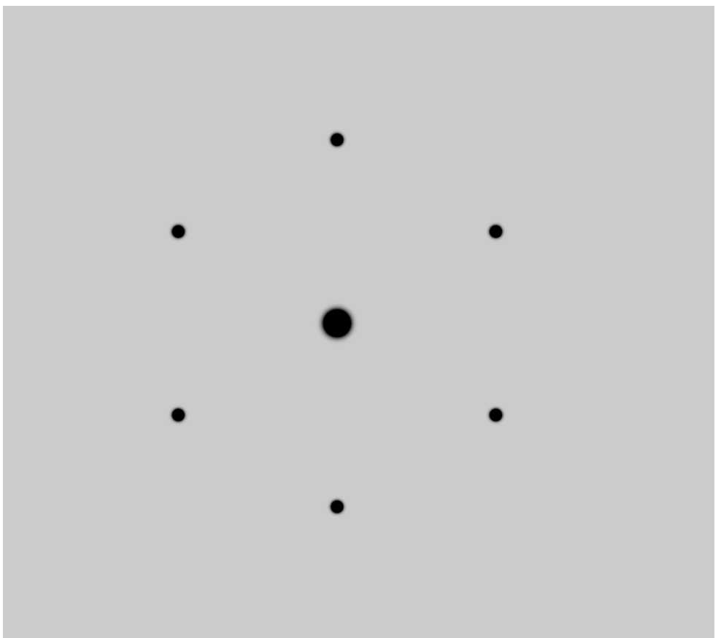
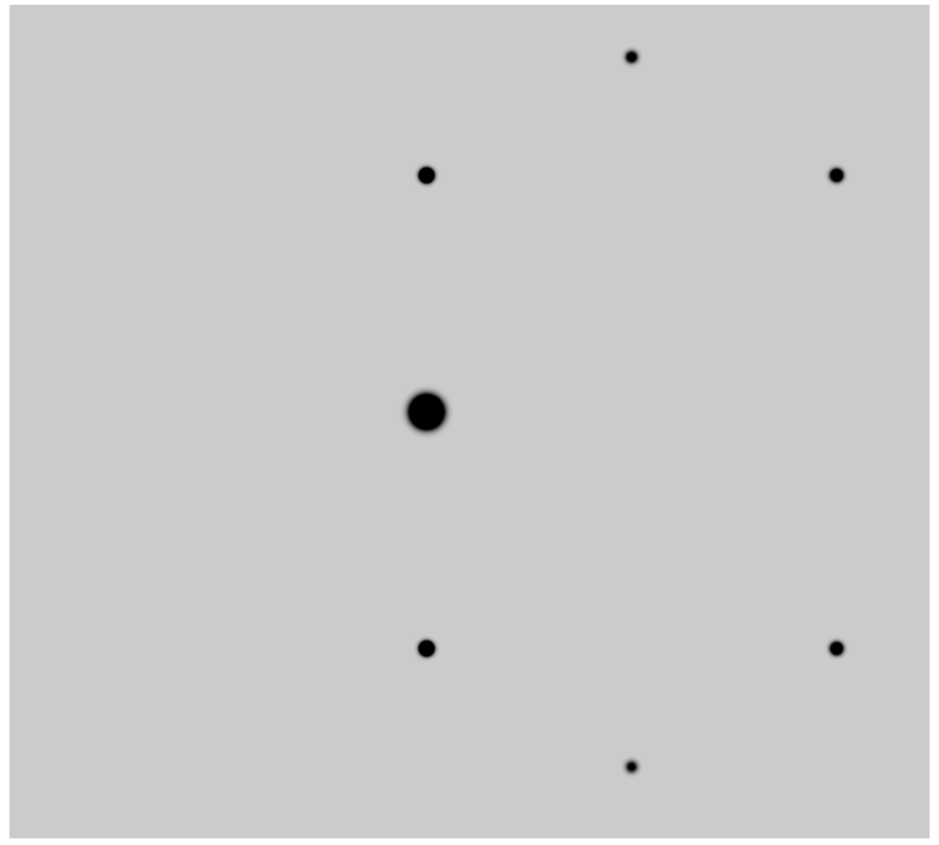
[111]
[1 1 0.9]

Slide 33
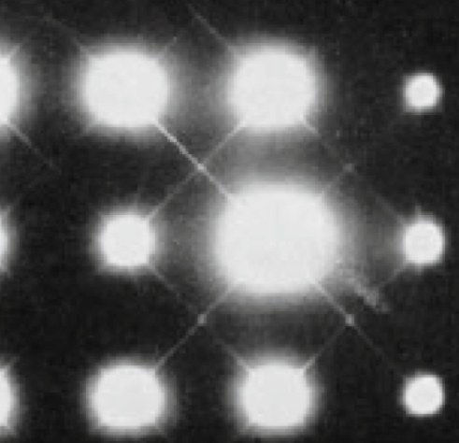
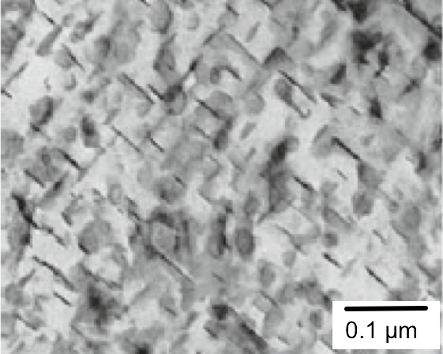
(R. Herring)

Slide 34
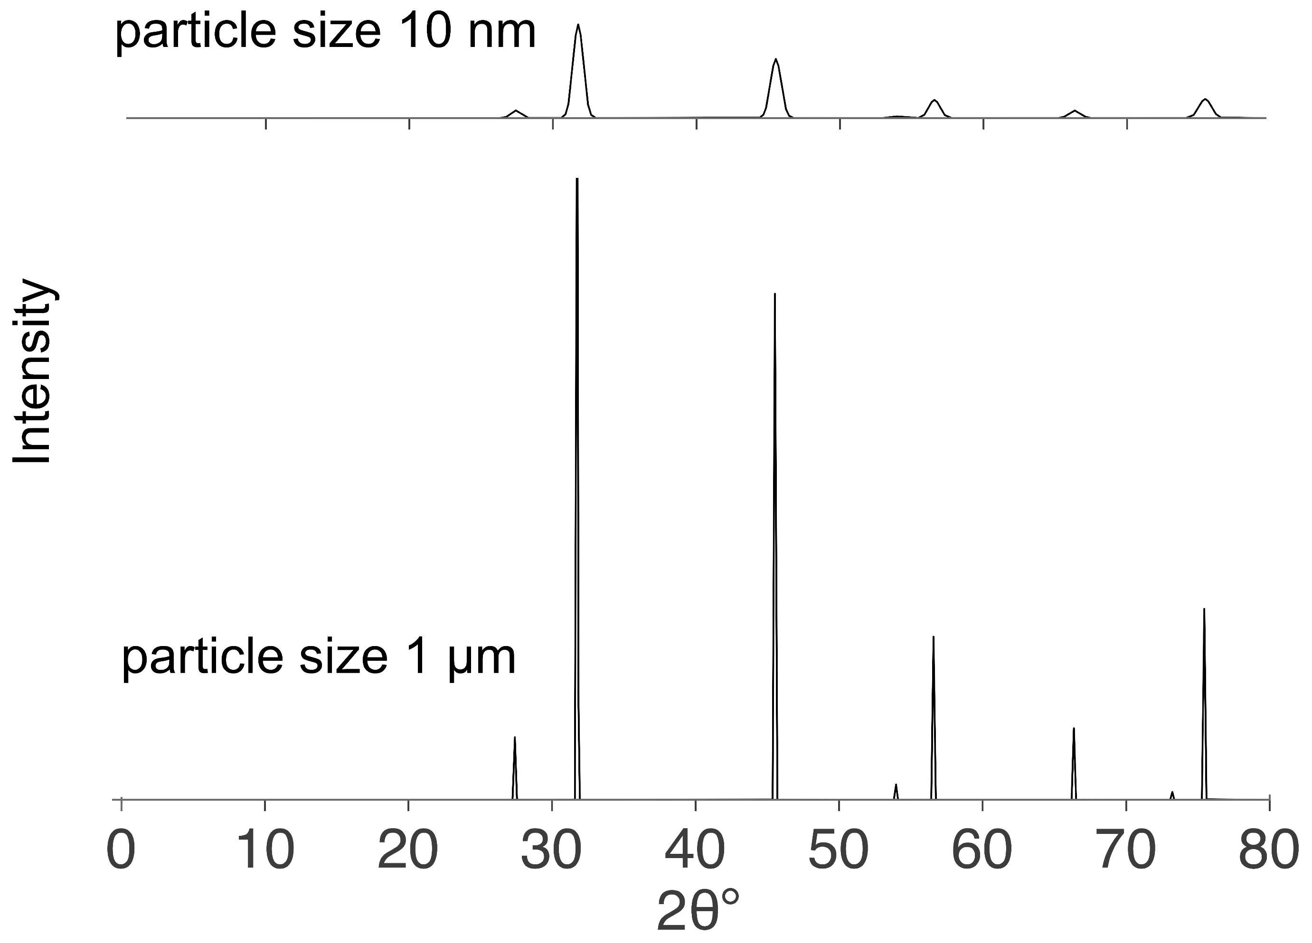

Slide 35
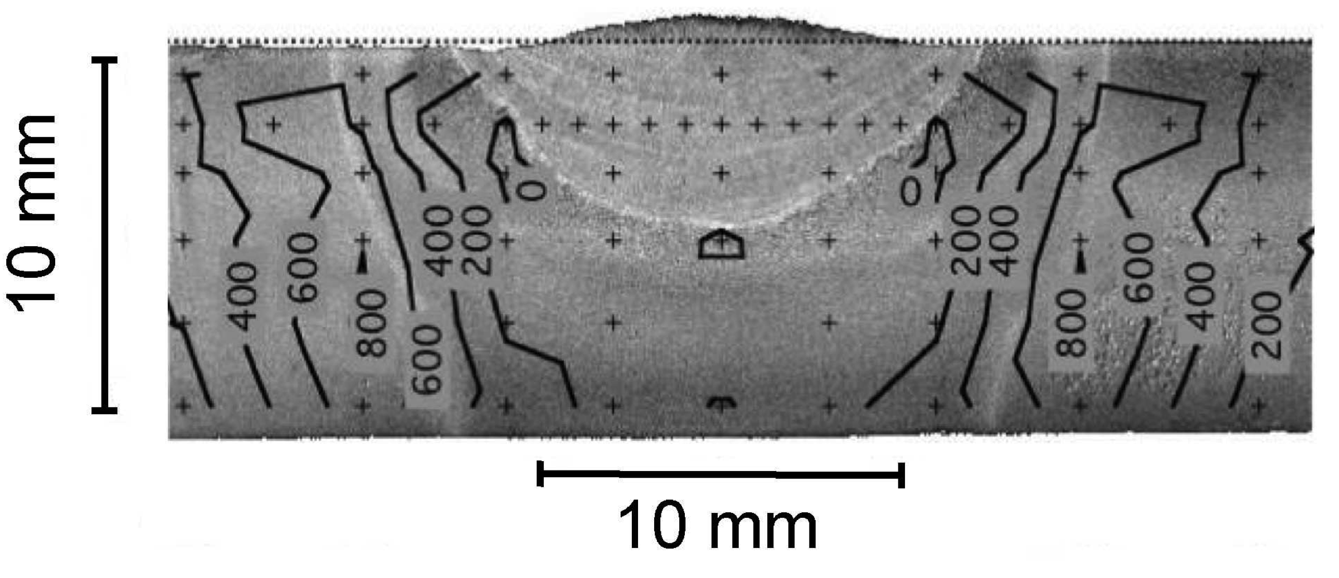

Slide 36
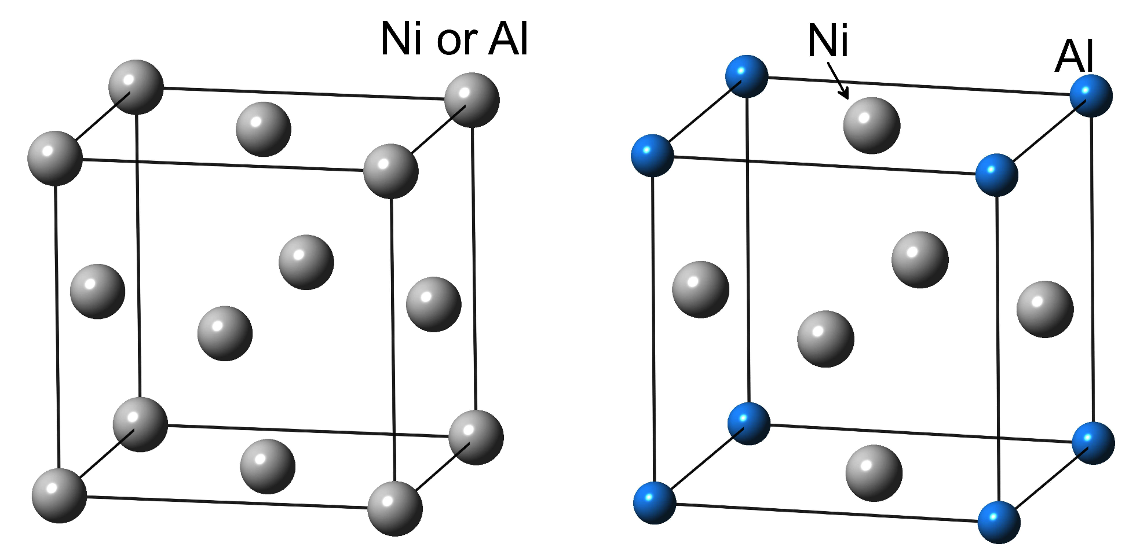
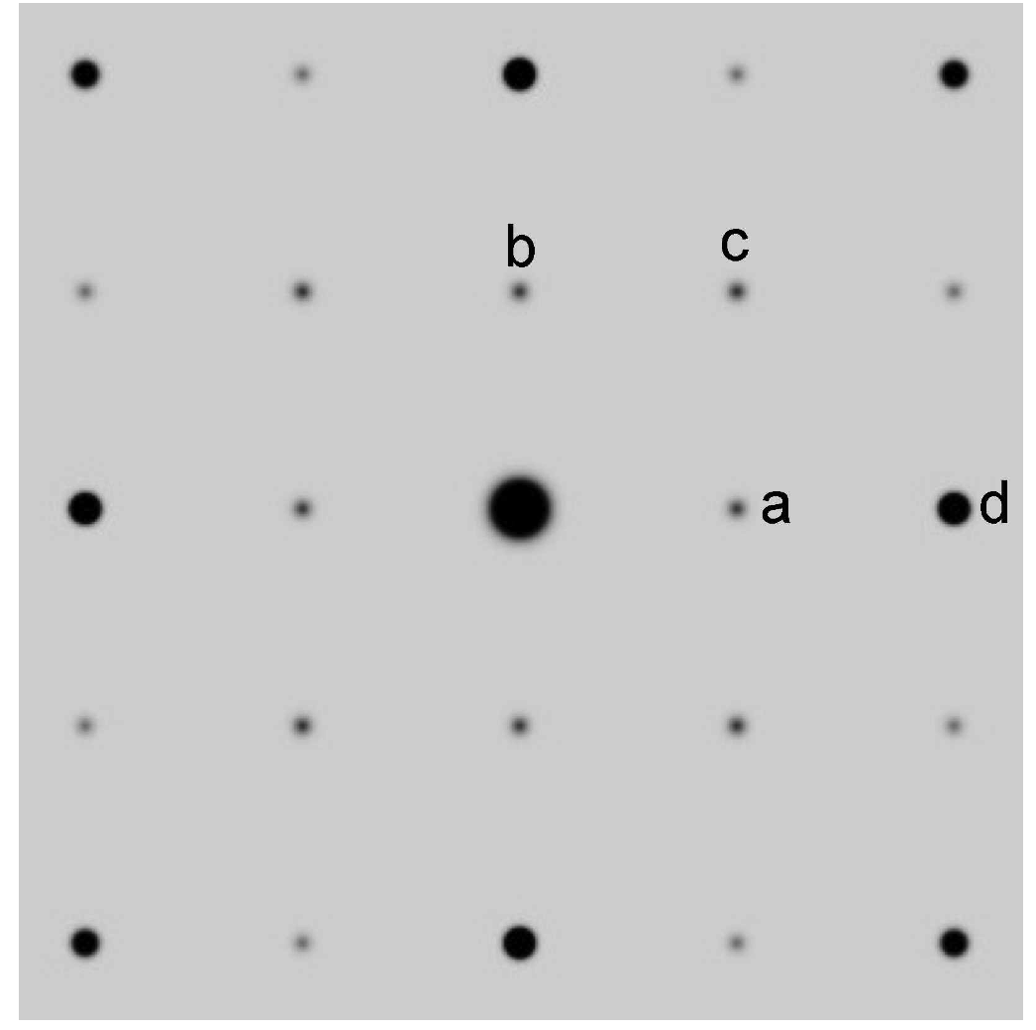
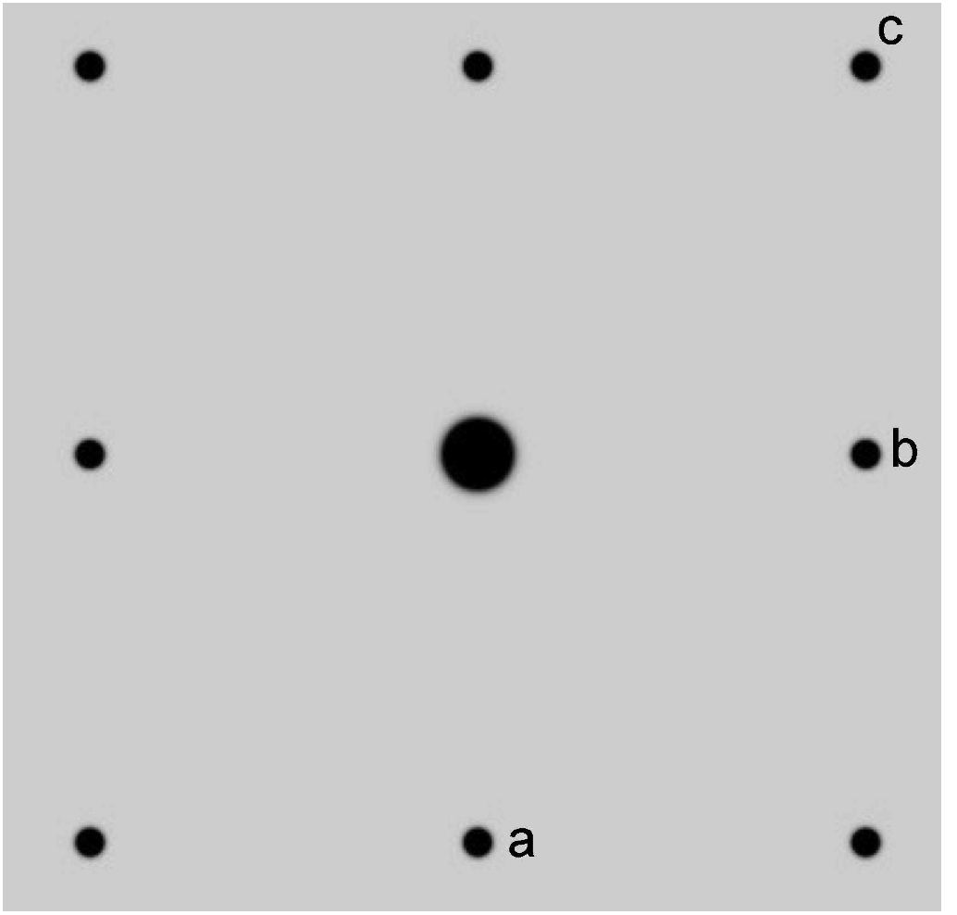

Slide 37
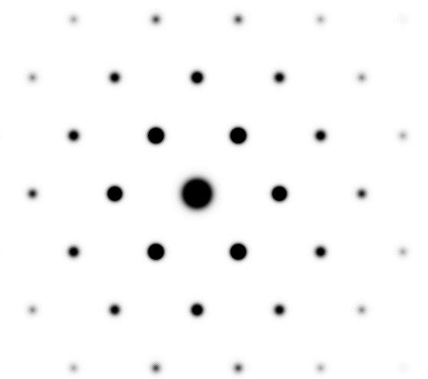
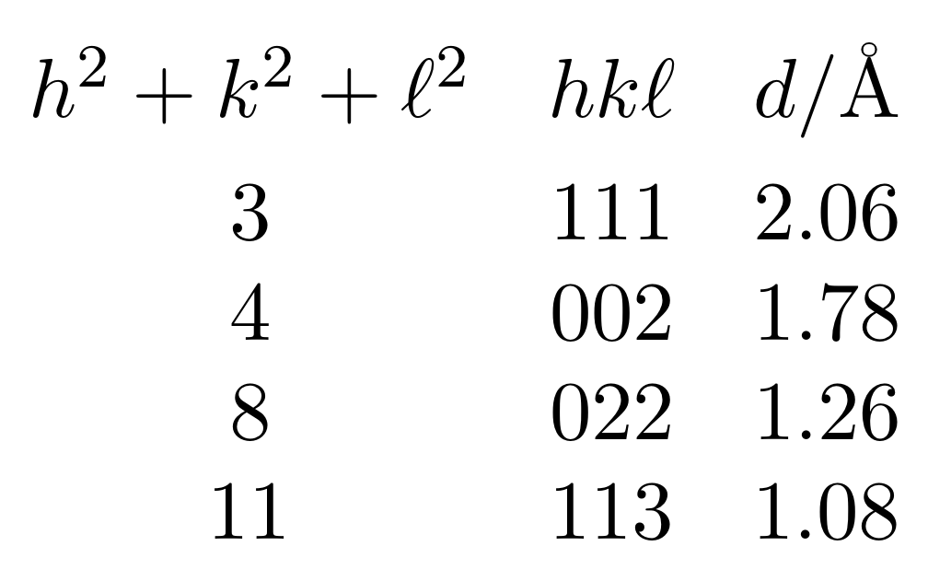
Cubic-F
lattice parameter 3.566 Å

Slide 38
electron diffraction

Slide 39
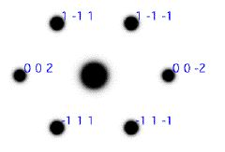

Slide 40

Su et al.
2014

