Slide 1


Steels
Martensite
Bainite
Alloy design: strong bainite
Widmanstaetten ferrite
Allotriomorphic ferrite
Pearlite
Overall kinetics
TRIP steel
TWIP steel
Mitigation of residual stress
Bulk nanostructured steel
www.phase-trans.msm.cam.ac.uk/teaching.html
H. K. D. H. Bhadeshia

Slide 2
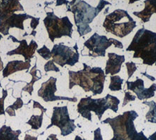
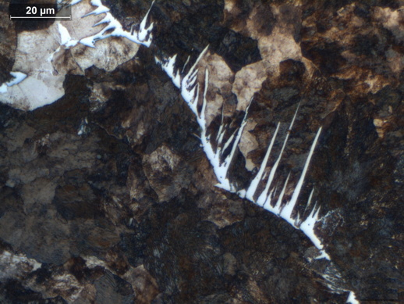
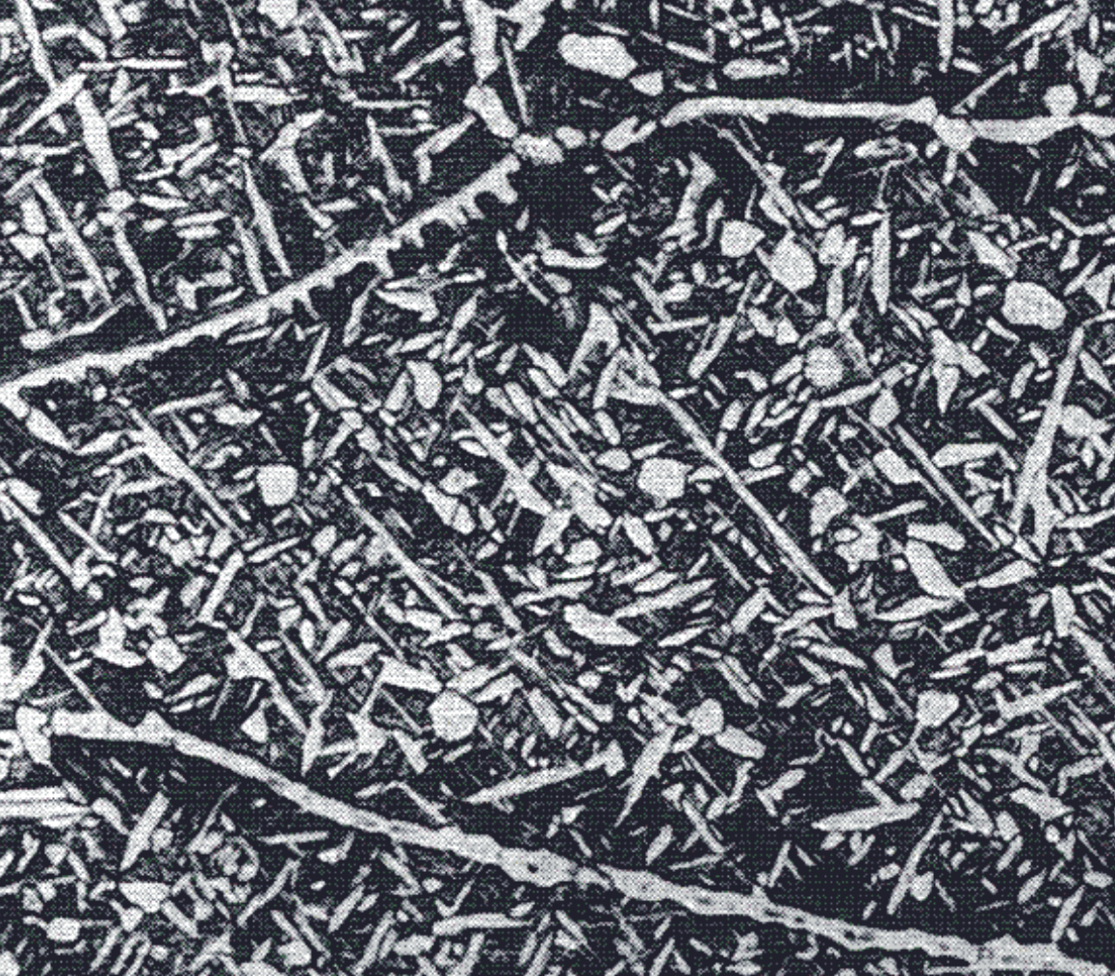
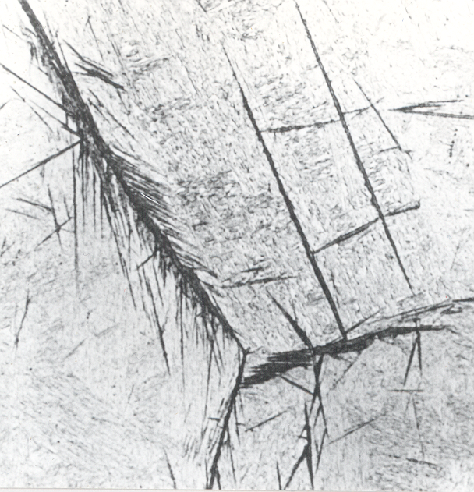
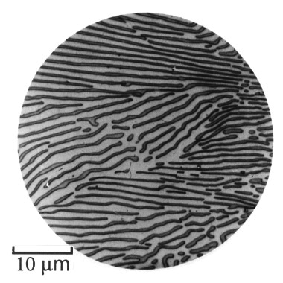
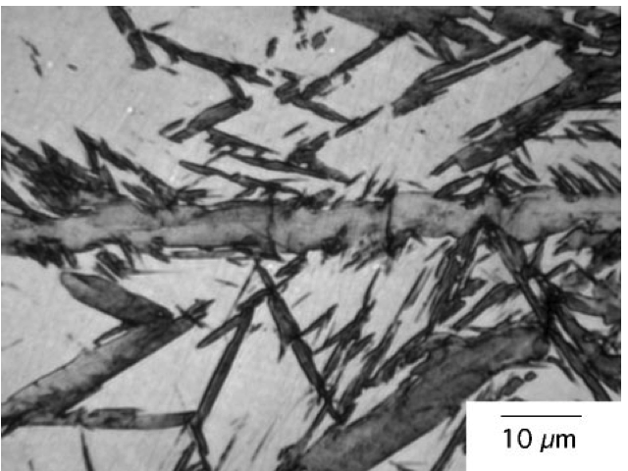

Slide 3
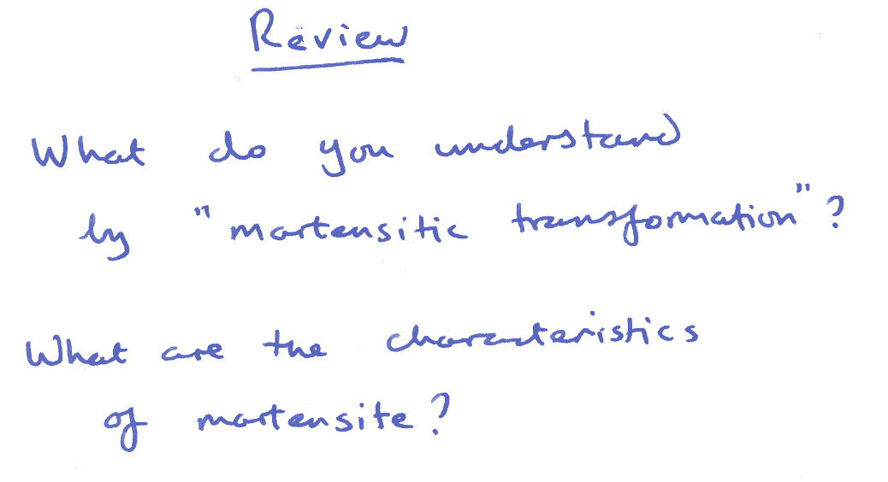
displacive
metastable
diffusionless
volume change
body-centred tetragonal
quenched
hard
plates or laths
brittle

Slide 4
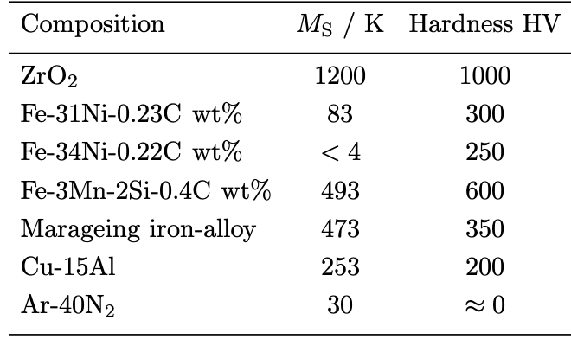
Materials, transformation temperatures & strength

Slide 5
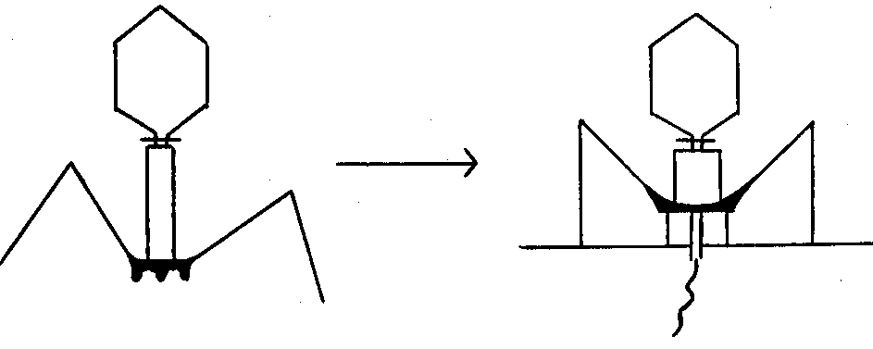
Olson and Hartman, 1982

Slide 6
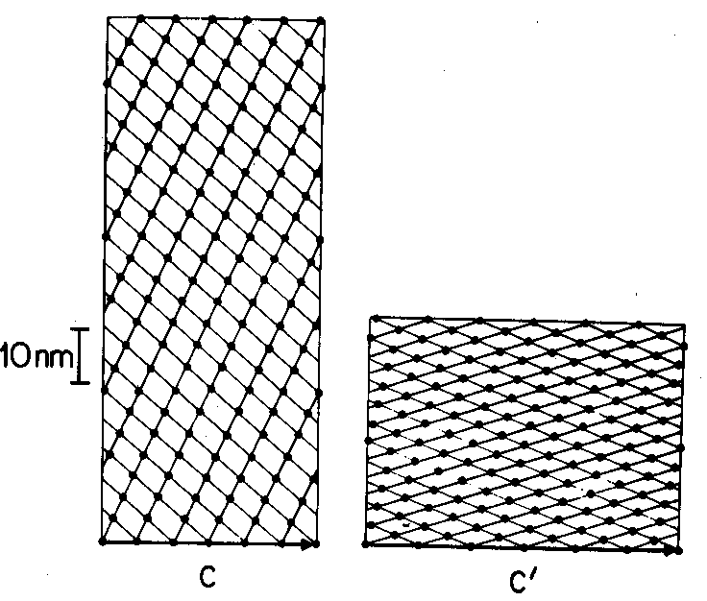
Olson and Hartman, 1982

Slide 7
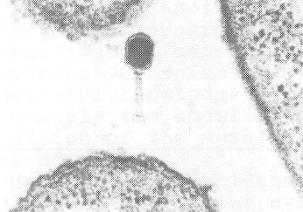
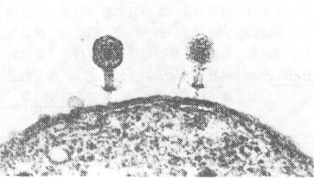
Olson and Hartman, 1982

Slide 8
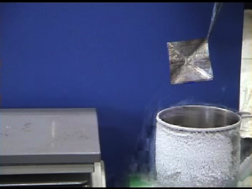
Courtesy of Professor Koichi Tsuchiya, Toyohashi University of Technology

Slide 9
Diffusionless
can form at incredibly
low temperatures
can form very rapidly
no composition change

Slide 10
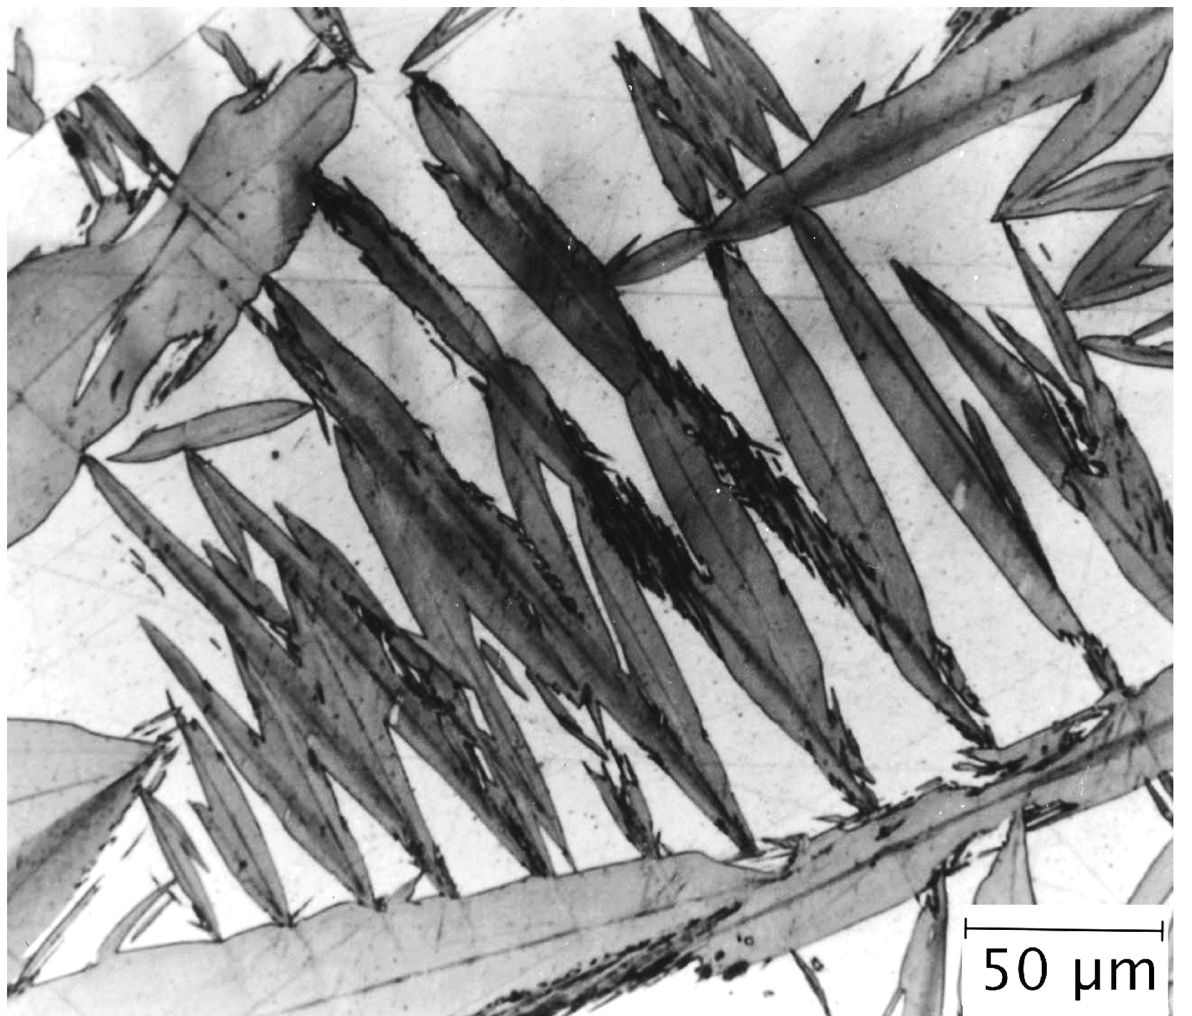
shape

Slide 11
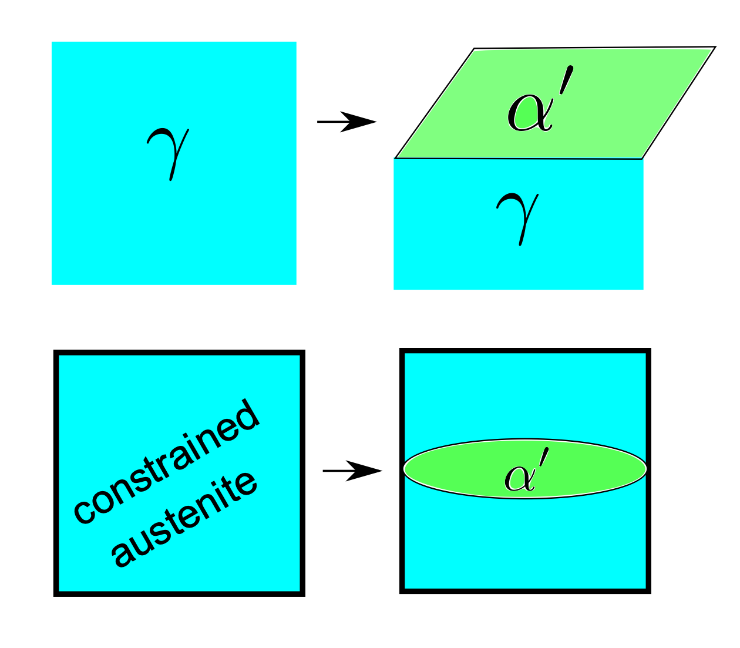

Slide 12
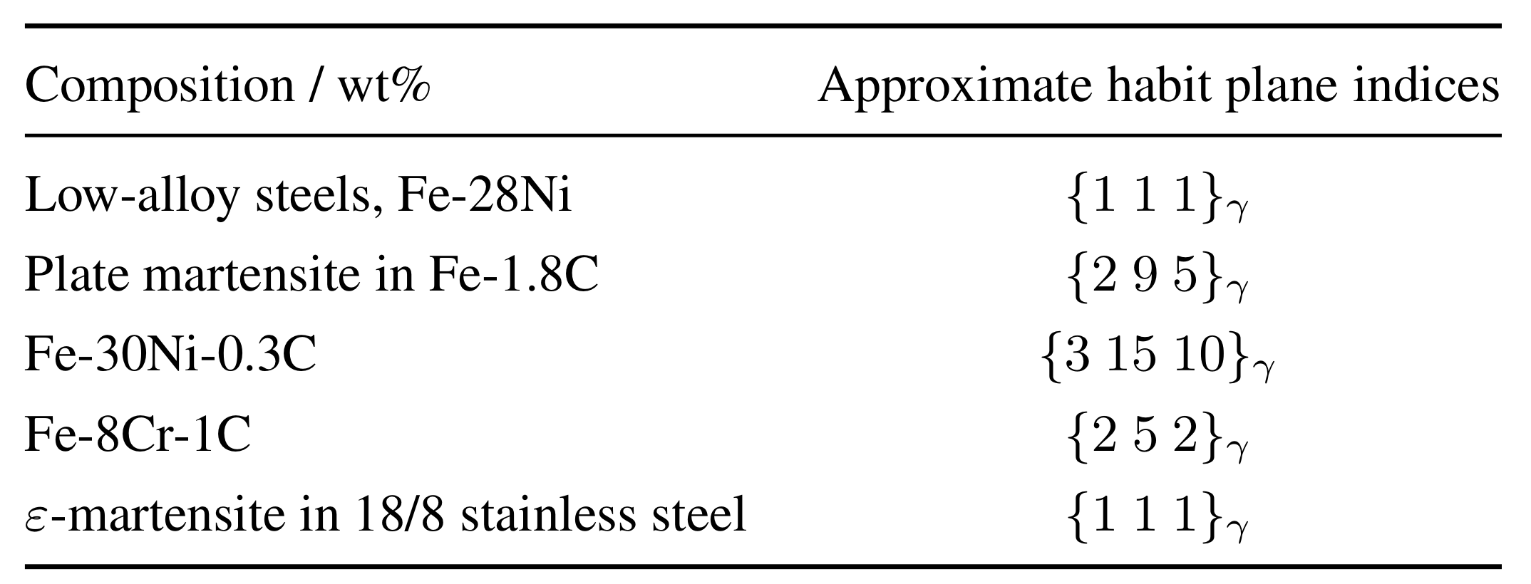
Irrational: why?

Slide 13
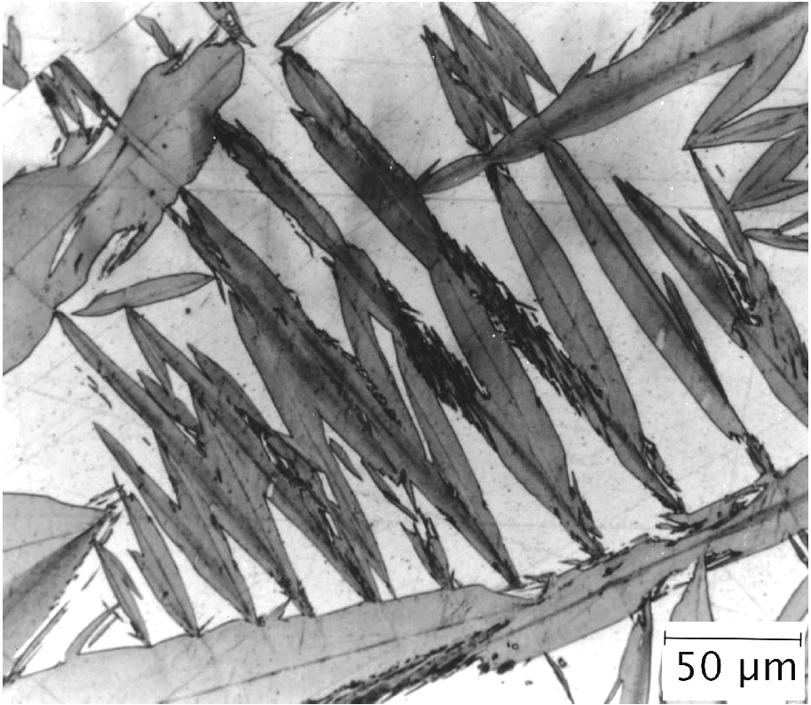
Shape of martensite ?

Slide 14
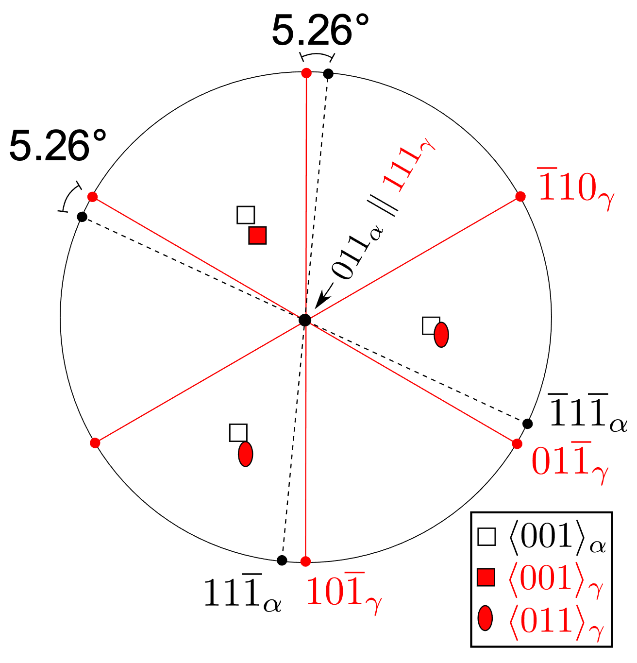
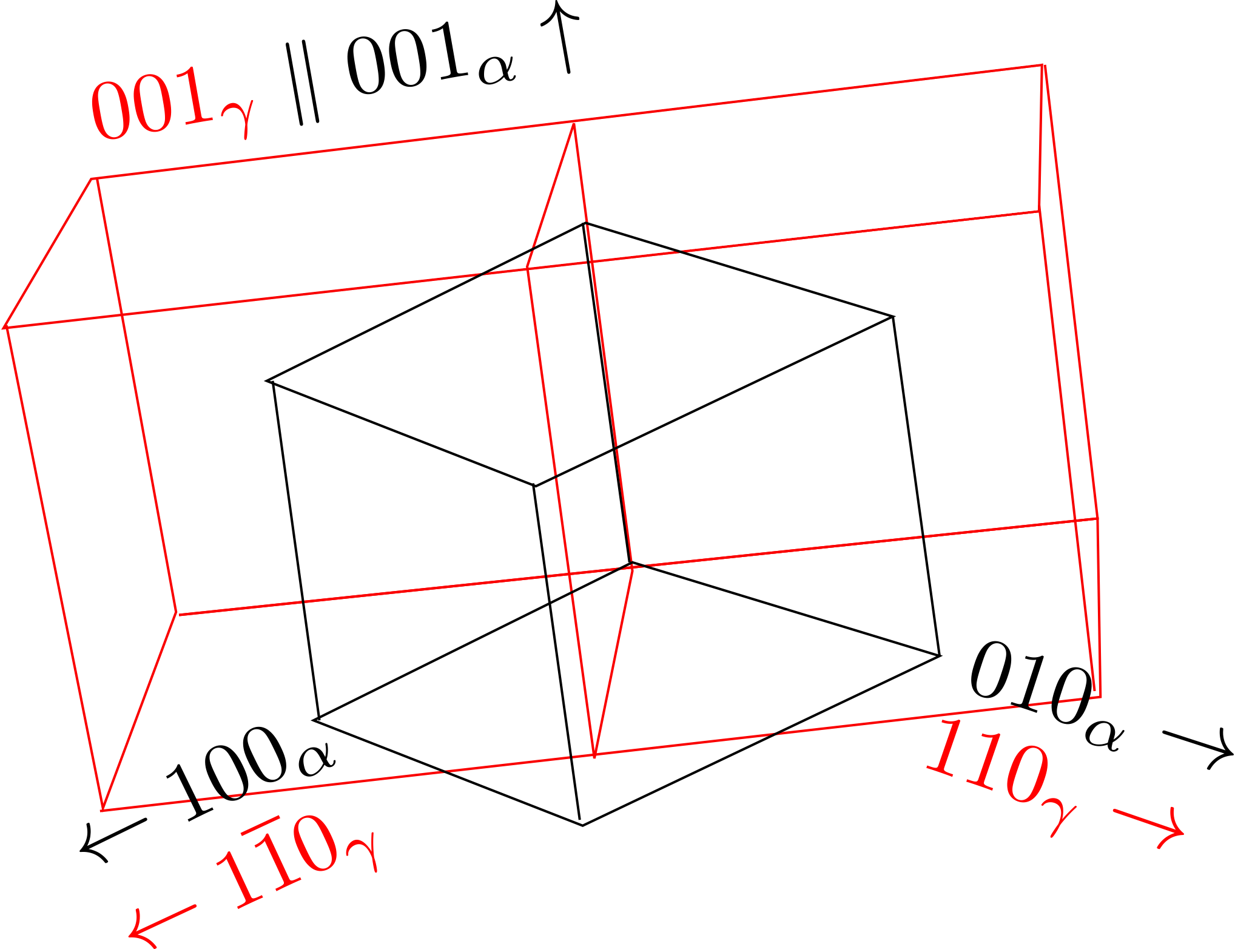
NISHIYAMA-WASSERMAN

Slide 15
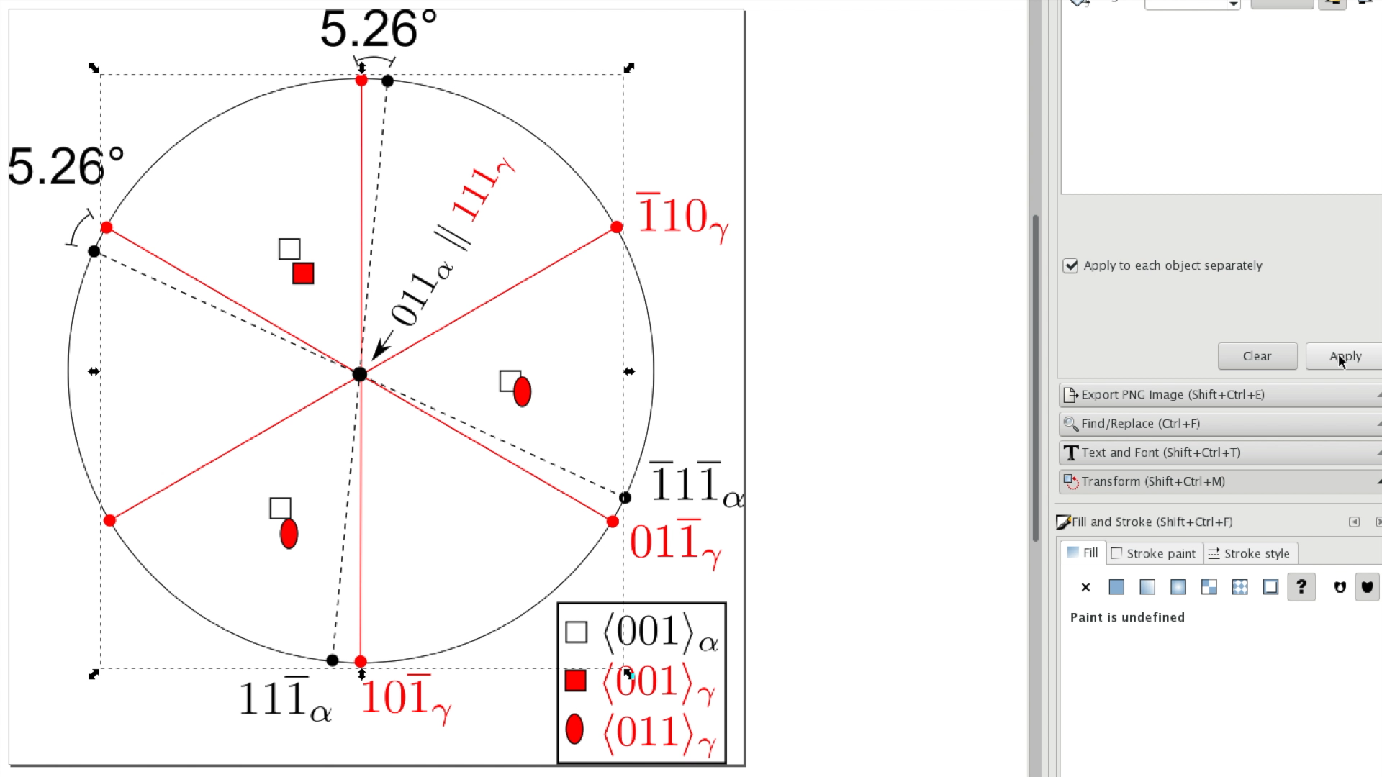
KURDJUMOV-SACHS

Slide 16

actual orientation
irrational

Slide 17
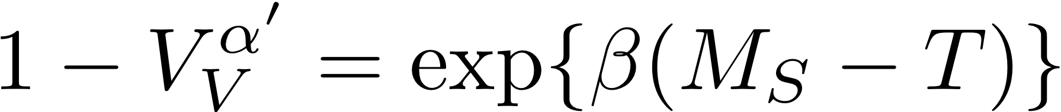
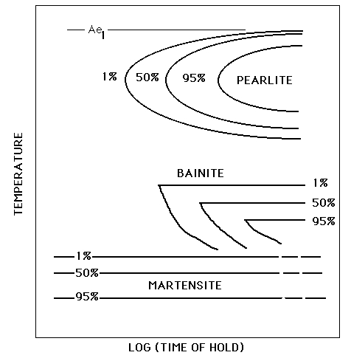
athermal transformation

Slide 18
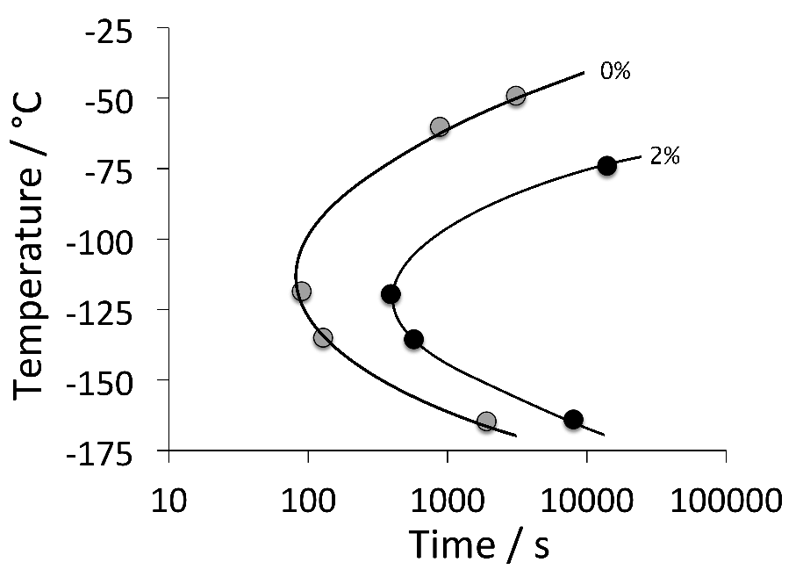
Fe-0.05C-24Ni-3Mn-0.2Cu wt%
Kurdjumov & Maximova

Slide 19
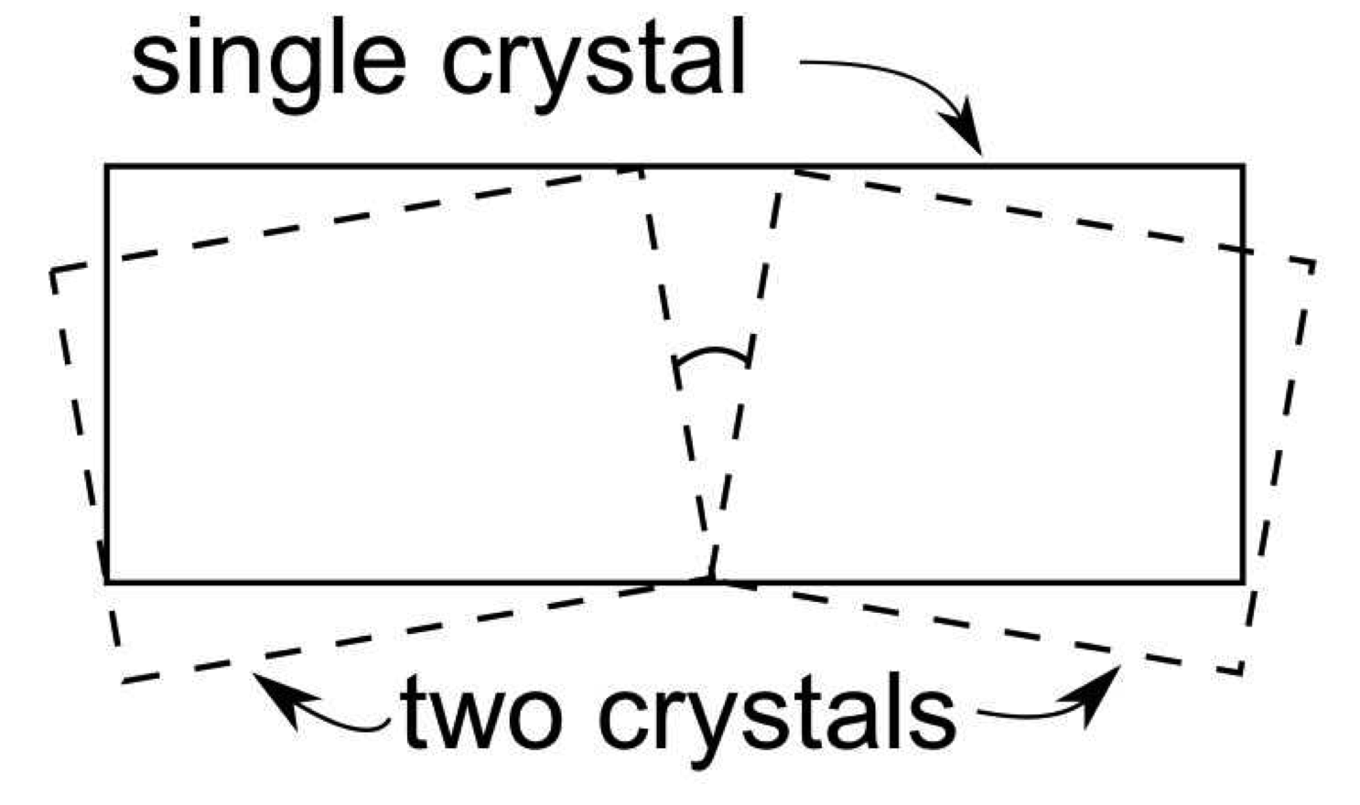

Slide 20
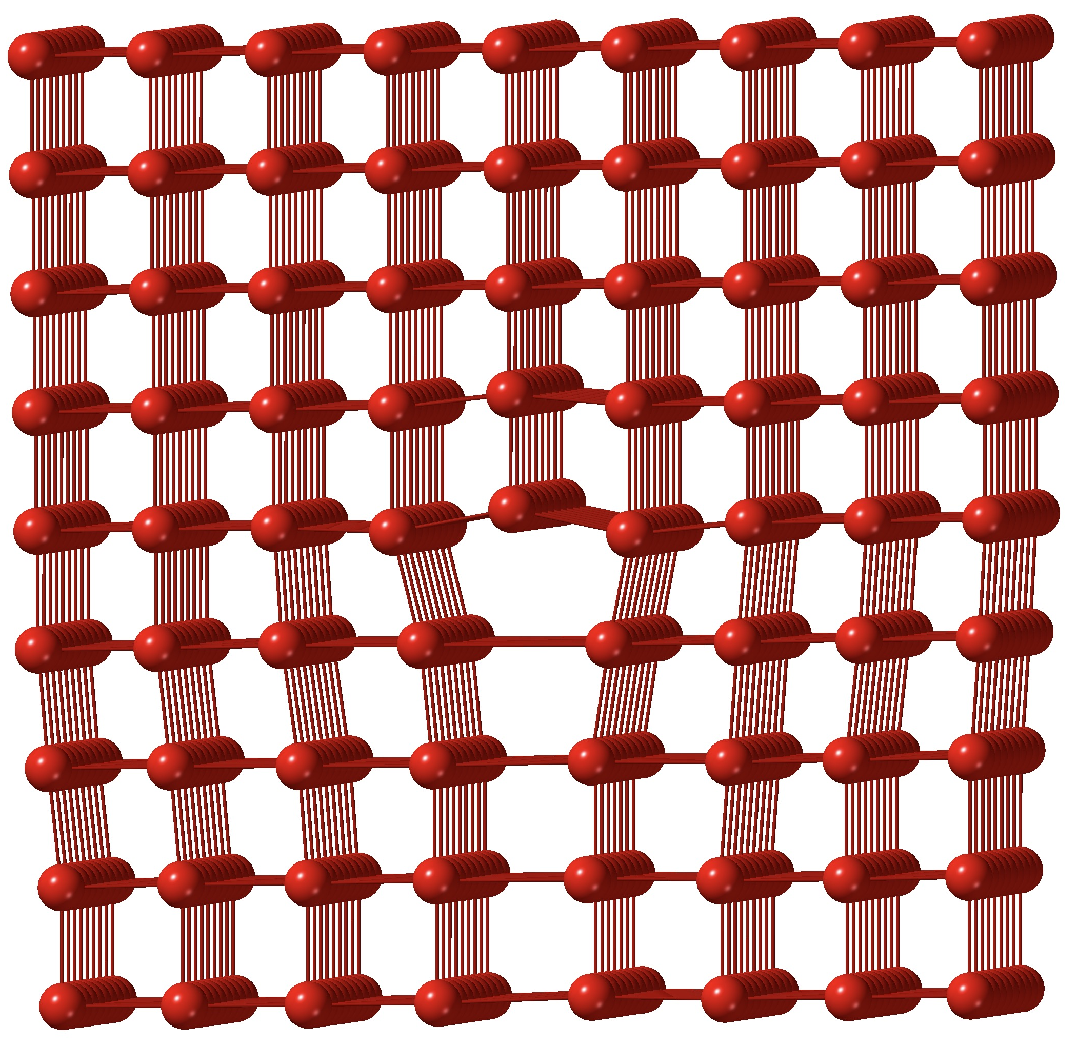

Slide 21
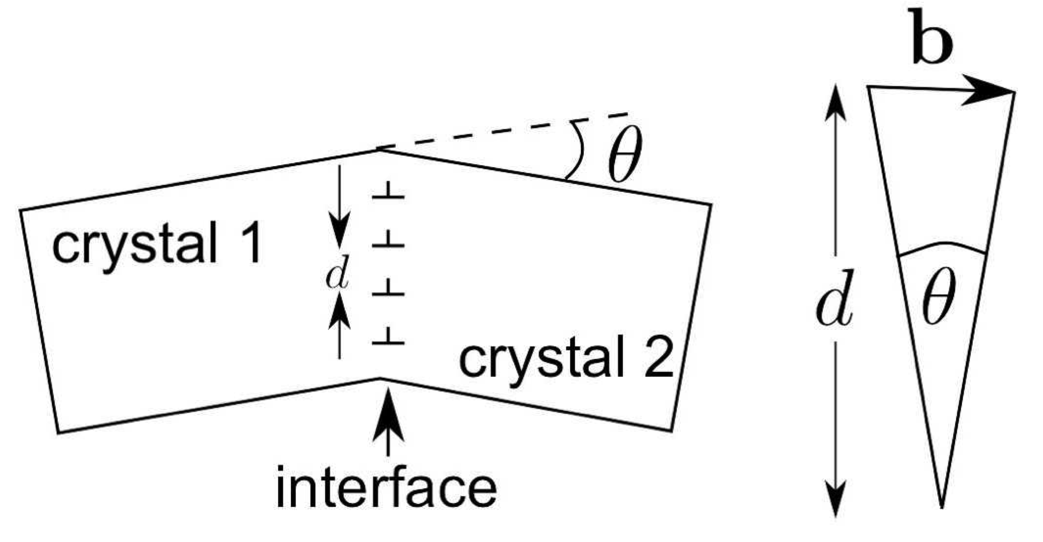
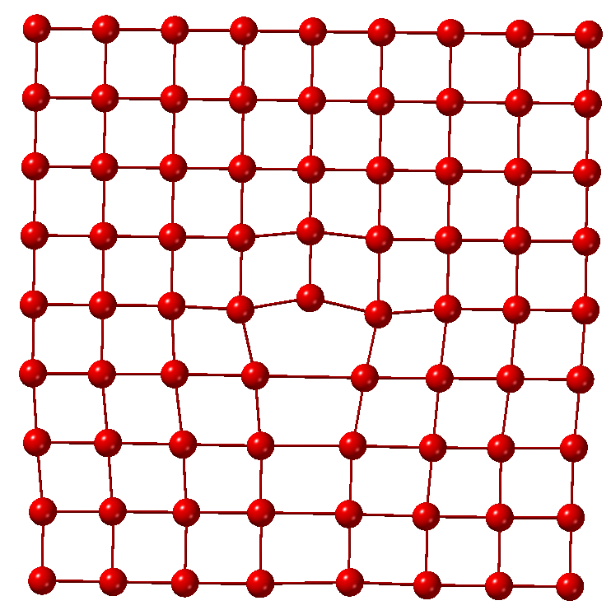
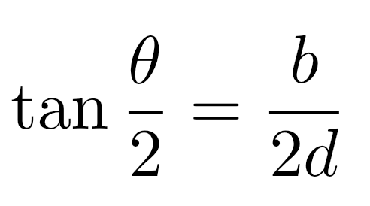

Slide 22
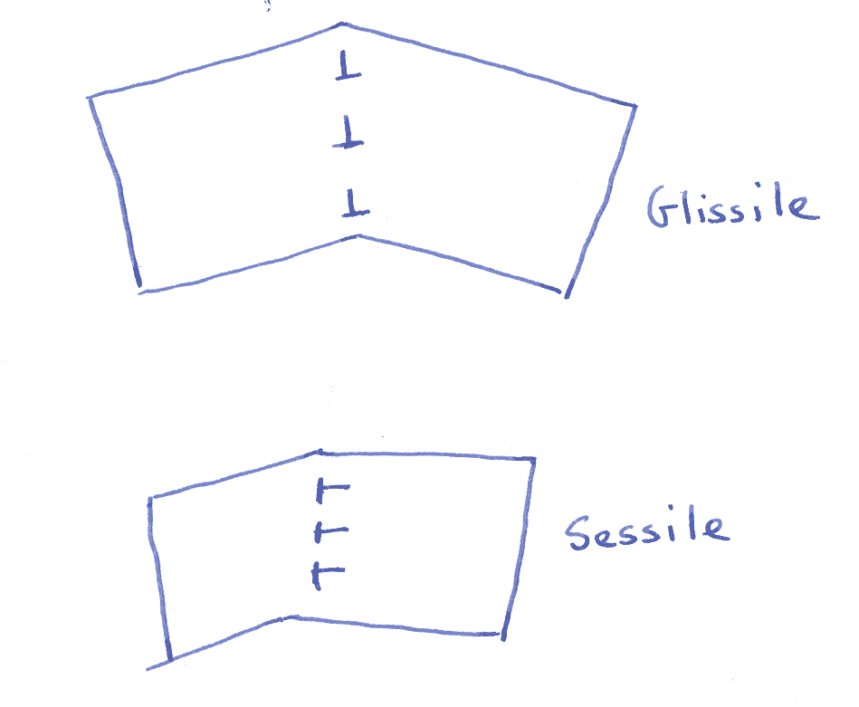
Glissile interface

Slide 23
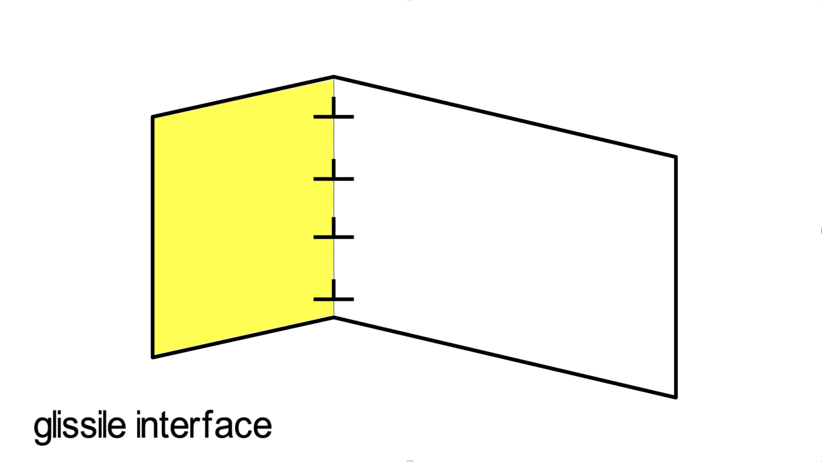

Slide 24
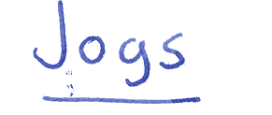
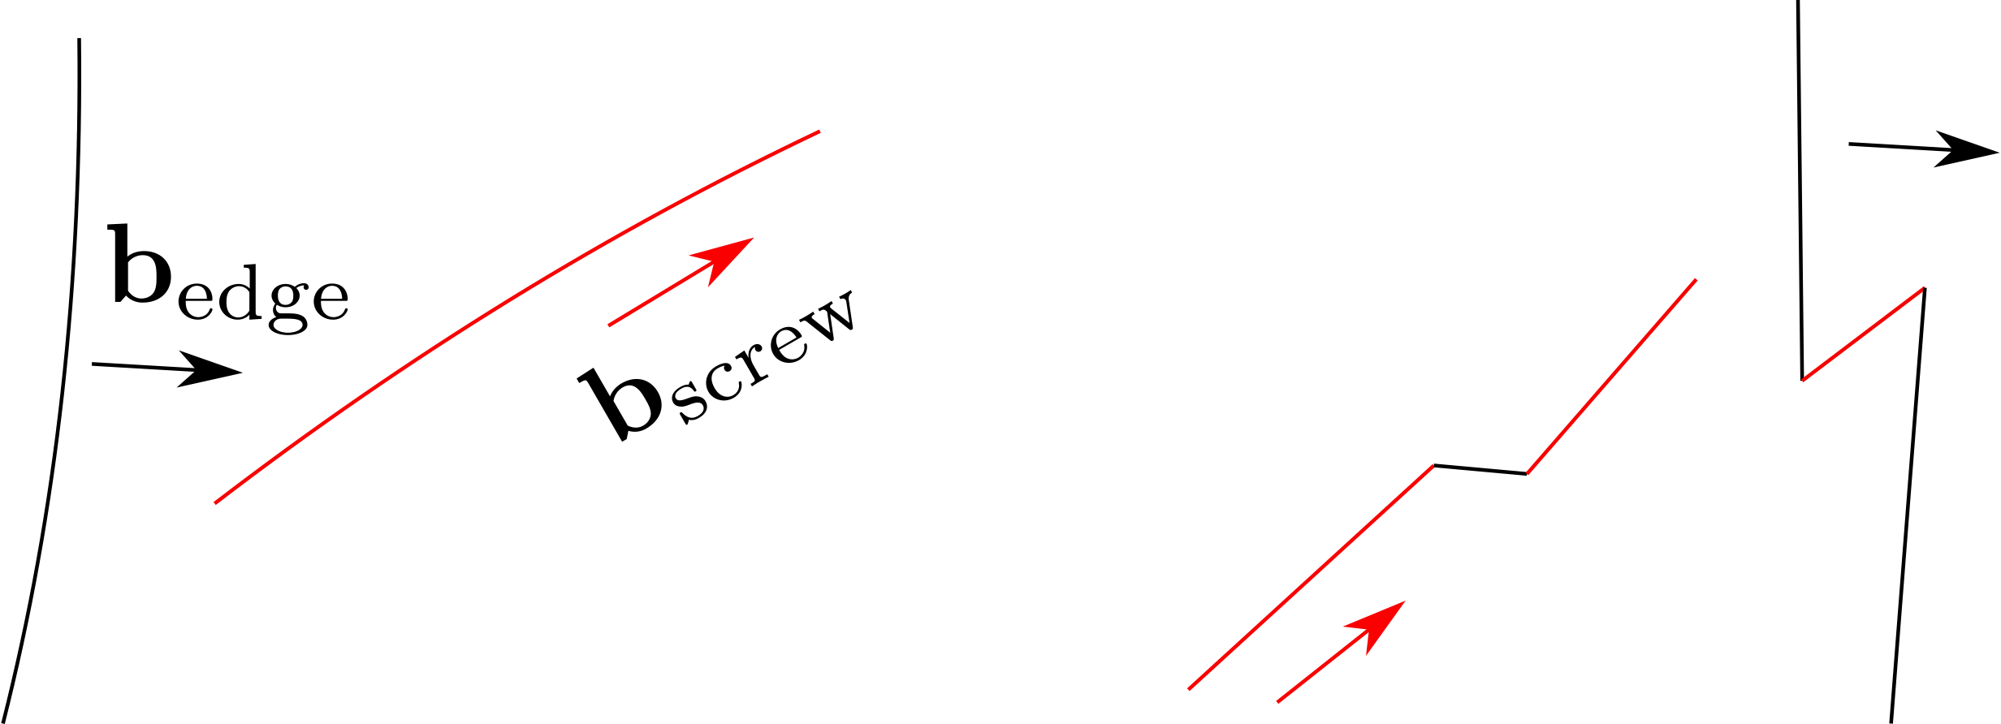

Slide 25
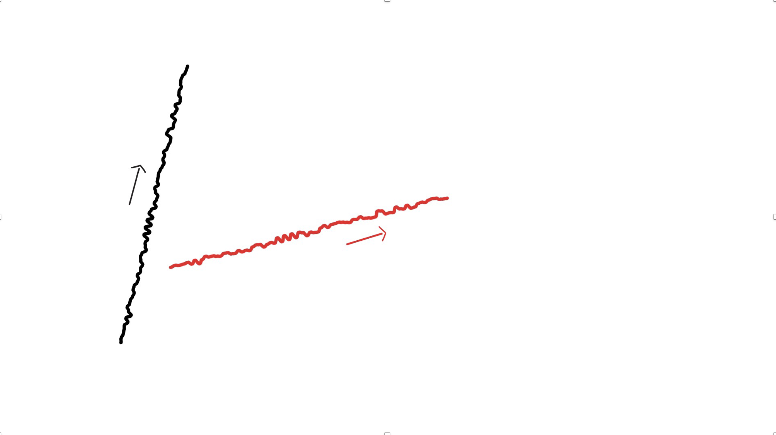

Slide 26
Glissile interface cannot contain more than one set of dislocations.
Martensitic transformation only possible if deformation which changes the parent into the product leaves one line undistorted and unrotated, i.e. an invariant-line.
Deformation is an invariant-line strain.

Slide 27
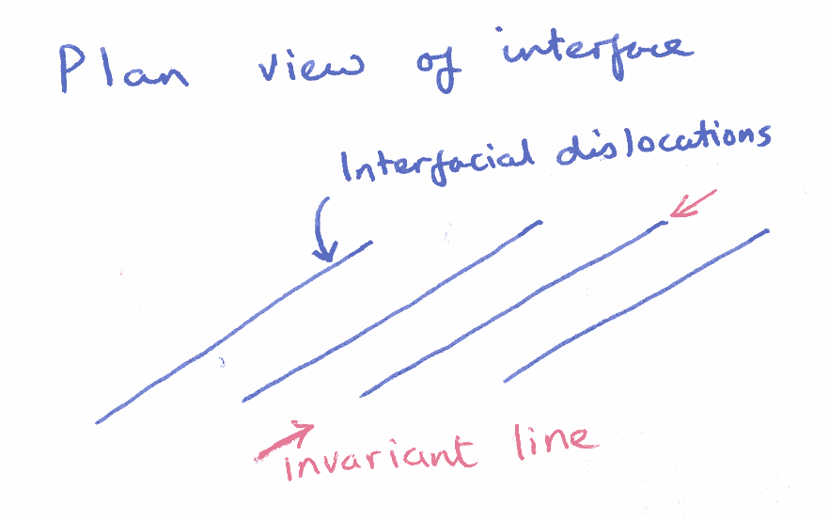

Slide 28
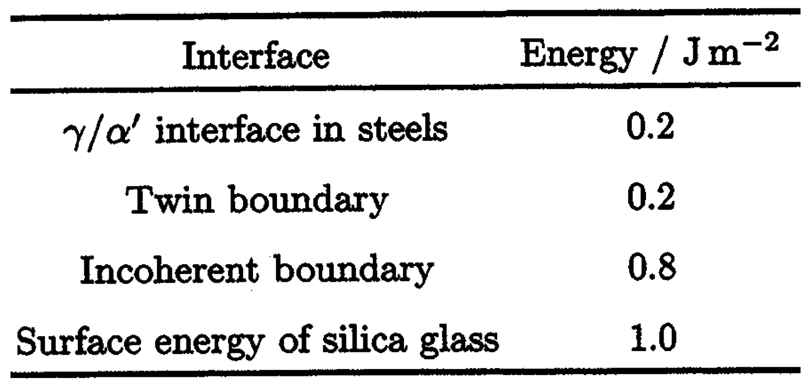

Slide 29
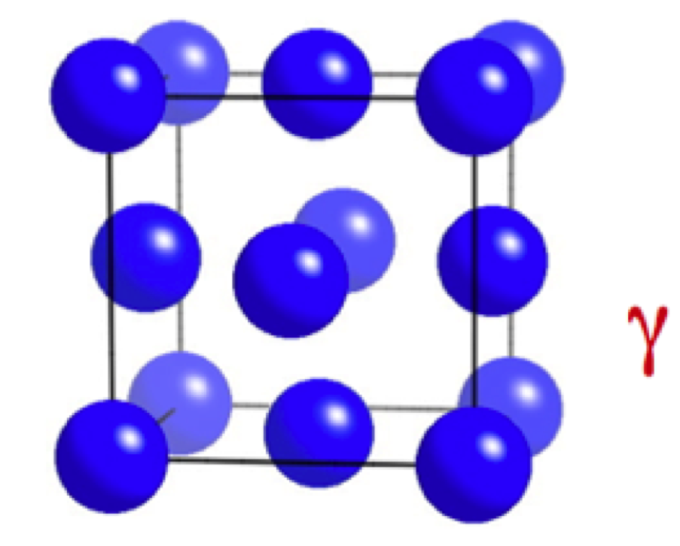
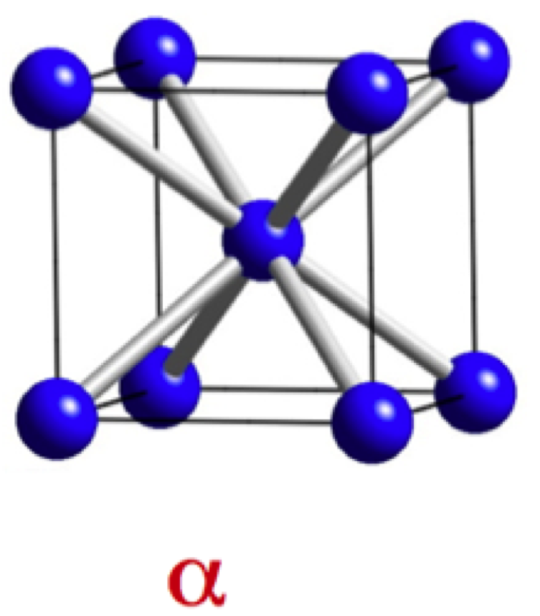

Slide 30
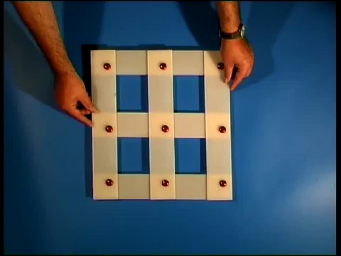

Slide 31
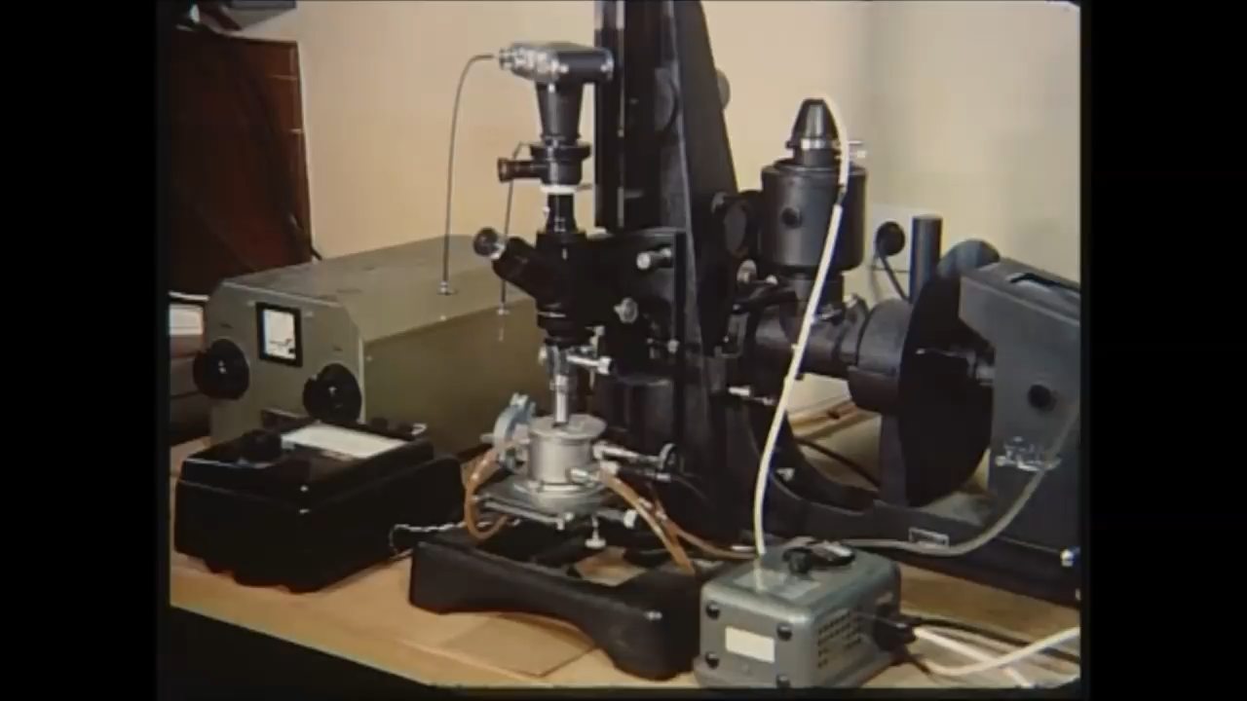
Wirtschaftsvereinigung Stahl, Düsseldorf
courtesy of Professor Hans Werner Zoch

Slide 32
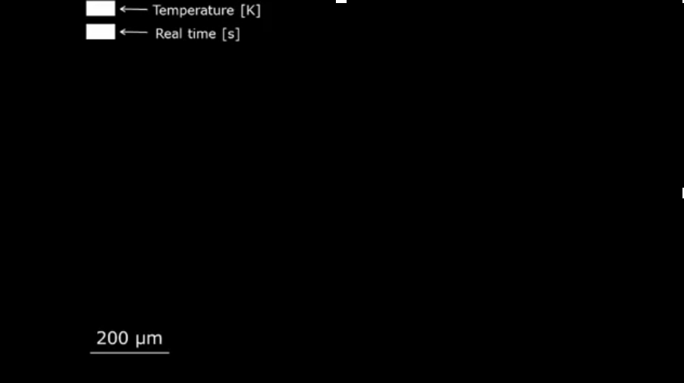
M. Benke, V. Mertinger, Institute of Physical Metallurgy, Metalforming and Nanotechnology, University of Miskolc
http://www.matsci.uni-miskolc.hu/new/

Slide 33
general invariant-plane strain
uniaxial dilatation
simple shear
s
s
δ
δ
1
1
1
s=0.26
δ=0.03

Slide 34
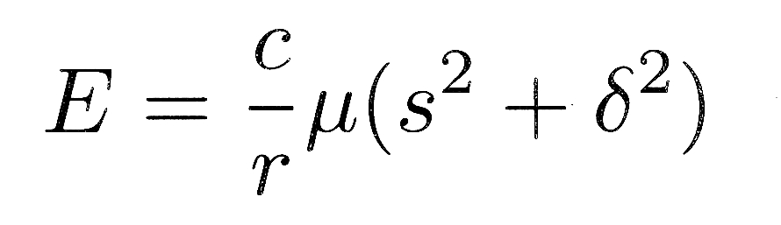
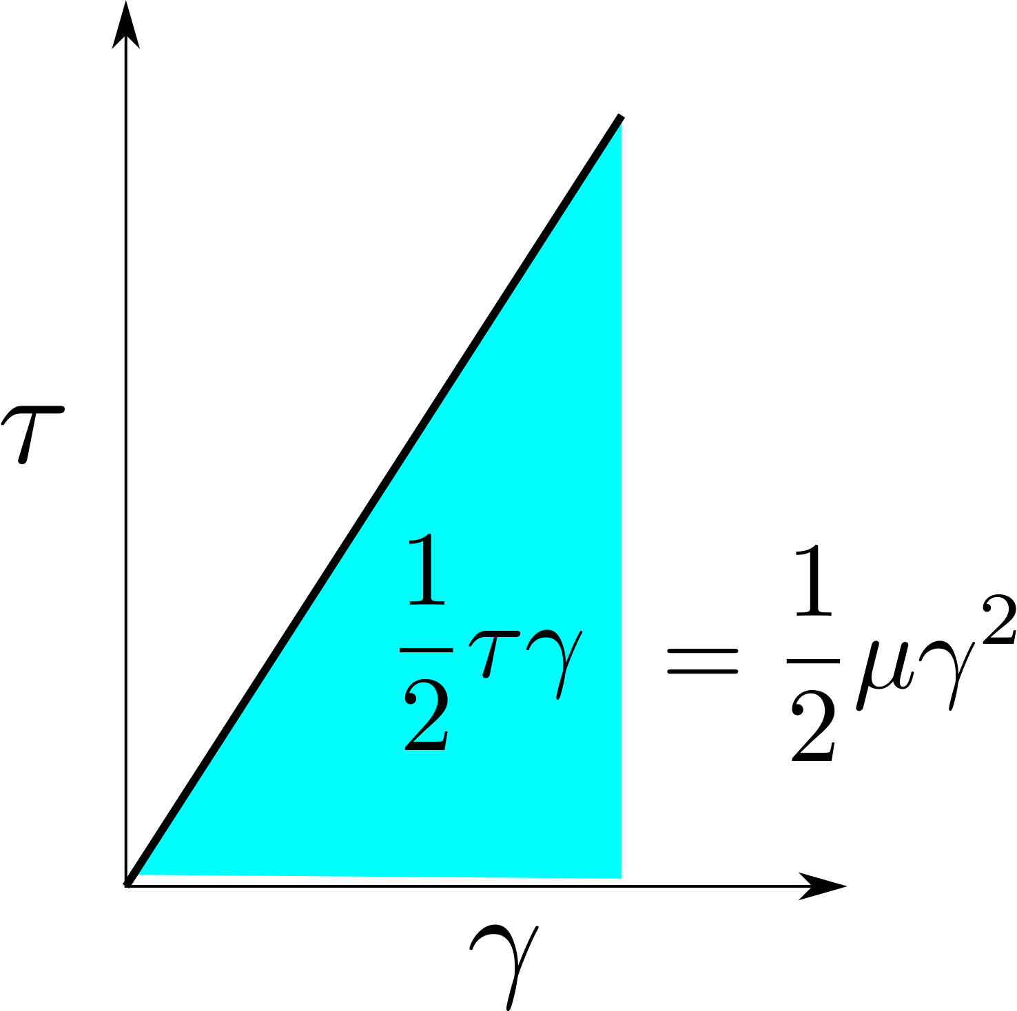
Christian, 1957
s
δ
c
r
1

Slide 35
