Slide 1


Steels: lecture 2 of 12
Martensite
Bainite
Alloy design: strong bainite
Widmanstaetten ferrite
Allotriomorphic ferrite
Pearlite
Overall kinetics
TRIP steel
TWIP steel
Mitigation of residual stress
Bulk nanostructured steel
www.phase-trans.msm.cam.ac.uk/teaching.html
H. K. D. H. Bhadeshia

Slide 2
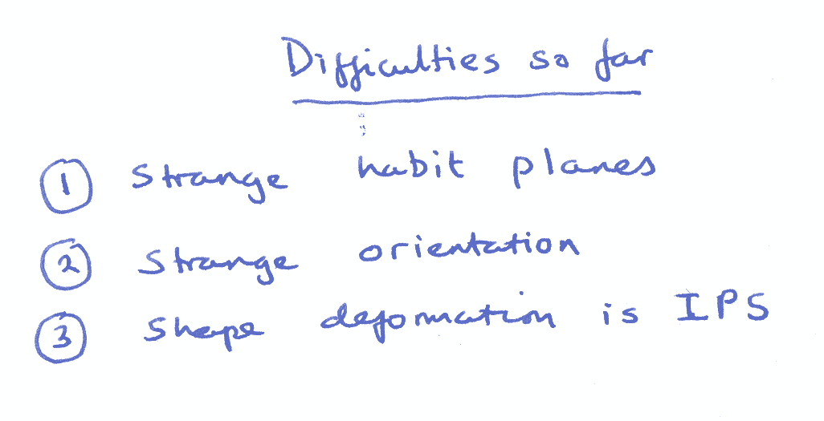

Slide 3
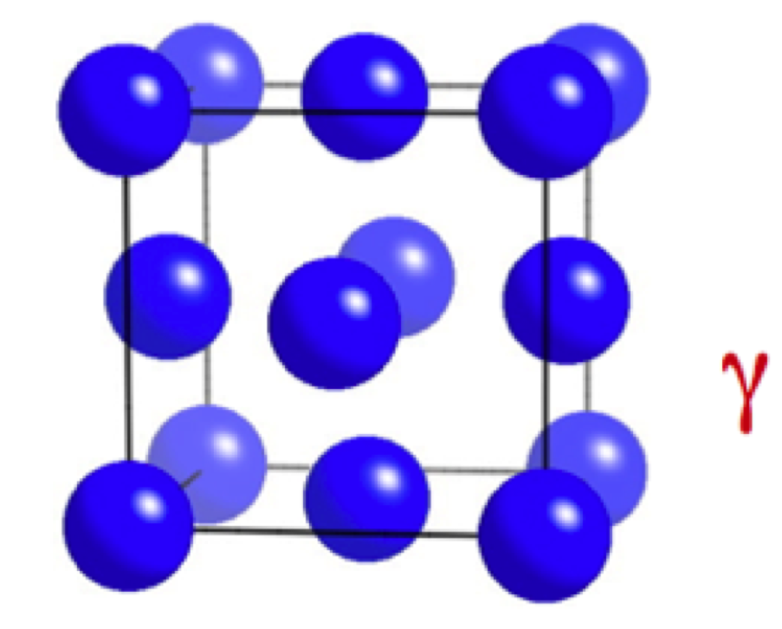
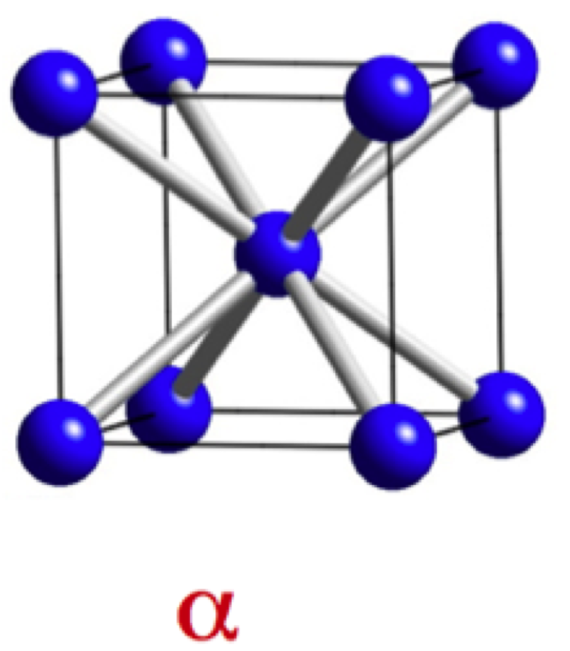

Slide 4
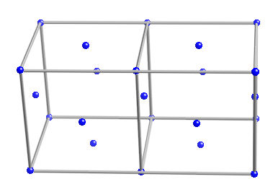
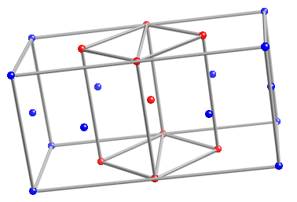
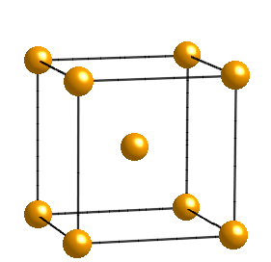

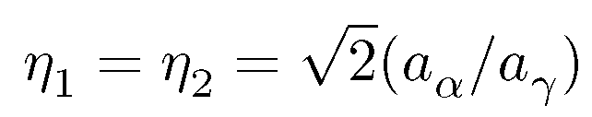
The Bain strain

Slide 5
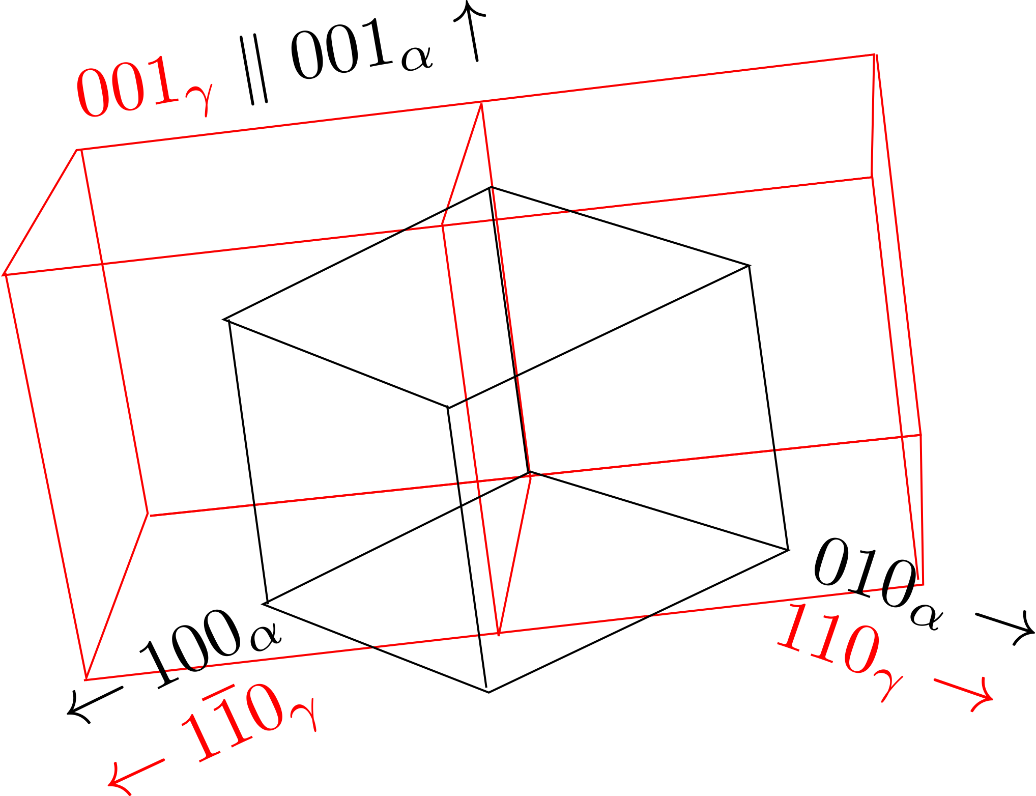
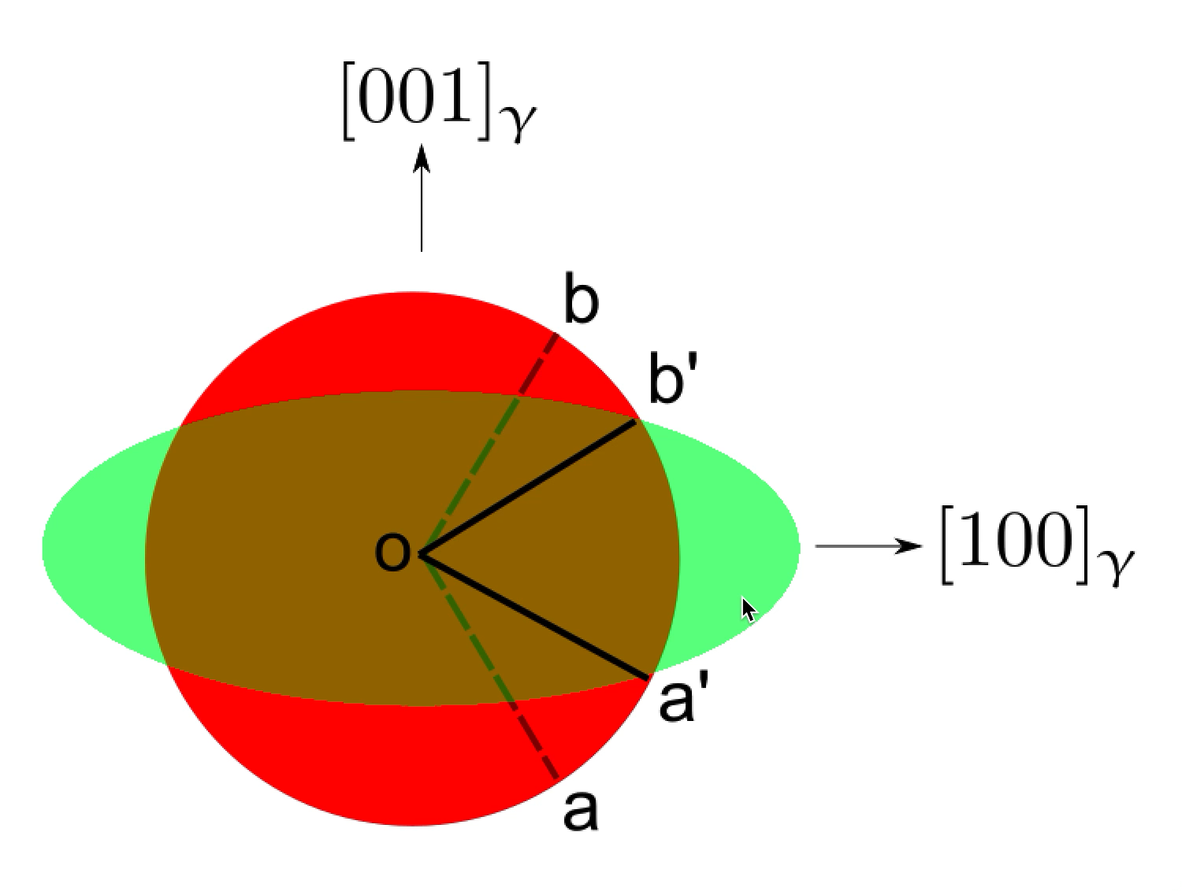

Slide 6
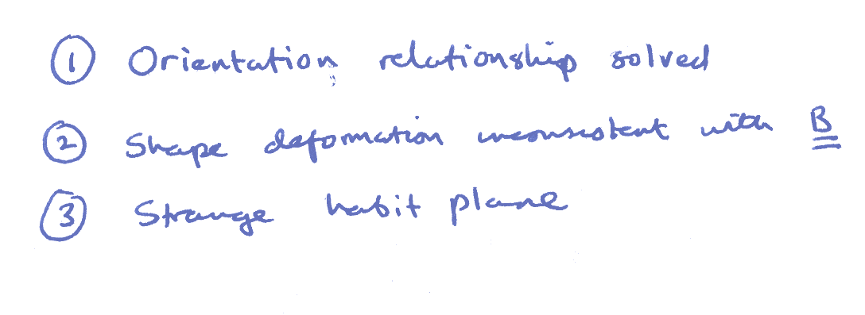

Slide 7
RB
z
w
w
z
w
z
P
Observed
P
Austenite
1
shape,
2
Martensite
wrong
(wrong
y
structure
shape)
x
x
y
x
y
(a)
(b)
(c)
LATTICE
-INVARIANT
DEFORMATION
Twin
w
z
w
z
Boundary
x
y
x
y
Twinned
Slipped
Martensite
Martensite
Correct macroscopic shape, correct structure

Slide 8
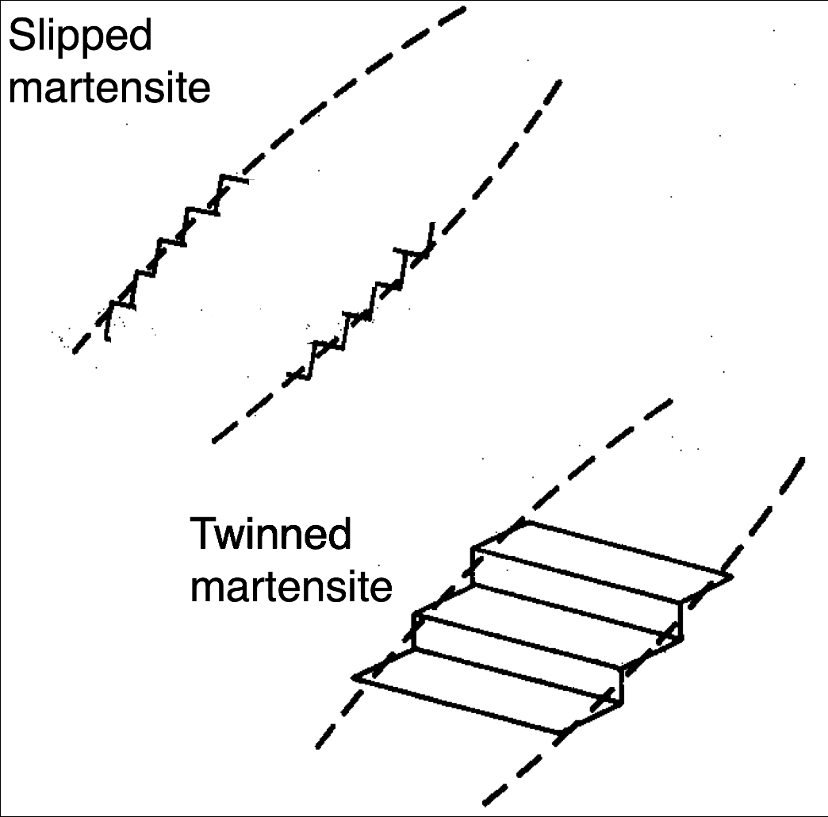

Slide 9
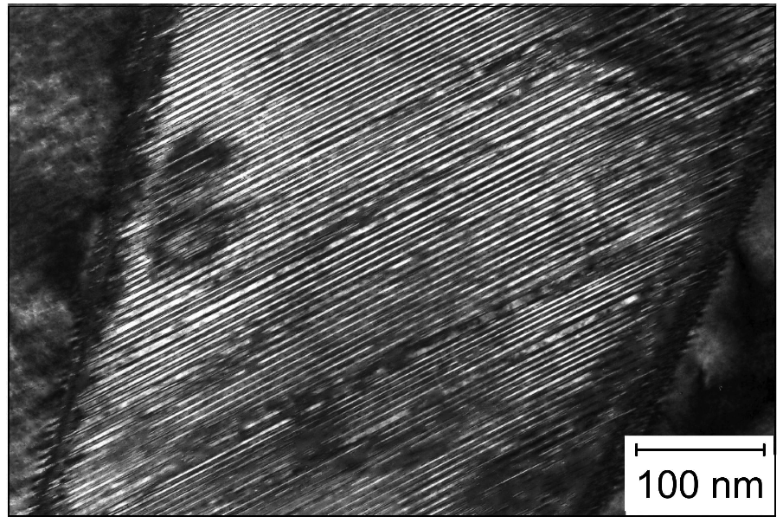
Transformation twins (Shibata, Maki)

Slide 10
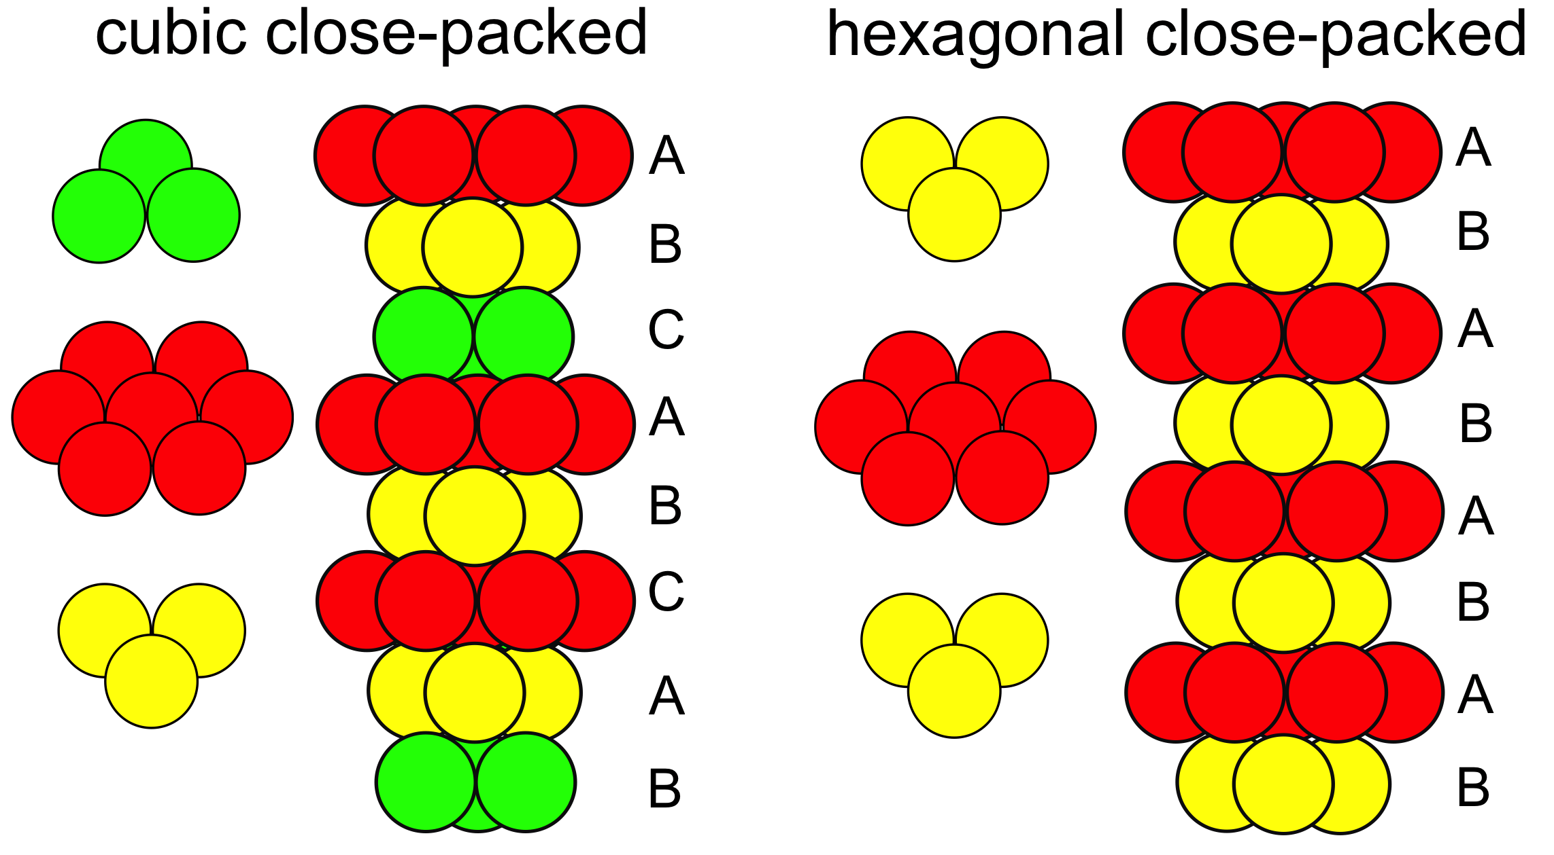

Slide 11
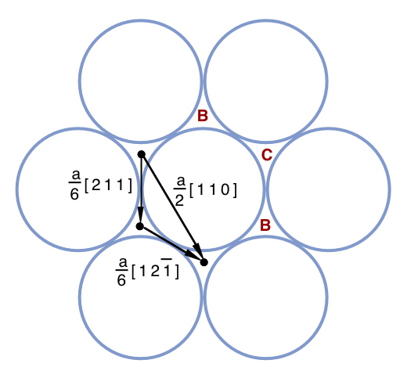


Slide 12
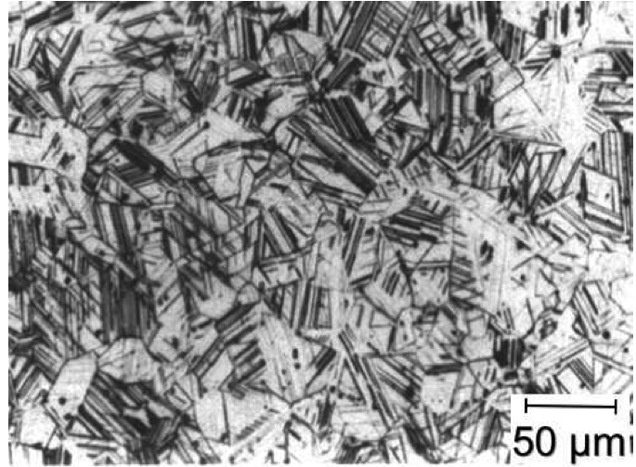
Tomota et al. 1988

Slide 13
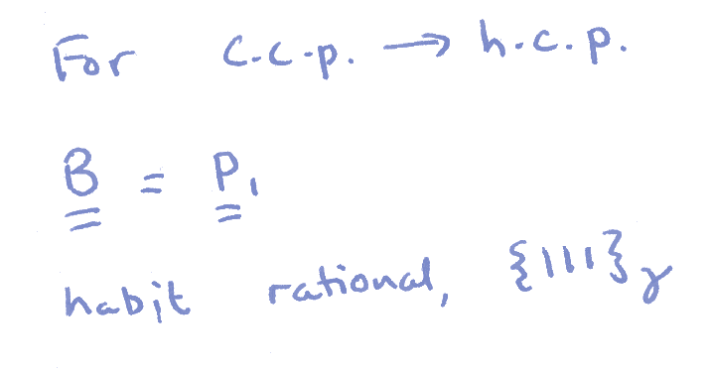
z
w
w
z
P
Observed
Austenite
1
shape,
y
correct
structure
x
x
y
(a)
(b)

Slide 14
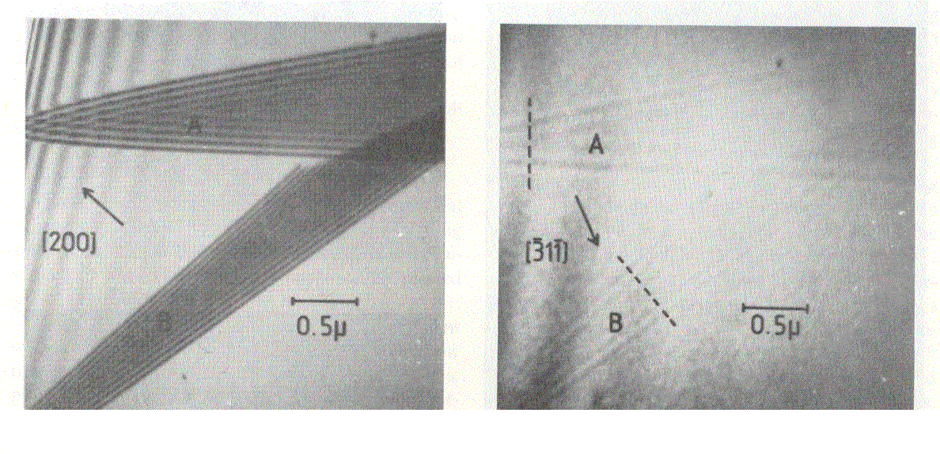
Brooks, Loretto and Smallman, 1979

Slide 16
T₁
Equilibrium transformation
γ
Free Energy
Free Energy
γ
α
α
x
αγ
x
x
γα
Carbon Concentration
x
αγ
x
x
γα
Carbon Concentration
Composition invariant
transformation

Slide 17
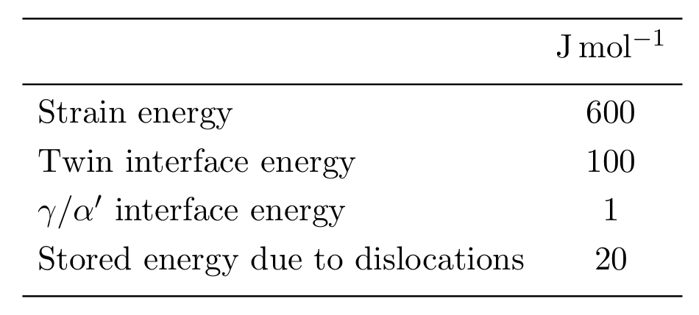

Slide 18
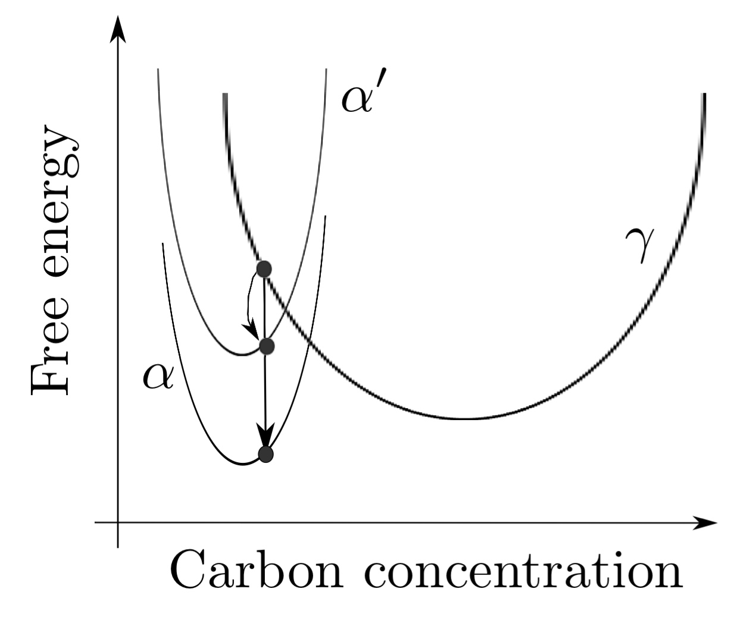
T₁

Slide 20
What have we learnt so far that may be useful in design?

Slide 21
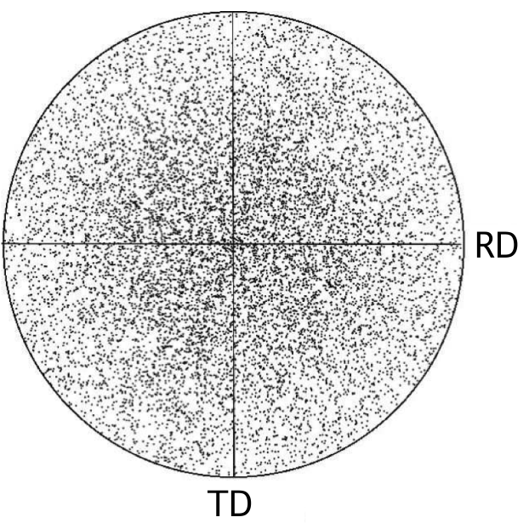
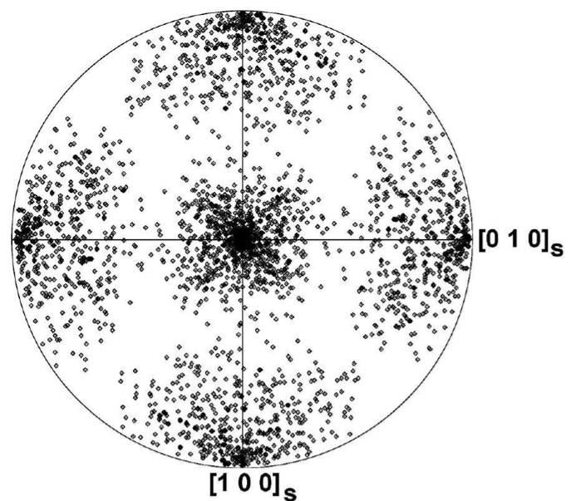
Can calculate the complete crystallography.
Therefore, the transformation texture.
Kundu

Slide 22
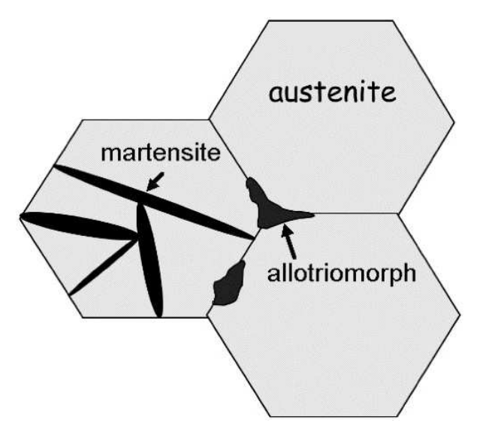
Martensitic transformation – disciplined motion of atoms.
Plates cannot cross boudaries.
Therefore, boundaries become susceptible to impurity embrittlement.

Slide 23
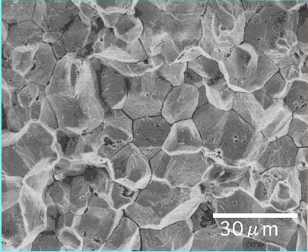
Therefore, strong martensitic steels must be pure (low P, Sn … ) or contain solutes that getter impurities, e.g. Mo

Slide 24
Can calculate the size and shape of martensite.
Therefore, can estimate mechanical behaviour.
General rule: make the structure fine for better properties.
How?

Slide 25
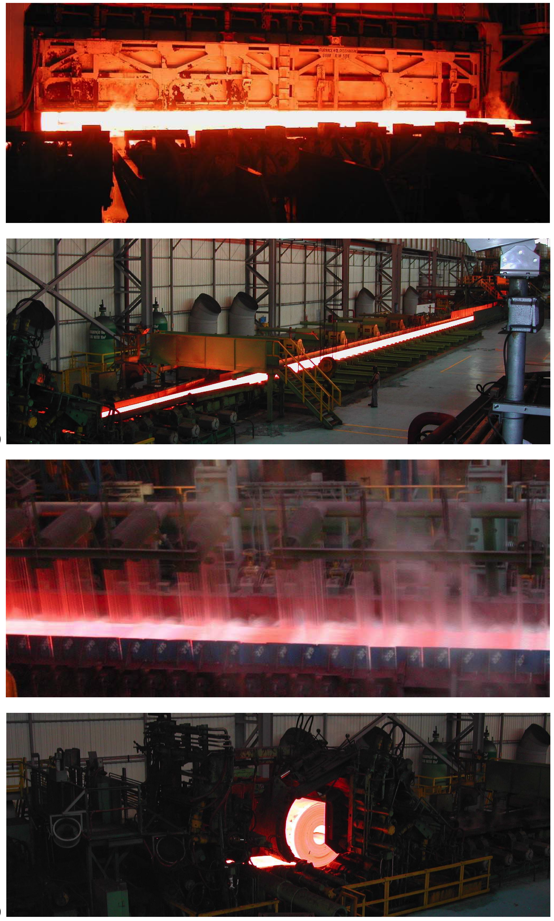
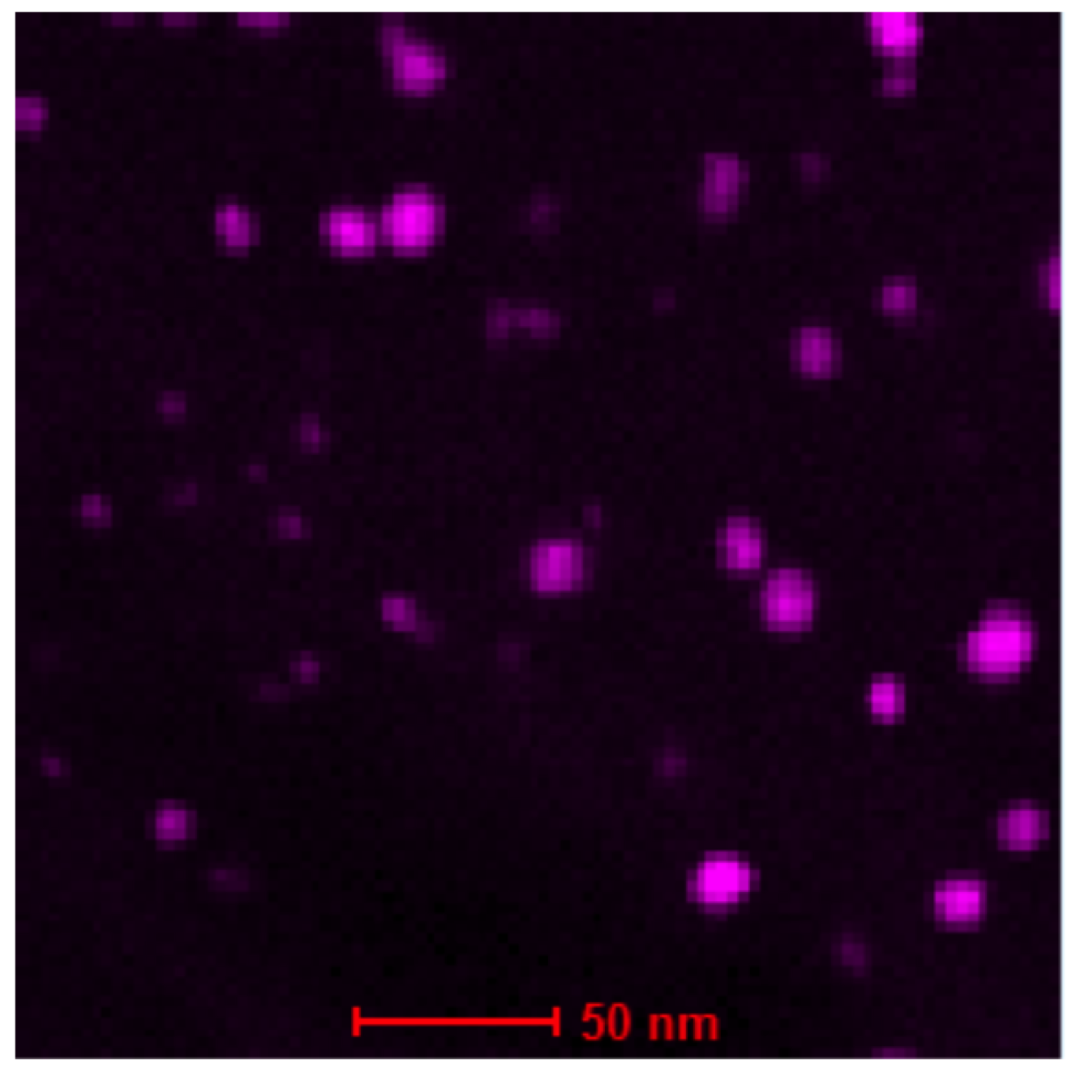
Mathew Peet

Slide 26
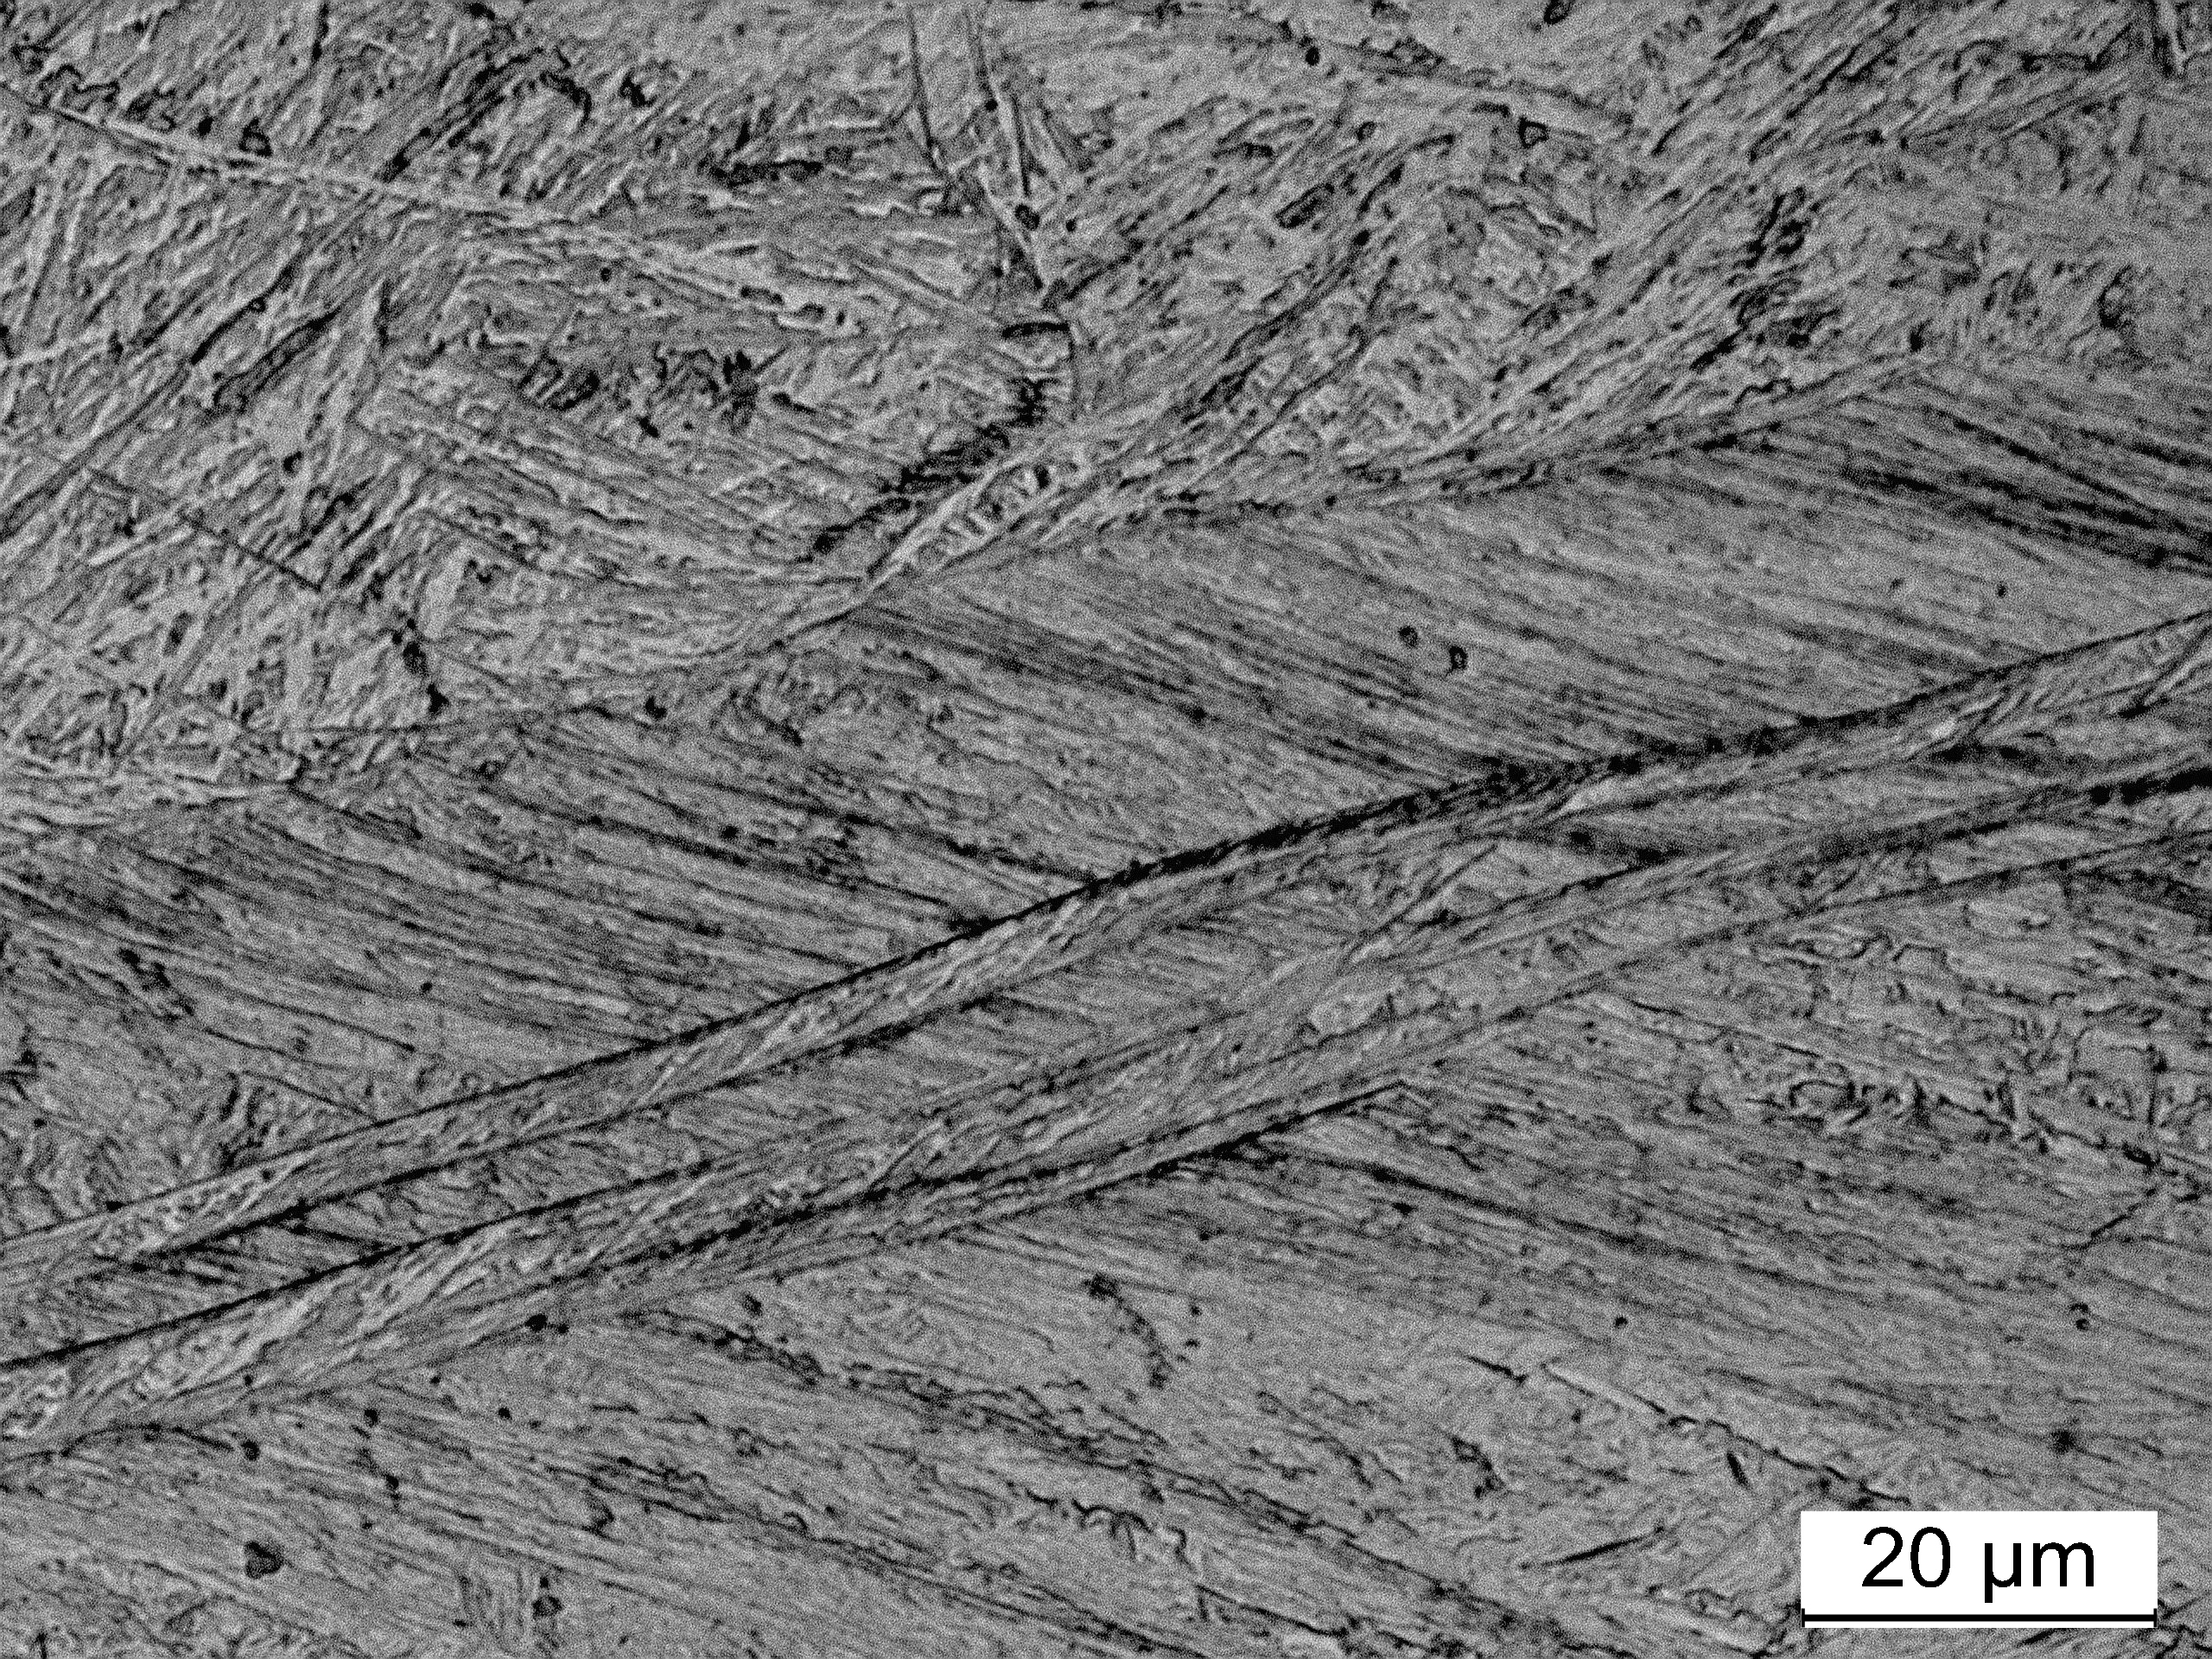
Kundu

Slide 27
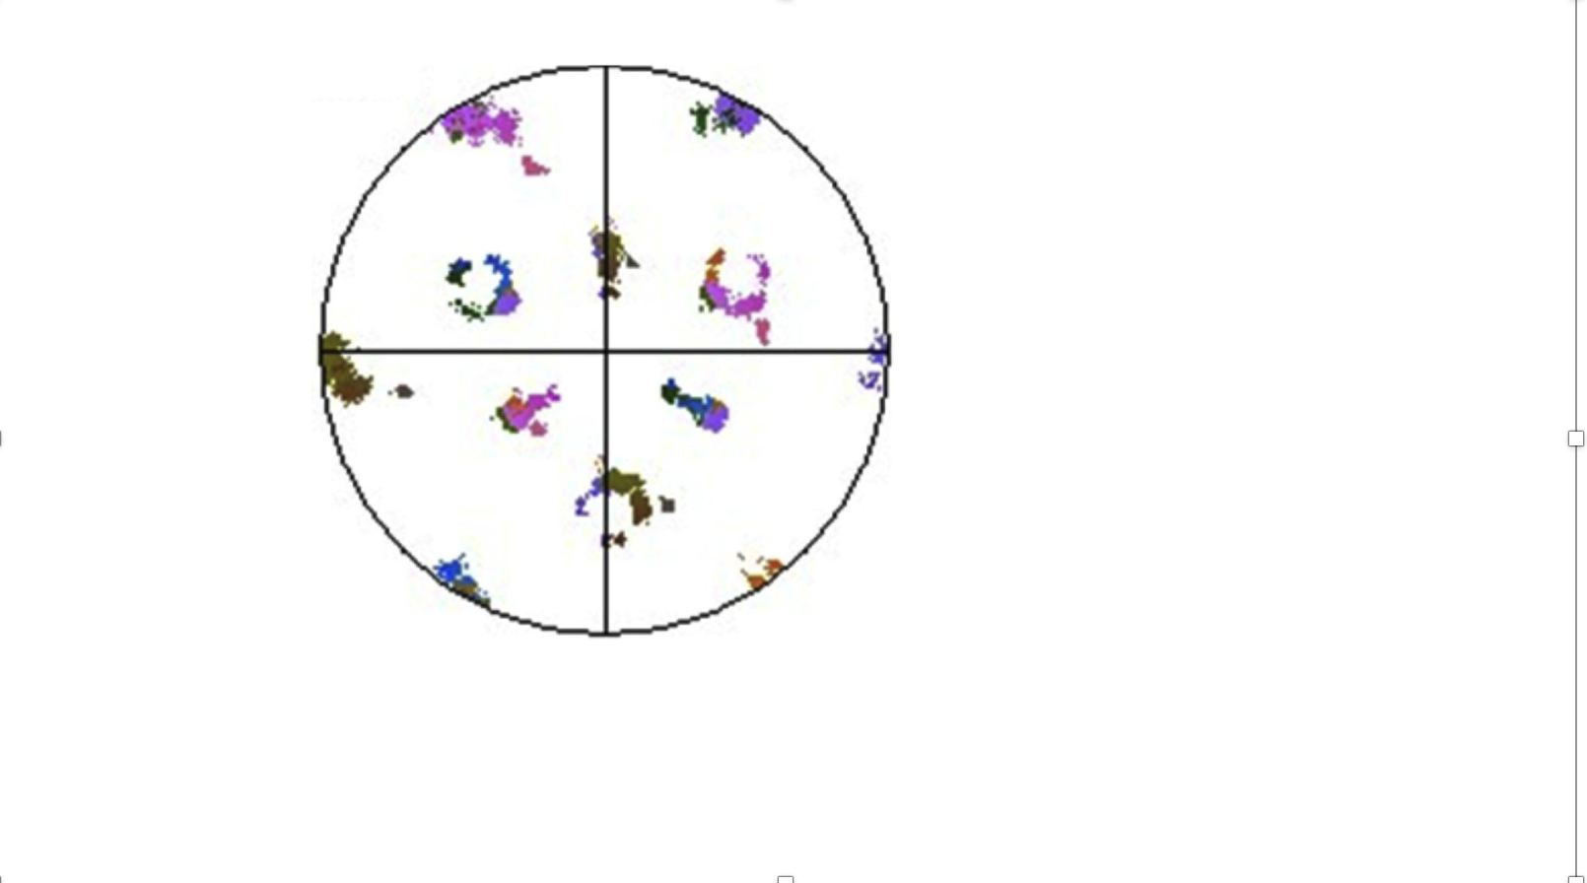

Slide 28
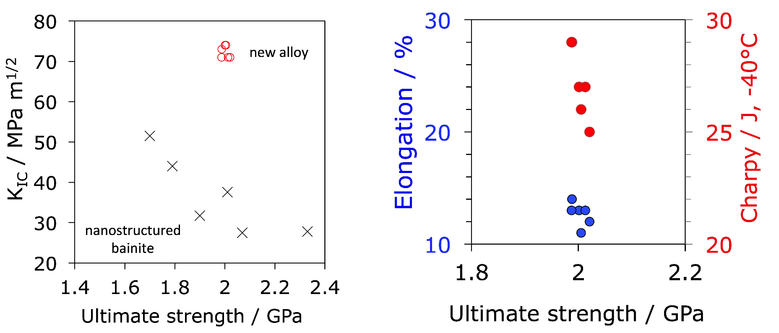
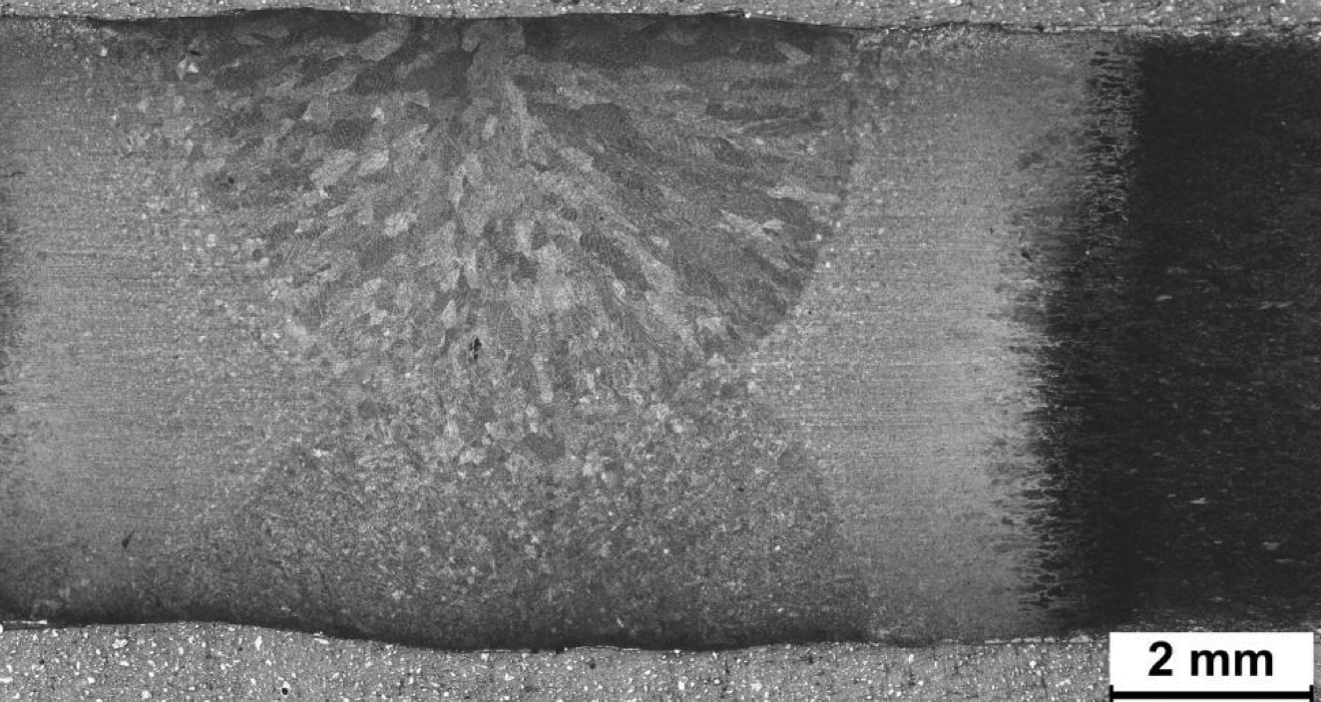
Fe-0.34C-1.5Si ….. wt%
untempered martensite

