Slide 1


Steels: bainite, lecture 3 of 12
Martensite
Bainite
Alloy design: strong bainite
Widmanstaetten ferrite
Allotriomorphic ferrite
Pearlite
Overall kinetics
TRIP steel
TWIP steel
Mitigation of residual stress
Bulk nanostructured steel
www.phase-trans.msm.cam.ac.uk/teaching.html
H. K. D. H. Bhadeshia

Slide 2
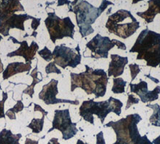
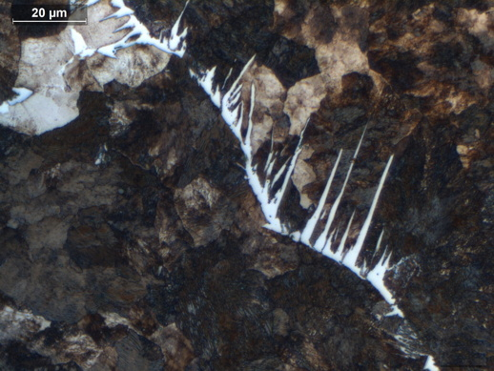
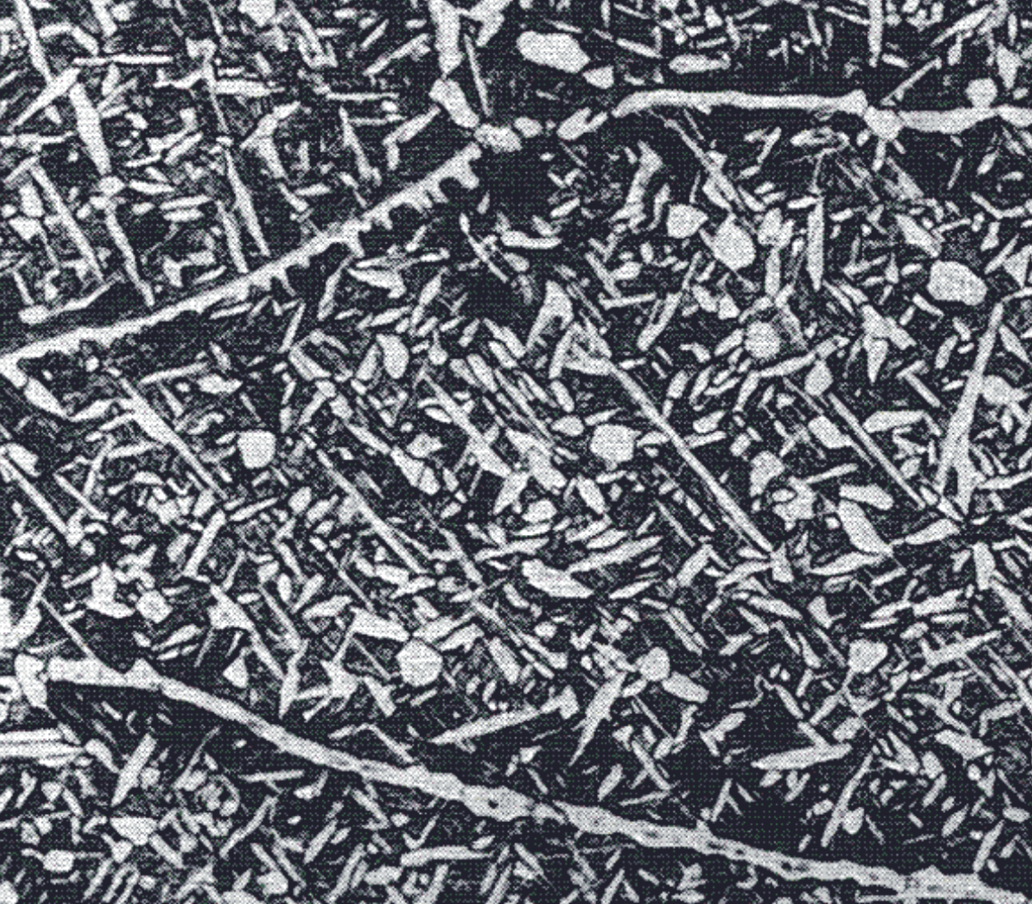
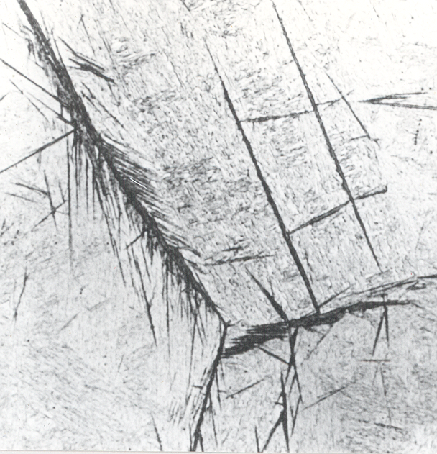
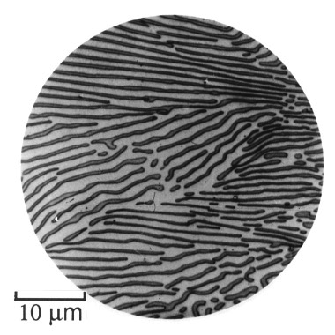
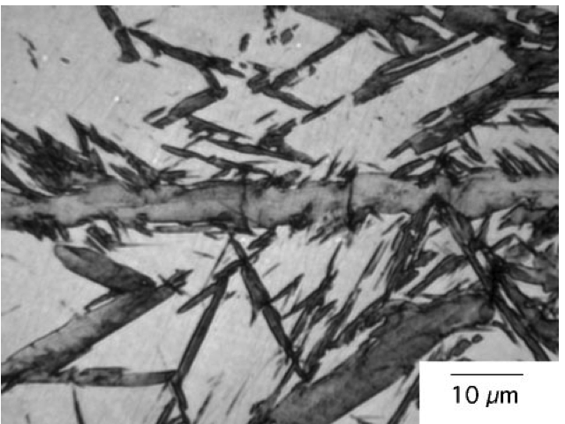

Slide 3
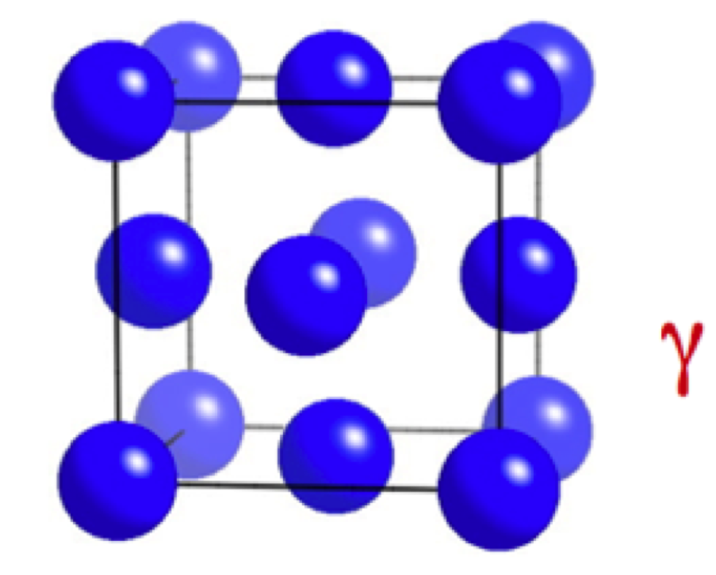
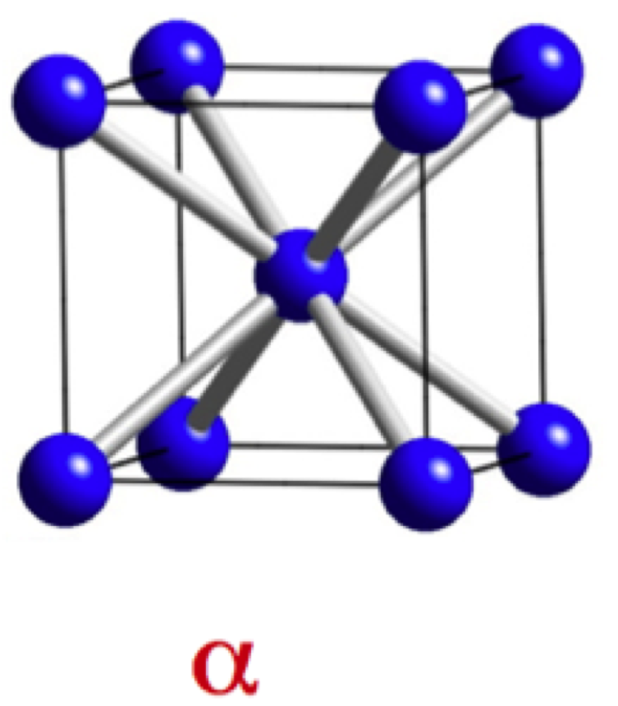

Slide 4
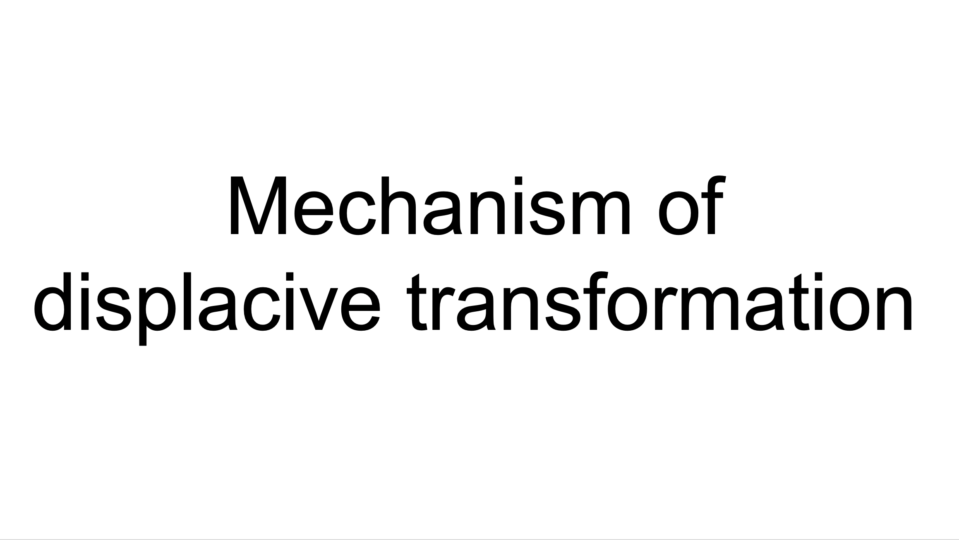

Slide 5
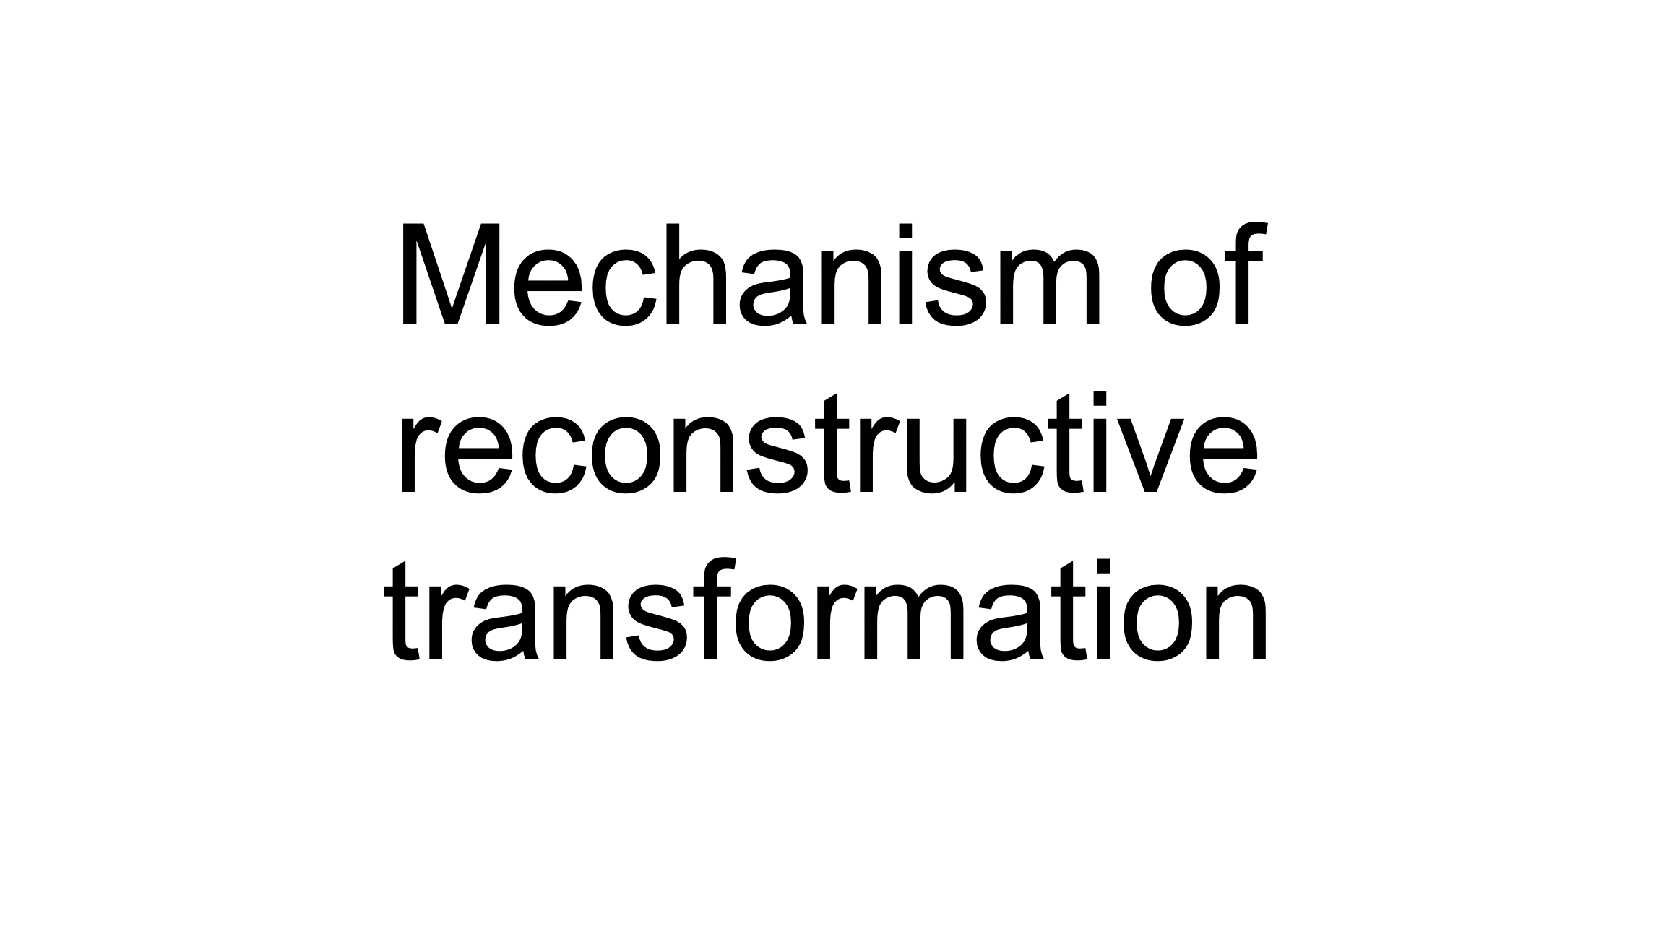

Slide 6
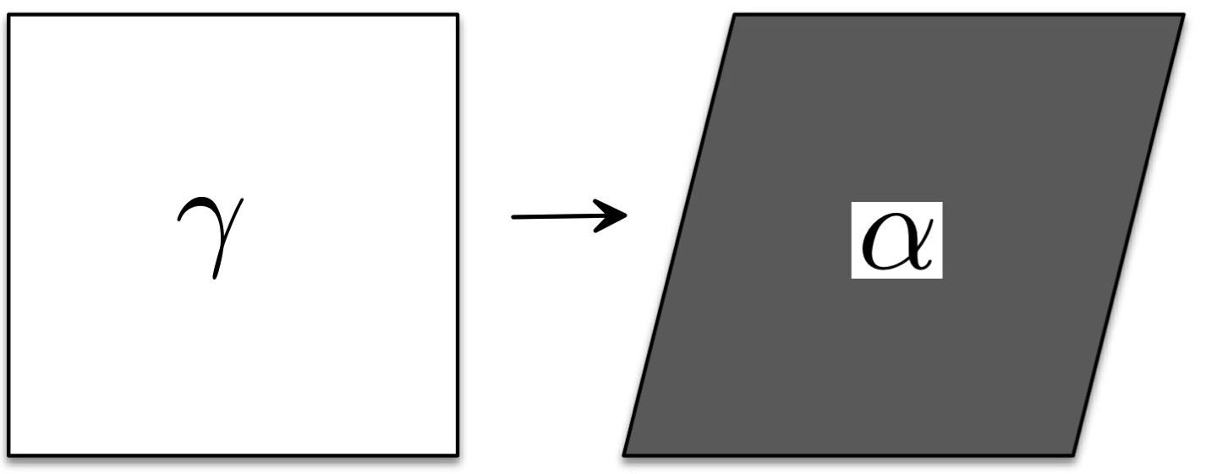
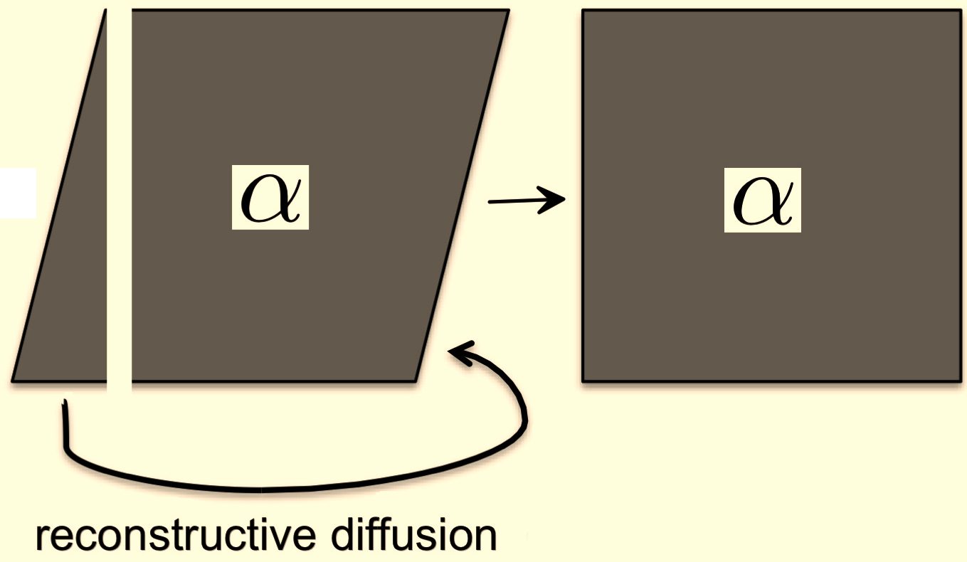

Slide 7
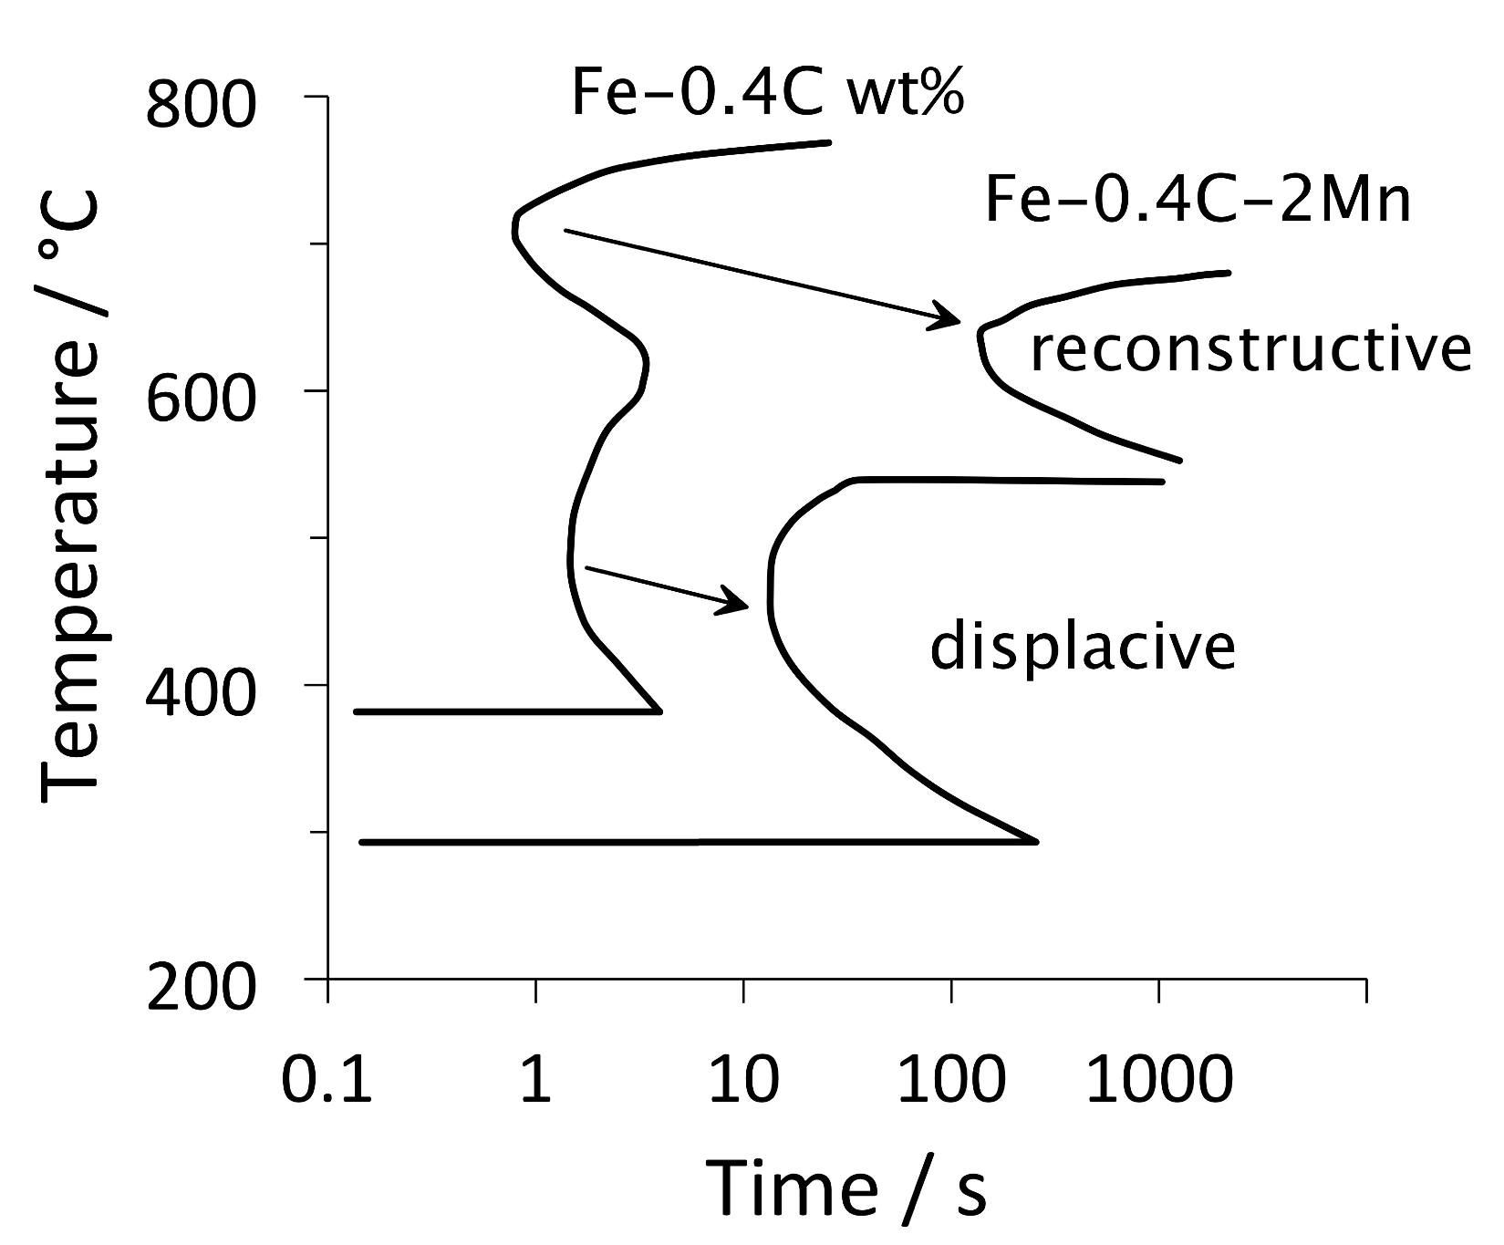
Notes:
7

Slide 8
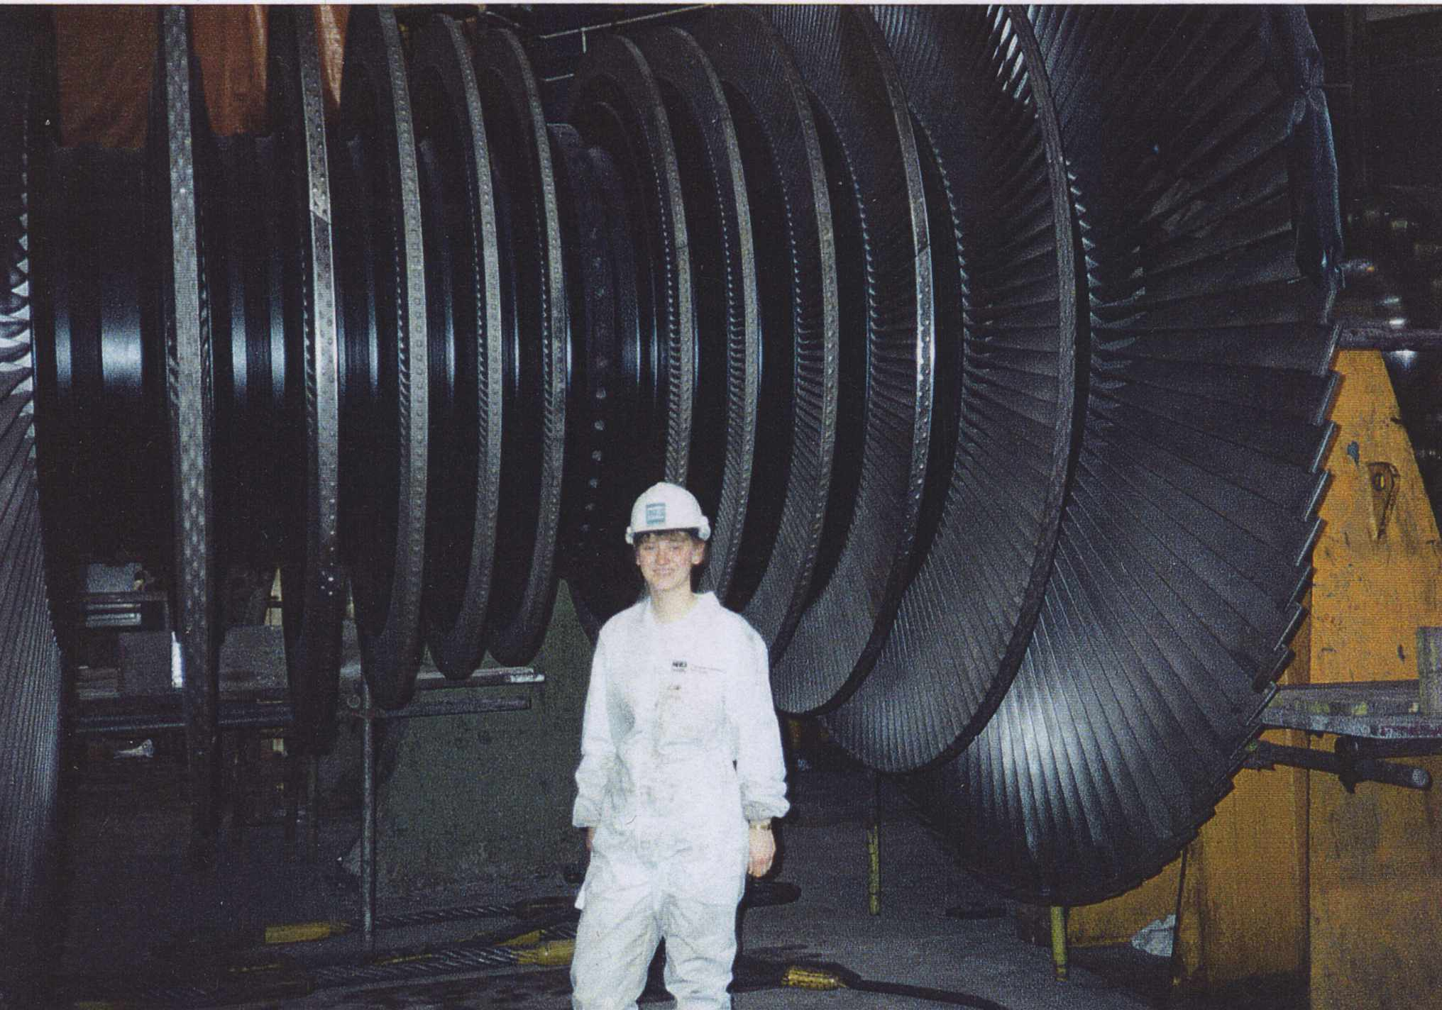

Slide 9
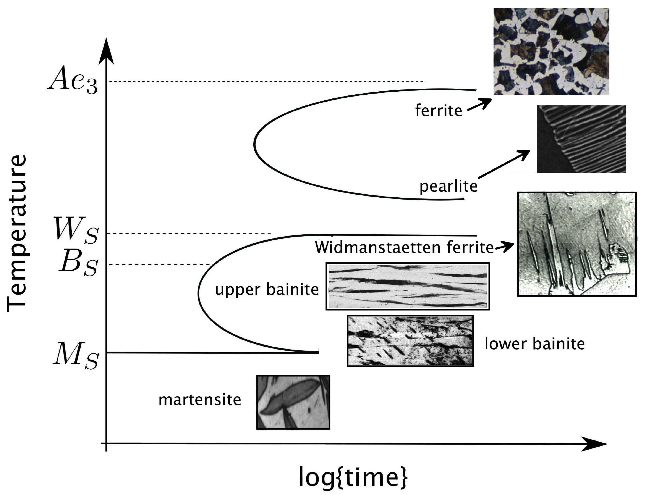
Notes:
9

Slide 10
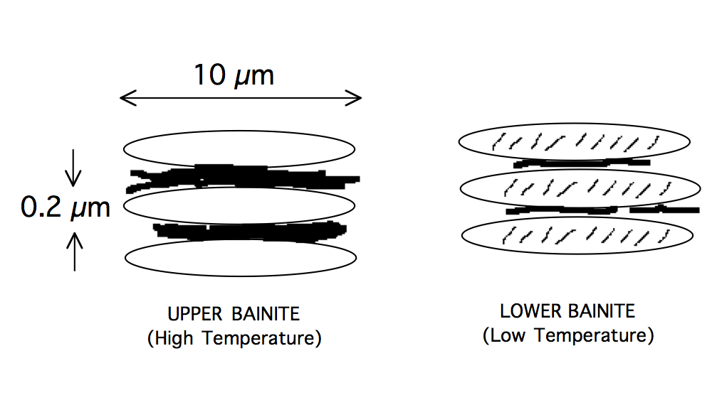

Slide 11
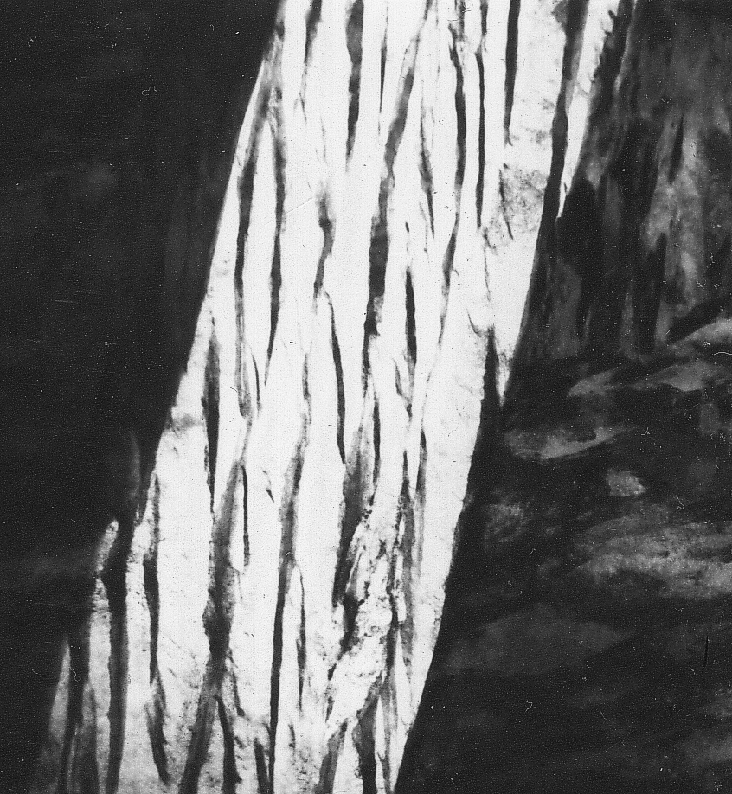
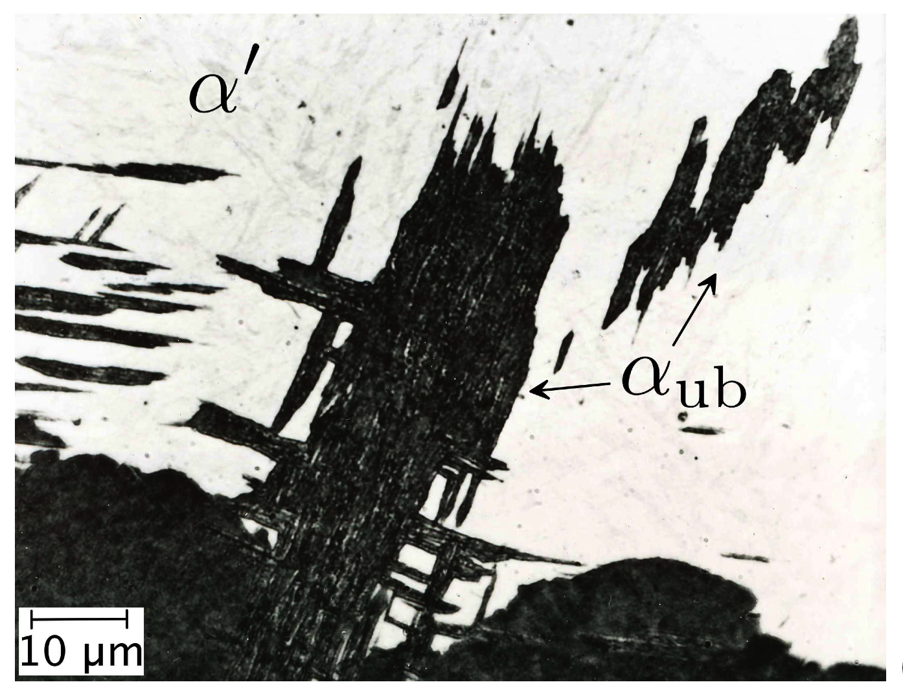
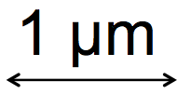
upper bainite

Slide 12
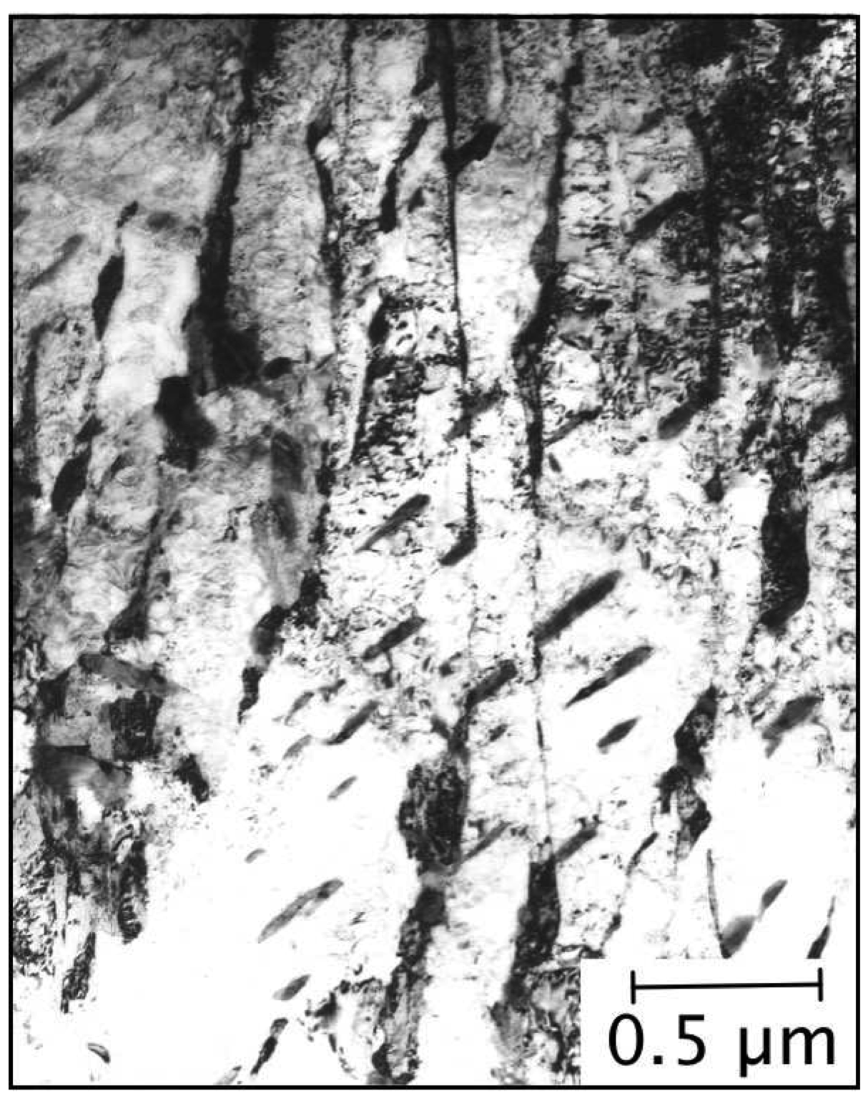
lower bainite

Slide 13
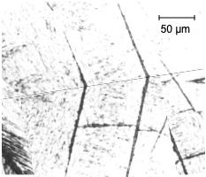
schematic illustration of
two-surface analysis

Slide 14
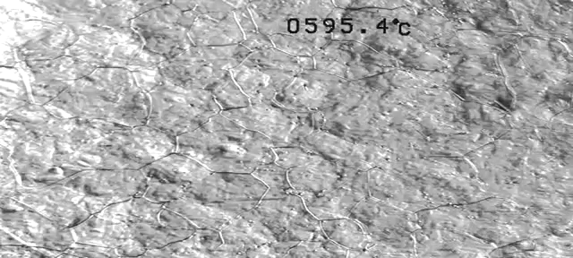
Jun Hak Pak & Bhadeshia

Slide 15
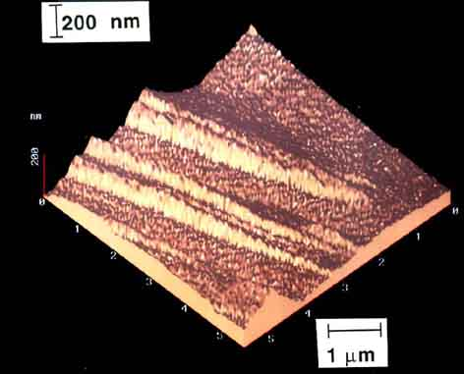
Swallow & Bhadeshia

Slide 16
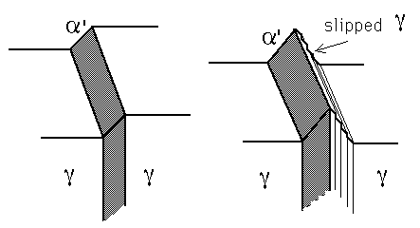

Slide 17
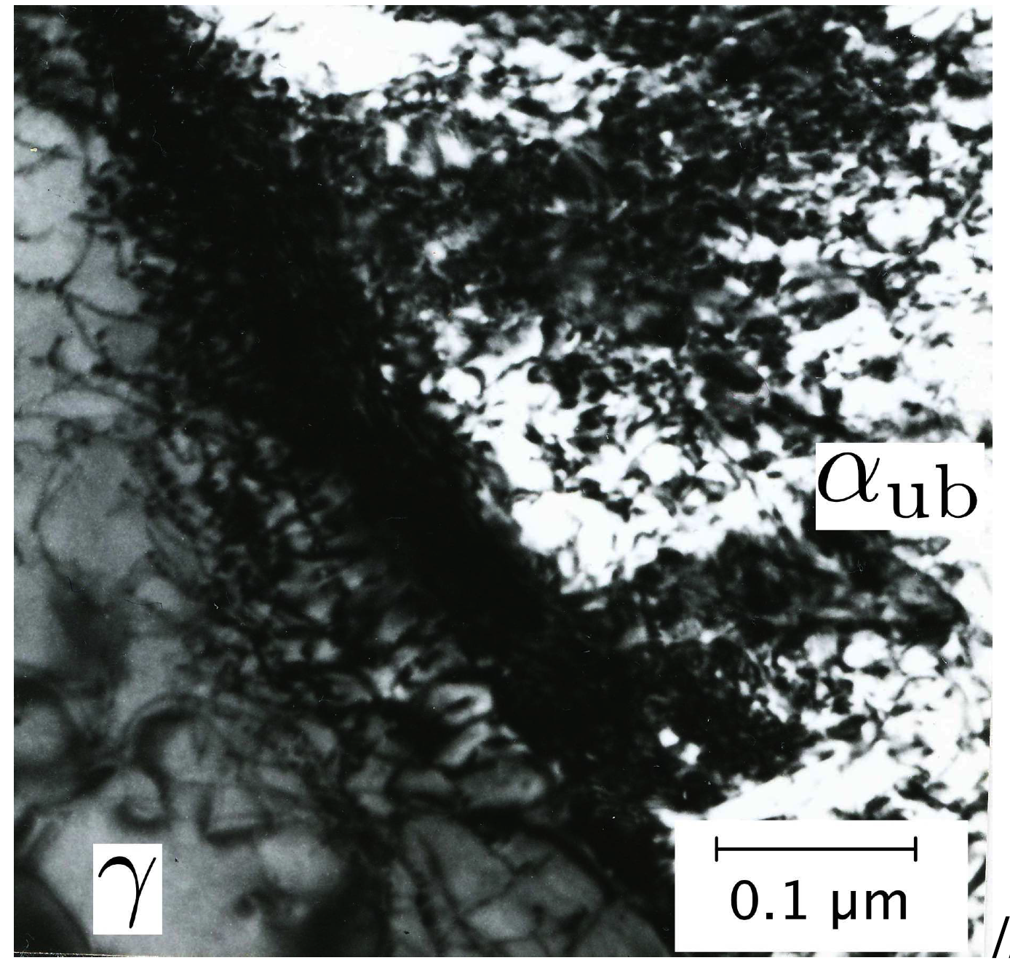

Slide 18
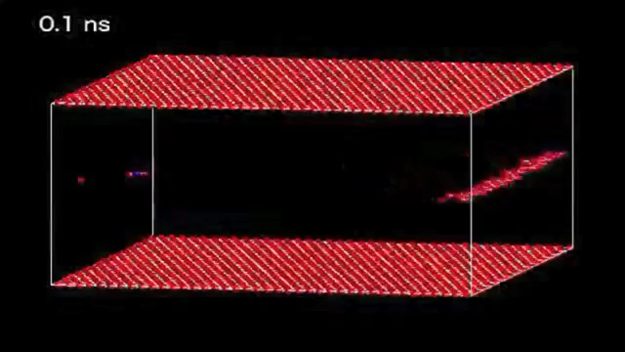
Molecular dynamics simulation: pinning of edge dislocation in bcc-iron by interstitial atom, 300 K. Courtesy of Katsutoshi Hyodo, Satoshi Araki, Shinji Munetoh, Toshihiro Tsuchiyama, Setsuo Takaki, Kyushu University. Steel Science (ISSS 2017) Characterization and design of multiscale heterostructures in advanced steels, 2017, ISIJ, Tokyo, pp. 175-178.

Slide 19
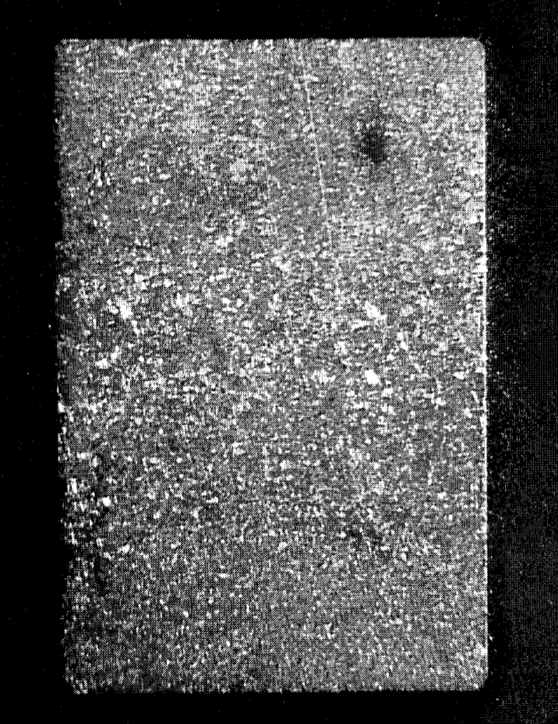
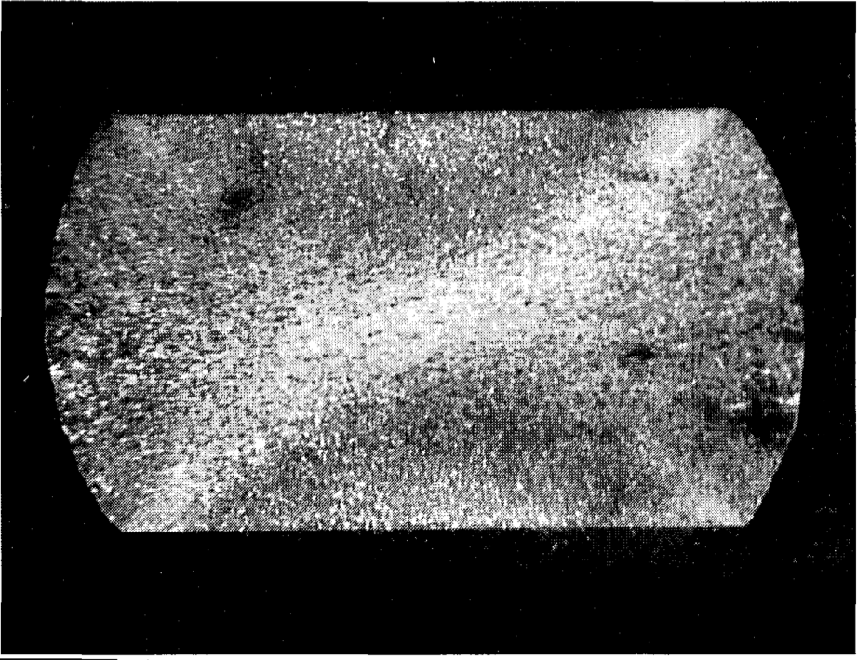

Slide 20
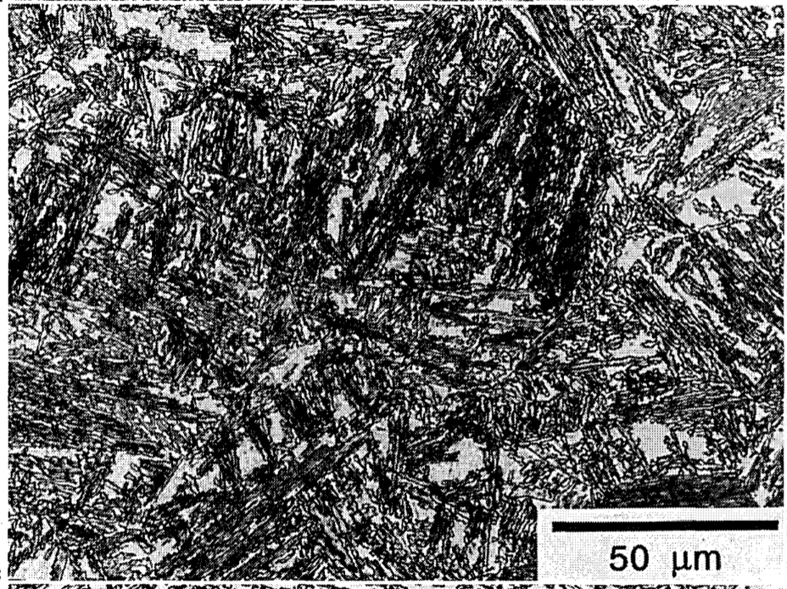
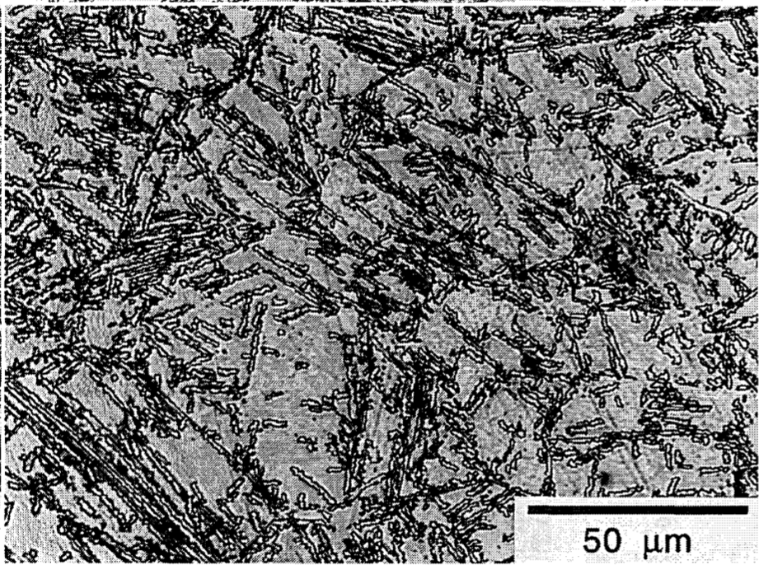
Shipway & Bhadeshia

Slide 21
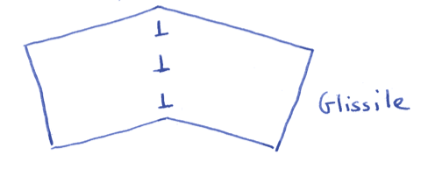
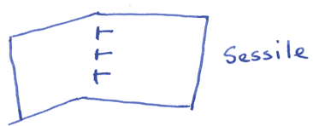
Mechanical stabilisation is only possible with displacive transformations.
Mechanical stabilisation never occurs with reconstructive transformations.

Slide 22
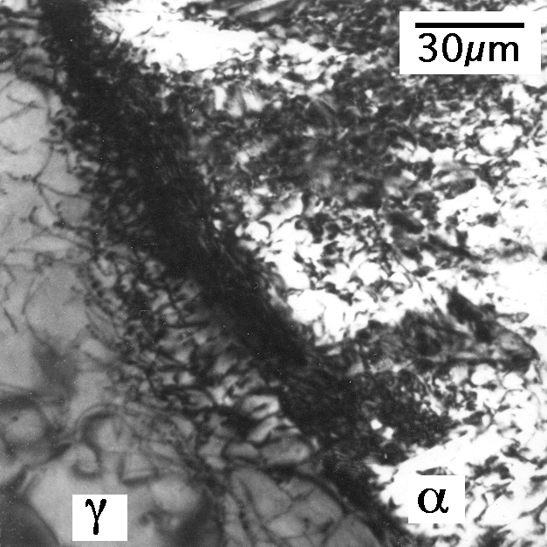

Slide 23
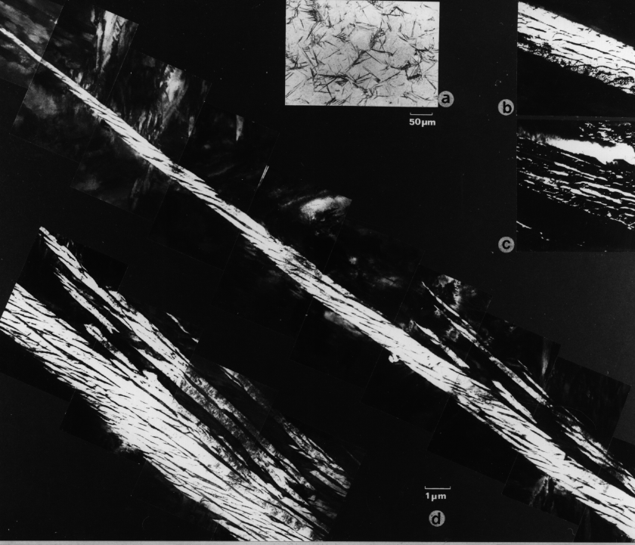
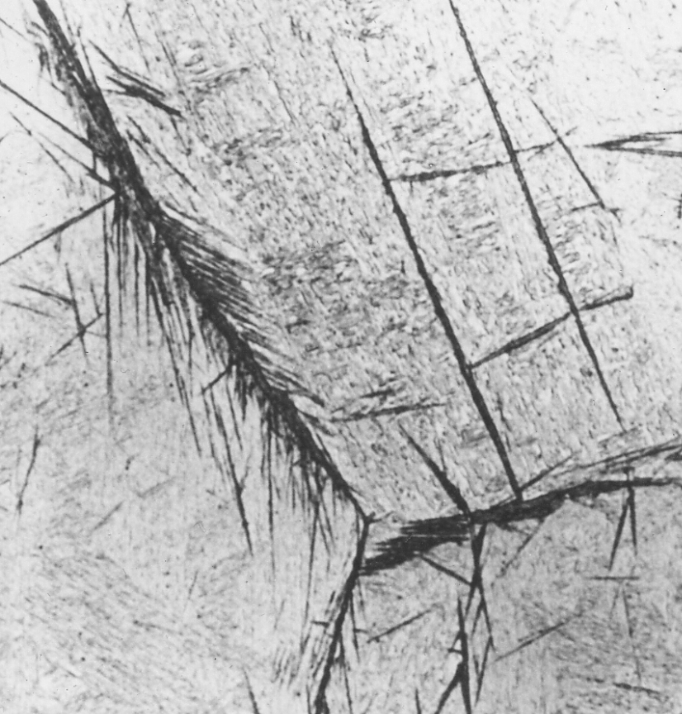
50 µm

Slide 24
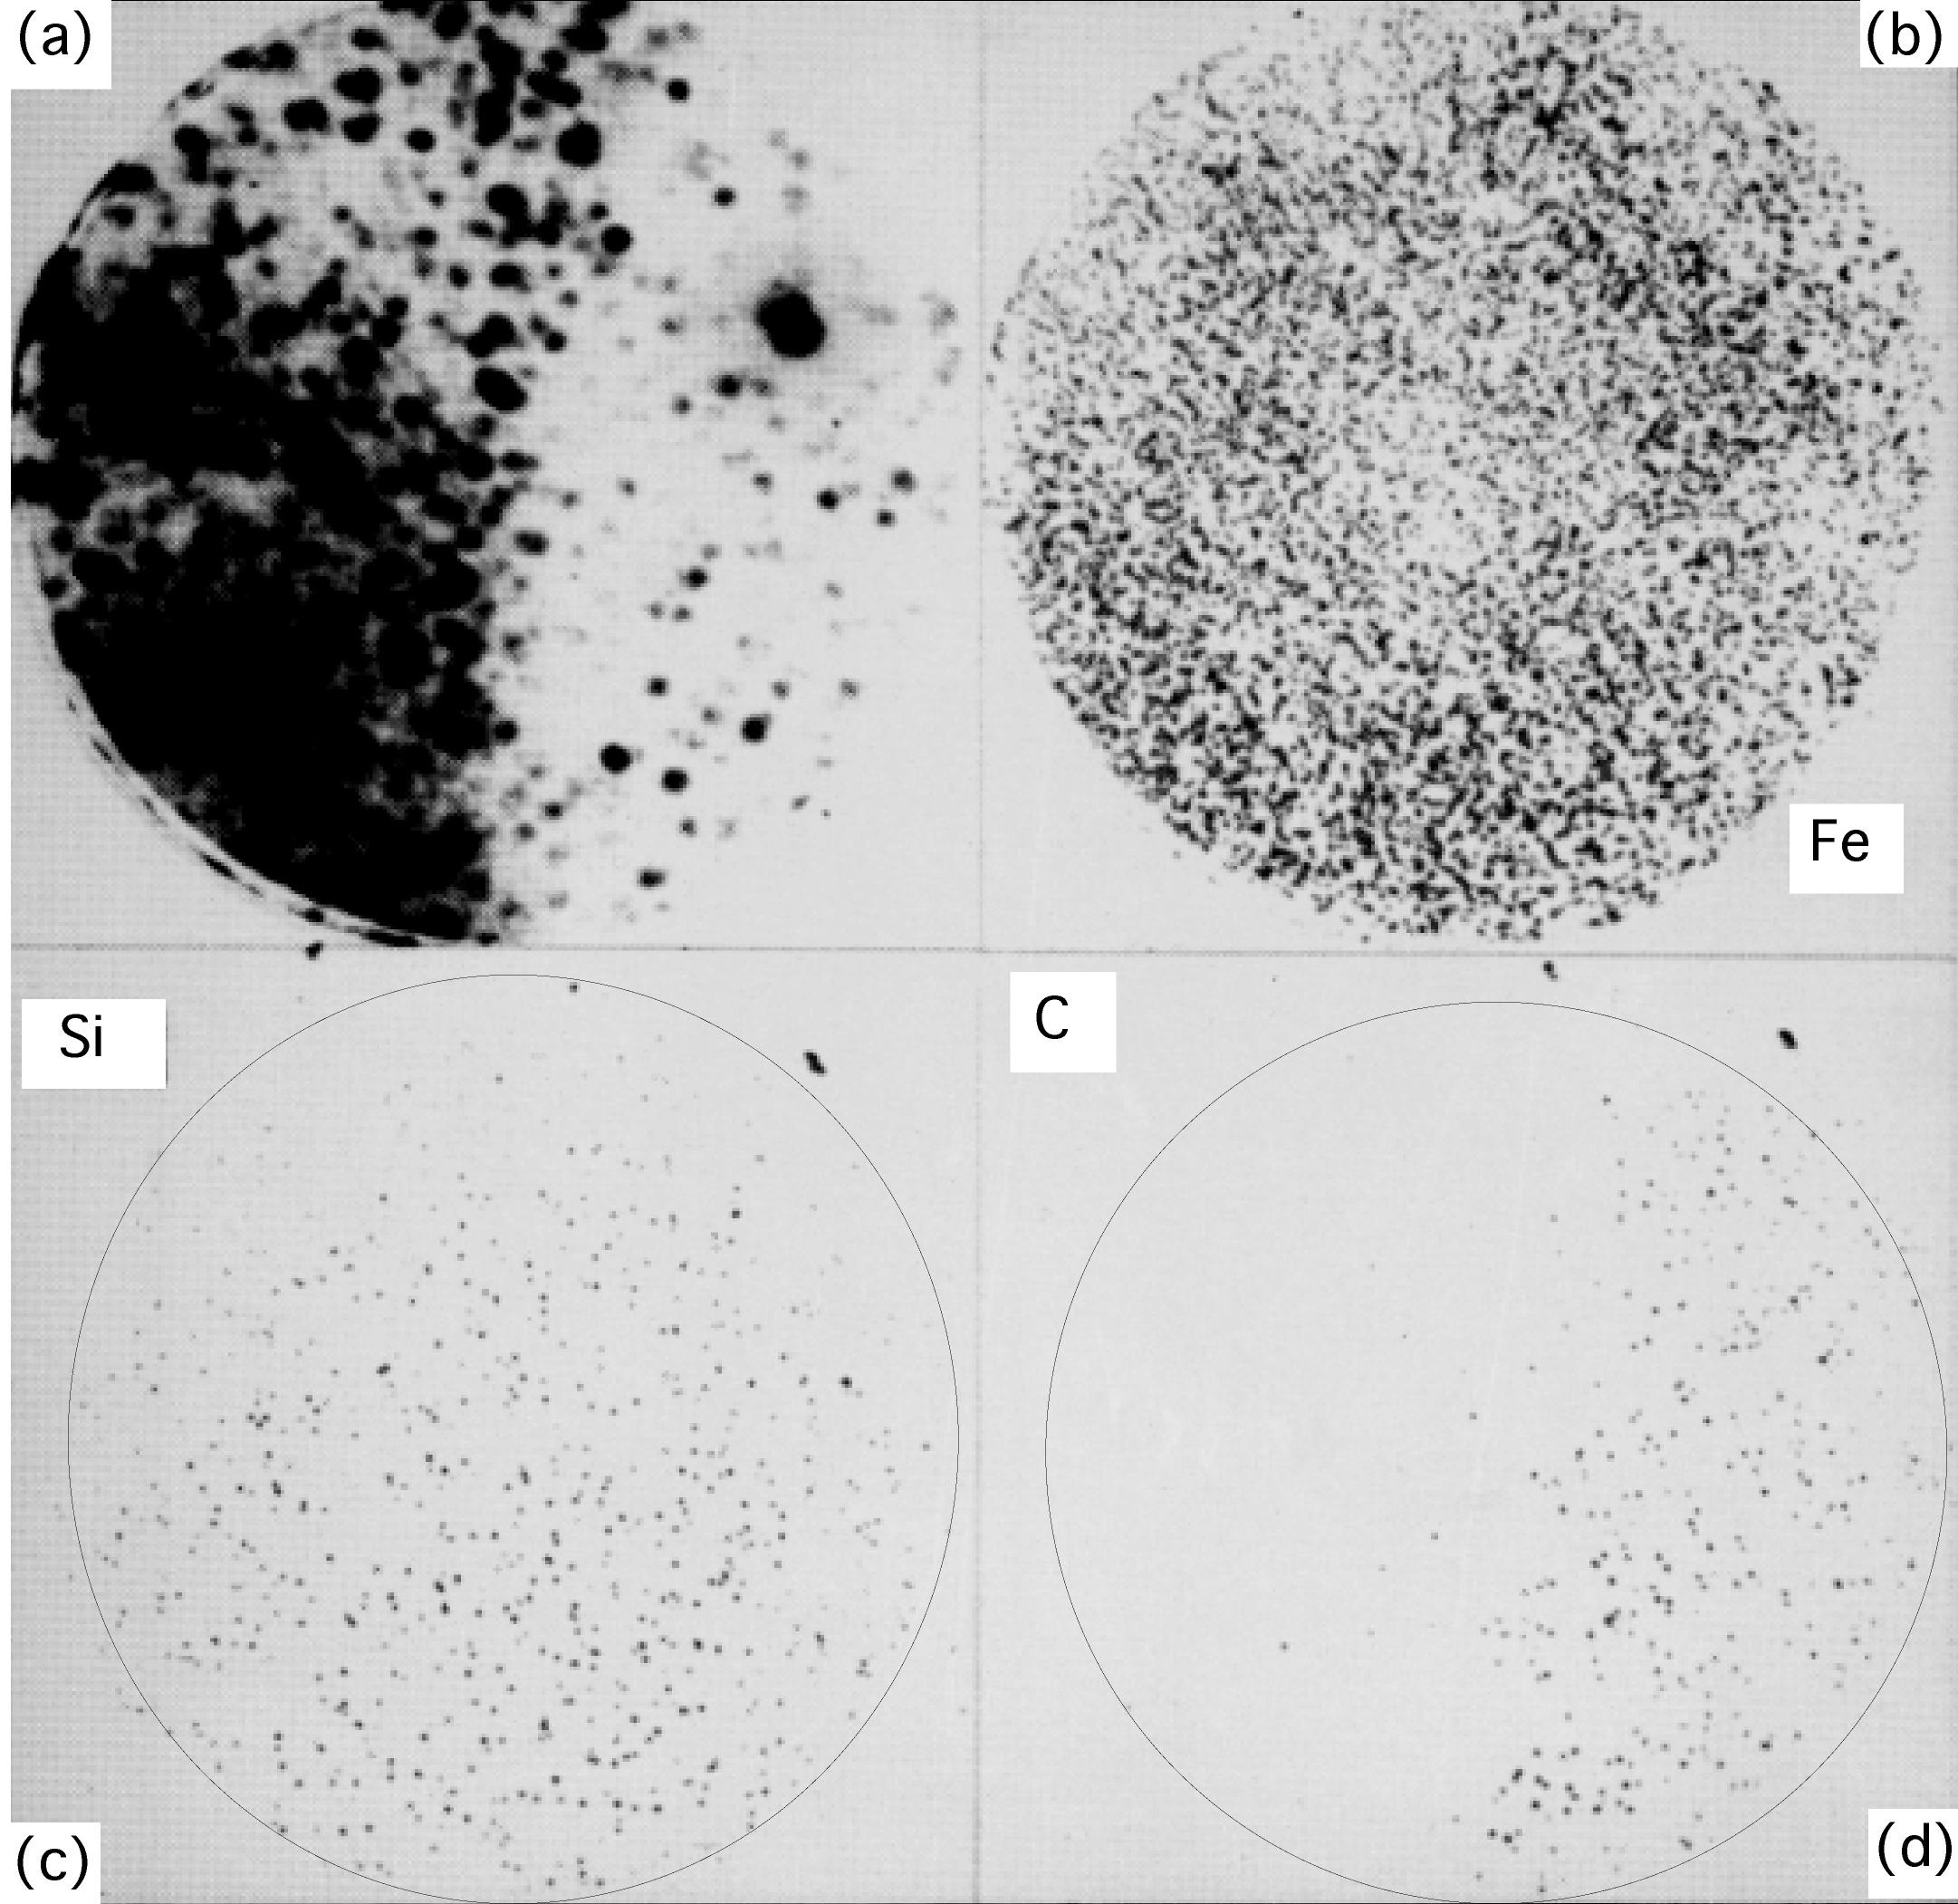
Bhadeshia and Waugh, 1981

Slide 25
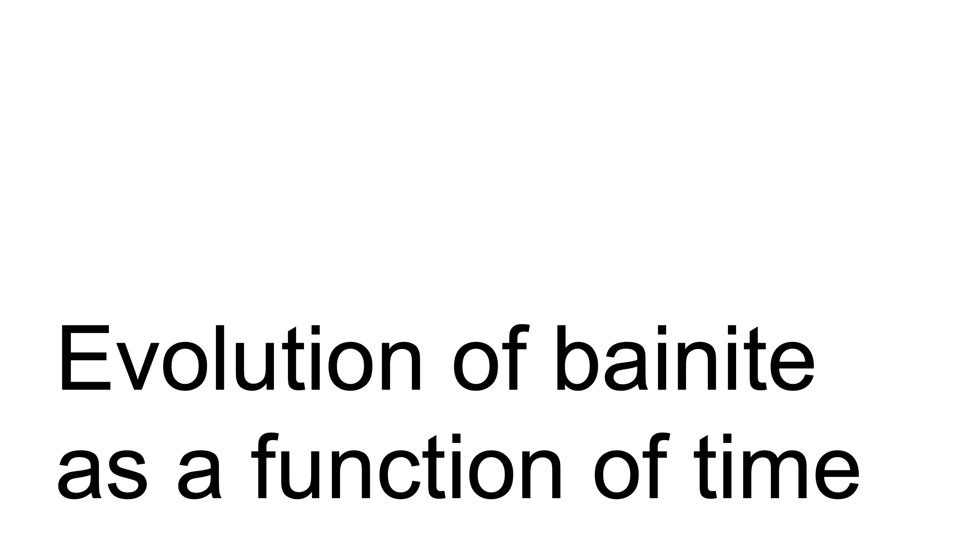

Slide 26
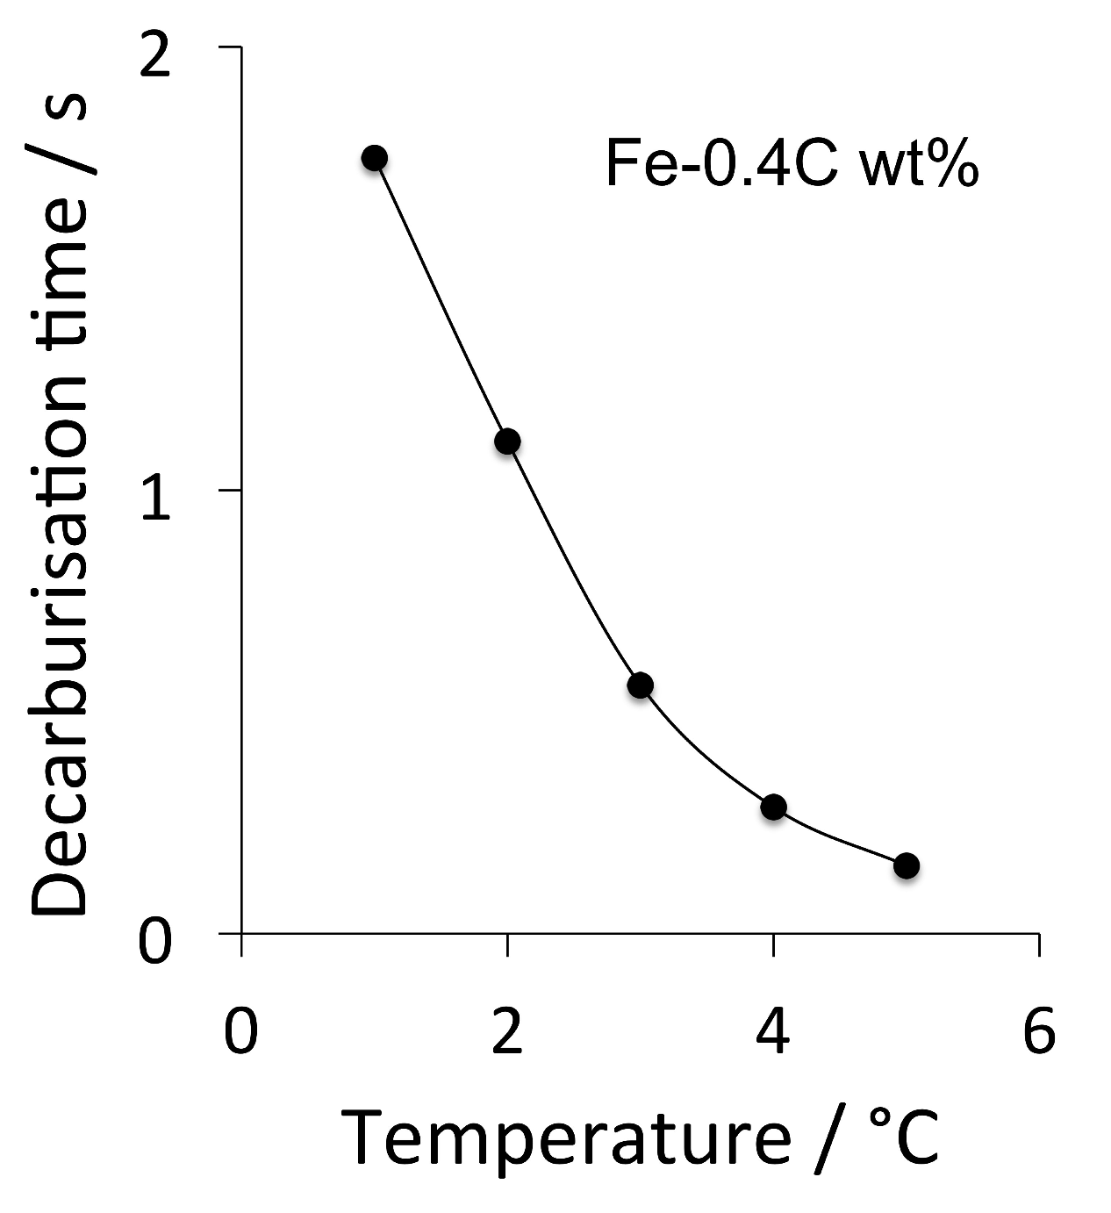

Slide 28
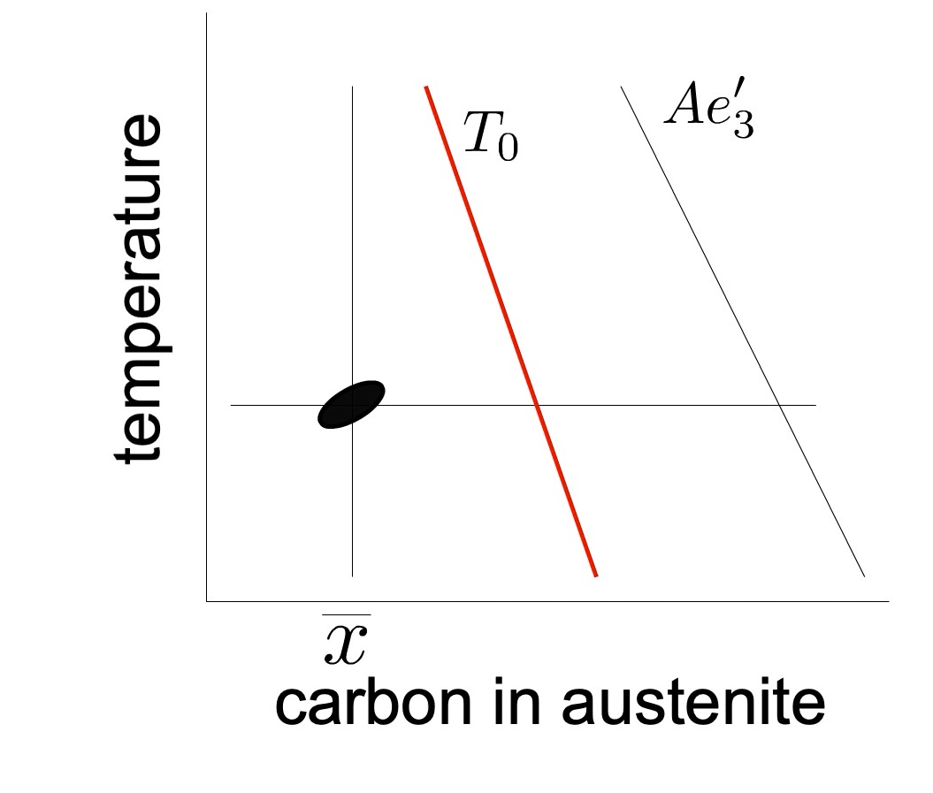

Slide 29

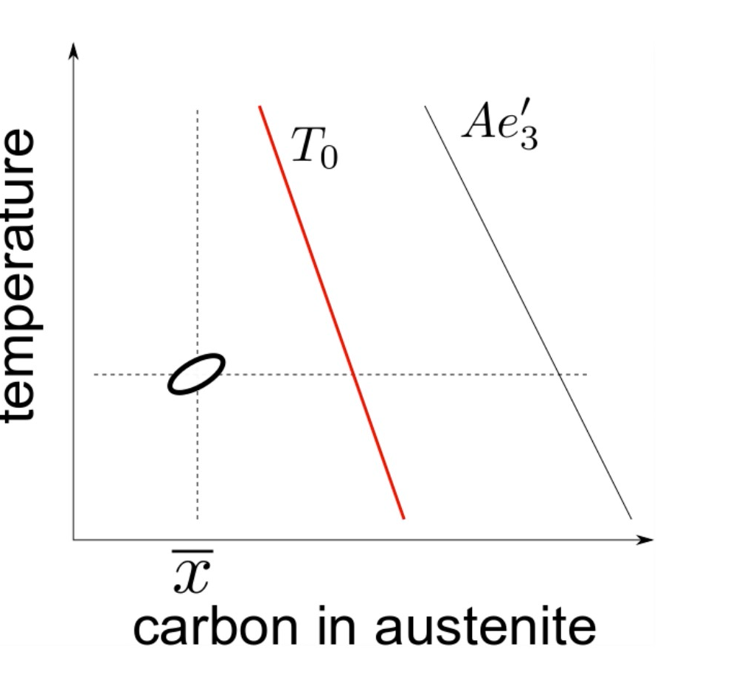

Slide 30
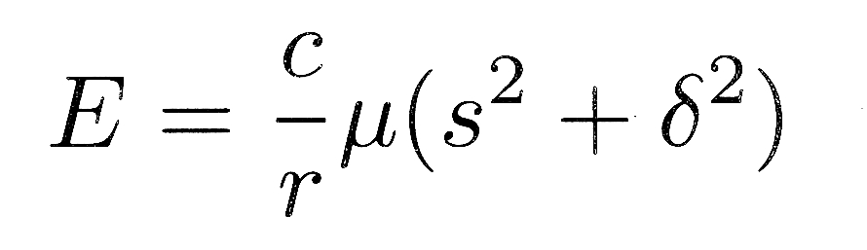
s
δ
c
r
1

Slide 31
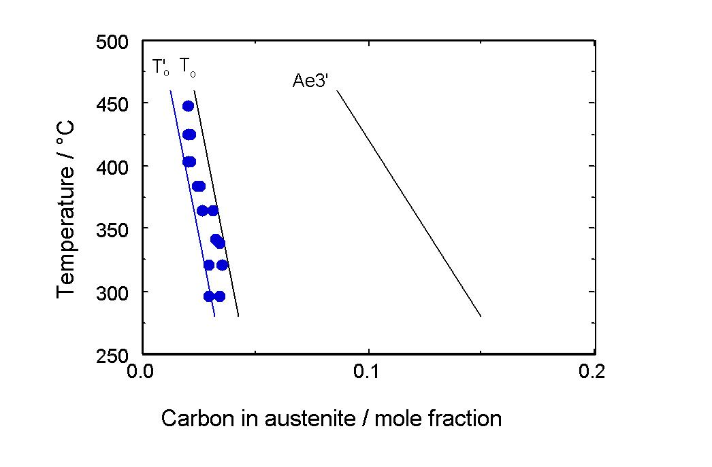

Slide 32
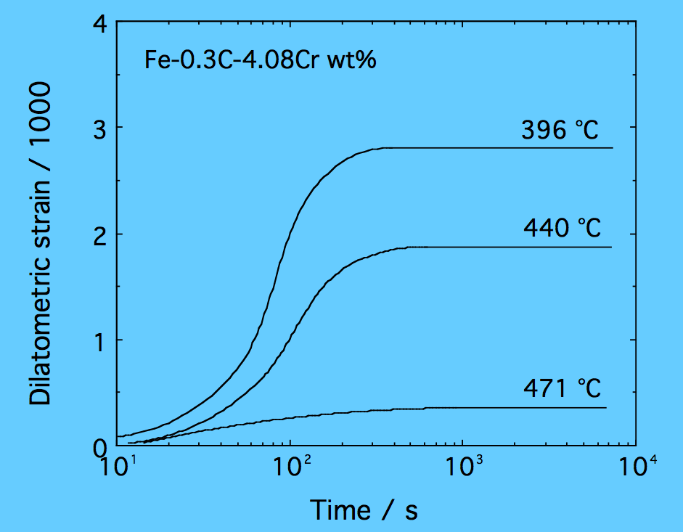

Slide 33
Growth is diffusionless.
Strain energy must be accounted for.

Slide 34
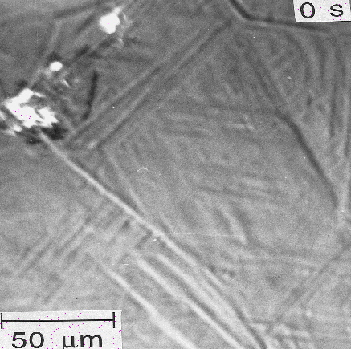
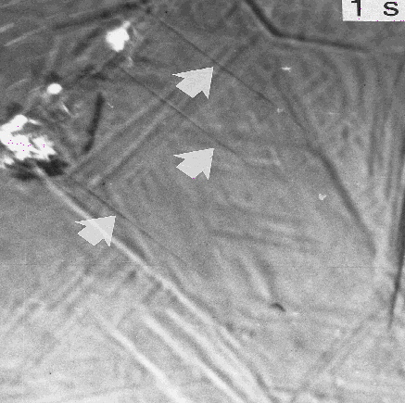
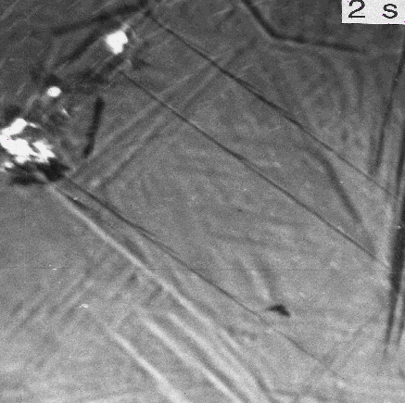
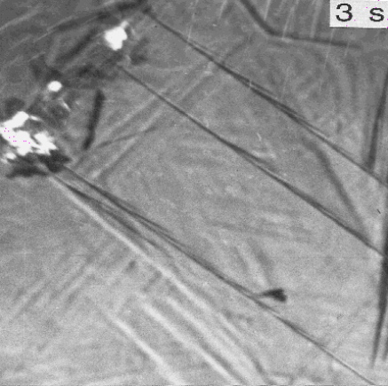
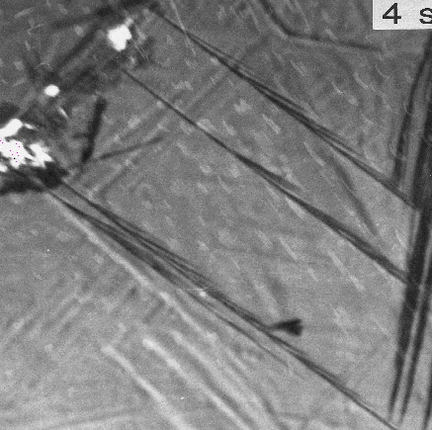
rate of growth of sub-units three orders of magnitude faster than permitted by carbon diffusion-control
photoemission electron microscopy

Slide 35
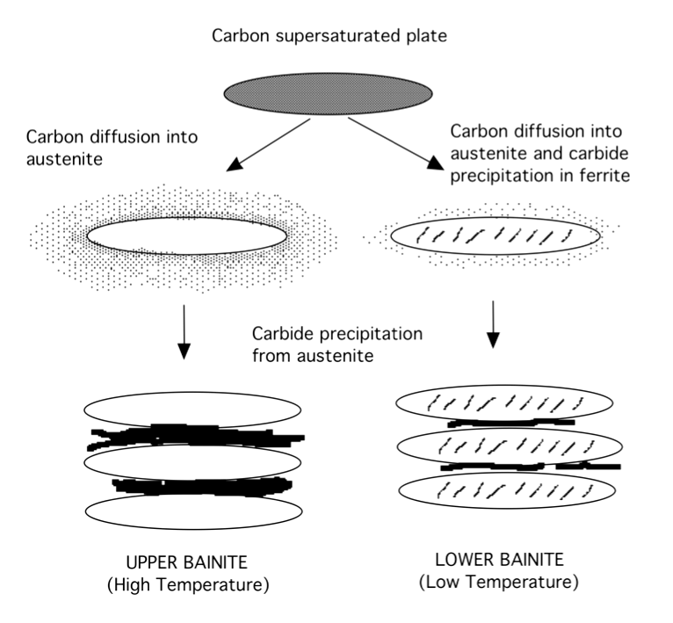
quantitative theory for the transition
from upper to lower bainite

Slide 36
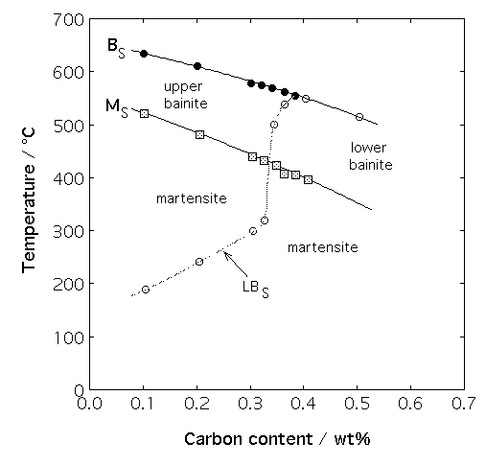
pearlite
Takahashi & Bhadeshia

Slide 37

no upper bainite
Oka and Okamoto

Slide 38

no lower bainite for C<0.4 wt%
Ohmori and Honeycombe

