Slide 1


Steels: Ferrite, lecture 6 of 12
Martensite
Bainite: mechanism based design
Alloy design: strong bainite
Widmanstätten ferrite
Ferrite
Pearlite
Overall kinetics
TRIP steel
TWIP steel
Mitigation of residual stress
Bulk nanostructured steel
www.phase-trans.msm.cam.ac.uk/teaching.html
H. K. D. H. Bhadeshia

Slide 2
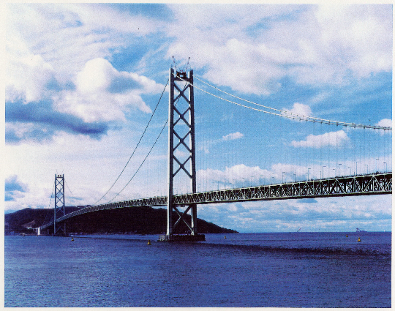
Akashi Kaikyō

Slide 3
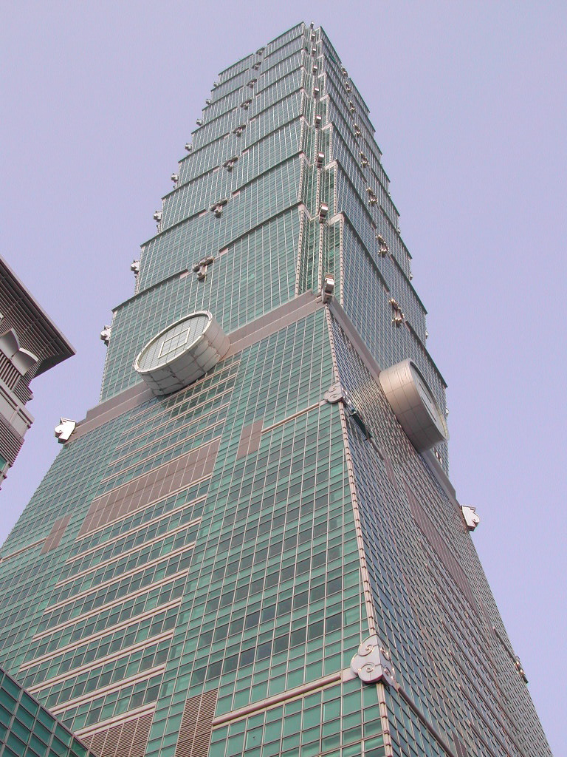
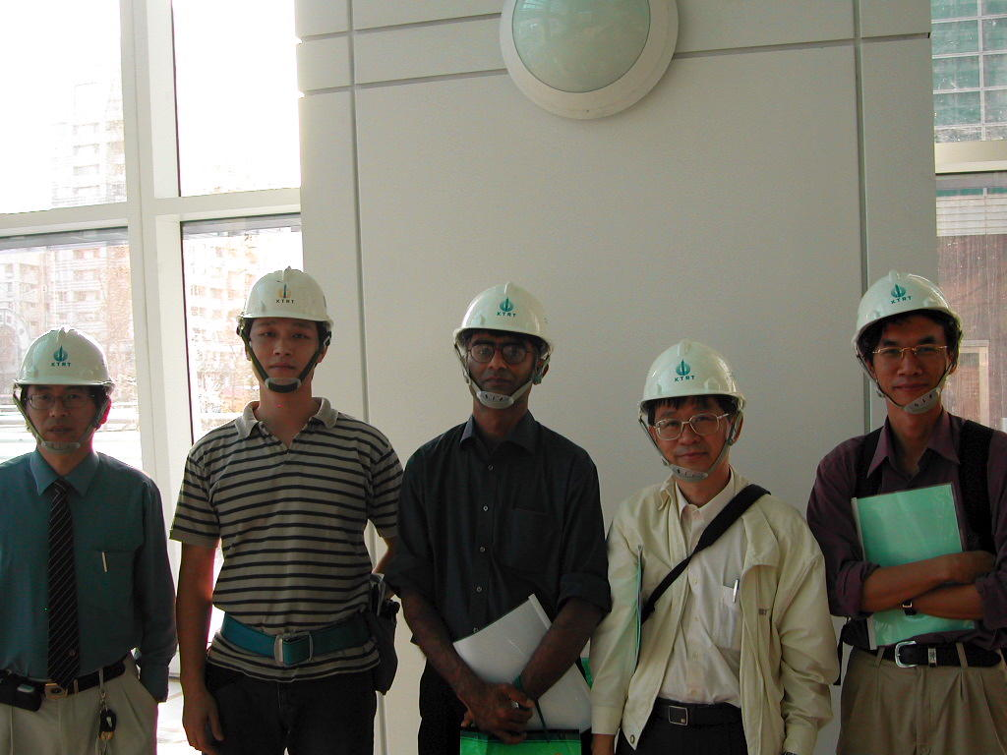
www.phase-trans.msm.cam.ac.uk/2005/t101/t101.html

Slide 4
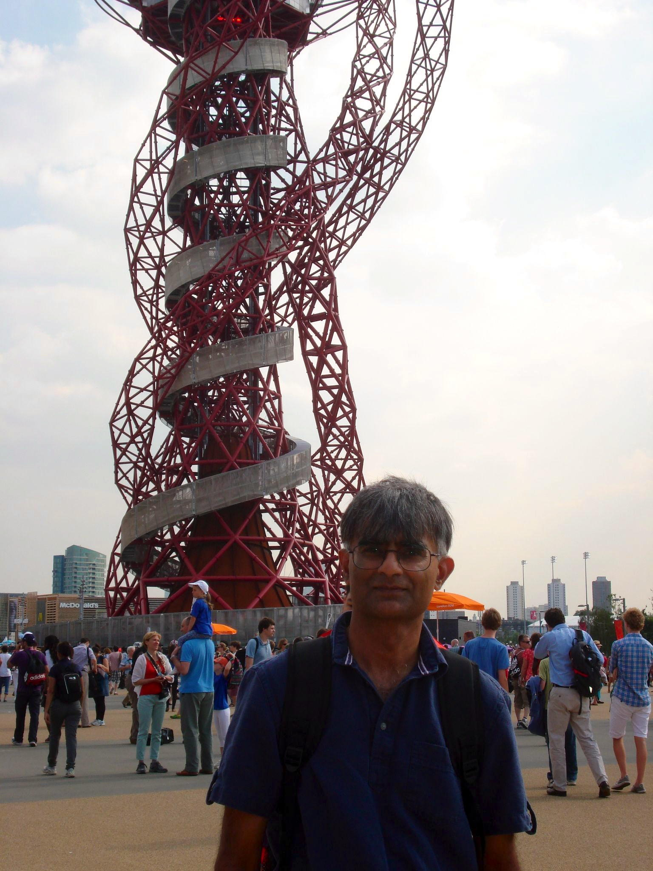
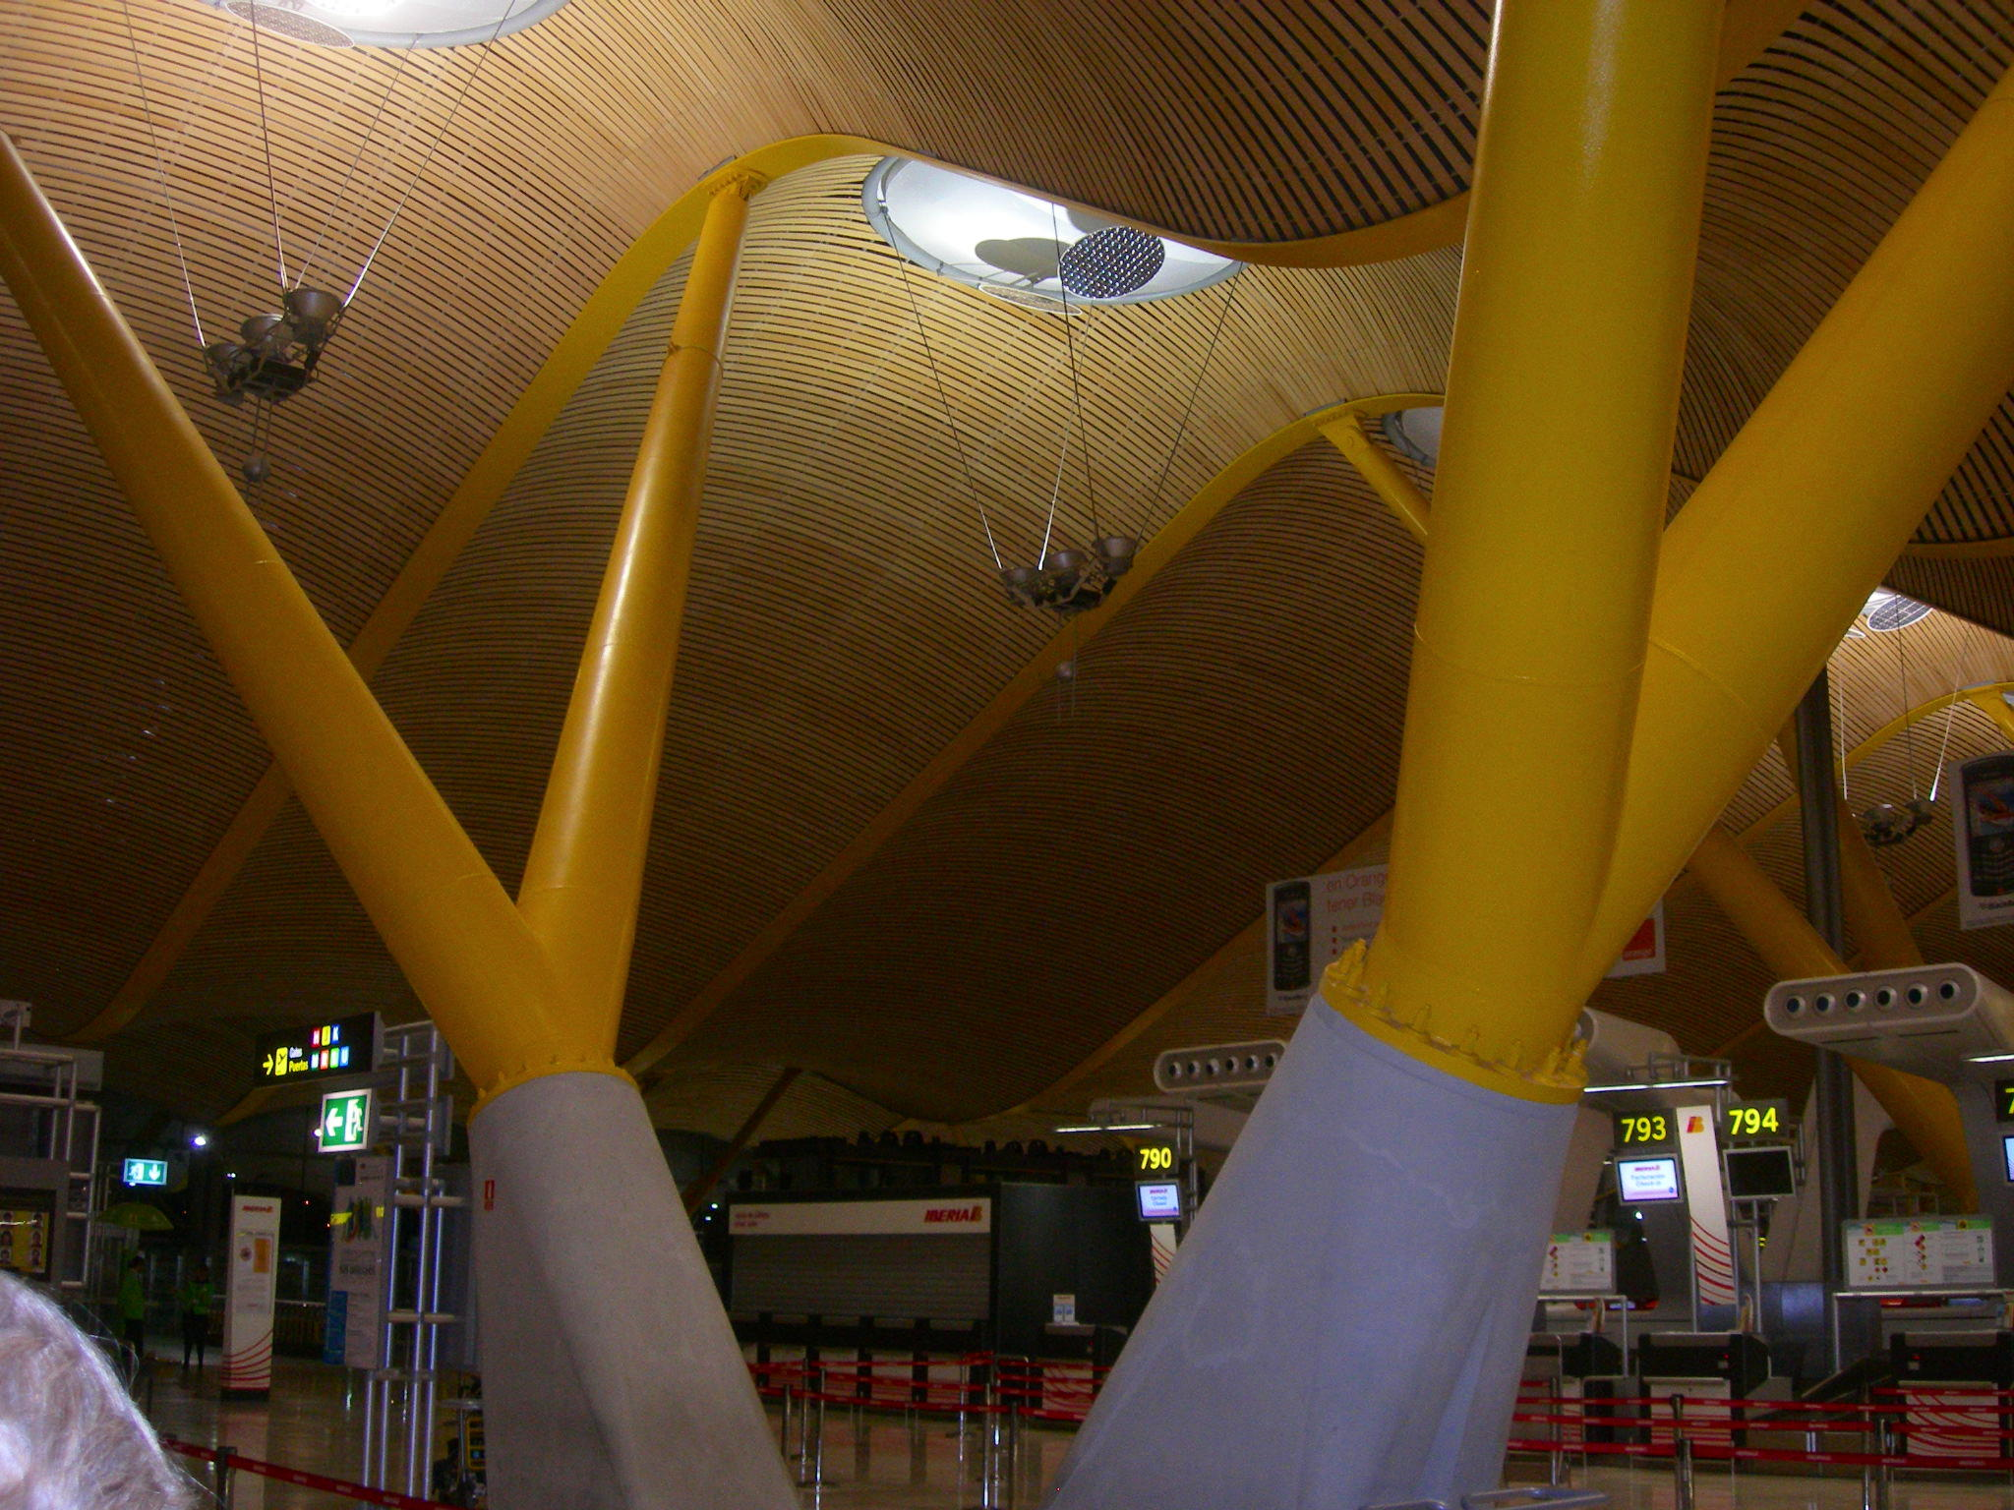

Slide 6
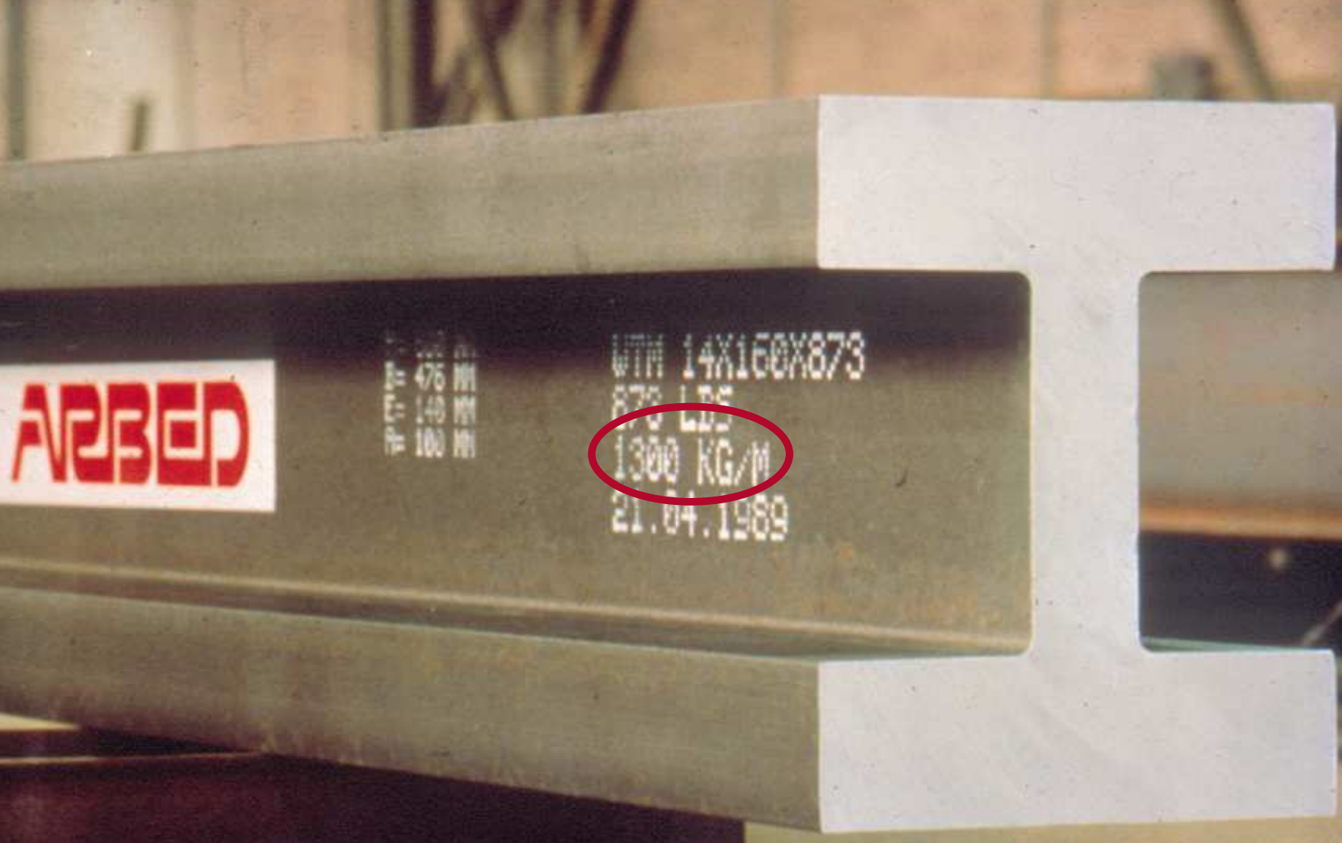

Slide 7
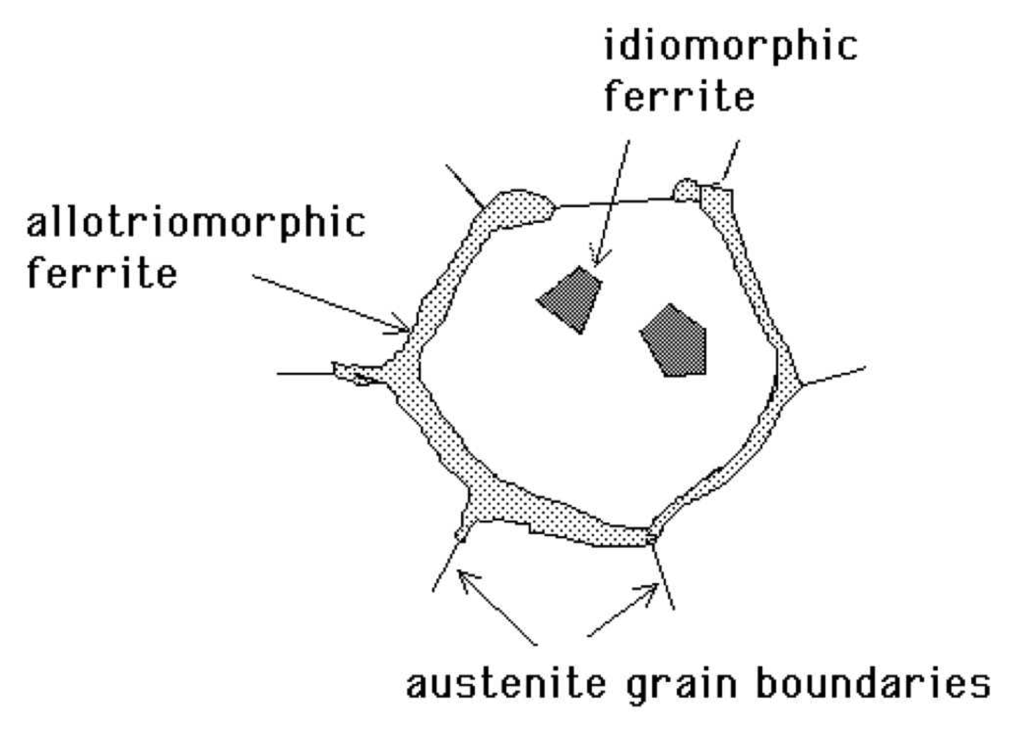
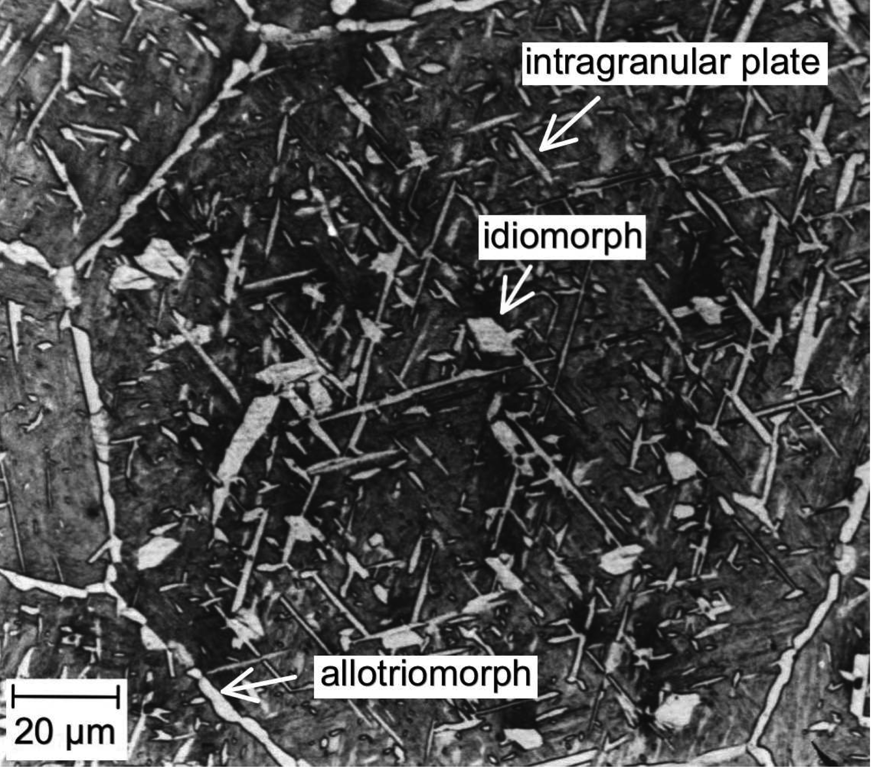
Ferrite

Slide 8
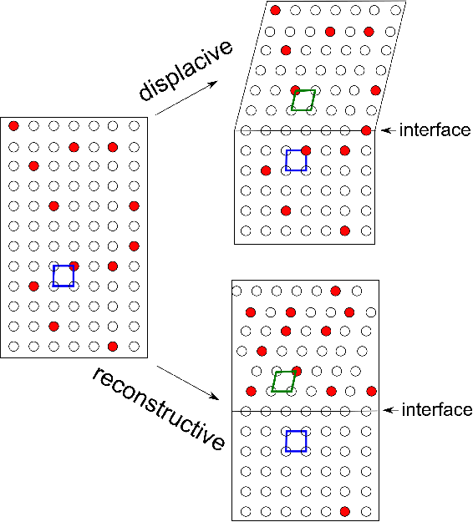
Notes:
8

Slide 9
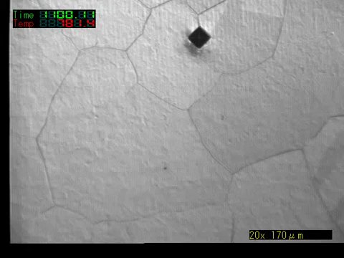
T. Koseki, University of Tokyo

Slide 10
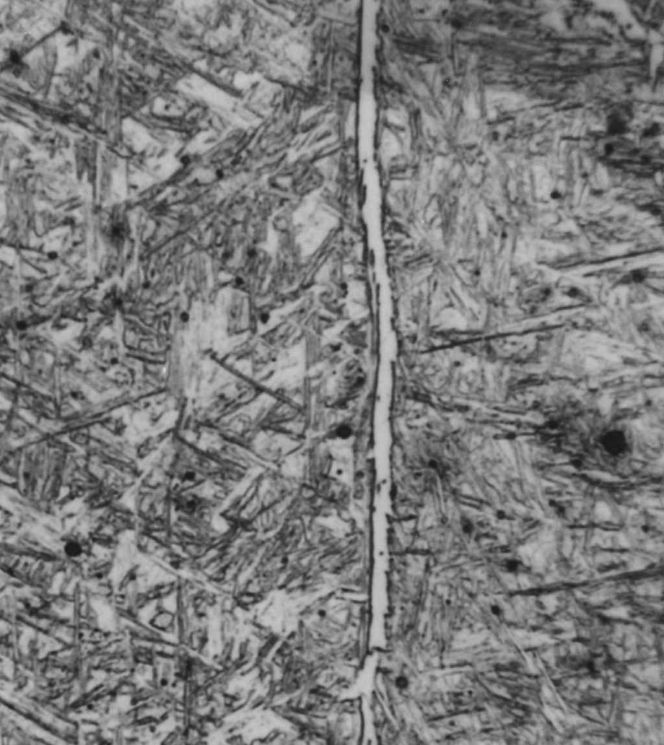
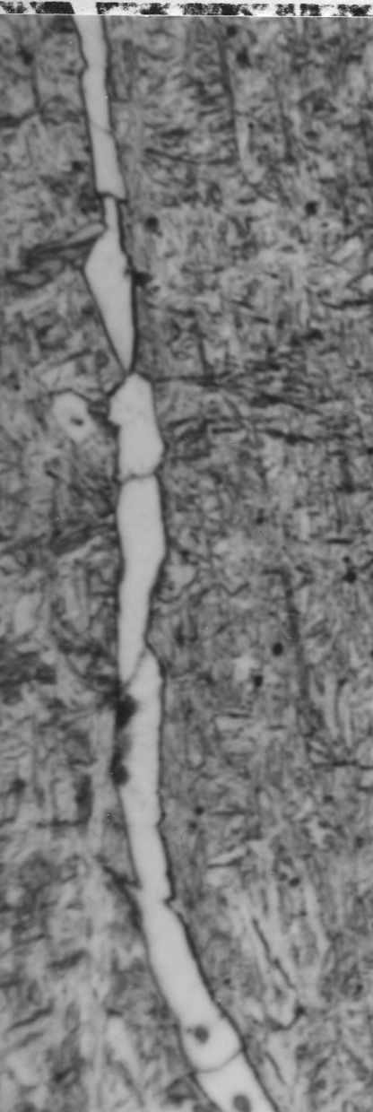
Barrite, 1982
20 µm

Slide 11
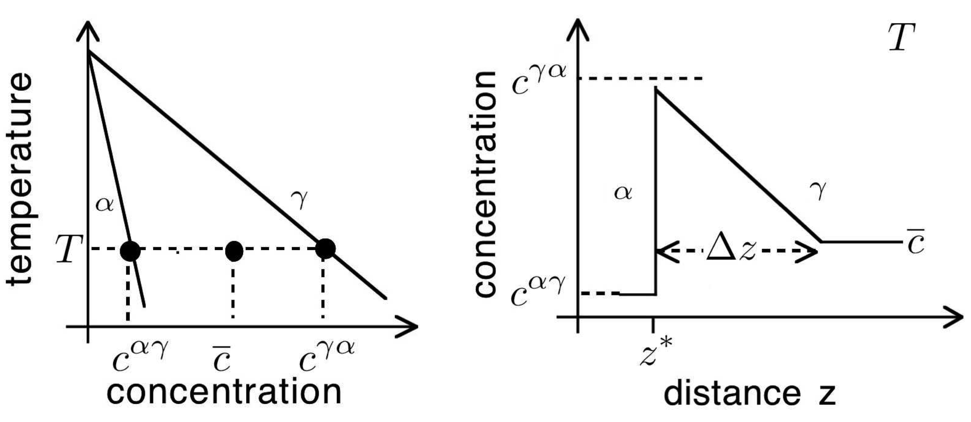

Slide 12
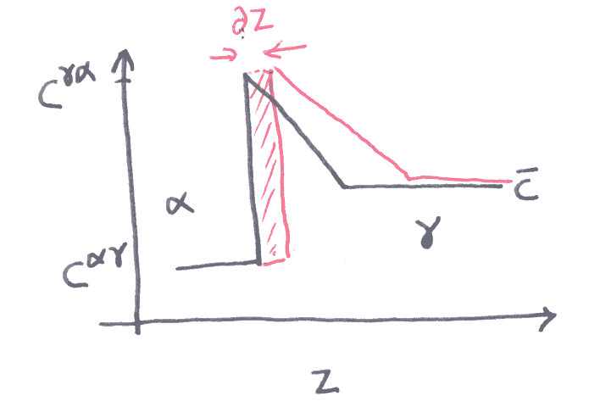
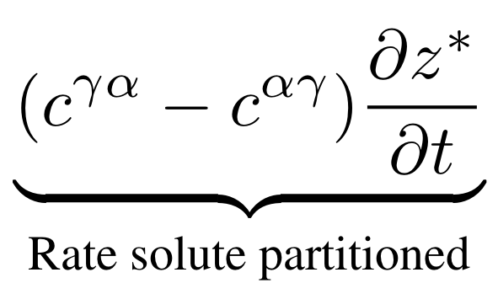

Slide 13
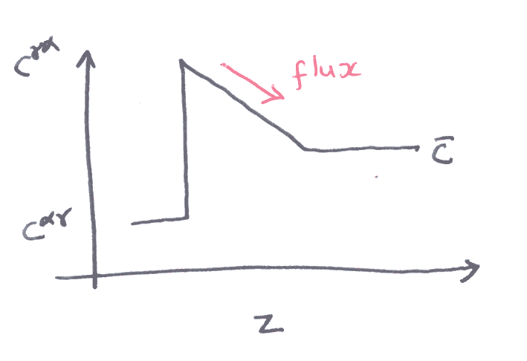
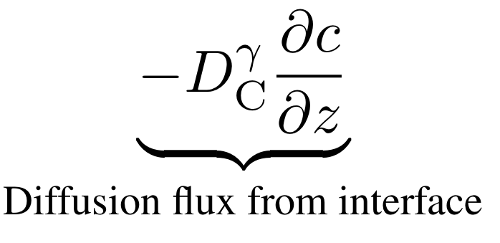

Slide 14

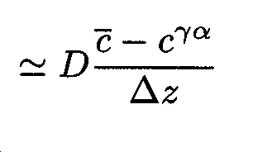
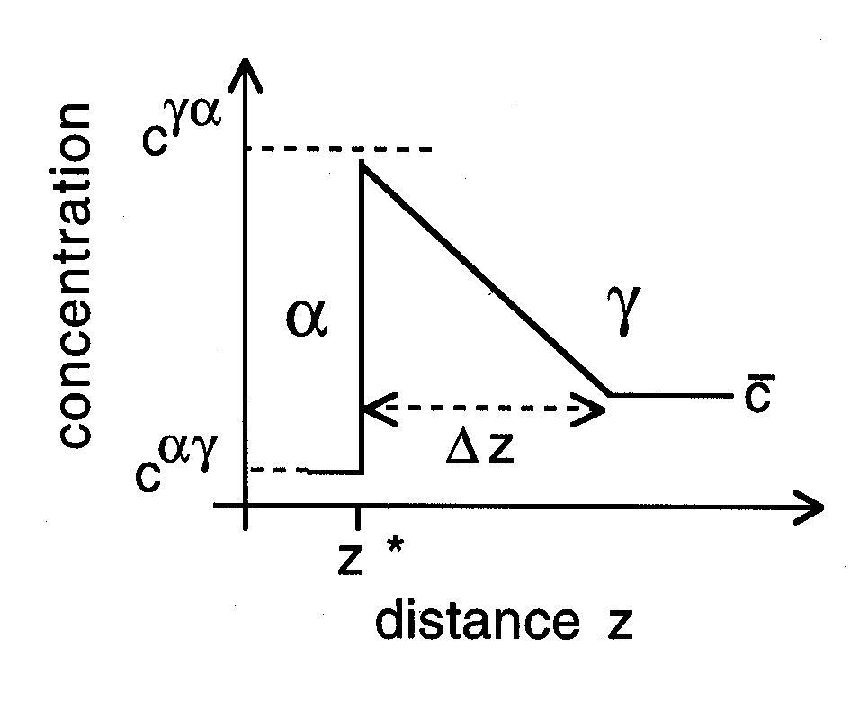

Slide 15
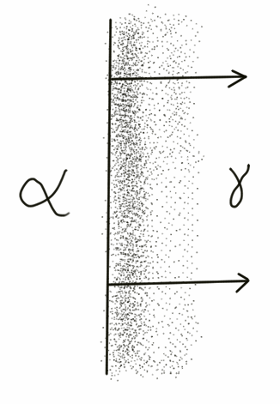
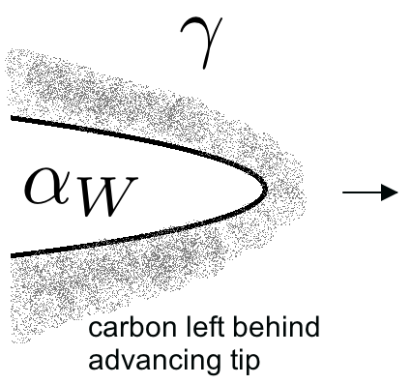

Slide 16

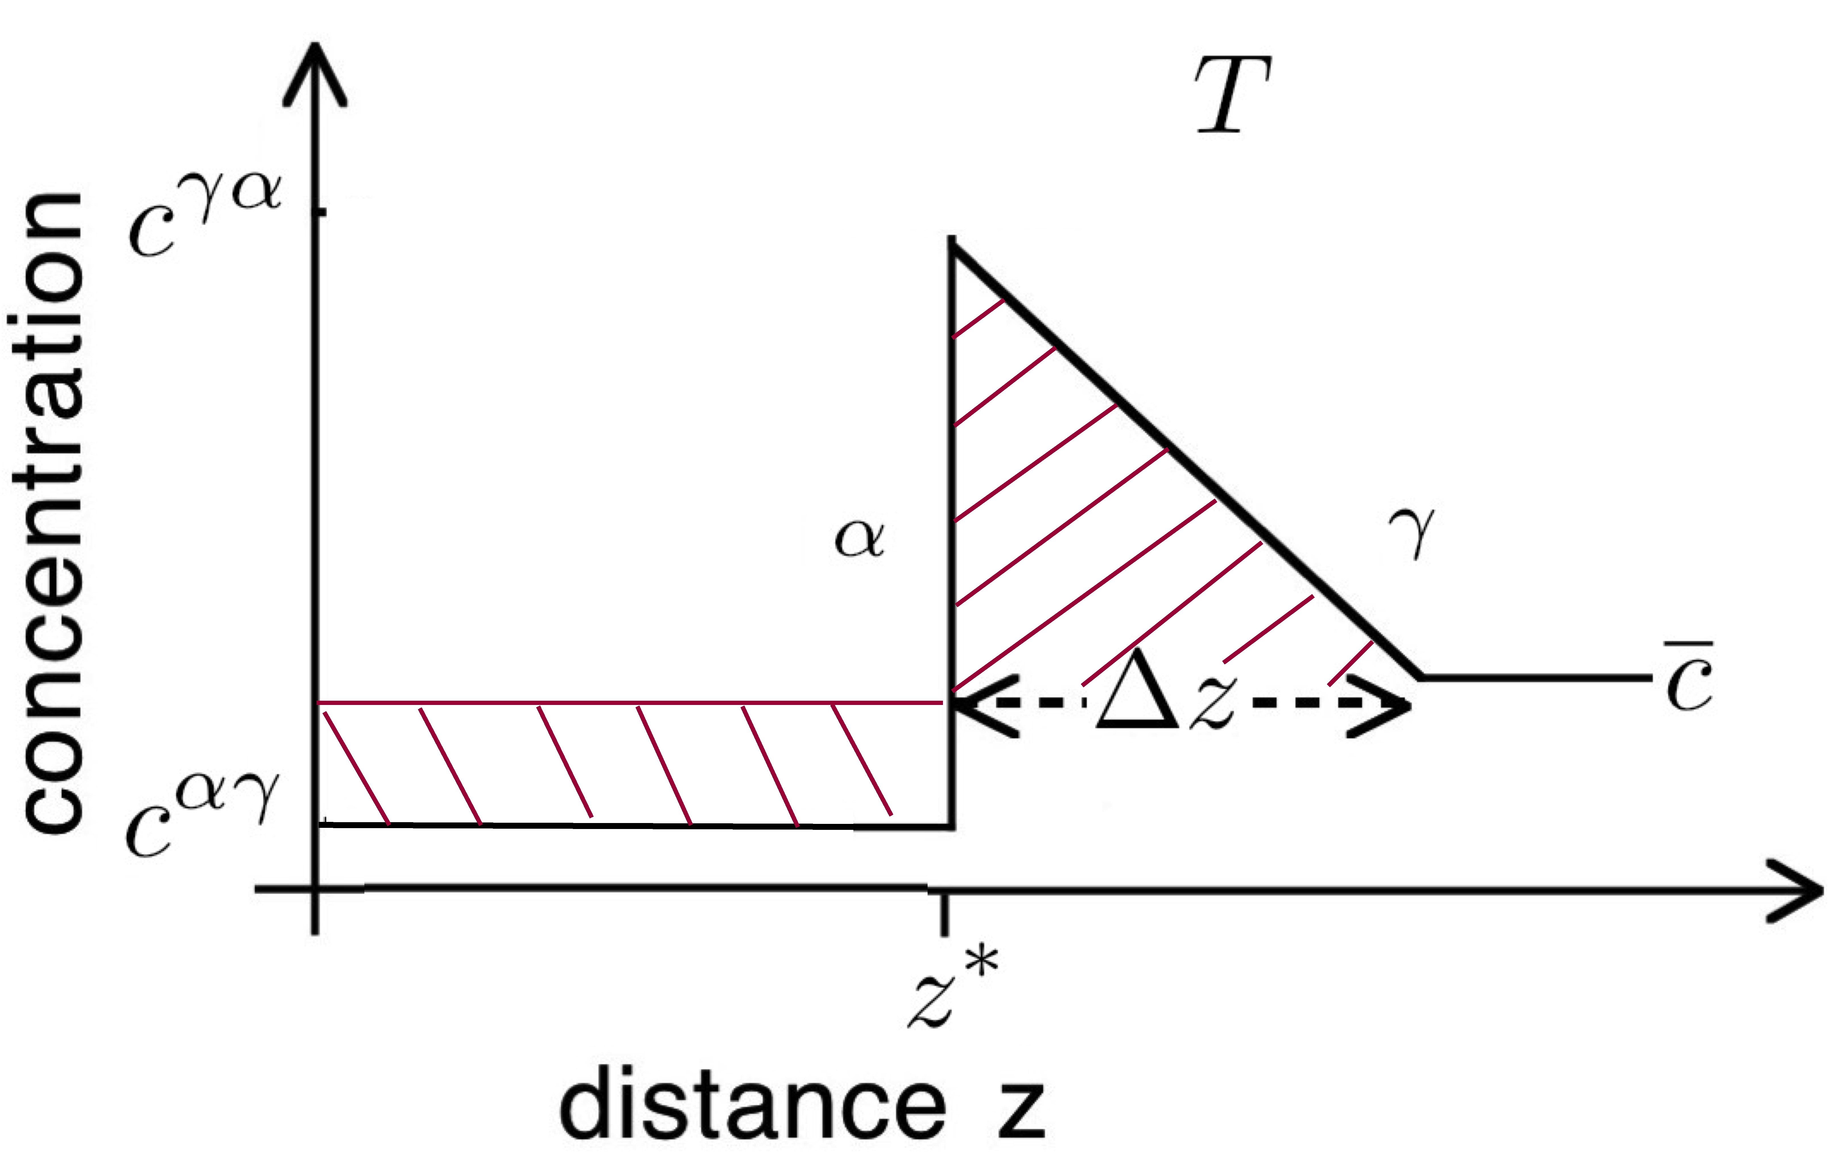

Slide 17


Slide 18

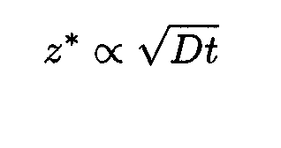

Slide 19
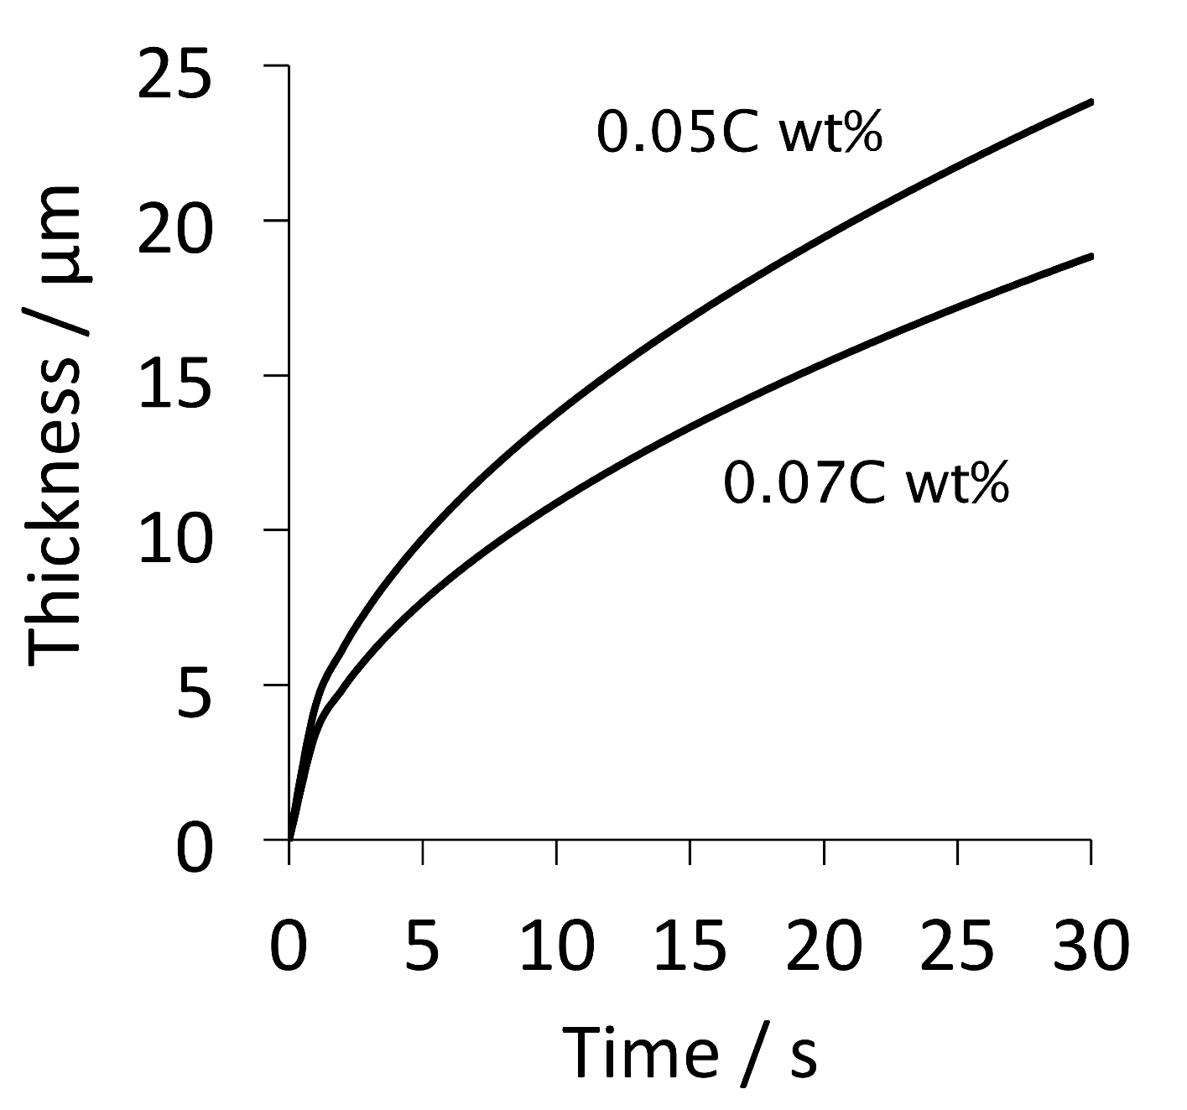

Slide 20
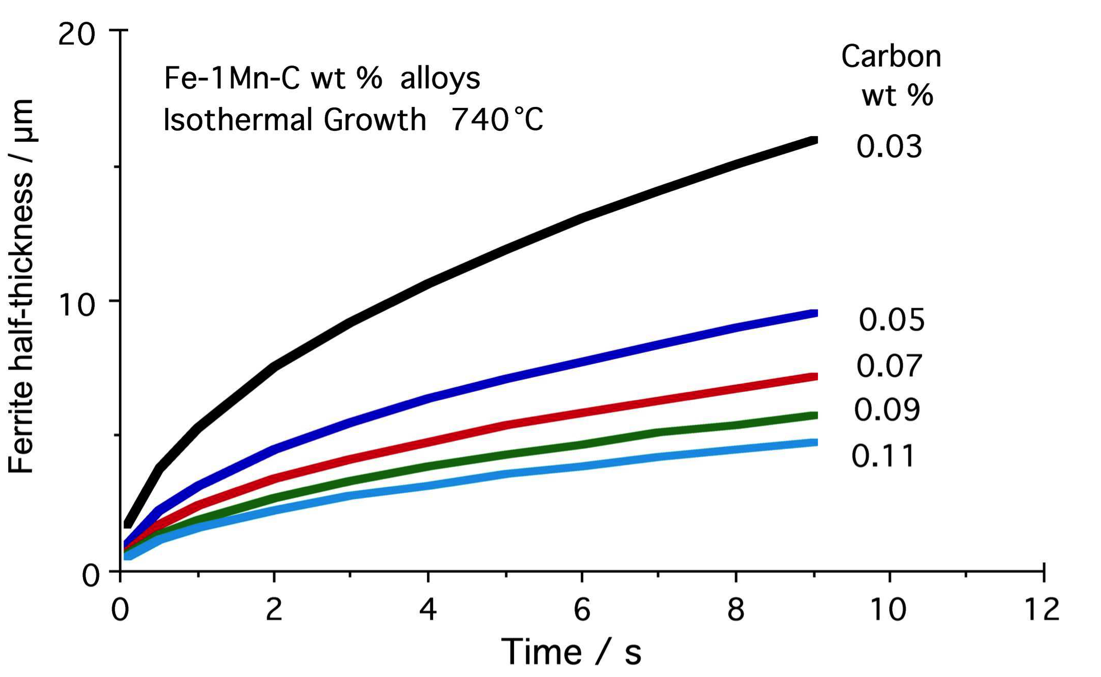

Slide 21
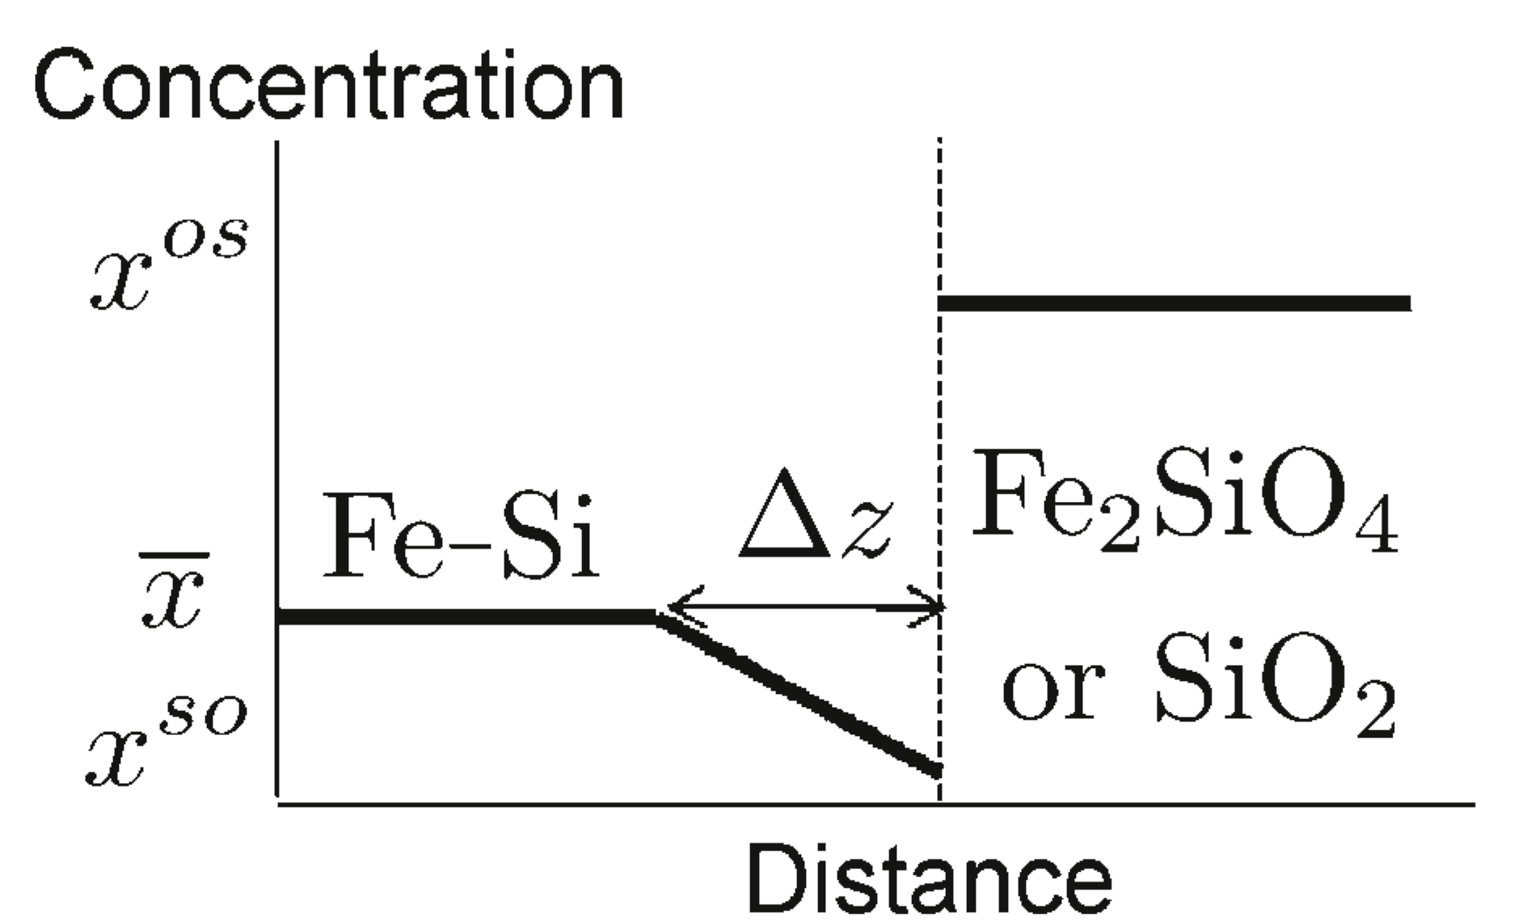
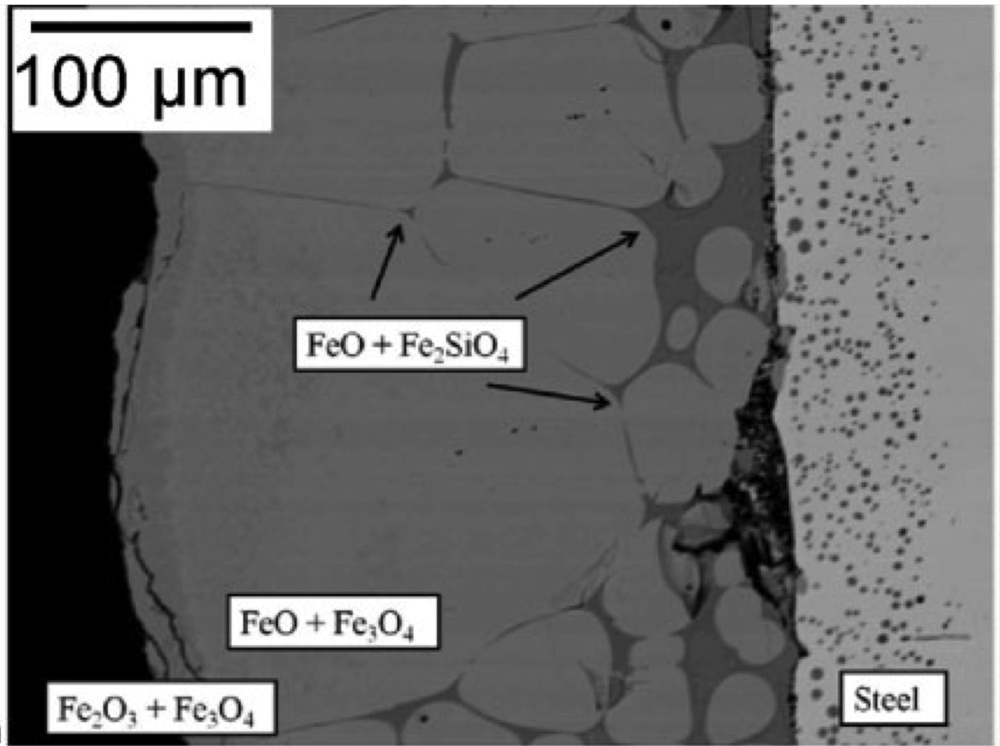
Song, Suh, Bhadeshia
Ironmaking & Steelmaking
39 (2012) 599

Slide 22
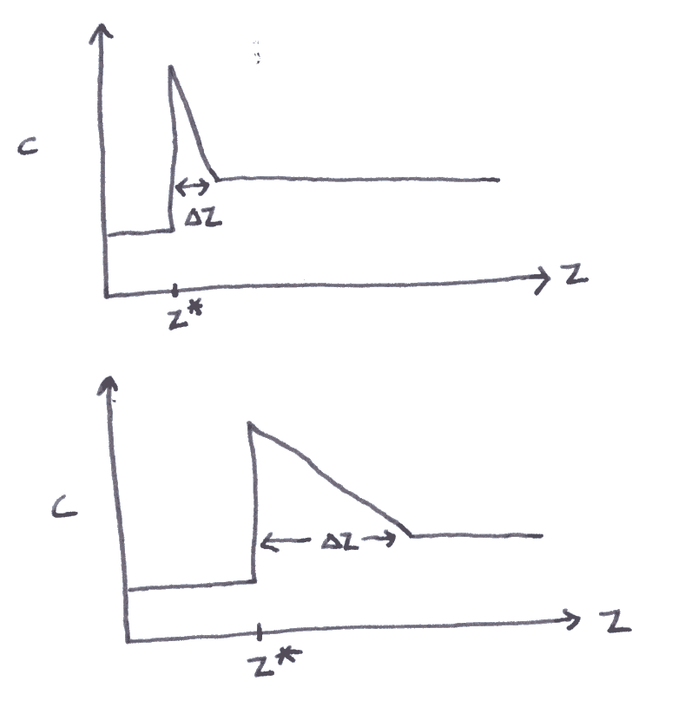

Slide 23
Approximations:
Far field composition does not change.
Growth is diffusion-controlled.
One-dimensional growth.

Slide 24
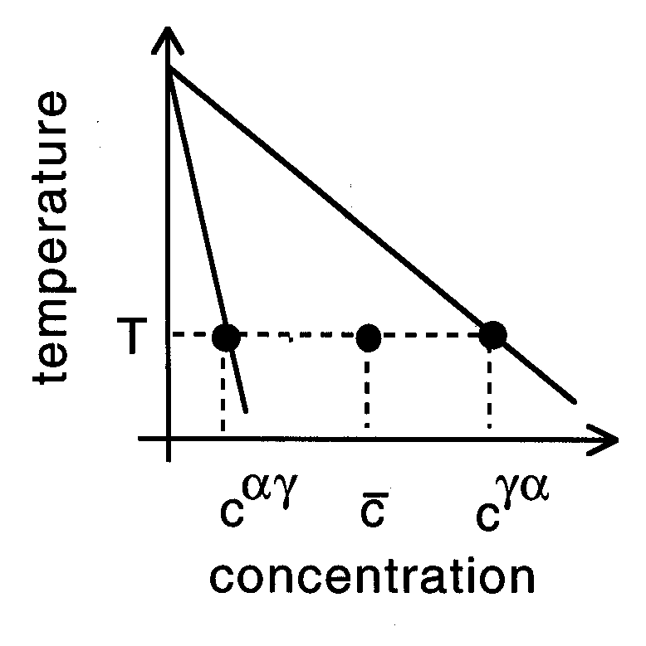

Slide 25
μ
o
B
μ
o
Gibbs free energy per mole
A
μ
A
G{x}
μ
B
A
B
x
Composition

Slide 26
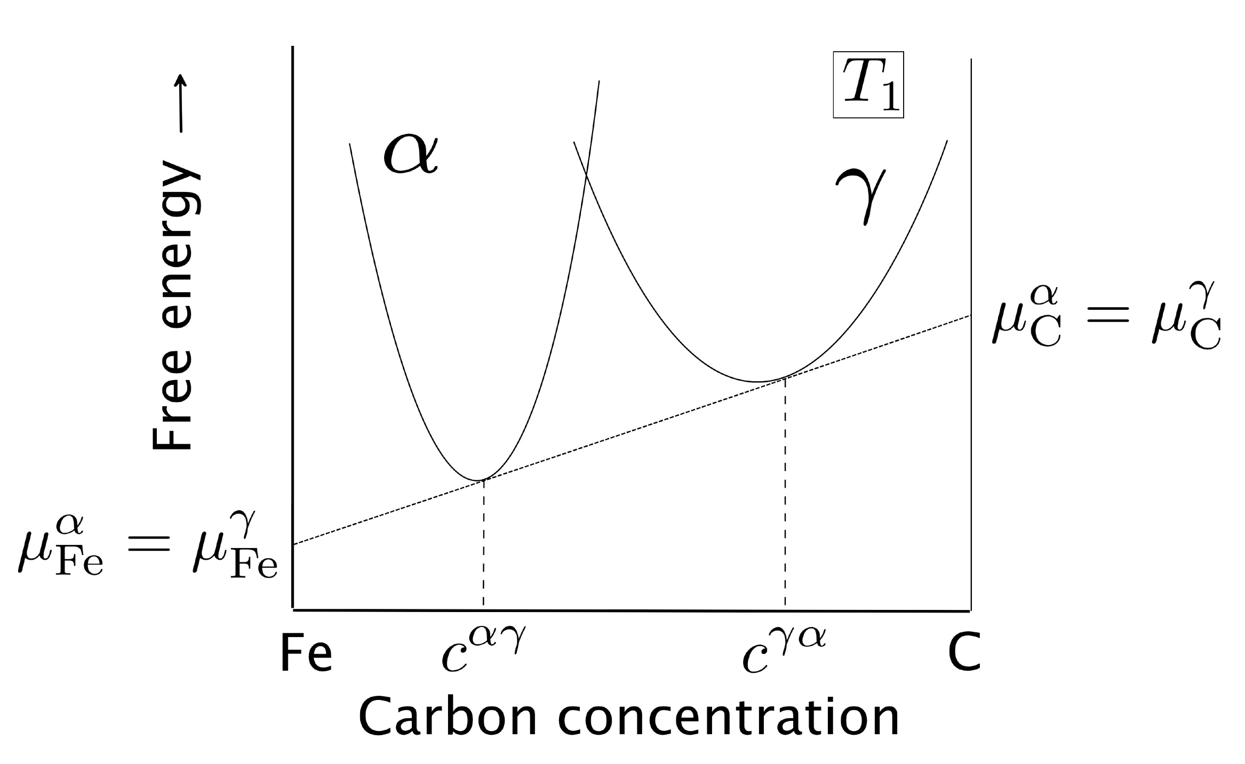

Slide 27
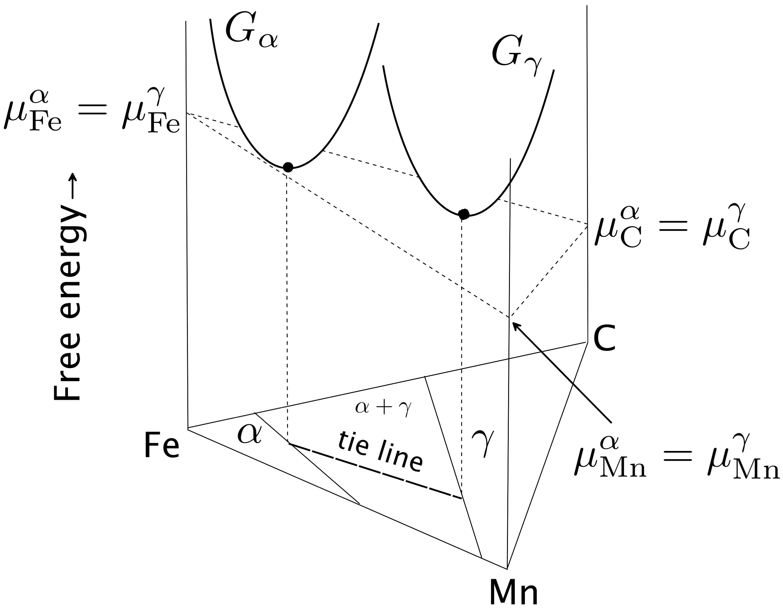

Slide 28
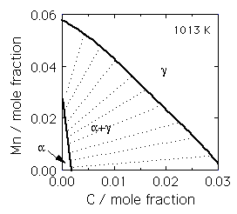

Slide 29
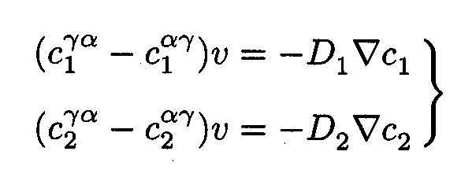

Slide 30
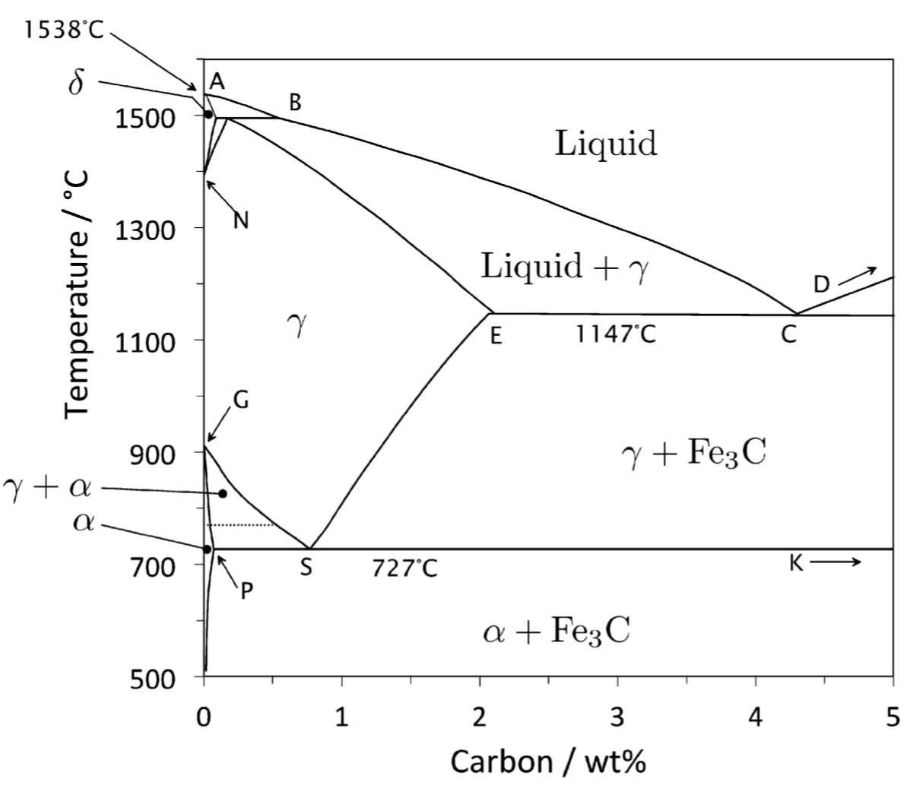

Slide 31
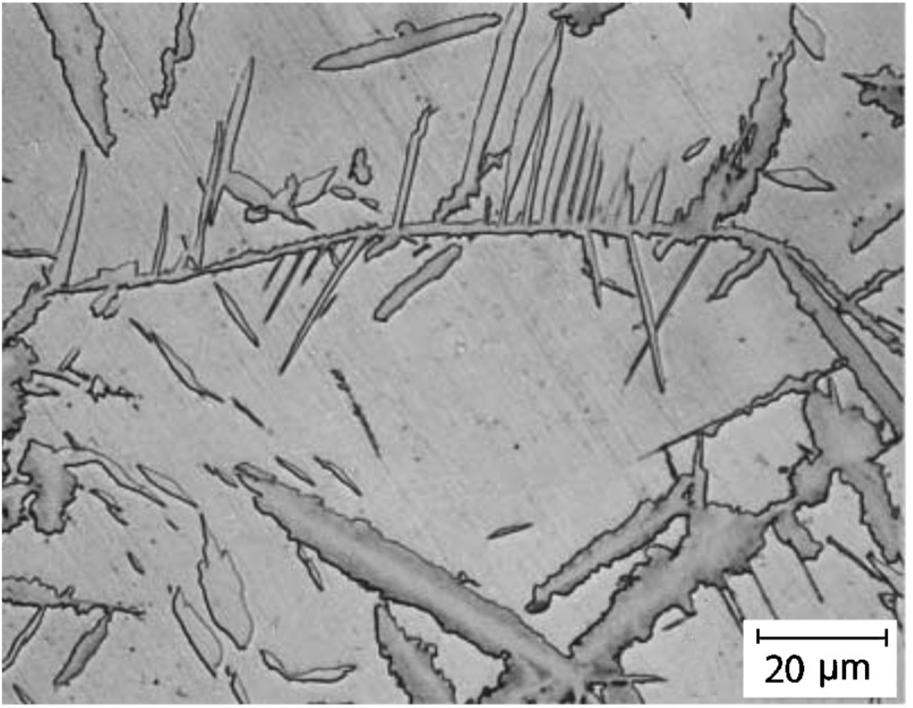
Cementite in hypereutectoid steel

Slide 32
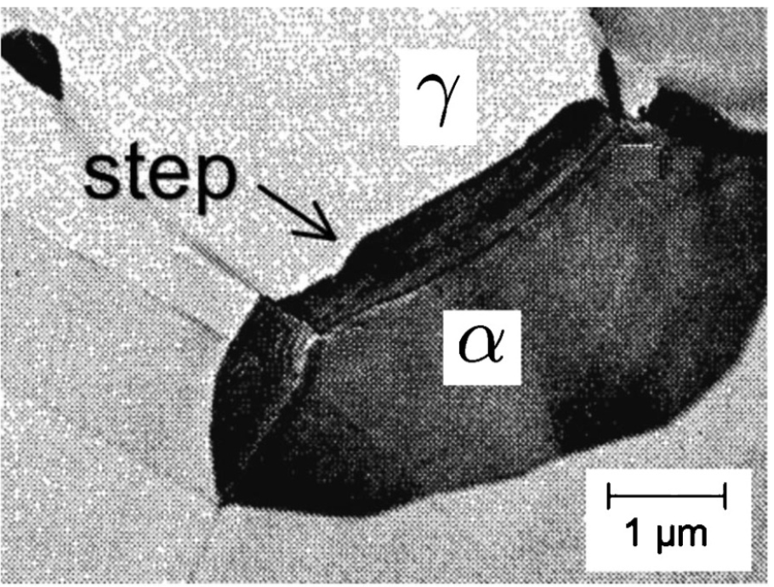

Slide 33
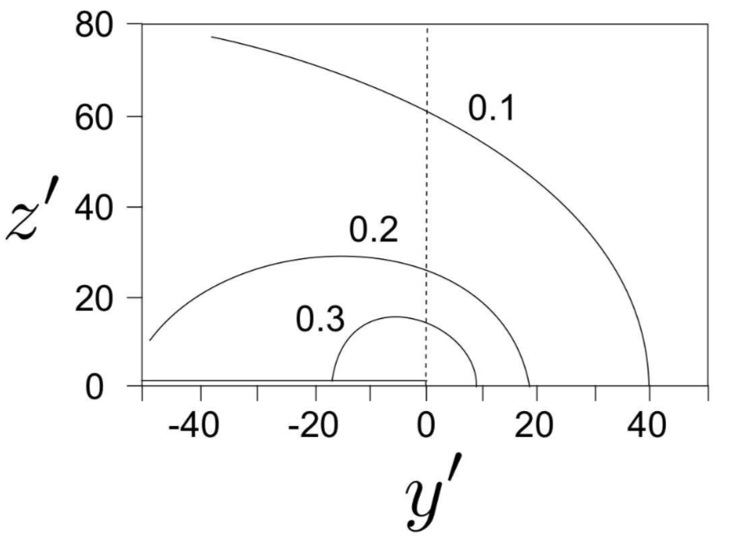

Slide 34
