Slide 1


Steels: irreversible processes, ferrite in multicomponent alloys, lecture 7 of 12
Martensite
Bainite: mechanism based design
Alloy design: strong bainite
Widmanstätten ferrite
Ferrite
Pearlite
Overall kinetics
TRIP steel
TWIP steel
Mitigation of residual stress
Bulk nanostructured steel
www.phase-trans.msm.cam.ac.uk/teaching.html
H. K. D. H. Bhadeshia

Slide 2
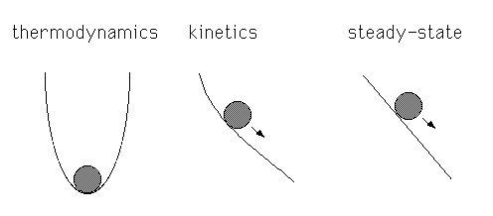
dissipating free energy

Slide 3
reversible
irreversible

Slide 4
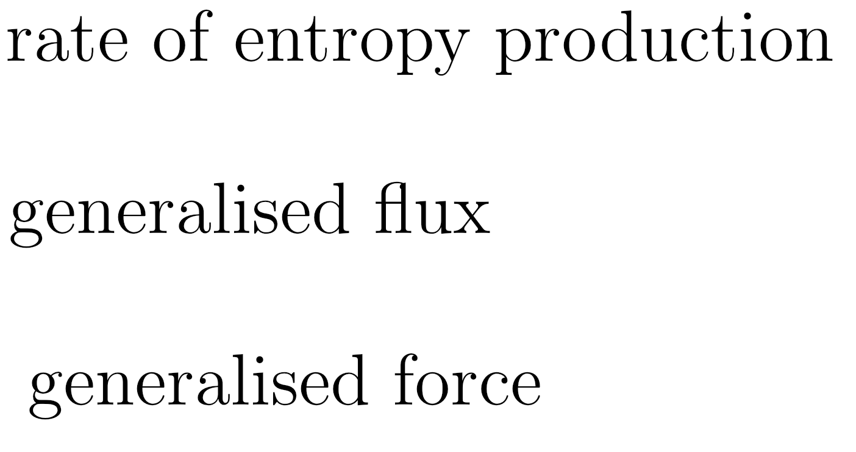
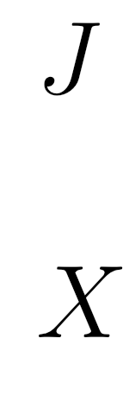

Slide 6
Heat transfer

Slide 7
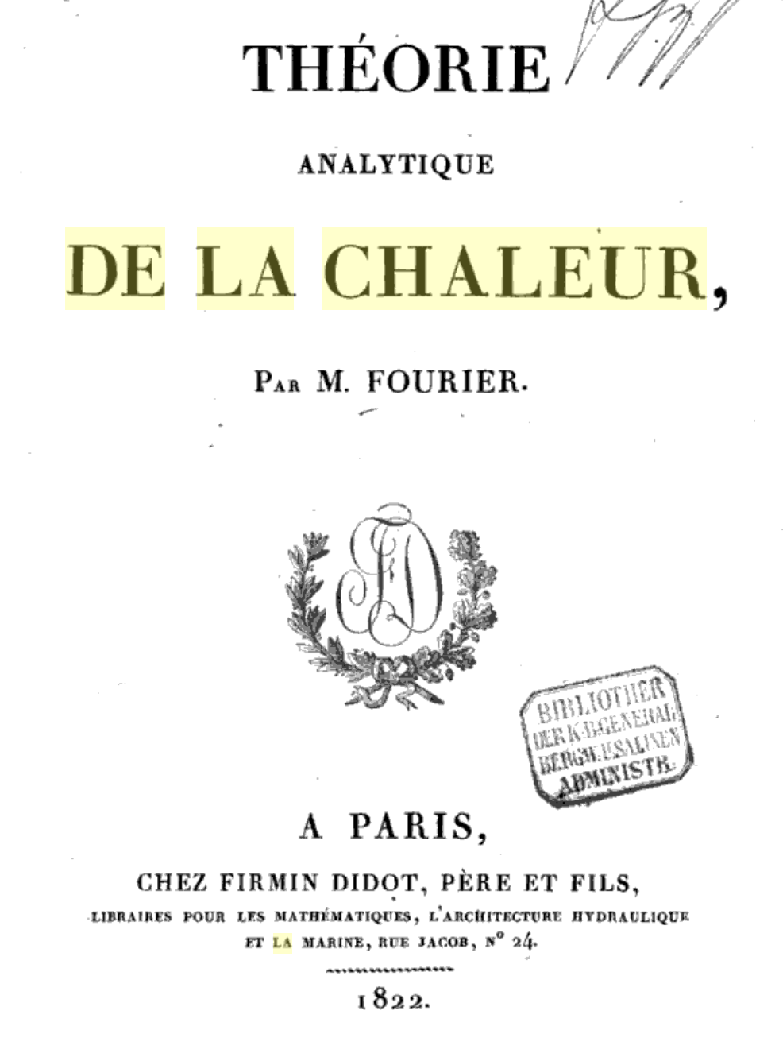

Slide 8
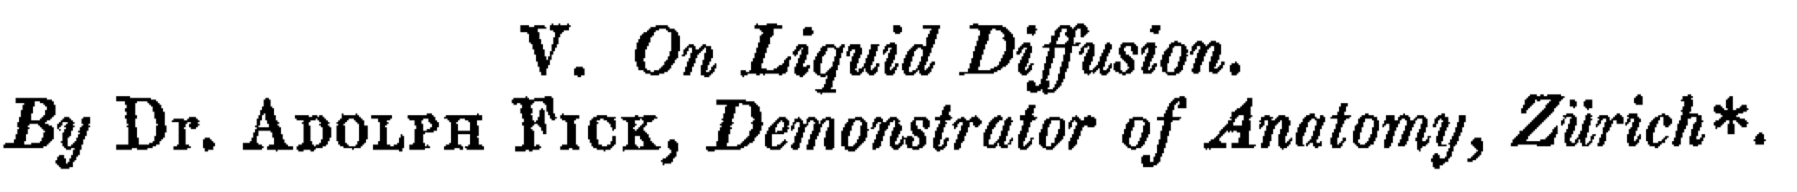
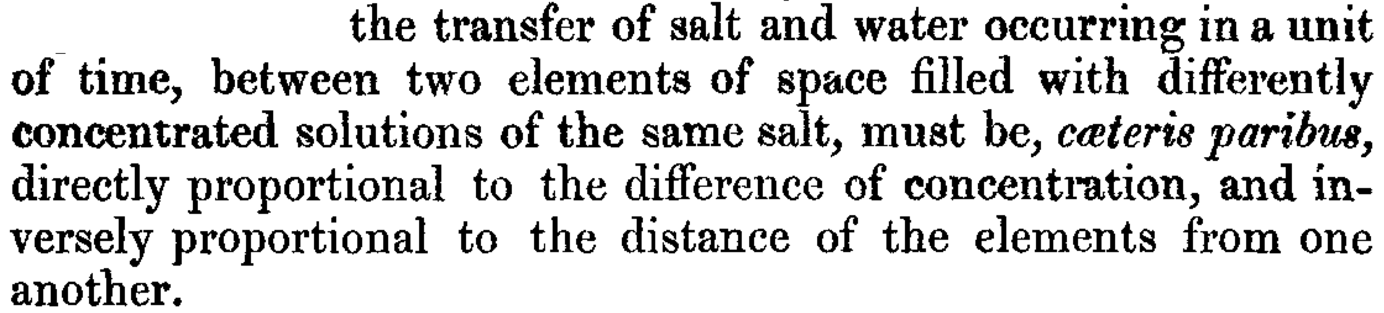
(1855)
}
concentration
gradient
flux
diffusion
coefficient

Slide 9
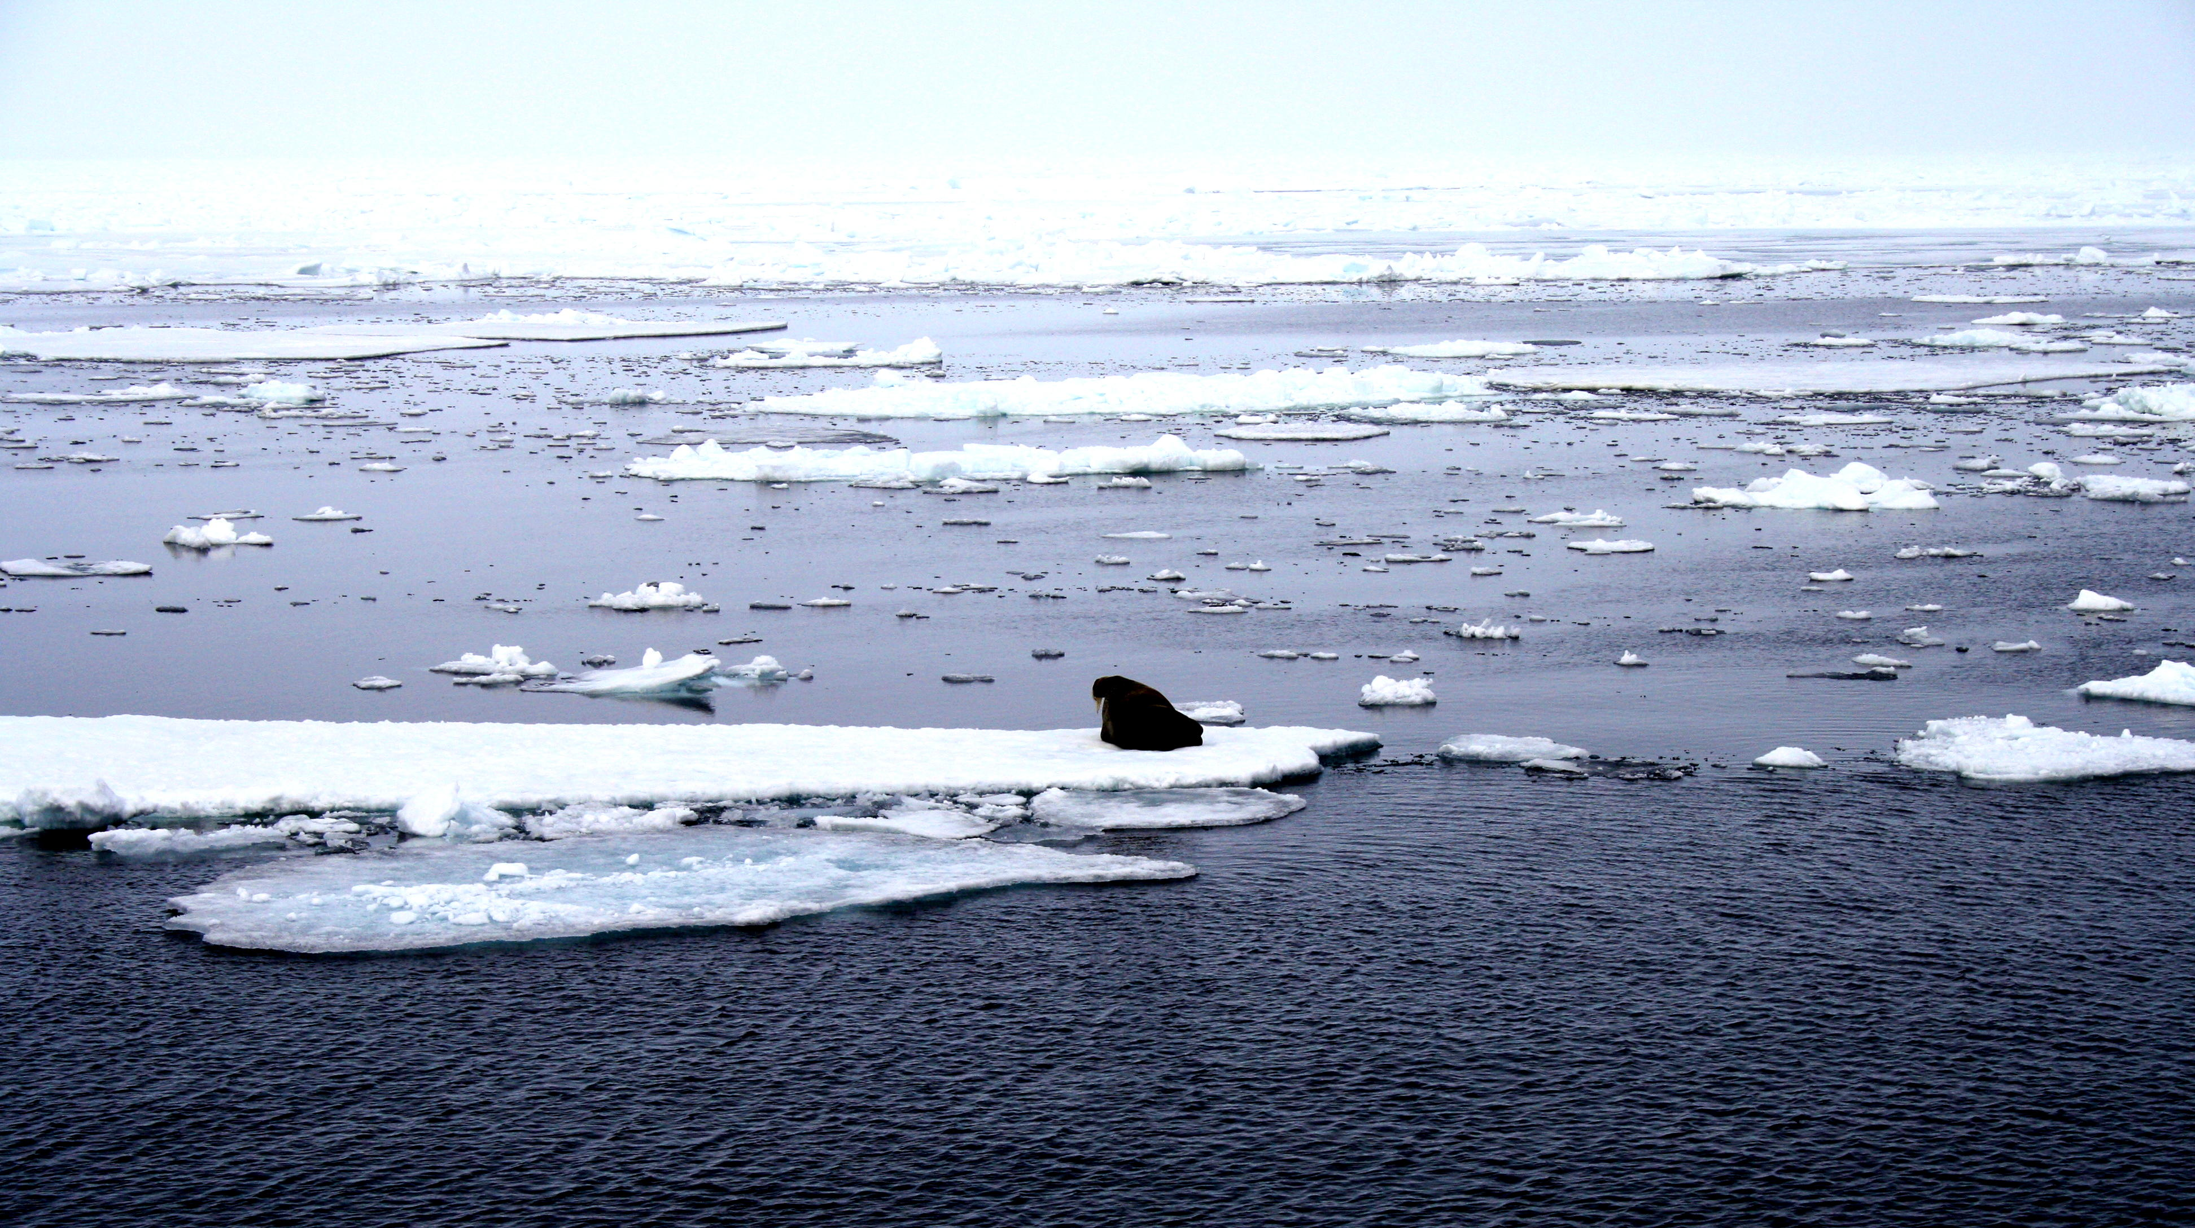
Why no diffusion of salt from sea-water into ice?
ice: pure
ocean: salty water
photograph courtesy of Sunita Hansraj from her Antarctica expedition

Slide 10
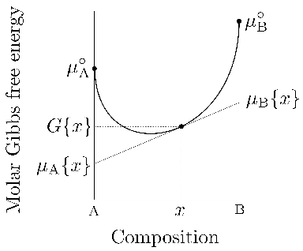

Slide 11
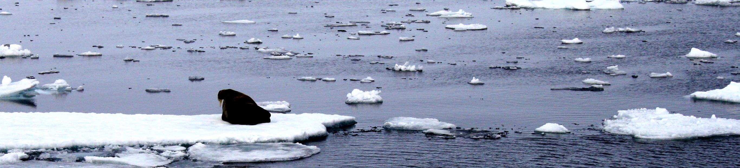

Slide 13
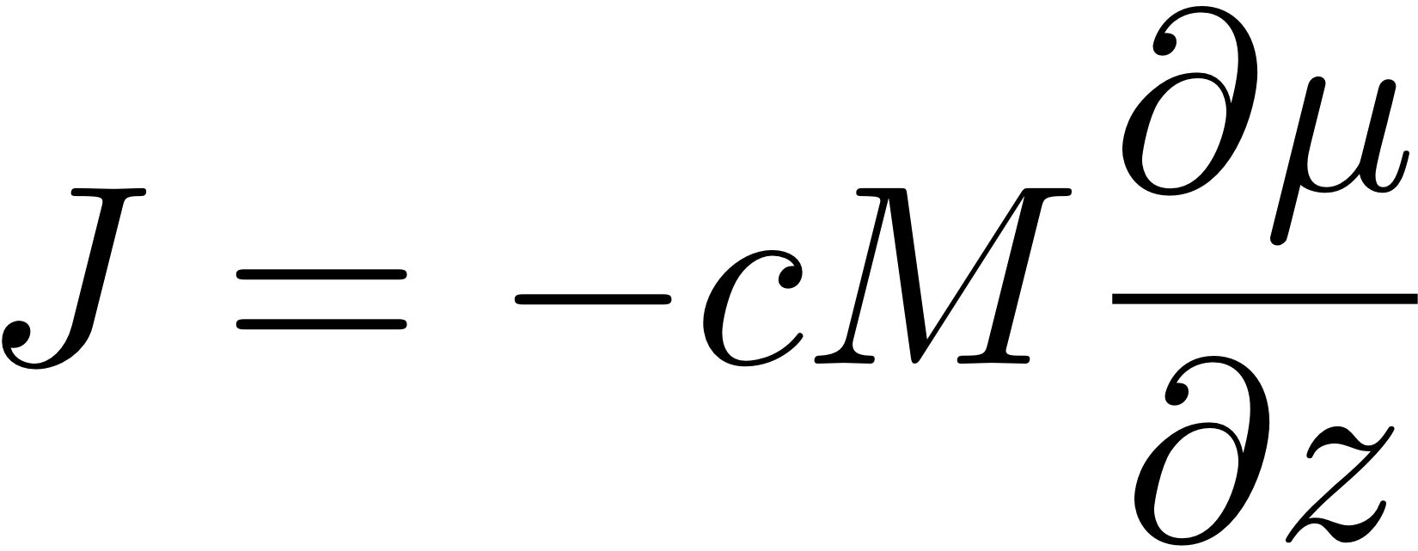

Slide 14
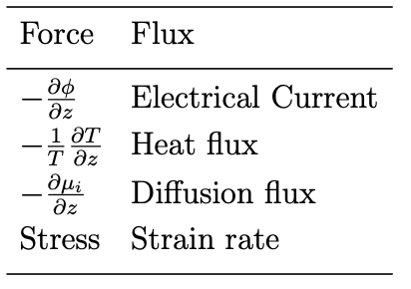
All of these processes driven by free energy gradients.

Slide 15

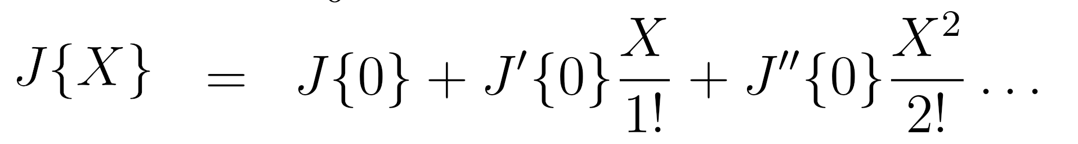
polynomial expansion of flux
as a function of force

Slide 17
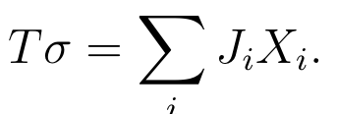



Slide 18
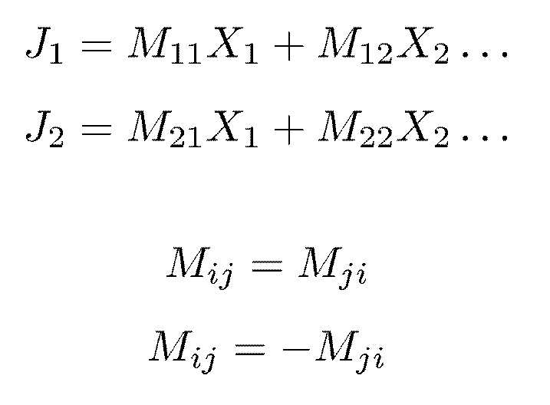

Slide 19
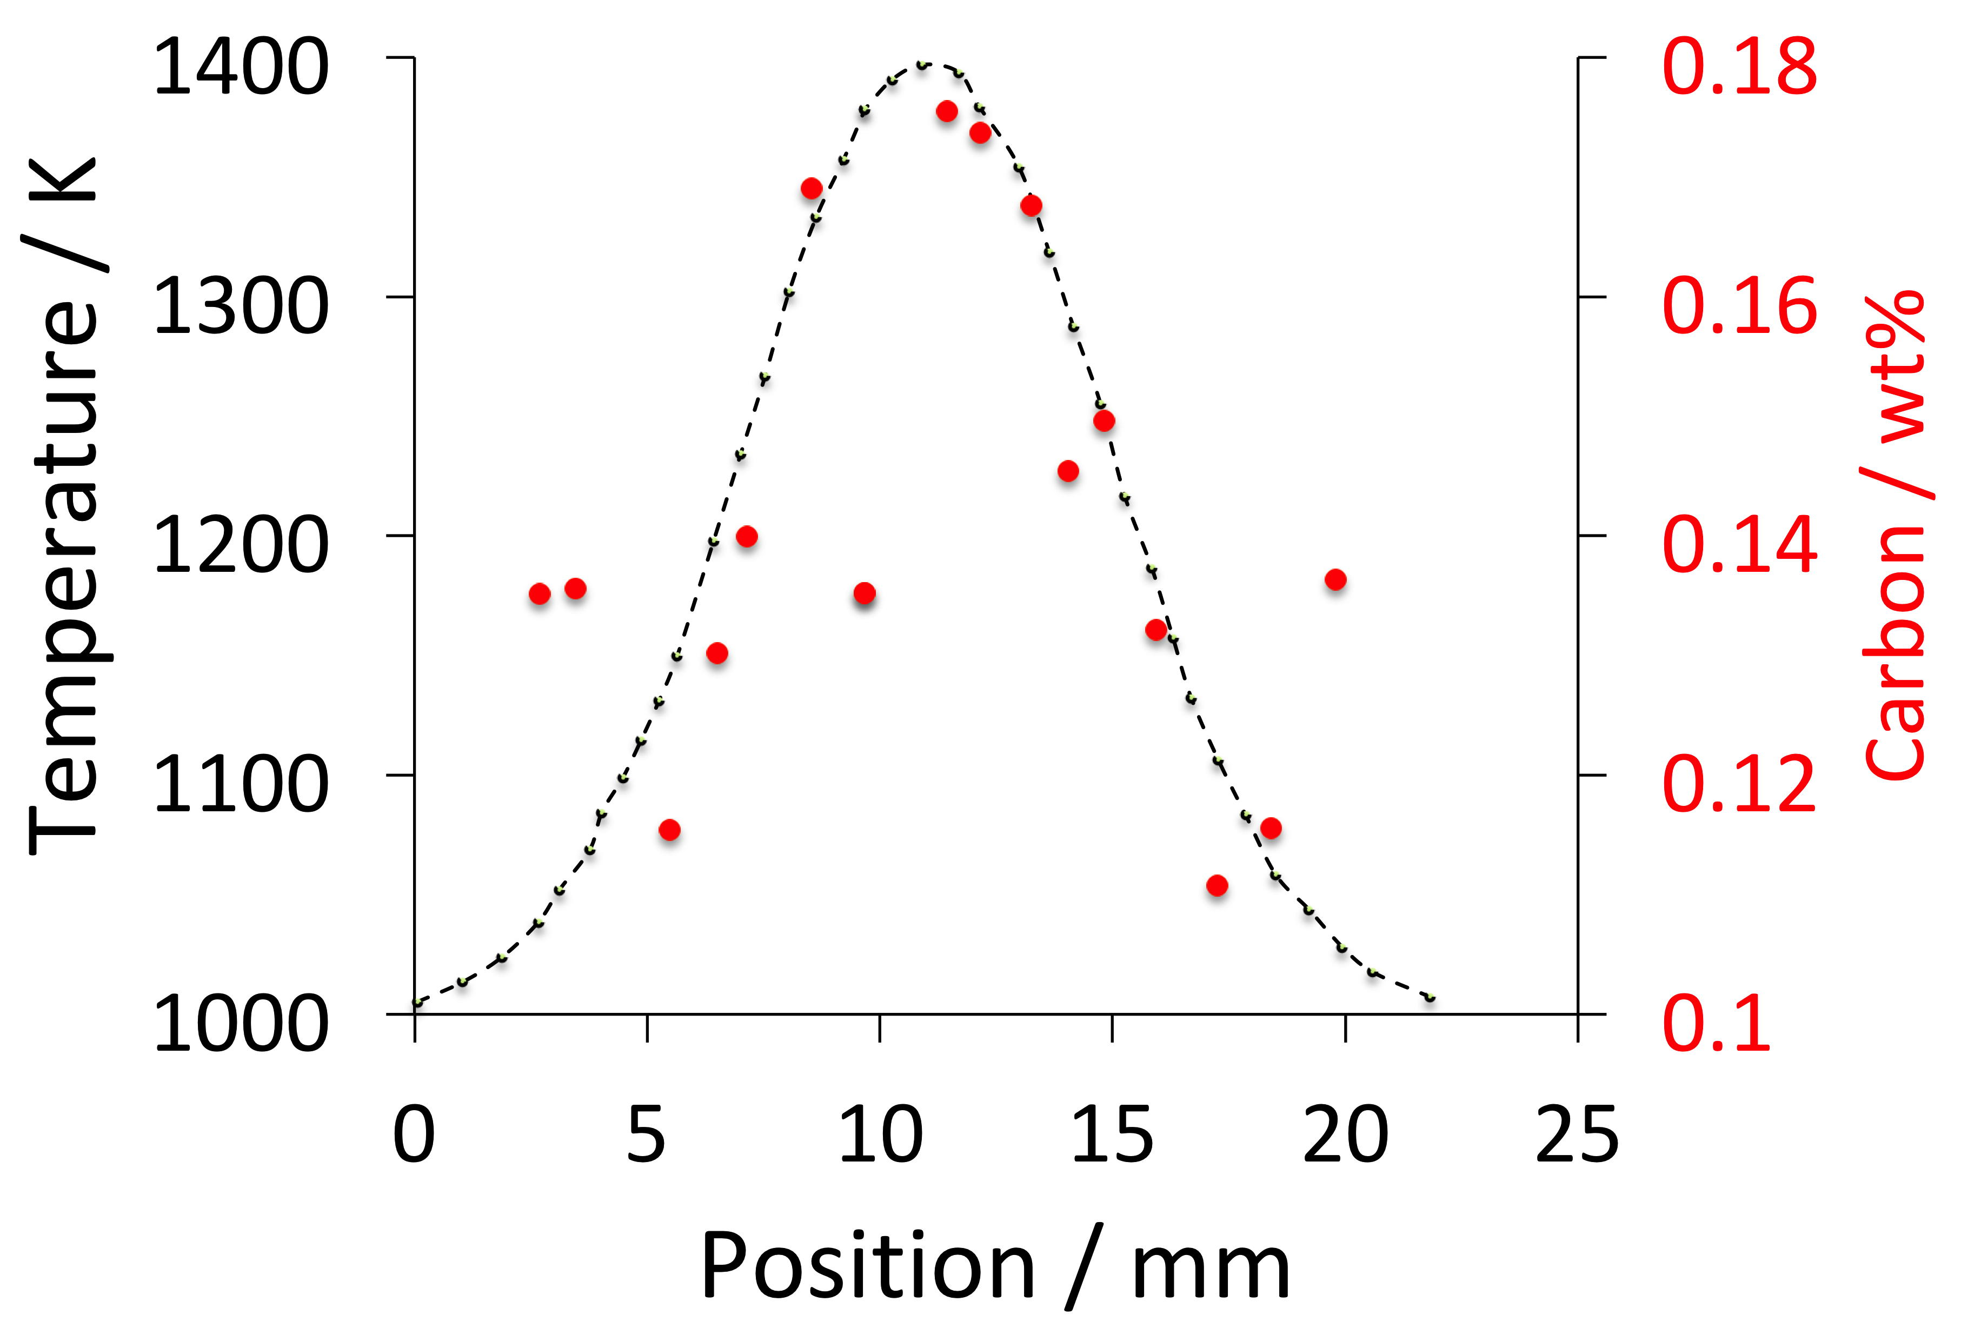
data from Okafor et al. 1982

Slide 20
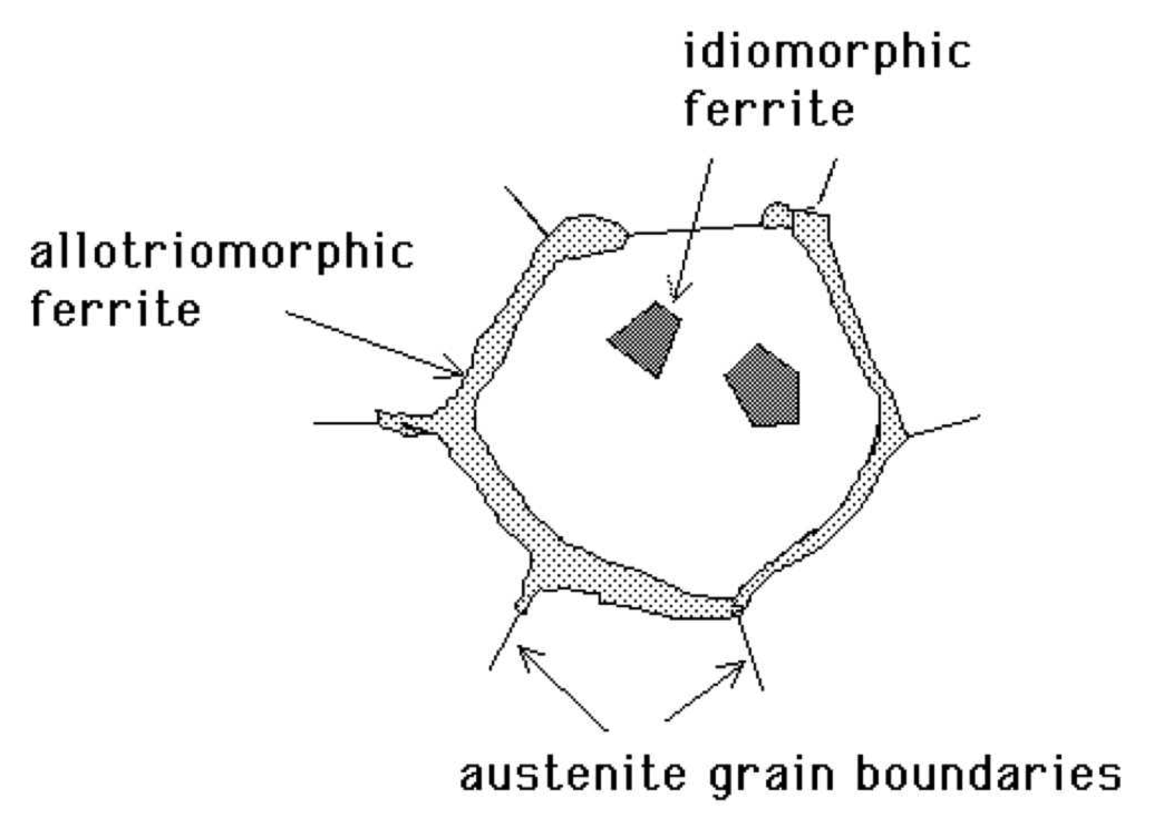
Ferrite in multicomponent steels

Slide 21
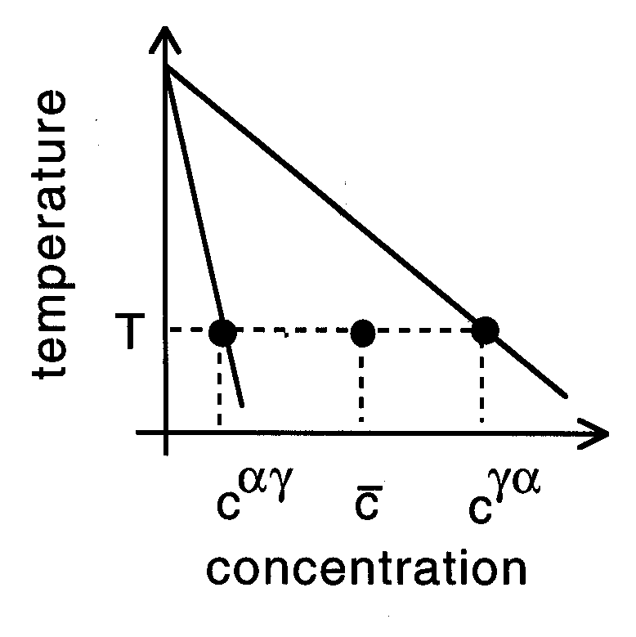

Slide 22
μ
o
B
μ
o
Gibbs free energy per mole
A
μ
A
G{x}
μ
B
A
B
x
Composition

Slide 23
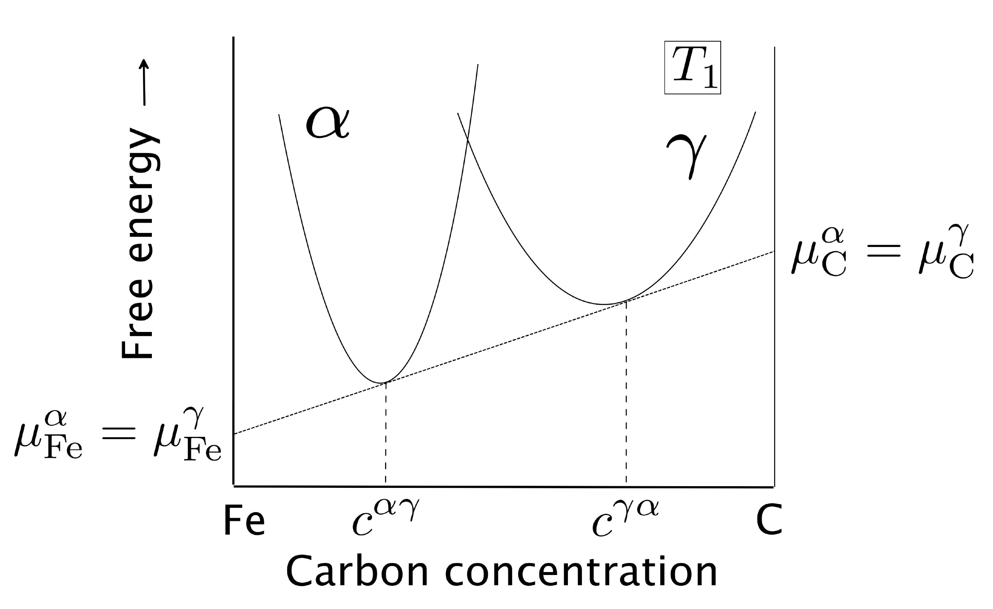

Slide 24
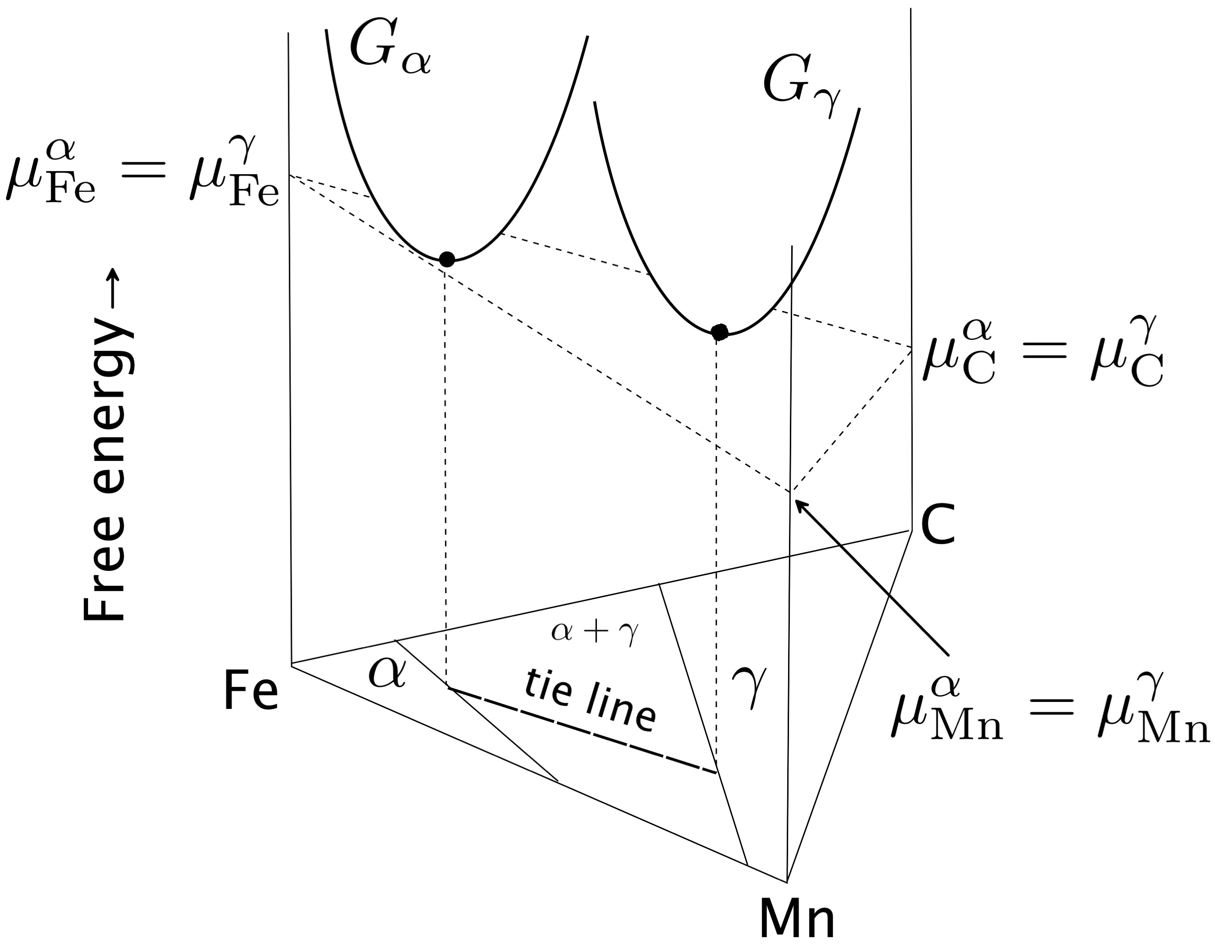

Slide 25
1013 K

Slide 26
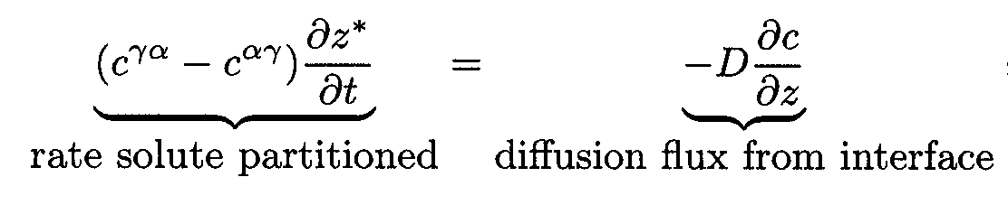
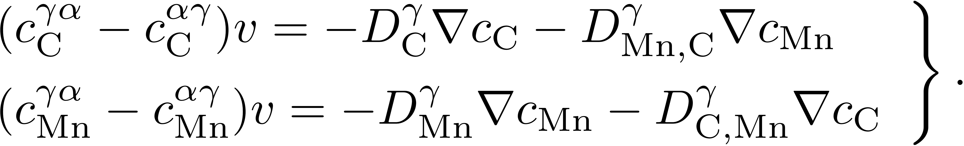
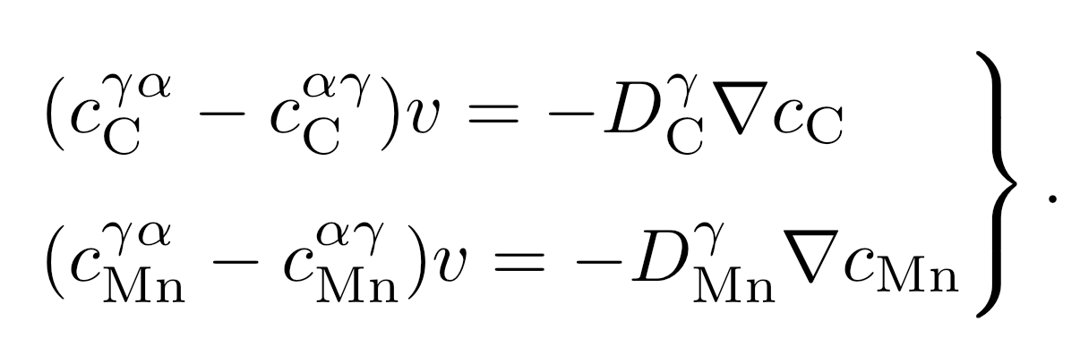

Slide 27

Low supersaturation
γ
P-LE mode
Manganese
γ
α
α
α+γ
Carbon
α
γ

Slide 28
γ
High supersaturation
NP-LE mode
Manganese
α
α
γ
α+γ
Carbon
α
γ

Slide 29

γ
α+γ
tie line
Manganese
α
Carbon

Slide 30
γ
High supersaturation
NP-LE mode
Manganese
α
α
γ
α+γ
Carbon
α
γ

Slide 31
Manganese
γ
α+γ
α
Carbon

Slide 32
0.06
0.06
1013 K
1053 K
0.04
0.04
equilibrium
γ
Mn / mole fraction
Mn / mole fraction
paraequilibrium
0.02
0.02
α+γ
α
0.00
0.00
0.00
0.01
0.02
0.03
0.00
0.01
0.02
0.03
C / mole fraction
C / mole fraction

Slide 33
Massive transformation

Slide 34
occurs in iron alloys without carbon
high ferrite growth rate
reconstructive transformation
no composition change
each ferrite grows to consume many austenite grains
Massive ferrite grains

Slide 35
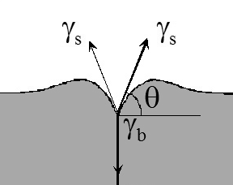
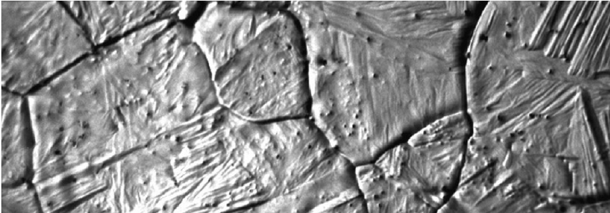
Thermal grooves

Slide 36
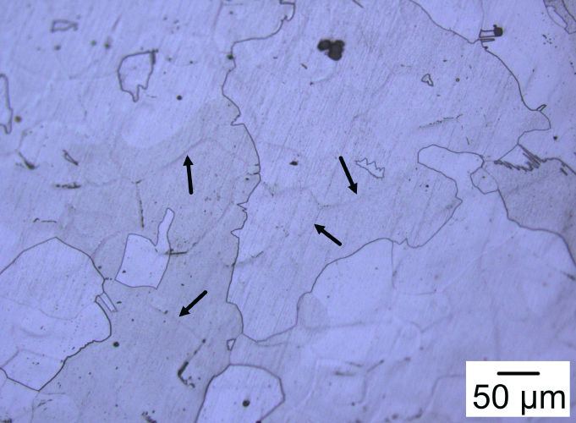
Fe-0.17P wt%
Jeong In Kim, Dong Woo Suh

