Slide 1


Steels: pearlite, lecture 8 of 12
Martensite
Bainite: mechanism based design
Alloy design: strong bainite
Widmanstätten ferrite
Ferrite
Pearlite
Overall kinetics
TRIP steel
TWIP steel
Mitigation of residual stress
Bulk nanostructured steel
www.phase-trans.msm.cam.ac.uk/teaching.html
H. K. D. H. Bhadeshia

Slide 2
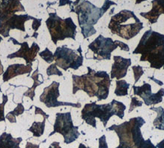
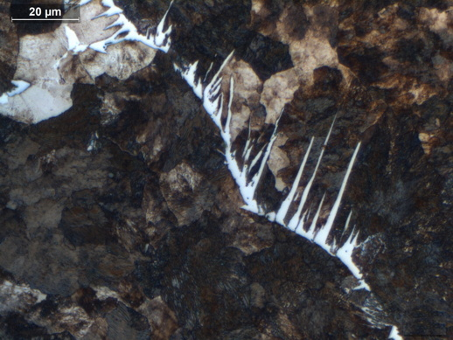
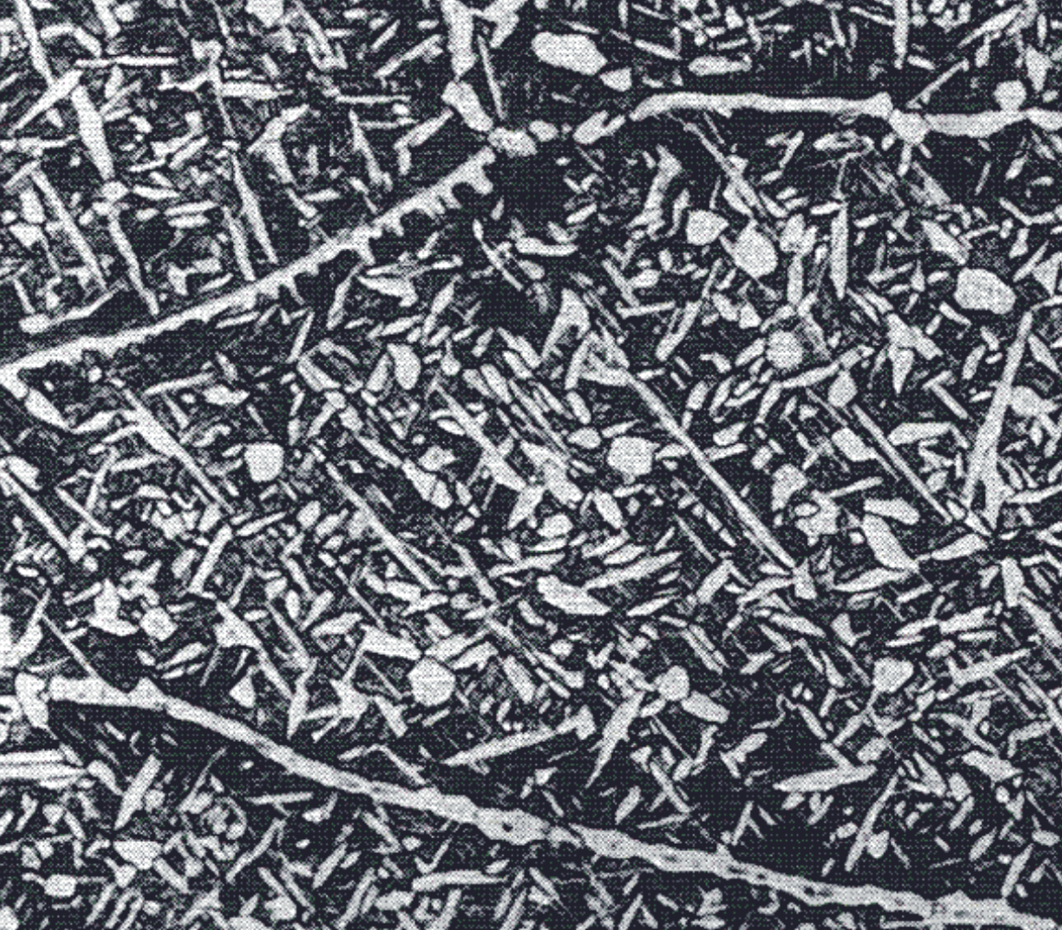
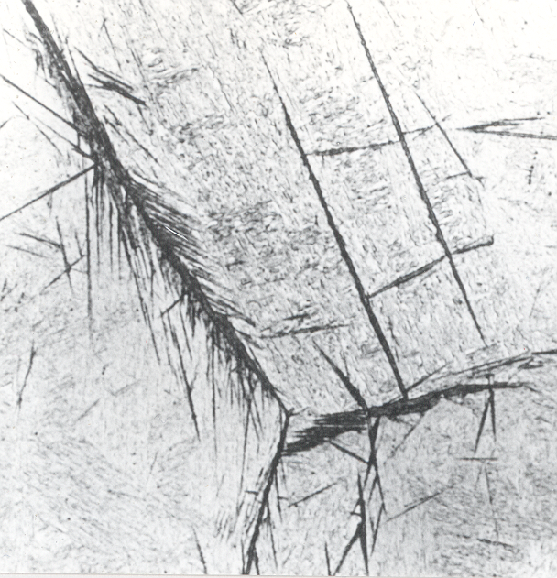
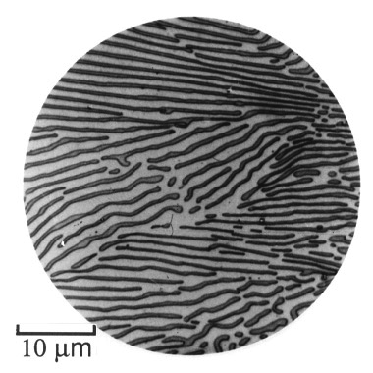
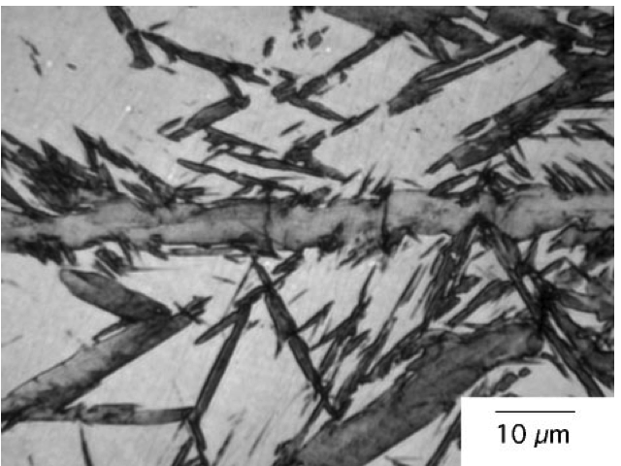

Slide 3
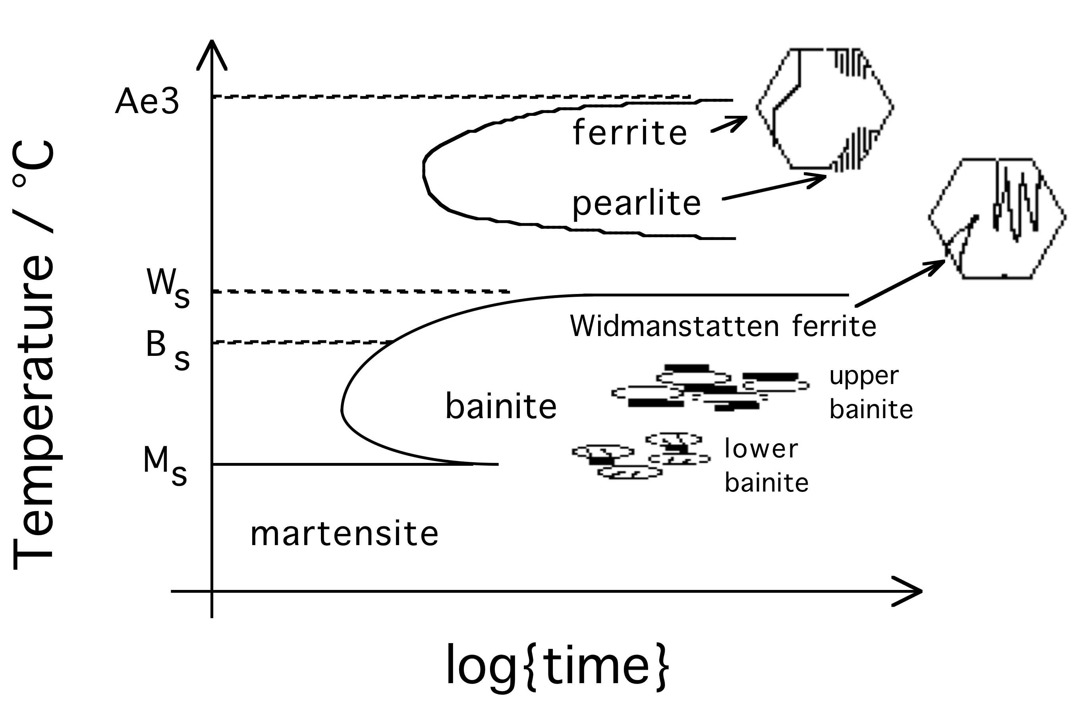
Notes:
3
3

Slide 4
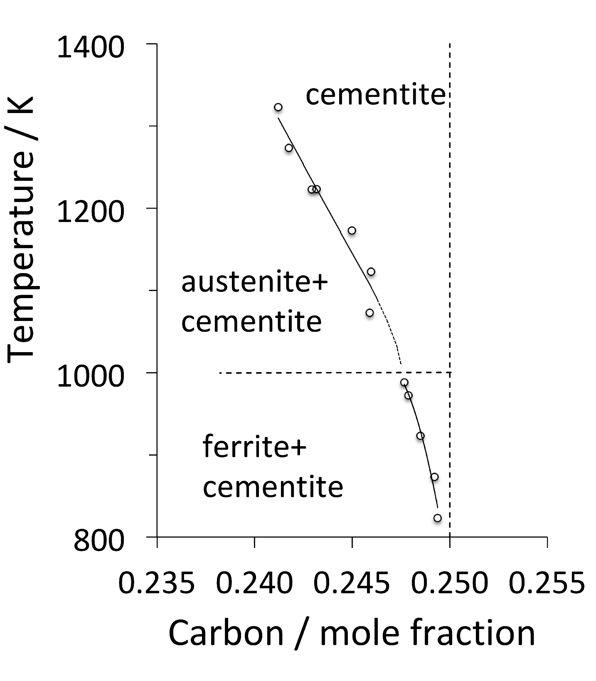
Fe₃C?
Cementite

Slide 5
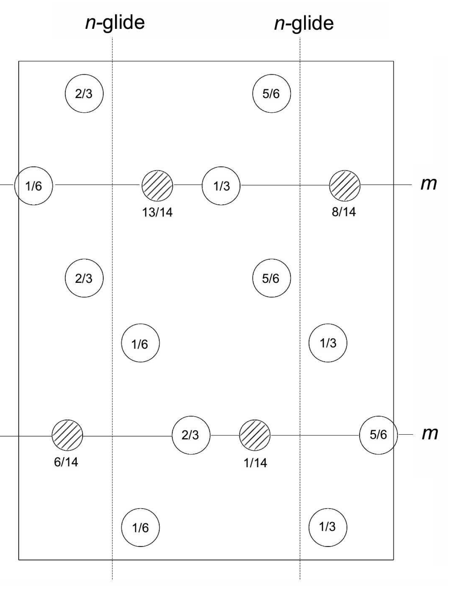
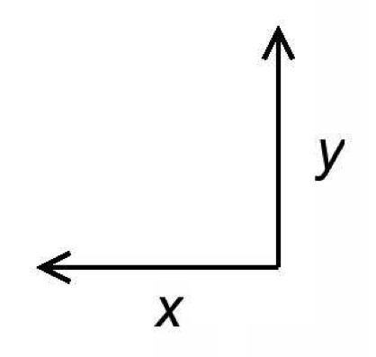
Cementite
a=0.51
b=0.68
c=0.45 nm
Pnma

Slide 6
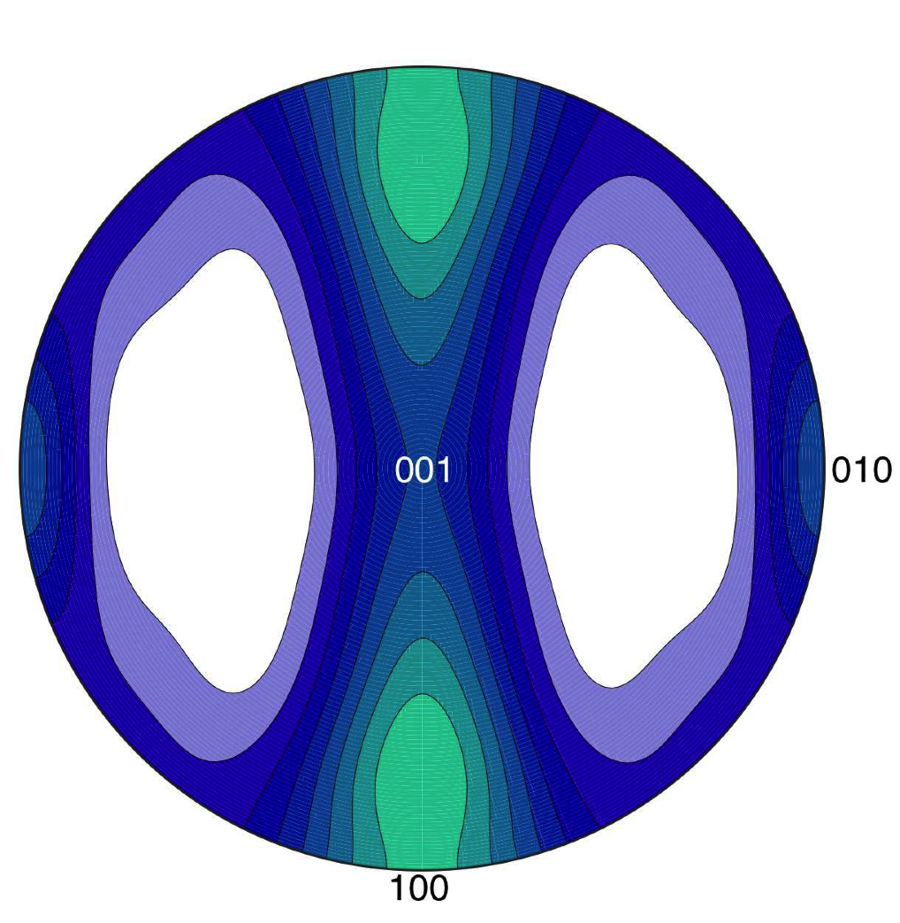
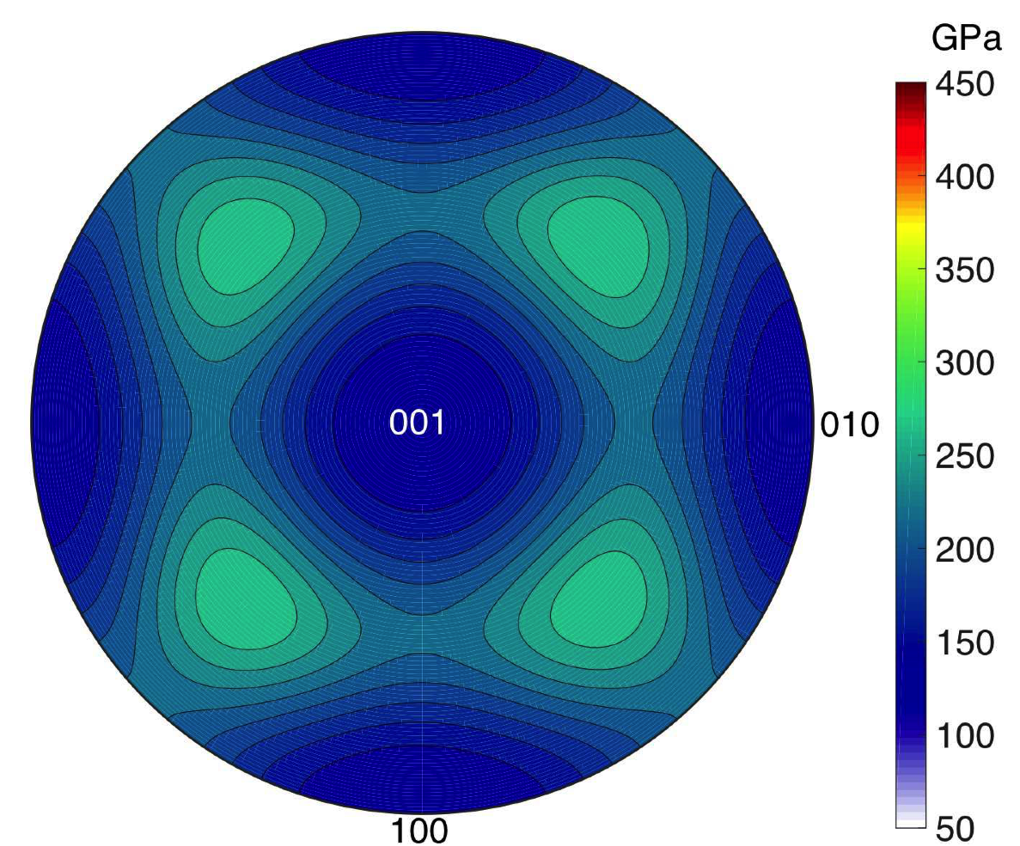
Cementite

Slide 7
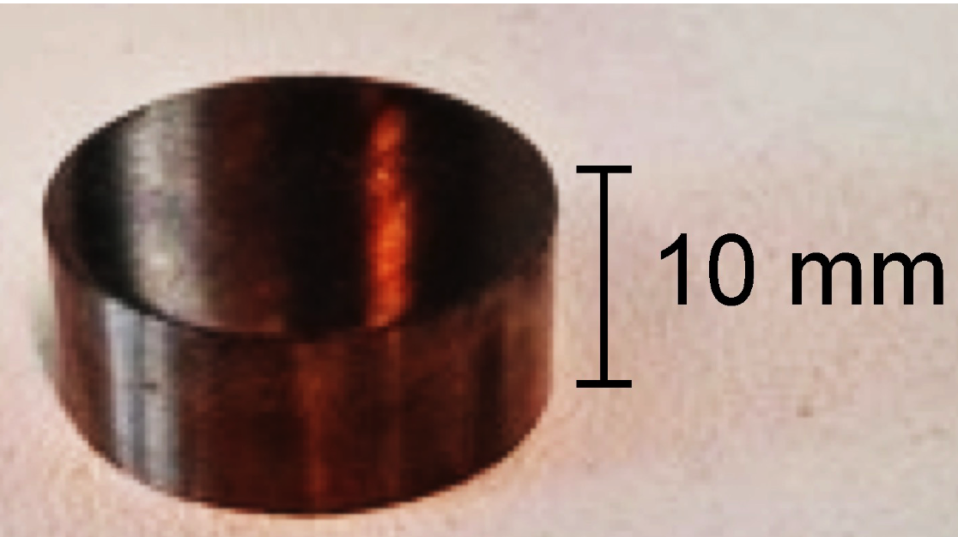
Cementite
Courtesy Umemoto, Toyohashi University

Slide 8
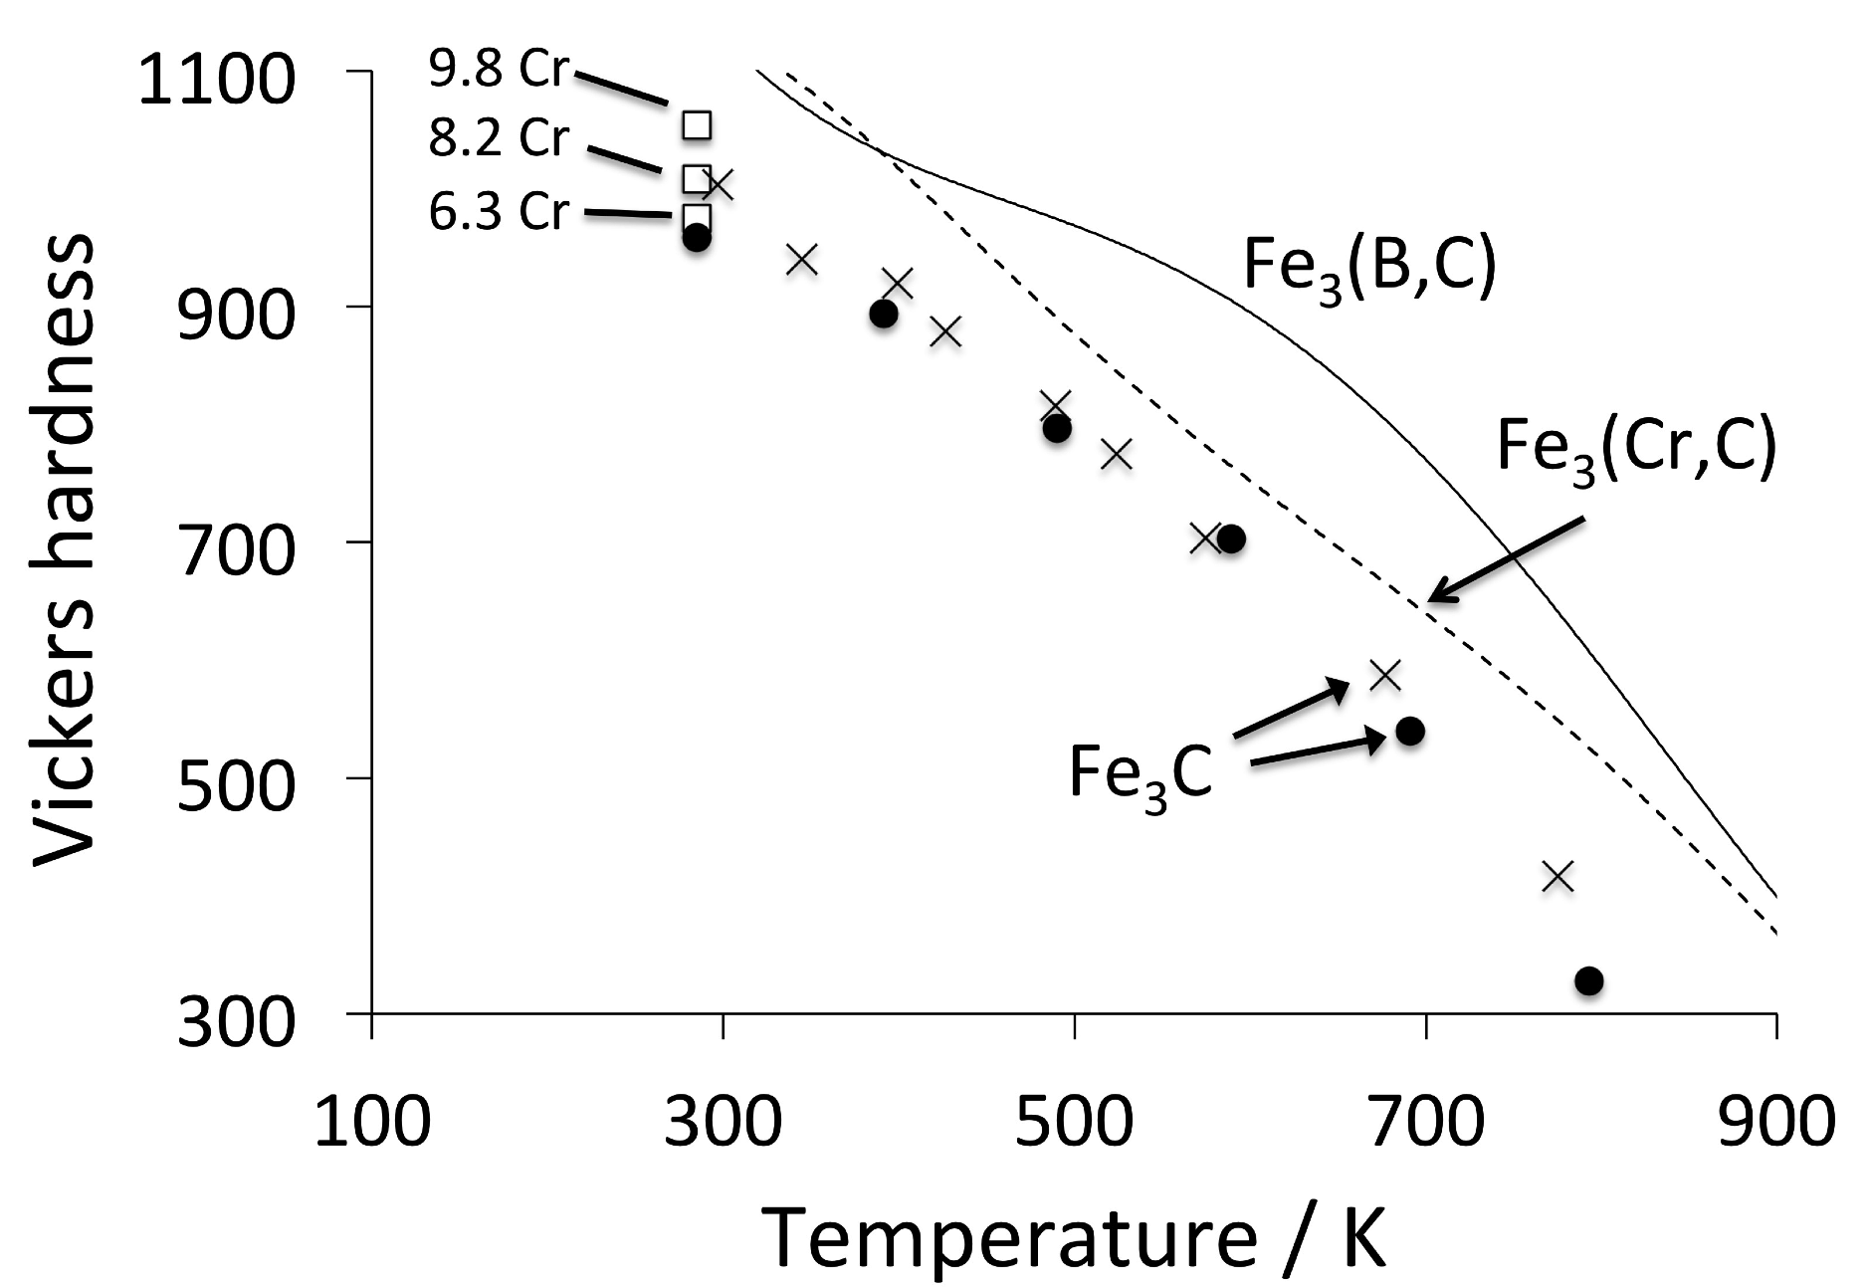
Cementite

Slide 9
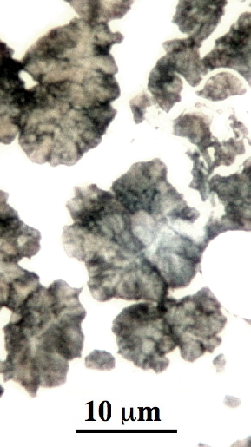
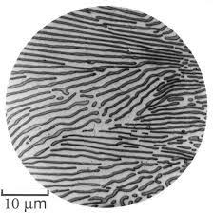
The Pearlite Reaction
(Bain, Alloying elements in steels)

Slide 10
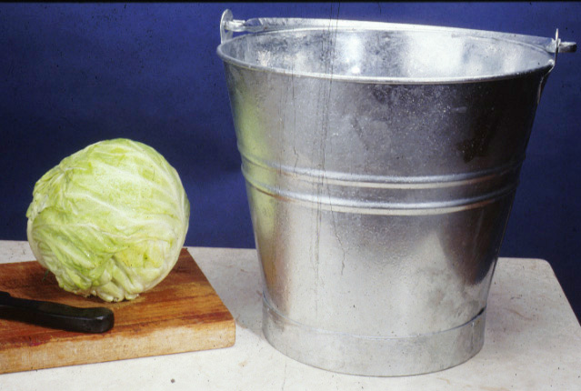
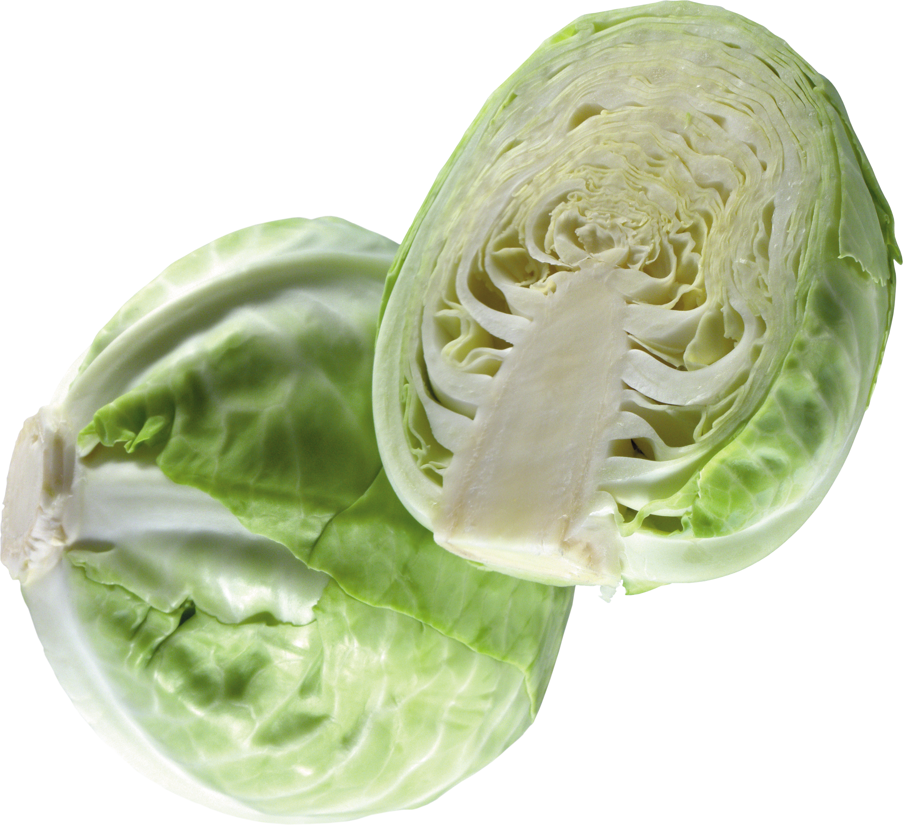
image courtesy of pngimg.com
Creative Commons 4.0 BY-NC
https://creativecommons.org/licenses/by-nc/4.0/

Slide 11
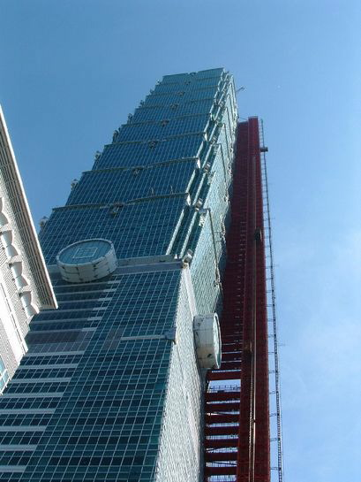
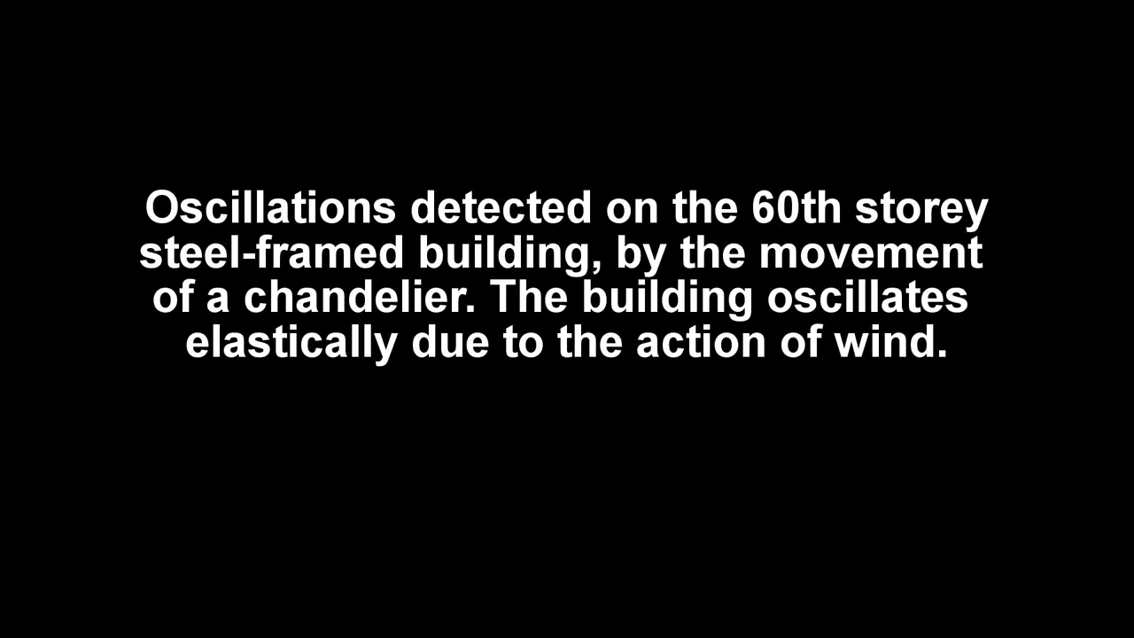

Slide 12
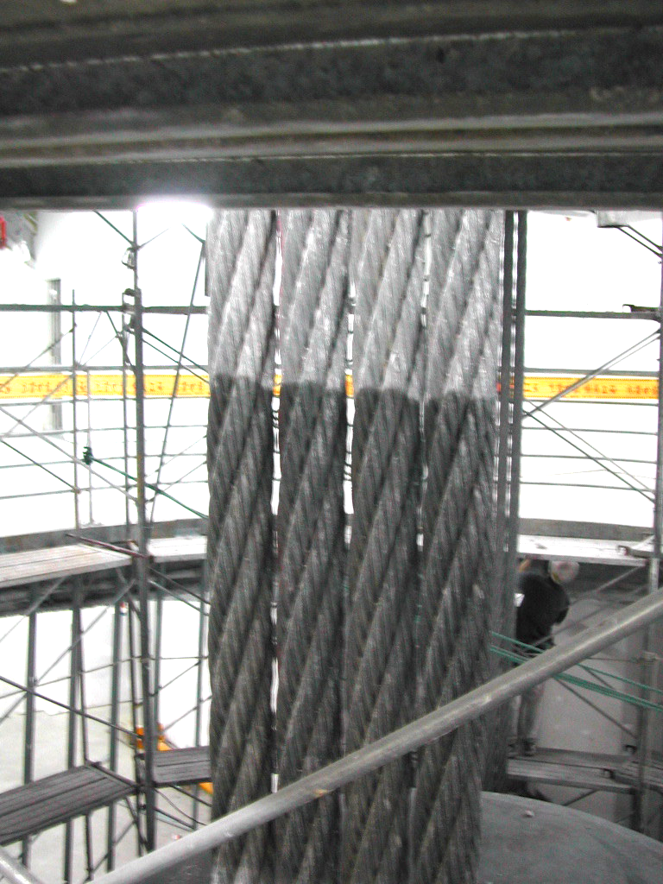
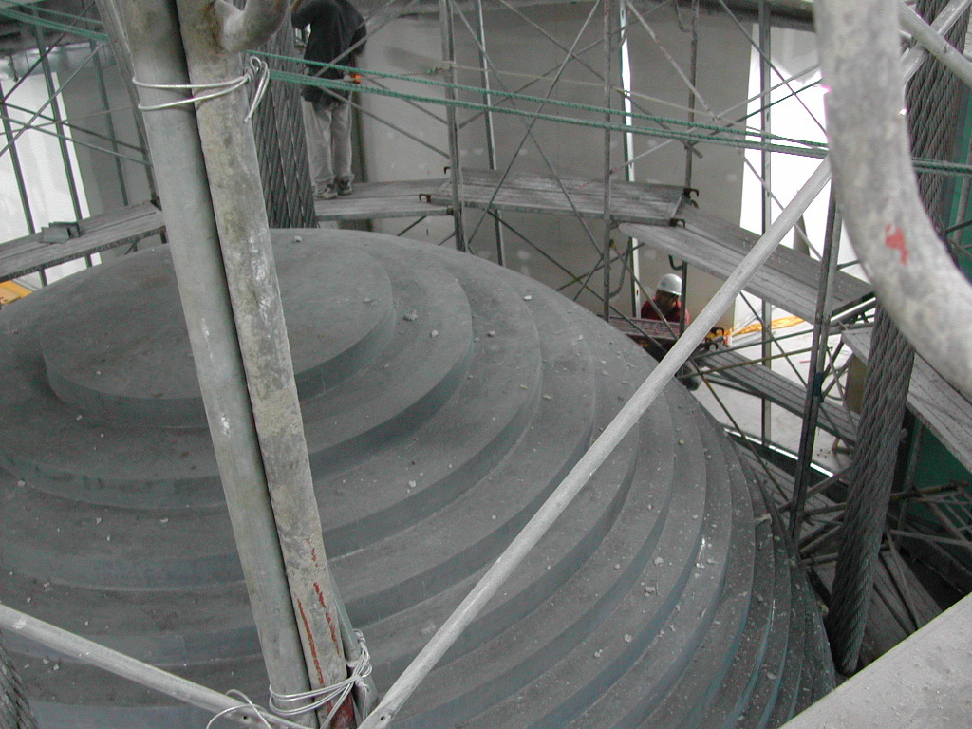

Slide 13
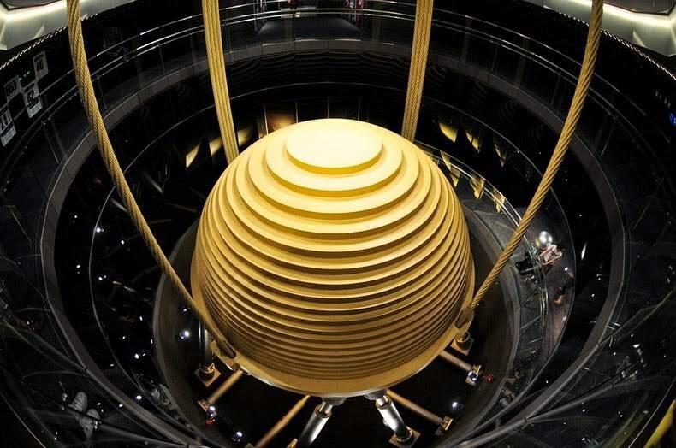
courtesy of Jessie Lin, T101

Slide 14
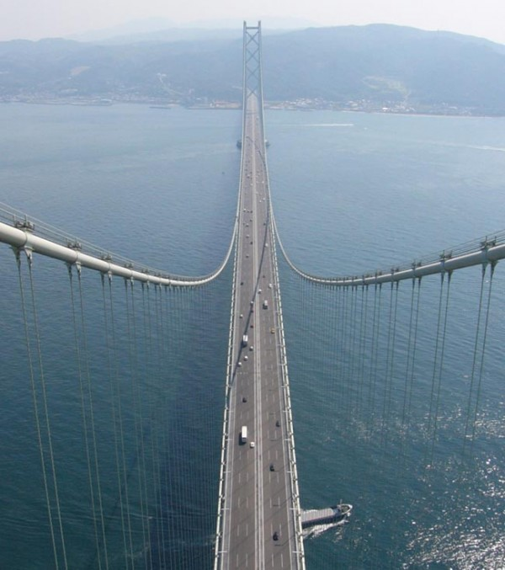
largest central span in the world, 2 km of free navigation underneath, Japan

Slide 15
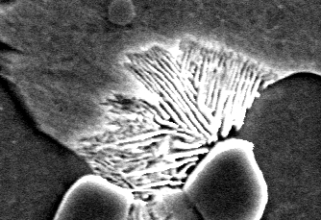
Nucleation begins either with ferrite or cementite depending on whether the steel is hypo- or hyper-eutectoid

Slide 16
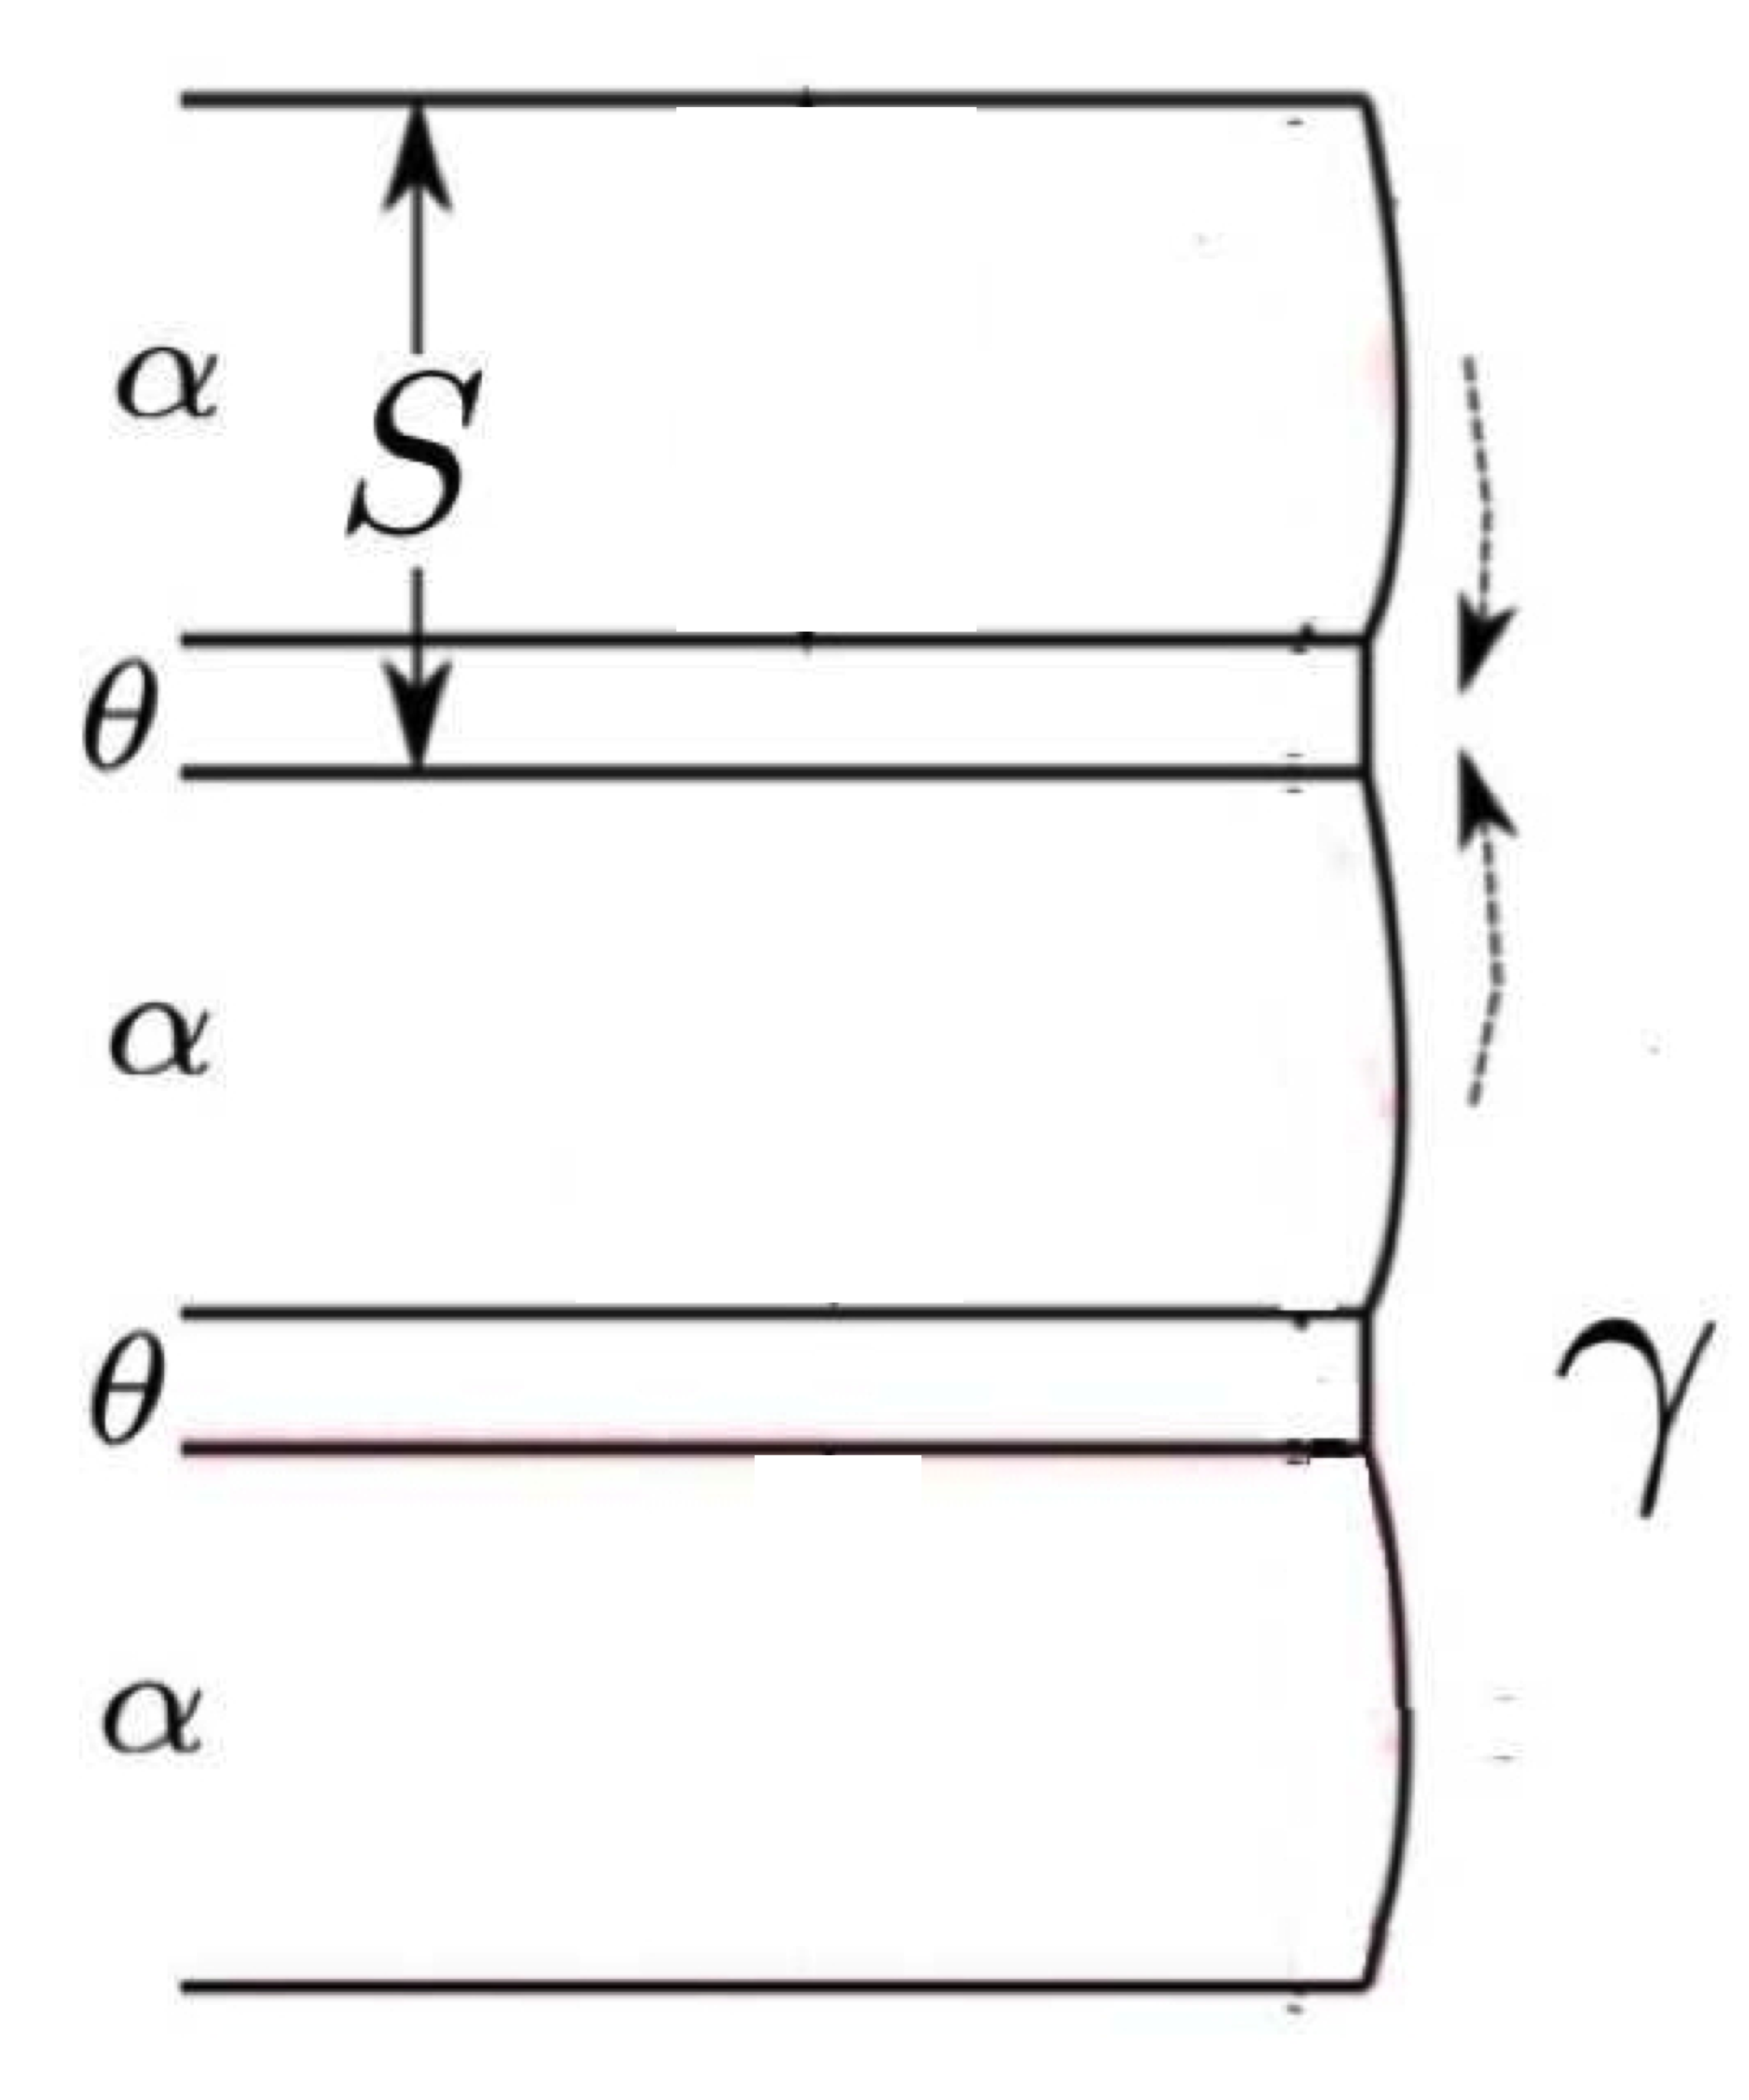

Slide 17
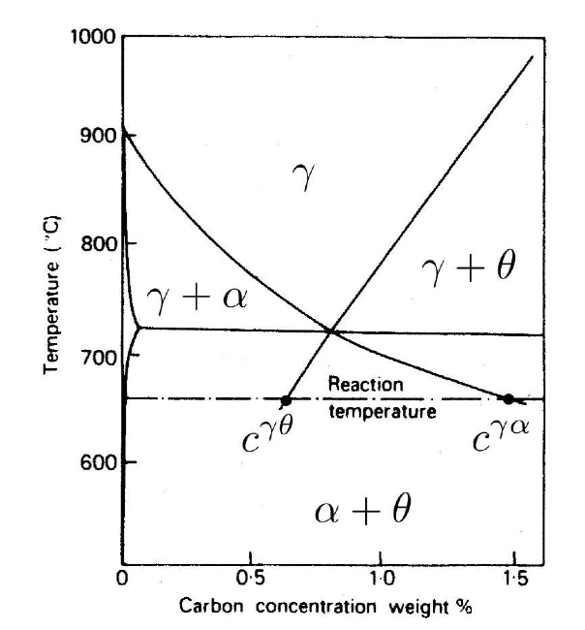
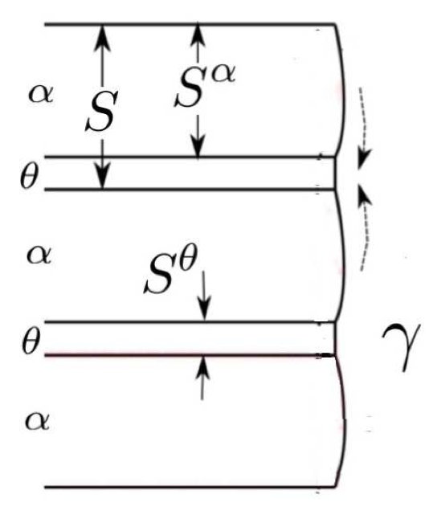

Slide 18

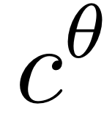


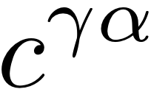
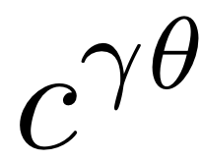


Slide 19
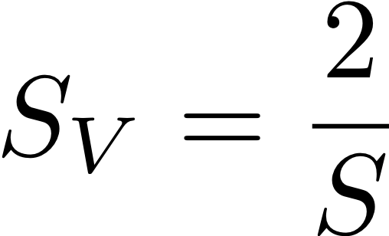

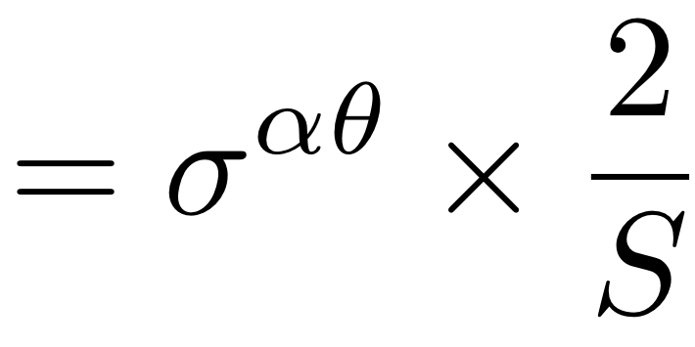
Energy stored in interfaces
S
2S
2S
2S

Slide 20
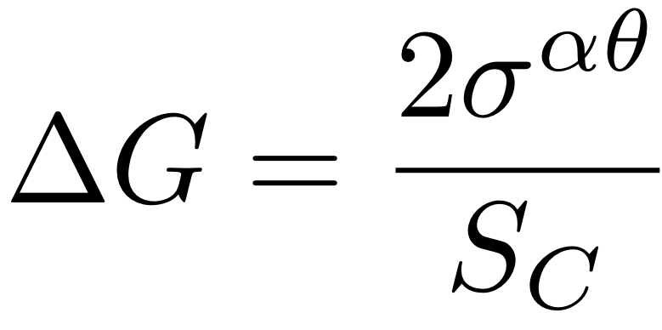

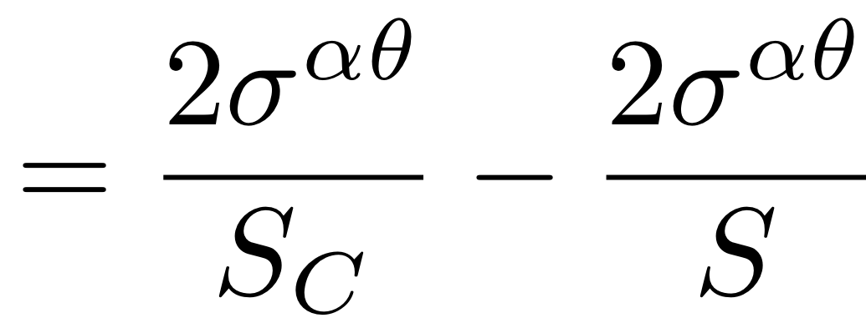
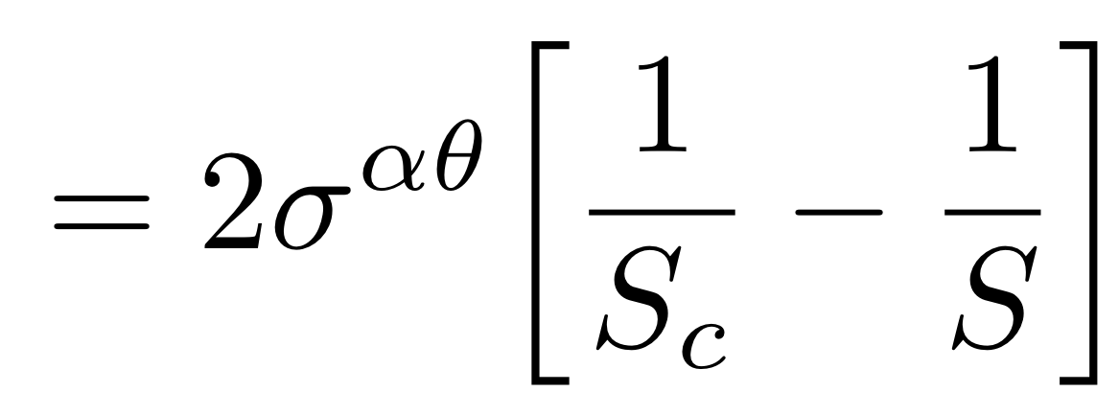
when all free energy
consumed as interface
effective driving force

Slide 21
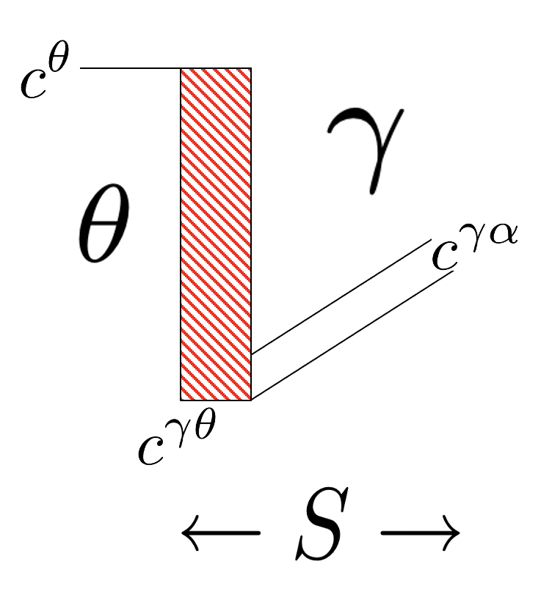


Slide 22
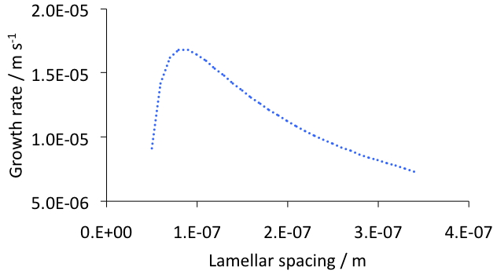

Slide 23
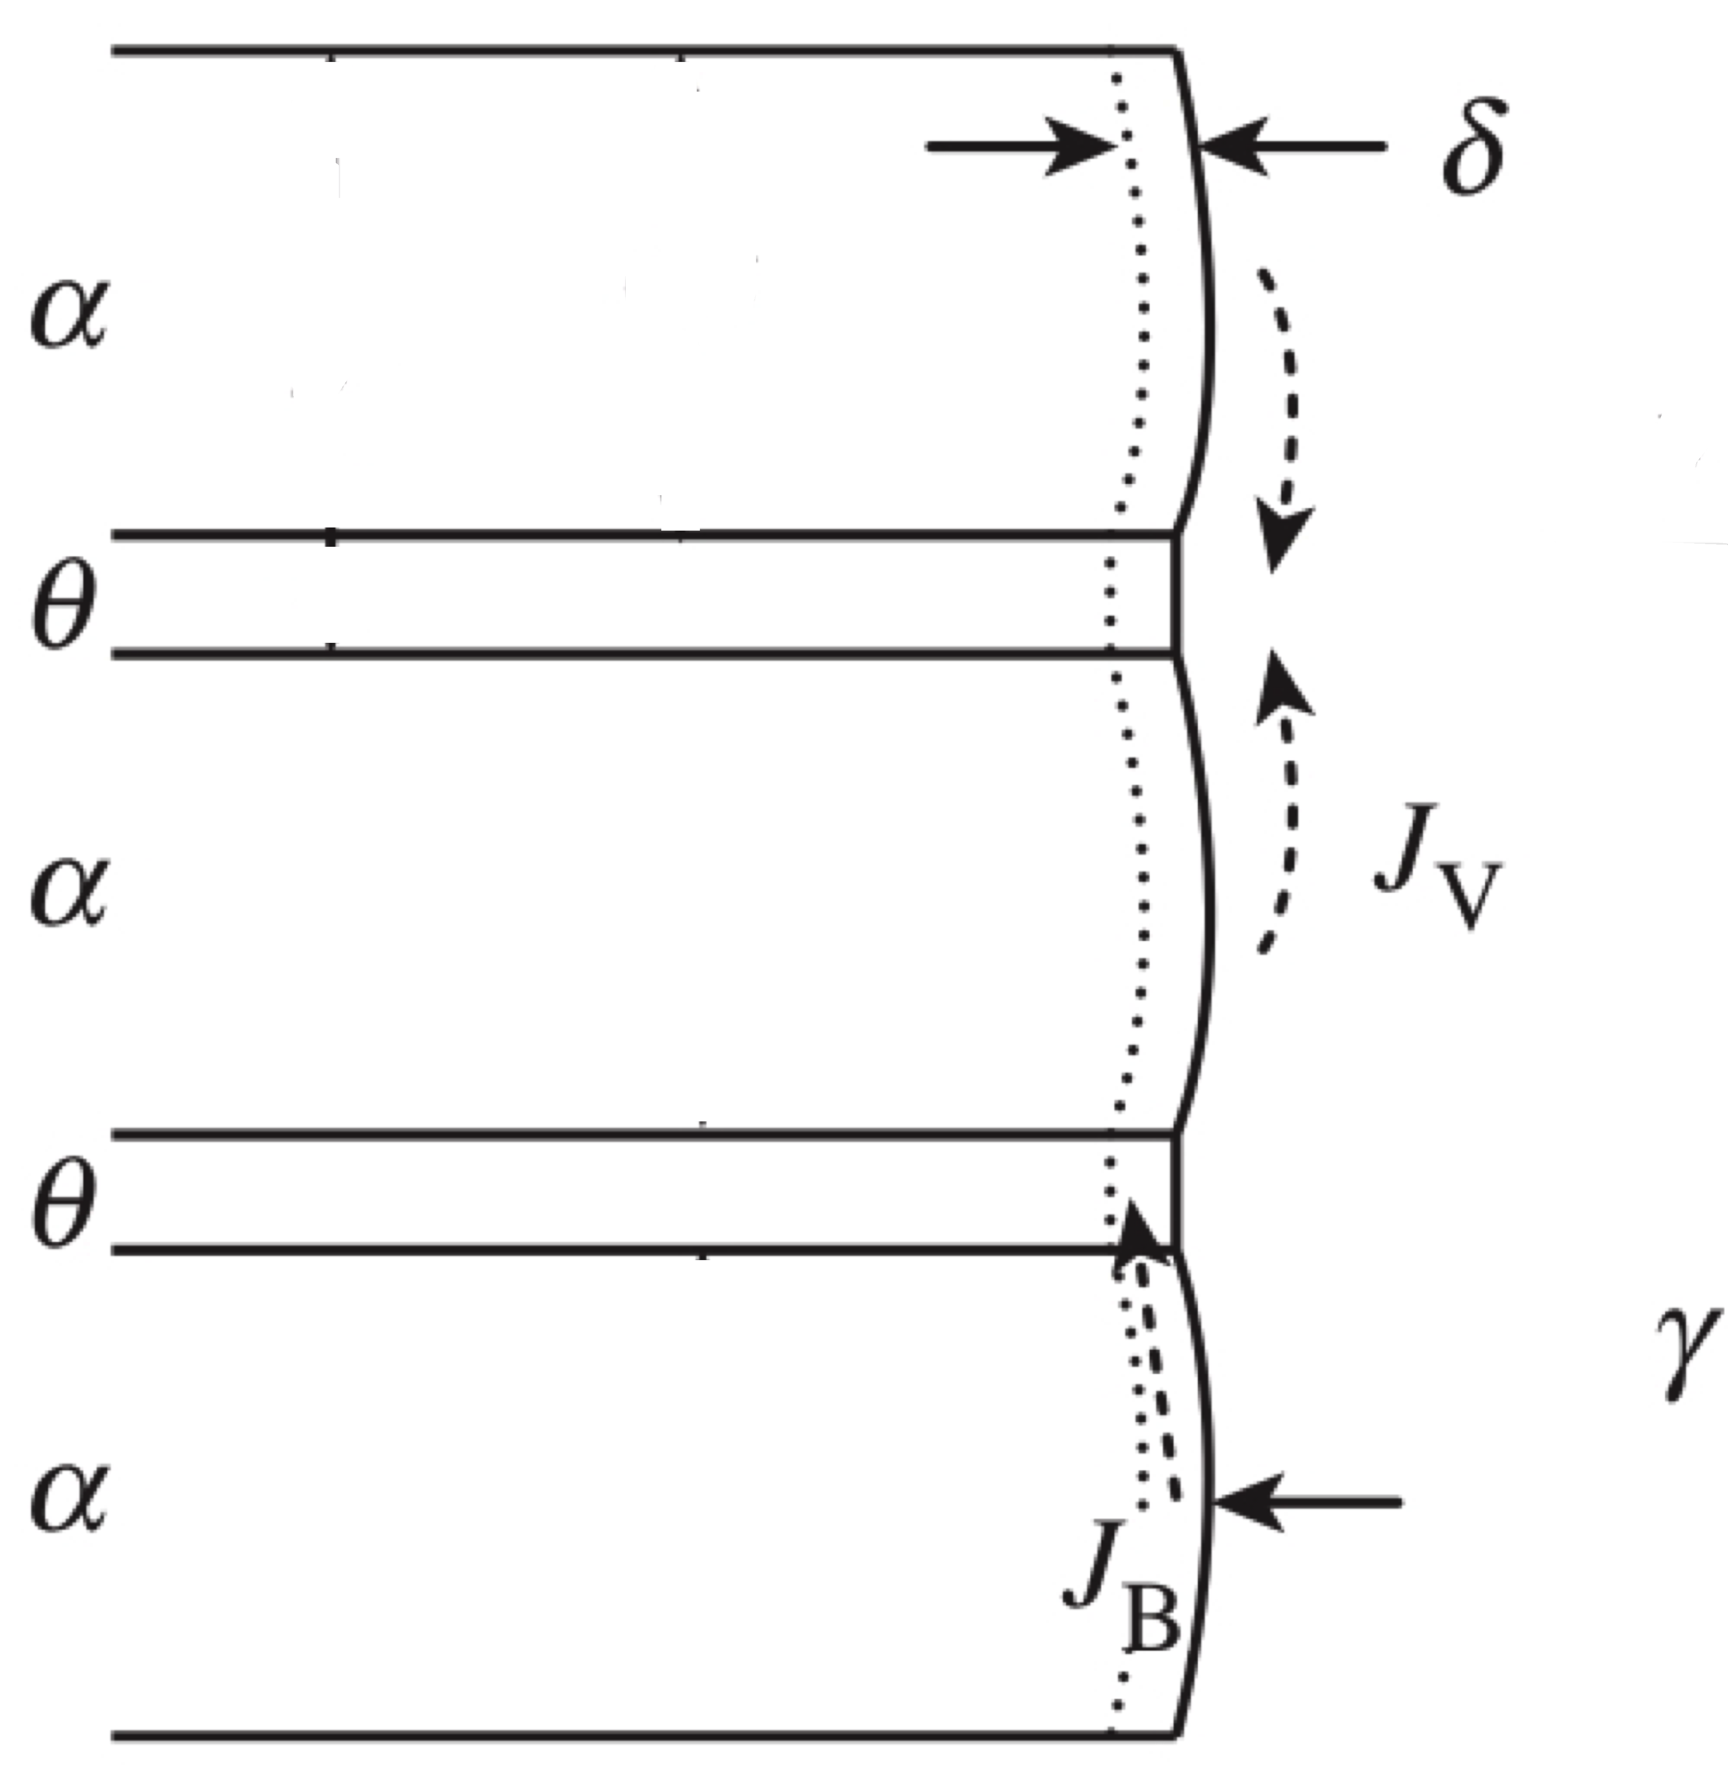
+ flux term due to flux
through interface

Slide 24
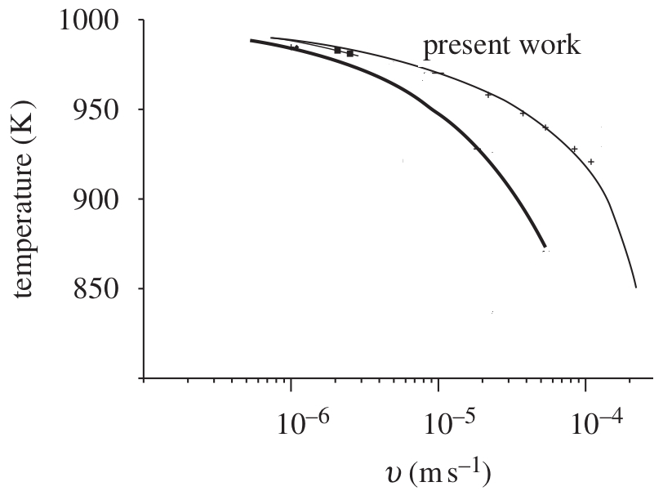
interface
volume
mixed
Fe-C

Slide 25
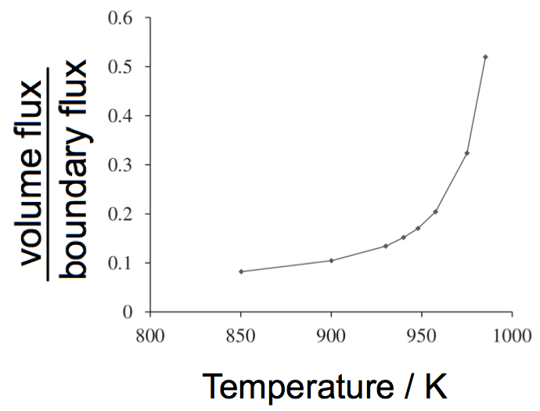

Slide 26
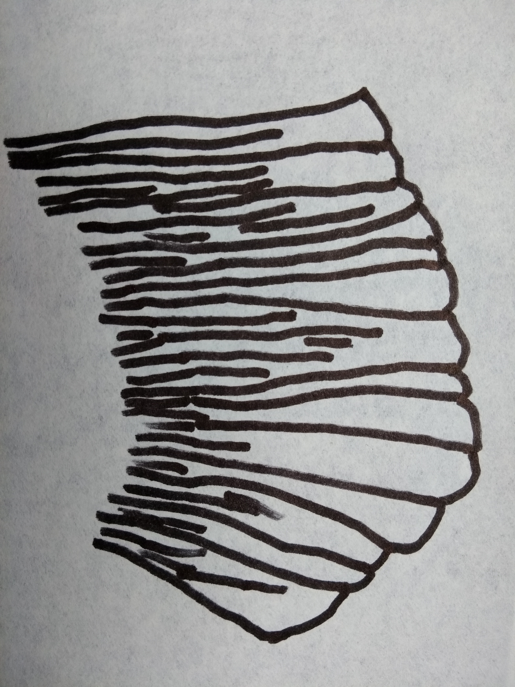
Divergent pearlite
To see a real image of divergent pearlite,
Figure 4.17 of “Steels” book.

