Slide 1
Effect of tempering upon the tensile properties of a nanostructured Bainitic steel

Slide 2
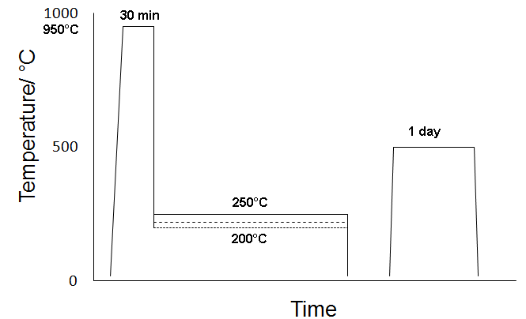
Chemical composition and heat treatments
Chemical compositions for the used steels in wt % after
homogenization at 1200°C for 2 days
C | Mn | Si | Mo | Cr | Co | Al
0.78 | 2.02 | 1.6 | 0.25 | 1.01 | 3.83 | 1.37

Slide 3
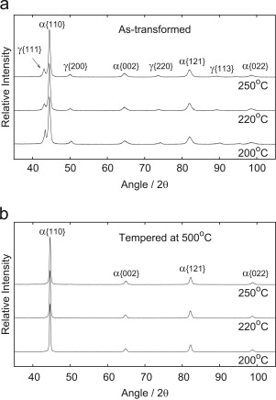
X-ray results
X-ray results of the samples before and after tempering at 500°C for 1day :
The volume fraction of austenite in the as transformed microstructure decrease with decreasing the isothermal transformation temperature.
Tempering has removed all the retained austenite in all transformation temperatures.

Slide 4
Results of X- ray diffraction analysis after different transformation temperatures.
Transformation Temp./◦C | Volume/ % | Lattice Parameter/ °A | Carbon / wt% |  | Carbon trapped at defects/ Wt%
Austenite
200 | 17.3 | 3.6218 |  | 1.23
220 | 18.3 | 3.6209 |  | 1.23
250 | 21.4 | 3.6366 |  | 1.68
Ferrite
200 | 82.7 | 2.8753 |  | 0.26 | 0.37
220 | 81.7 | 2.8748 |  | 0.24 | 0.37
250 | 78.6 | 2.8671 |  | 0.22 | 0.53
After tempering at 500/◦C for 1 day.
Transformation Temp./◦C | Lattice Parameter / °A | Carbon / wt%
200 | 2.8721 | 0.14
220 | 2.8706 | 0.1
250 | 2.8621 | 0.15

Slide 5
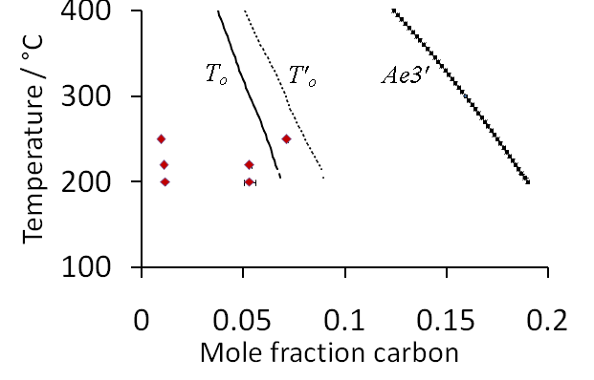
T_{O} curve and the Carbon contents of ferrite and austenite
Notes:
[1] C. Garcia-Mateo, F. G. Caballero, and H. K. D. H. Bhadeshia. Low temperature bainite. Journal de Physique, 112:17–25, 2003.
[2] F. G. Caballero, H. K. D. H. Bhadeshia, K. J. A. Mawella, D. G. Jones, and P. Brown. Very strong low temperature bainite. Materials Science and Technology, 18:279–284, 2002.
[3] C. Garcia-Mateo and F. G. Caballero. Ultra–high–strength bainitic steels. ISIJ, 45(11):1736–1740, 2005.
[4] C. Garcia-Mateo and F. G. Caballero. The role of retained austenite on tensile properties of steels with bainitic microstructures. Materials Transactions, 46(8):1839–1846, 2005.

Slide 6
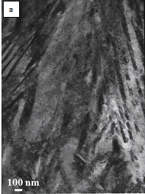
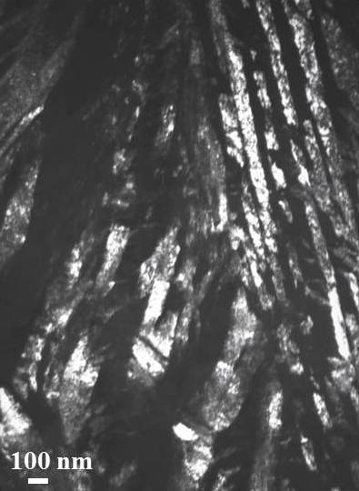

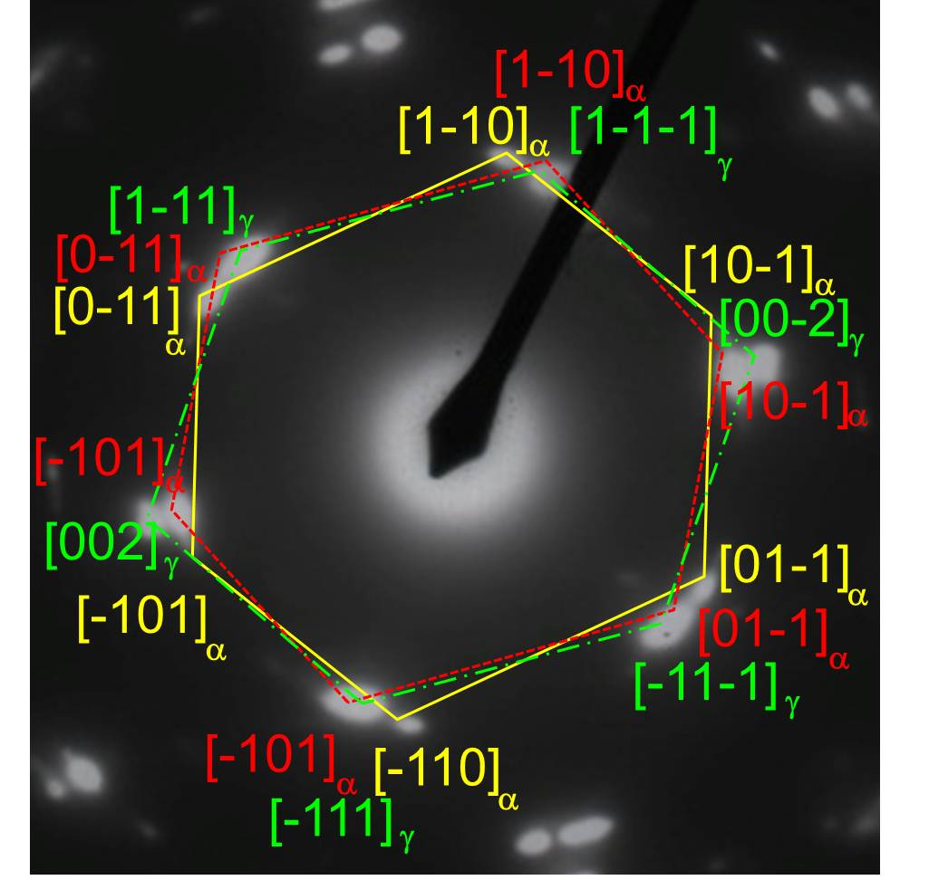
(a) TEM images (BF micrograph) for the as transformed sample at 250°C for 16 hrs.
c
(b) The selected area electron diffraction pattern of figure a.
(c) DF micrograph corresponding to the red encircled spot in figure b.
(d) Magnification of figure b.
b
d

Slide 7
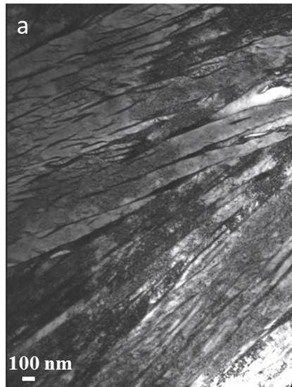
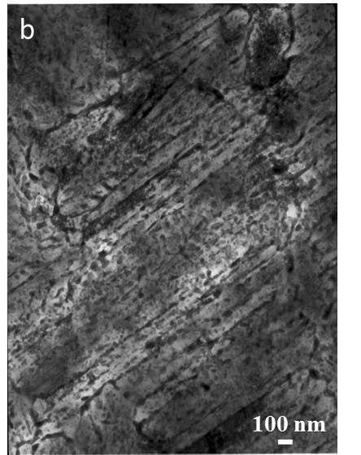
Effect of tempering for 1 day at 500°C on the microstructure of the specimen isothermally held at 250°C for 16h:
Both samples are constituted of bainitic ferrite plates.
The thickness of the bainitic ferrite plates has changed after tempering from 38 ± 3 to 43 ± 4 nm.
Instead of austenite at the interface of the bainitic ferrite plates, some fine carbides have precipitated during tempering.

Slide 8
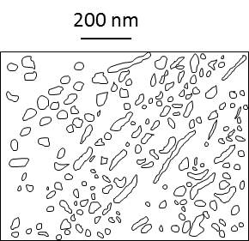
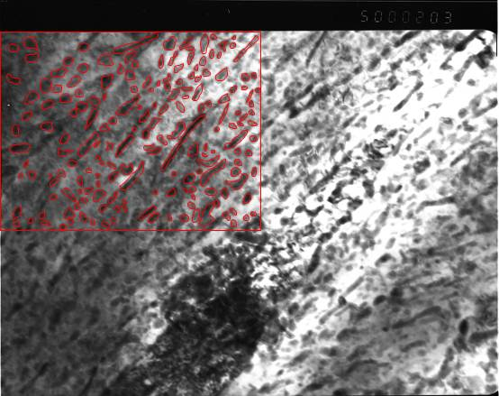
Stereology of the fine carbides
The mean radius is 5.8 nm assuming that they are equiaxed,
The volume fraction is 2.47%
The interspacing of precipitates is 60 nm

Slide 9
Effect of tempering on the respective contributions of various factors to the strengthening of the specimen isothermally held at 250°C for 16h:
It is mainly due to the contribution of both the dislocations and the thickness of the bainitic ferrite plates.
the strengthening of carbides is very low in the tempered sample since their interspacing (60 nm) is about 6 times greater than their size (11.6 nm).
Strengthening contributions (MPa) | Untempered specimen | Tempered specimen
Solid solution of C and alloying elements | 986 | 178
Thickness of the bainitic ferrite plates | 1513 | 1337
Dislocations | 583 | 60
Carbides | 0 | 265
Fe | 168.0 | 168.0
Sum of the contributions (MPa) | 3250 | 2008
Power-weighted sum σk ¼∑σki,k¼3.0 | 1666 | 1324

Slide 10
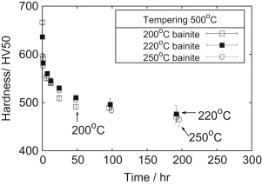
Mechanical properties
Hardness measurements with tempering time for samples transformed at different transformation temperatures (200, 220, 250°C)and then tempered at 500°C for different times.
Initial hardness increases as transformation temperature is reduced.
Upon tempering the hardness values converged.

Slide 11
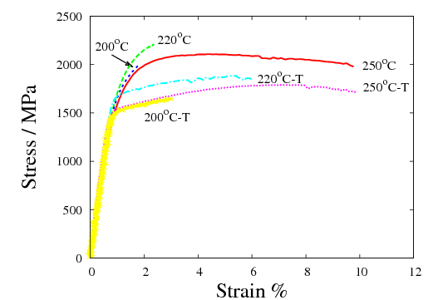
Tensile behaviour
Linear hardening from the yield point to fracture.
The elongation is higher after tempering, also the toughness as measured by energy consumed during tensile test (area under tensile curve).
The samples transformed at 250°C shows some difference:
It has almost the same elongation after tempering. but the elongation became a uniform elongation rather than the early necking appeared in the as transformed condition.
There is reduction in toughness after tempering results from the reduction of tensile stress.

Slide 12
Mechanical Properties observed for the as transformed microstructure and also after tempering at 500◦C for 1 day.
Condition | Hardness /HV50 | YS /MPa | UTS /MPa | Elong. /% | Tougnhess /MJm⁻³
200°C | 666±3.56 | 1680 | 1996 | 0.83 | 6.578
220°C | 636±4.04 | 1755 | 2210 | 1.27 | 10.5
250°C | 597±4.65 | 1620 | 2110 | 8.7 | 87.2
200°C -T500°C | 509±5.51 | 1500 | 1680 | 2.2 | 13.04
220°C -T500°C | 530±2.94 | 1670 | 1870 | 5.1 | 43.57
250°C -T500°C | 525±2.15 | 1520 | 1780 | 9.2 | 75.06

Slide 13
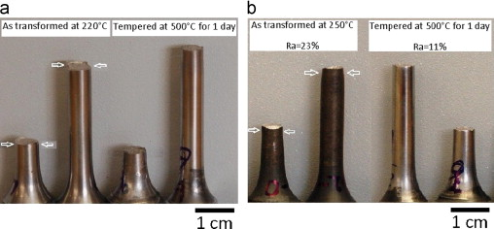
Tensile samples

Slide 14
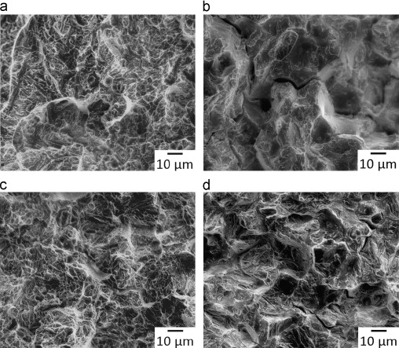
Scanning electron micrographs of the fracture surfaces of untempered samples at different transformation temperatures (a) 220 °C, (b) 250 °C, and corresponding tempered samples (c) 220 °C (d) 250 °C after 500 °C for 1 day.

Slide 15
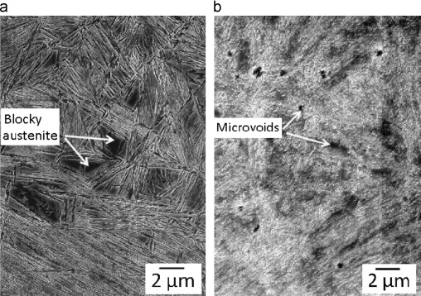
SEM images for the area below the fracture surfaces of as transformed sample at 250°C for 16 hrs and the same sample after tempering at 500°C for 1 day.

Slide 16
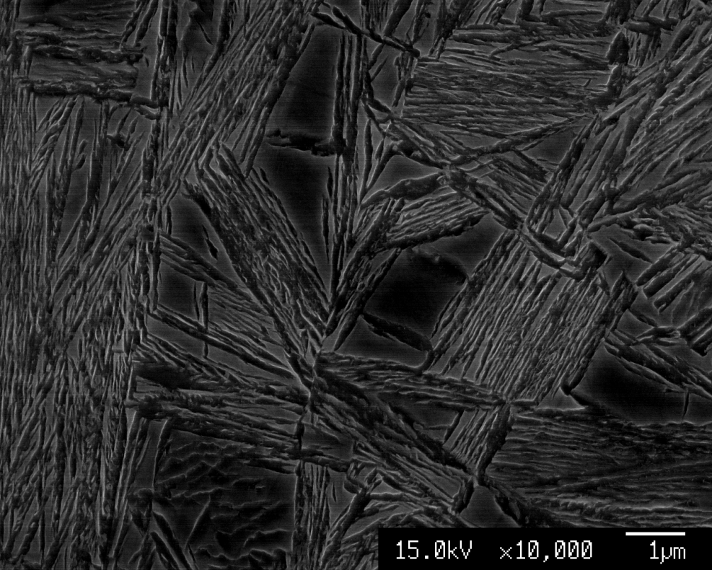
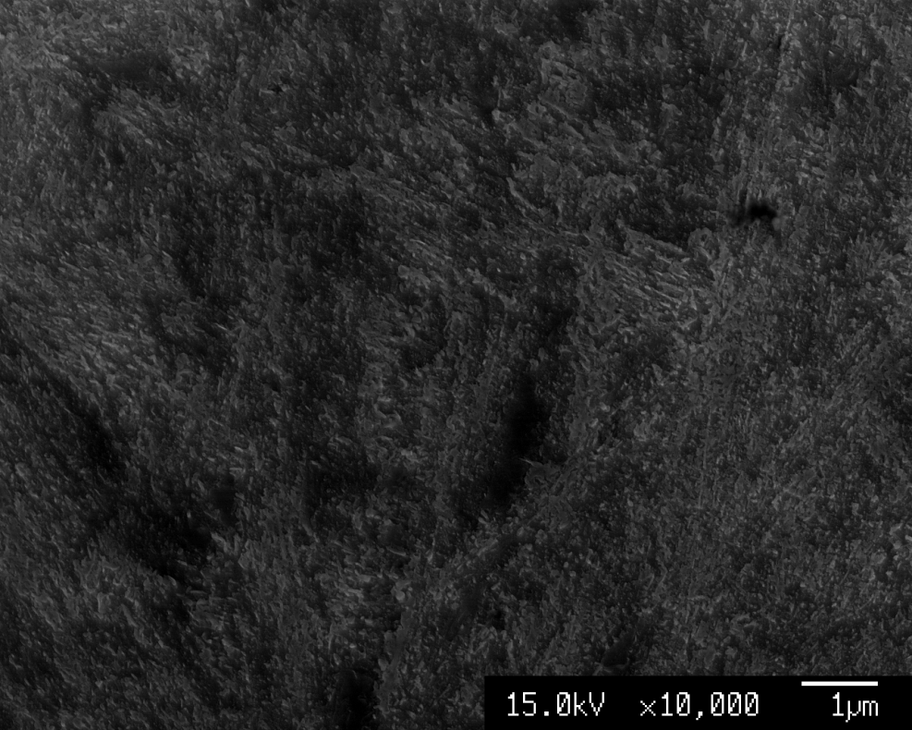
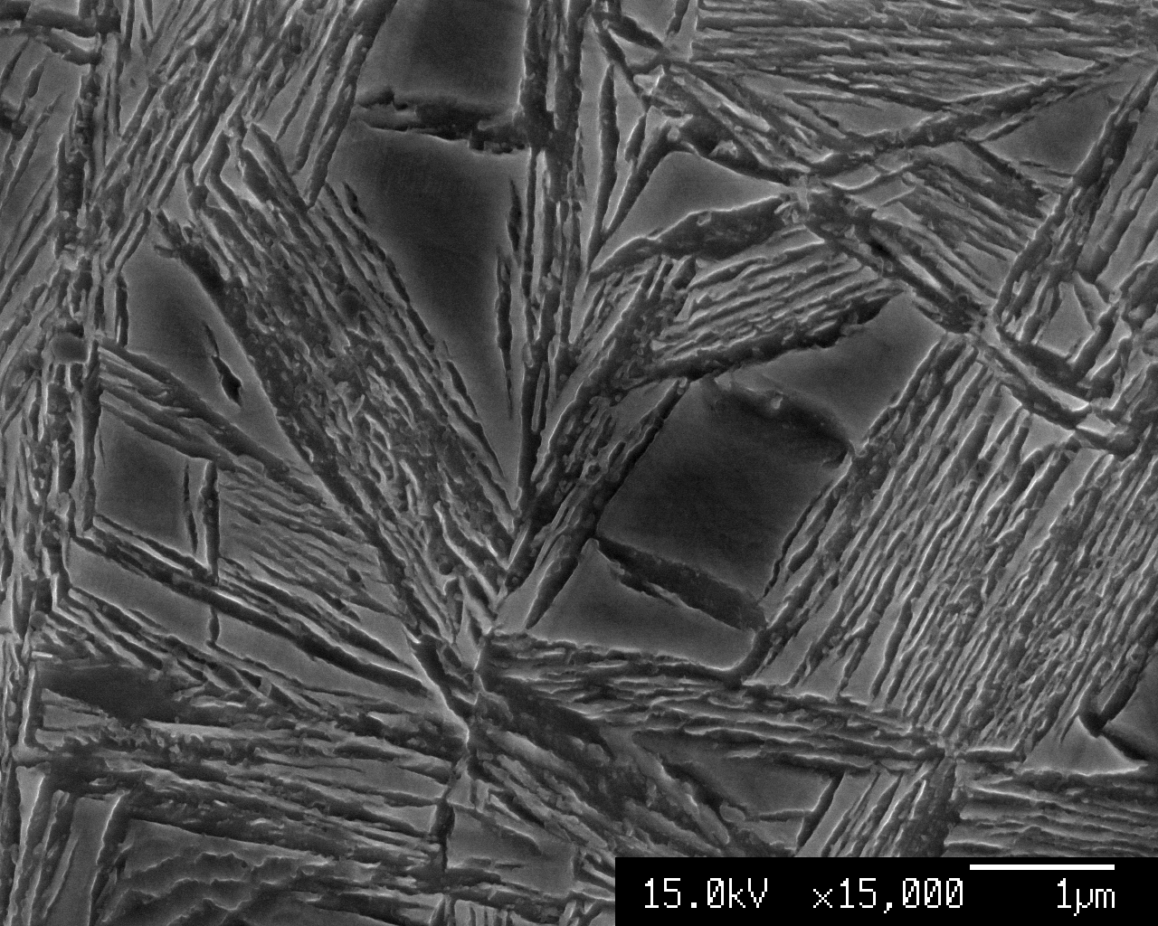
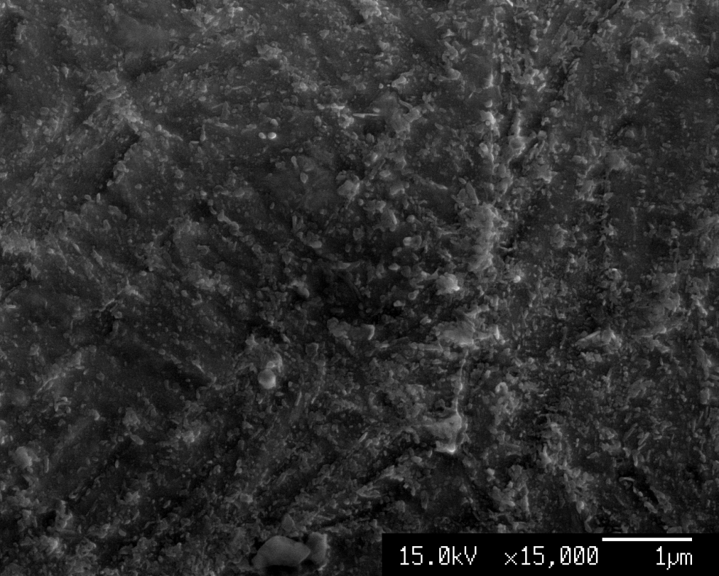

Slide 17
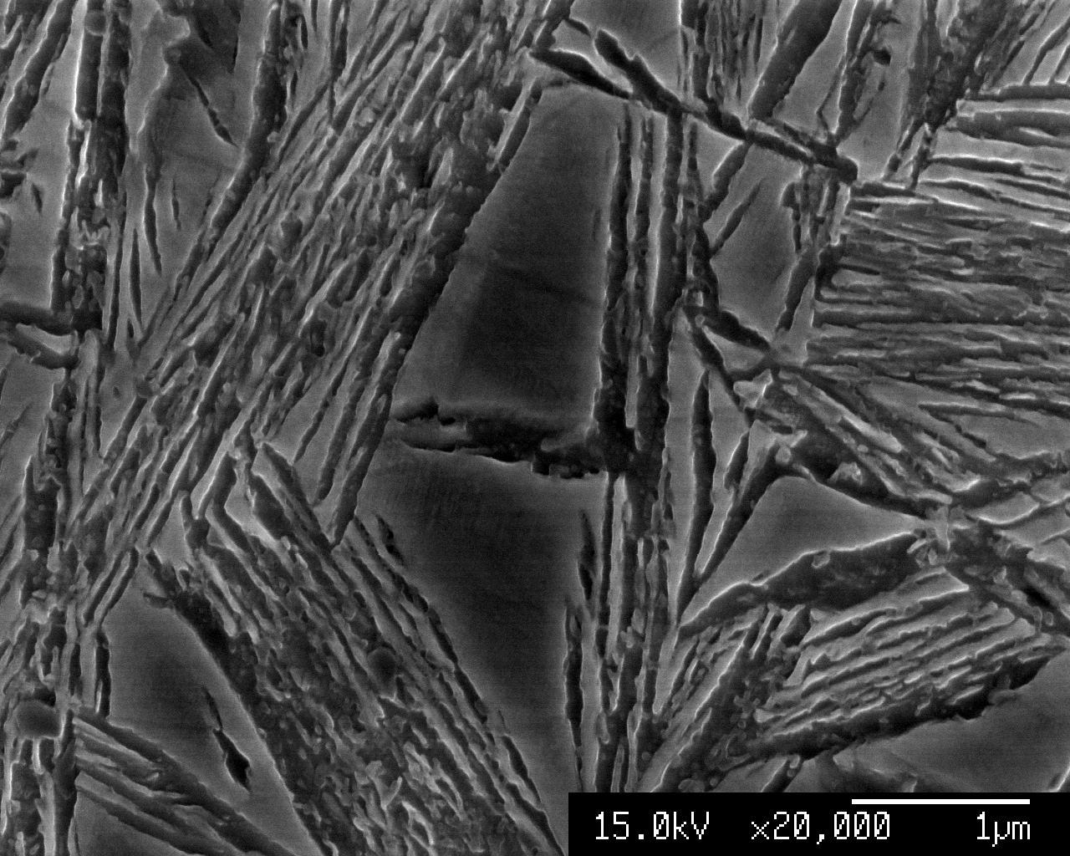
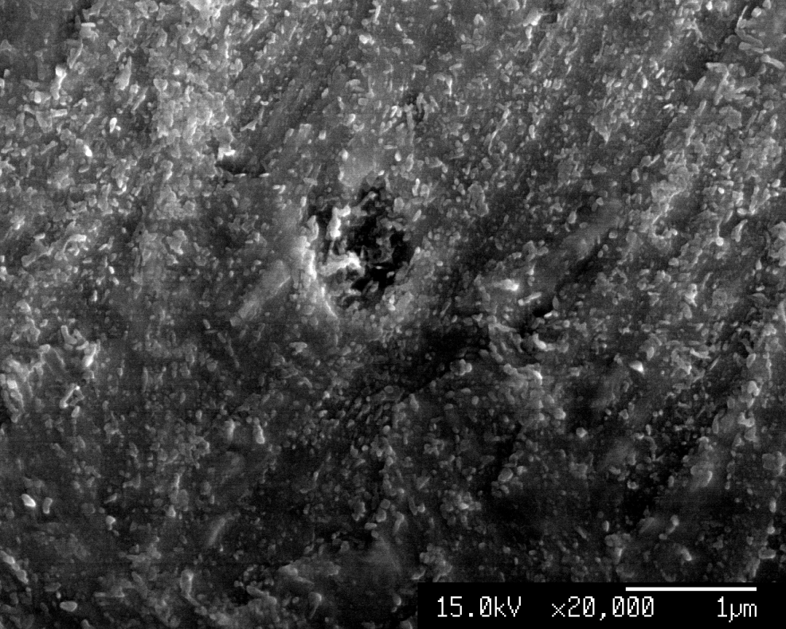
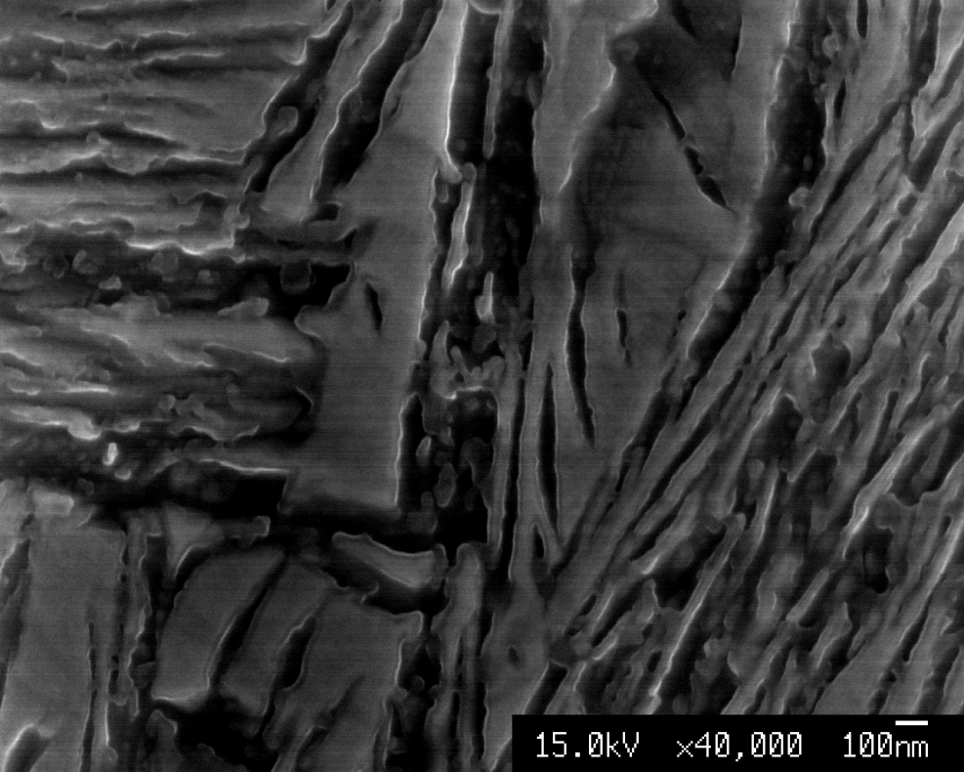
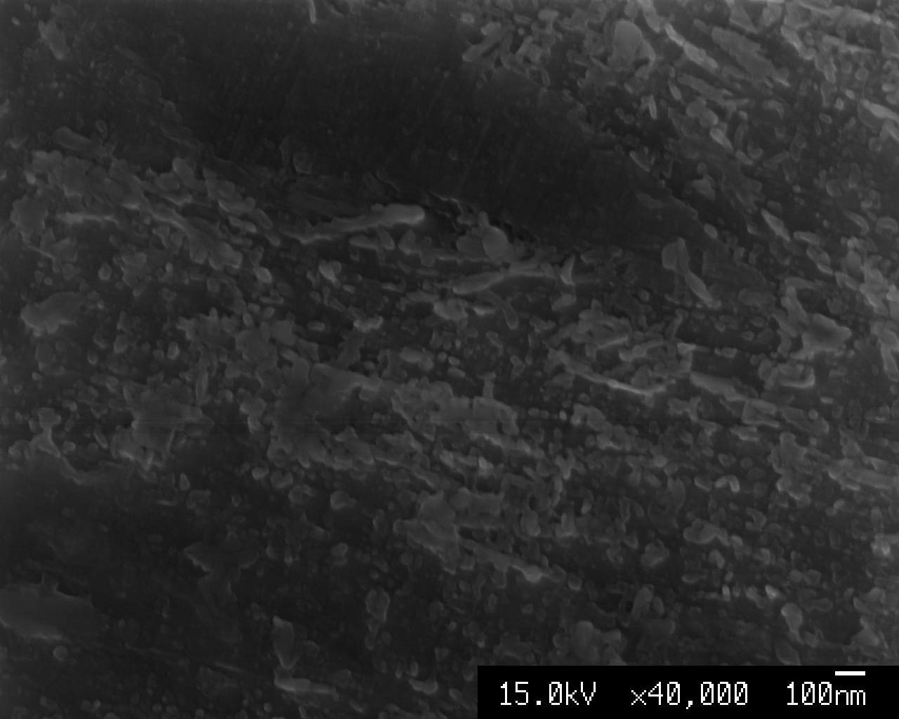

Slide 18
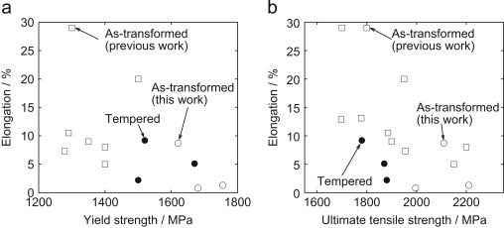
Strength and elongation as a result of tempering at 500 °C (filled circles) compared to those of the as-transformed steels. Unfilled circles are for this work, unfilled squares represent previously reported results for as-transformed low-temperature.

Slide 19
Conclusions
The effect of tempering on high strength bainitic steel has been assessed.
Toughness slightly reduced in one case, but generally improved. The elongation always increased.
This may be because the carbides did not cause embrittlement when they were very small
Compared to steels of similar ultimate strength the elongation is reduced after tempering to remove austenite.

