Slide 1
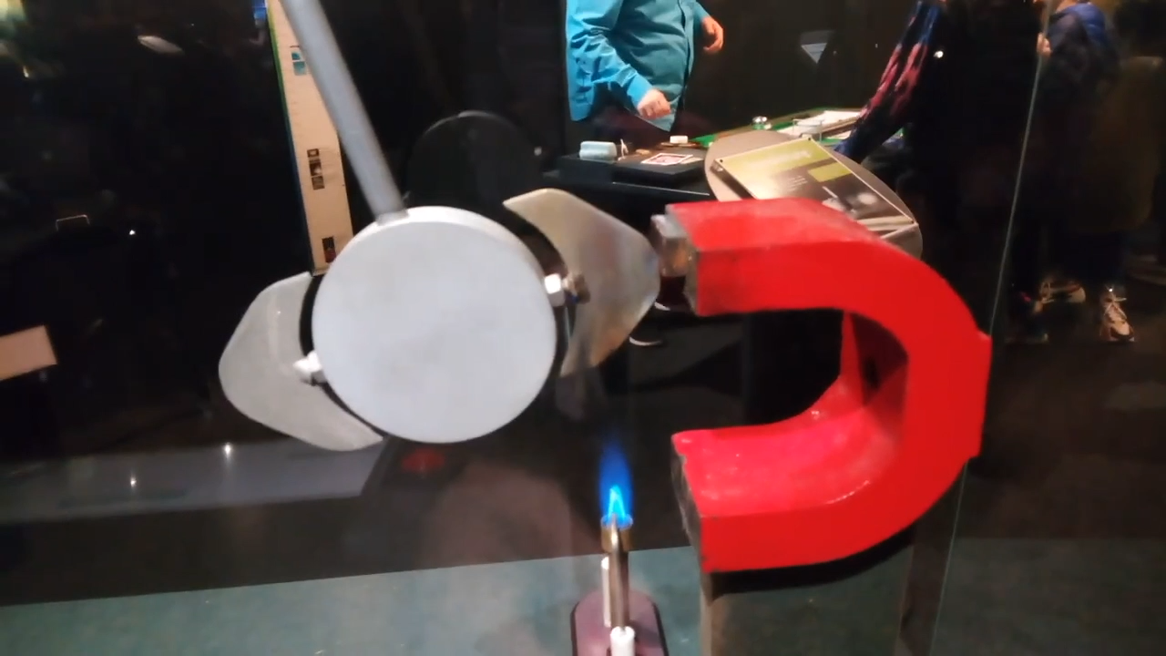

Slide 2
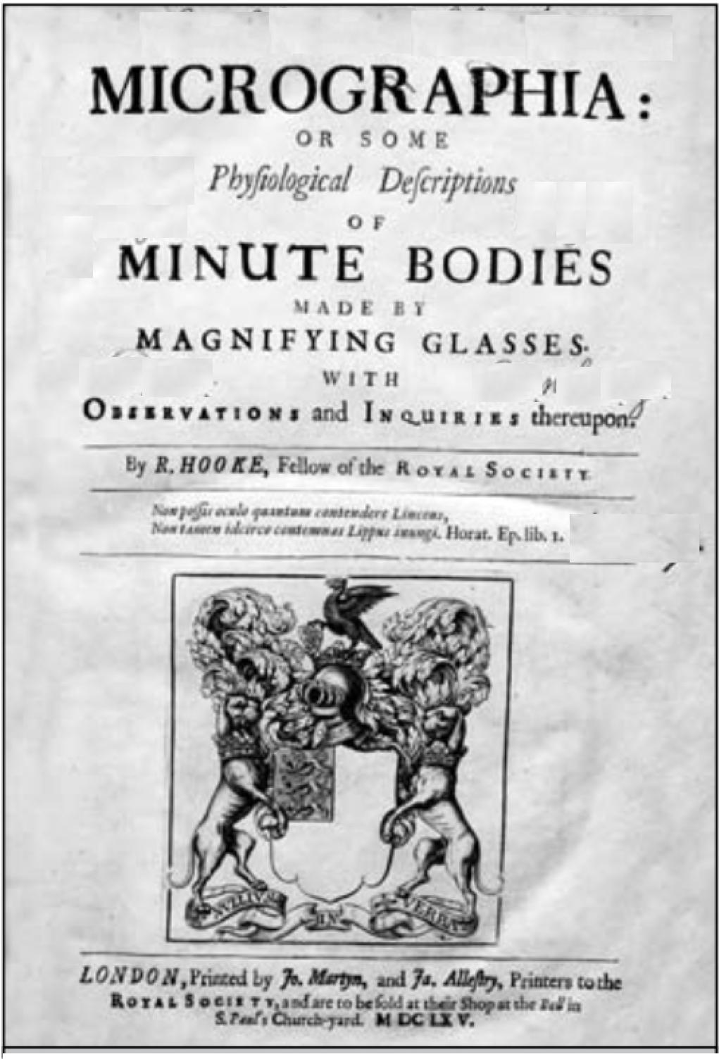
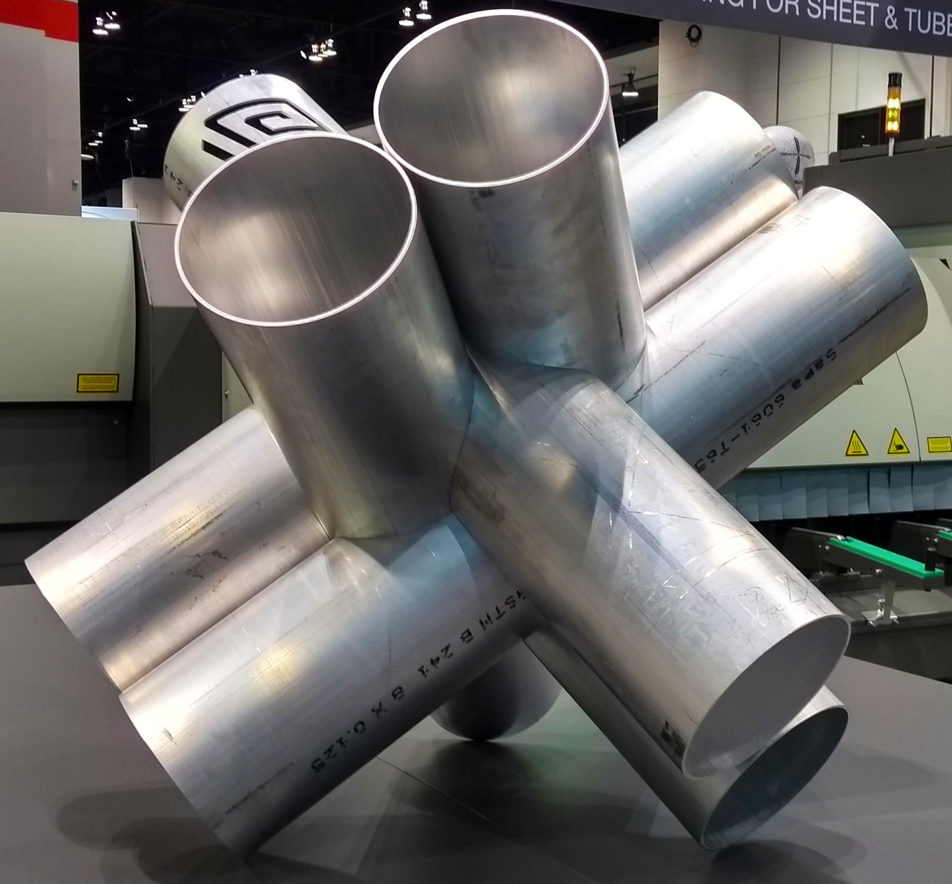


Slide 3
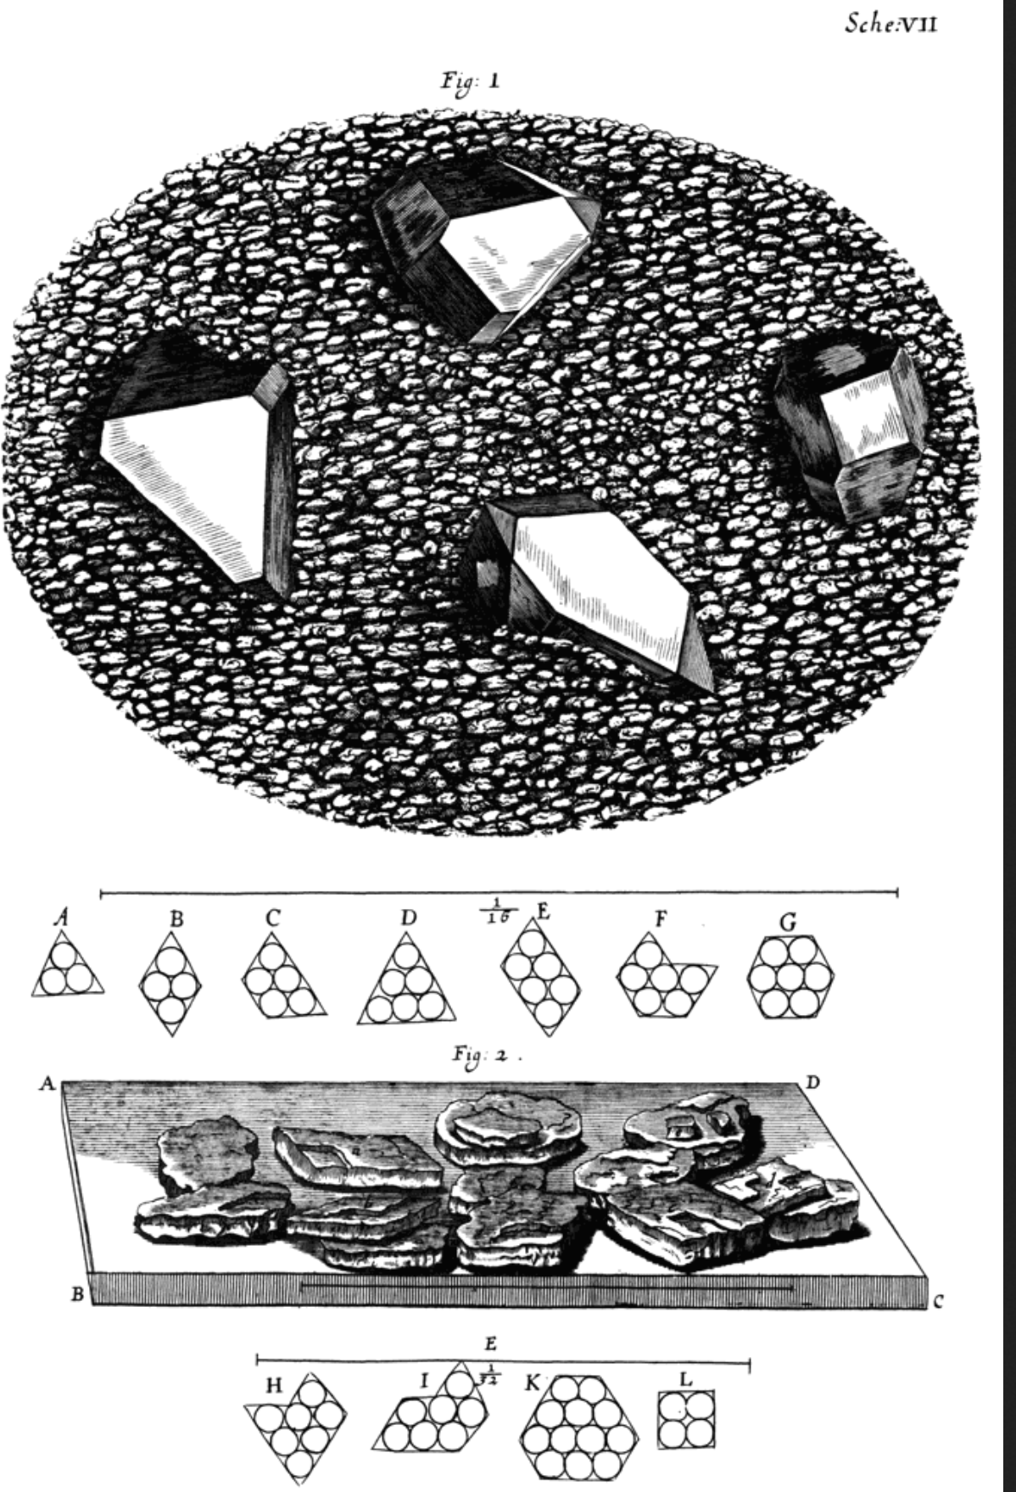
Robert Hooke, Micrographia, 1665
Sche:VII

Slide 4
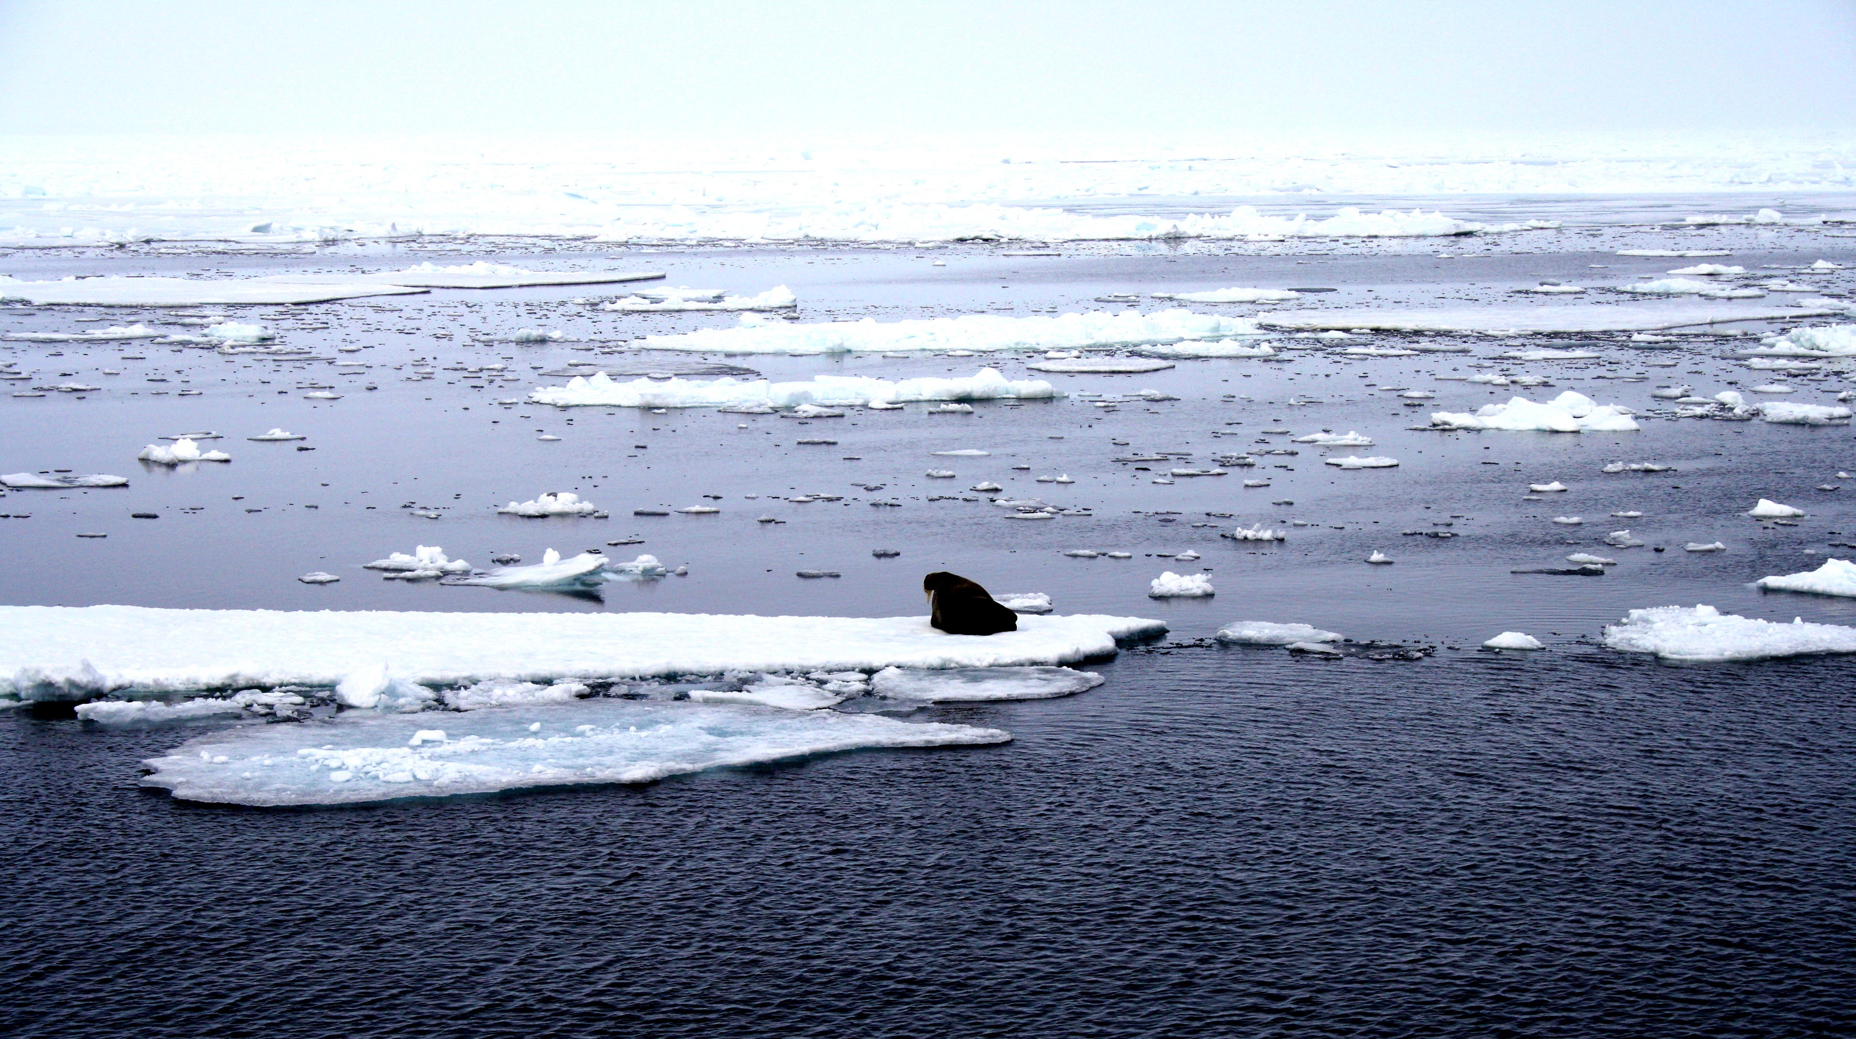
Phase transitions
Harry Bhadeshia
Haixue Yan
Phase transformations
ice: pure
ocean: salty water
photograph courtesy of Sunita Hansraj from her Antarctica expedition

Slide 5
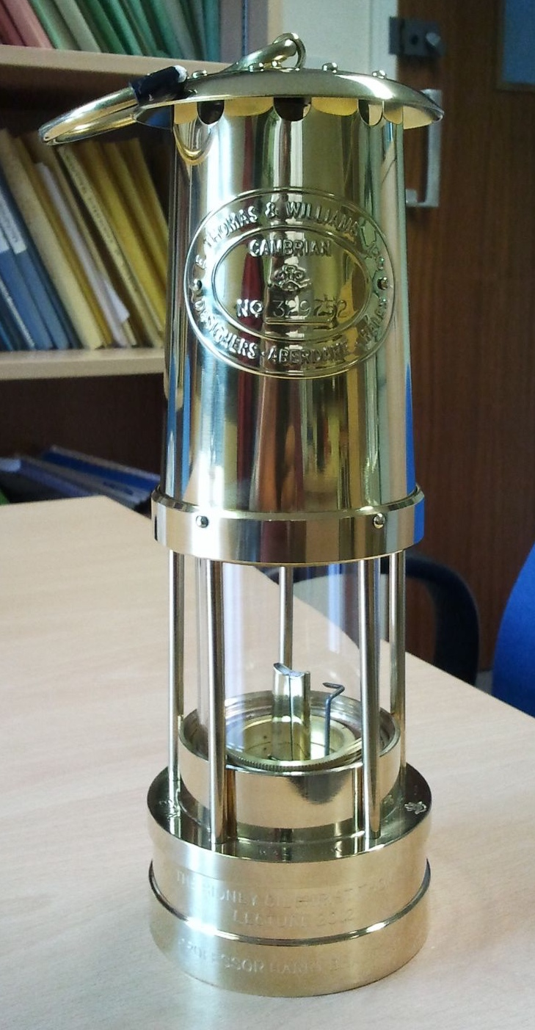
Definition of a phase

Slide 6
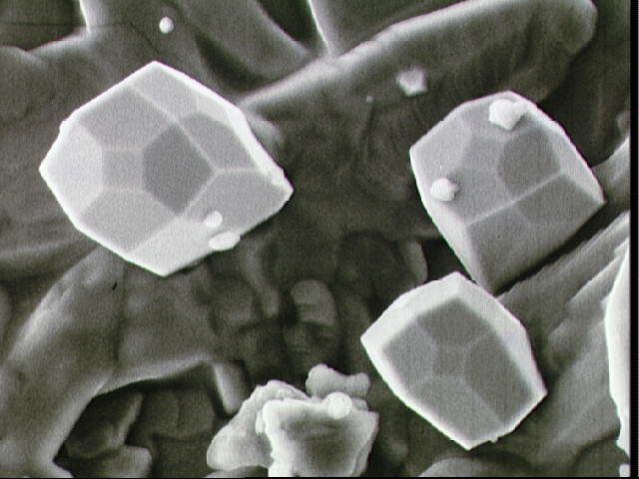

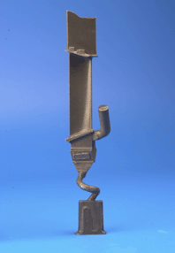
crystalline
NASA image S72-552082

Slide 7
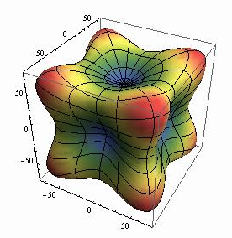
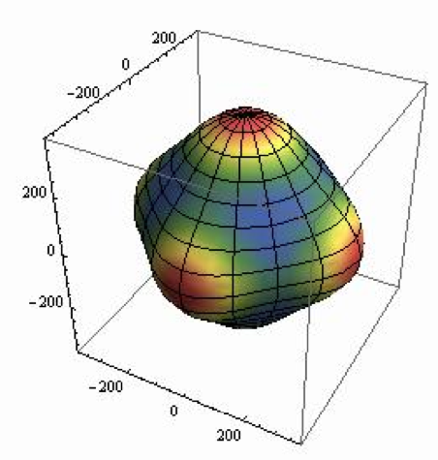
Anisotropy elastic modulus / GPa
Mo
Ag

Slide 8

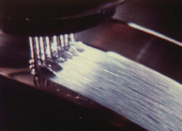
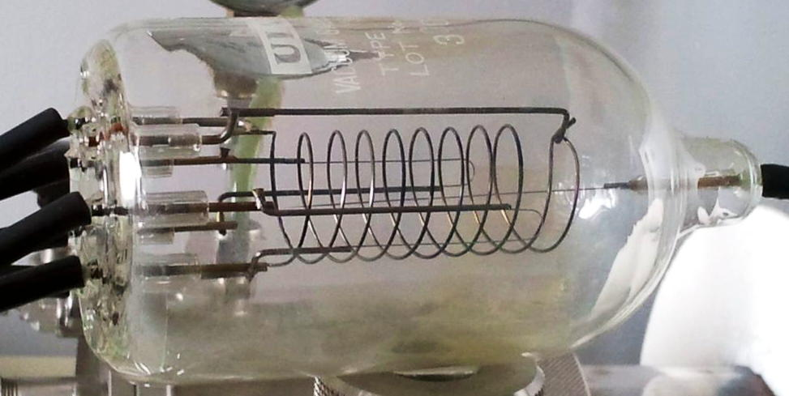
liquid to glass transition
amorphous

Slide 9
anisotropic molecules
liquid crystal,
somewhat ordered
liquid: cannot support
shear stress
solid crystal, ordered

Slide 10
A transformation: change in atomic arrangement.
….. by breaking all original bonds and making new ones
….. by deformation into a new pattern

Slide 11
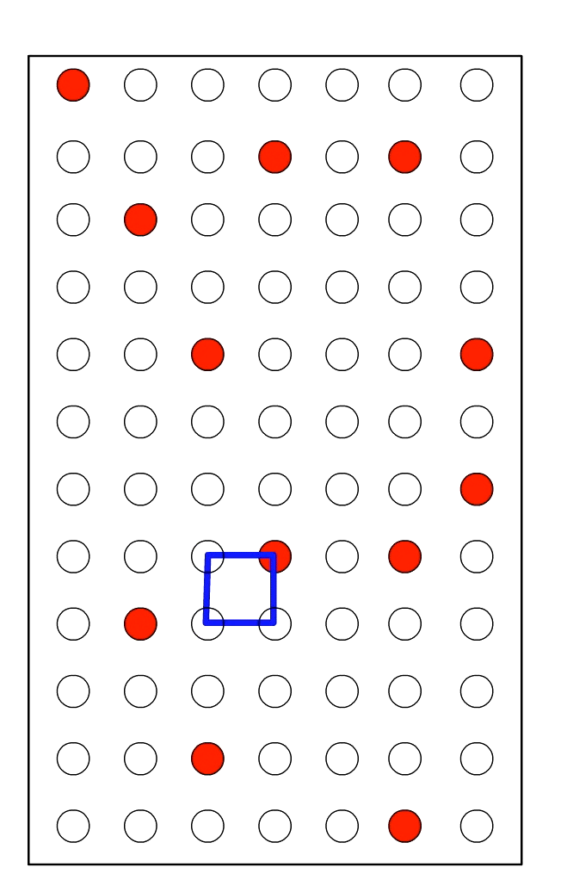
reconstructive transformation
diffusion
change in composition
minimal strain energy
close to equilibrium

Slide 12
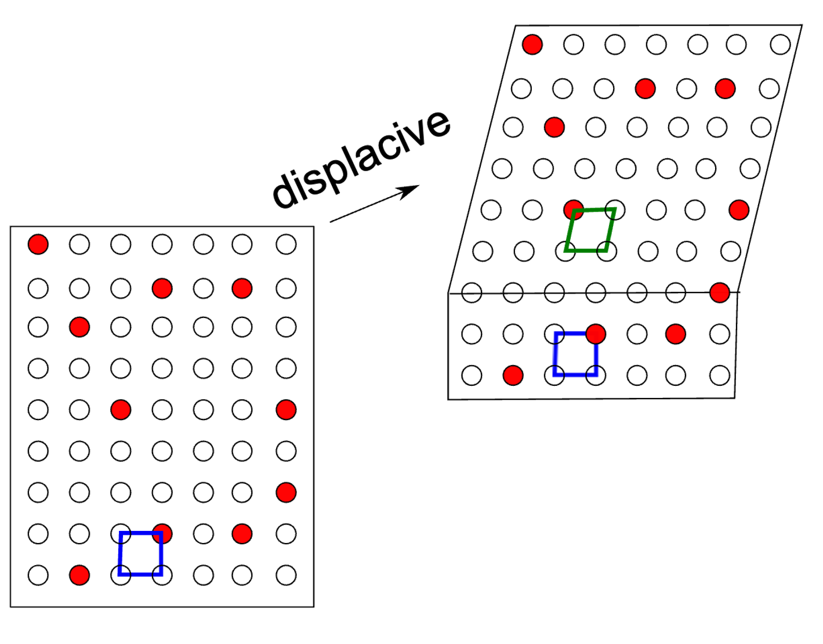
Low atomic mobility:
all atoms

Slide 13
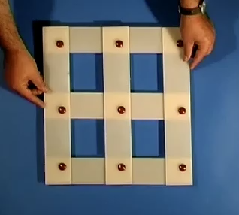
displacive transformation
diffusionless
no change in composition
large strain energy
far from equilibrium

Slide 14
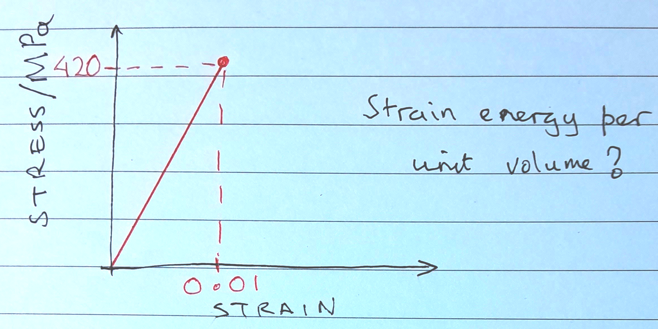
Problem 1
Elastic modulus = 200 GPa

Slide 15
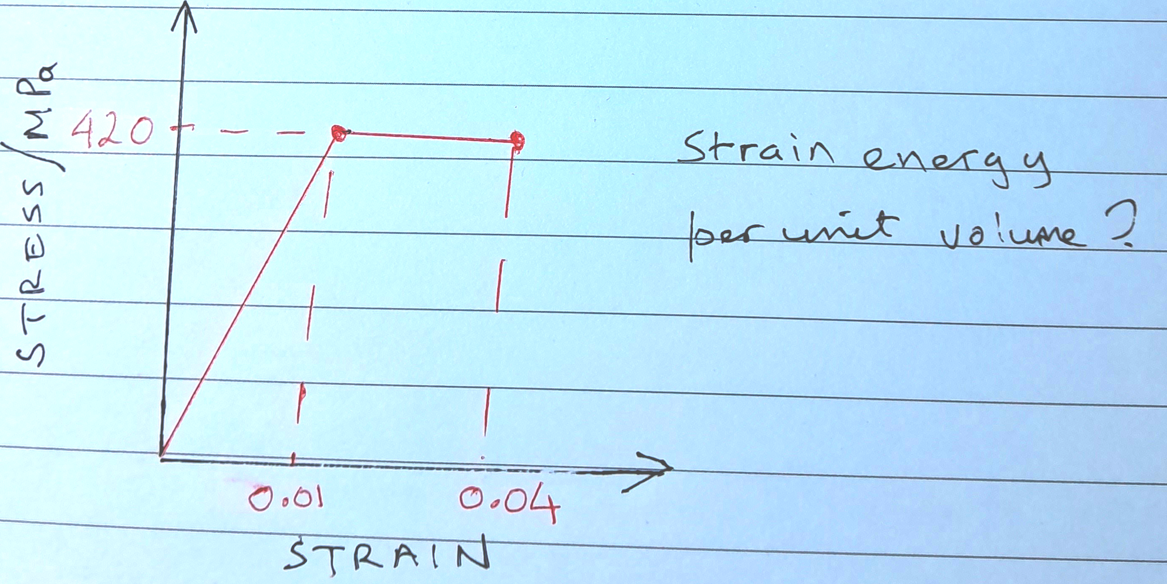
Problem 2
Elastic modulus = 200 GPa

Slide 16
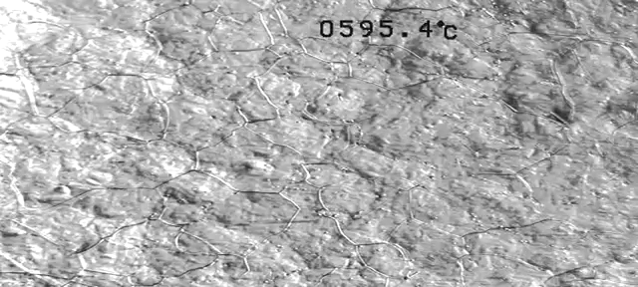
Real time
thermally induced, steel
|
|
50 µm
J. H. Pak, D. W. Suh, H. K. D. H. Bhadeshia
Metall. & Mater. Trans A 43 (2012) 4520

Slide 17
one condition for diffusionless growth

Slide 19
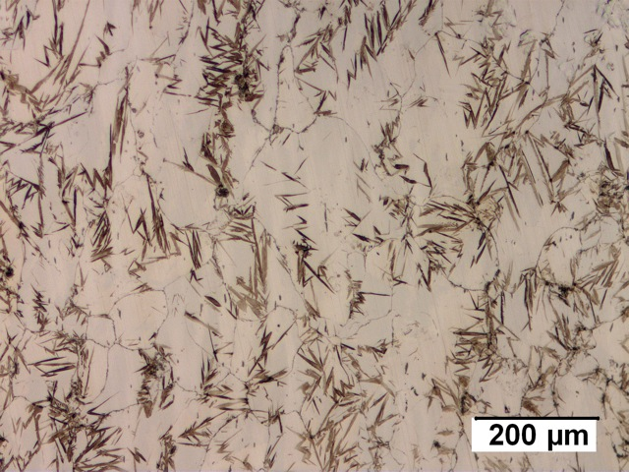
martensite

Slide 20
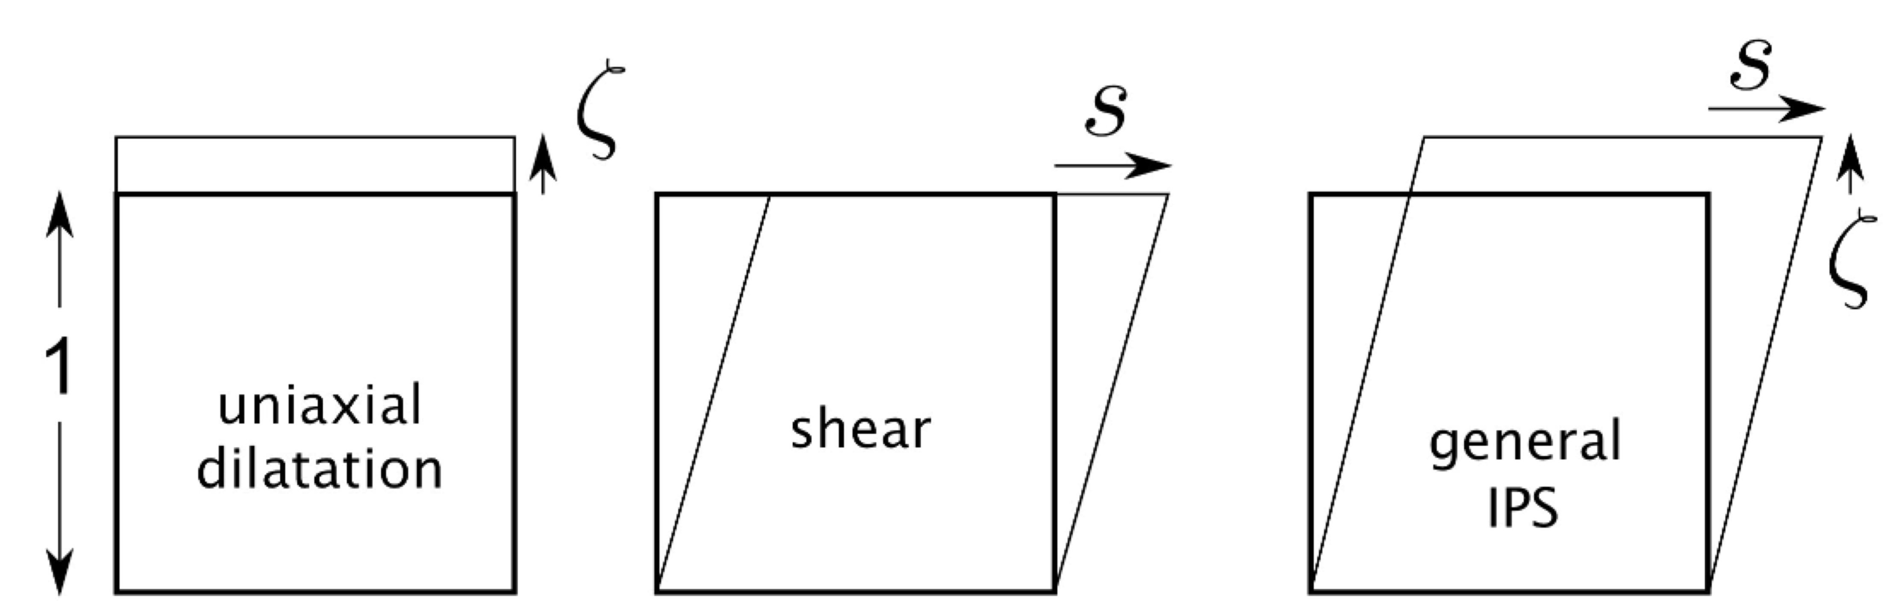
IPS: invariant-plane strain

Slide 21
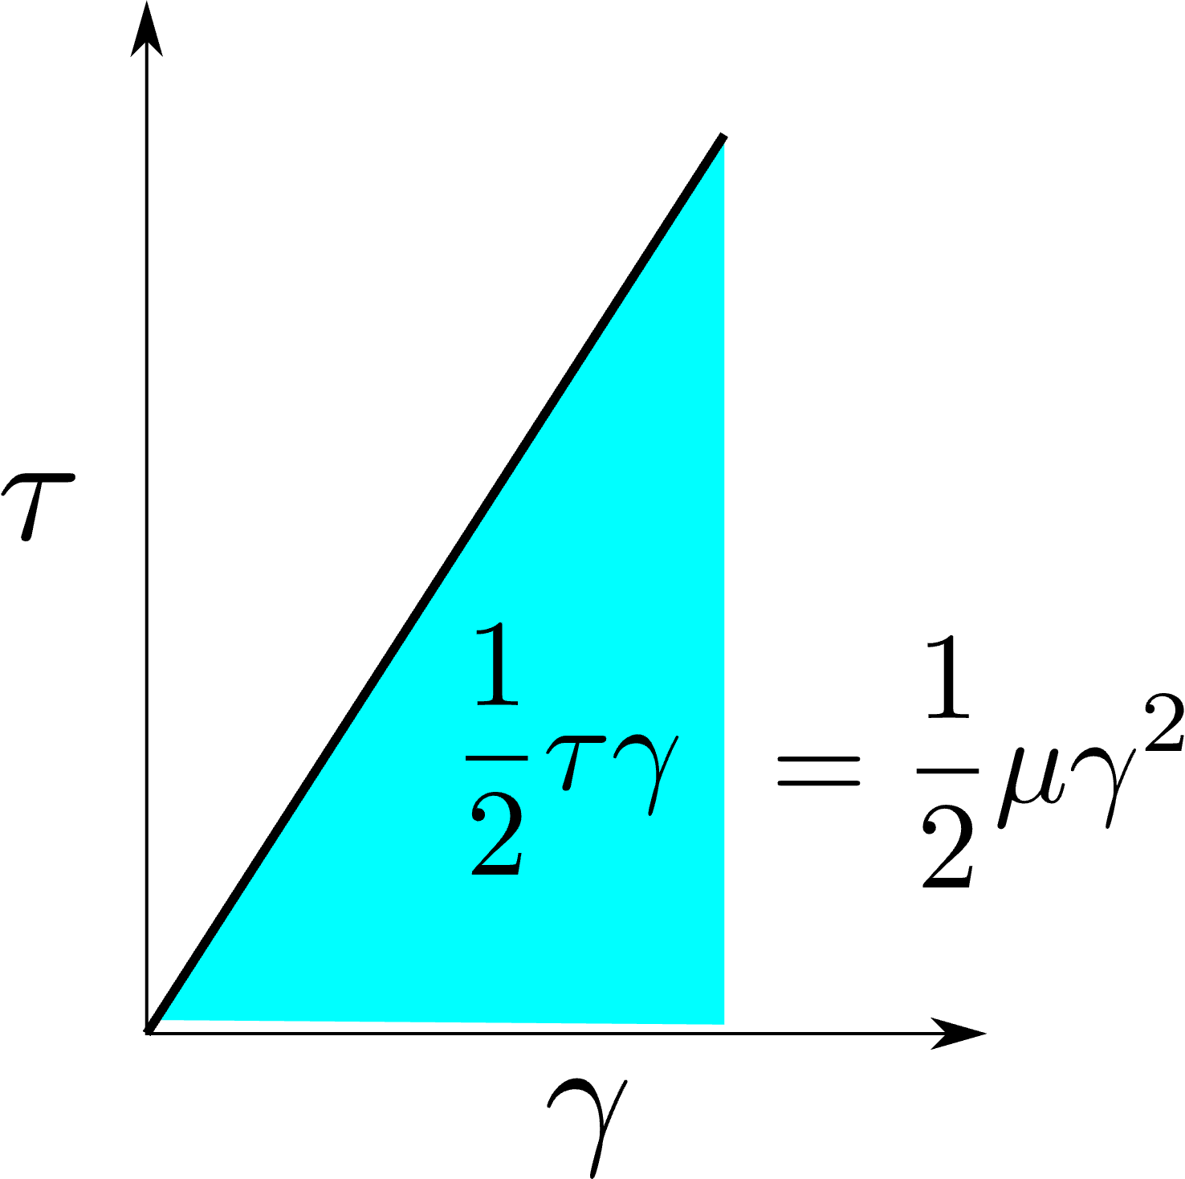

Slide 22
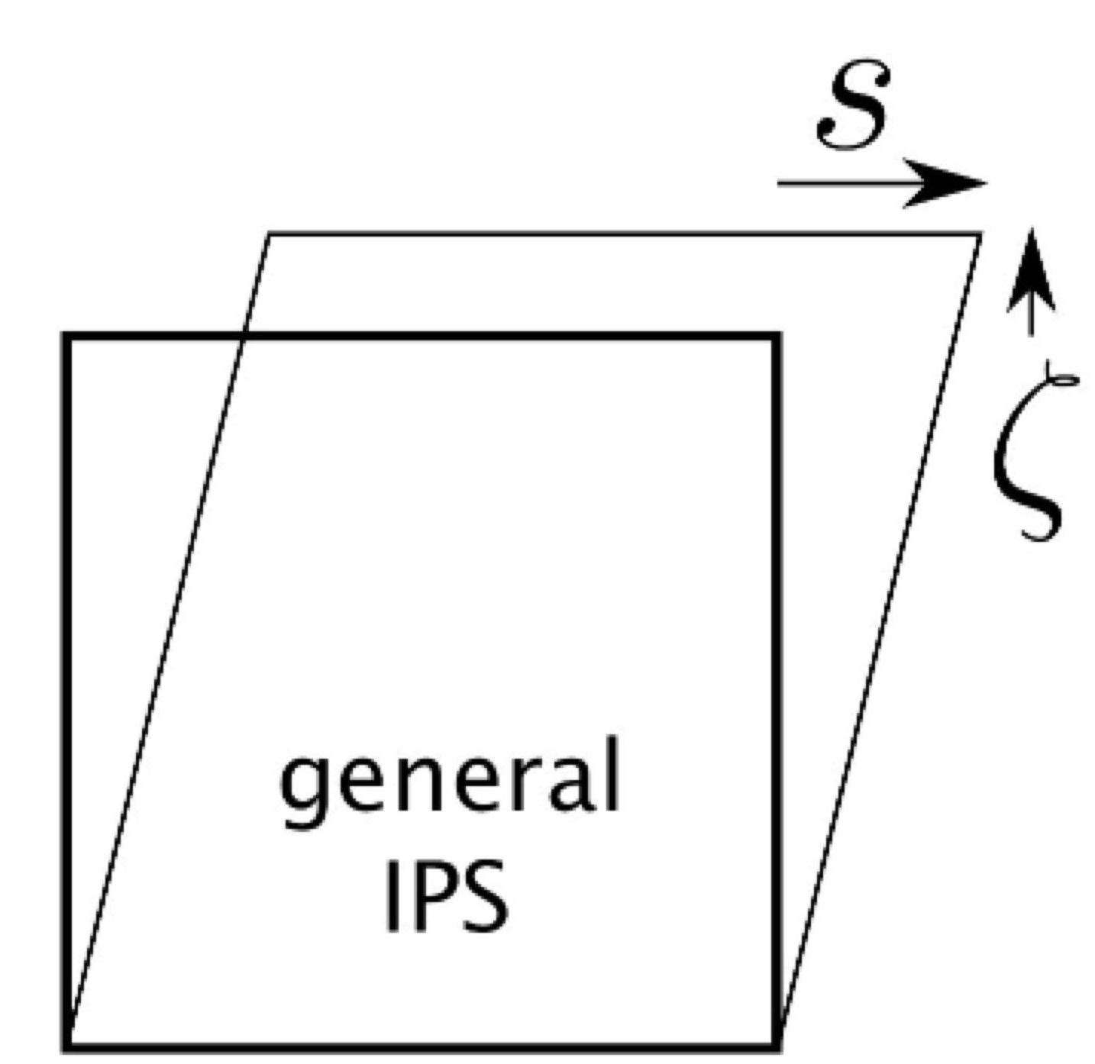

Slide 23
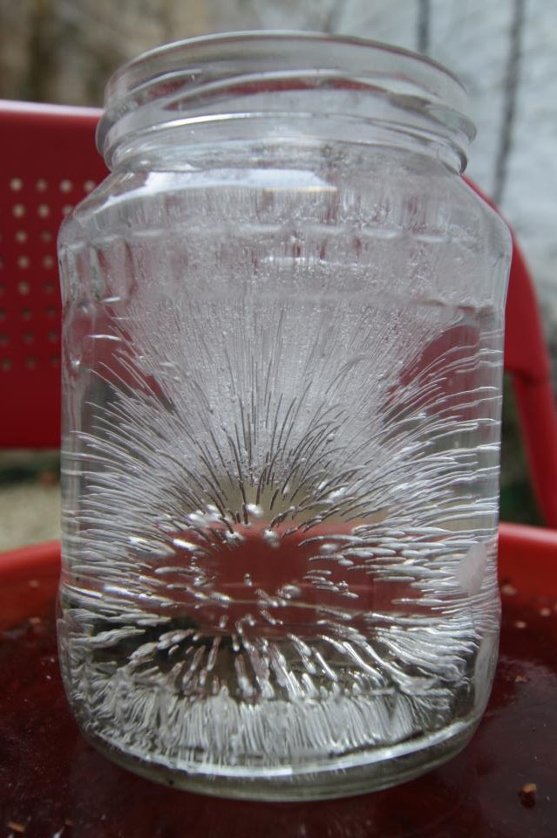
Reconstructive
transformation
Sufficient atomic mobility

Slide 24
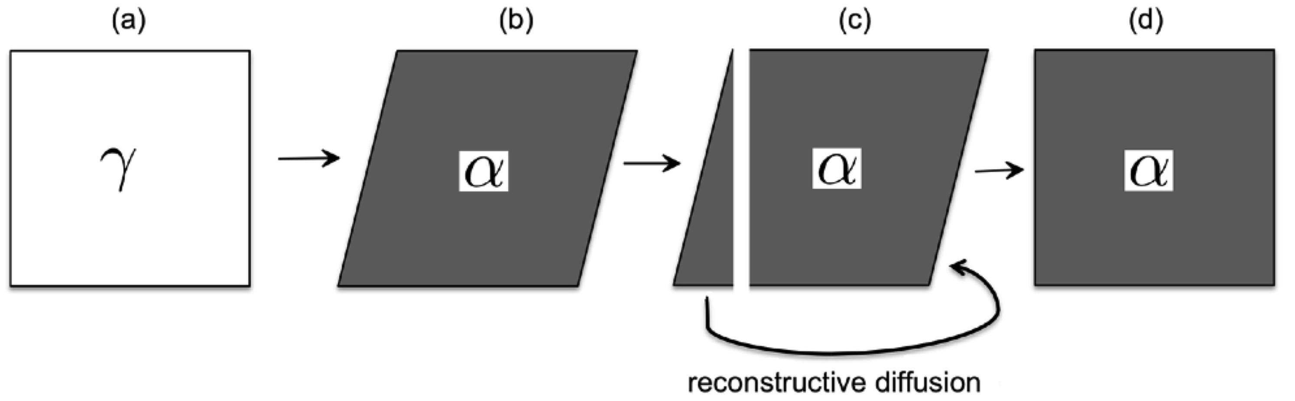
Phenomenological interpretation of reconstructive transformation

Slide 25
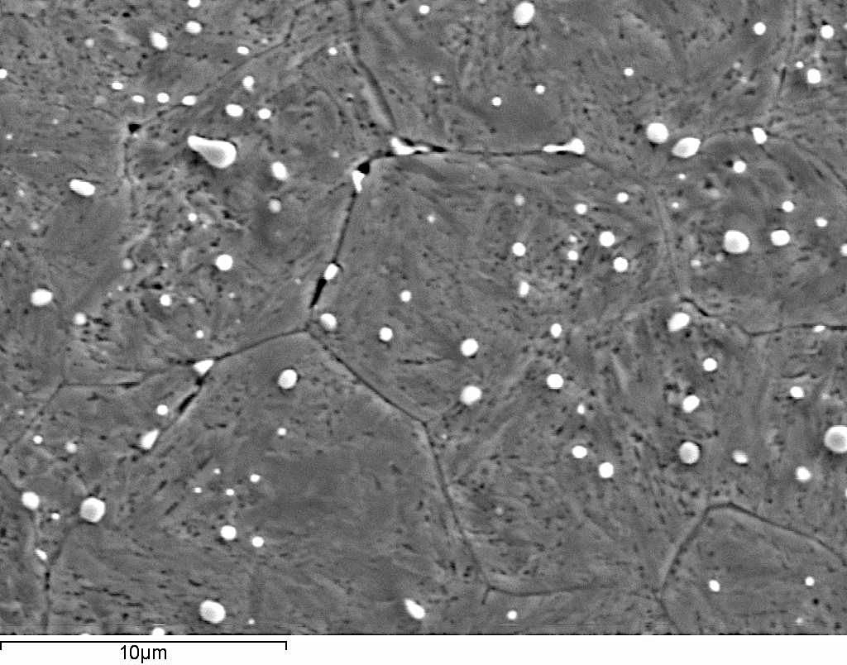

Slide 26
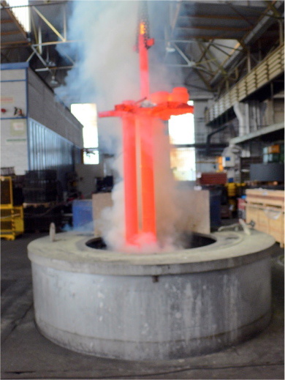
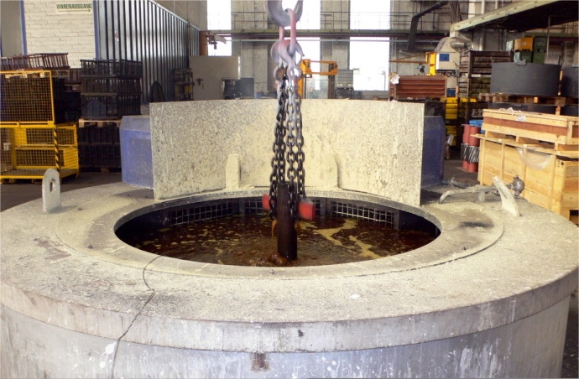
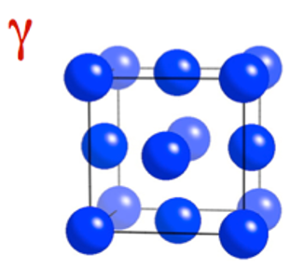
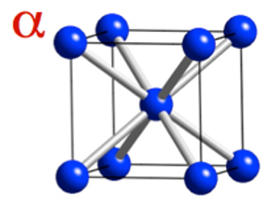
Transformation of a phase

Slide 27
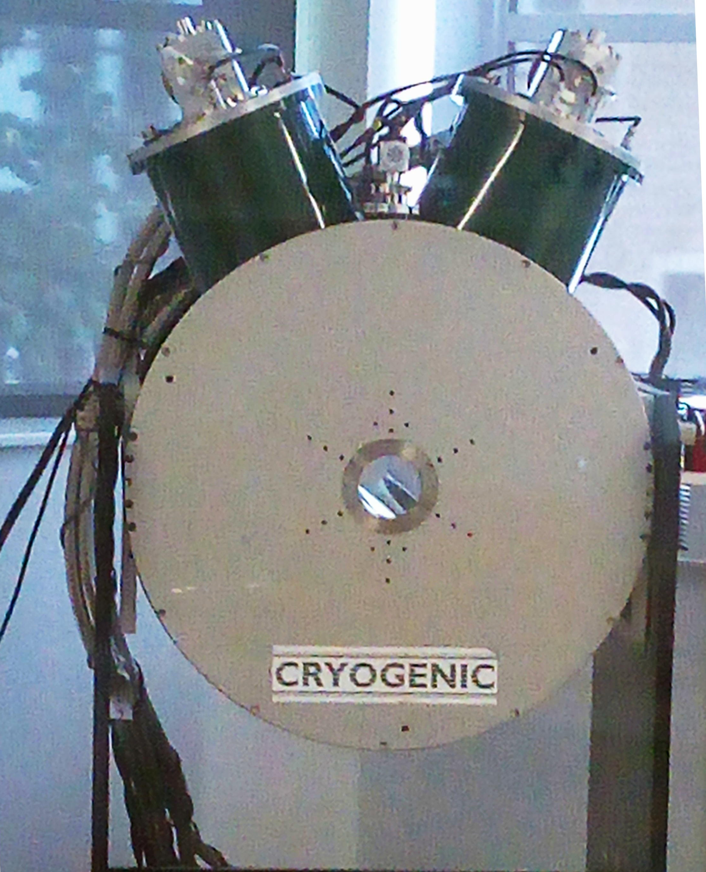
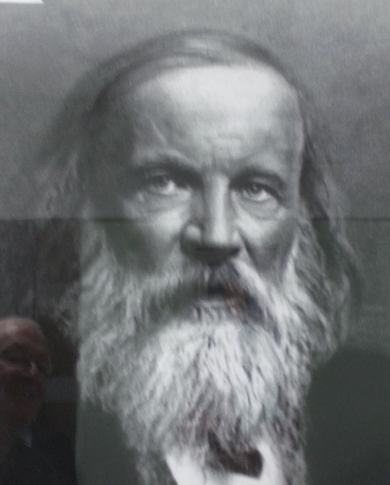
Transformation of a phase
magnetic fields
field strength at Earth's magnetic equator is 0.0000305 Tesla.
We can do experiments using 10 Tesla.
field measured in Teslas
QMUL-SEMS laboratory 136
Nikola Tesla

Slide 28
Why does a change in temperature sometimes cause a change in phase? Why … change in magnetic field …

Slide 29
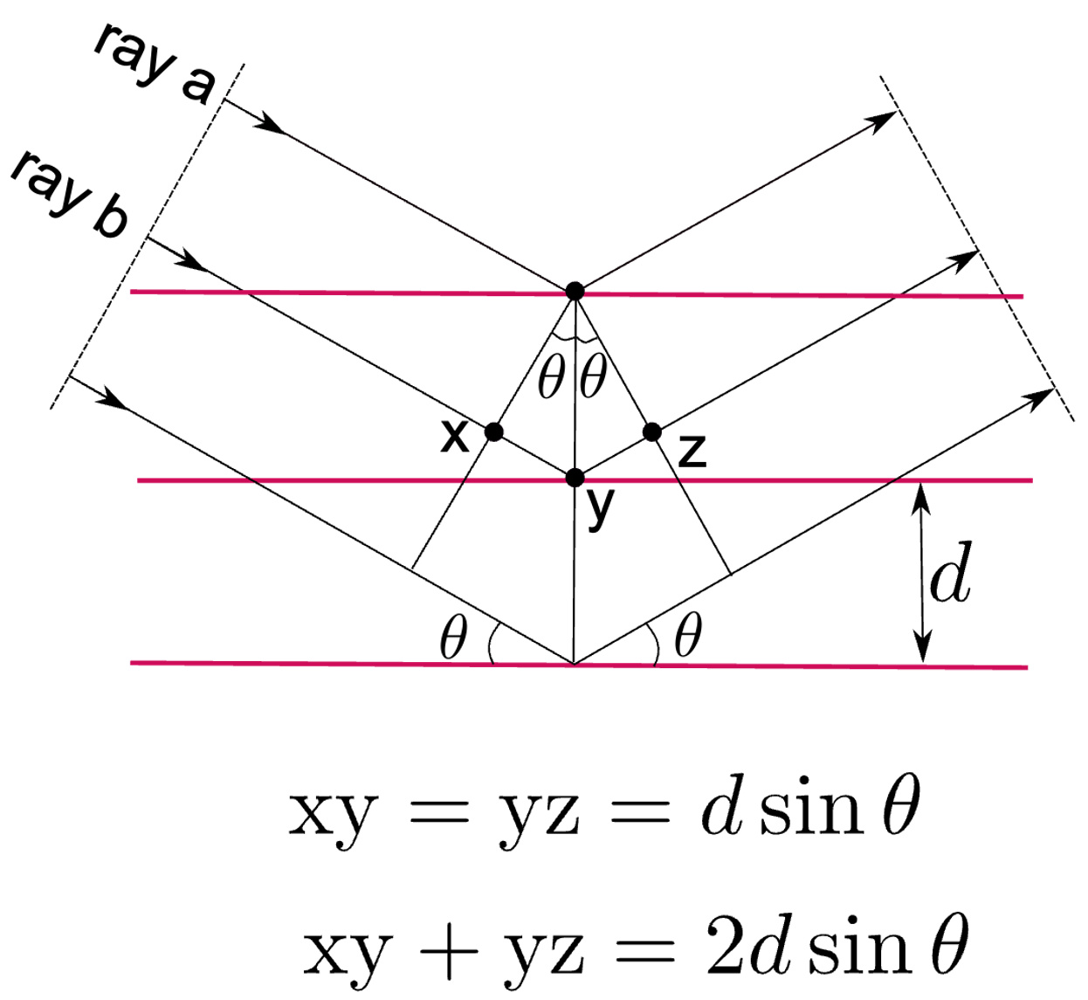
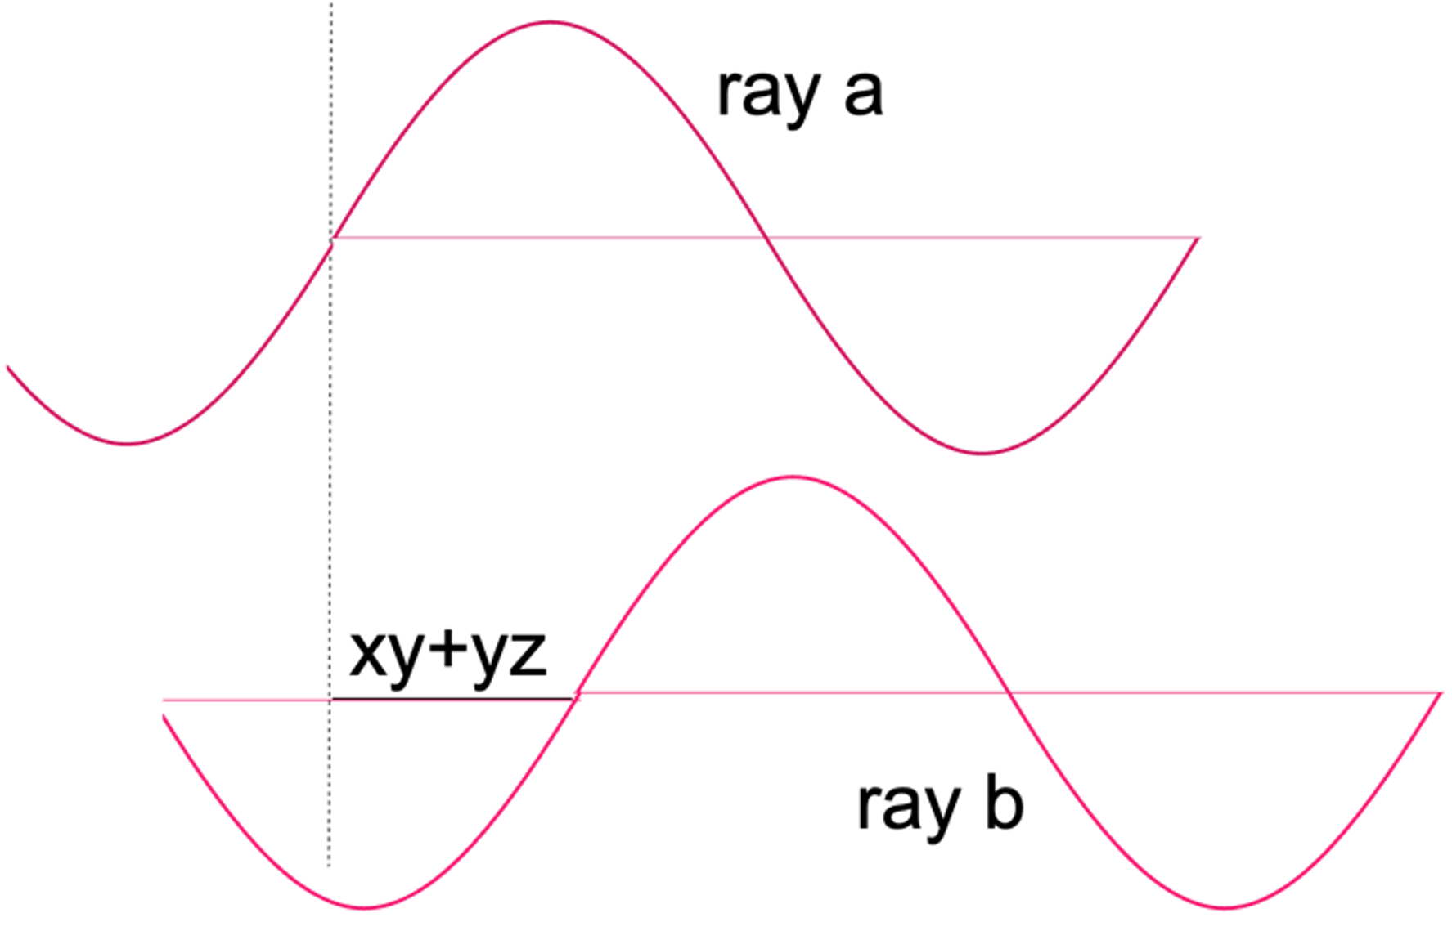
How to detect change in phase: one method, diffraction

Slide 30
Bragg equation: constructive interference

Slide 31
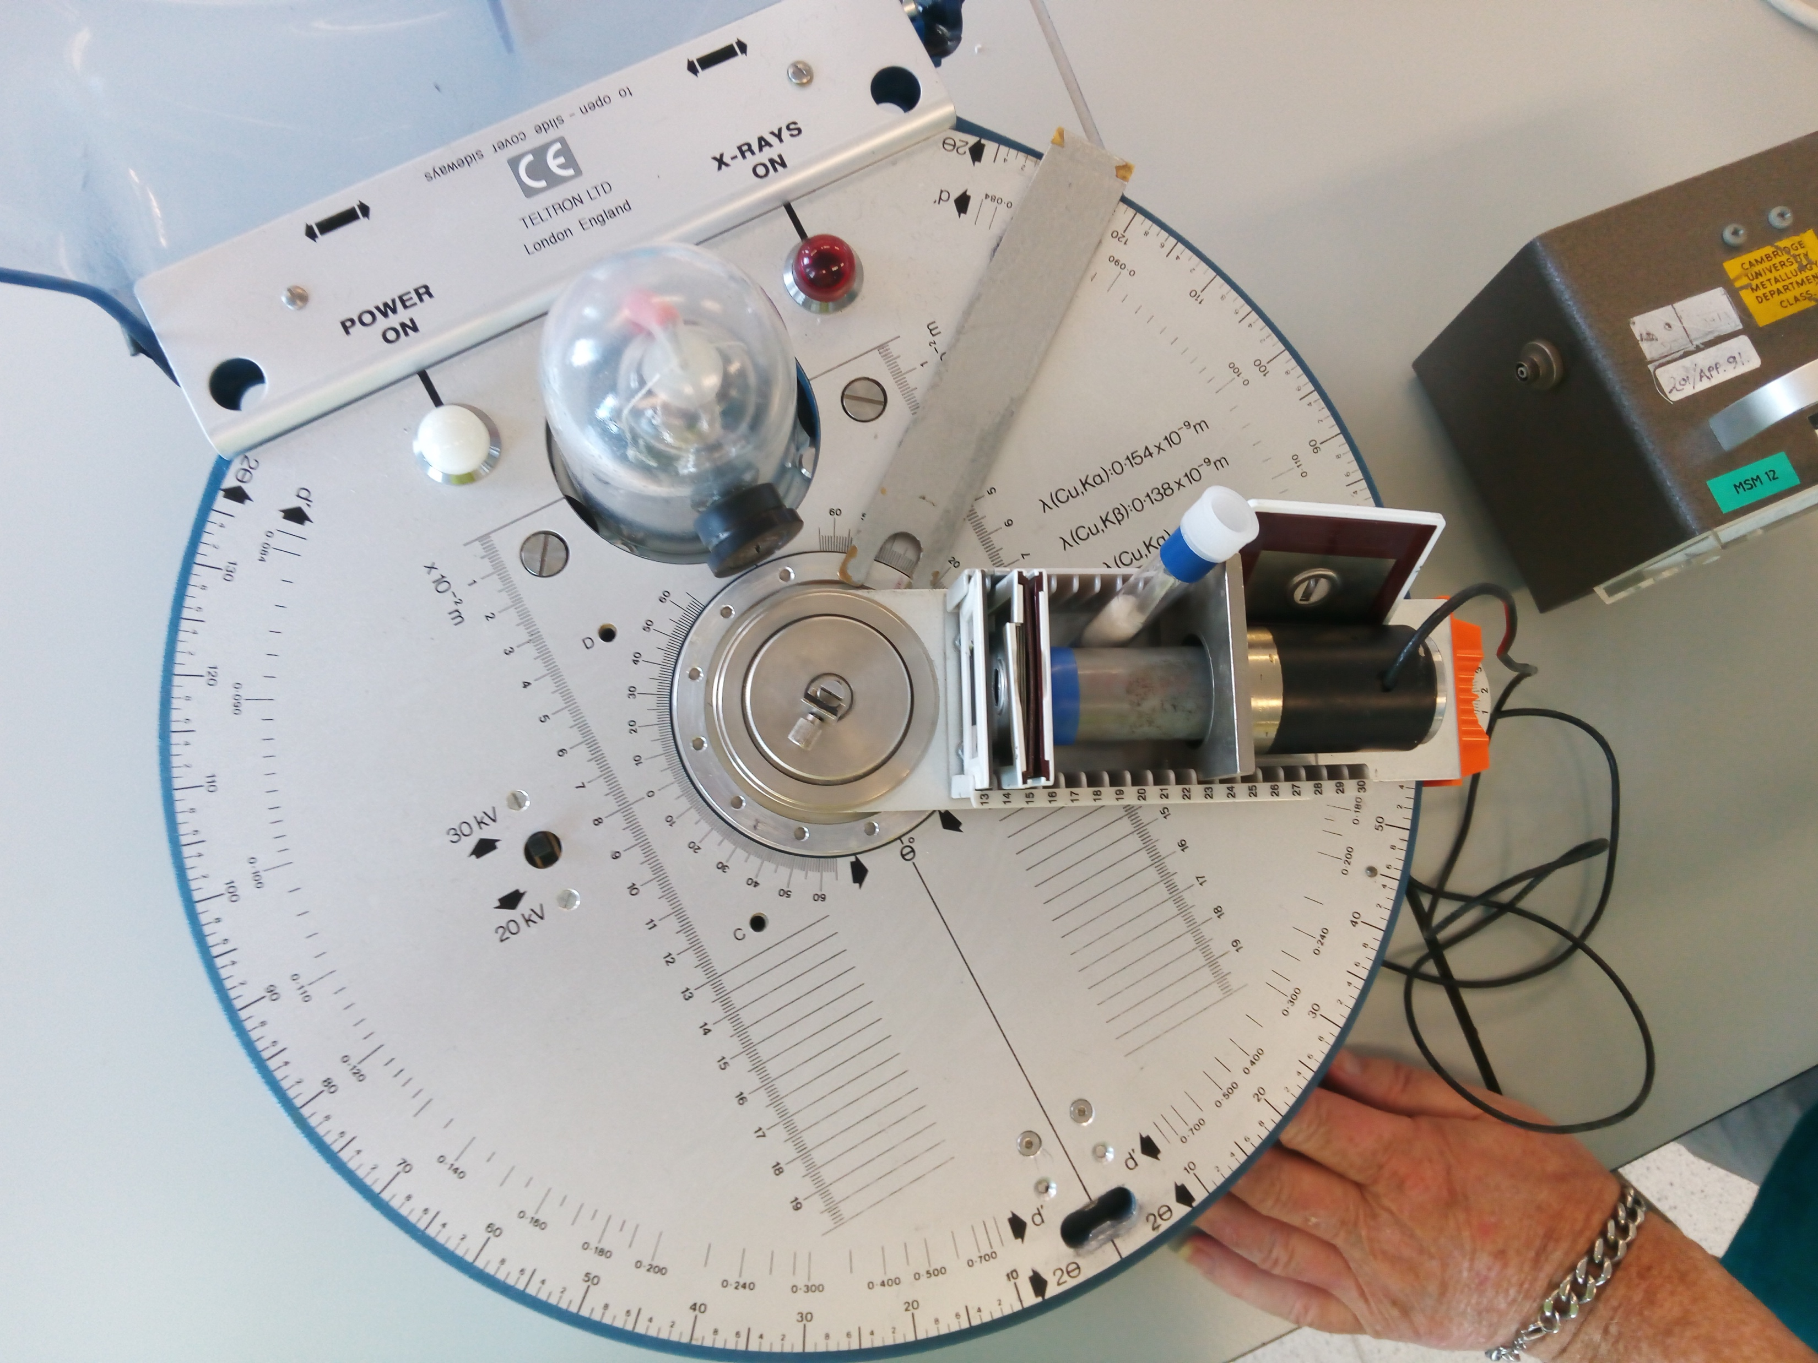
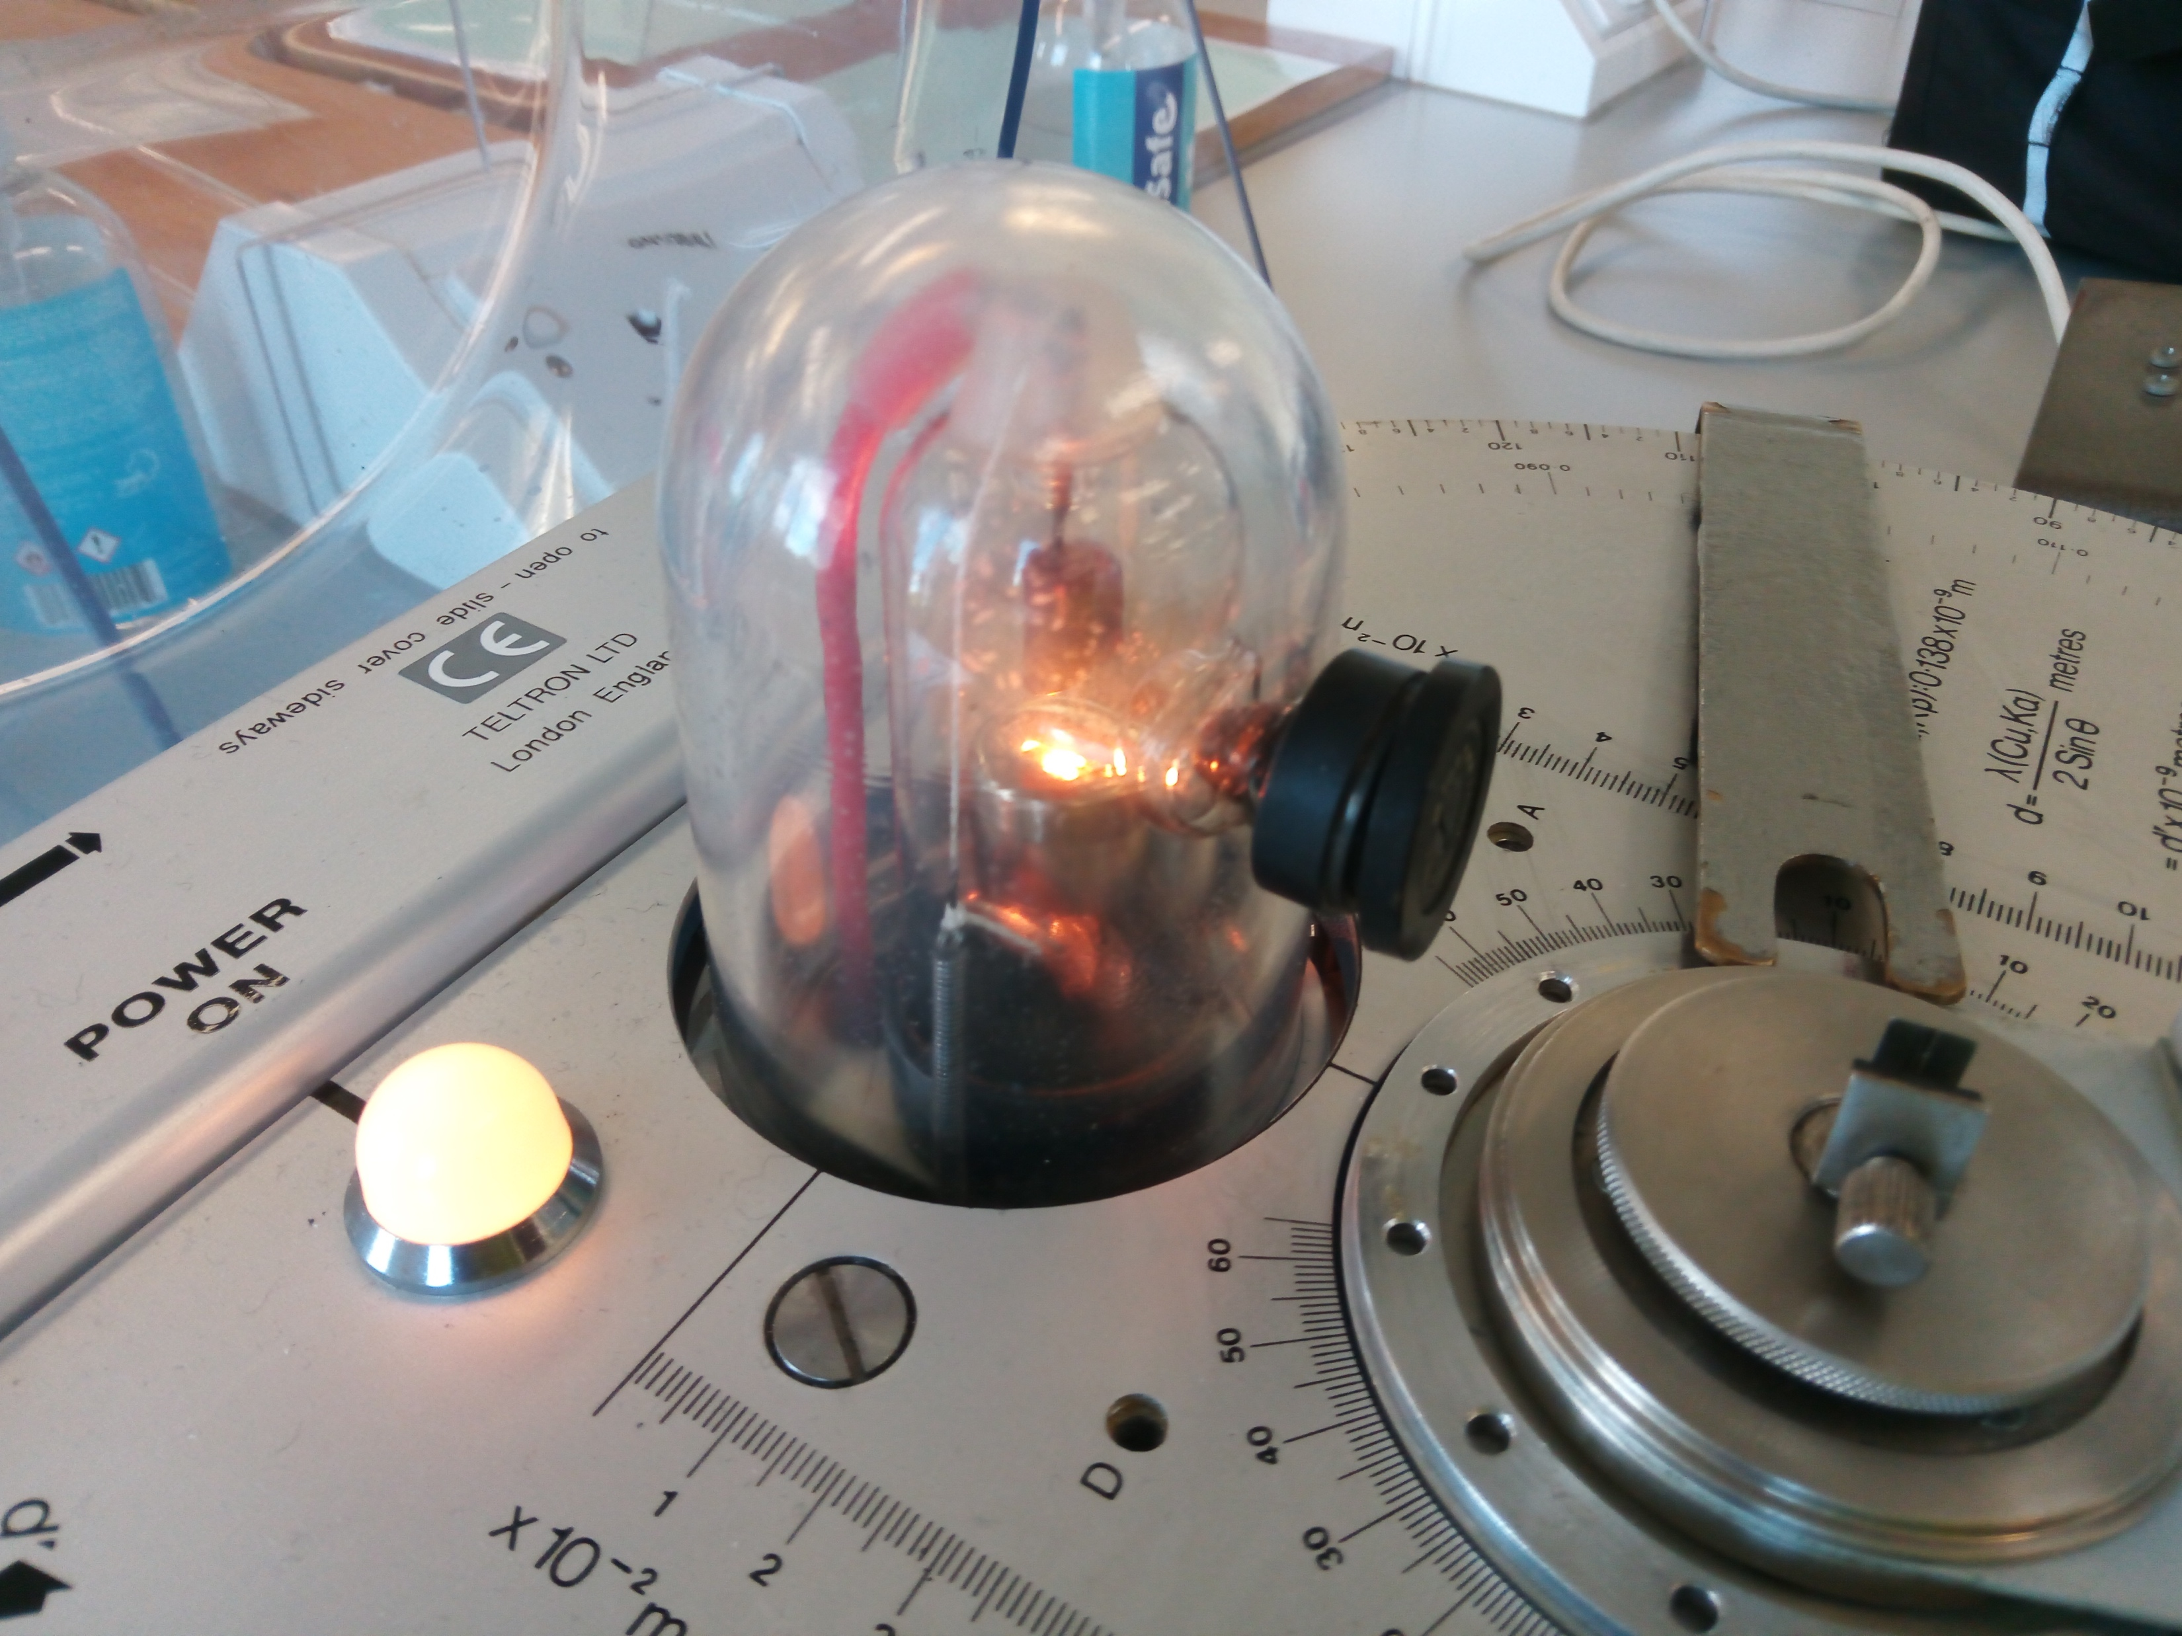
Desktop X-ray diffraction equipment

Slide 32
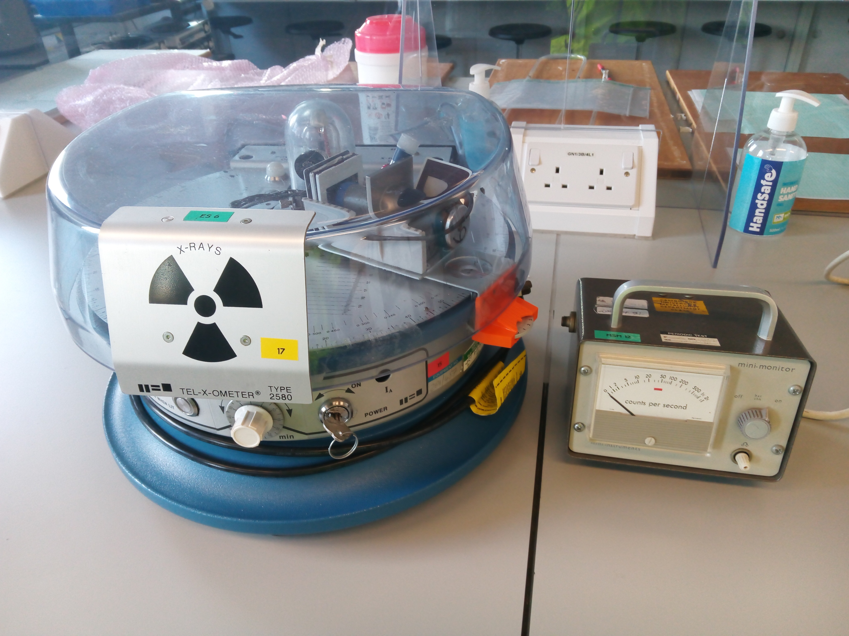
Shielding

Slide 33
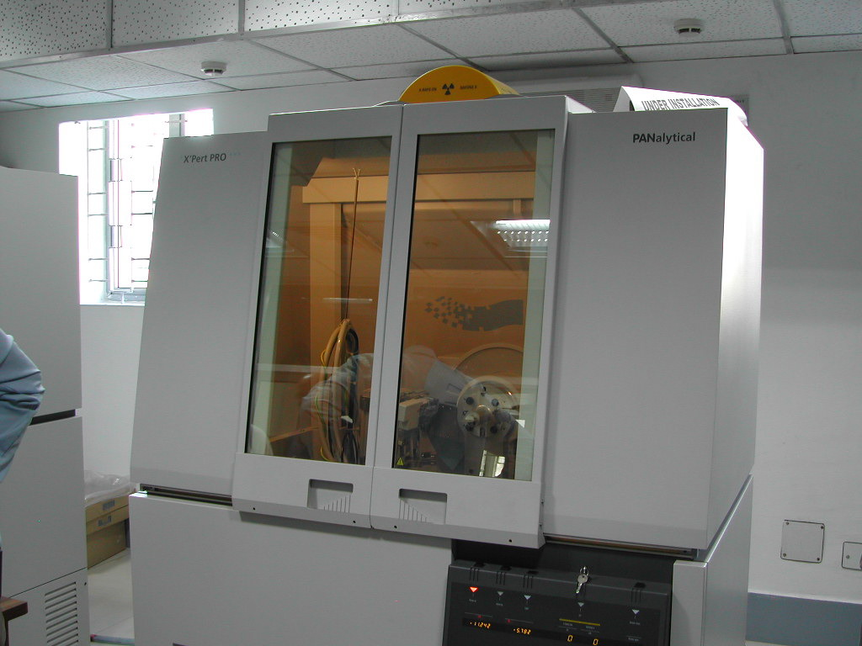
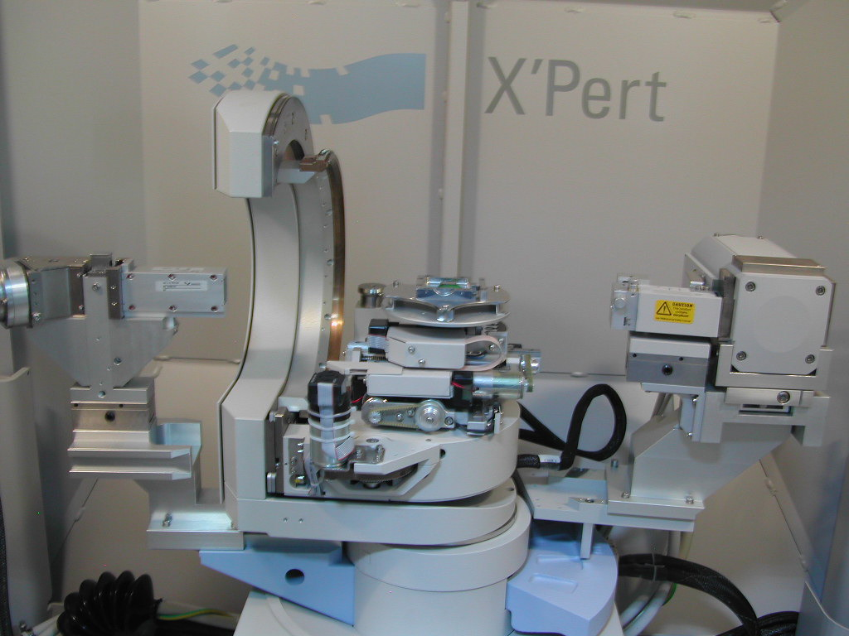
X-ray diffraction

Slide 34
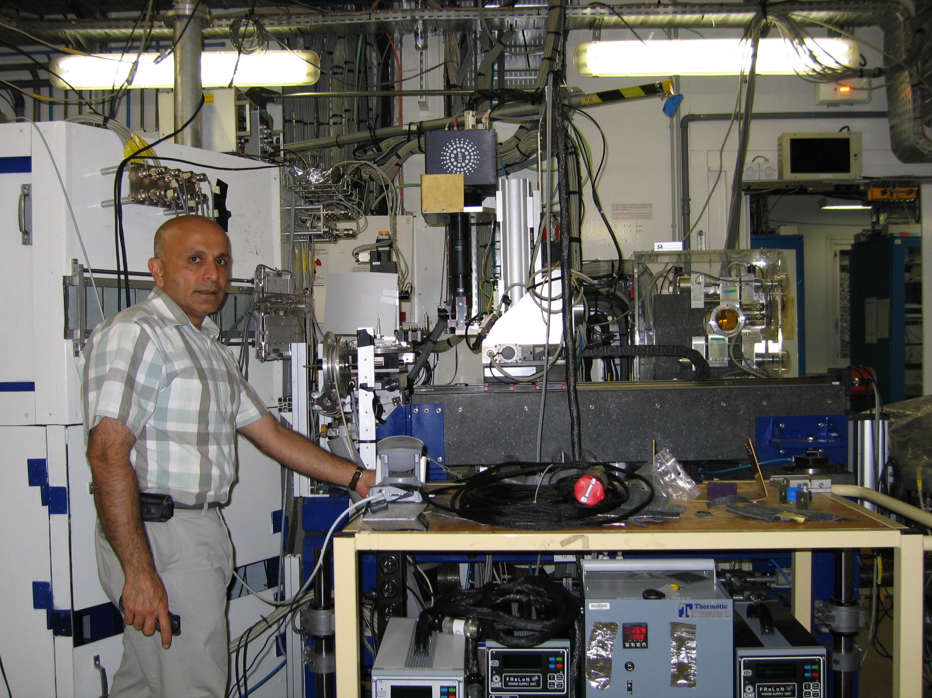
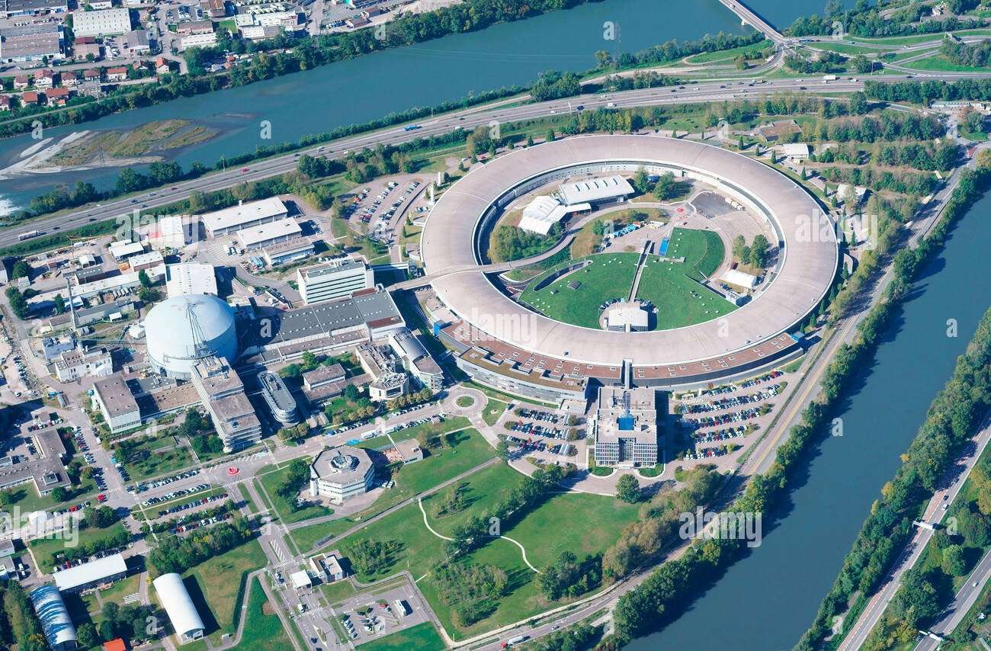
European synchrotron facility

Slide 35
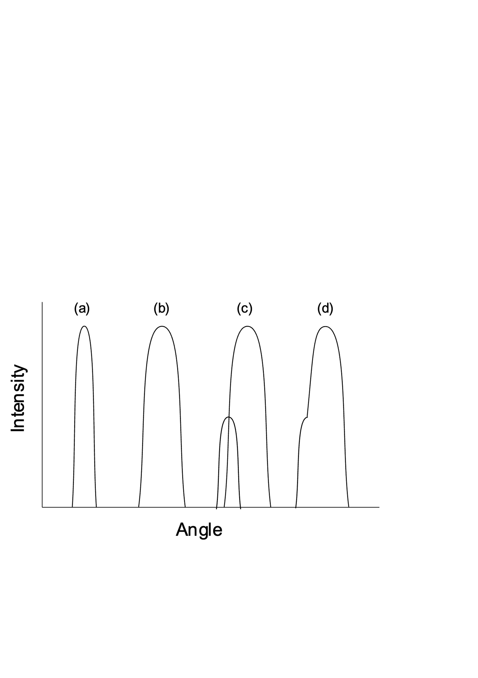
Symmetrical
Symmetrical
Not symmetrical

Slide 36
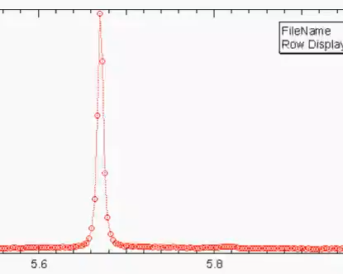
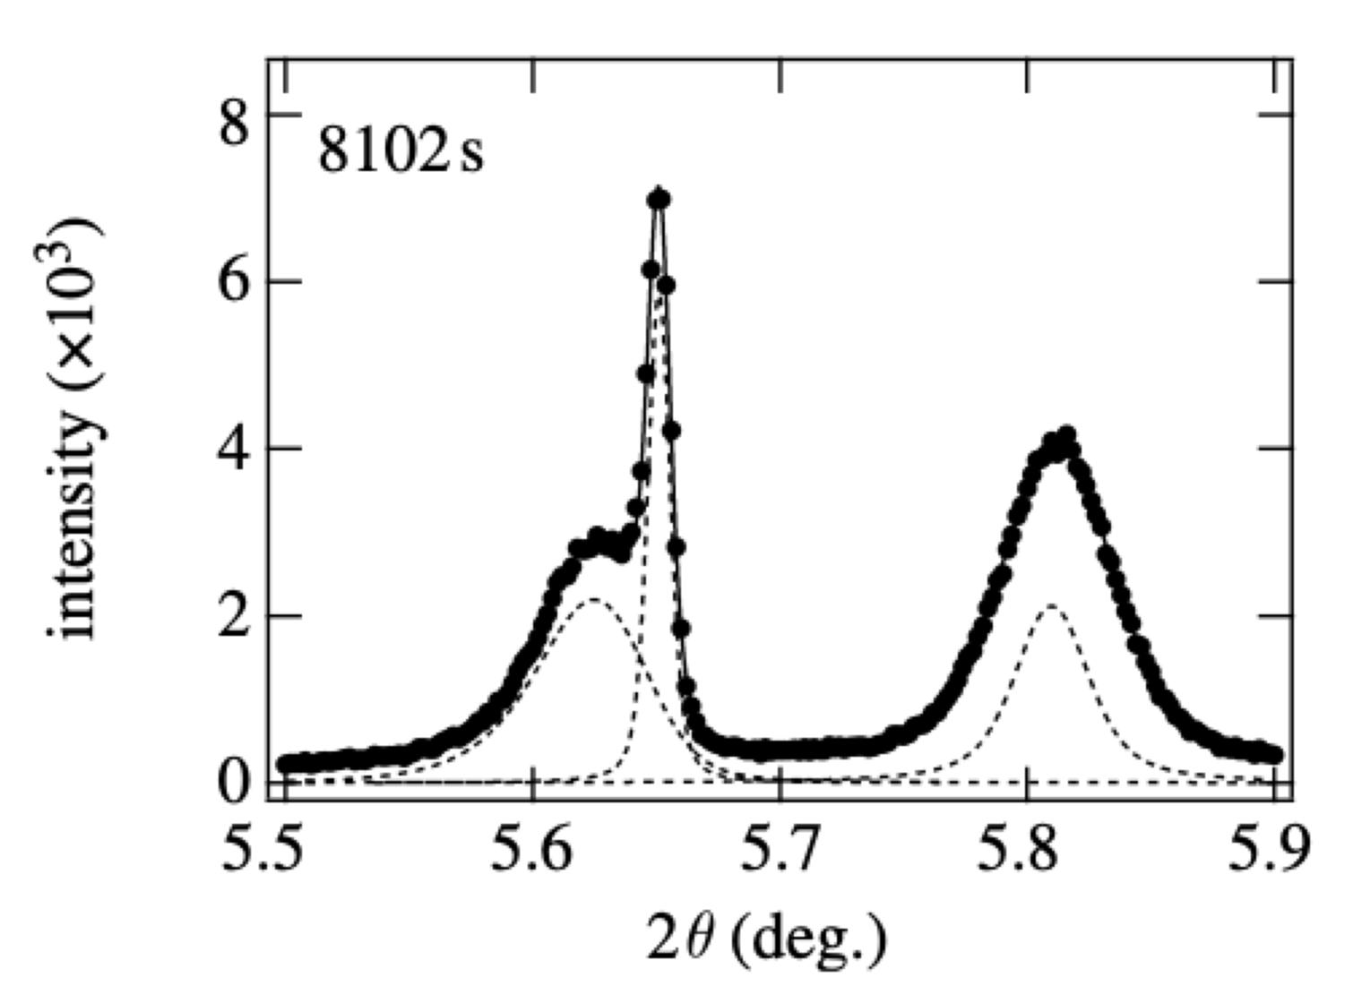
Real-time sequence
Intensity
Diffraction angle 2θ
H. J. Stone, M. J. Peet, H. K. D. H. Bhadeshia, P. J. Withers, S. S. Babu, E. D. Specht
Proc. of the Royal Society A, 464 (2008) 1009-1027

Slide 37
orthogonal axes

Slide 38
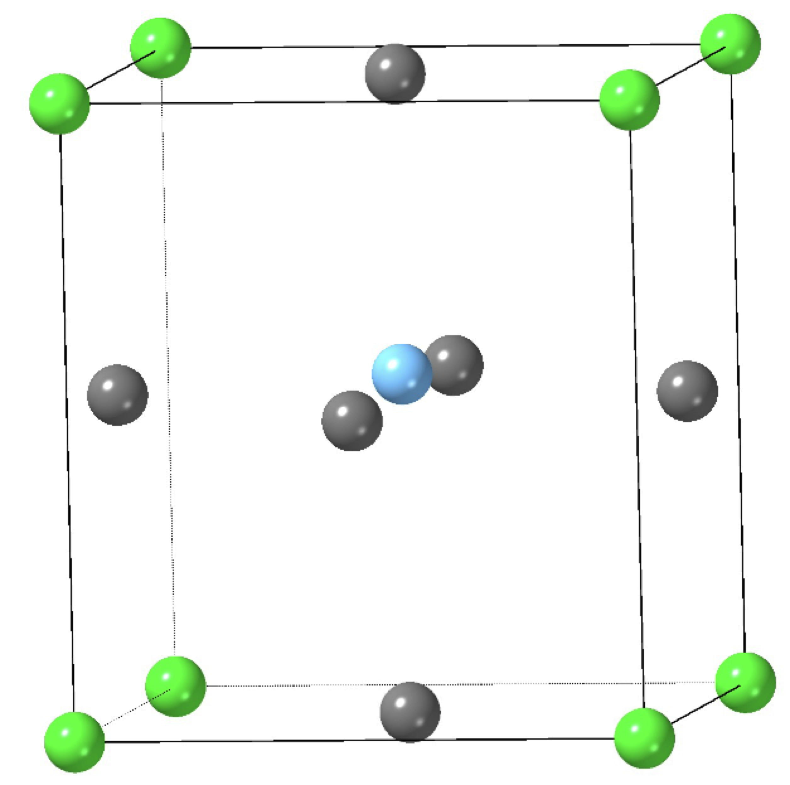
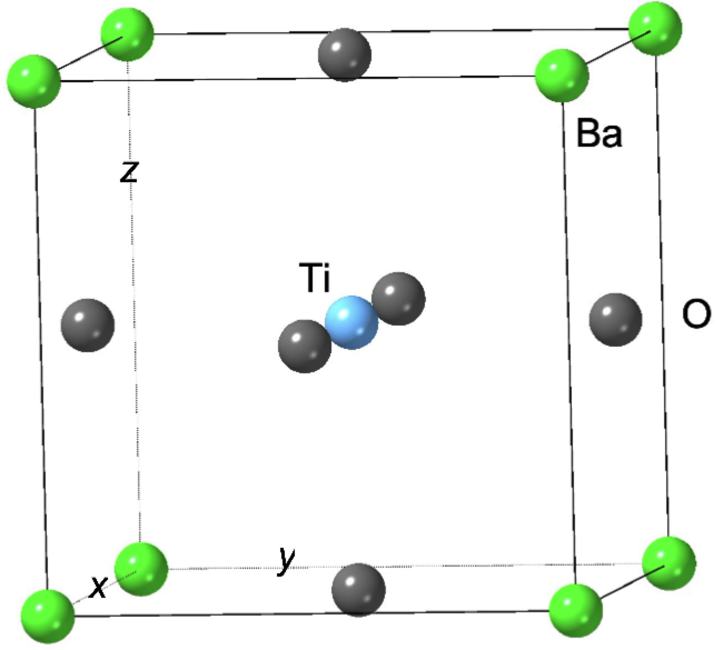
Barium titanate

Slide 39
Lattice parameter of cubic form = 0.404 nm

Slide 40
Cubic barium titanate

Slide 42
Tetragonal barium titanate

Slide 43
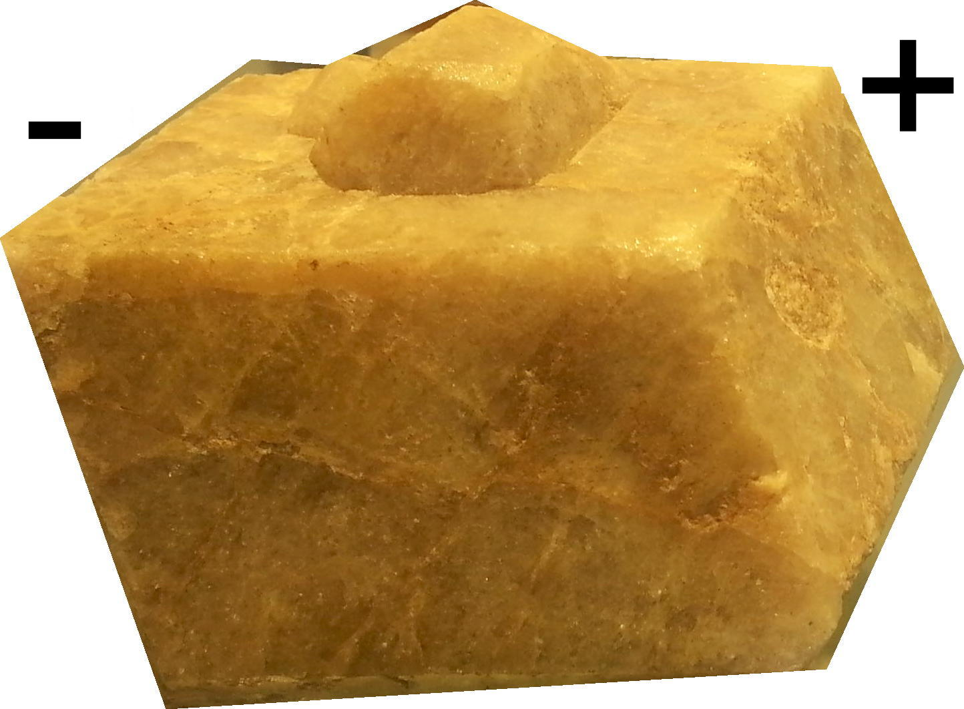


ferroelectric
piezoelectric
pyroelectric
no centre of symmetry

Slide 44
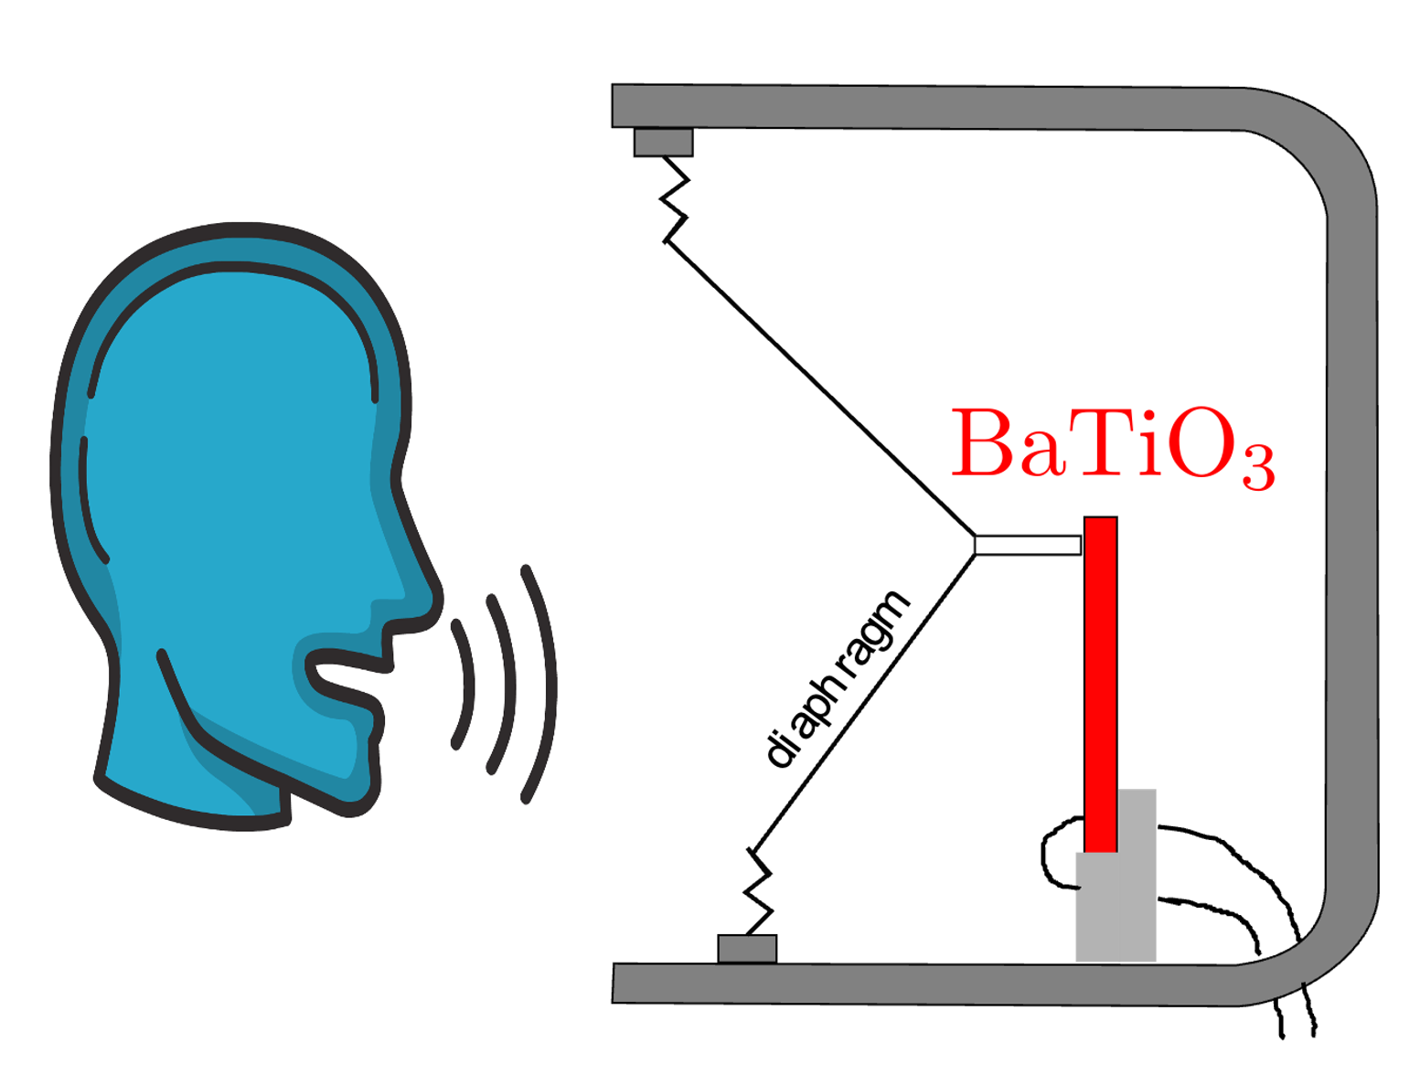
First ceramic microphone, 1957, barium titanate
convert mechanical vibrations into electrical signals

Slide 45
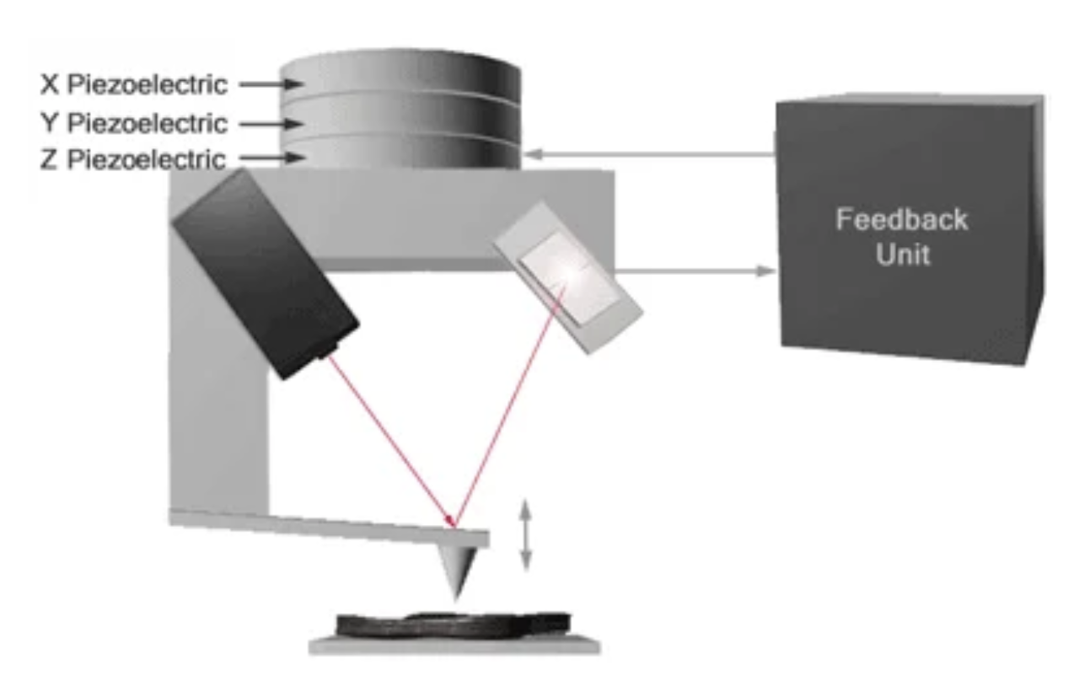
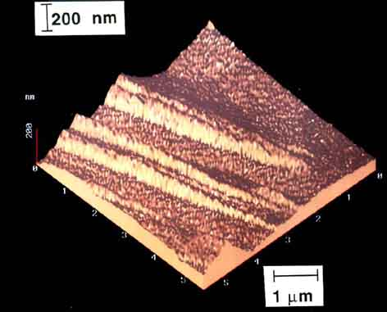
Atomic force microscopy
control such tiny movements using peizoelectric devices

Slide 46
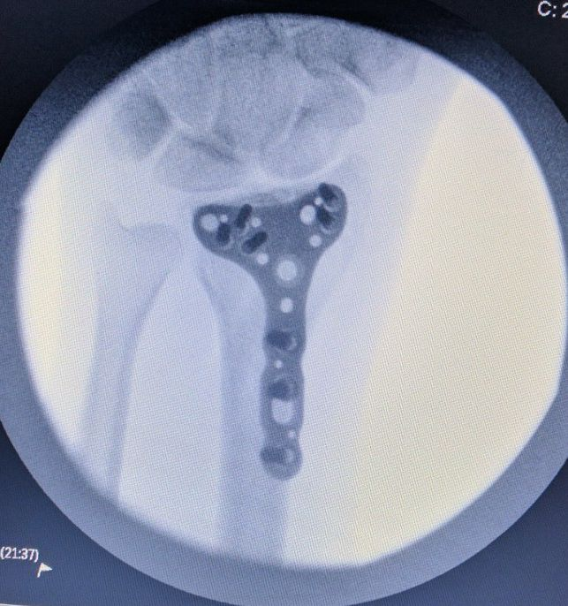
Imagine barium titanate inside the human body
can electrically stimulate tissue
without an external power source
high biocompatibility (absence of inflammation or foreign body responses)
However, no difference between electrically stimulated and inactive implants

Slide 47

Reversible if no damage accumulated
Professor Koichi Tsuchiya
Toyohashi University of Technology, Japan.
magnetically-induced, Ni-24Mn-24Ga at.%

Slide 48

Olson and Hartman, 1982

Slide 49

Olson and Hartman, 1982

Slide 50


Olson and Hartman, 1982

