Slide 1
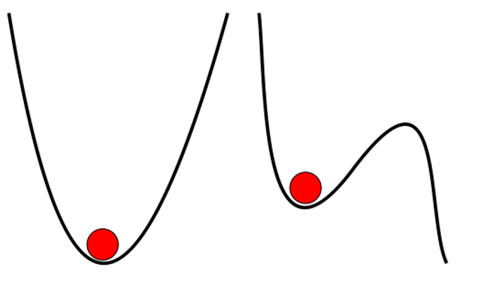
Phase transitions equilibrium state
“nothing changes, no matter how long it is observed”
stable to infinitesimal perturbation
photograph courtesy of Sunita Hansraj from her Antarctica expedition

Slide 2
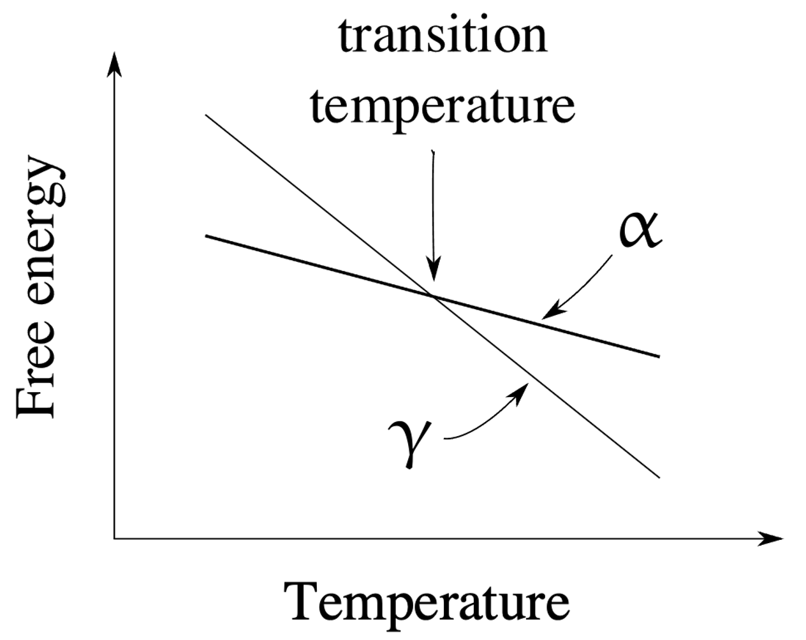
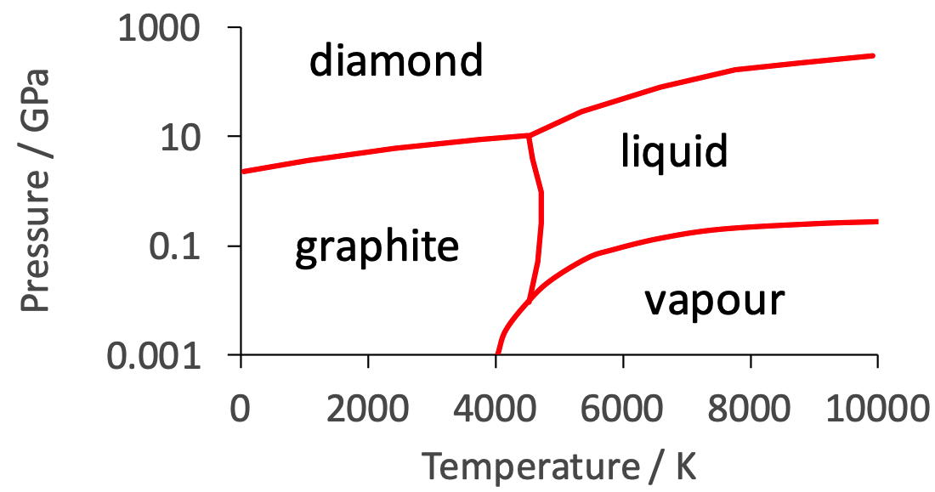

transformation without composition change

Slide 3
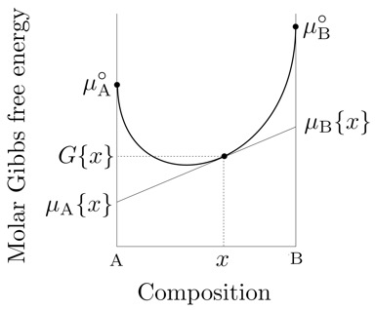
chemical potential

Slide 4
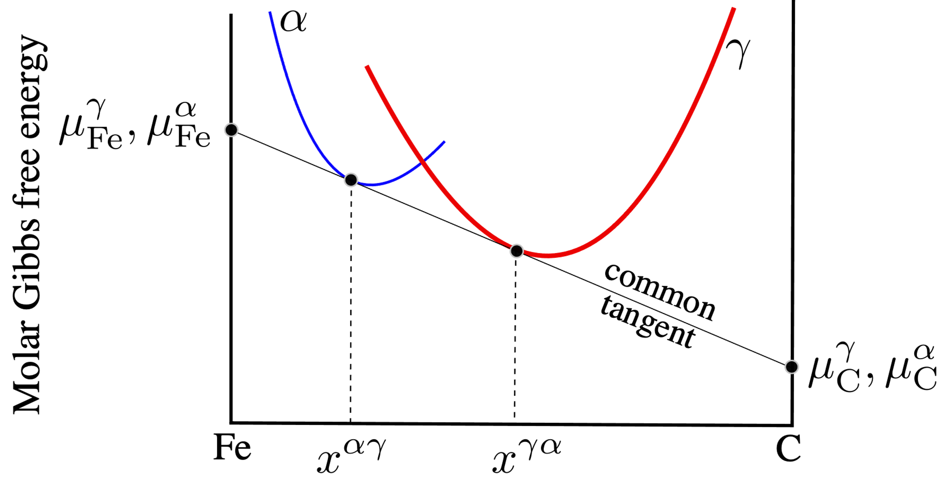

Slide 5
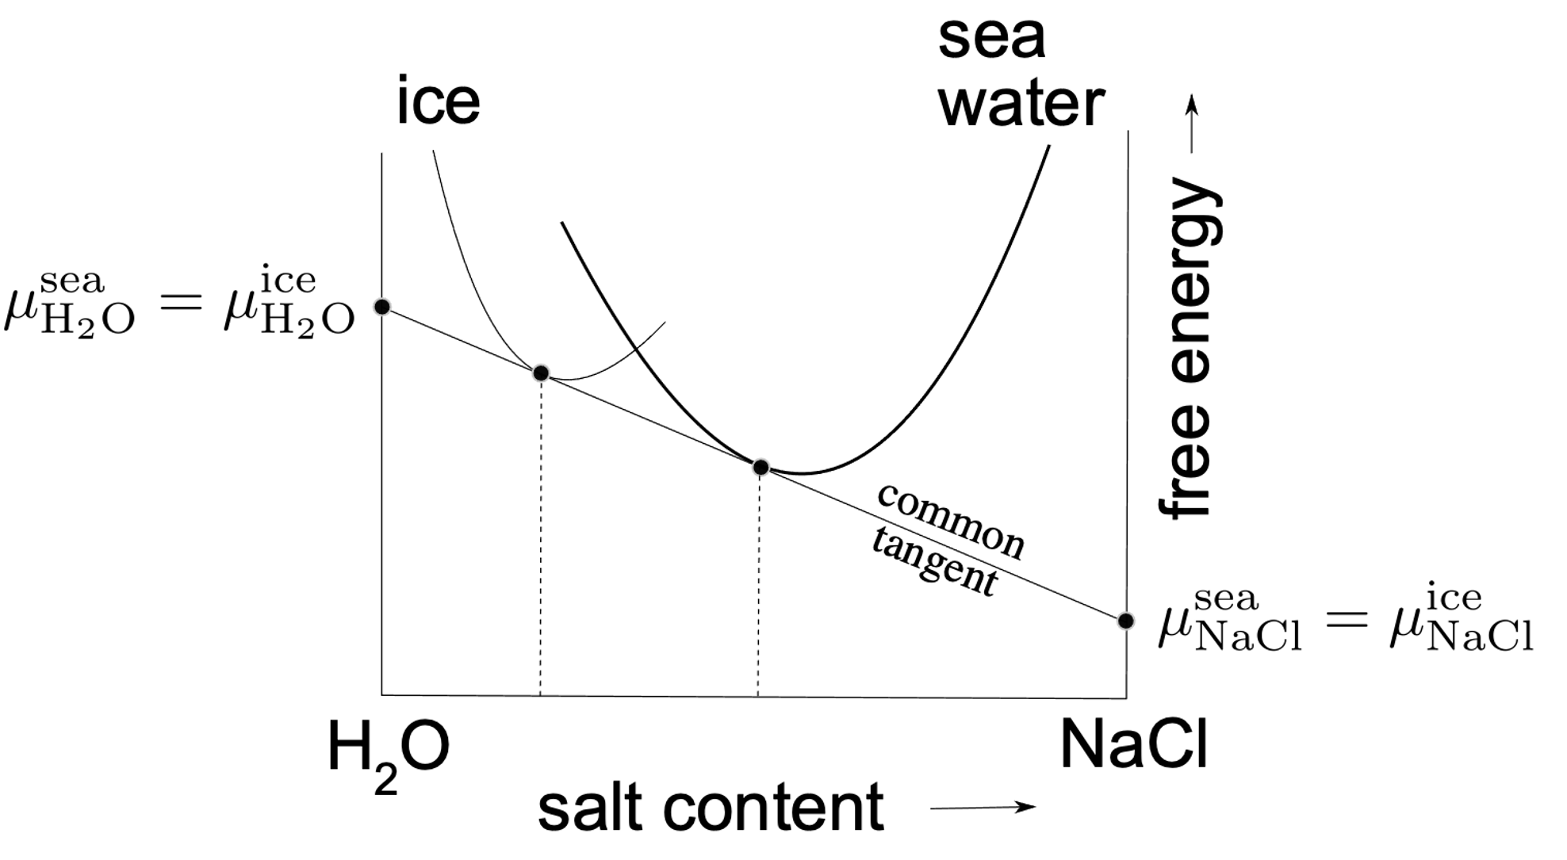
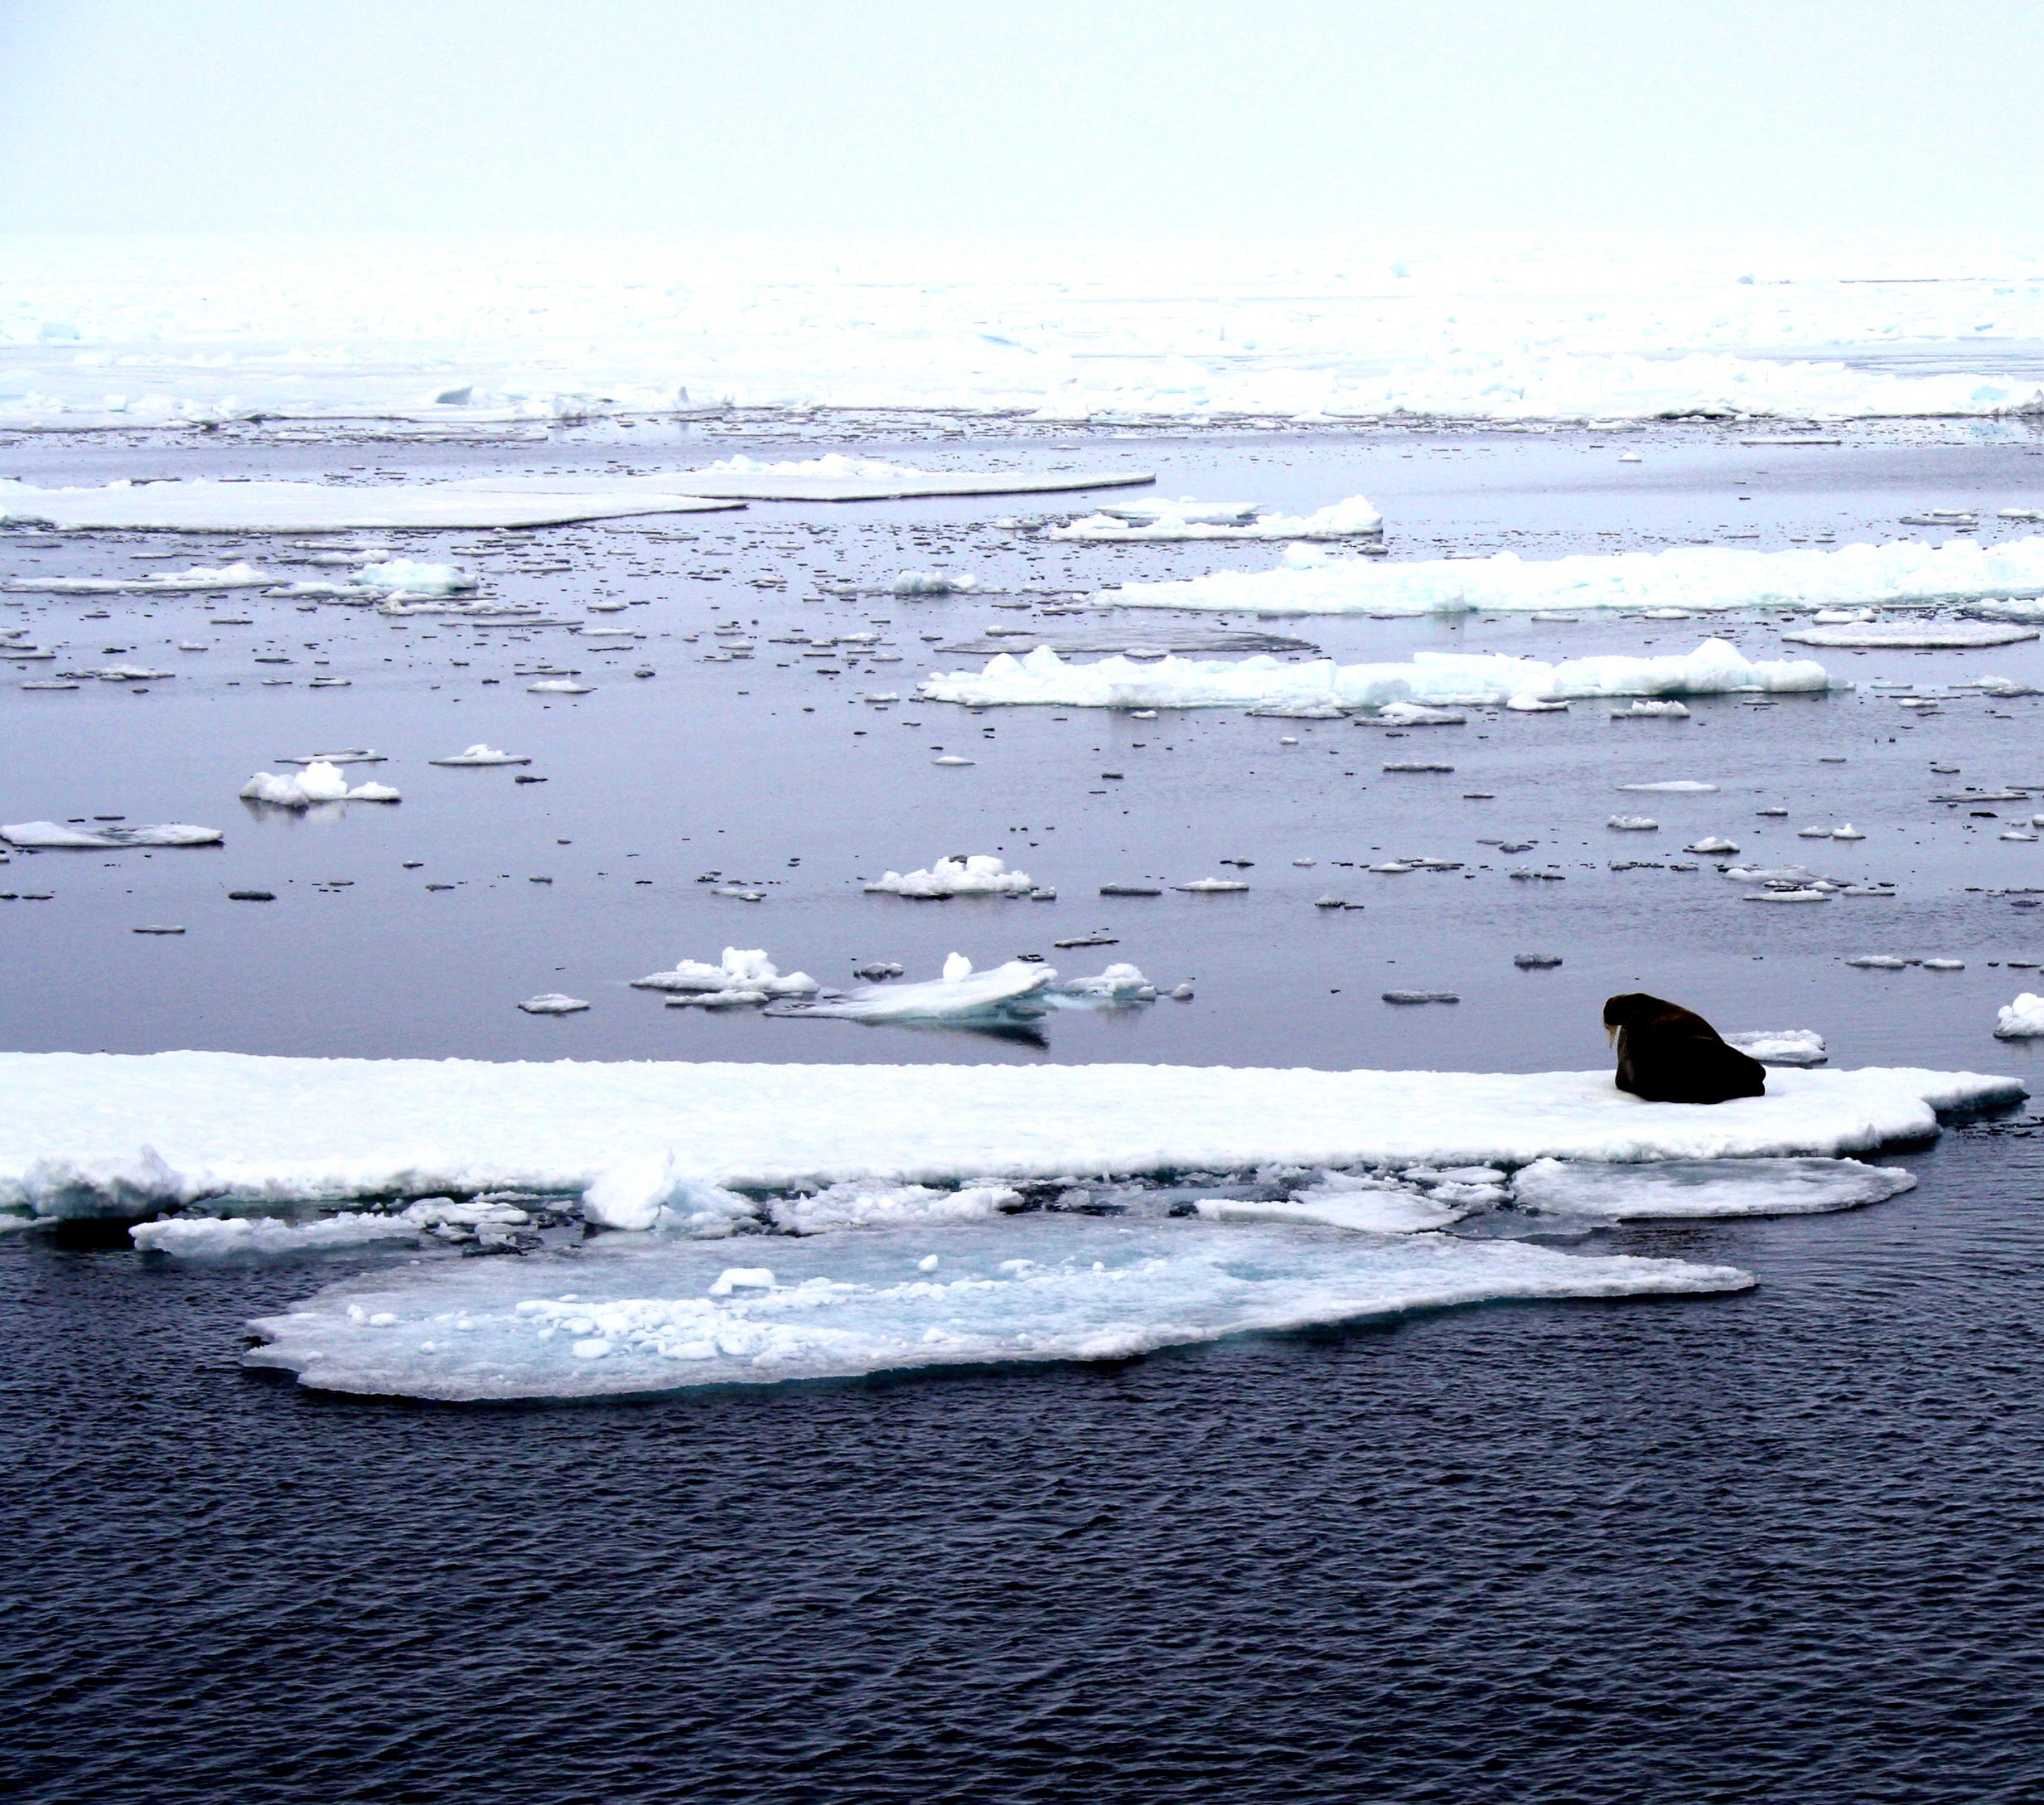

Slide 6
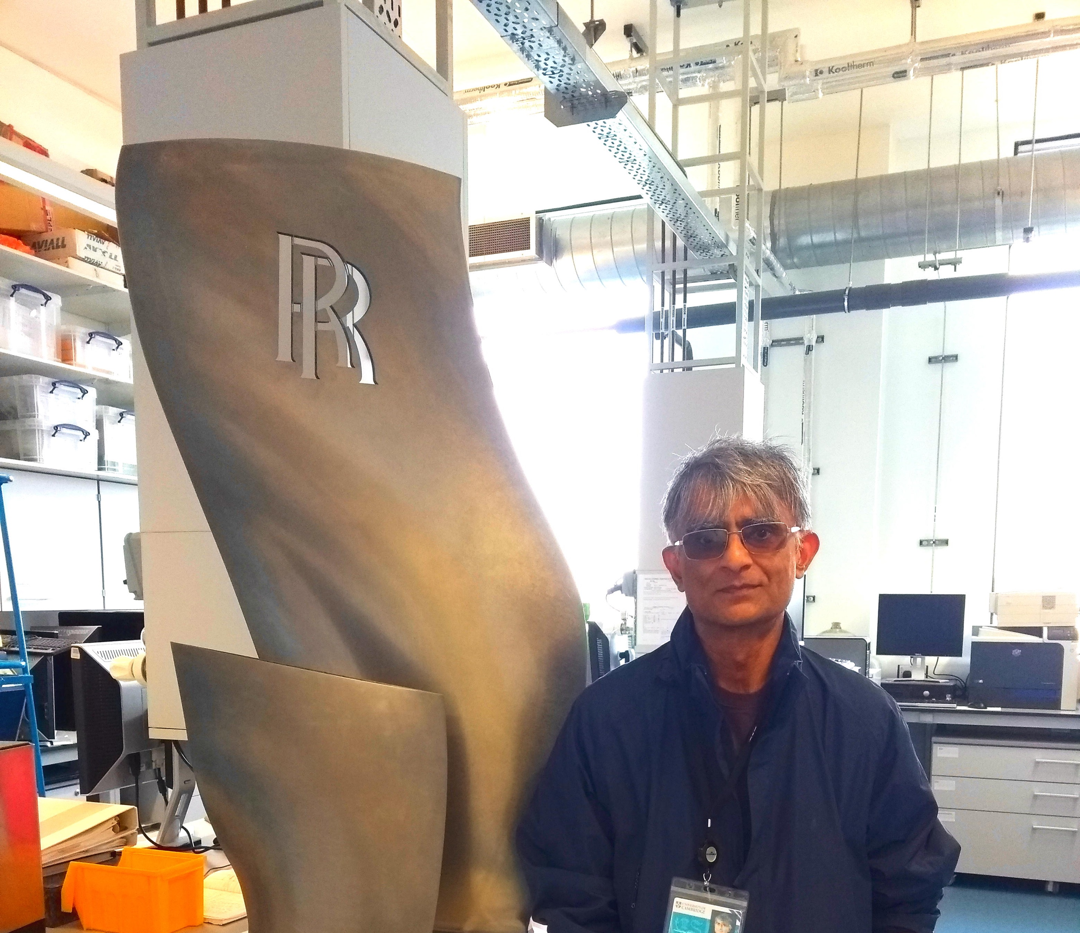
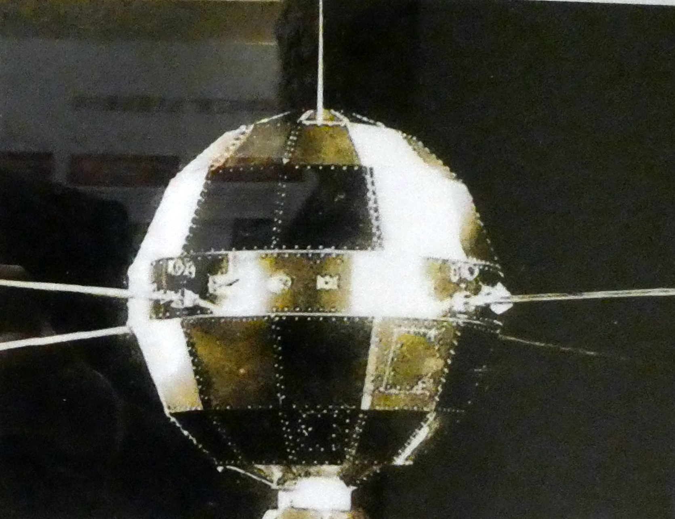

Slide 7
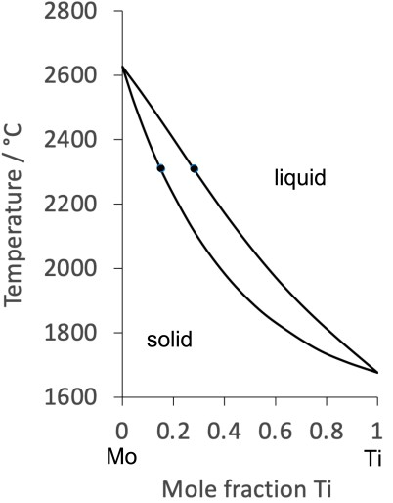
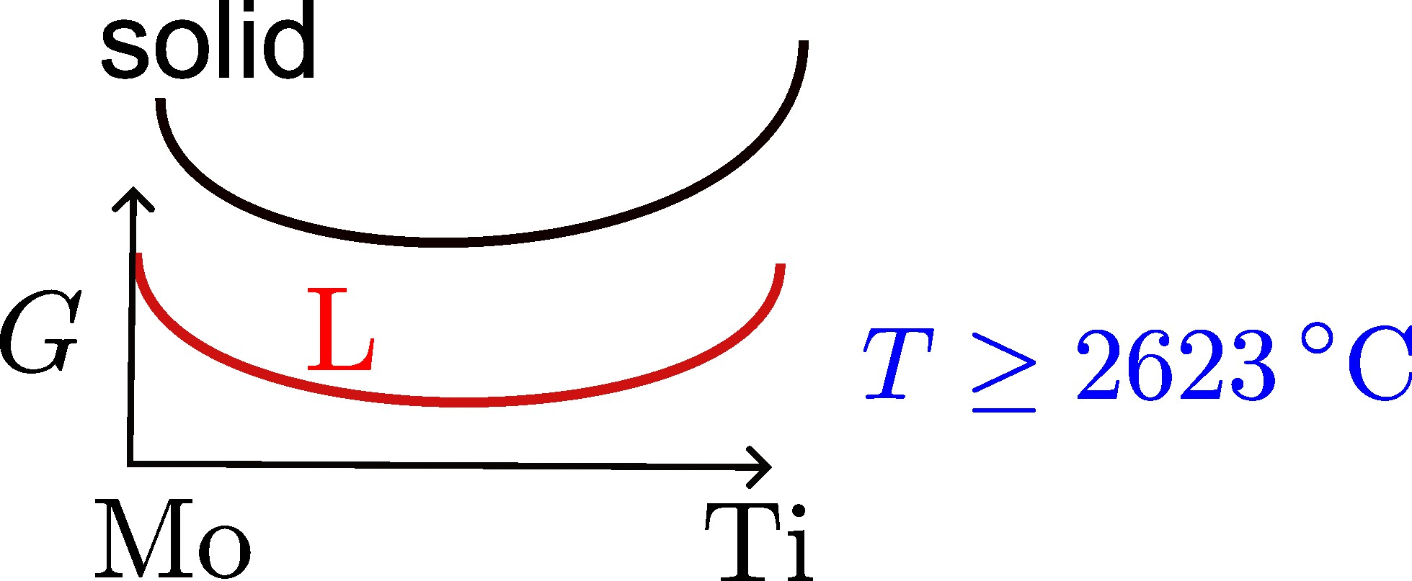
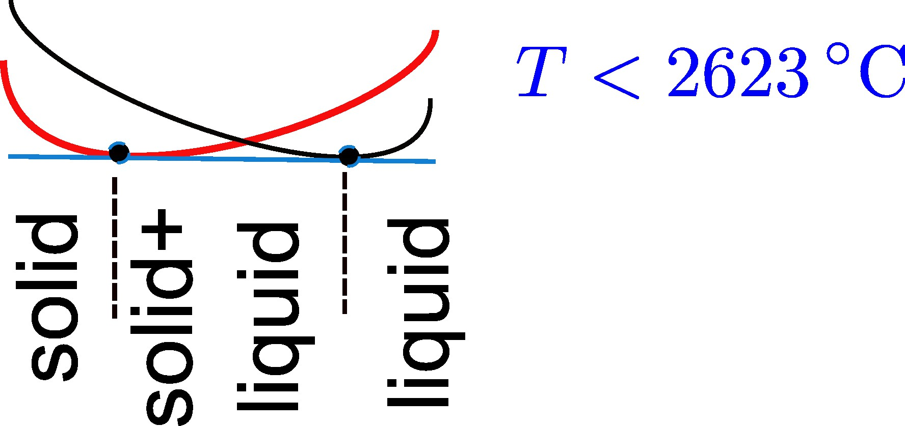
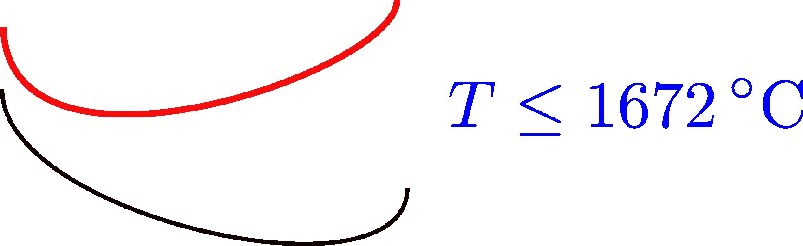

Slide 8
lever rule

Slide 9
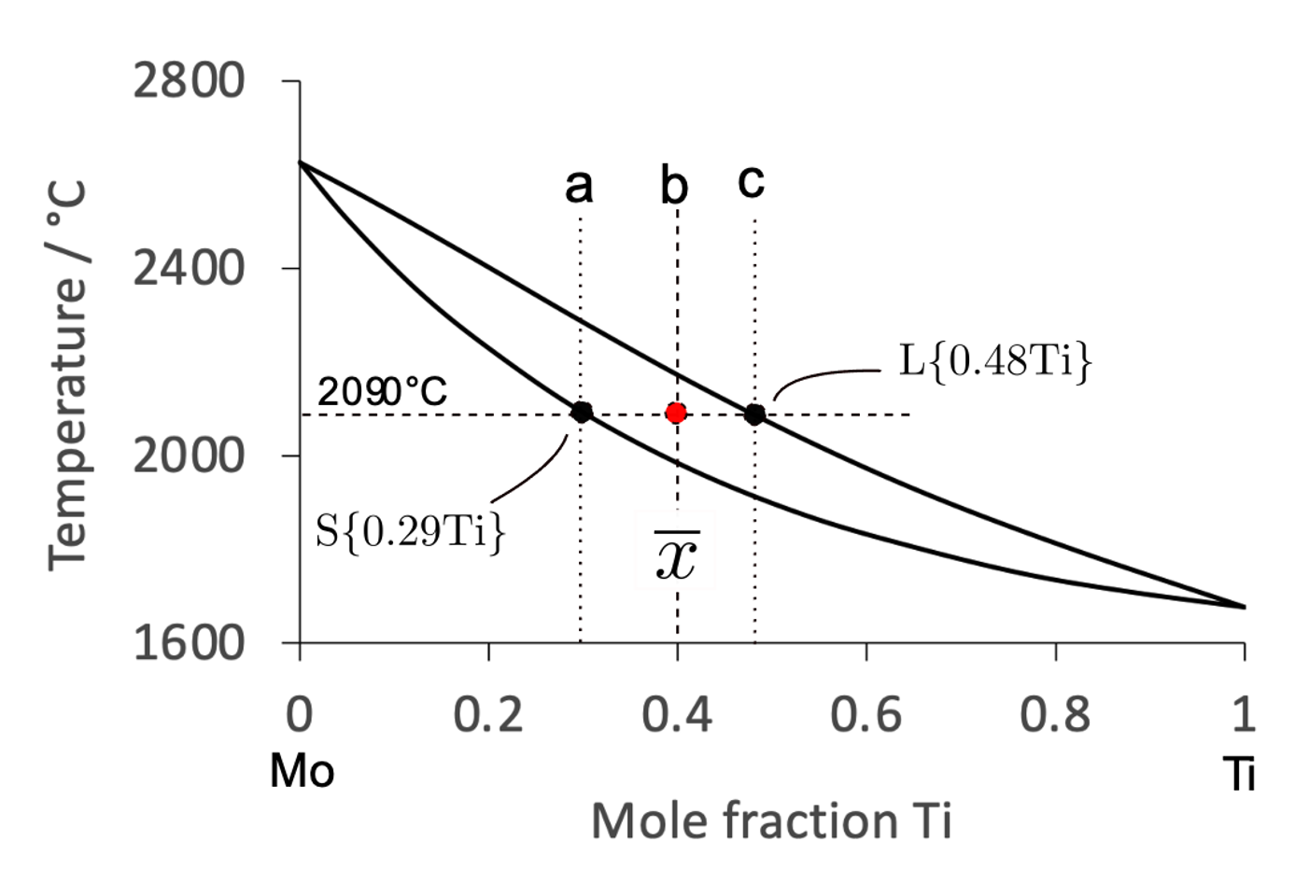
lever rule

Slide 10
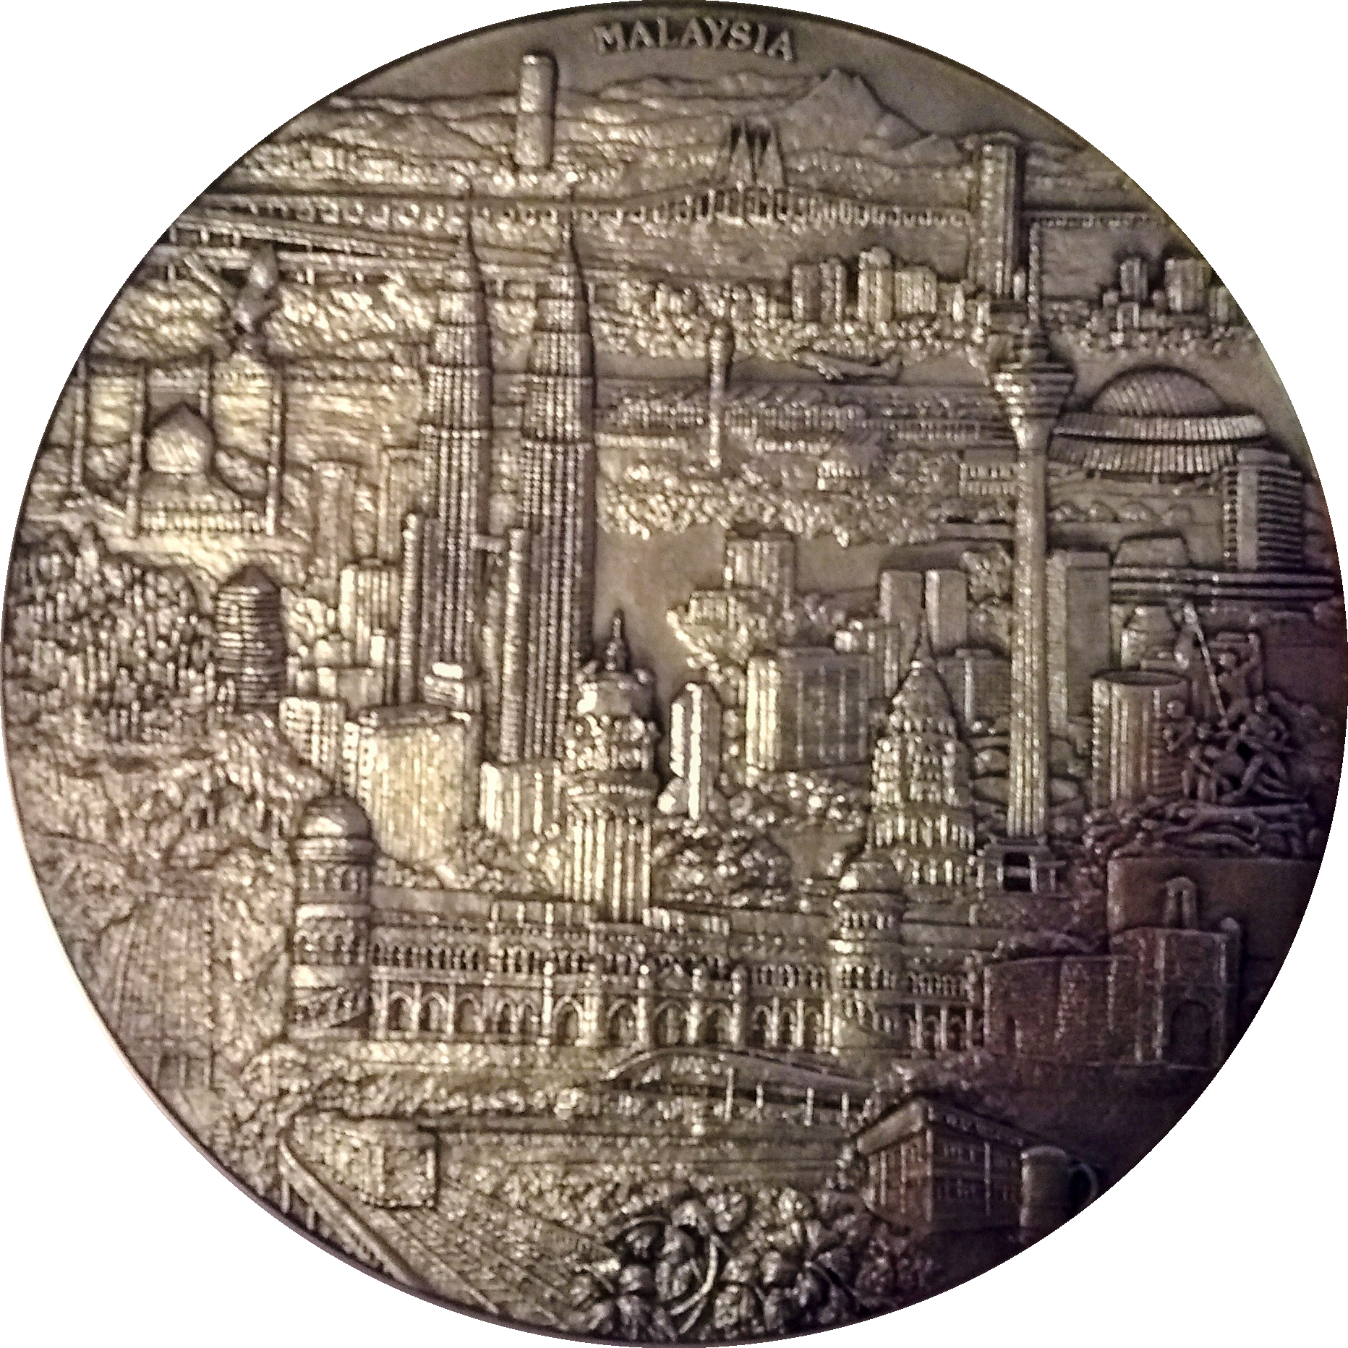
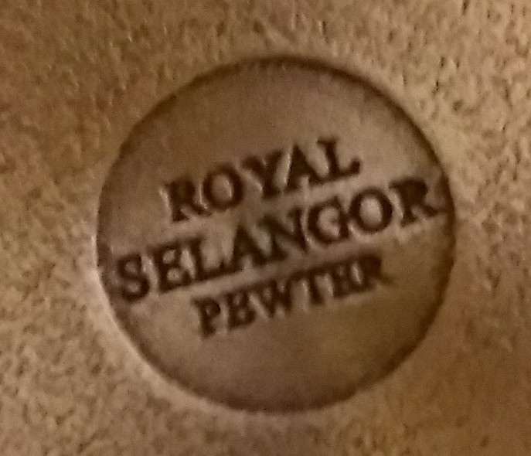
Modern pewter: tin with Cu, Sb, Bi

Slide 11
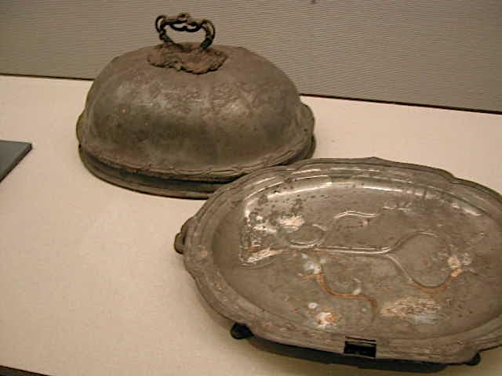
eutectic
Melting temperatures
Lead 328°C
Tin 232°C
Pb-62Sn wt% 183°C
Edo Museum in Tokyo. Shogun era, about 130 years ago.

Slide 12
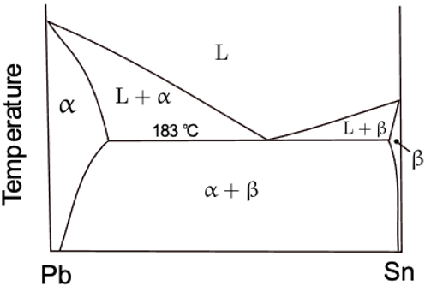
hypoeutectic
eutectic
hypereutectic

Slide 13
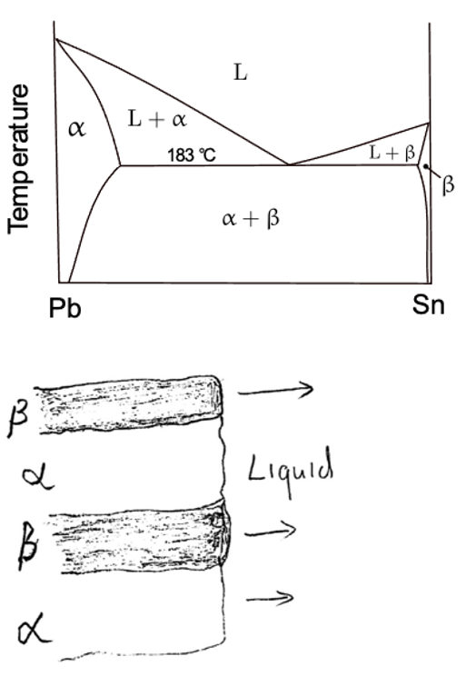
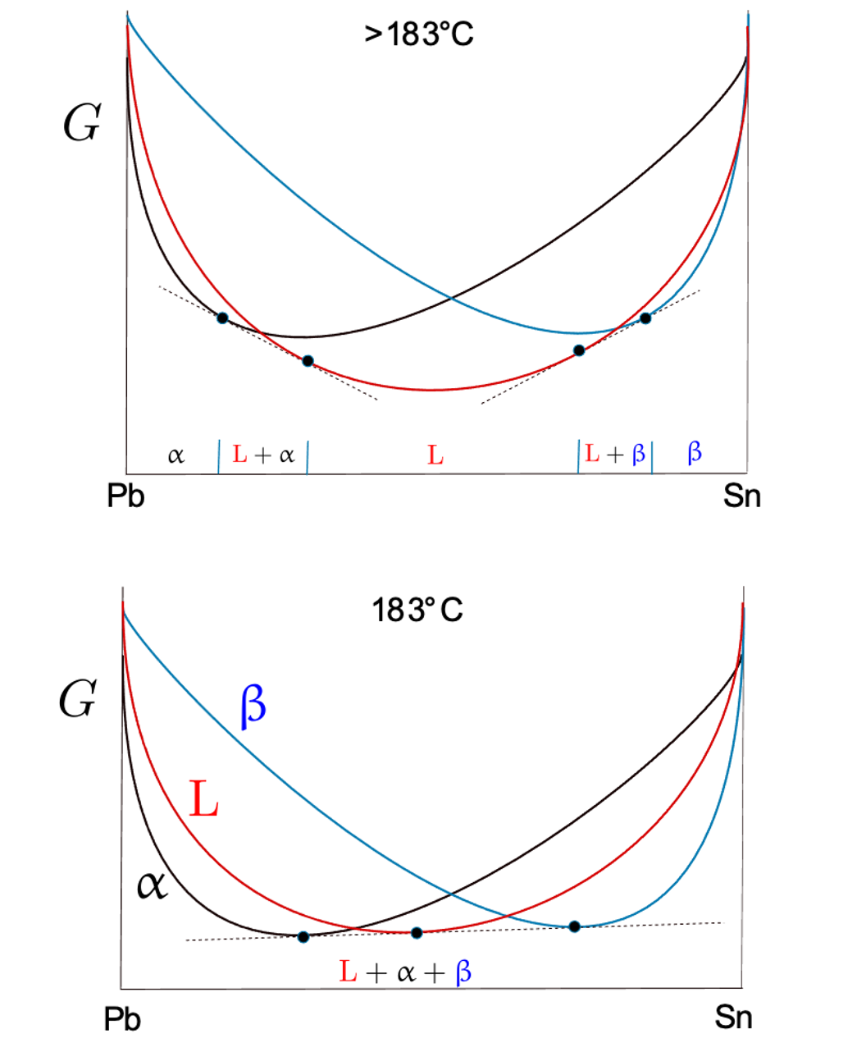

Slide 14

Simulation, Britta Nestler, RWTH Aachen

Slide 15
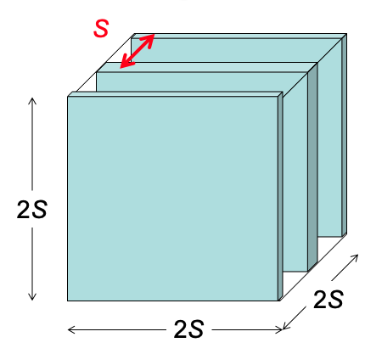
Why eutectic?
,

Slide 16
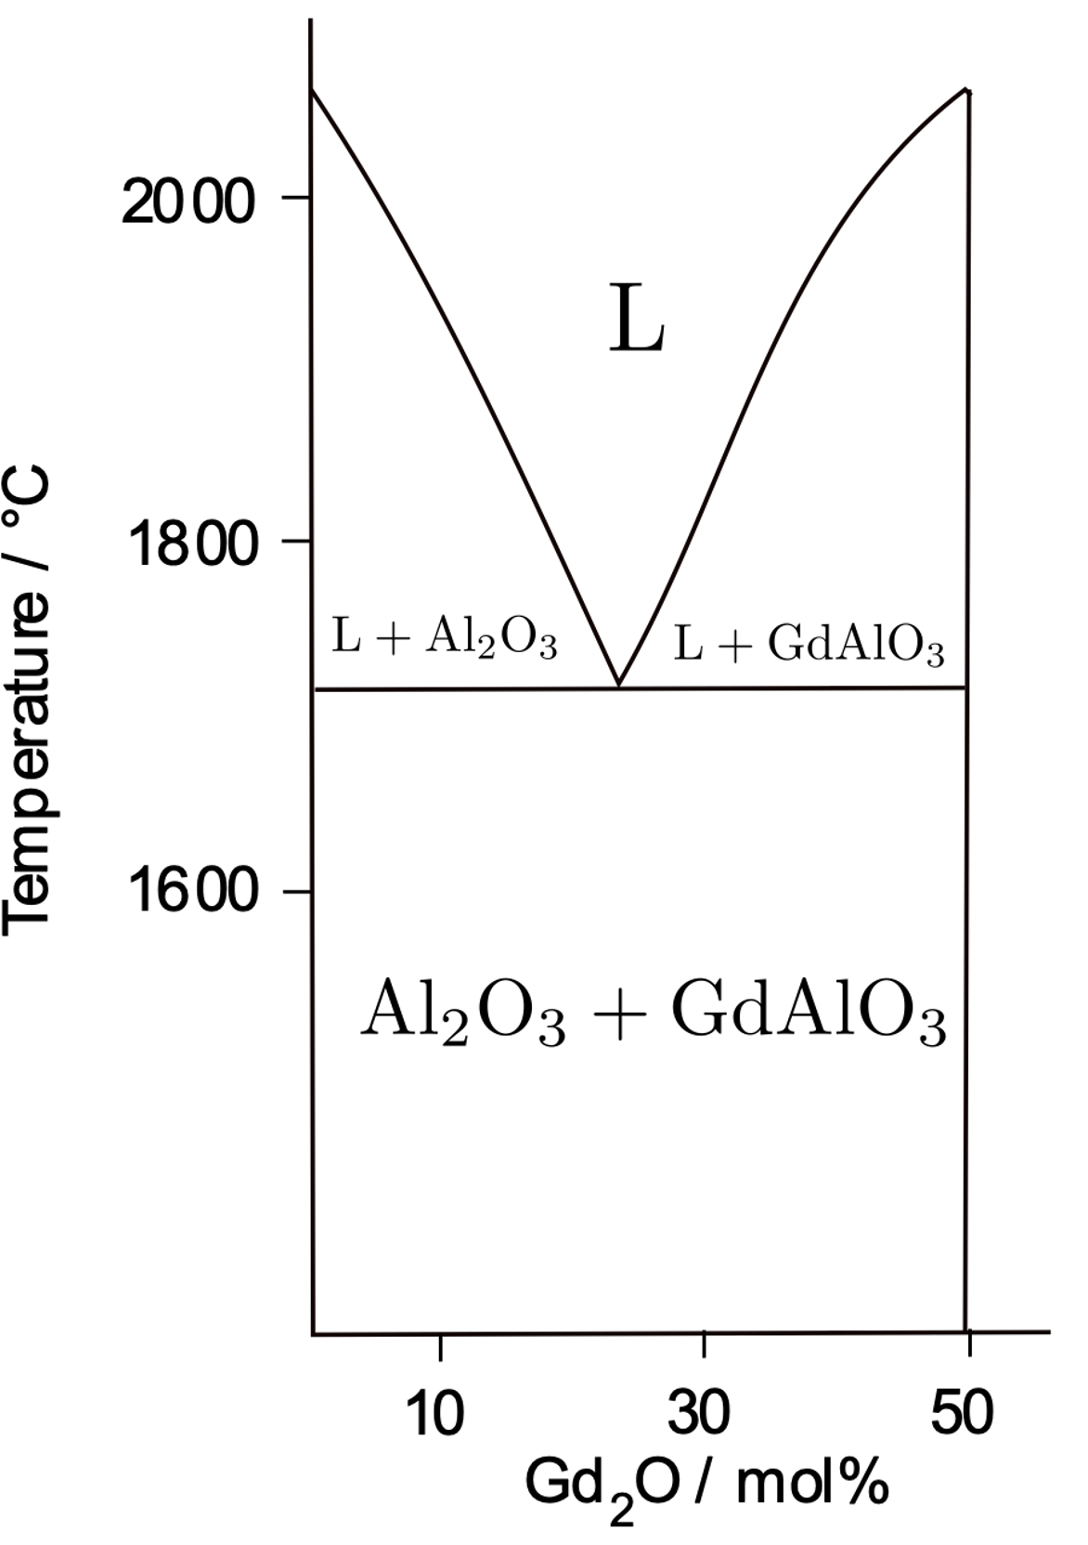
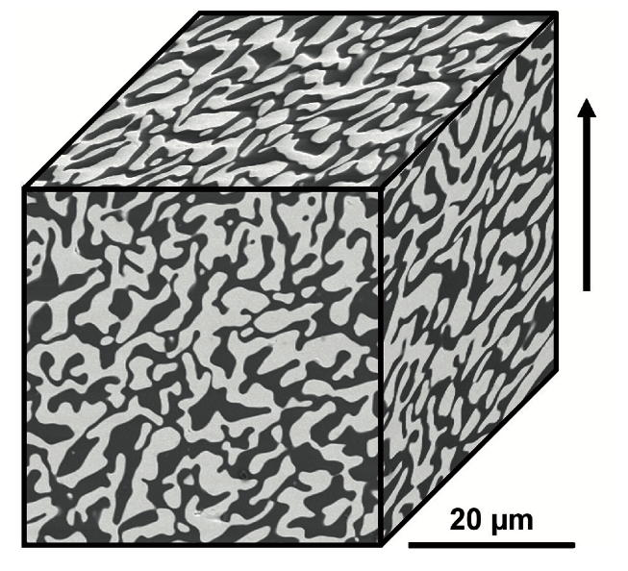
Parlier M, Valle R, Perrière L, Lartigue-Korinek S, Mazerolles L. Potential of directionally solidified eutectic ceramics for high temperature applications. Aerospace Lab. 2011 Nov 1(3):p-1.

Slide 17
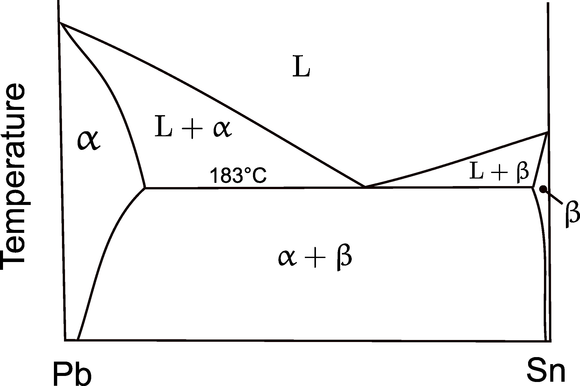
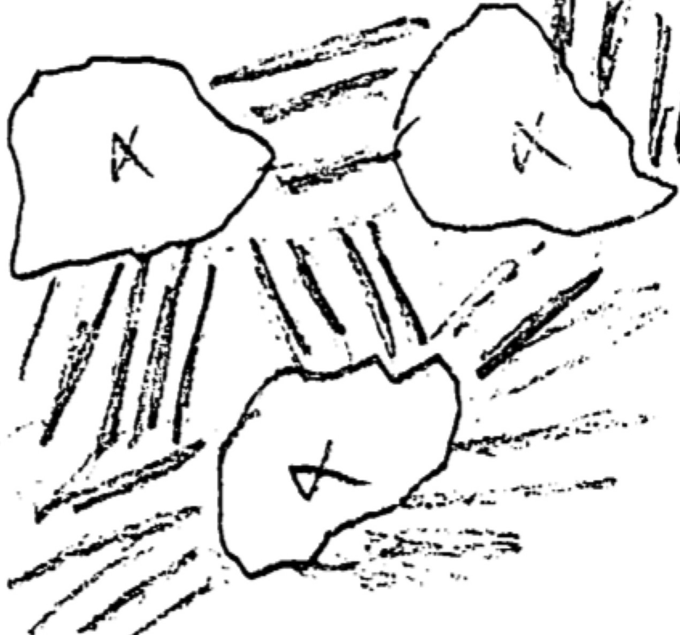
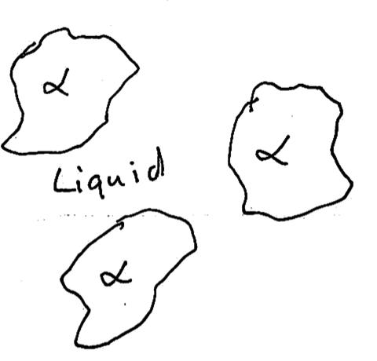

Slide 18
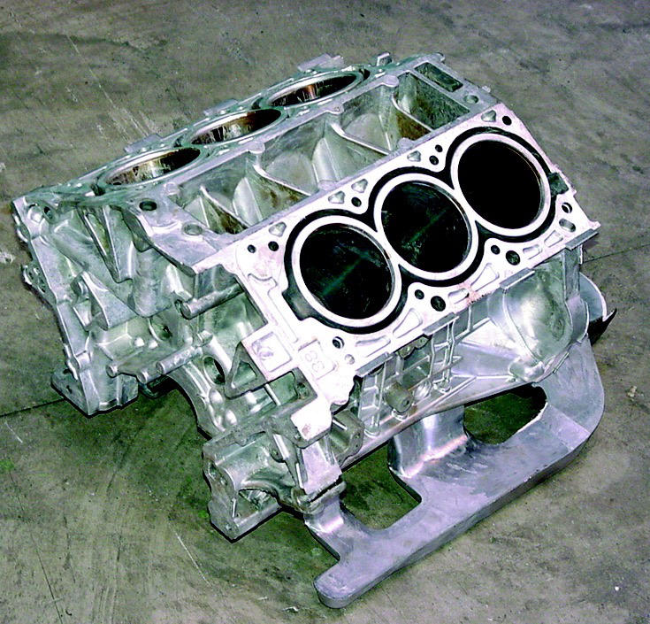
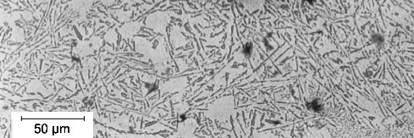

Slide 19
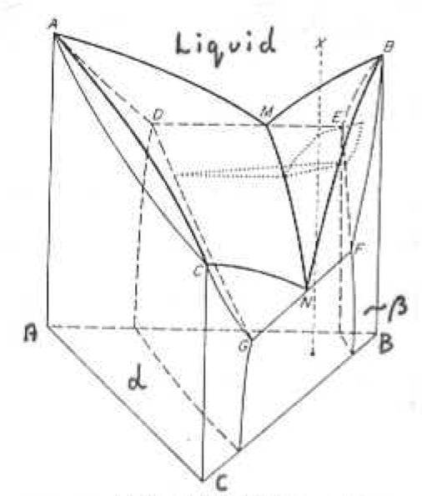
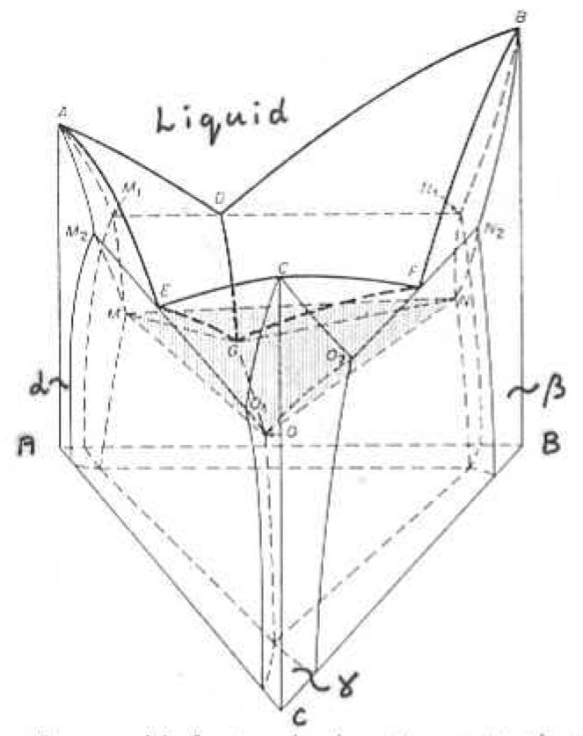
images courtesy of
Jane Weston

Slide 20
ternary phase diagram

Slide 21
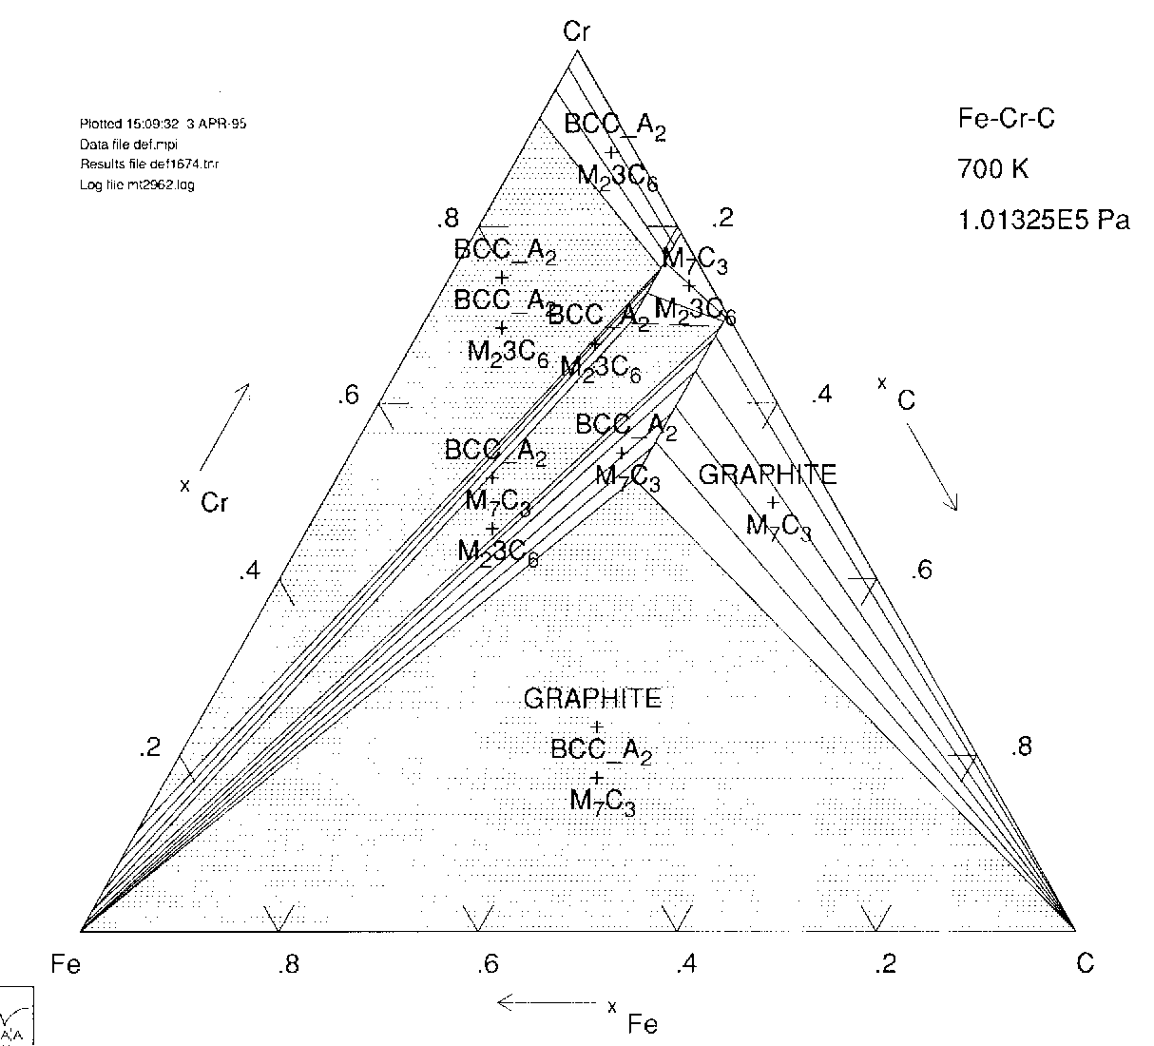

Slide 22
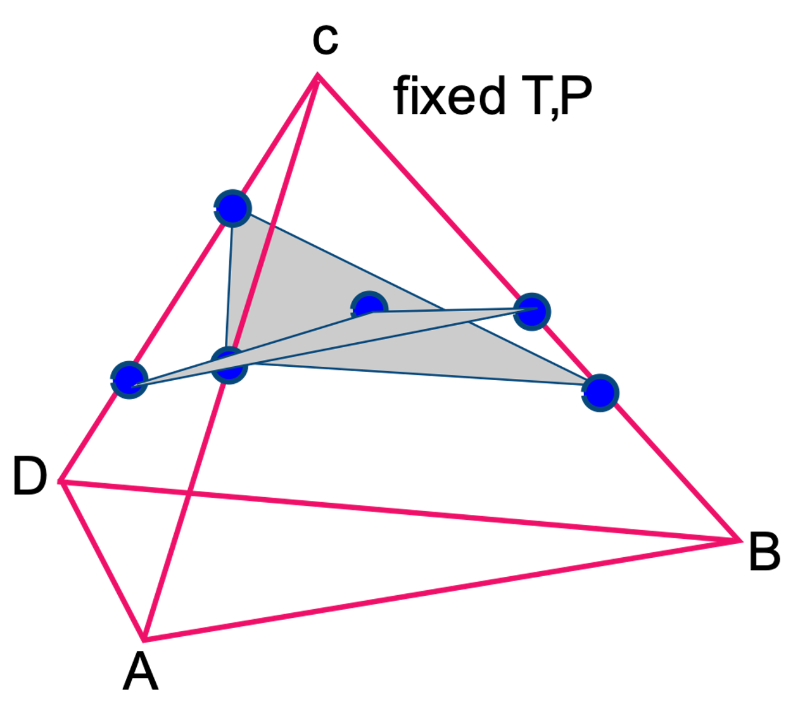
quaternary
system

Slide 23
What do we need from phase diagrams?
stable phases
fractions of phases
compositions of phases
as a function of temperature, pressure etc.
consider 7 components (Fe, C, Si, Mn, Ni, Mo, Cr)
three phases BCC, Fe₃C, M₂₃C₆

Slide 25
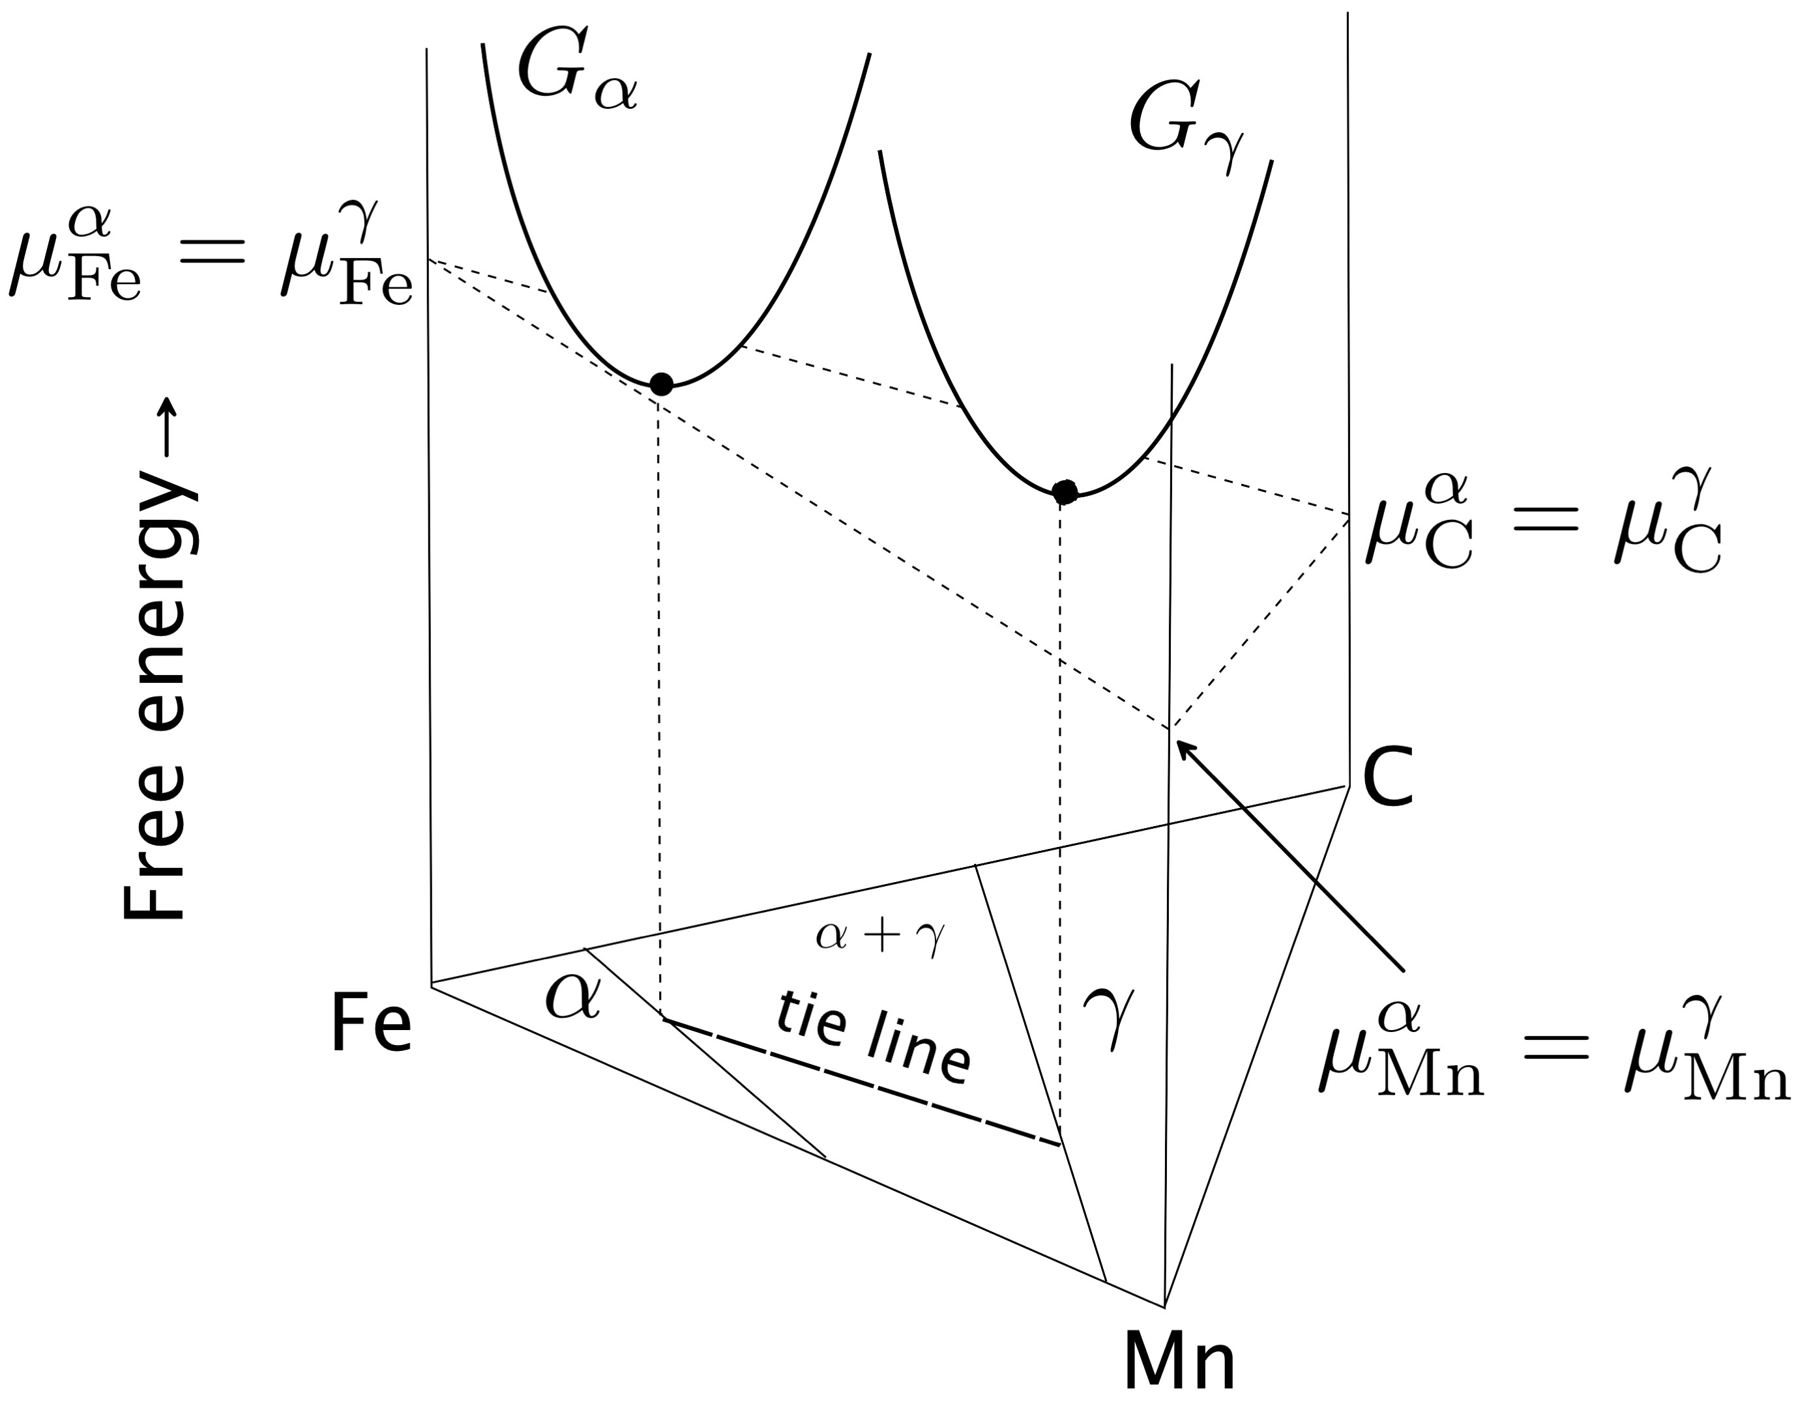

Slide 26
Condition for equilibrium is simple:
uniform chemical potential defines equilibrium

Slide 27
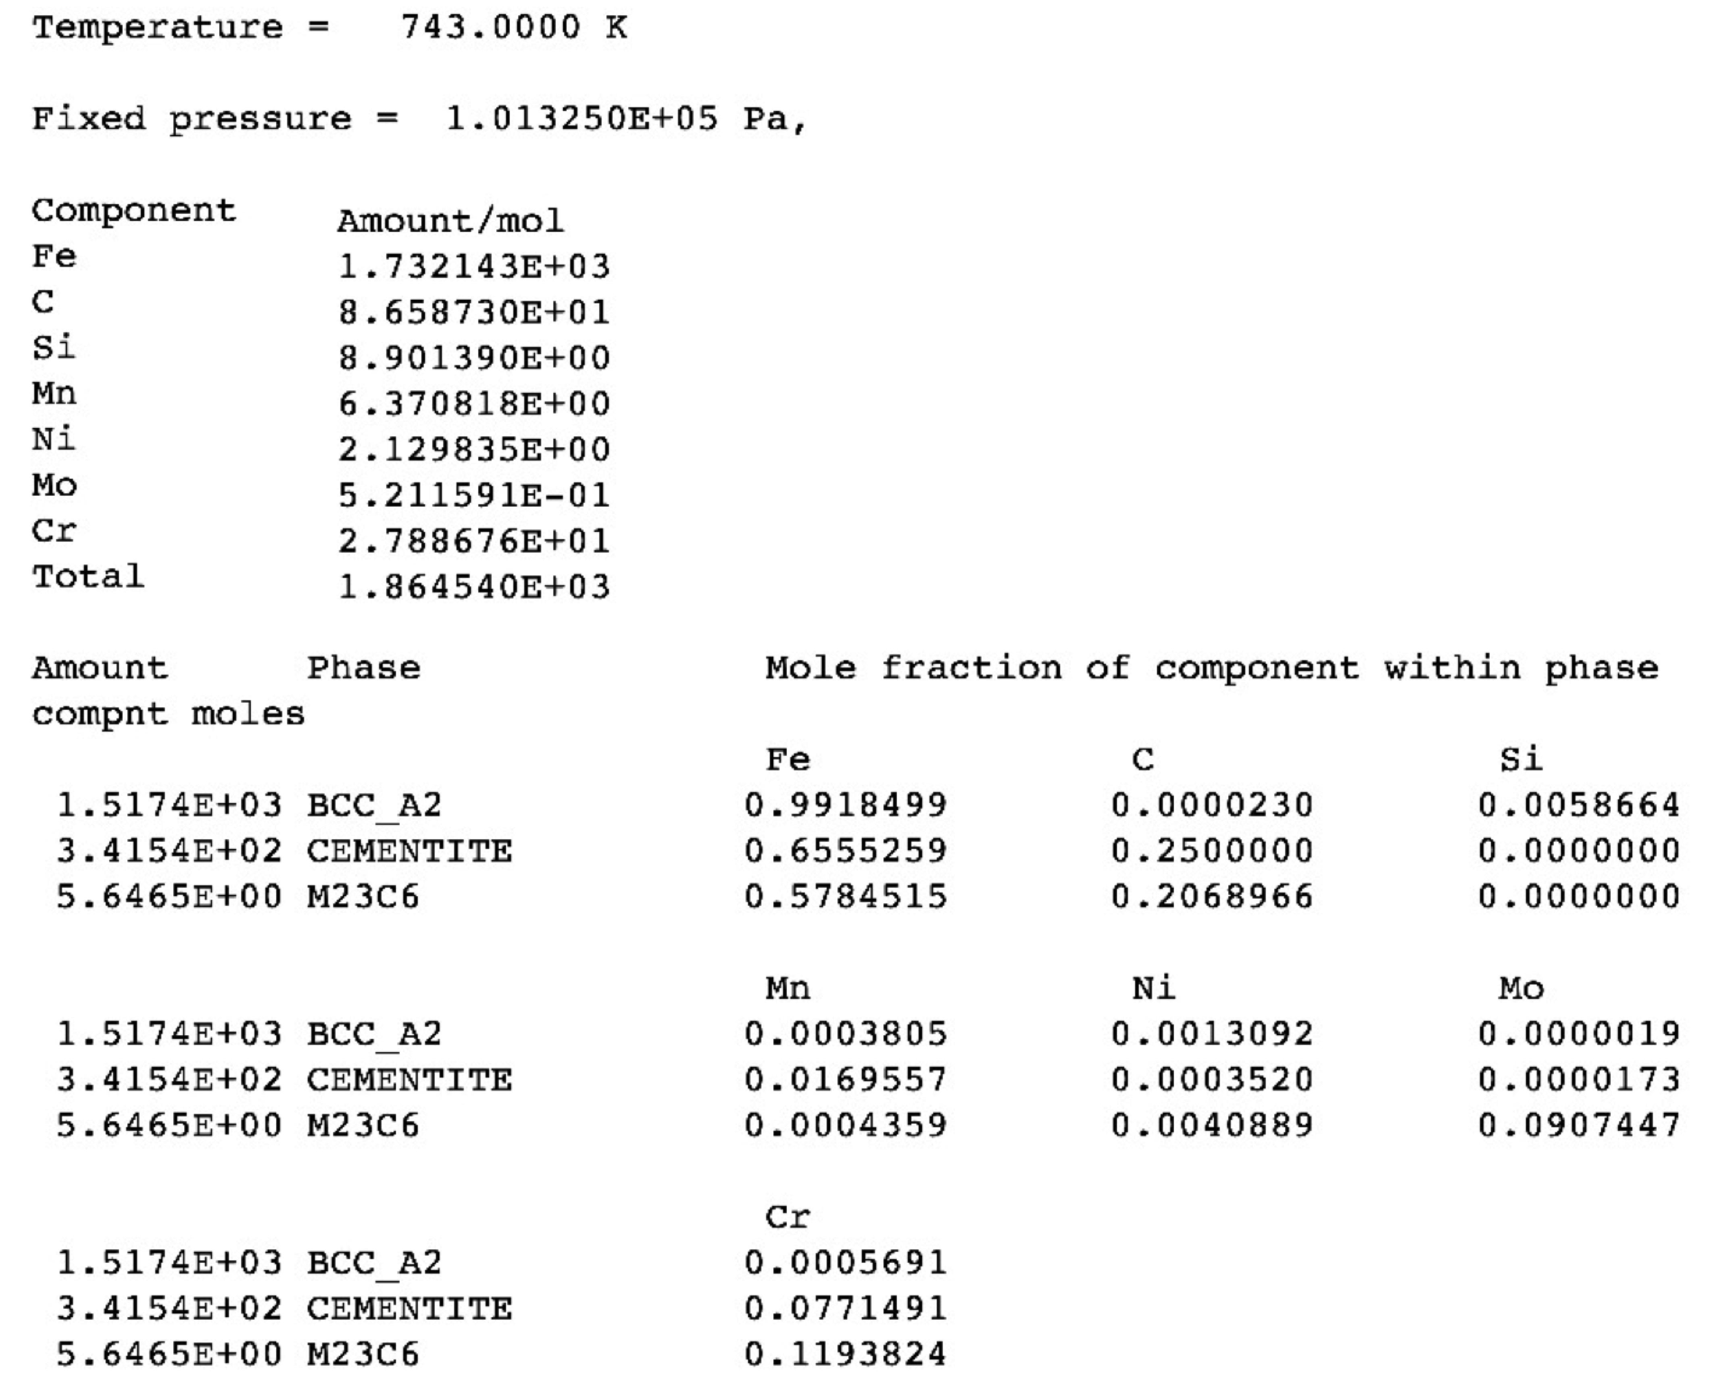

Slide 28
ideal solution: random mixture of atoms concentration of `A’ atoms = (1-x)
no enthalpy of mixing
only entropy of mixing

Slide 29
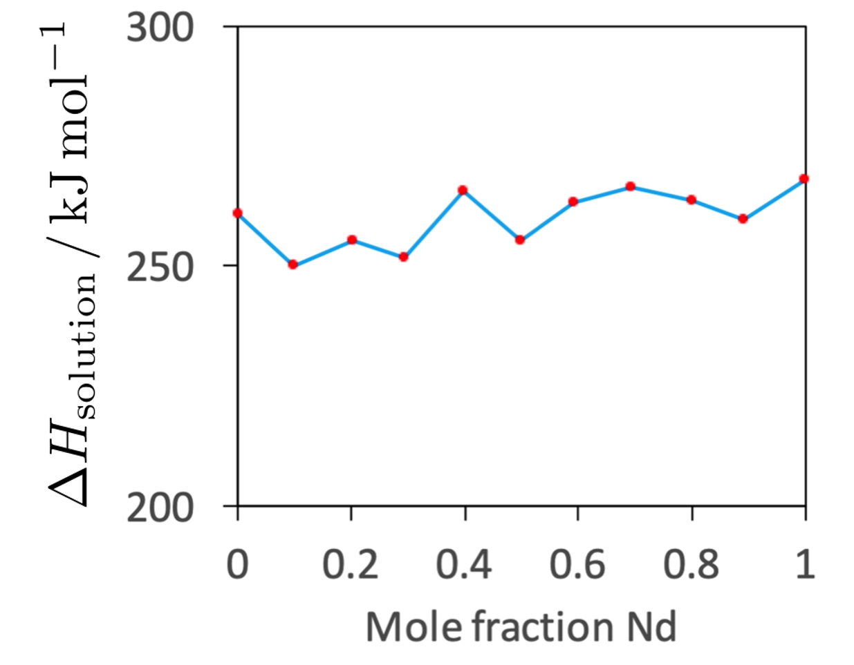
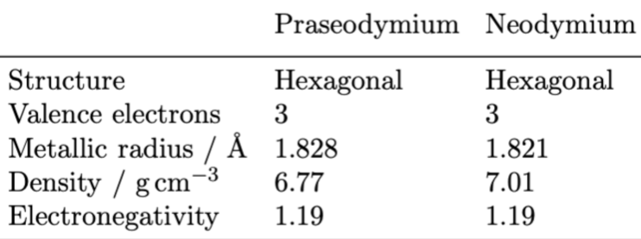
Praseodymium-neodymium solid solutions
Lundin, Pool: J. Less Common Metals 9 (1965) 48-53

Slide 30

configurational entropy maximum at equiatomic concentration
free energy minimum at equiatomic concentration, assuming only the entropy contributes to free energy
1000 K

Slide 31
“regular” solution
change in bond energy when AA and BB bonds replaced in part by AB and BA bonds

Slide 32
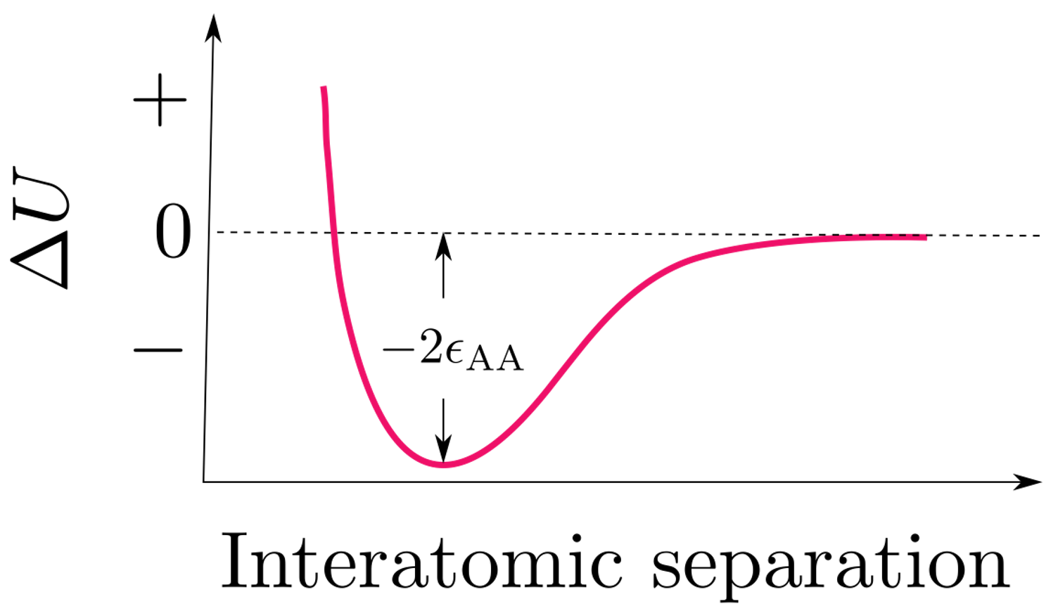

Slide 33
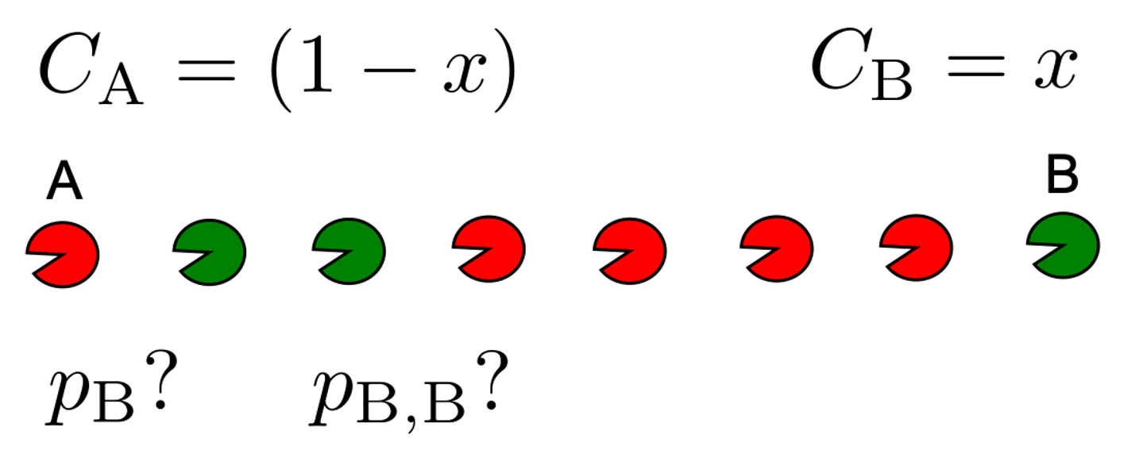

Slide 34
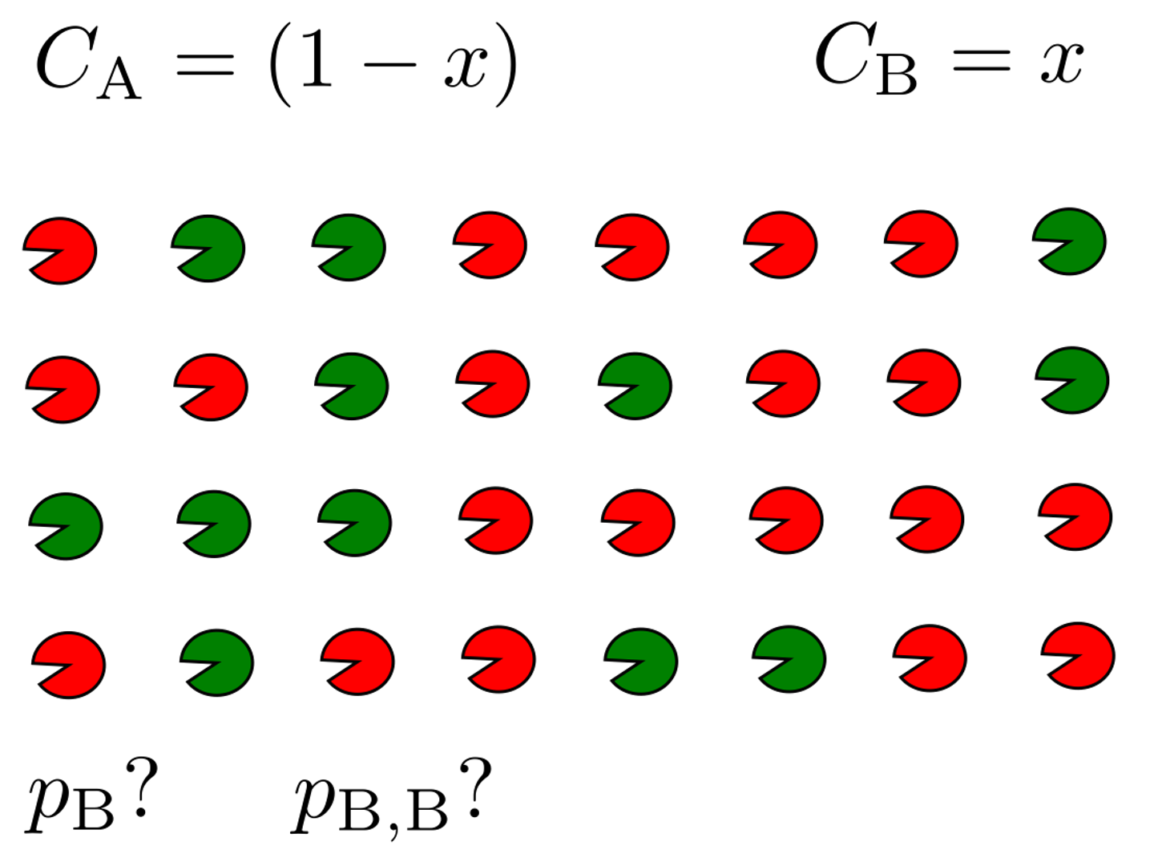

Slide 36
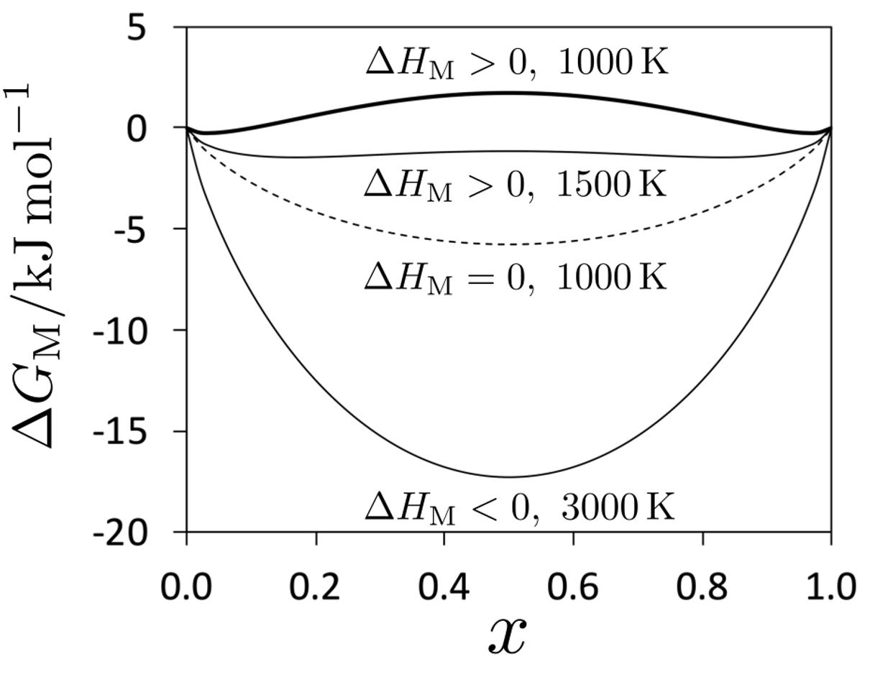
A
B

