Slide 1
Fourier’s law
Ohm’s law
Fick’s law

Slide 2

Joseph Fourier
1822
Notes:
Analytical theory of heat

Slide 3
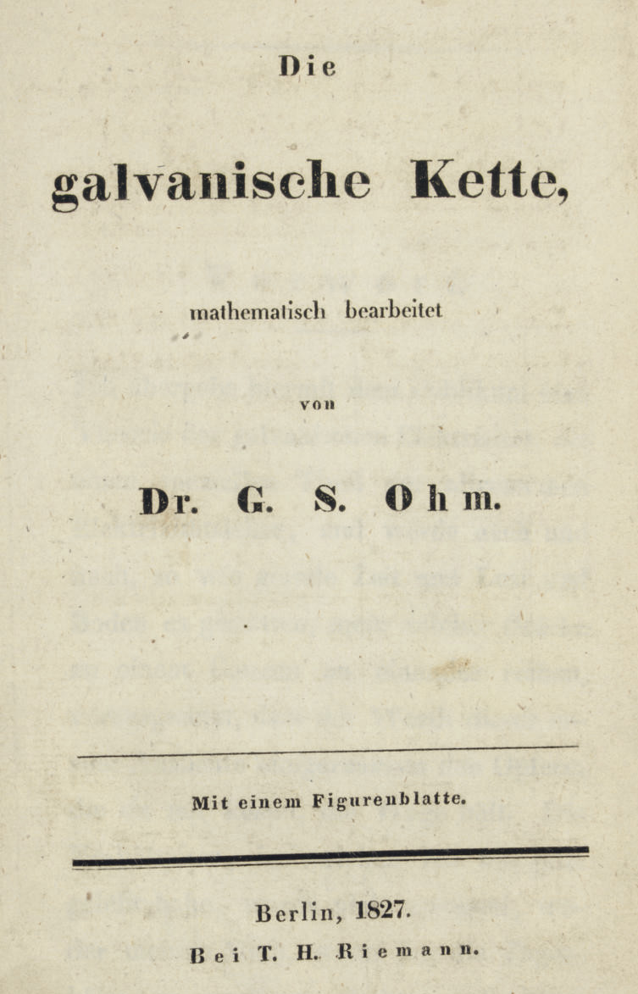
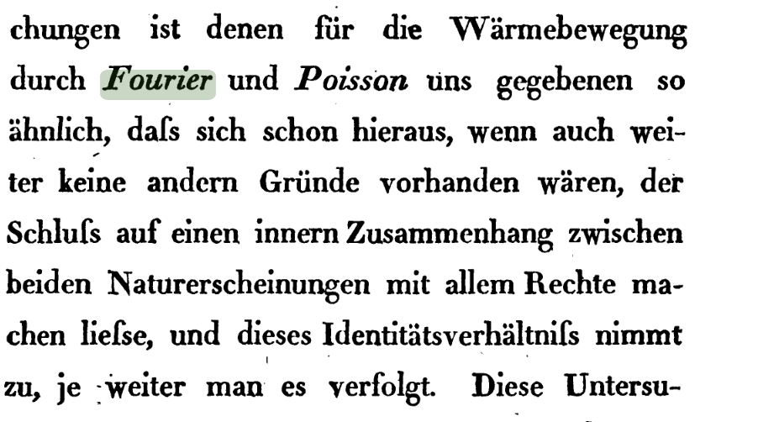
Georg Simon Ohm
1827
Notes:
The galvanic circuit investigated mathematically

Slide 4

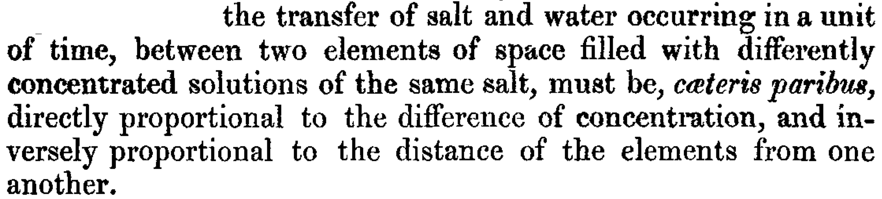
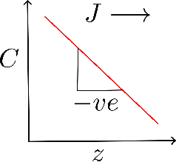
1855
flux
diffusion
coefficient
concentration
gradient
Notes:
all other things being equal

Slide 5
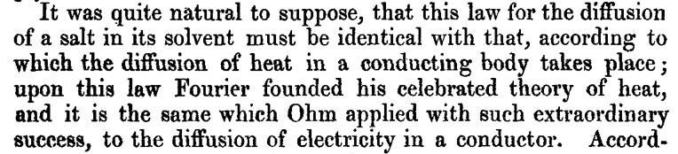

Slide 6
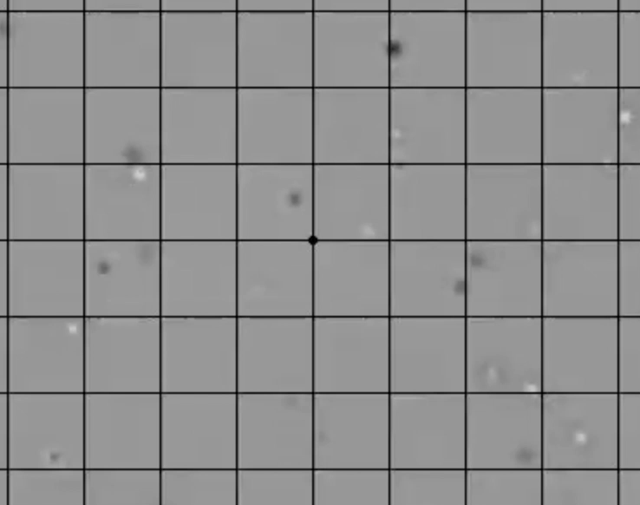
Brownian motion
recorded by
Harukazu Yoshino,
Osaka Metropolitan University

Slide 7
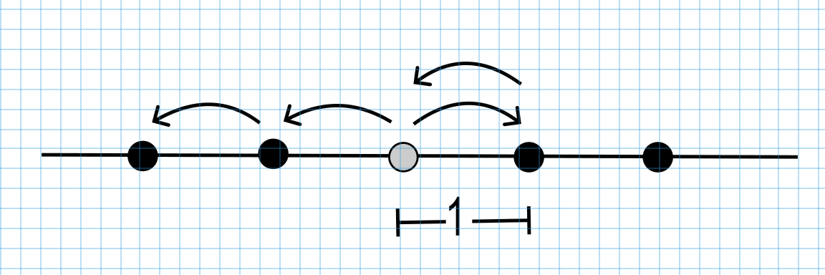
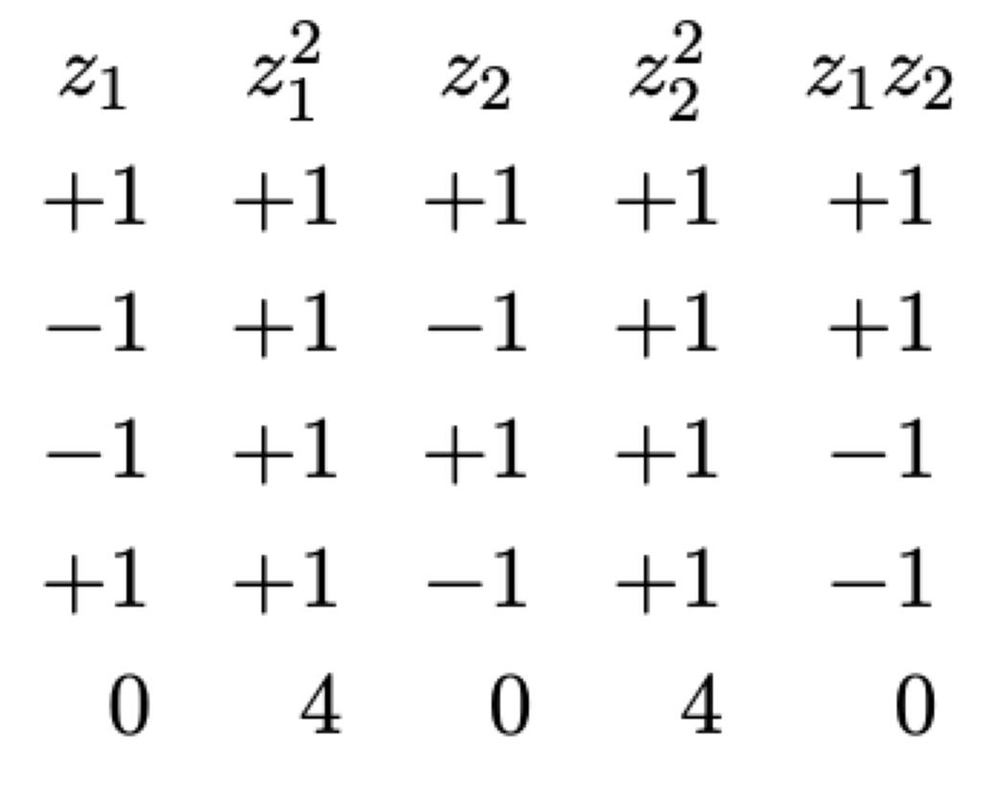
assume no correlations between successive steps, isotropic, each step of unit length
consider all combinations
of first 2 steps

Slide 9
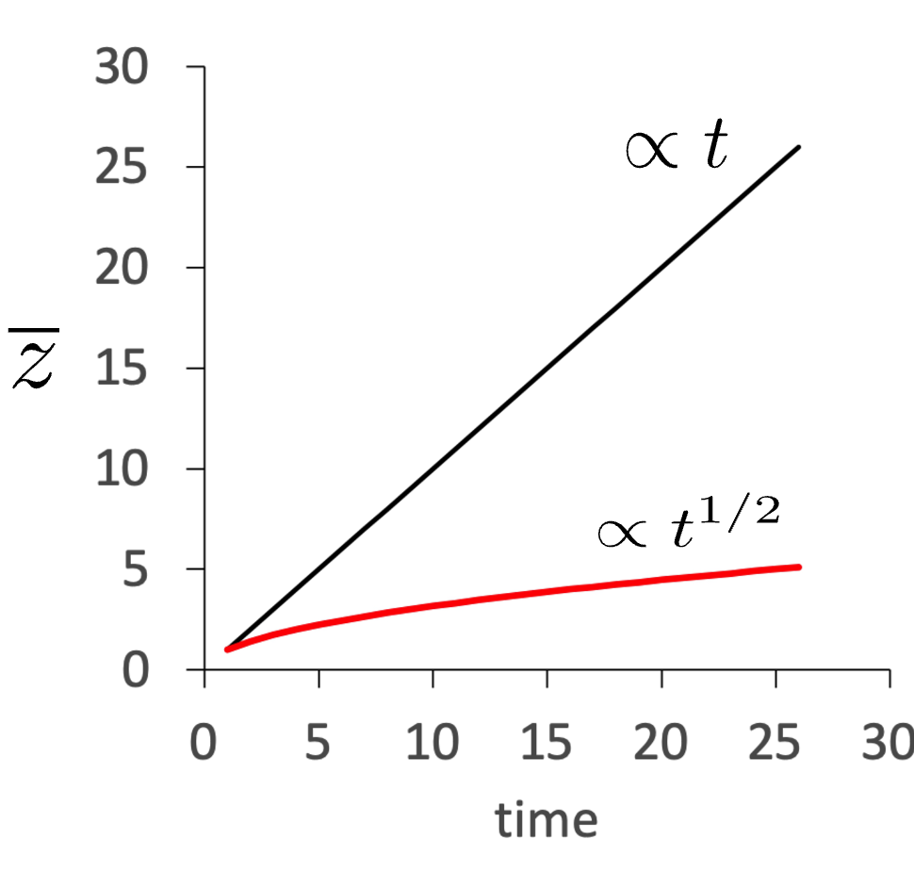

Slide 10
random walk has no stimulus other than thermal vibrations
no preferred direction
Diffusion, on the other hand, can bias an otherwise random walk

Slide 11
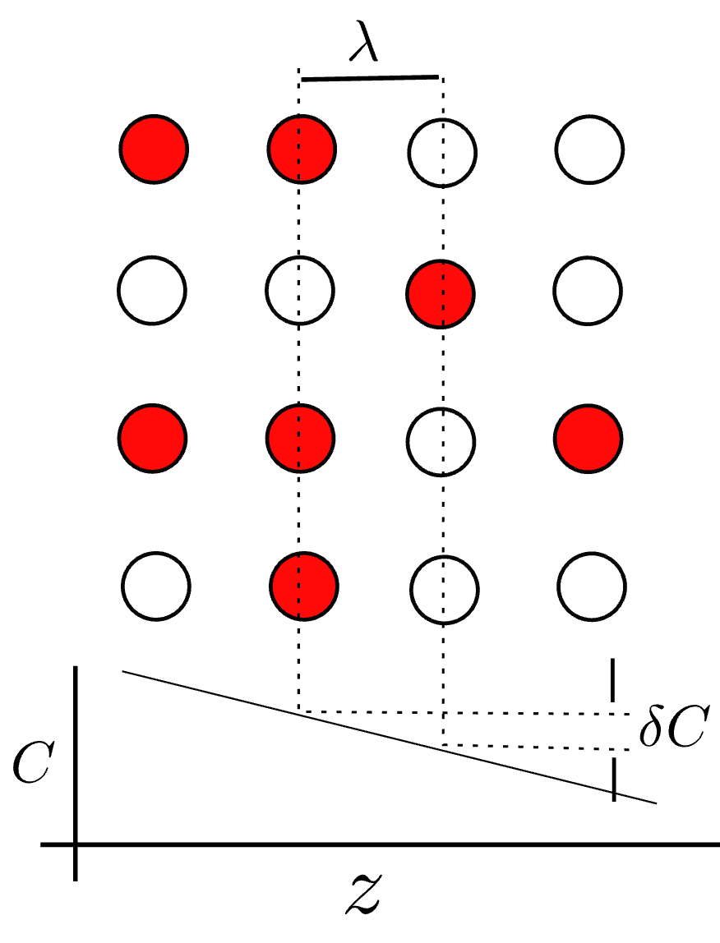
diffusion in a gradient of composition

Slide 12
increment of composition on travelling

Slide 14
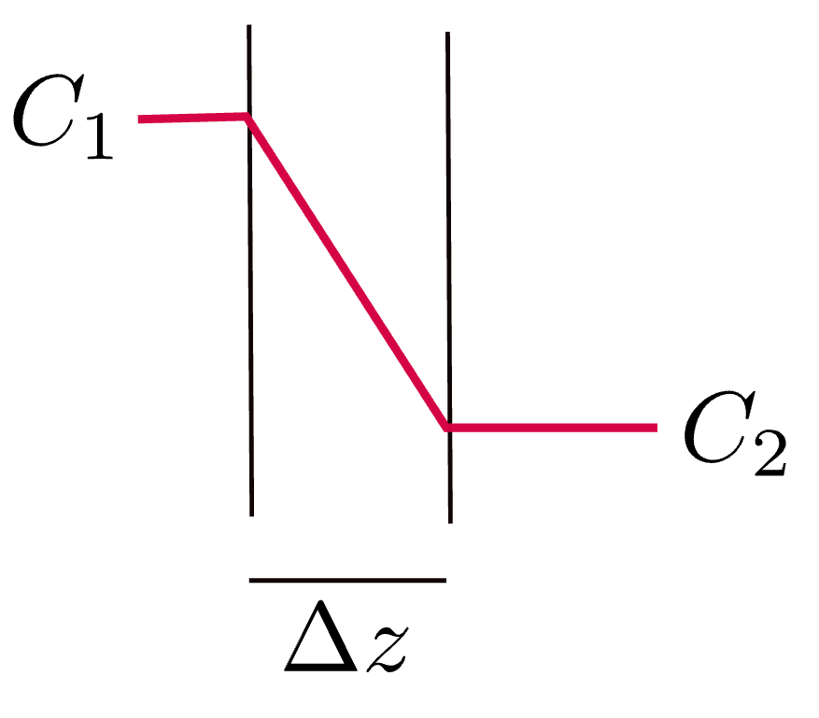
Most drugs cross biological membranes by “passive” diffusion, i.e., Fick’s law, rate of drug transfer proportional to difference in concentration

Slide 15
Biological membranes have structure
some amines highly polar, cannot dissolve in membrane lipids, cannot penetrate
diazepam, fentanyl, dissolve, diffuse rapidly
morphine, less soluble, slow diffusion, delayed response

Slide 16
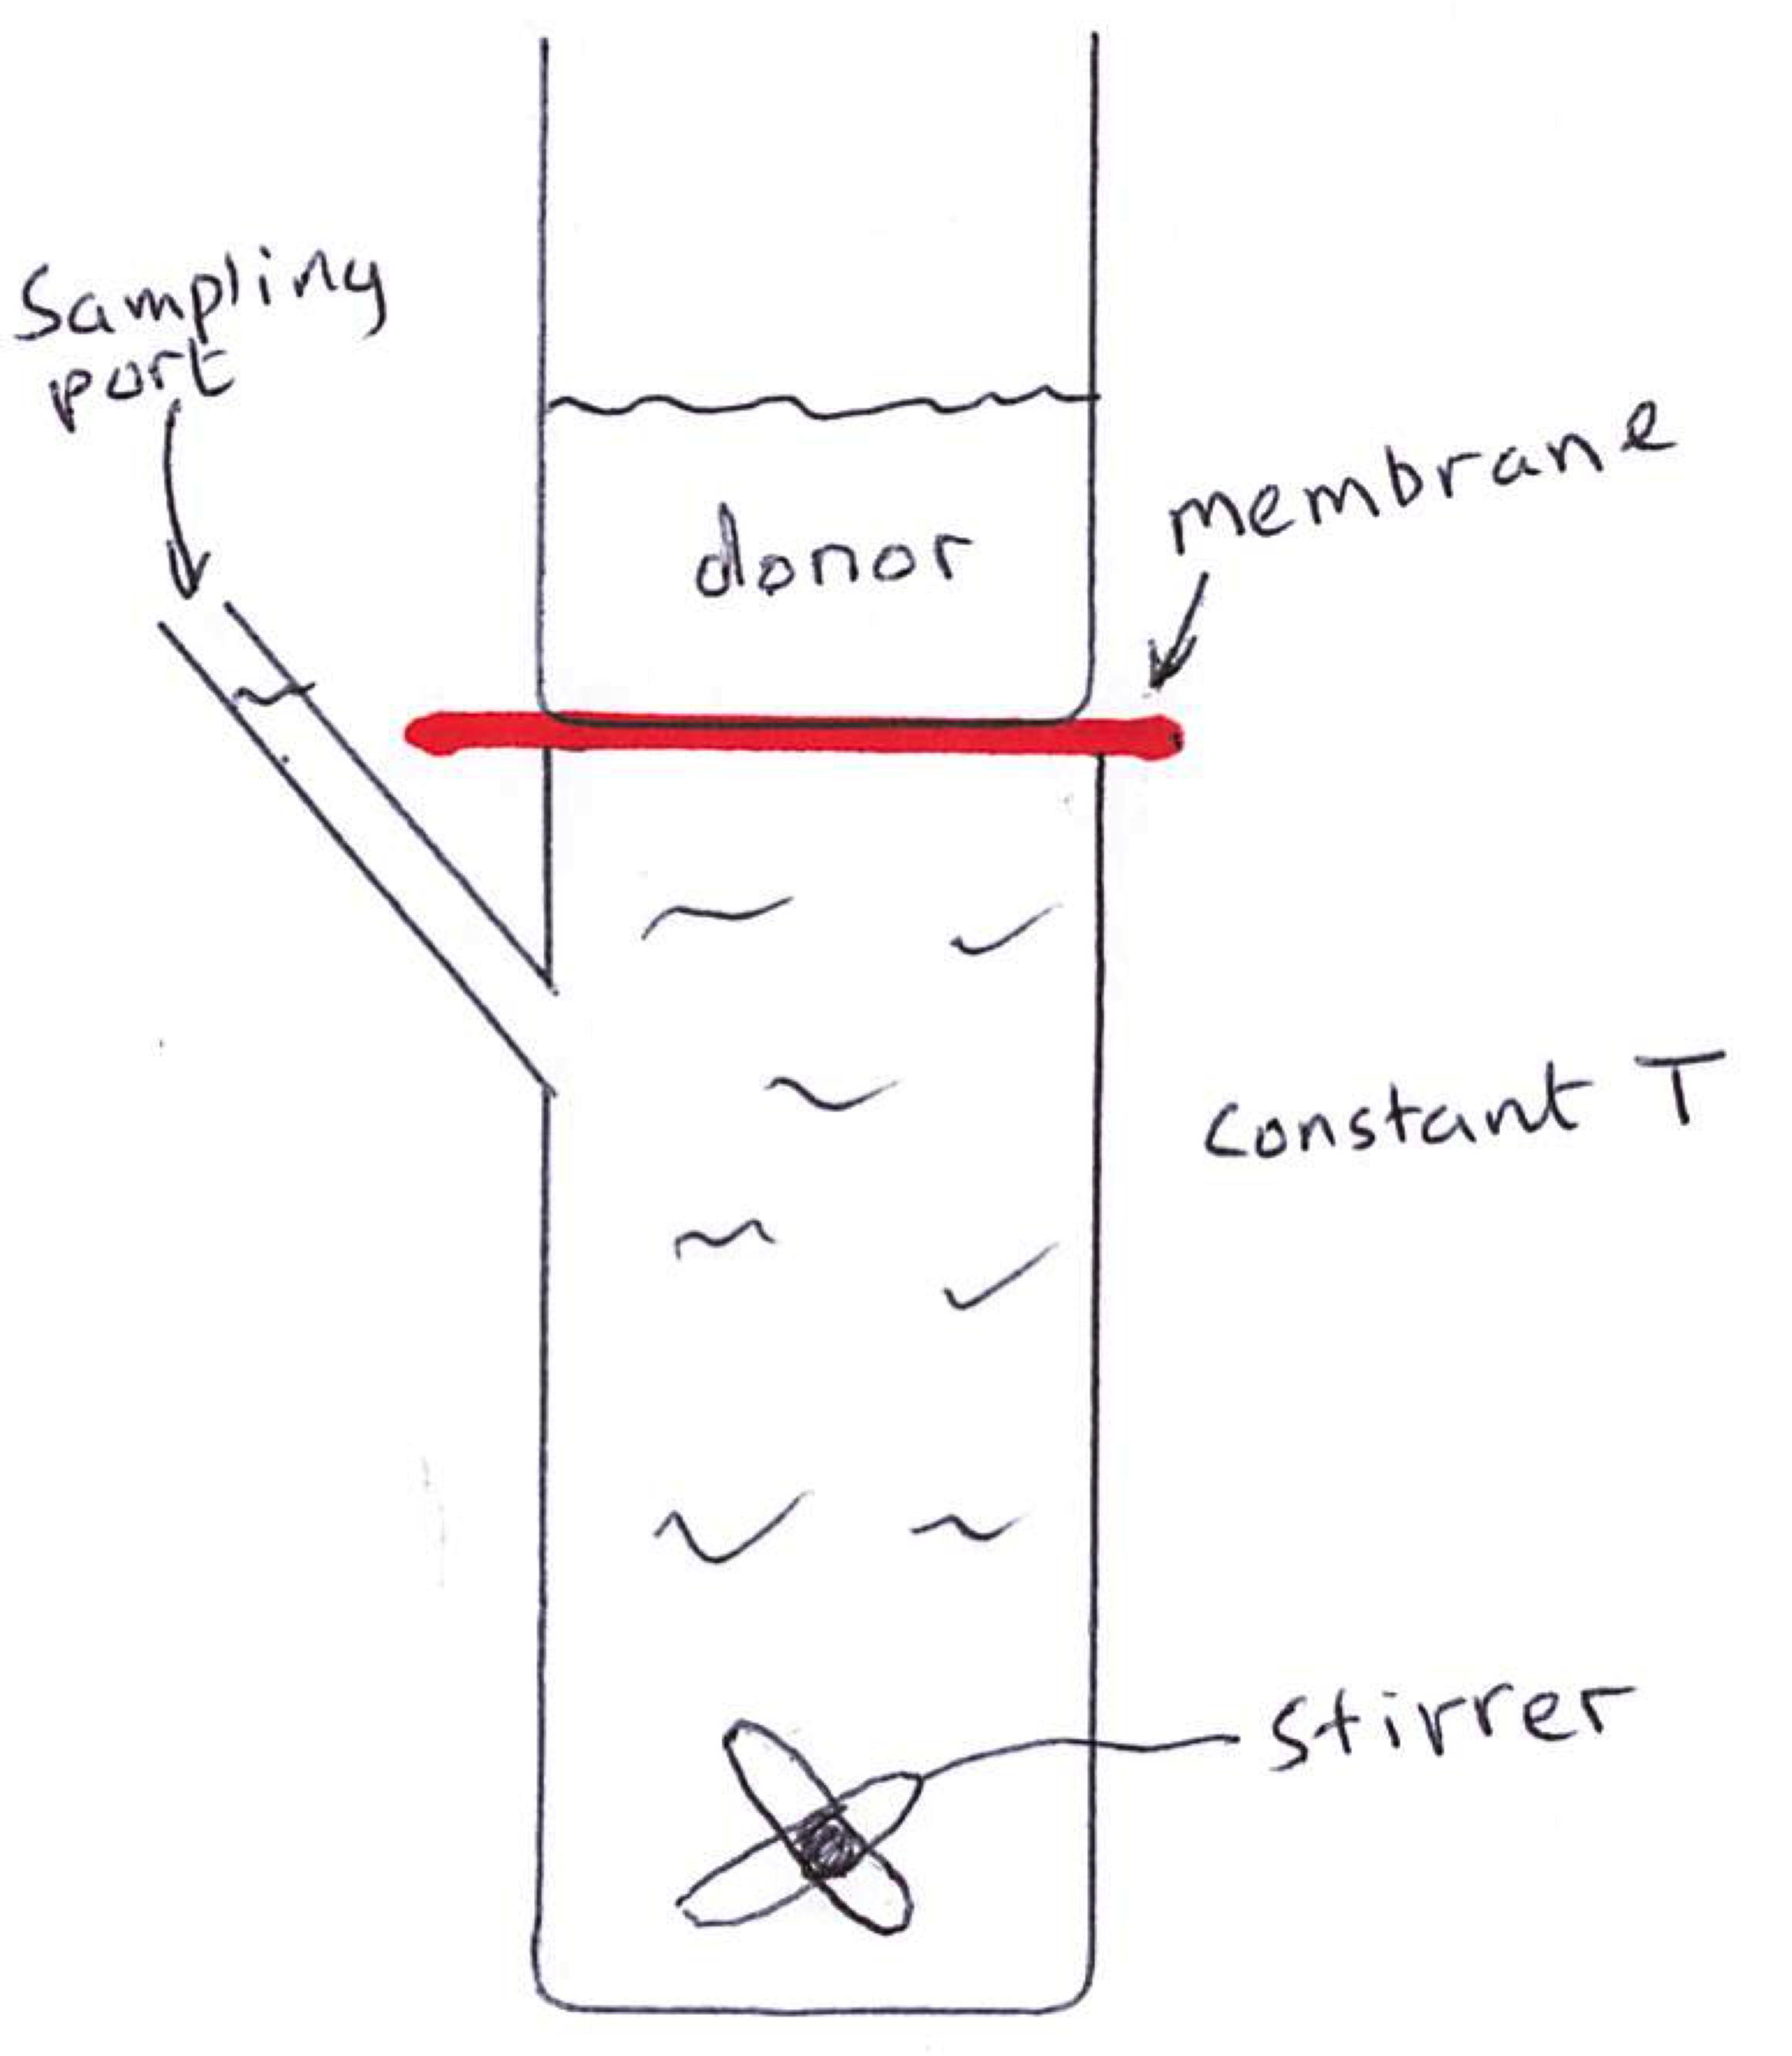
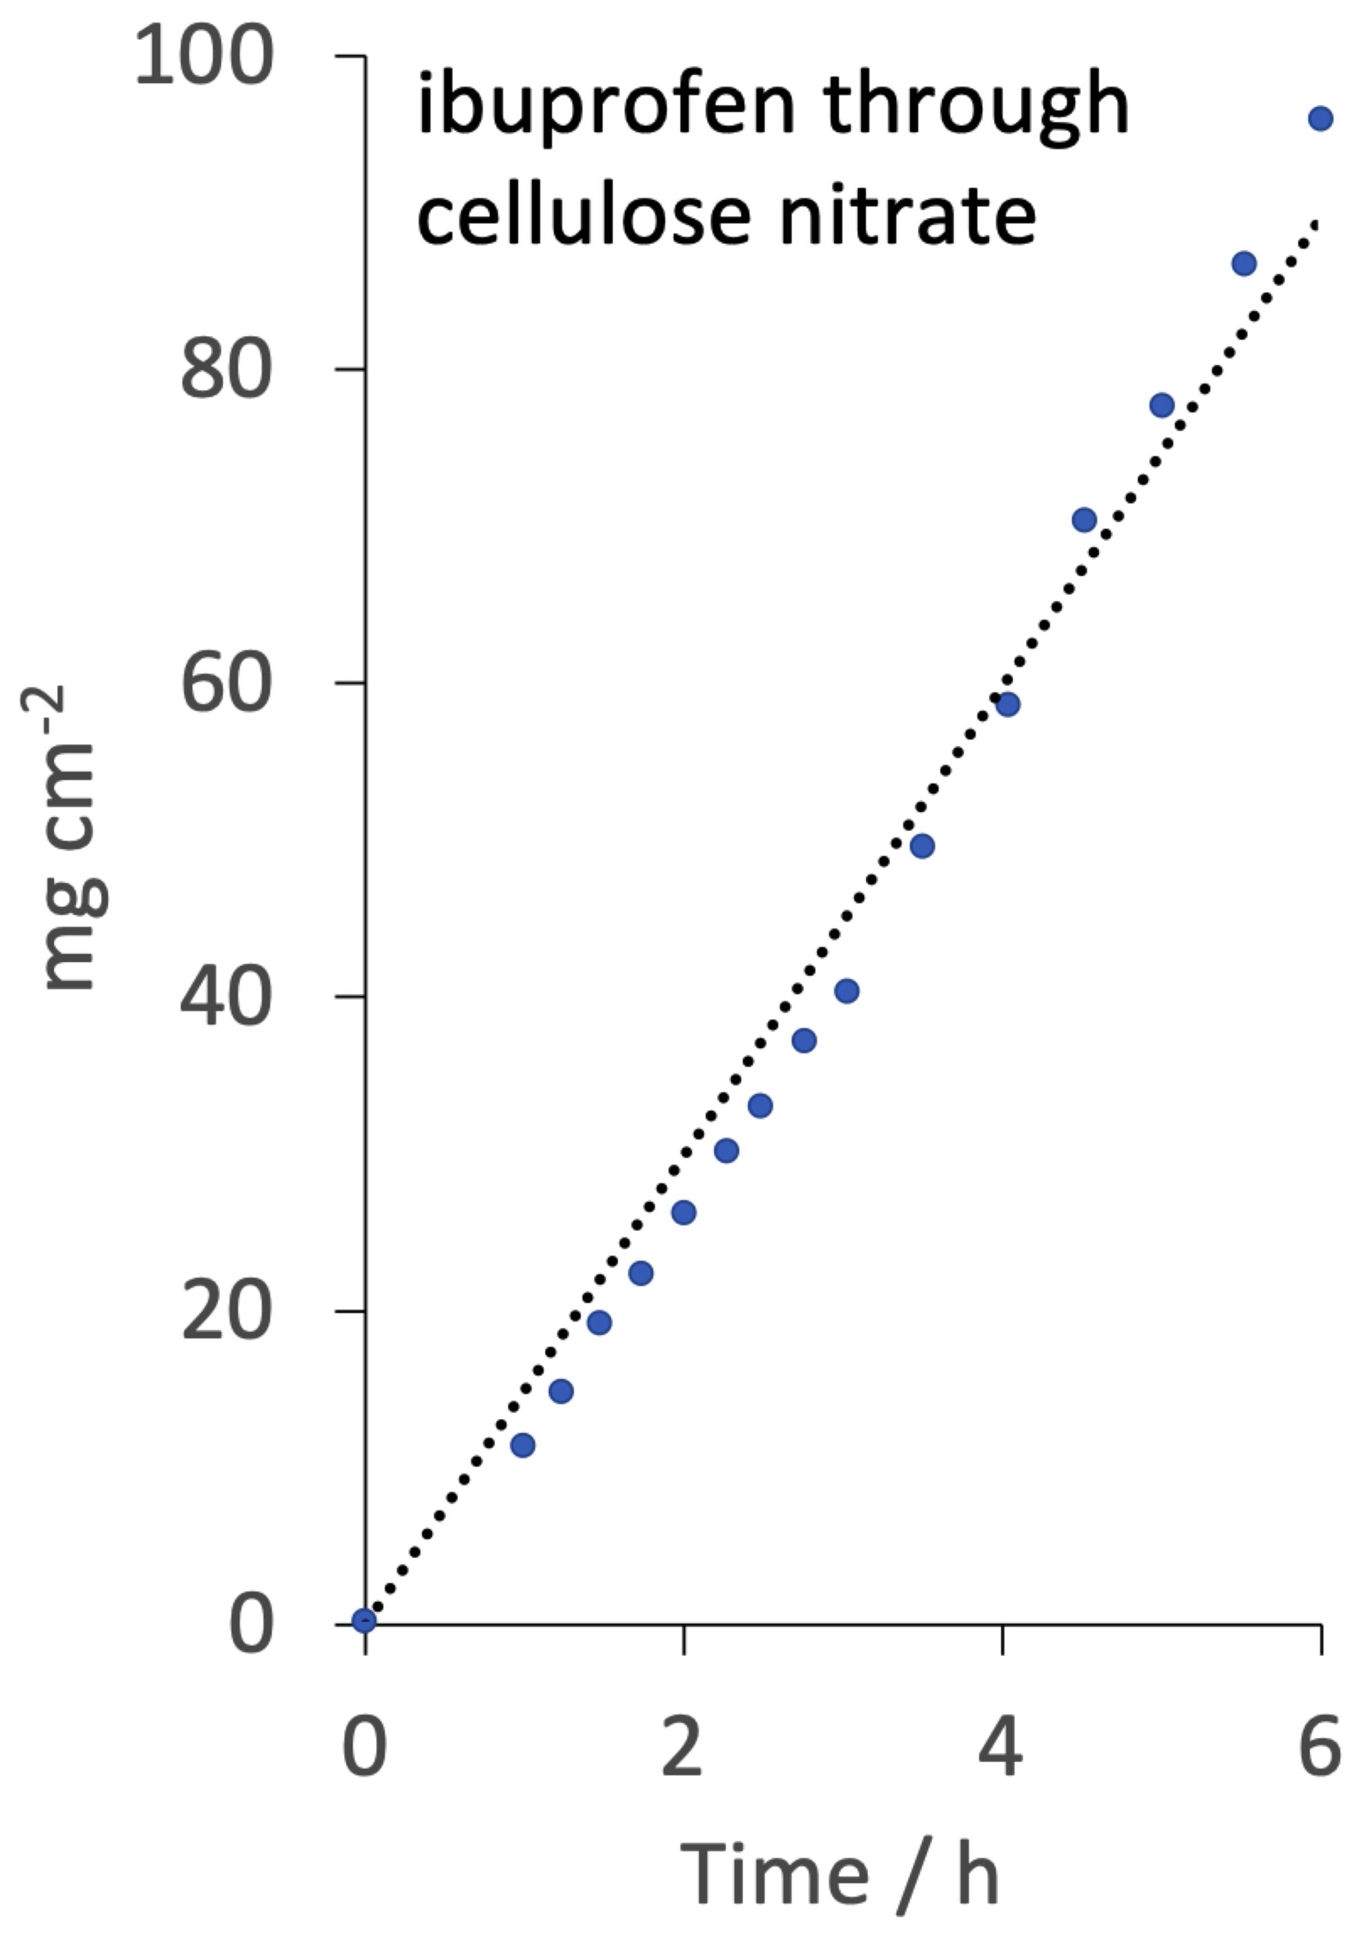
Ng, Rouse, Sanderson, Eccleston
Pharmaceutics 2 (2010) 209

Slide 17
Non-uniform concentration gradients

Slide 19
thin plating on surface of semi-infinite bar of unit cross-sectional area

Slide 20
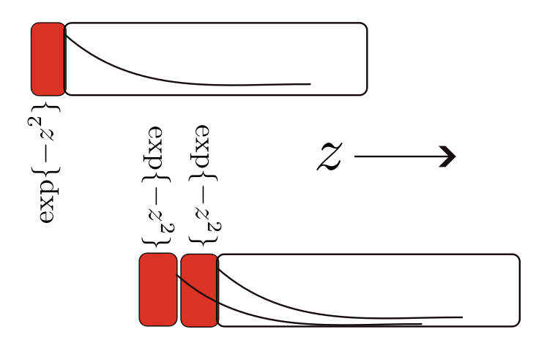

Slide 21
error function

Slide 22
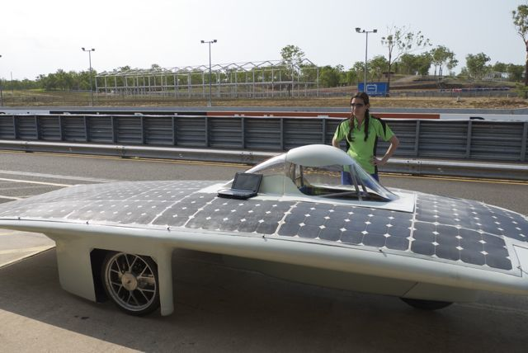
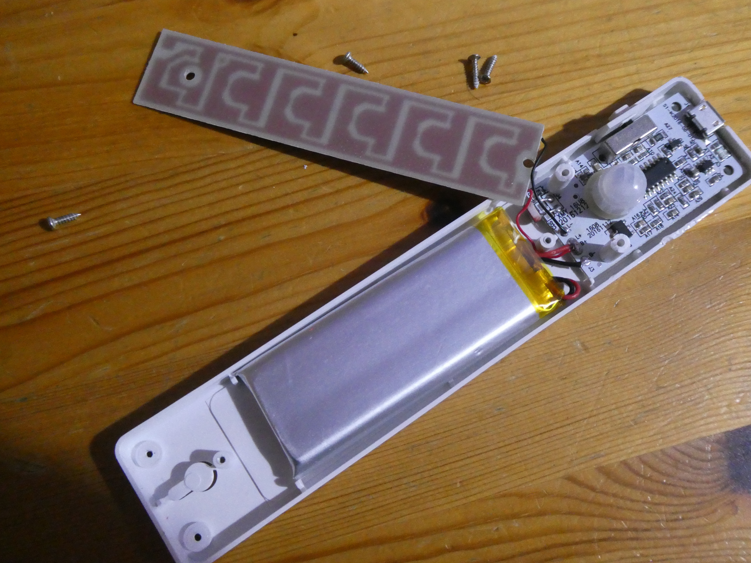


Slide 23
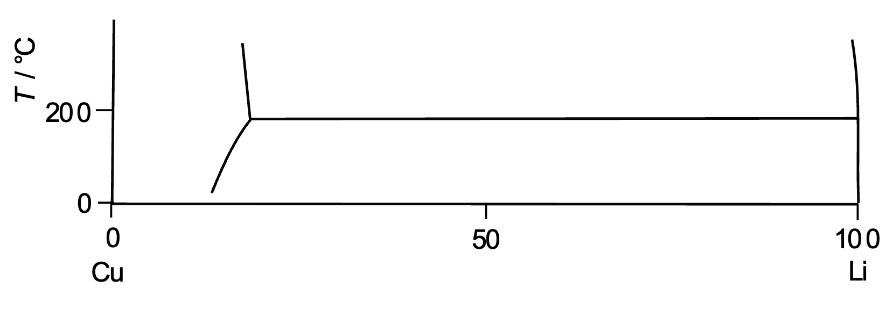
No intermetallic compounds at ambient temperature
but lithium does dissolve in copper
Adapted from
H. Okamoto
JPEDAV (2011) 32:172

Slide 24
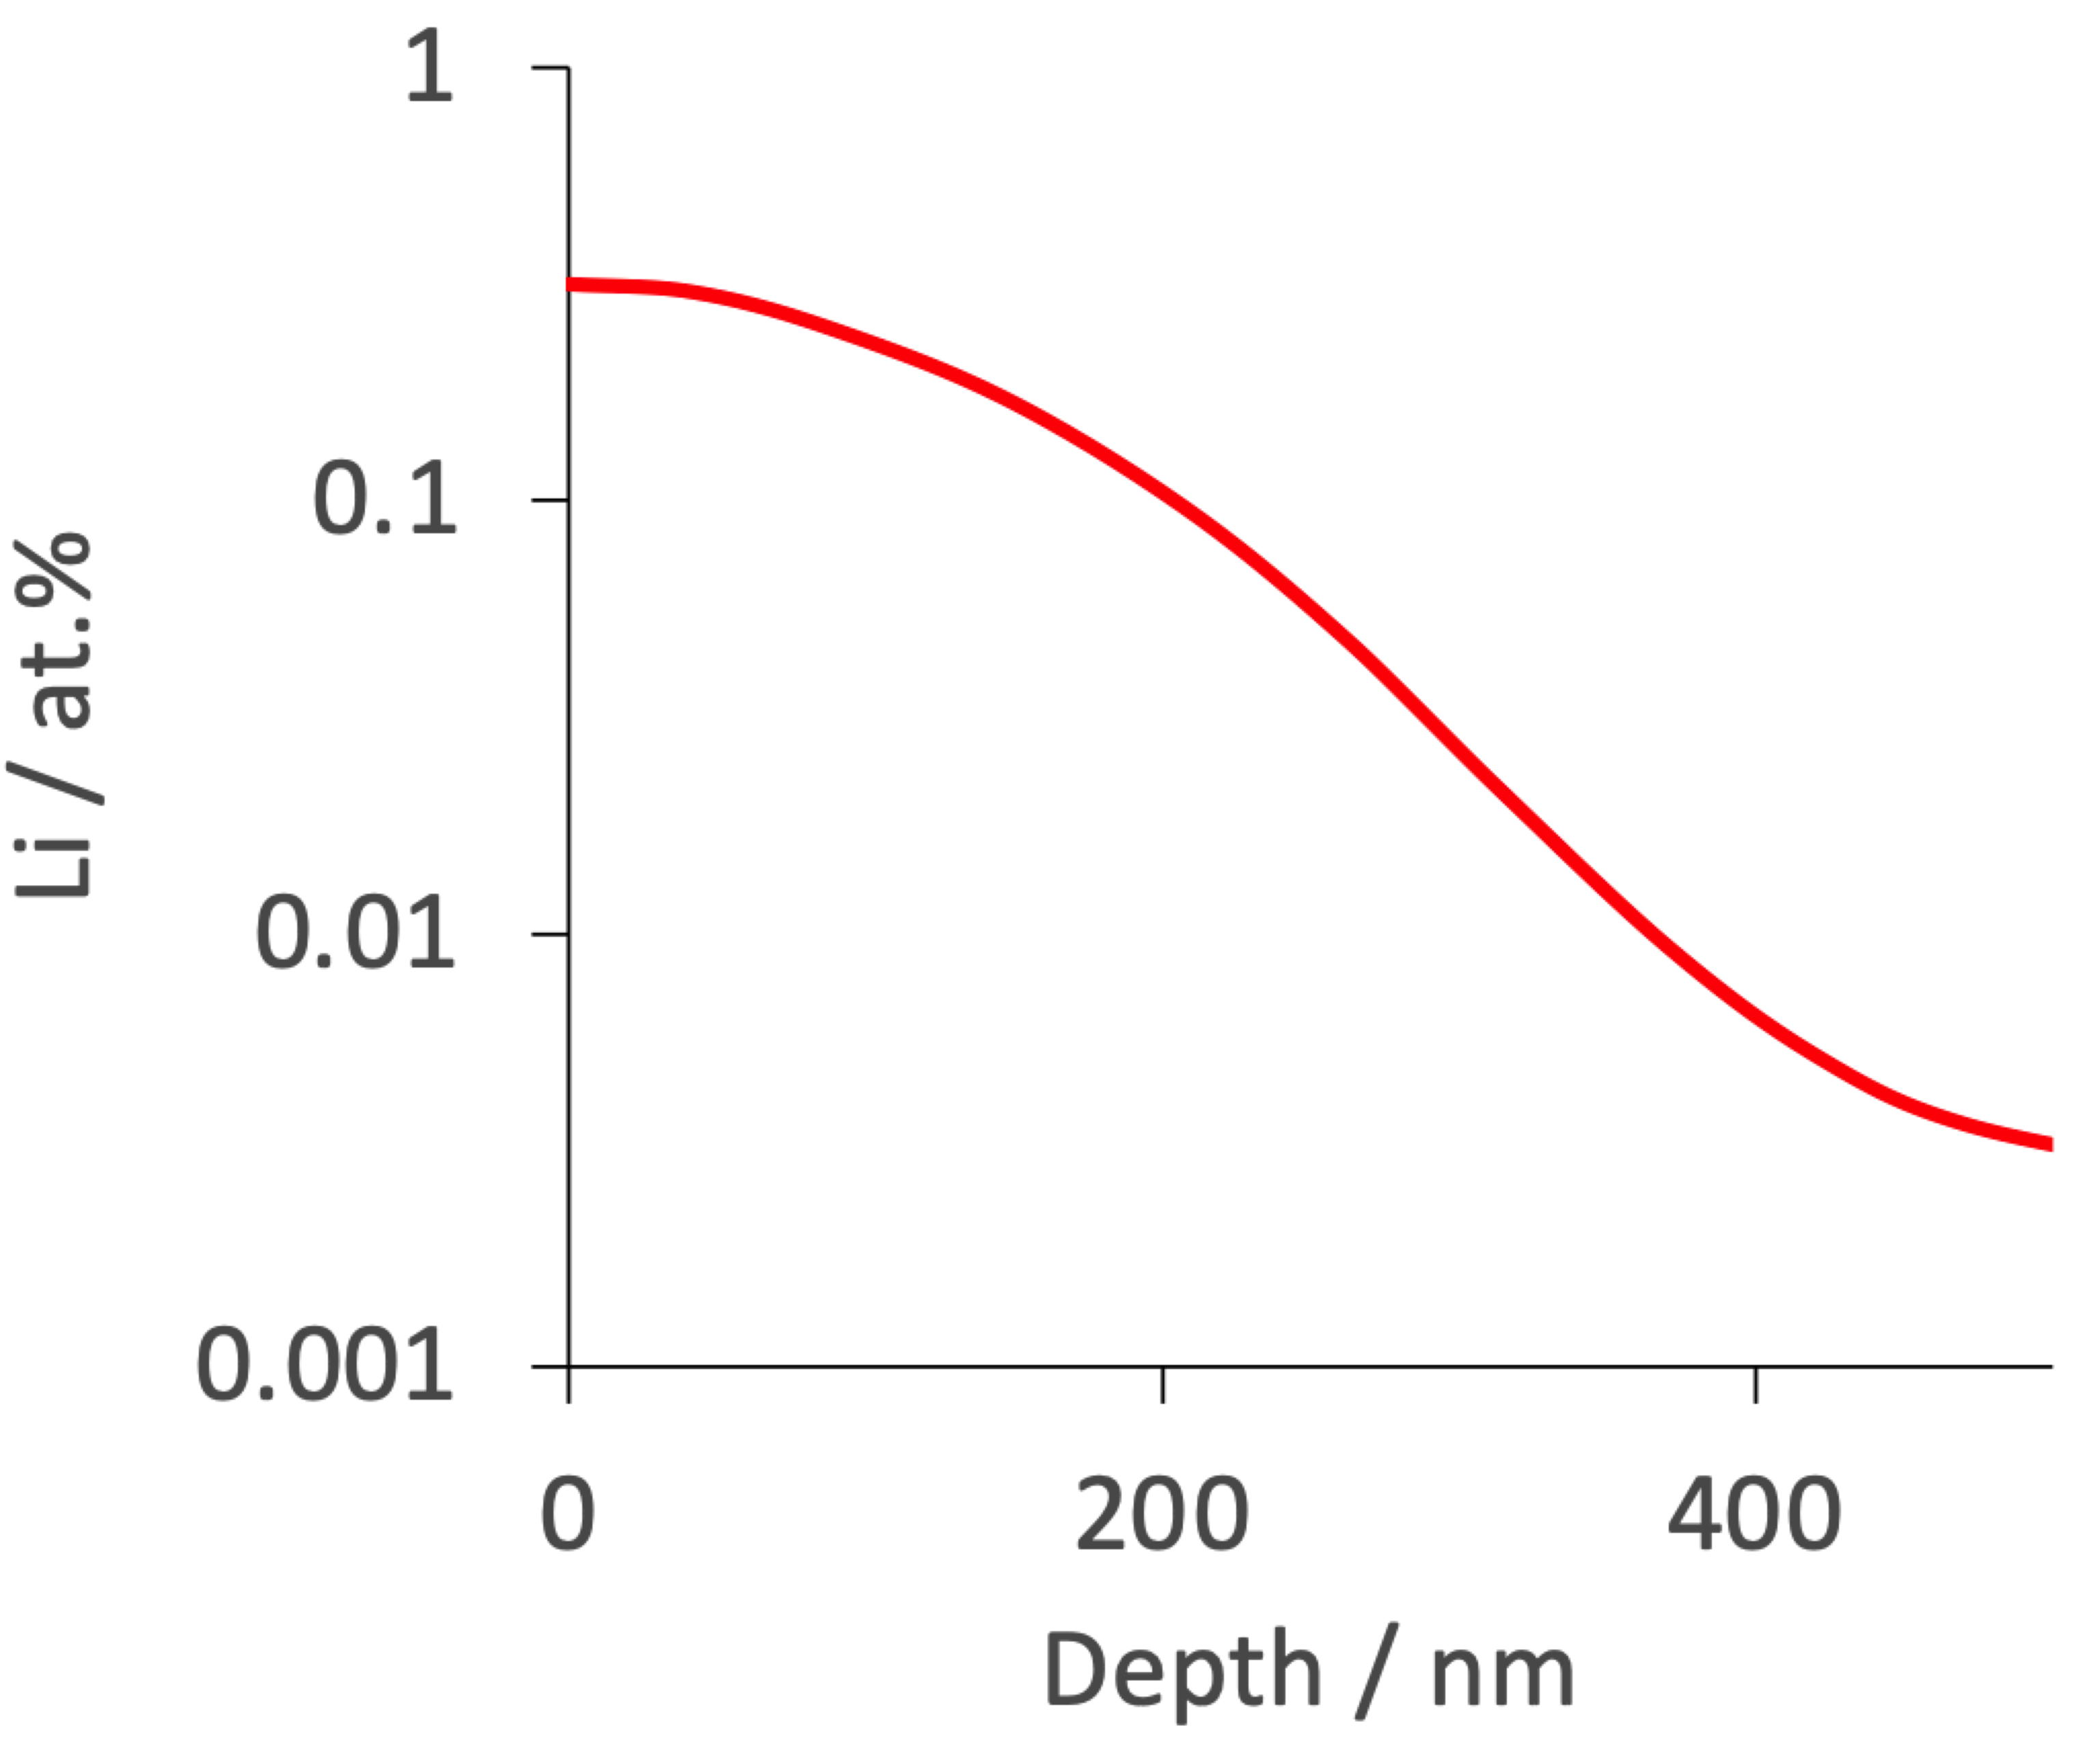
“lattice and grain boundary diffusion coefficients found to be 13 orders of magnitude smaller than previously reported”
Greatly simplified and adapted from:
Rupp, Caerts, Vantomme, Fransaer, Vlad. The journal of physical chemistry letters
10 (2019) 5206.

Slide 25
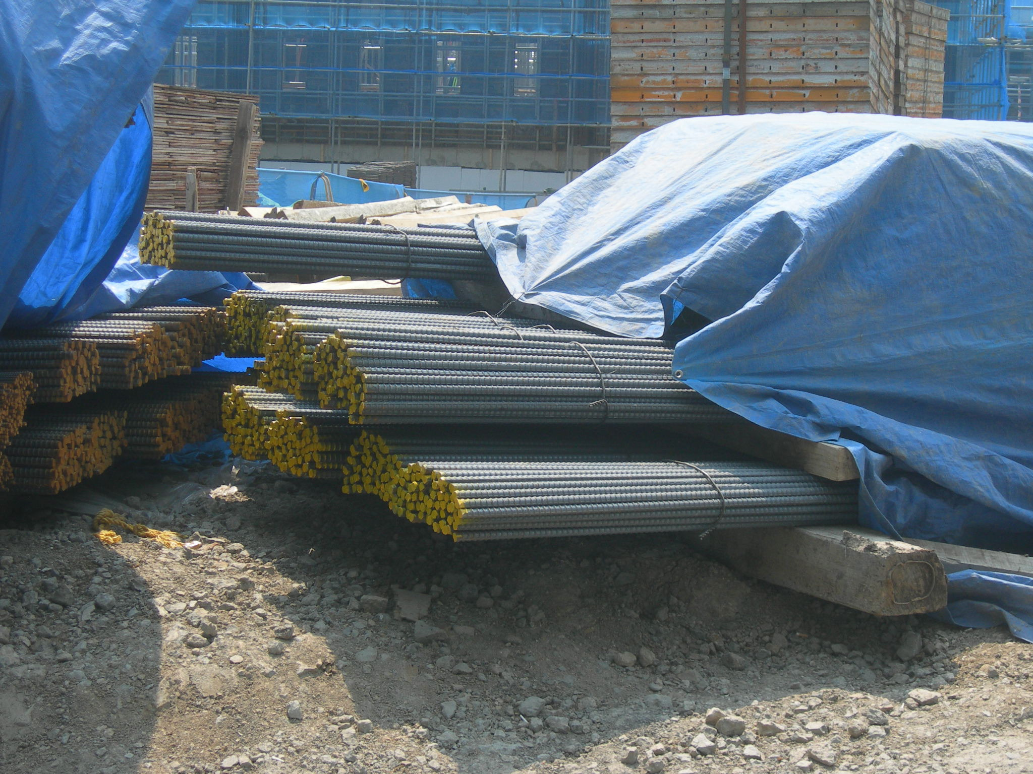

Slide 26
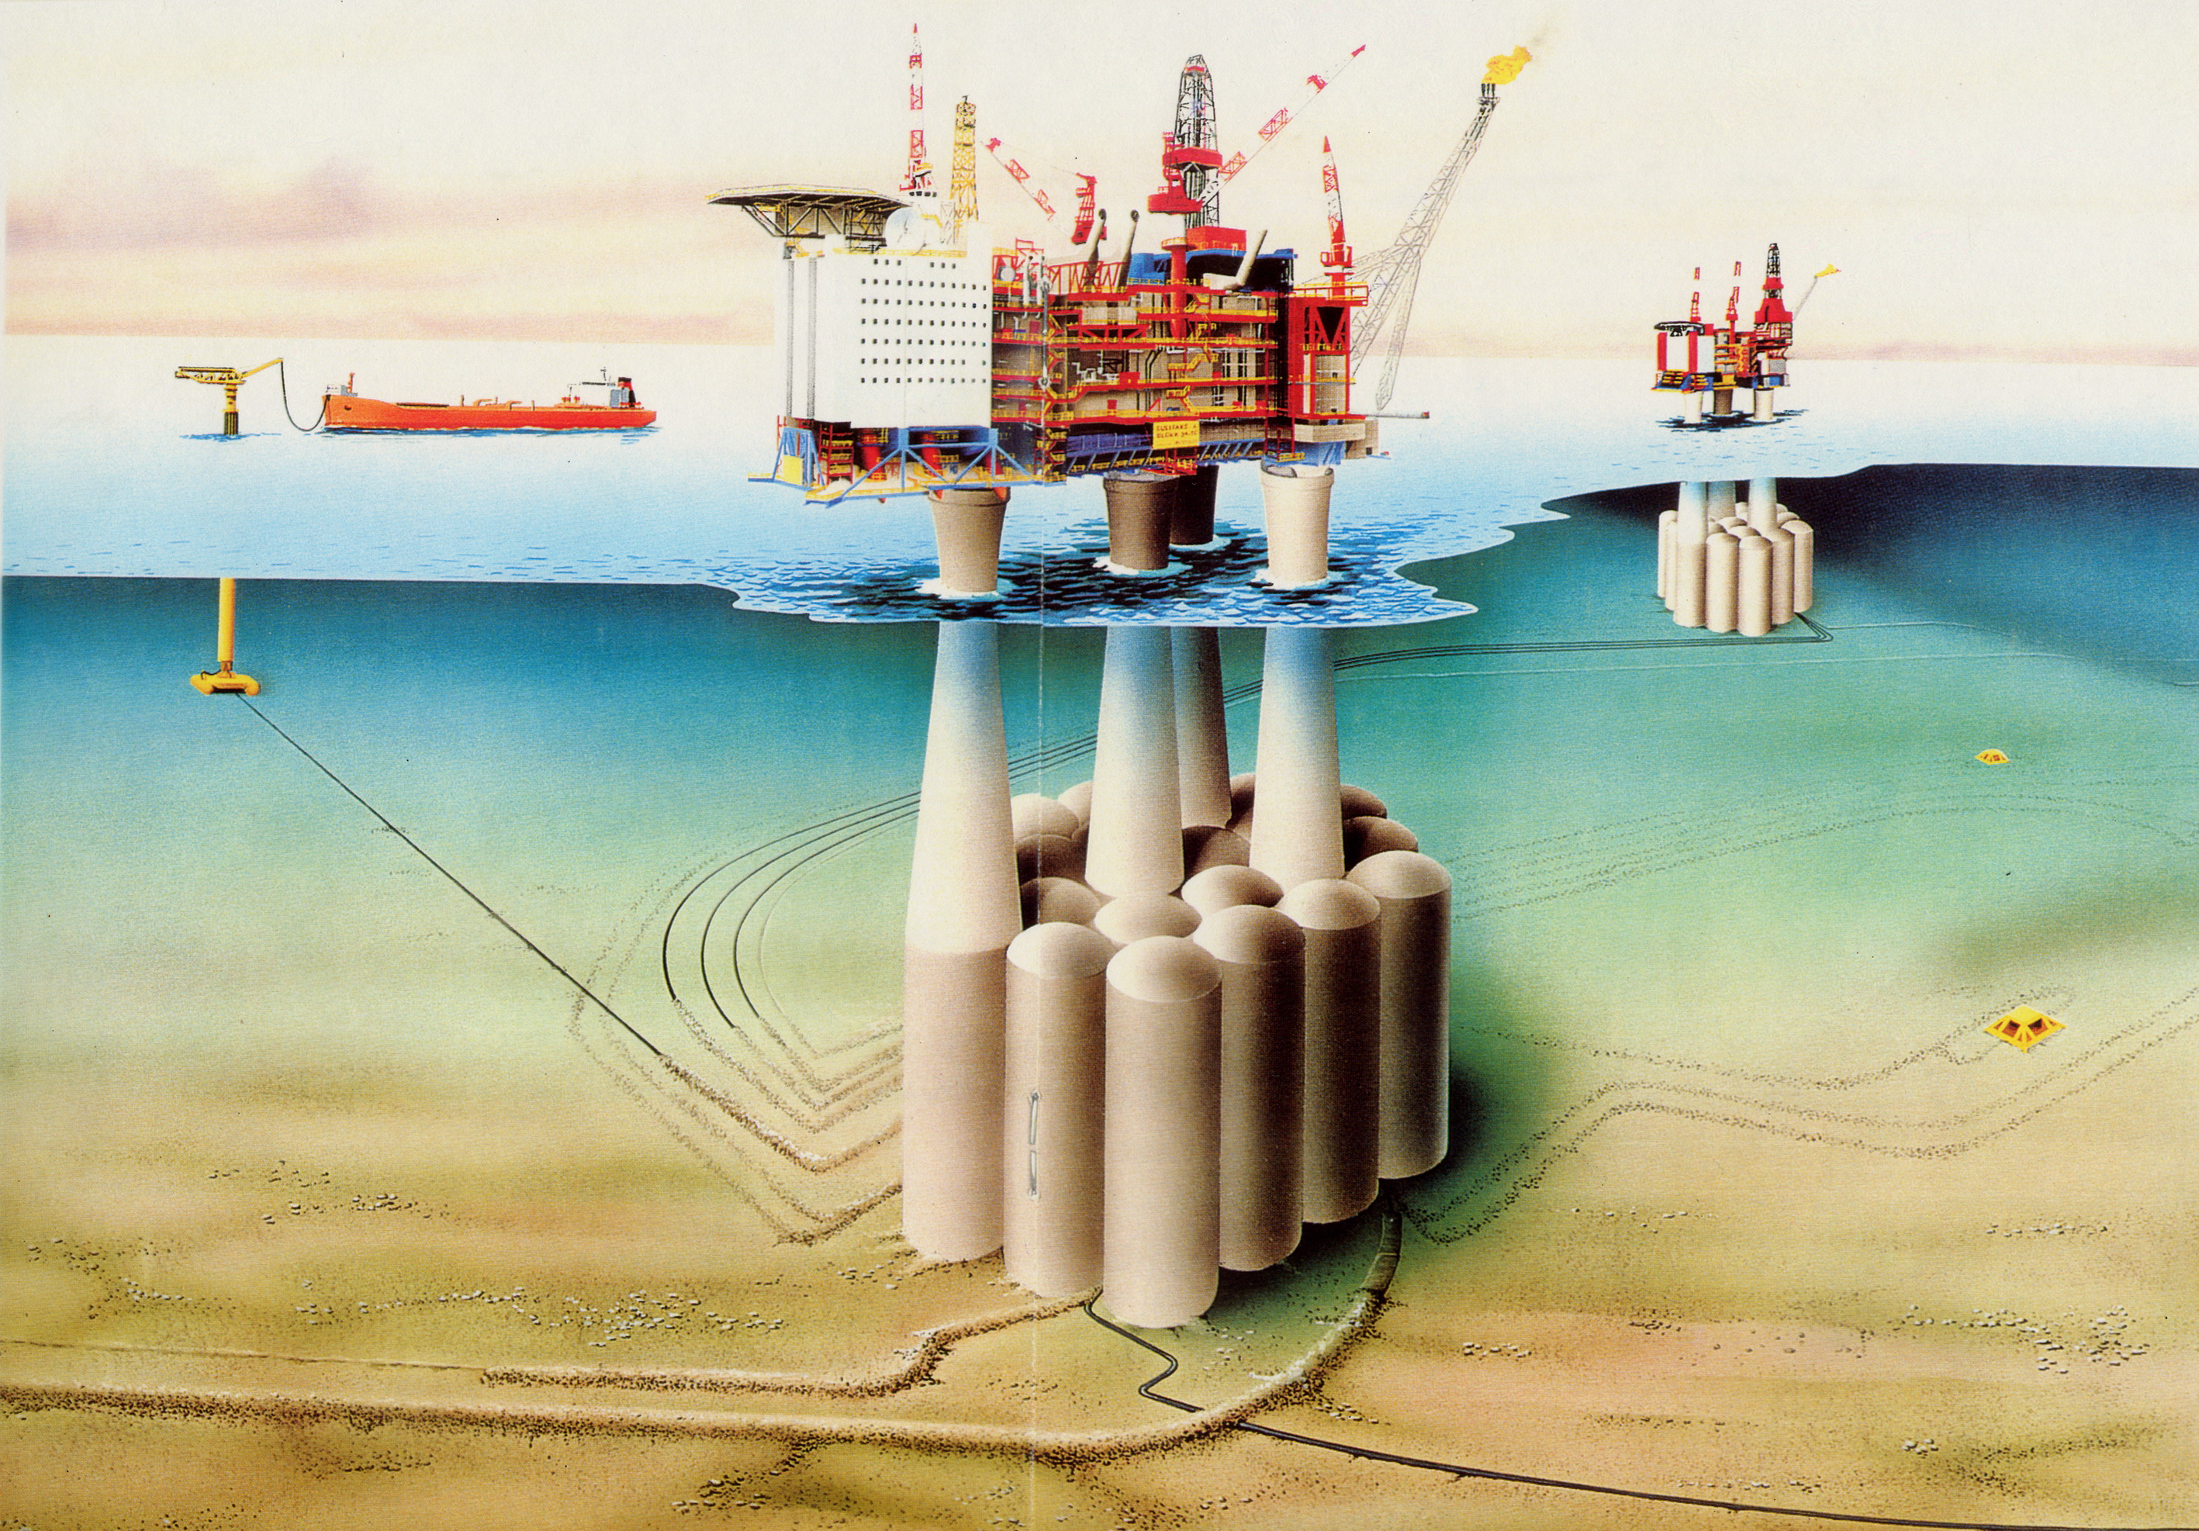

Slide 27
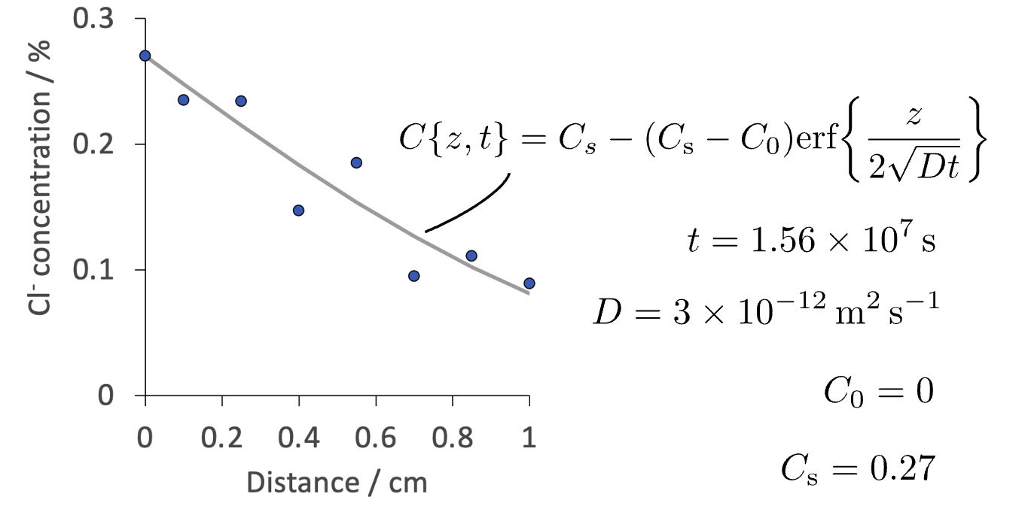
Diffusion of chloride ions into concrete
Any approximations?
Data from:
Ye, Zheng, Wan, Cheng. Advanced Materials Research 306 (2011) 1038.

Slide 28
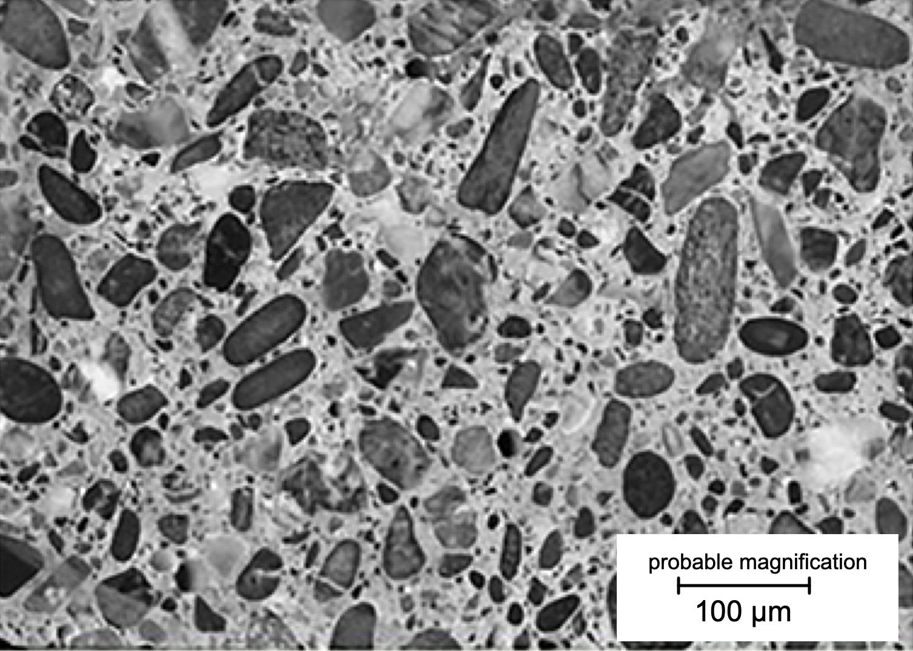
Hilal AA. Microstructure of concrete. High performance concrete technology and applications. (2016) 3-24.
CC BY 3.0

