Slide 1

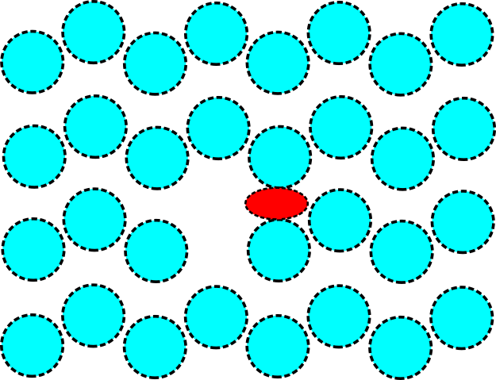
Phase transitions atomic mechanism of diffusion

Slide 2
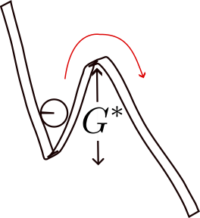

Slide 3
how to relate D and T linearly?

Slide 5
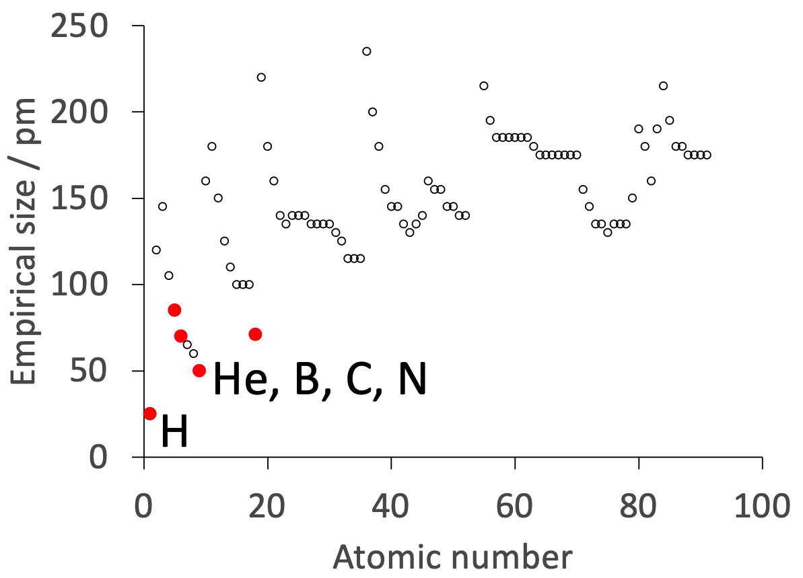
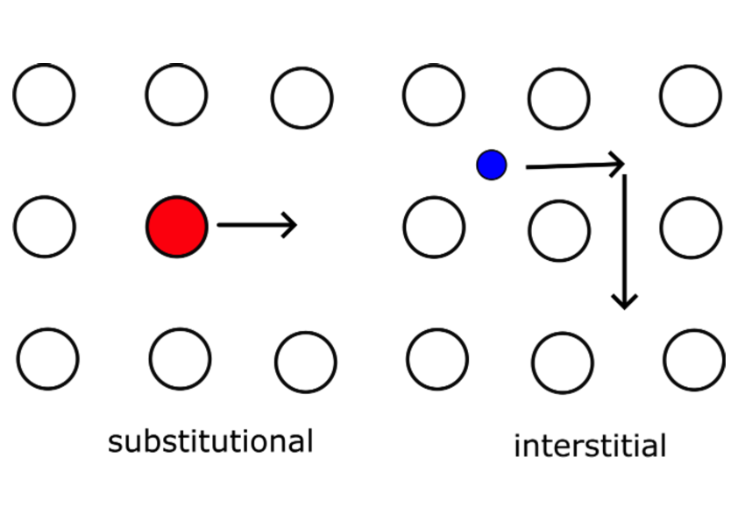
Mechanism of interstitial-atom diffusion

Slide 6
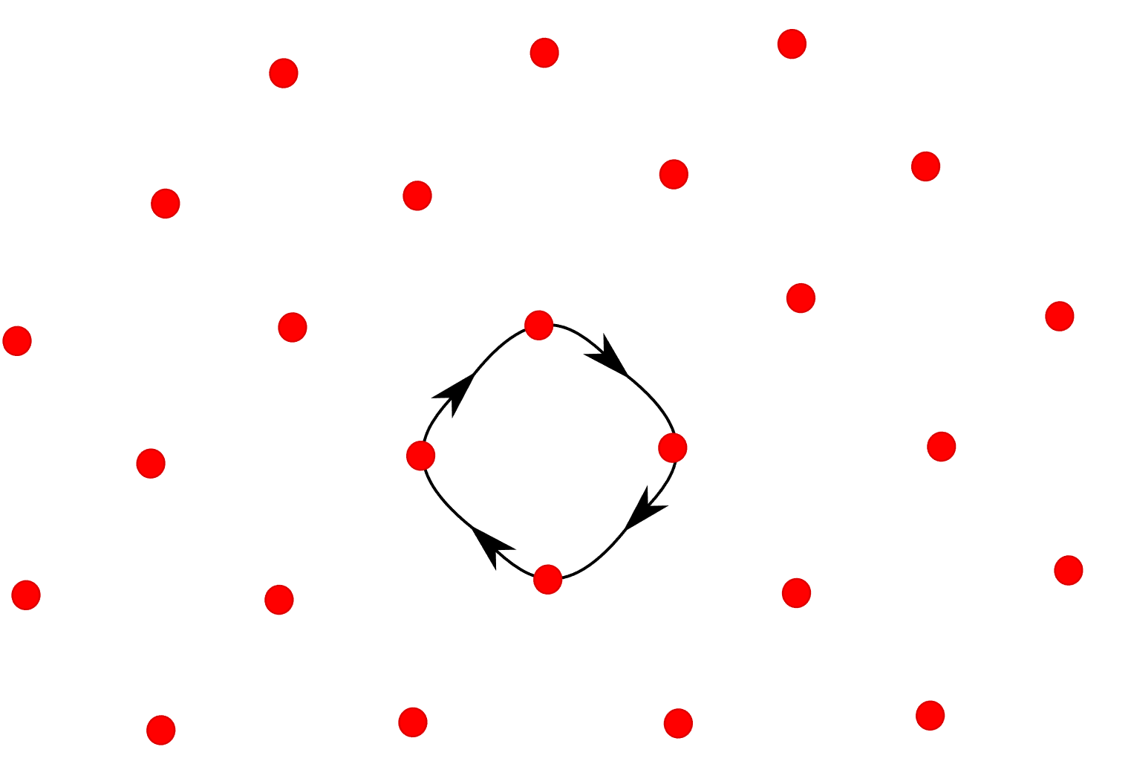

Slide 7
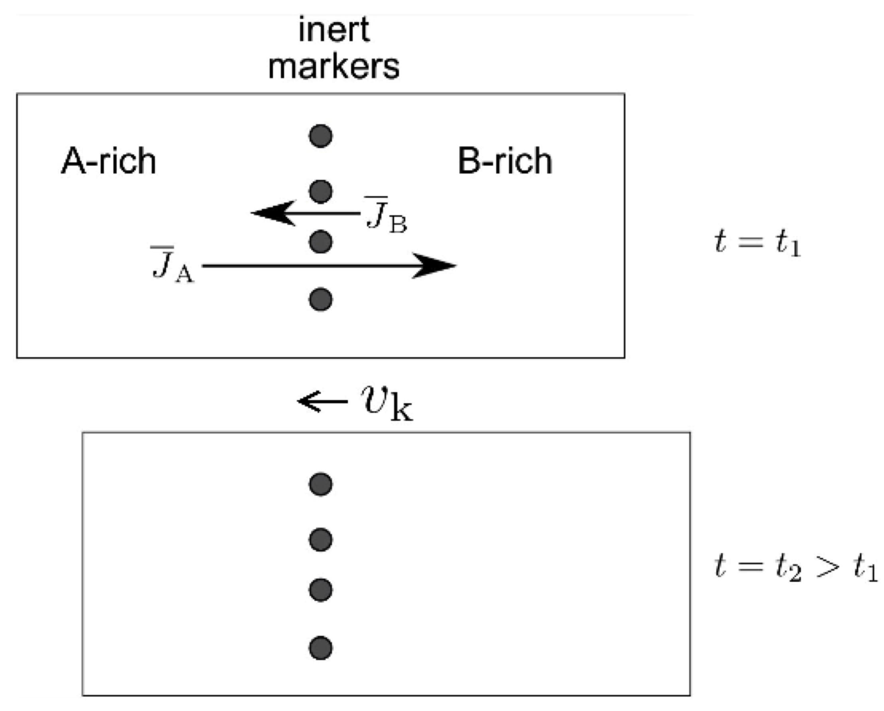
Kirkendall effect

Slide 8
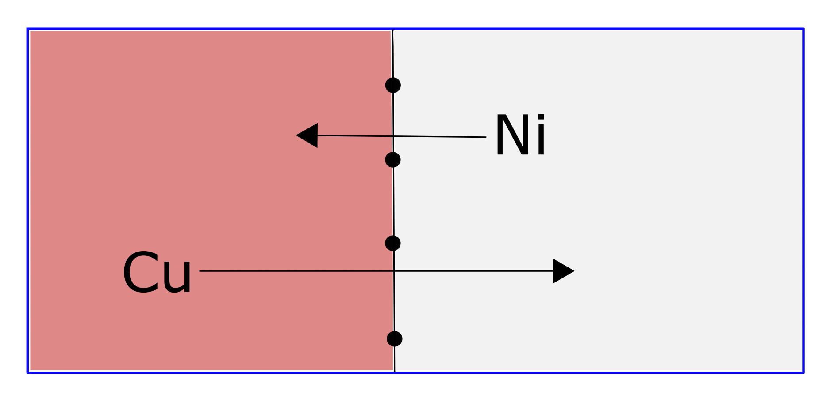
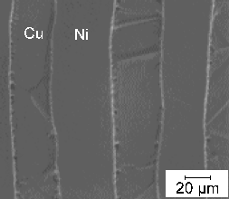
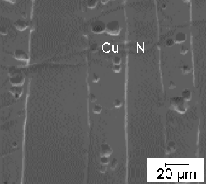
diffusion couple (Choi, Matlock, Olson)

Slide 9
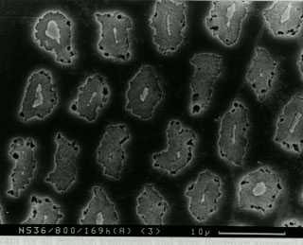
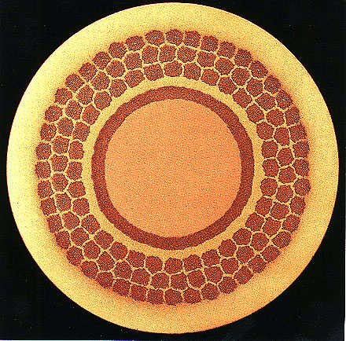
Nb₃Sn superconductor
Robertson, Evetts and Wallach

Slide 10
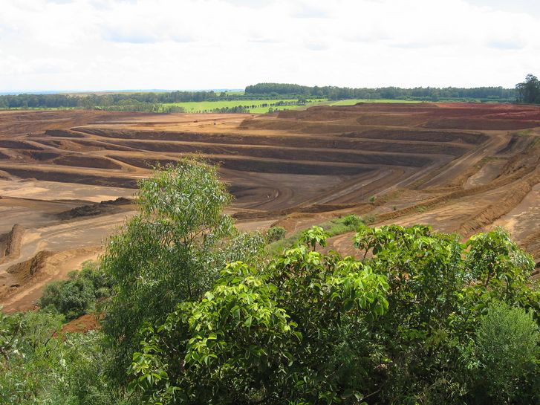
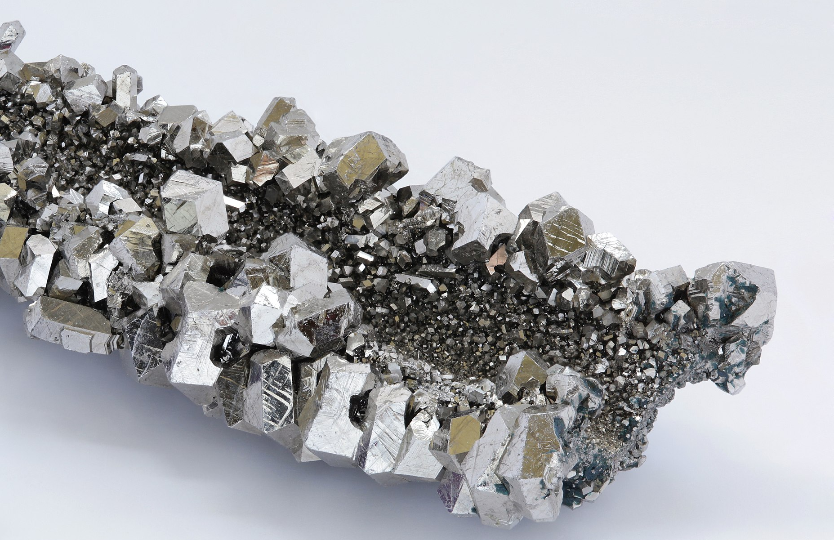
Niobium mine in Brazil

Slide 11
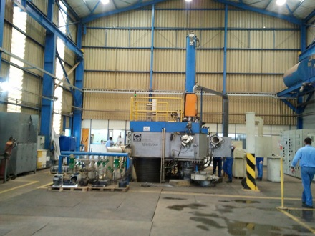
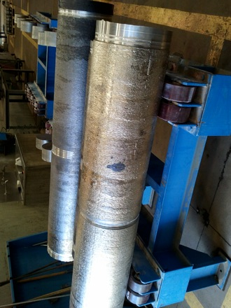
Niobium

Slide 12
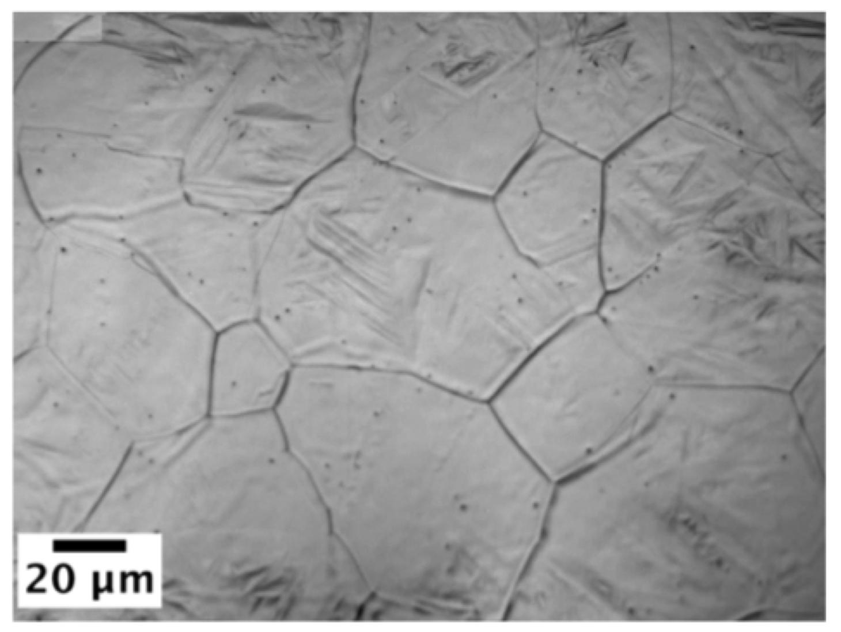
structure sensitive diffusion

Slide 13
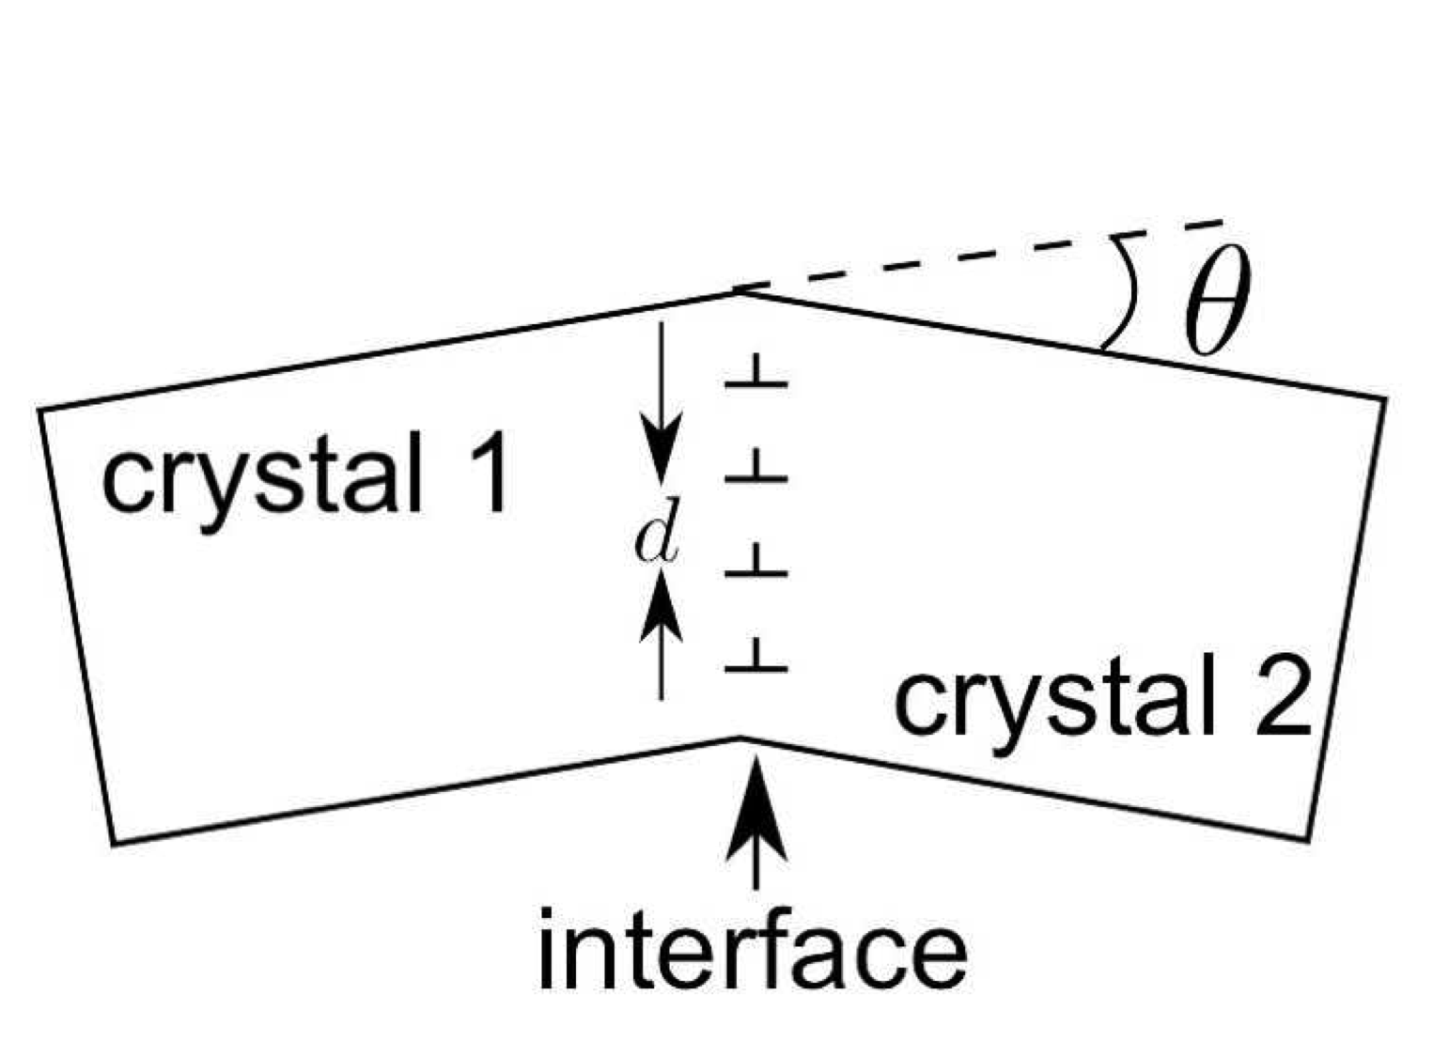
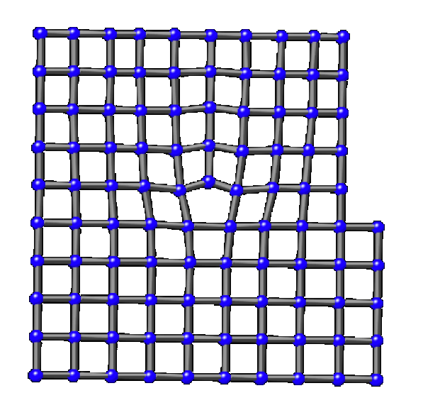

Slide 14
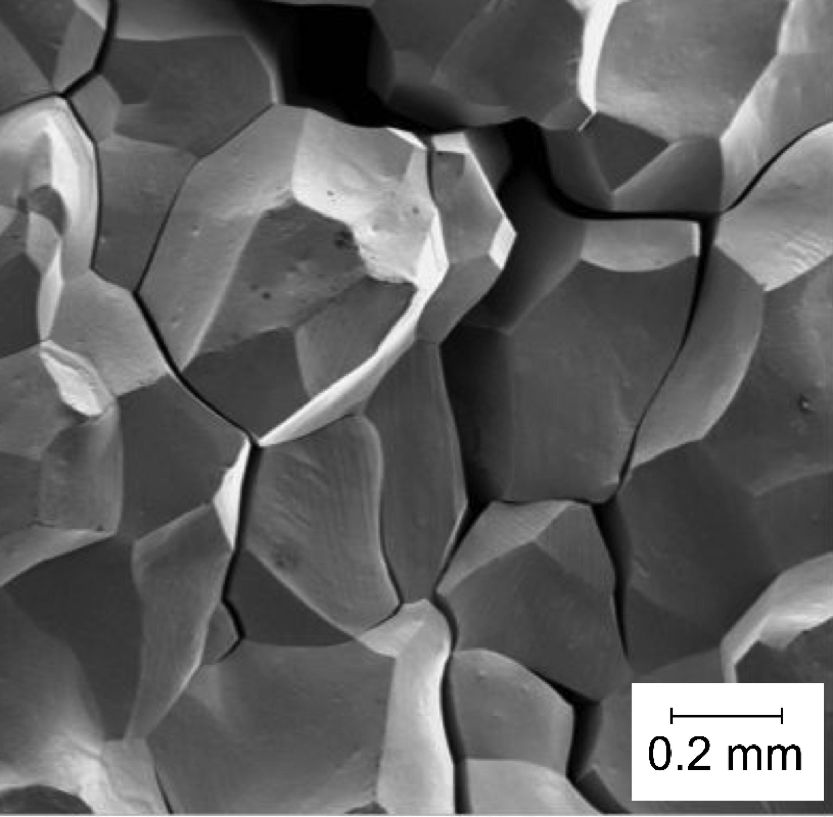
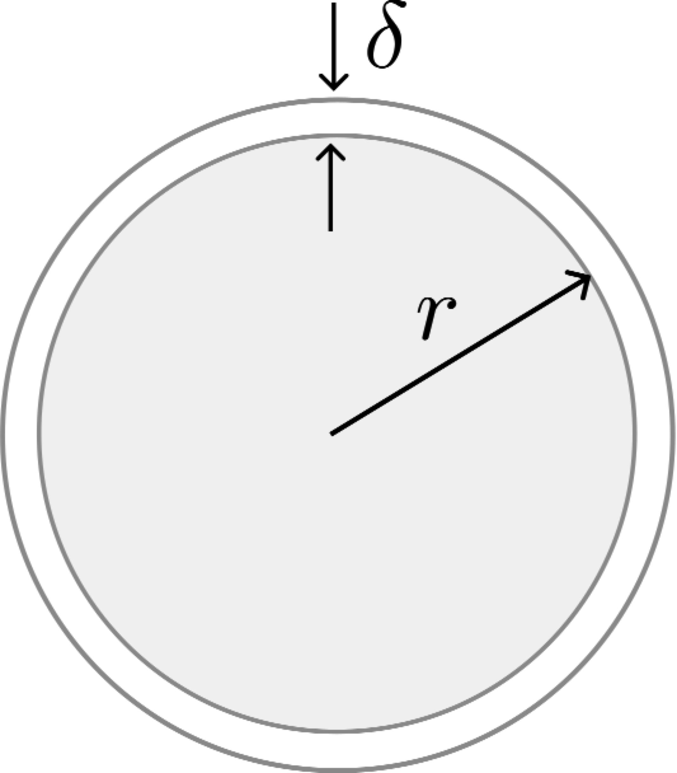

Slide 16
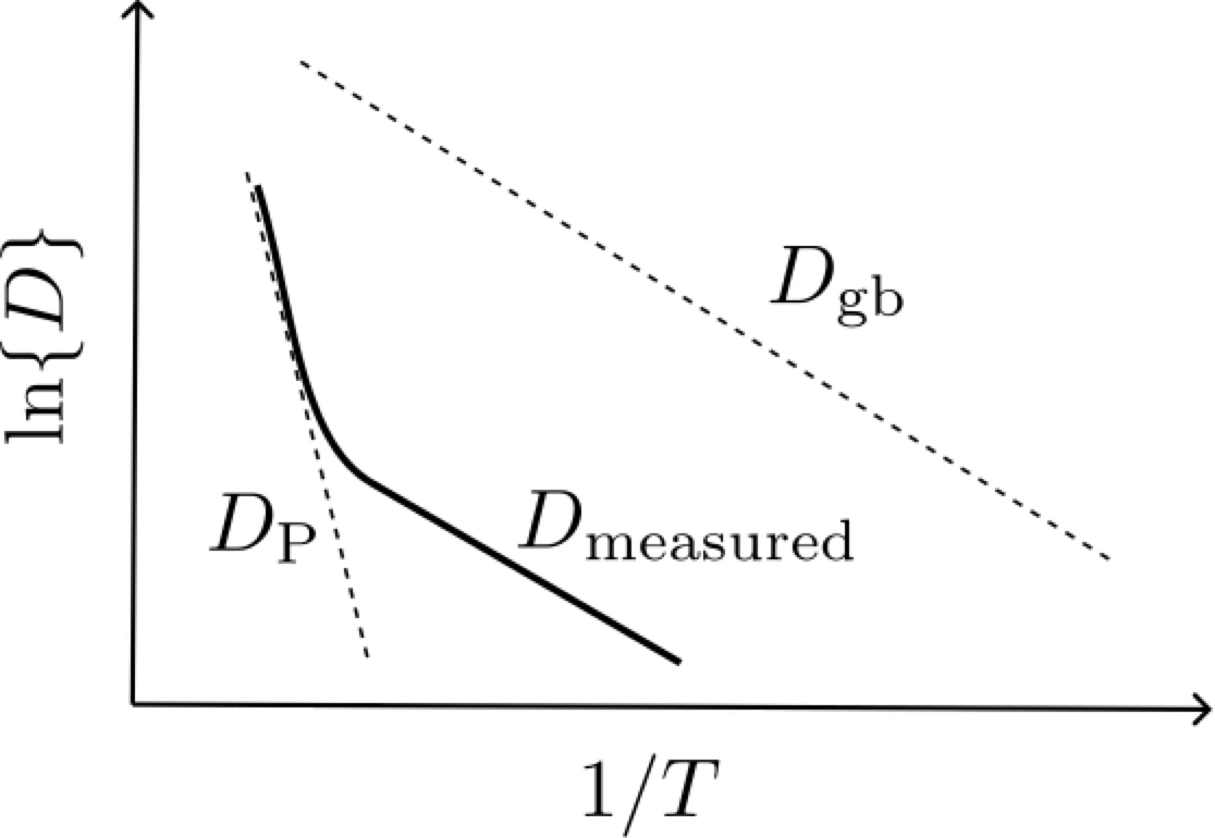
higher temperature

Slide 17
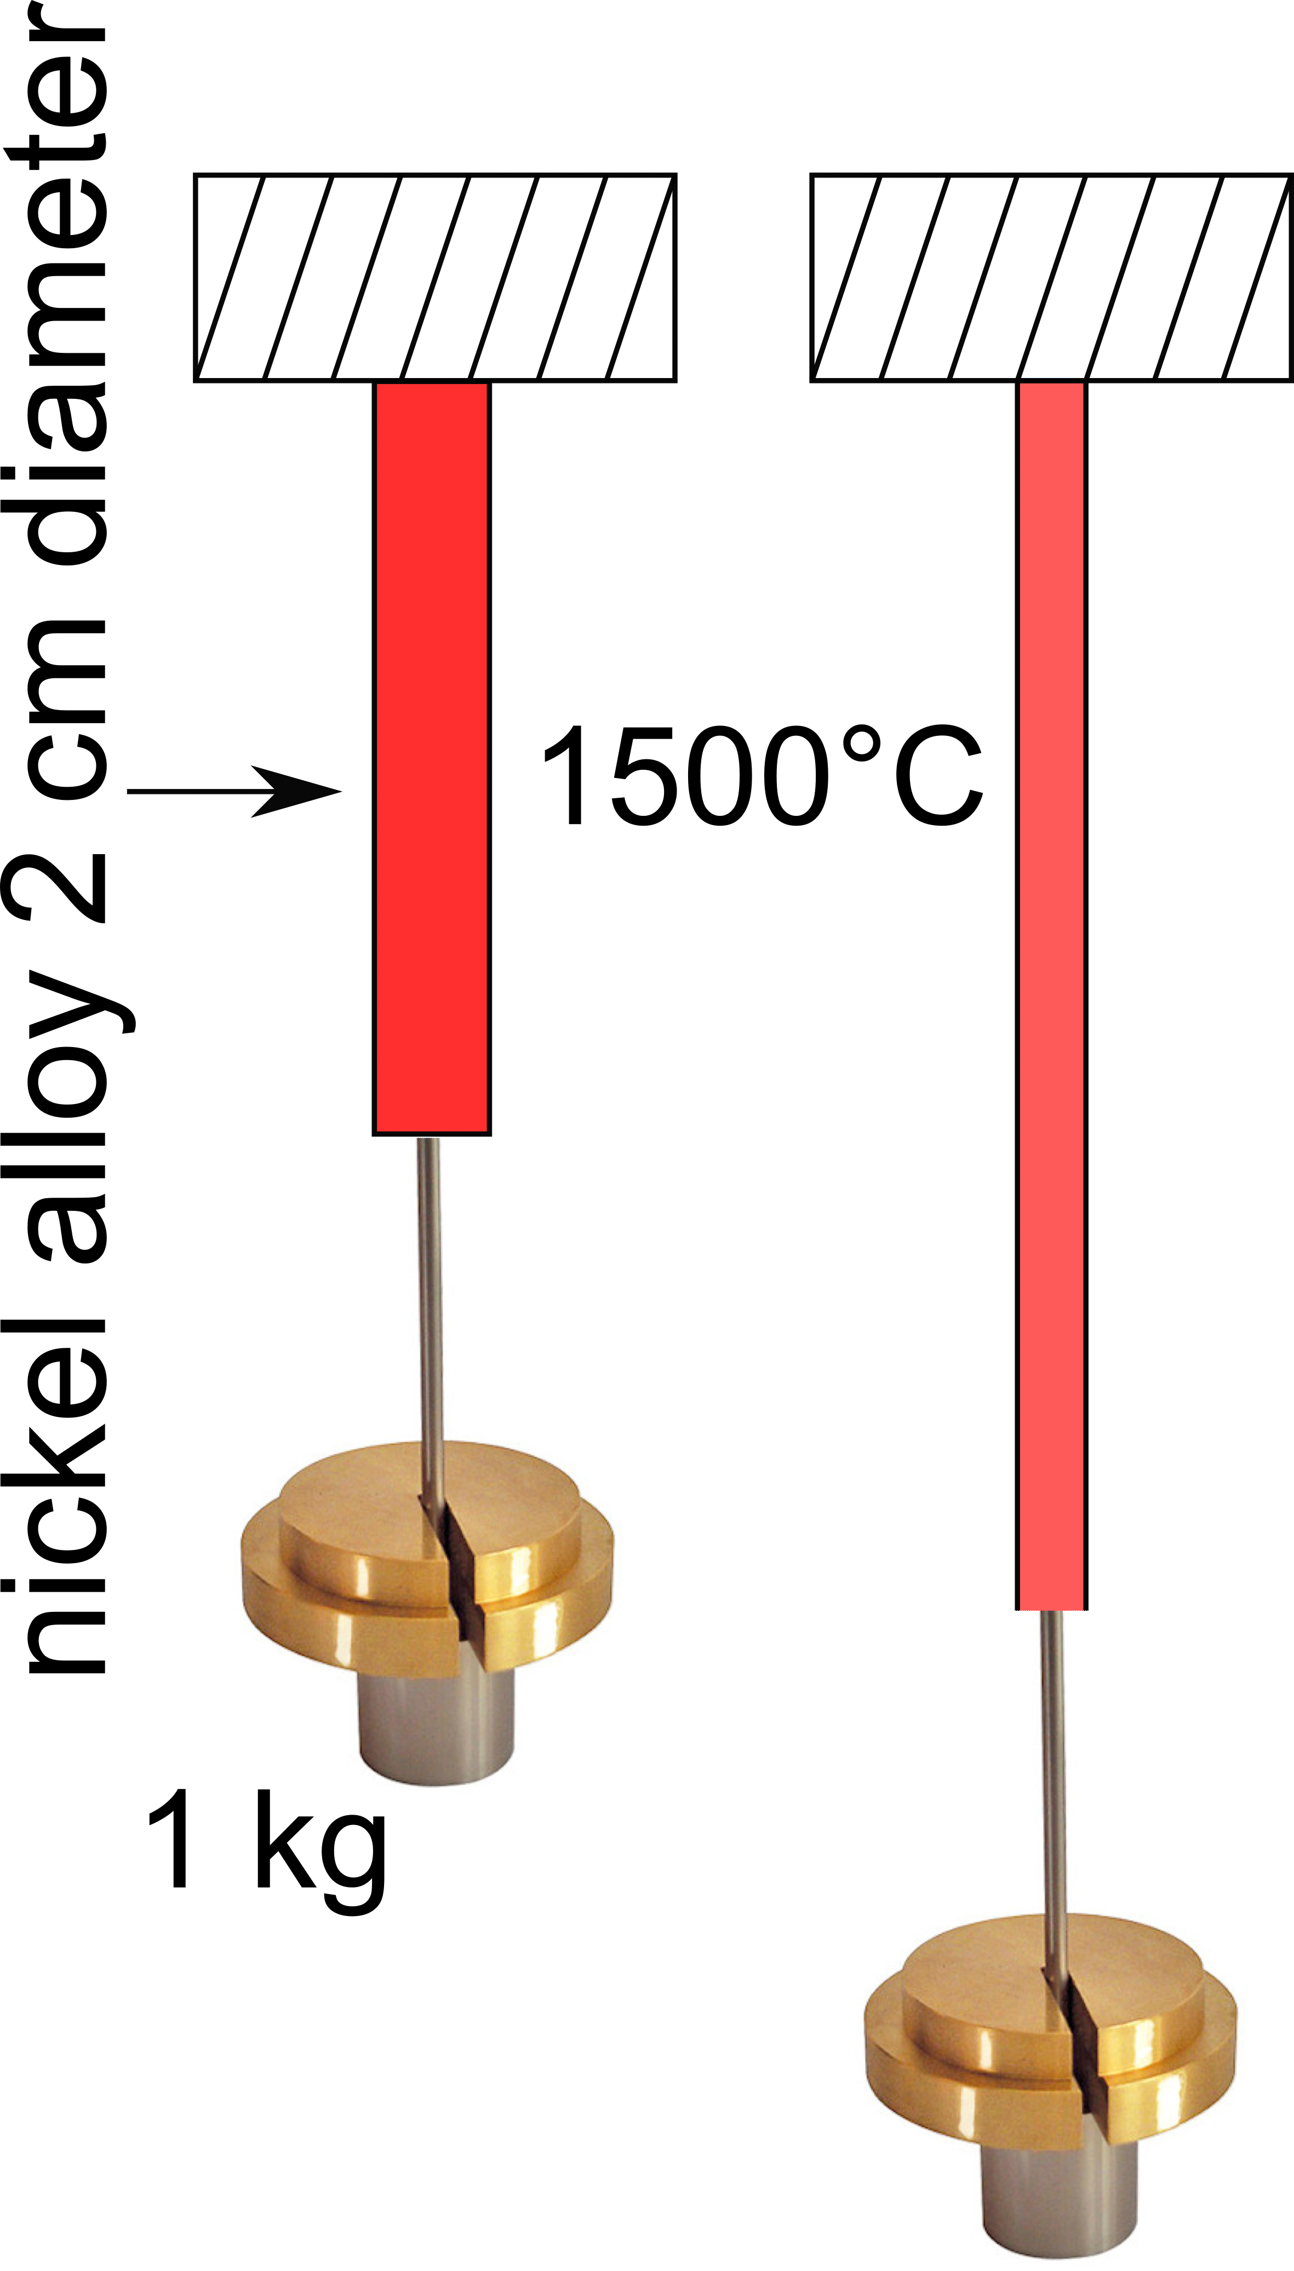
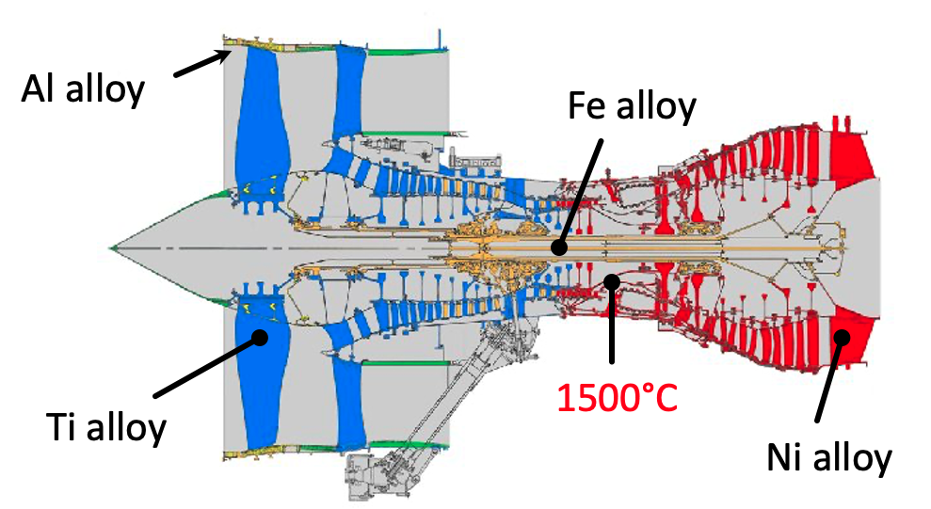
Creep

Slide 18


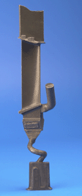
Ni-alloy turbine blades in hottest part of aeroengine
equiaxed polycrystal
directional polycrystal
single crystal

Slide 19
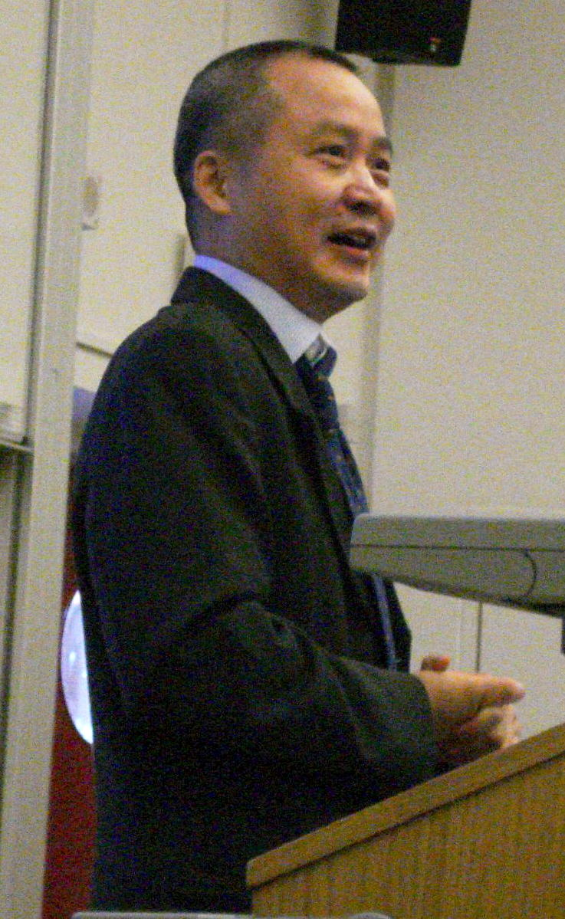
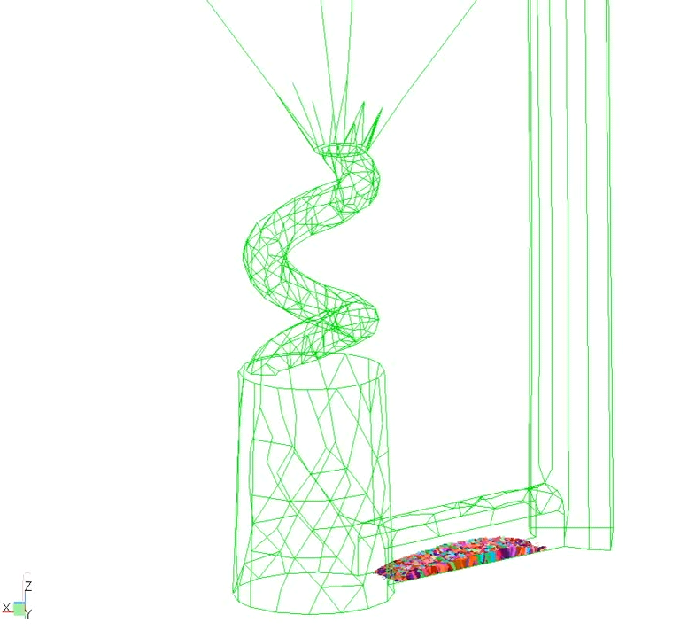
Professor Hongbiao Dong
Leicester University

Slide 20
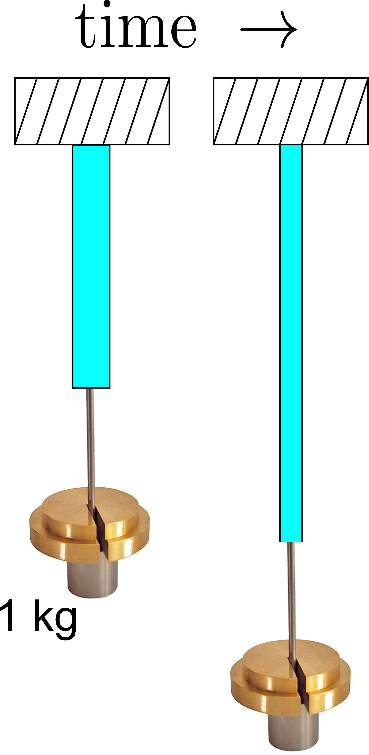

Slide 21
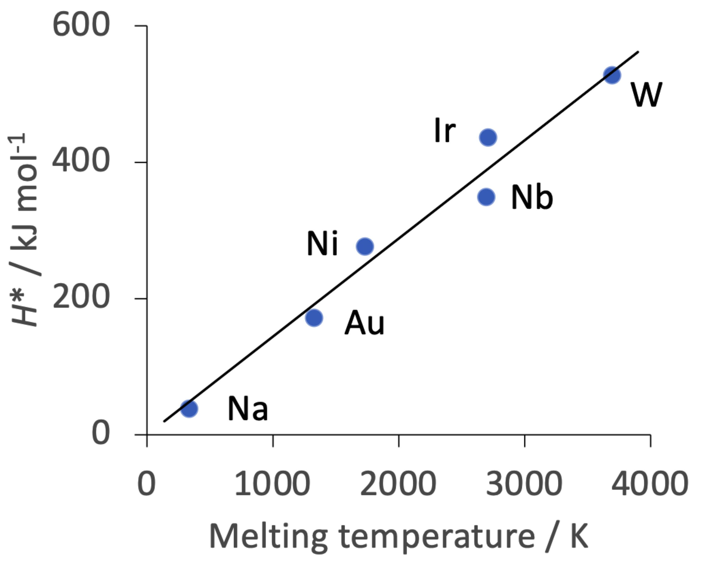
W, Nb oxidise easily
Iridium rare, expensive

Slide 22
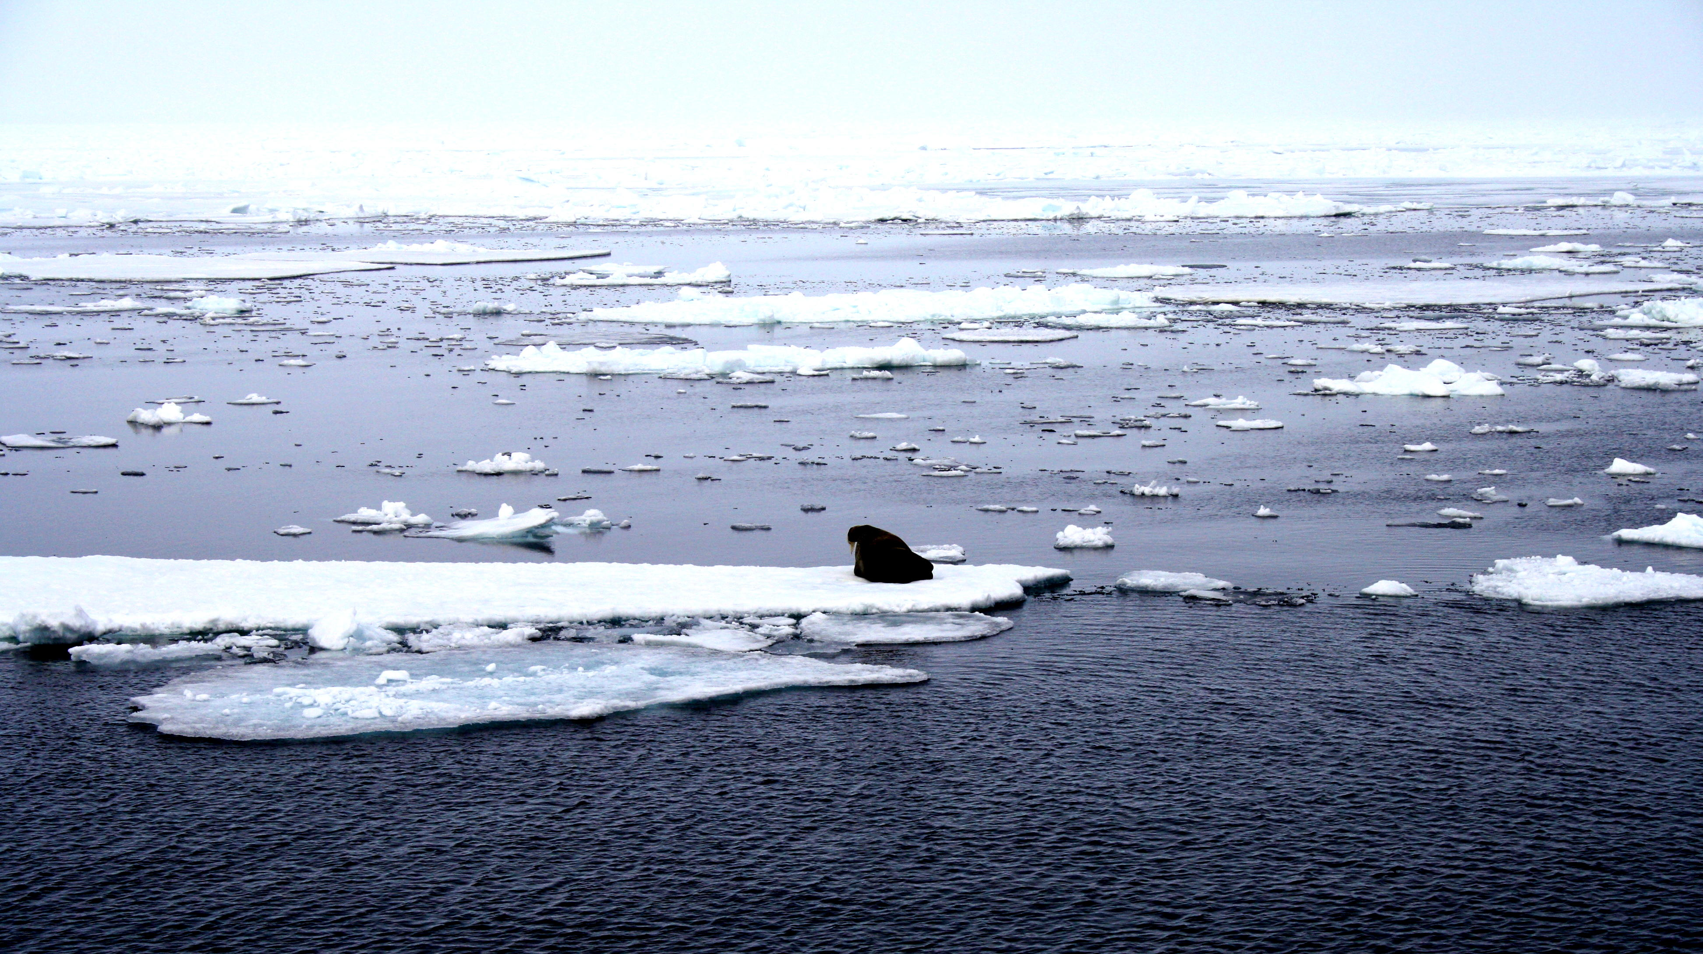
compositions different, yet in equilibrium
ice: pure
ocean: salty water
photograph courtesy of Sunita Hansraj from her Antarctica expedition

Slide 23
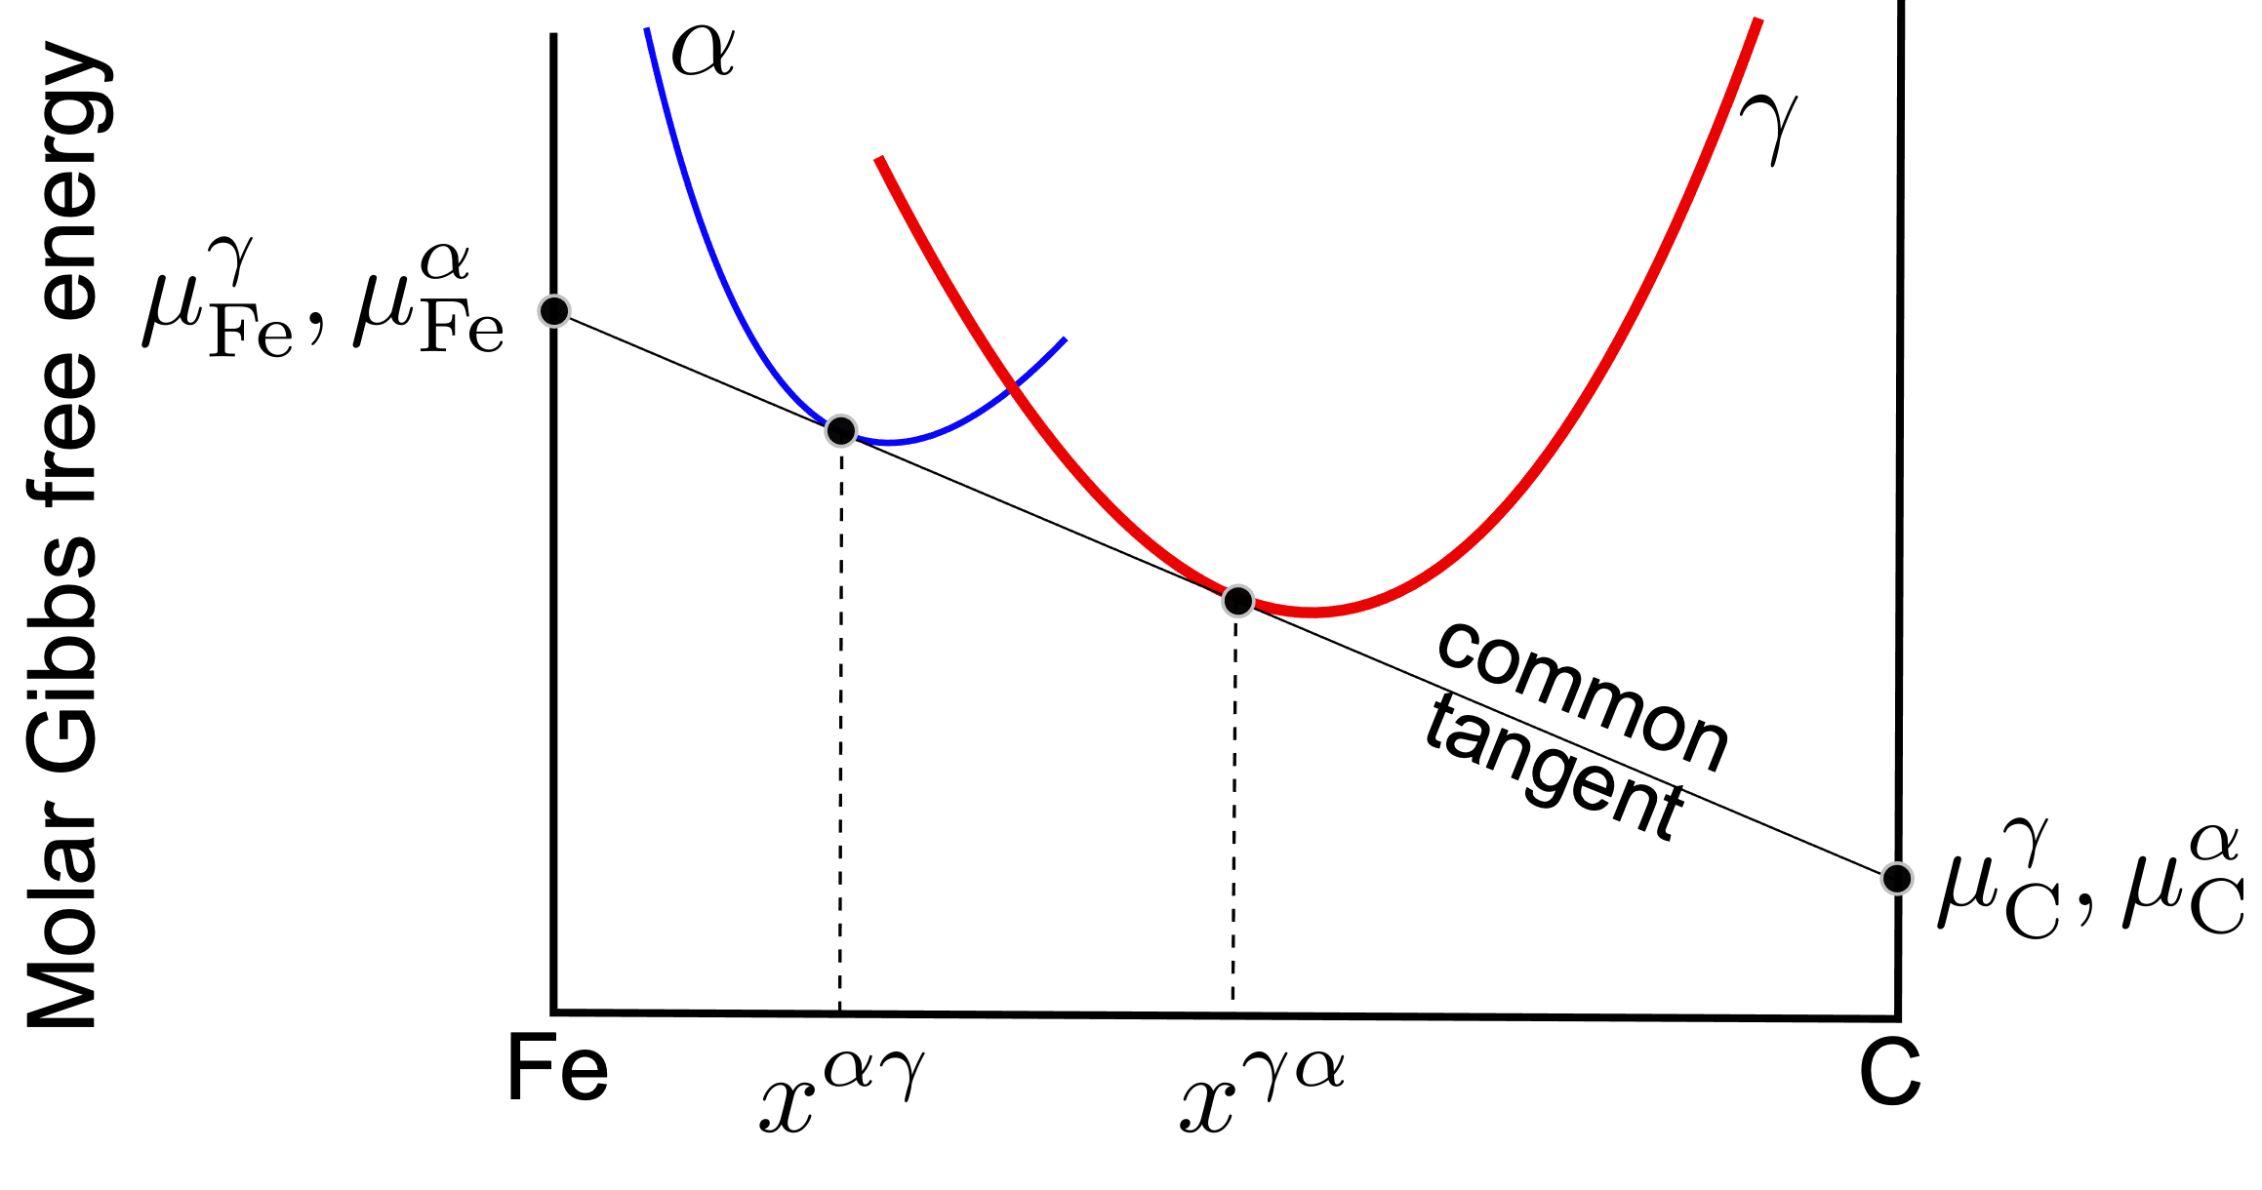

Slide 24
diffusion driven by chemical potential gradient
Fick’s law

Slide 27
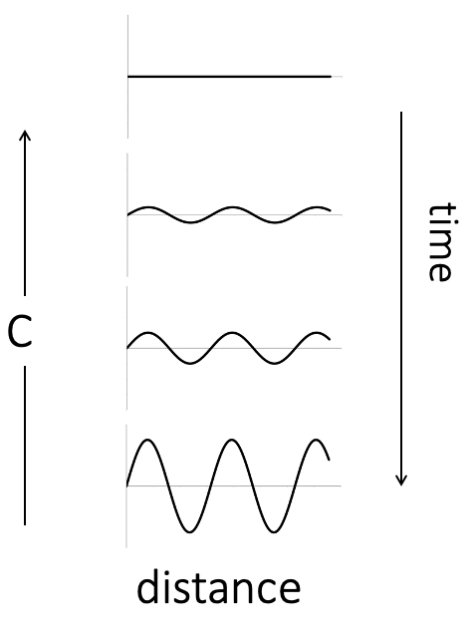
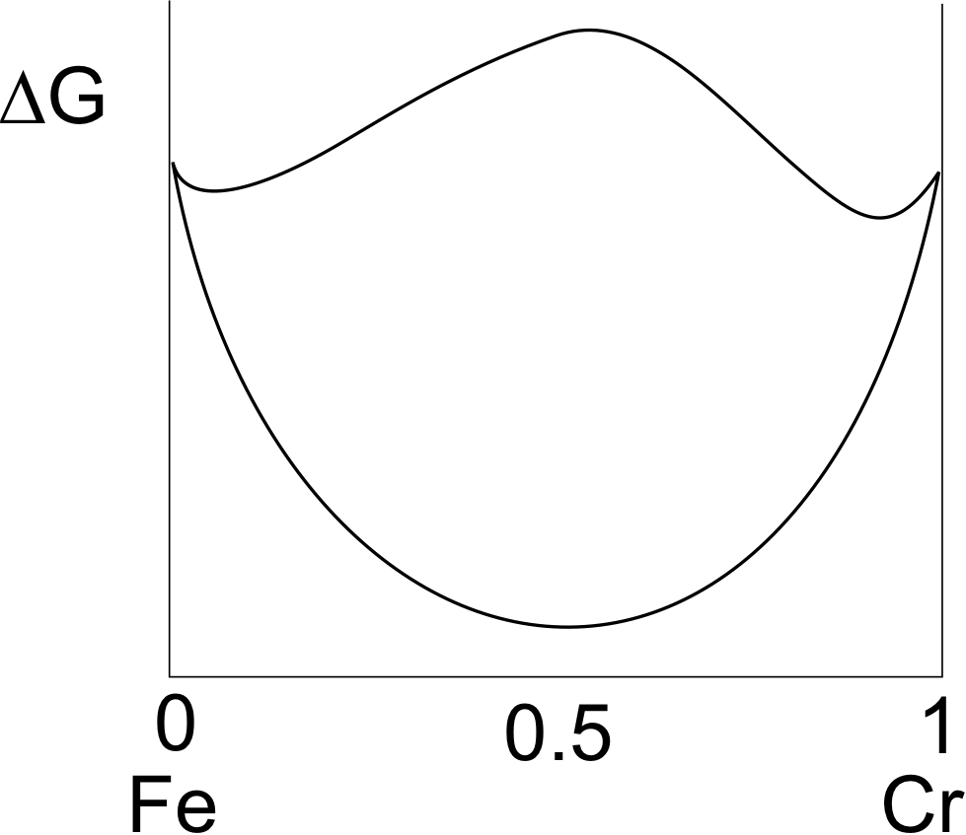


Slide 28
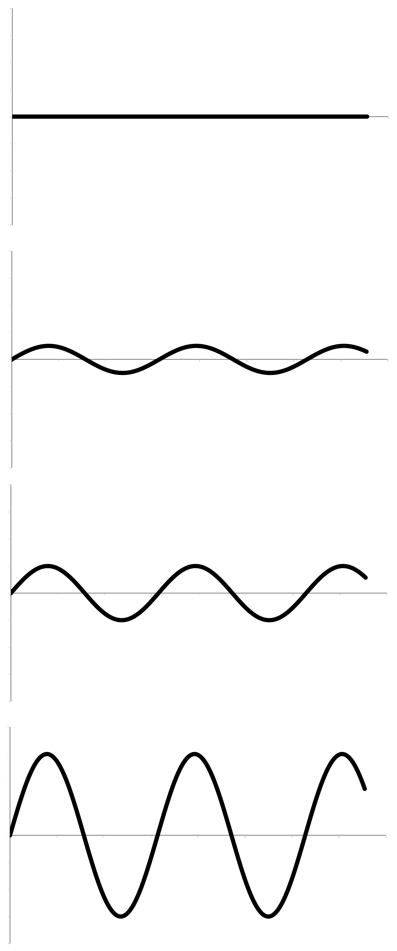


Yoshiyuki Saito
Cr
time
Carlos Martins
distance

Slide 29
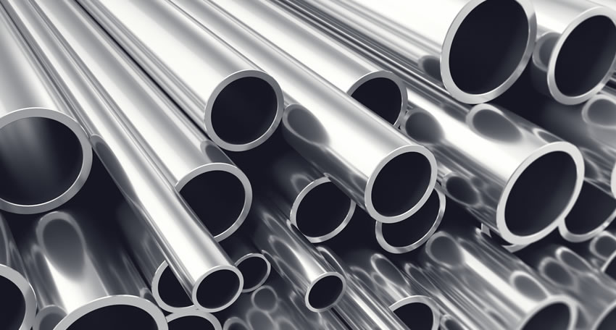

Guy Immega
Cu-Ni-Sn spinodal alloy
Cu-Be

