Slide 1
Phase transitions Nucleation
Harry Bhadeshia
Haixue Yan
photograph courtesy of Sunita Hansraj from her Antarctica expedition

Slide 2
Nucleation of α from γ
Driving force ΔG < 0
At T = Te,

Slide 3
Homogeneous nucleation
r*

Slide 4
Strain energy is a barrier for the transition

Slide 5
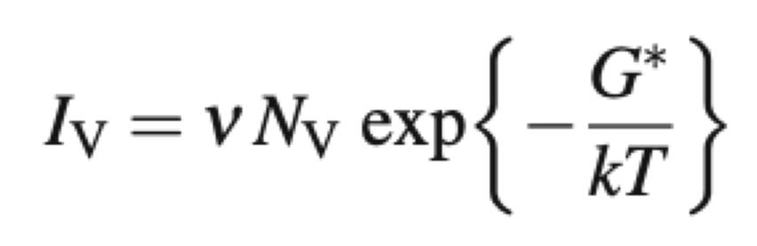
The nucleation rate per unit volume
Iv: the nucleation rate per unit volume
ν: the frequency to overcome the activation barrier
Nv: the number of nucleation sites per unit volume
k and T: the Boltzmann constant and the absolute temperature respectively.

Slide 6
Size & free energy of formation
of critical nucleus decreases as
temperature falls
ΔT = Te-T
G*
or
r*
r*
G*
Temperature, T

Slide 7
Rate of nucleation vs. ΔT
Metal | T_{m}, K | 0.2T_{m}
Pb | 600 | 120
Ag | 1233 | 247
Cu | 1356 | 271
Fe | 1803 | 361
Iv
Effective nucleation temperature
ΔT
T_{m}
When numbers are inserted, theory predicts that significant nucleation rates require supercooling of at least 0.2T_{m}, e.g.
In practice, nucleation occurs at very much smaller ΔT ( 0.02T_{m}, i.e. tens of degrees, not hundreds, below T_{m}).
Supercoolings ~0.2T_{m} are only obtained in, e.g. dispersions of very fine droplets where foreign bodies/impurities are excluded by the smallness of the volume.
Nucleation control
ΔT
Transport control
T_{g}
Nucleation Rate, I

Slide 8
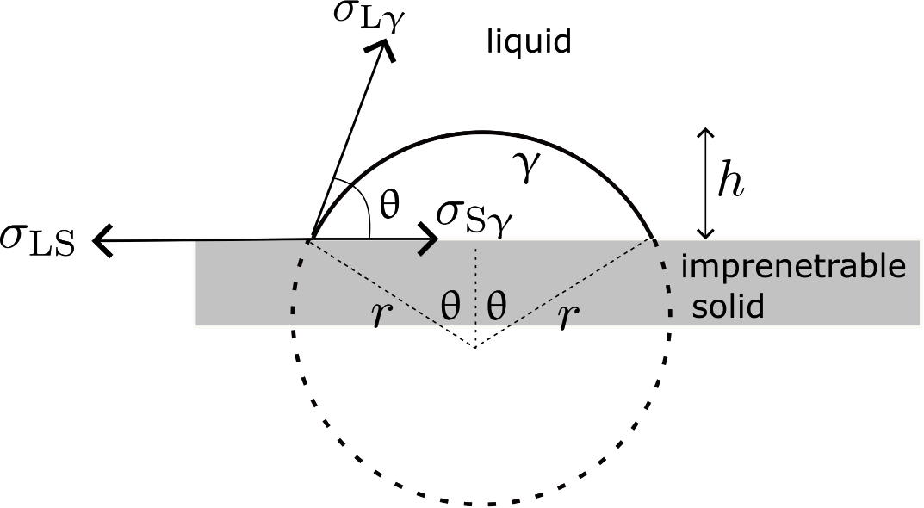
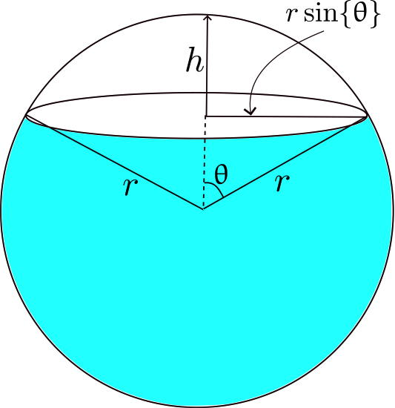
Heterogeneous nucleation
At equilibrium,
As before, ΔG of nucleation involves surface & volume terms:
1) top surface area of the sphere cap = 2πr²(1-cos θ)
2) Flat surface area of the sphere cap = πr²(1-cos²θ)
3) Volume of the crystal nucleus Vn= πr³(2-3cosθ+cos³θ)/3

Slide 9
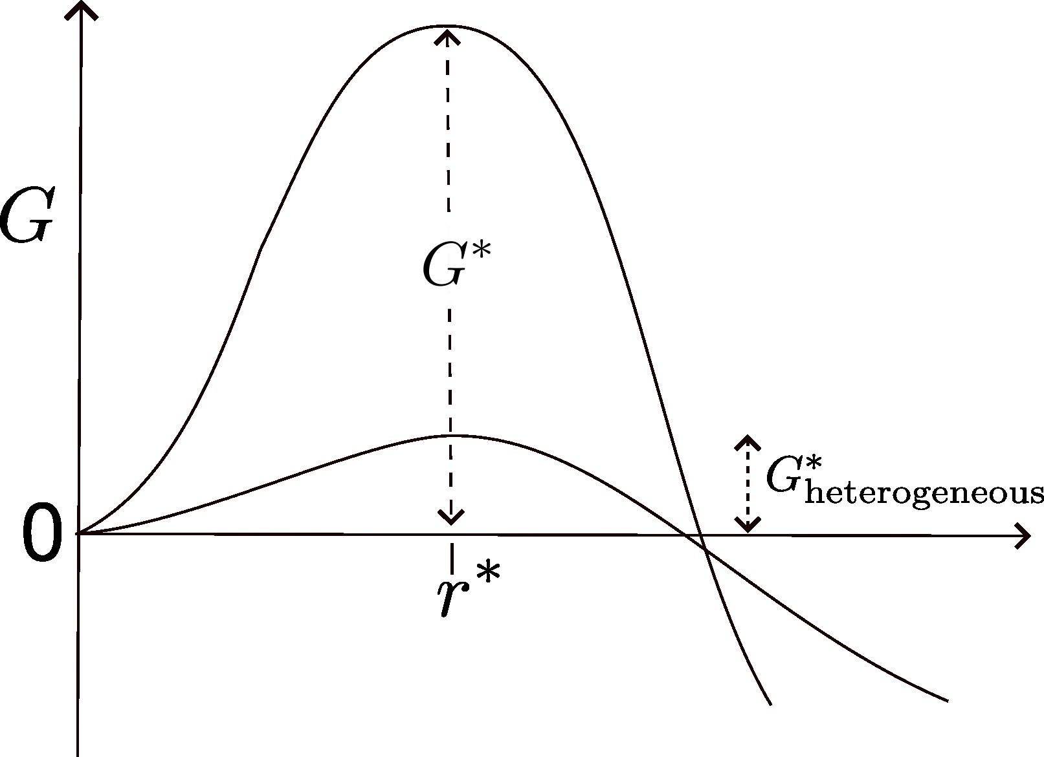
At r = r*
0
~0.2T_{m}
I
Homo.
~0.02T_{m}
Note: as θ = 180°, G*(het) = G*(hom)
Hom. nucleation is a special case of het. nucleation.
Het.
ΔT

Slide 10
Solidification: Nucleation Types
Homogeneous nucleation
nuclei form in the bulk of liquid metal
requires considerable supercooling (typically 80-300ºC)
Heterogeneous nucleation
much easier since stable “nucleating surface” is already present — e.g., mold wall, impurities in liquid phase
only very slight supercooling (0.1-10ºC)

Slide 11
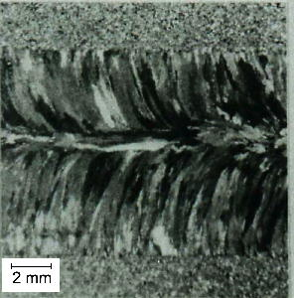
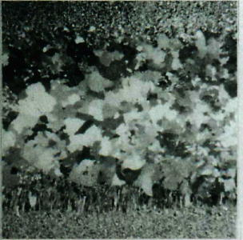

Slide 12
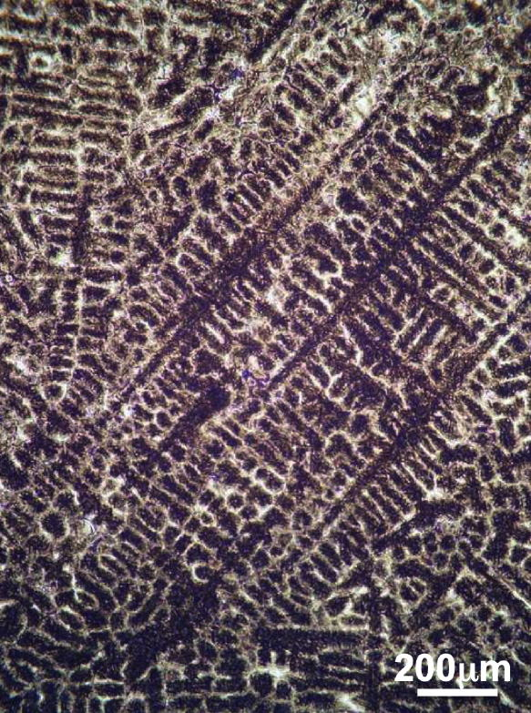
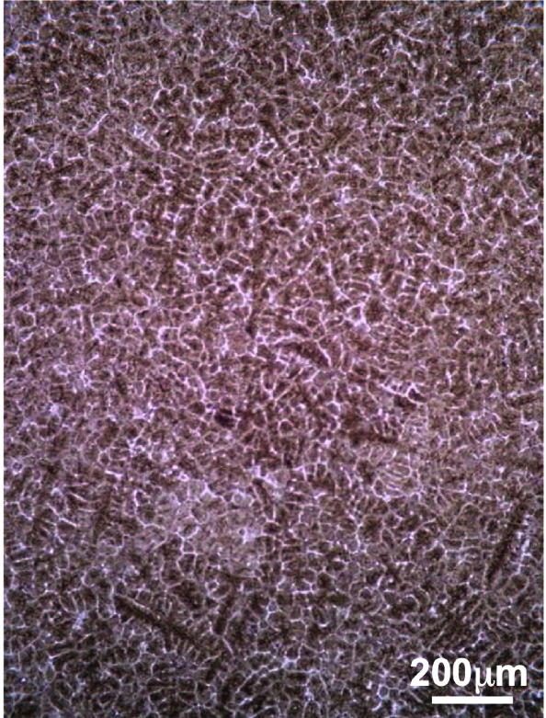

Slide 13
PBL one
Calculate the critical size for homogeneous and heterogeneous nucleation. In terms of their nucleation barriers G (free energy), why is homogeneous model a special case of heterogeneous model?

