Slide 1
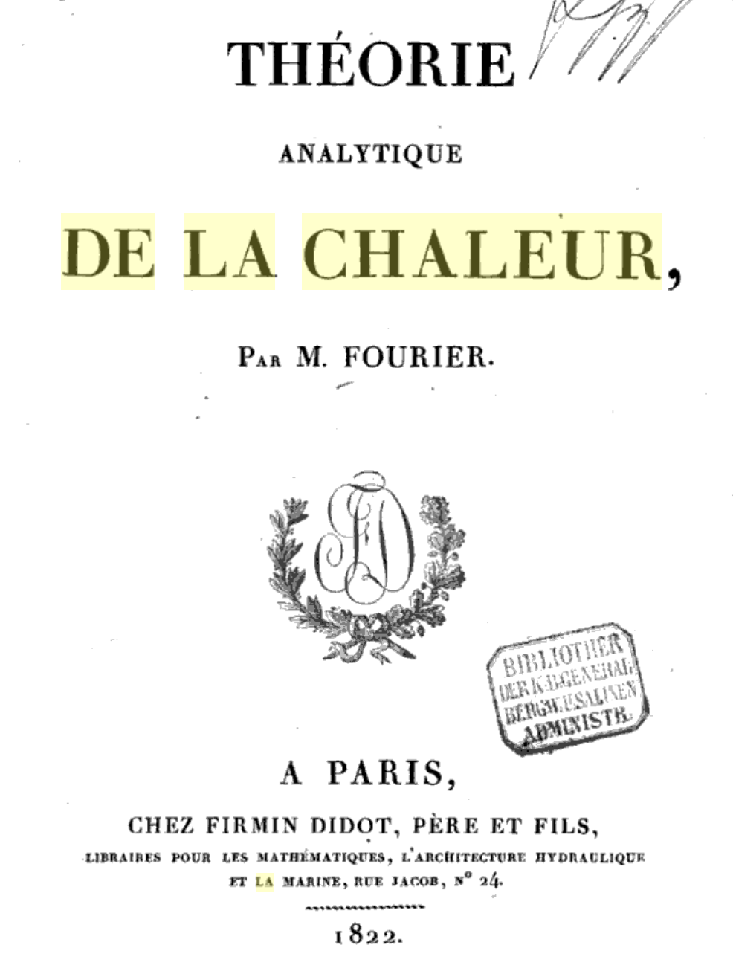
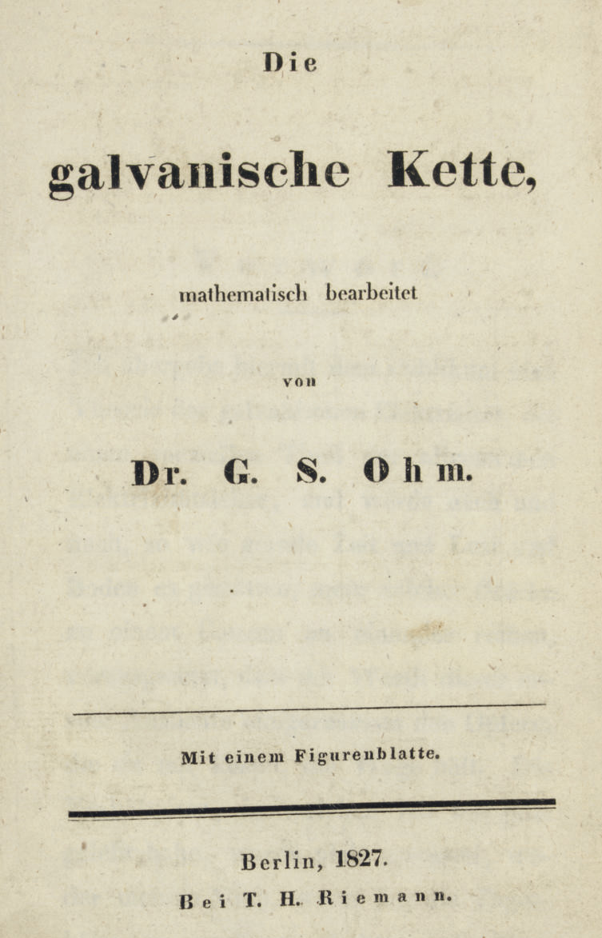
1822
1827

Slide 2
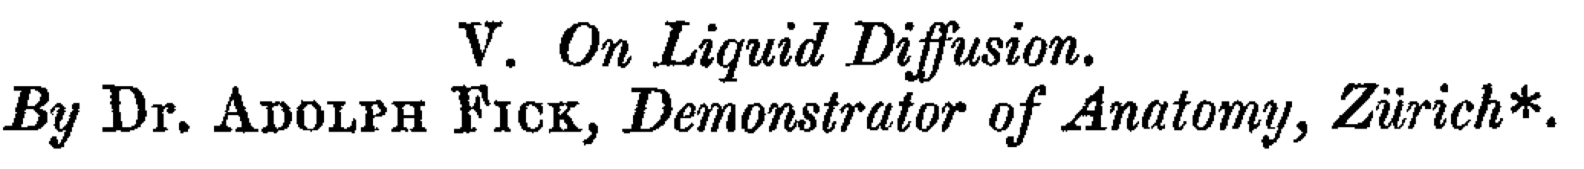
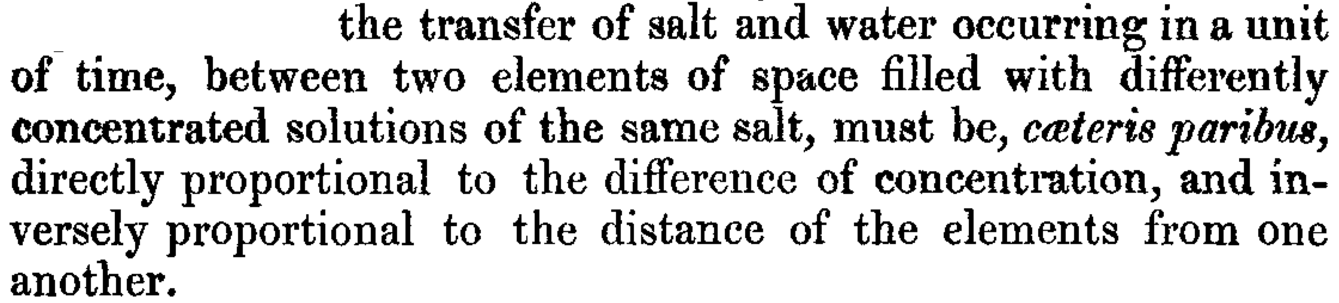
(1855)
}
concentration
gradient
flux
diffusion
coefficient

Slide 3
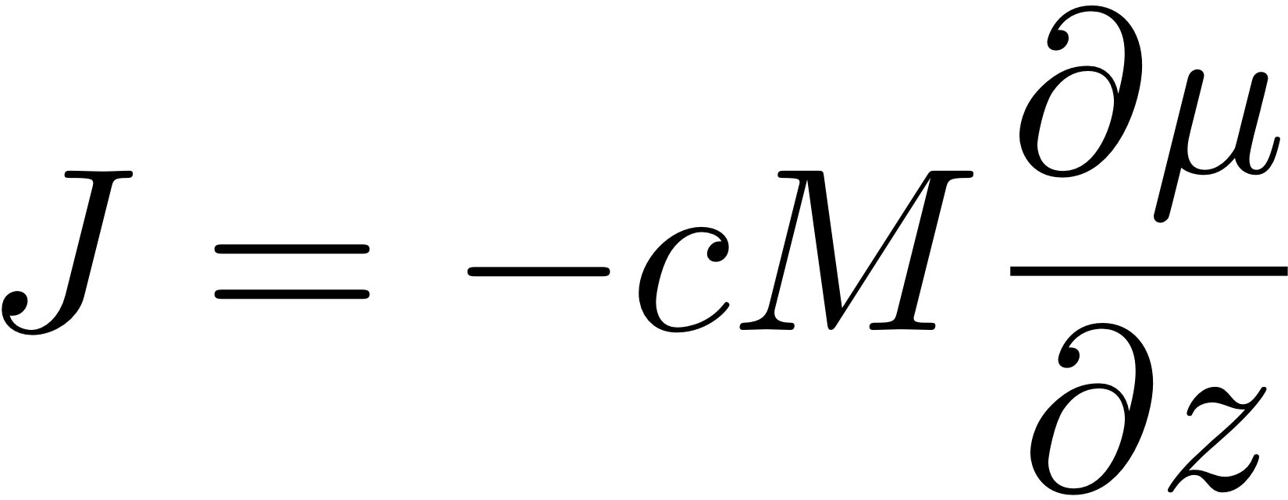
concentration gradient
free energy gradient
no dependence of D or M
on magnitude of the gradient

Slide 4
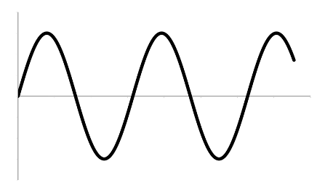
consider a small volume element containing one-dimensional composition variation
Hilliard, Phase Transformations
(1970) 497-560.

Slide 6
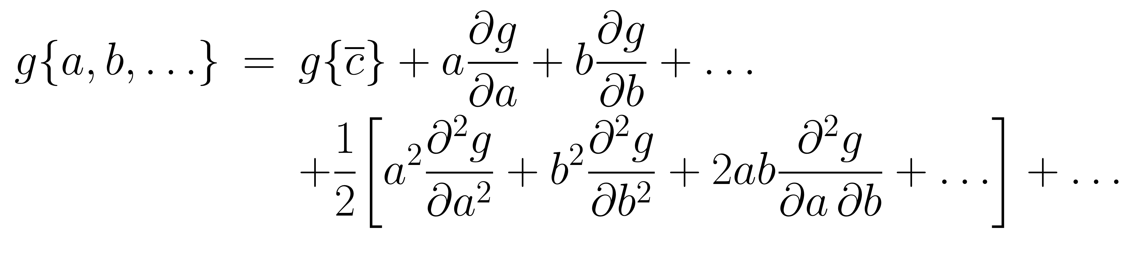
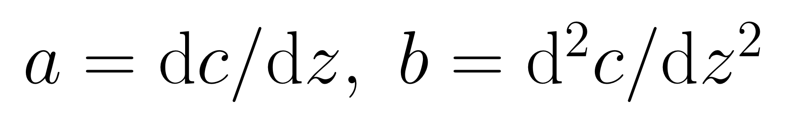
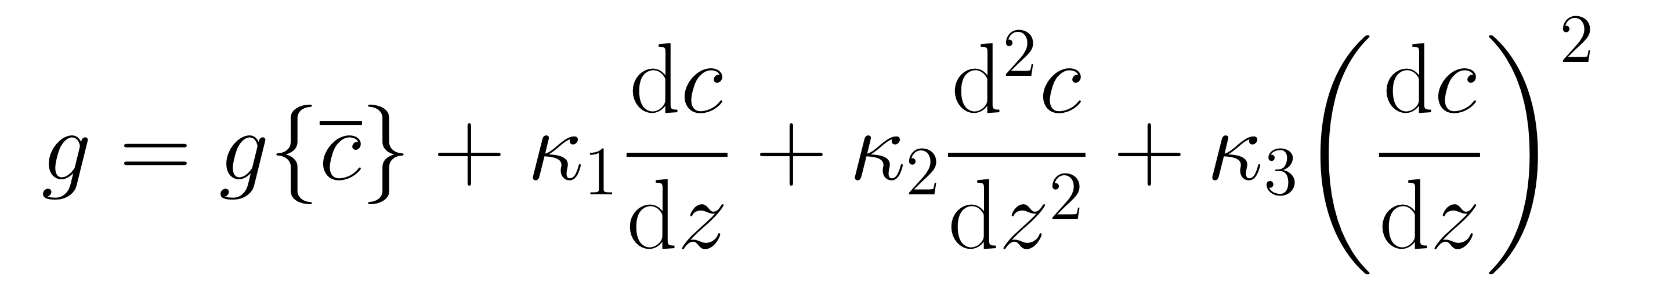

Slide 7
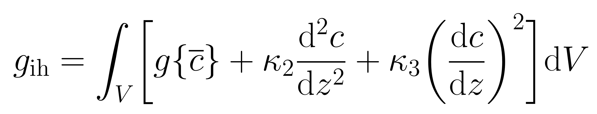
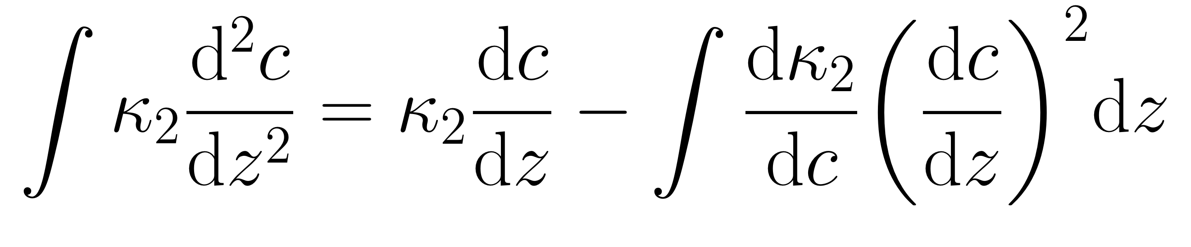
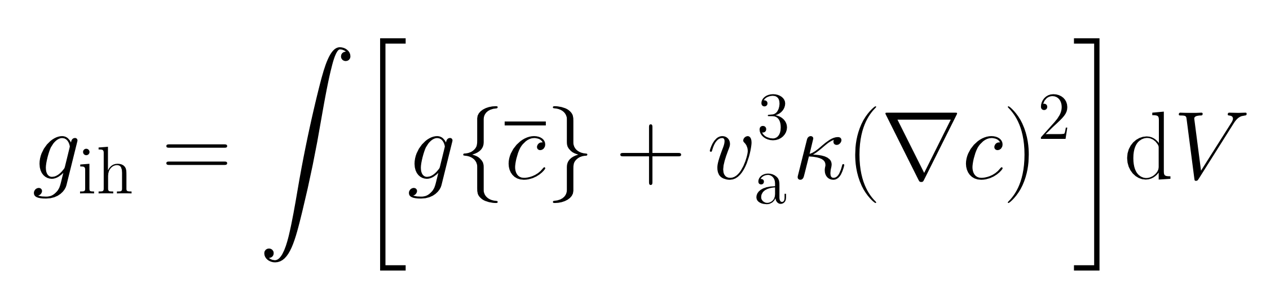

Slide 8
strain gradients
solute cause lattice parameter changes
strain energy
per atom =

Slide 9
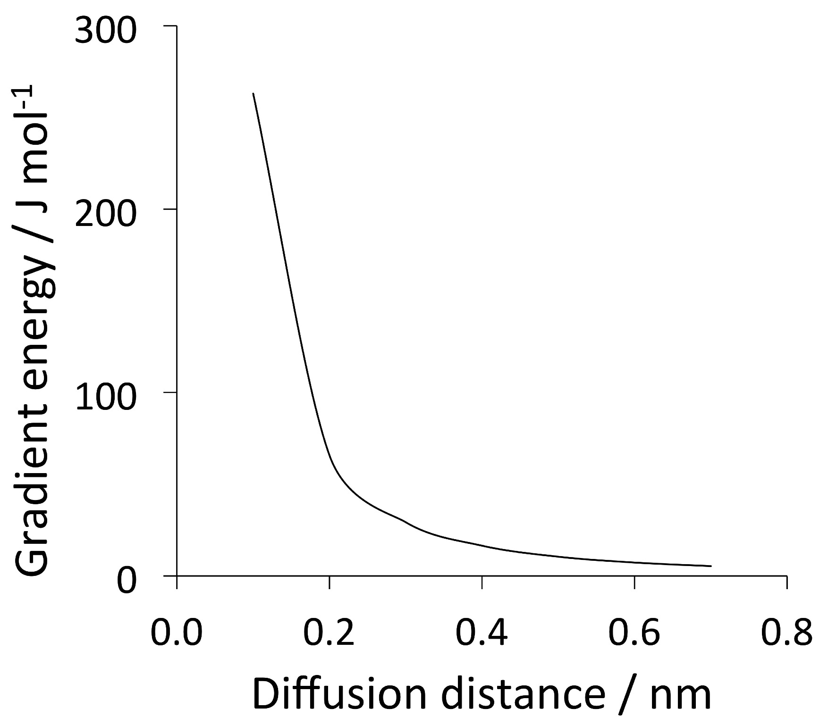
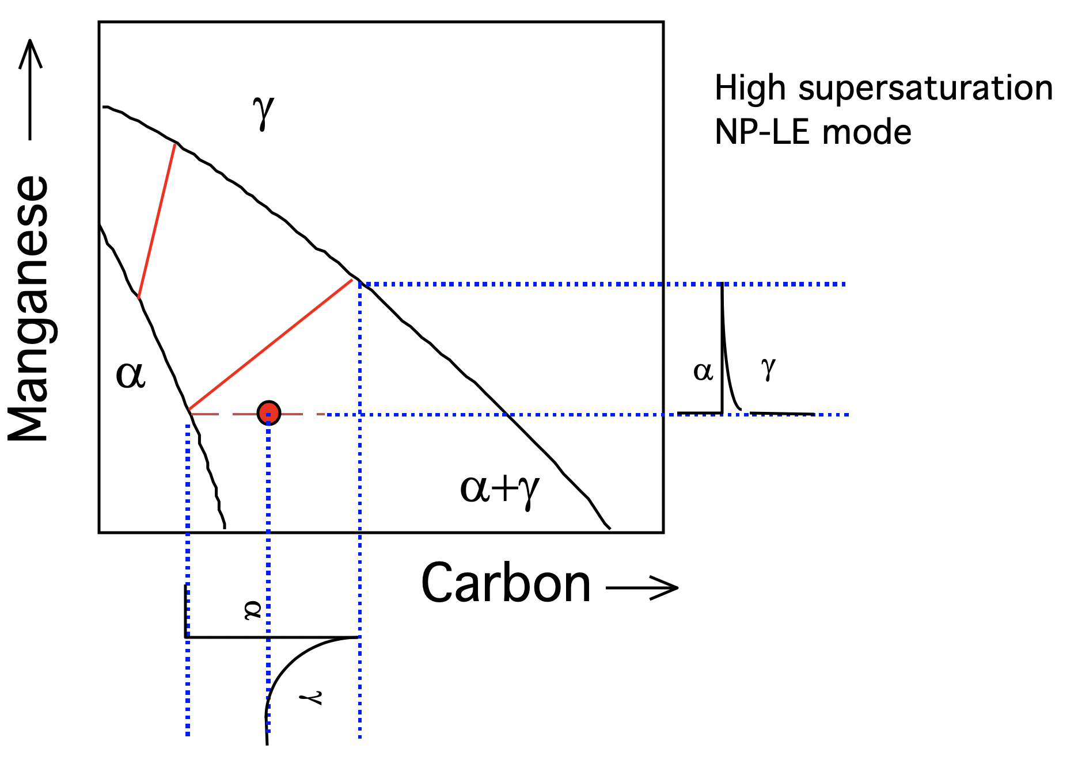
Impossible to avoid partitioning substitutional solutes if local equilibrium is demanded.

Slide 10
γ
High supersaturation
NP-LE mode
Manganese
α
α
γ
α+γ
1790 papers
Carbon
α
γ

Slide 11
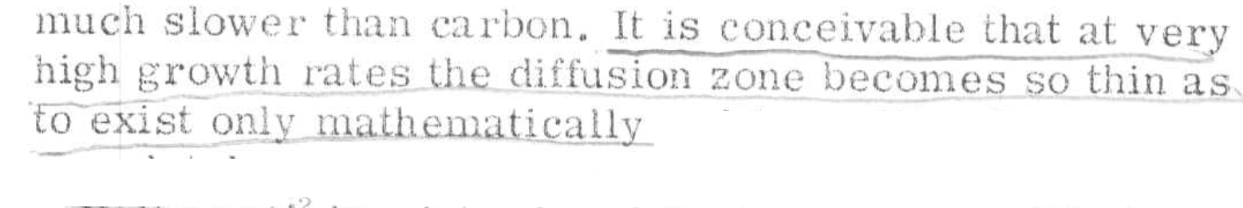
G. Zhang and R. Wei and M. Enomoto and D. W. Suh
Metall. Mater. Trans. A 43 (2012) 833
diffusion distance 0.03 nm
Y. Xia and G. Miyamoto and Z. G. Yang and C. Zhang and T. Furuhara
Metall. Mater. Trans. A 46 (2015) 2347
diffusion distance 0.002-0.04 nm

Slide 12
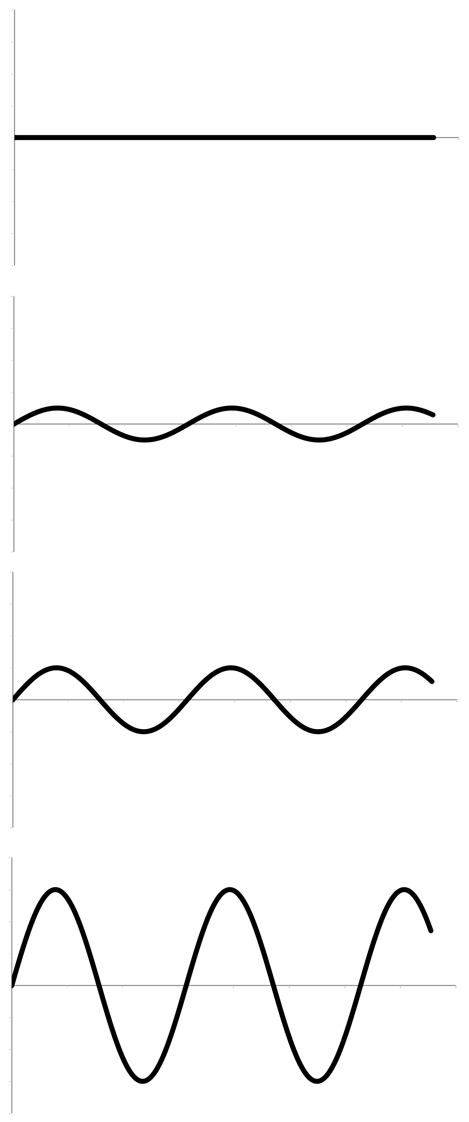
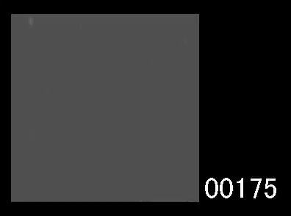
Yoshiyuki Saito
Cr
time
distance

Slide 13
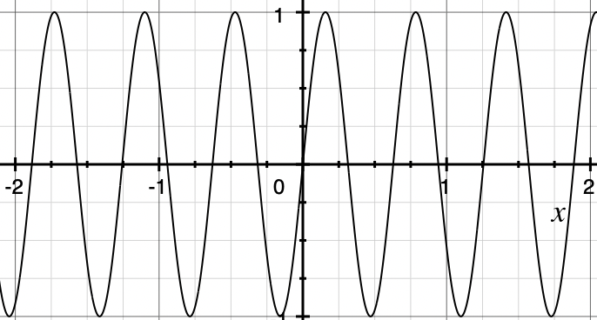
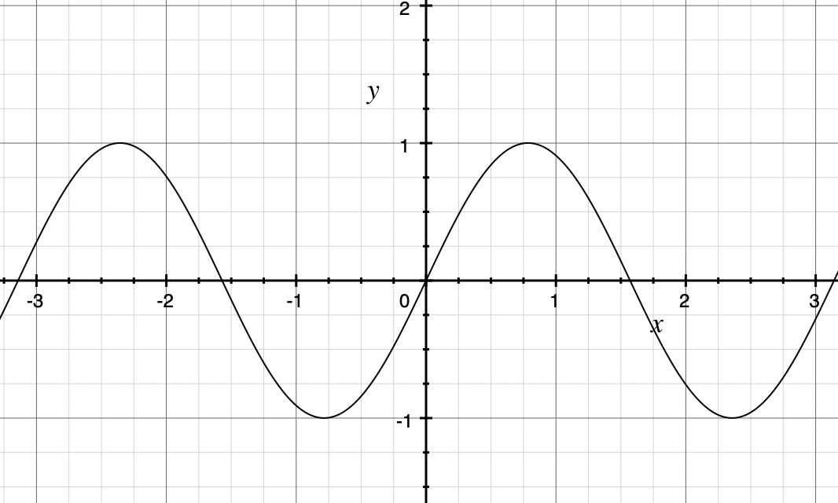
small wavelengths
penalized during spinodal
decomposition because of
gradient energy term

Slide 14
Spinodal in ceramics

Slide 15
Ceramics (contain ions)
Virkar & Plichta
Journal of the American Ceramic Society 66 (1983) 451

Slide 16
Most rapidly growing Fourier components have infinitely small wavelength
However, diffusion coefficient
is actually a function of the concentration gradient. Large gradients retard diffusion. i.e. free energy is a function of gradient of concentration.

Slide 17
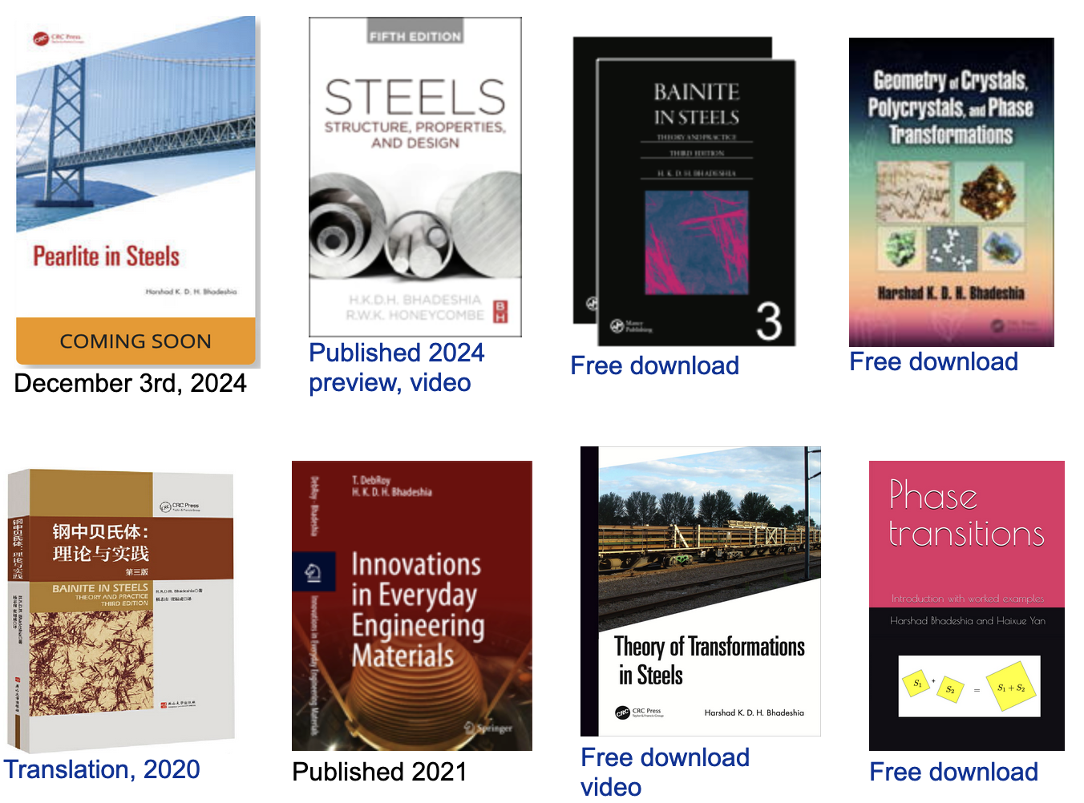
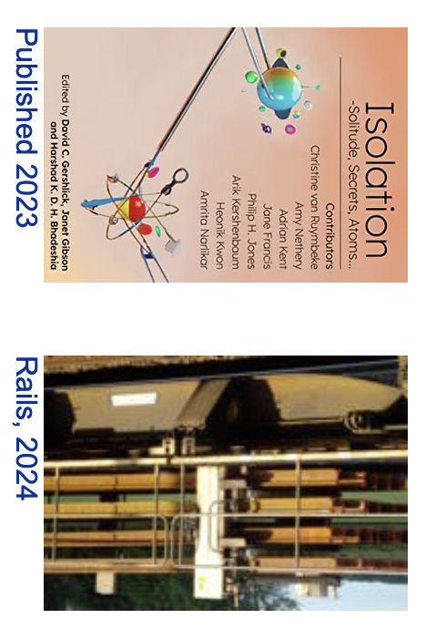
www.phase-trans.msm.cam.ac.uk

