Slide 1

Part IB
Materials Science and Metallurgy
Course A: Metals & Alloys
Professor Harry Bhadeshia
Lecture 10: Iron Alloys

Slide 2
body-centred cubic (ferrite)
cubic close-packed (austenite)

Slide 3
DISPLACIVE
RECONSTRUCTIVE

Slide 4
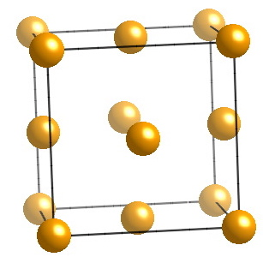
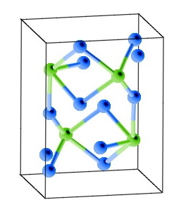
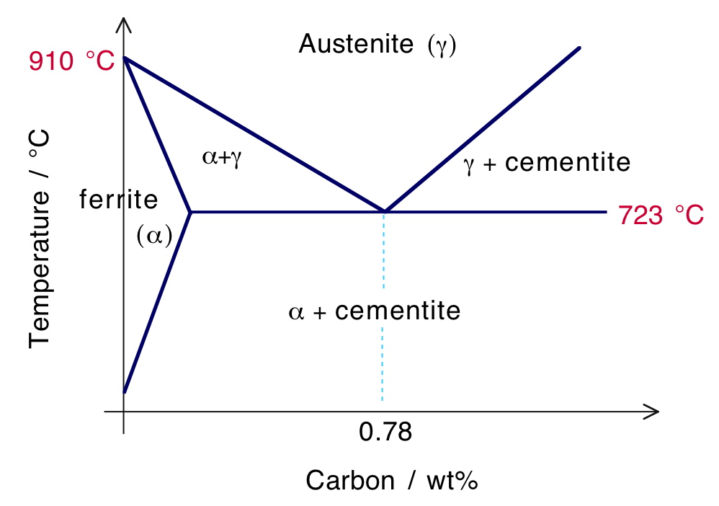
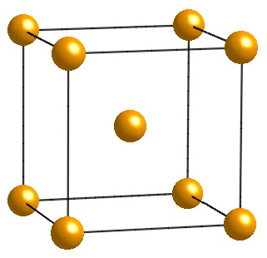

Slide 5
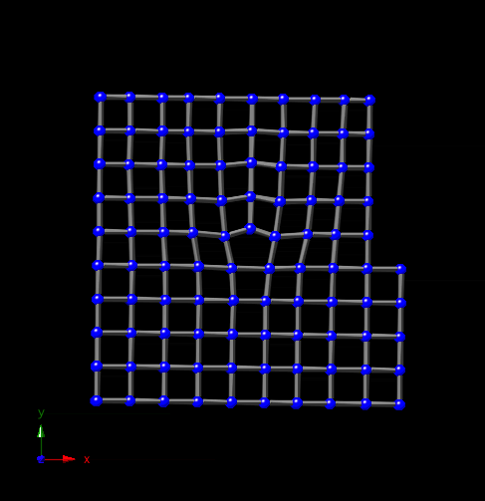

Slide 6
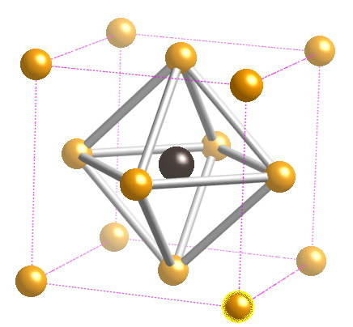
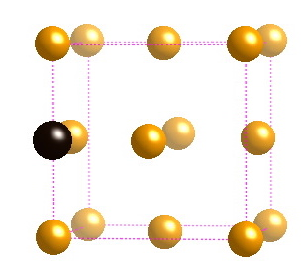
Carbon in octahedral interstices in austenite

Slide 7
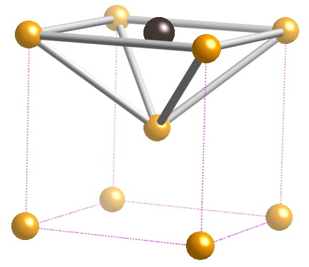
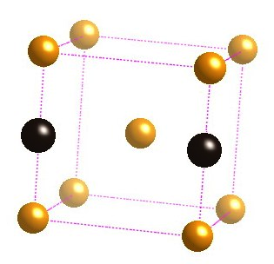
Carbon in irregular octahedral interstices in ferrite

Slide 8
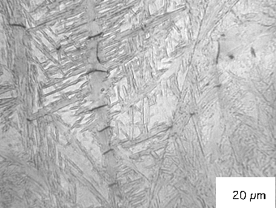
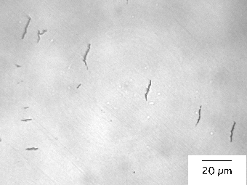
Chatterjee & Bhadeshia, 2006

Slide 9
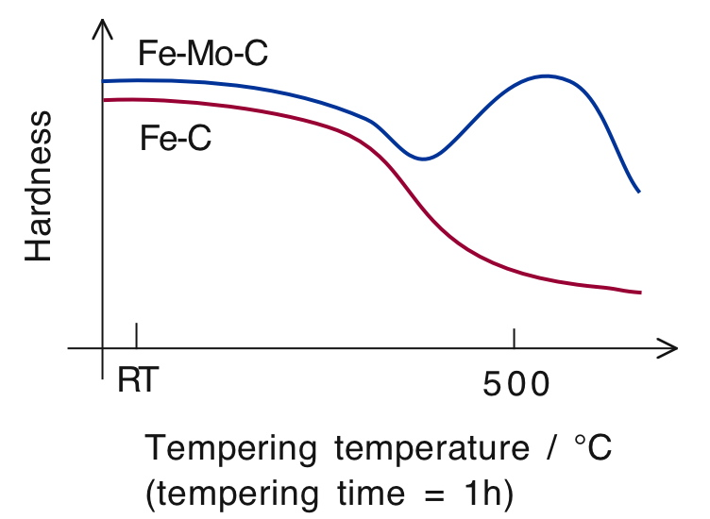

Slide 10
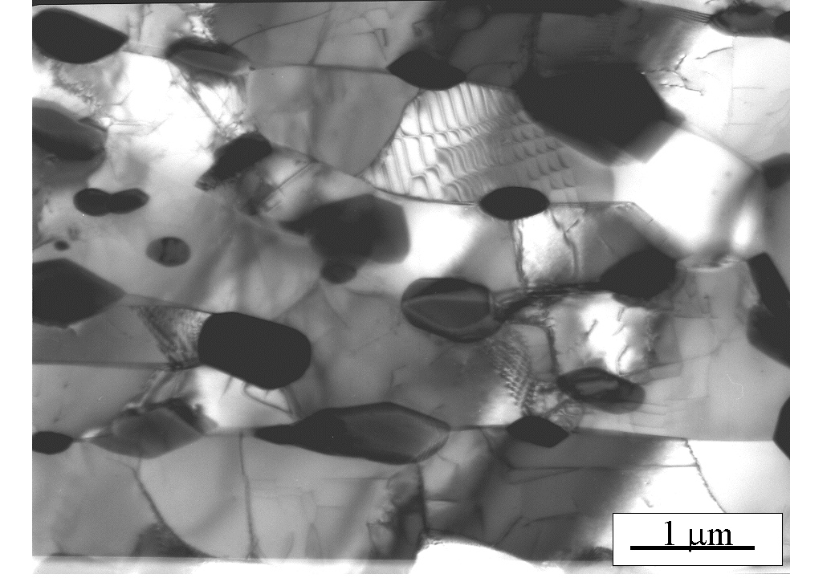

Slide 11
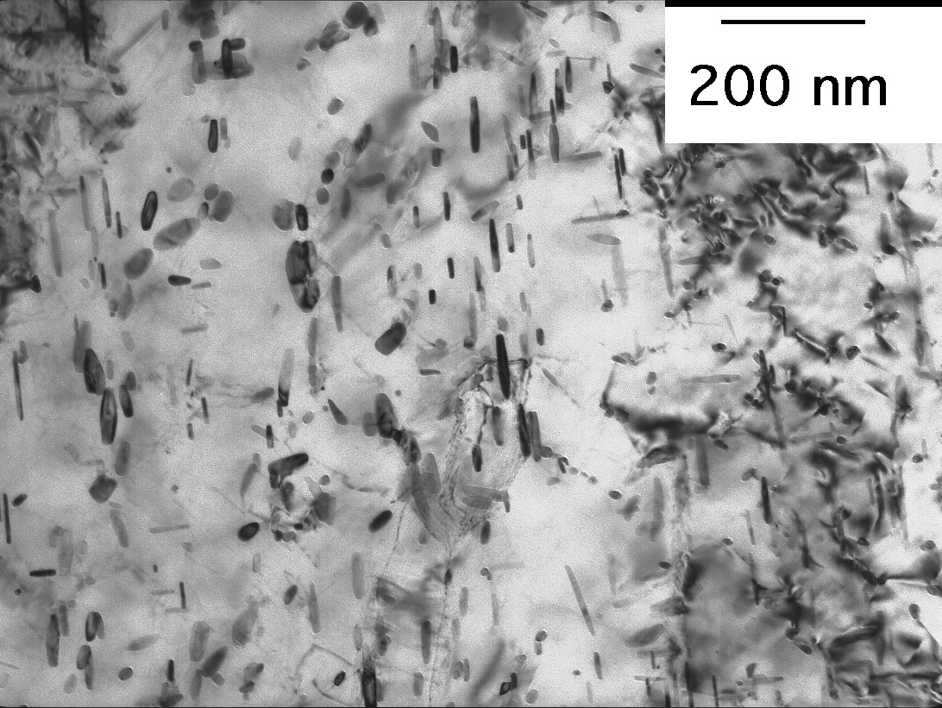
Yamasaki & Bhadeshia, 2004

Slide 12
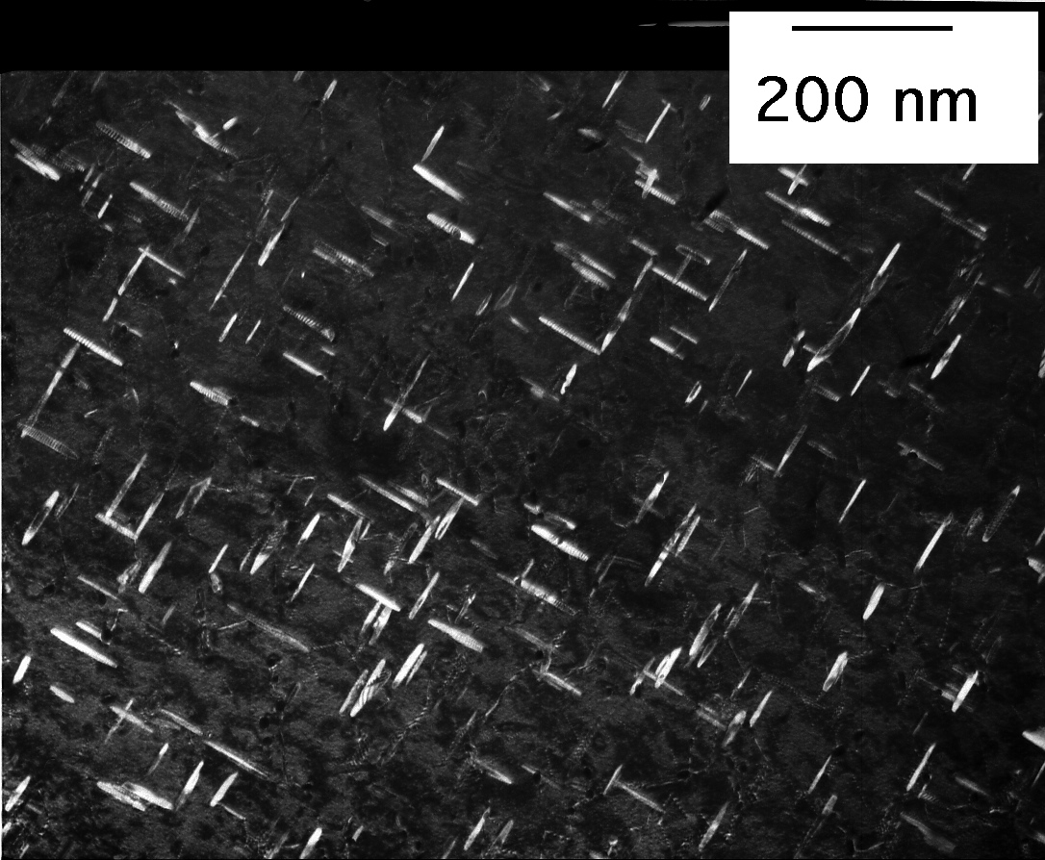

Slide 13
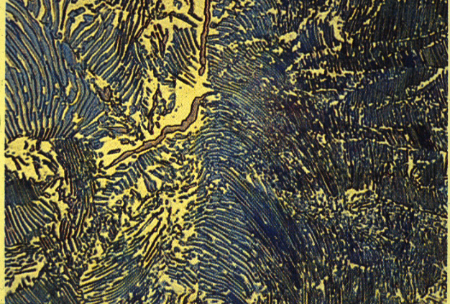
20 µm

Slide 14
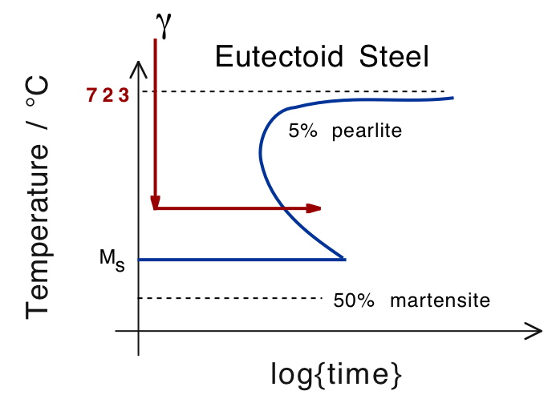

Slide 16
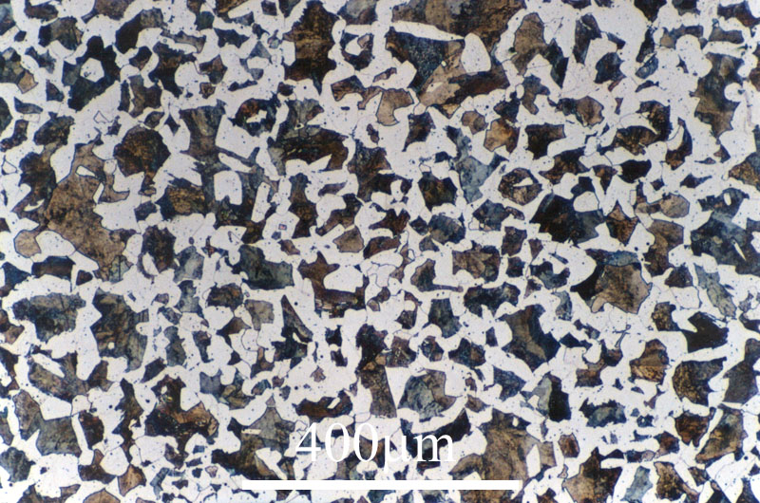

Slide 17
20 µm

Slide 18
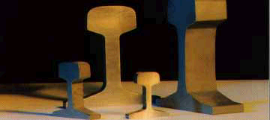

Slide 19
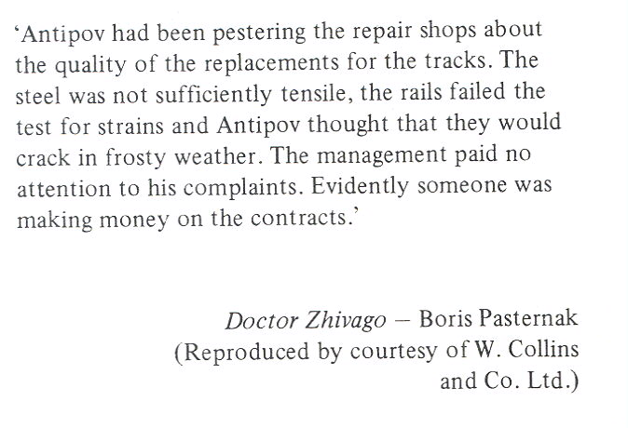


Slide 20
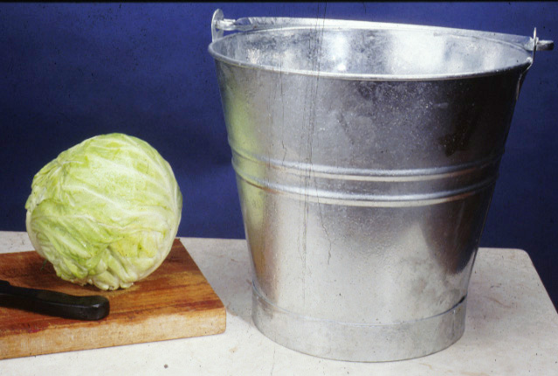

Slide 21
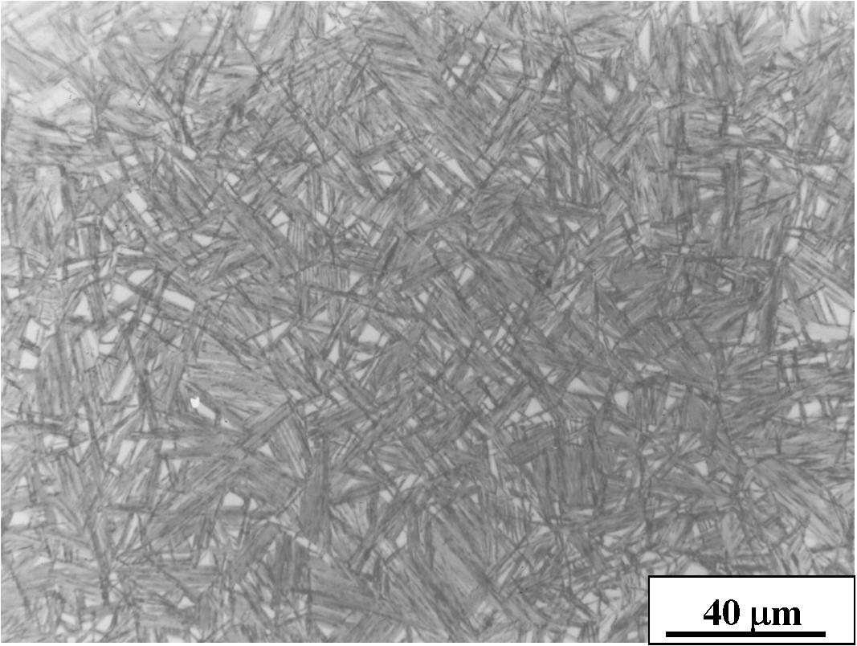

Slide 22
Bainite
Martensite
Pearlite
0
200
400
600
800
1000
1200
kilocycles to Crack Initiation
Yates, Jerath

Slide 23
Yates, Jerath

Slide 24
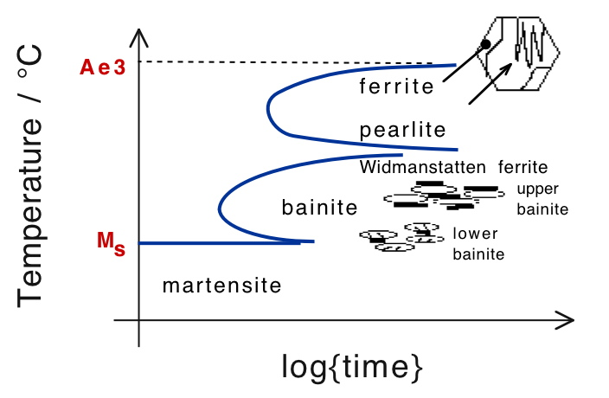

Slide 25


Carbon supersaturated plate
Carbon diffusion into
Carbon diffusion into
austenite
austenite and carbide
precipitation in ferrite
Carbide precipitation
from austenite
UPPER BAINITE
LOWER BAINITE
(High Temperature)
(Low Temperature)

Slide 26
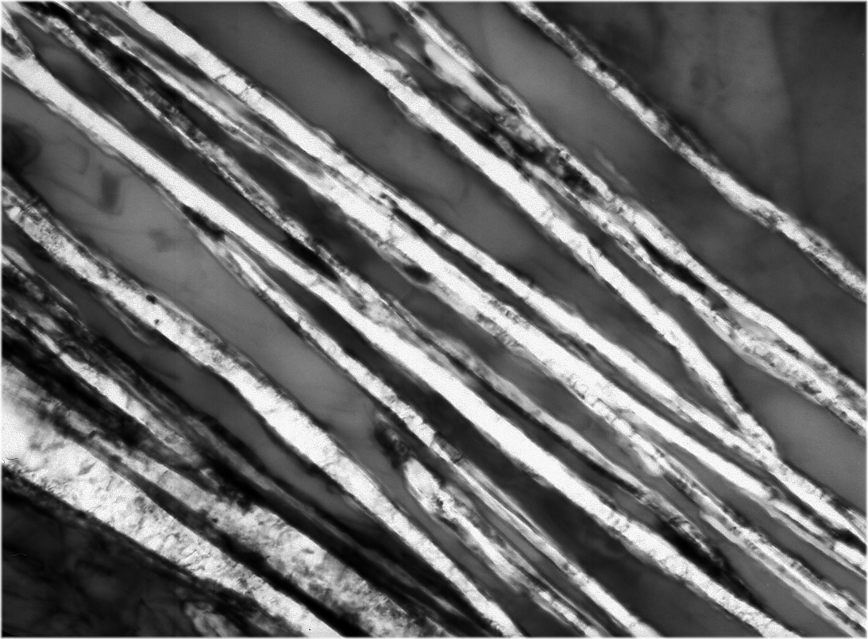
γ
γ
α
α
α
Mateo, 2002
200 Å

Slide 27
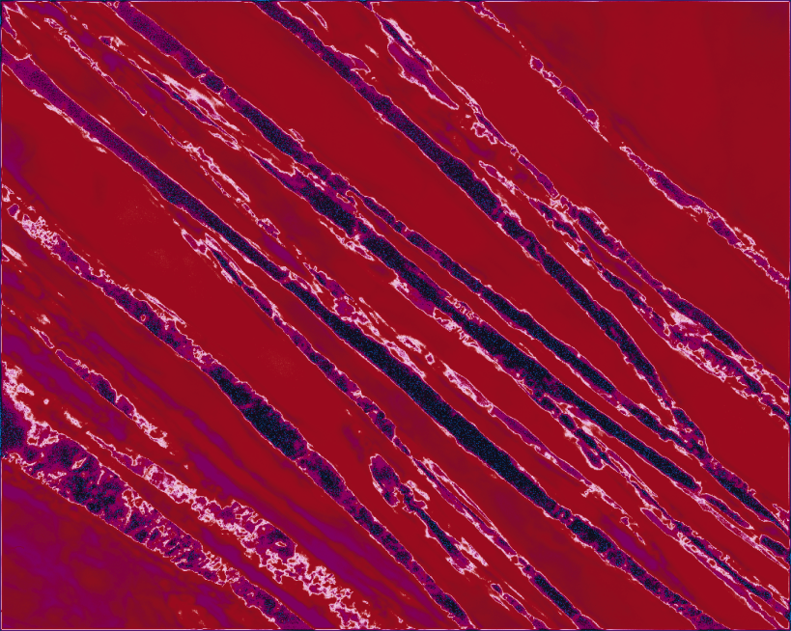
Cambridge University / Science Musuem, London

Slide 29
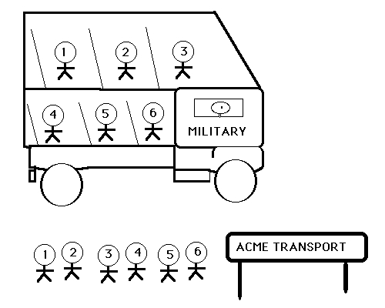

Slide 30
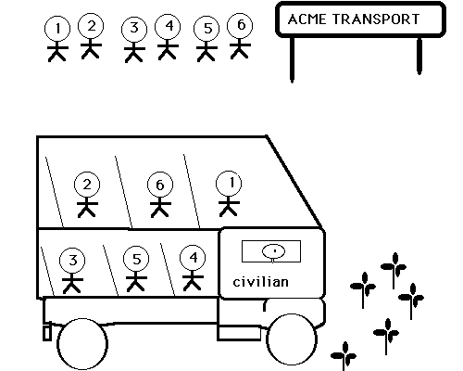

Slide 31
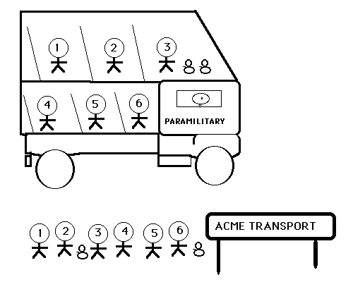

Slide 32
