Slide 1

Part IB
Materials Science and Metallurgy
Course A: Metals & Alloys
Professor Harry Bhadeshia
Lecture 2: Atomic Diffusion

Slide 2
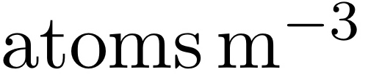
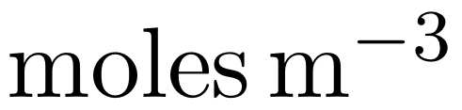
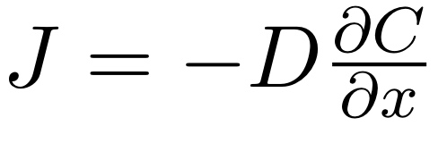
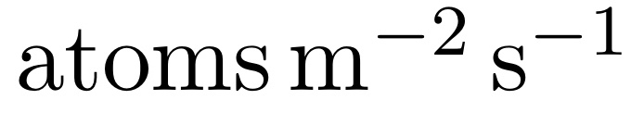
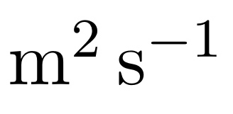
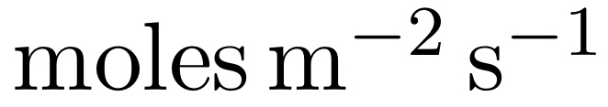
Revision of Lecture 1

Slide 3
Revision of Lecture 1
Steady state diffusion
Fick’s first law
Cylinder containing gas under pressure
Atmosphere

Slide 4

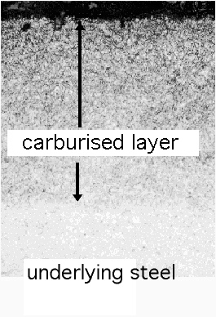
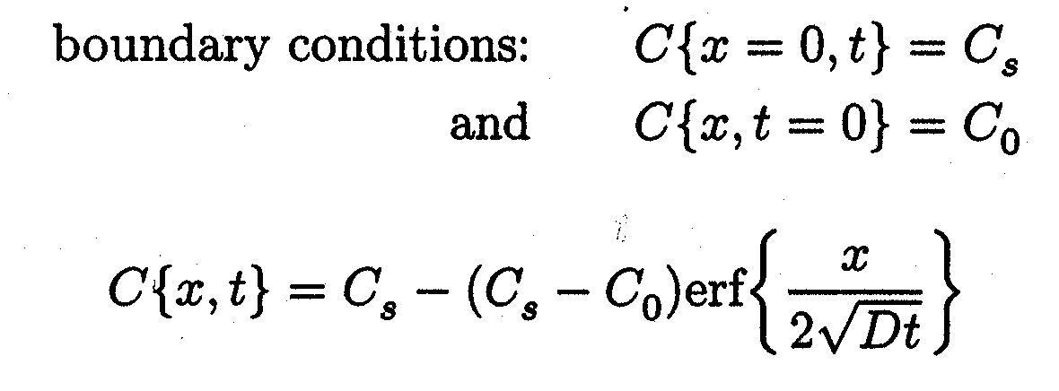
Revision of Lecture 1
Non-steady state diffusion
Fick’s second law
Constant concentration at surface, C_{S}
Average concentration far from surface, C₀

Slide 5
Interdiffusion
Structure sensitive diffusion
Thermodynamics of diffusion
Uphill diffusion

Slide 6
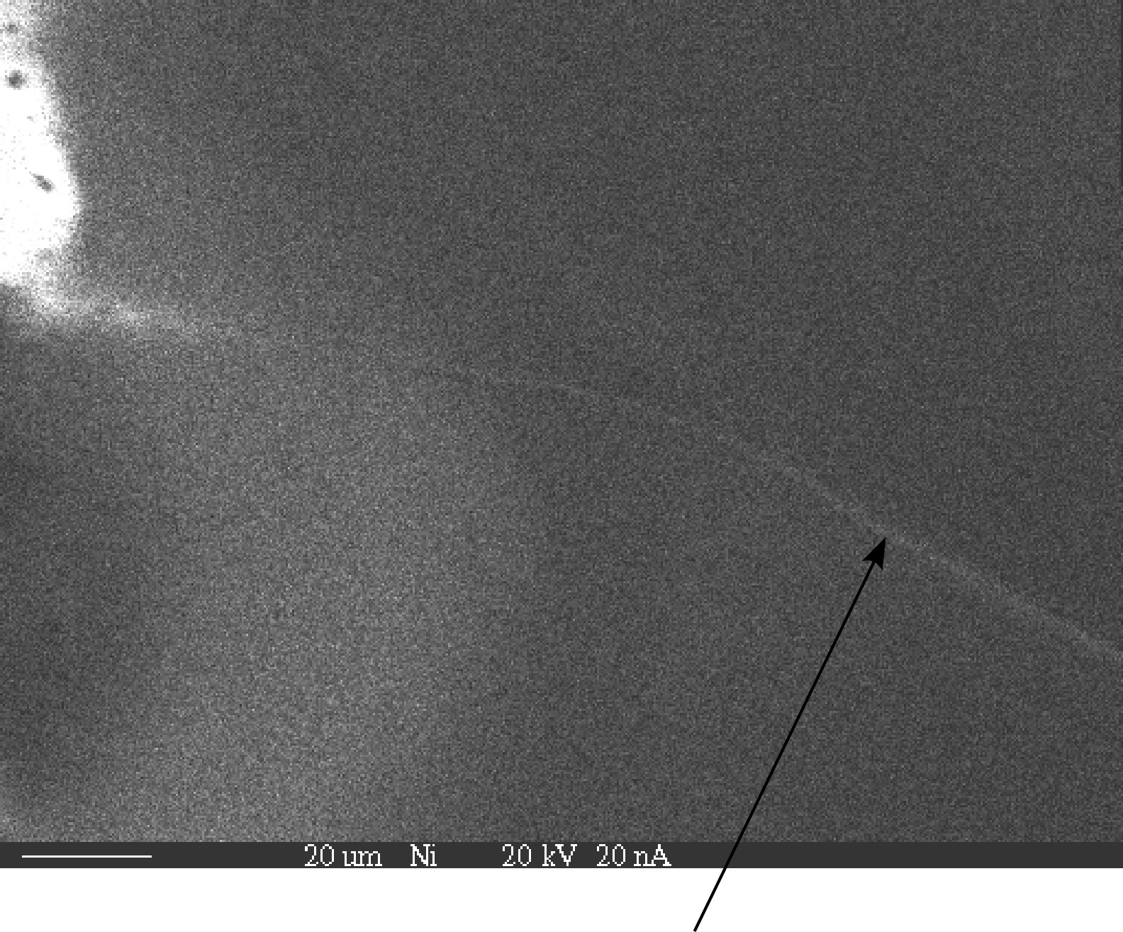

Slide 7
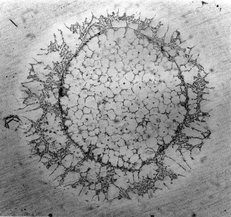
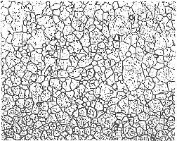
pure aluminium
Al-7Si wt%
Moreno D, Embury JD, SCRIPTA MATERIALIA 40 (7): 821-824 MAR 5 1999

Slide 8
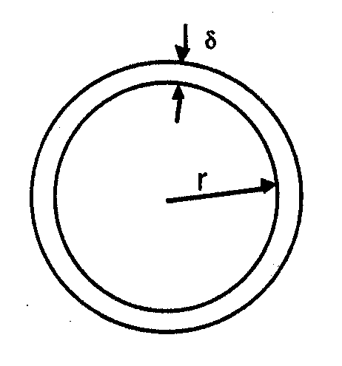
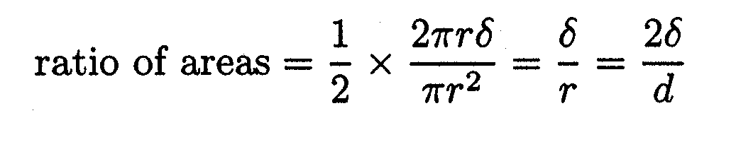
Structure sensitive diffusion

Slide 9
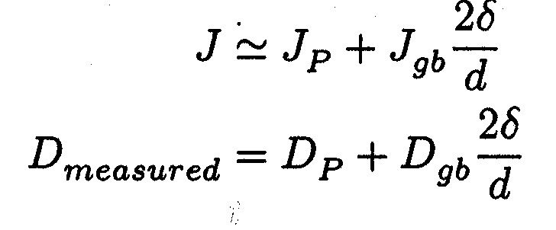

Slide 10
Thermodynamics of diffusion
Flux proportional to solute-concentration gradient?
Flux proportional to solute-free energy gradient?

Slide 11
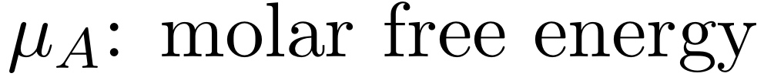


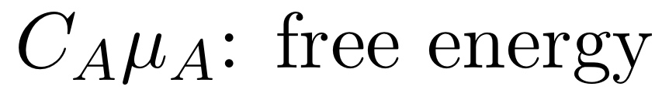
Binary A-B solution
in which A is the solute

Slide 12
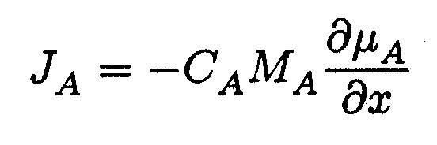
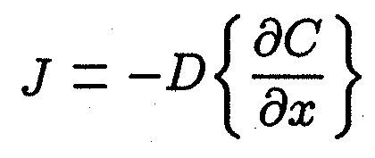
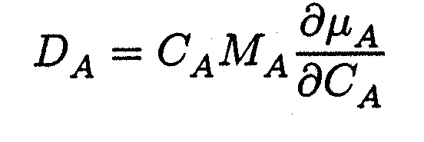

Slide 13
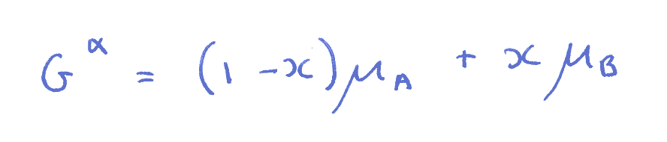

Slide 14
μ
o
B
μ
o
Gibbs free energy per mole
A
μ
A
G{x}
μ
B
A
B
x
Composition

Slide 15
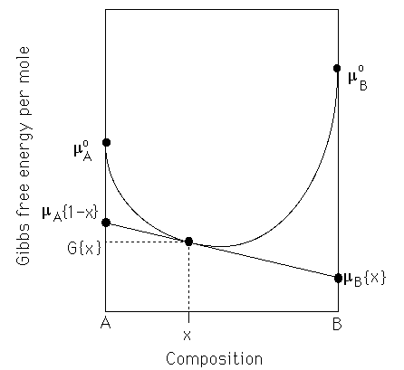

Slide 16
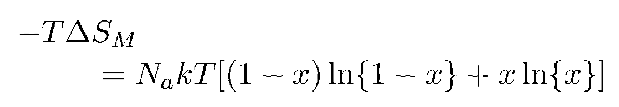
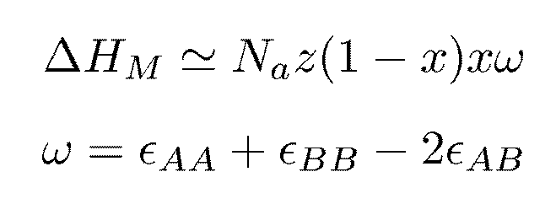

Slide 17
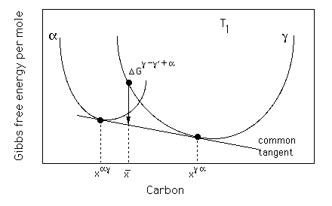

Slide 18
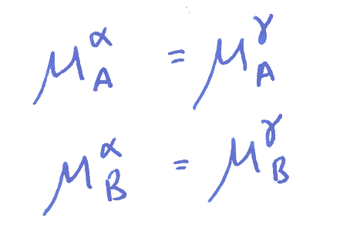

Slide 19
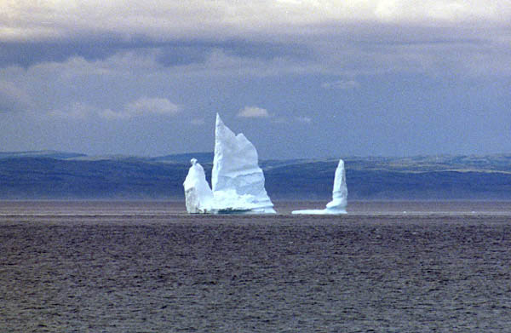

Slide 21
