Slide 1

Part IB
Materials Science and Metallurgy
Course A: Metals & Alloys
Professor Harry Bhadeshia
Lecture 3: Solidification

Slide 2
Solidification of pure metal
Interface motion
Geometry of solidificaiton
Dendrites
Soidification of binary alloy

Slide 3
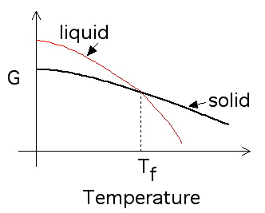

Slide 4


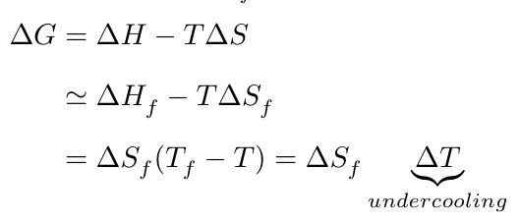

Slide 5
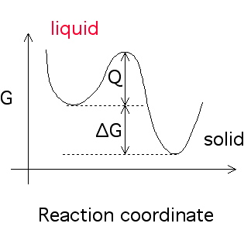
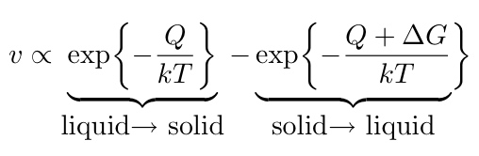

Slide 6
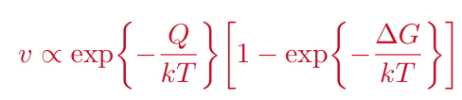
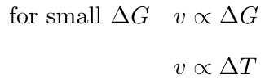

Slide 7
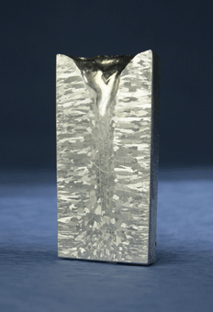
Ingots

Slide 8
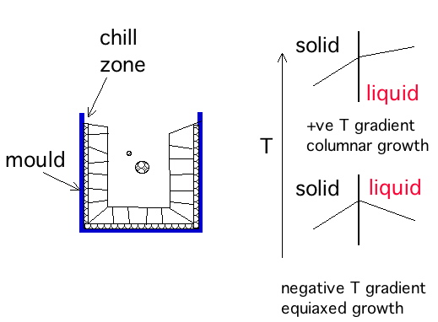

Slide 9

dendrites

Slide 10
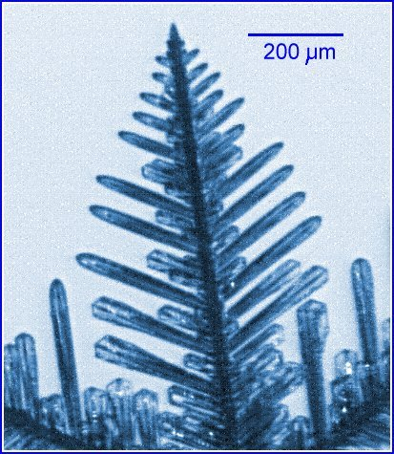
dendrite of ice in water

Slide 11
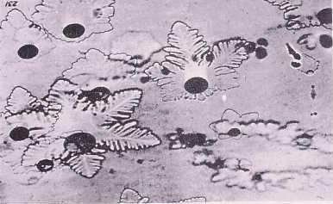
dendrites of water in ice

Slide 12

Dendrites of ice on window, Harbin, China

Slide 13
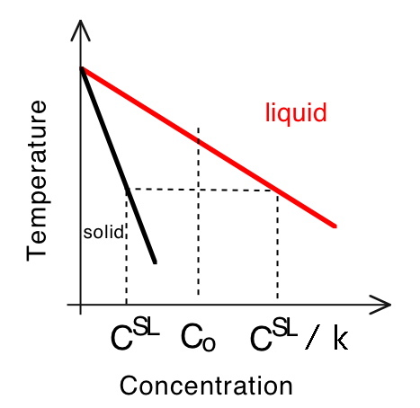

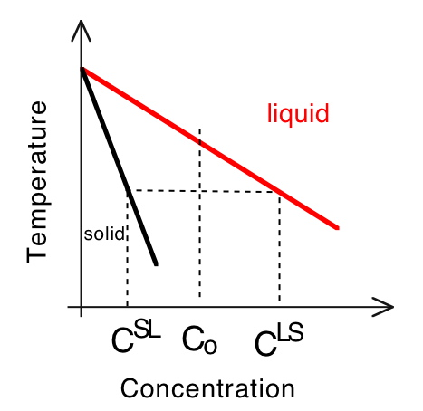
Binary alloy

Slide 14
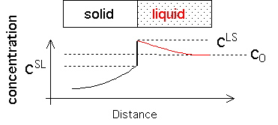

Slide 15
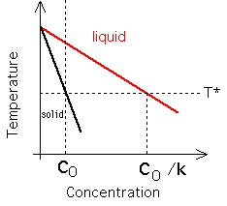

Slide 16
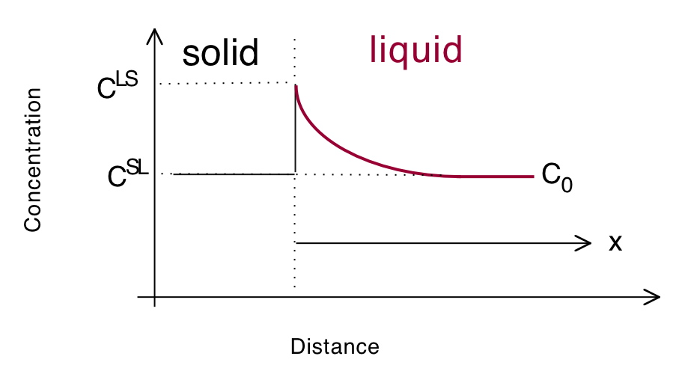



Slide 17
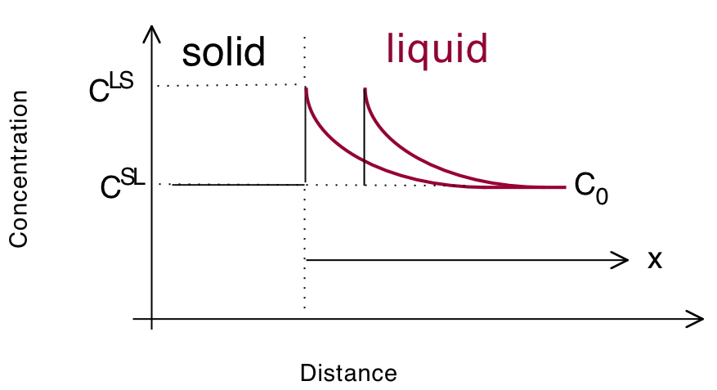
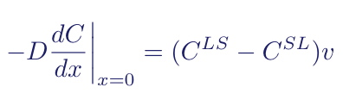

Slide 18
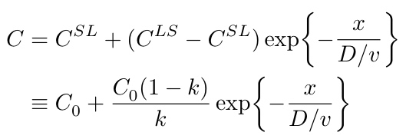

Slide 19
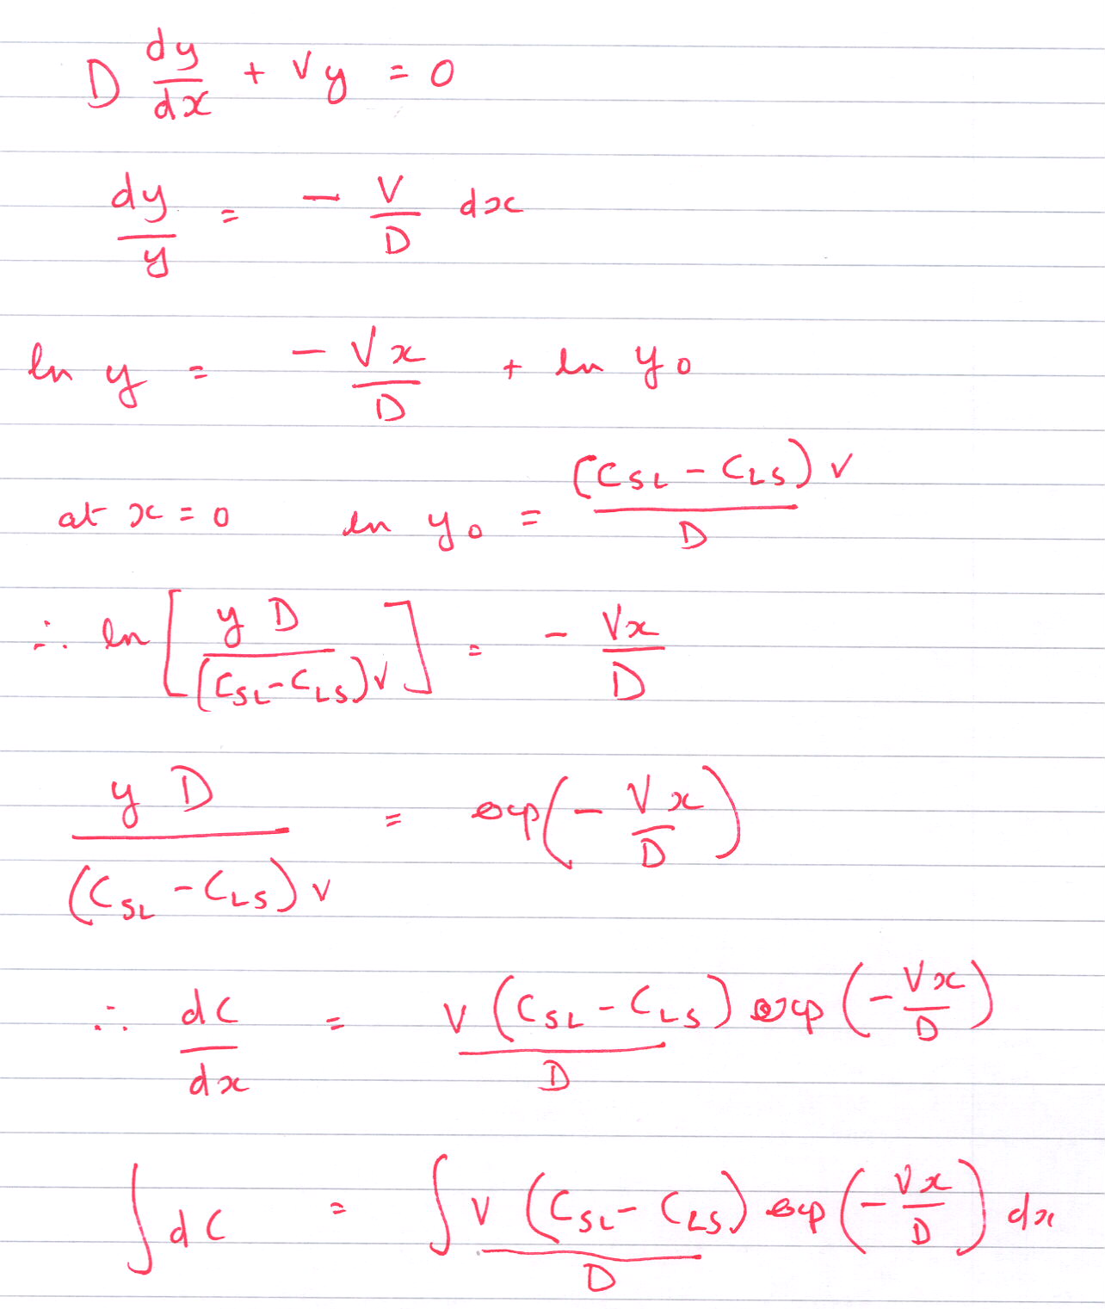

Slide 20
Assumptions
Steady-state growth
Binary alloy
Equilibrium at interface

Slide 21
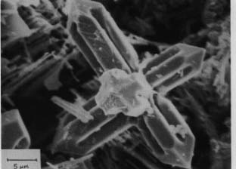
Facetted dendrites

