Slide 1

Part IB
Materials Science and Metallurgy
Course A: Metals & Alloys
Professor Harry Bhadeshia
Lecture 4: Solidification

Slide 2
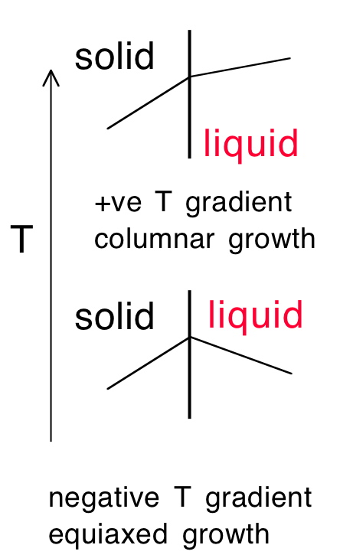
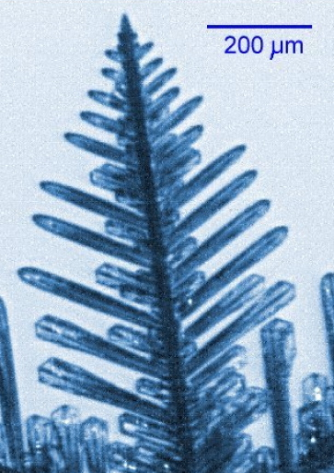

Slide 3
Constitutional supercooling
Cells and dendrites in alloys
Non-equilibrium solidification
Segregation
Banding

Slide 4

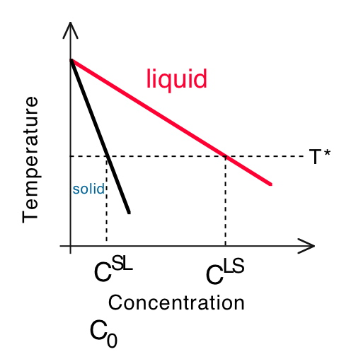
Consider steady-state solidification

Slide 5
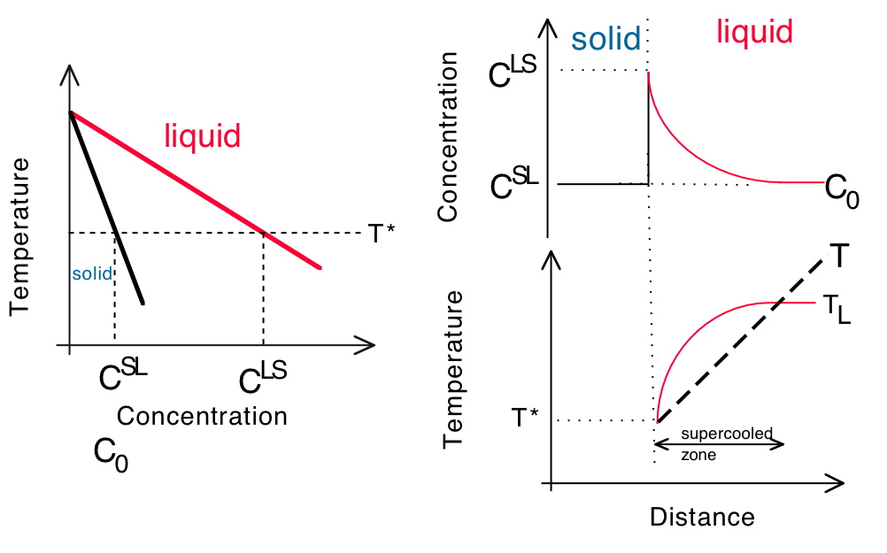

Slide 6
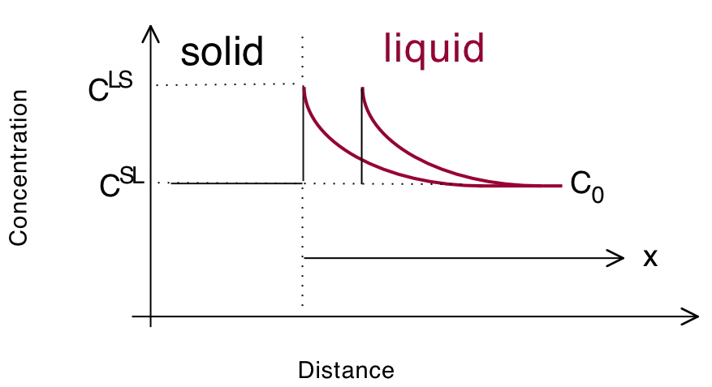
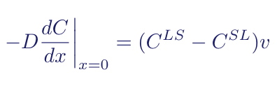

Slide 7
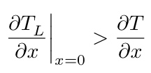
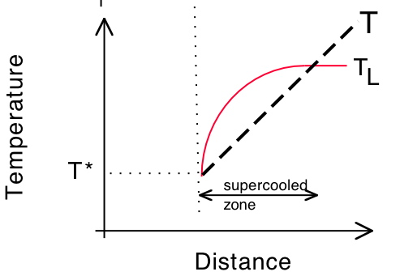
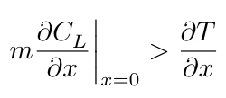
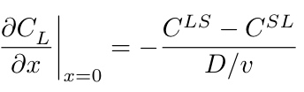

T

Slide 8

Vitali Pavlik of Aachen University

Slide 9
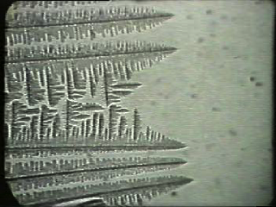
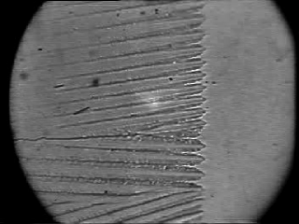
Professor Wilfried Kurz of the Swiss Federal Institute of Technology Lausanne

Slide 10
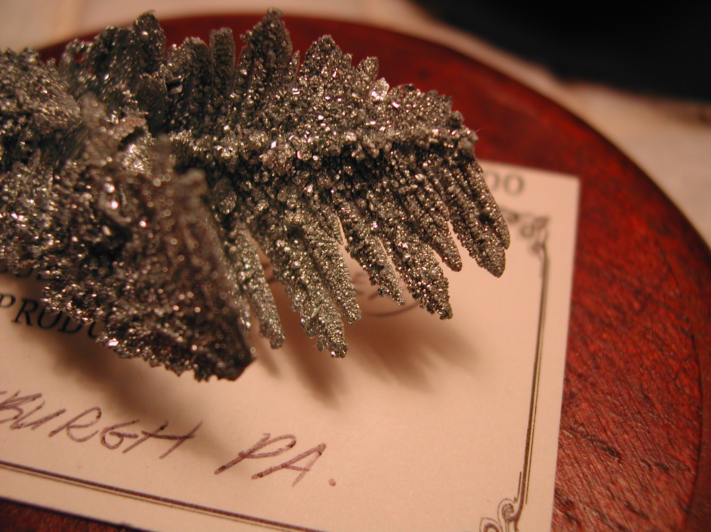
Dendrites of zinc rescued from partially solidified melt

Slide 11
Constitutional supercooling
Cells and dendrites in alloys
Non-equilibrium solidification
Segregation
Banding

Slide 12
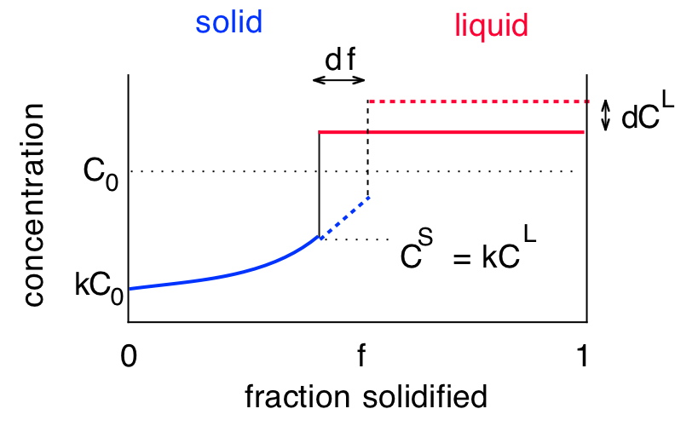


Slide 13




Slide 14
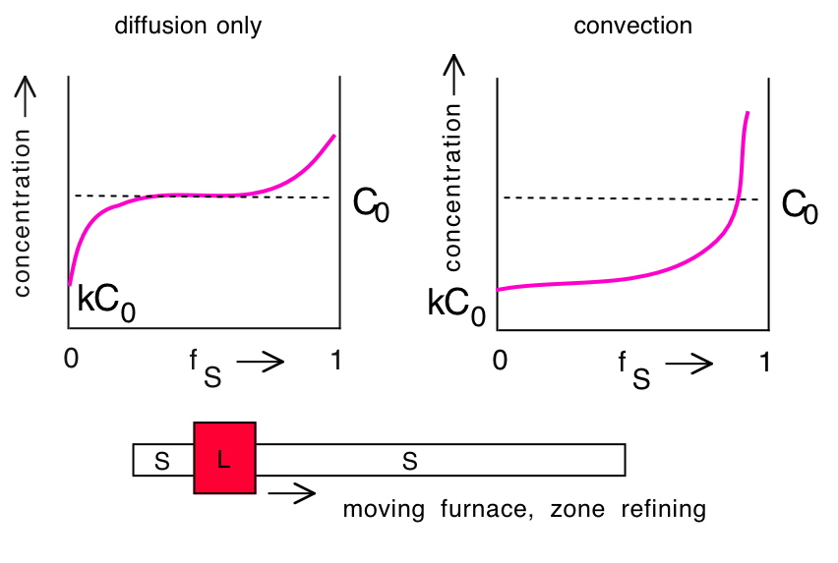

Slide 15
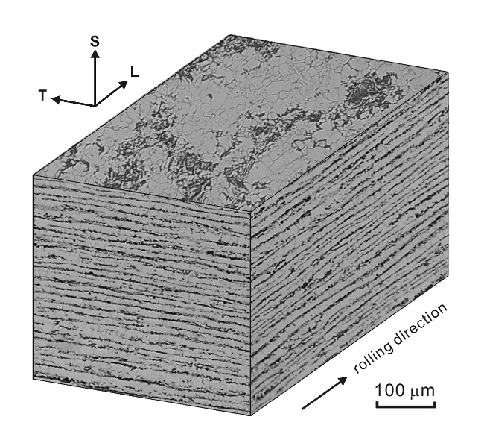
Korda et al., 2006

Slide 16
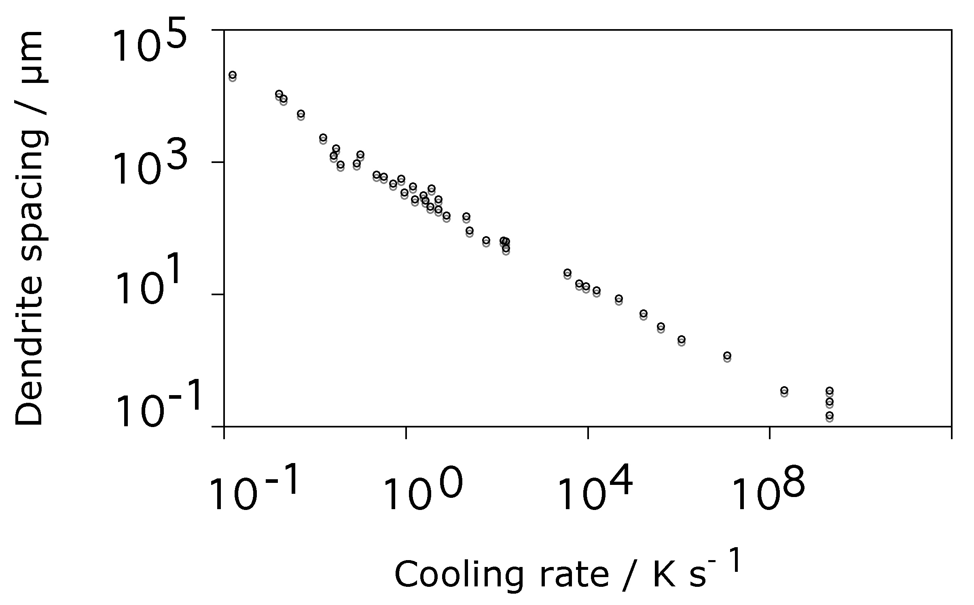

Data from H. Jones, 1982

