Slide 1

Part IB
Materials Science and Metallurgy
Course A: Metals & Alloys
Professor Harry Bhadeshia
Lecture 6: The Solid-State

Slide 2
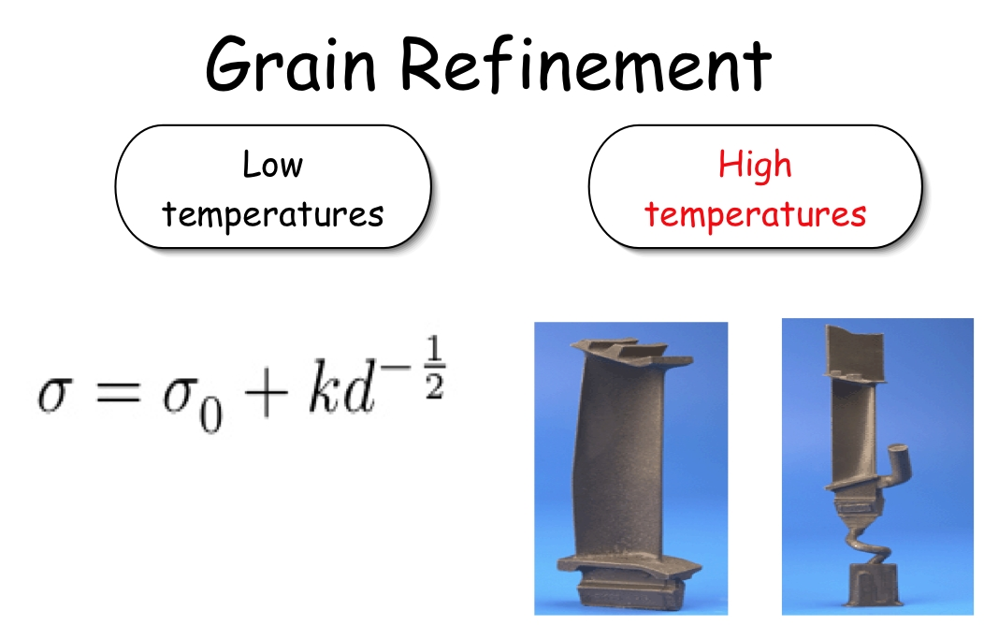

Slide 3

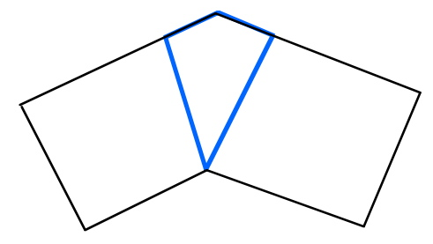
Single crystal
bicrystal

Slide 4
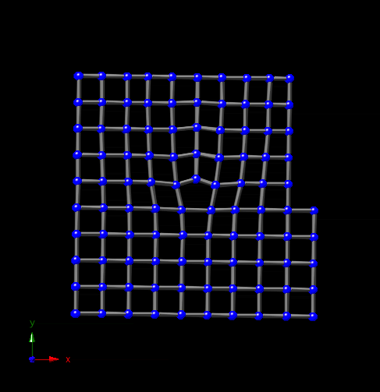

Slide 5
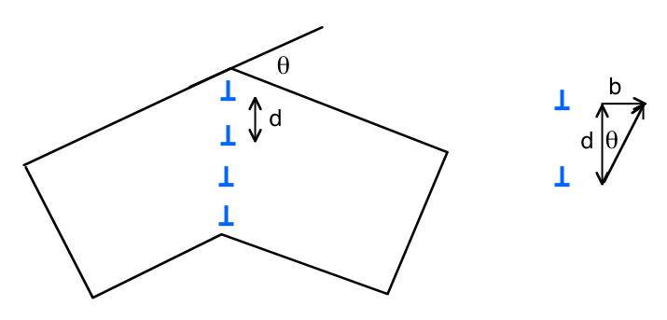

Slide 6
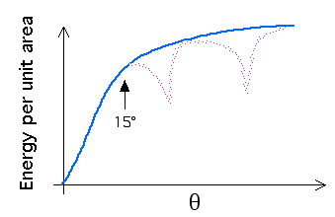
Dislocation has an energy per unit length
Boundary has an energy per unit area

Slide 7
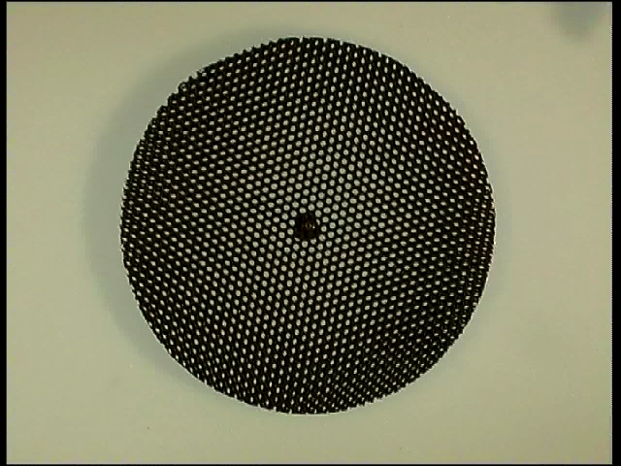
Coincidence site lattice

Slide 8
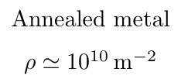
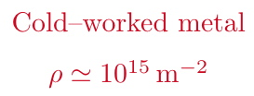

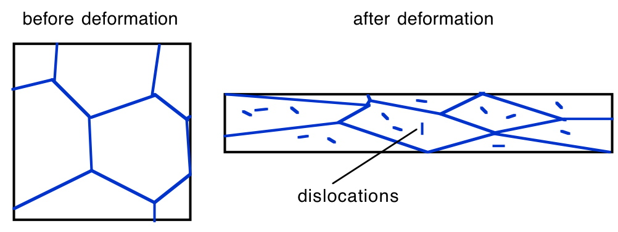

Slide 9
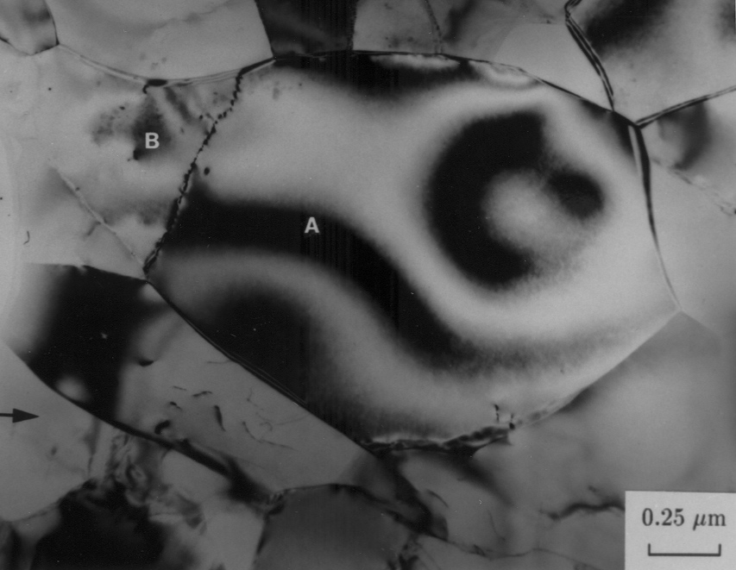
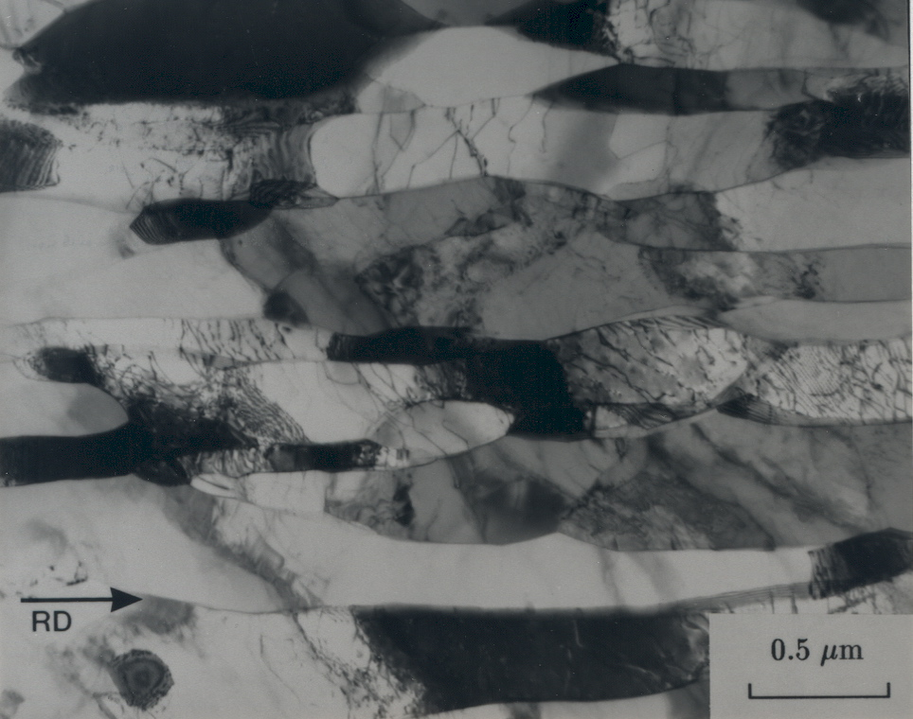
after deformation
before deformation
Deards, 1992

Slide 10
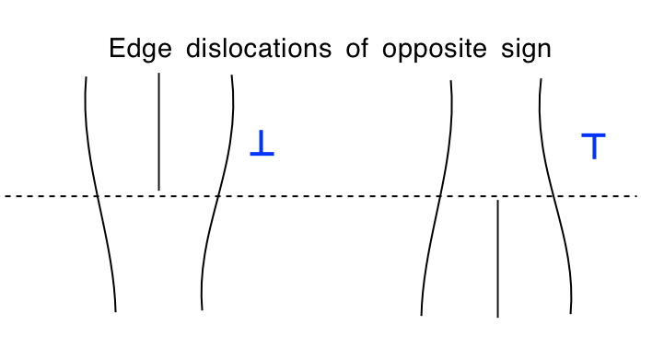

Slide 11
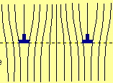
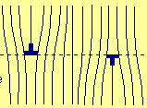
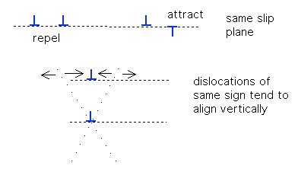

Slide 12
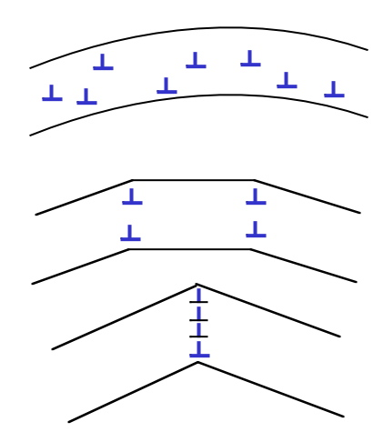
polygonisation

Slide 13
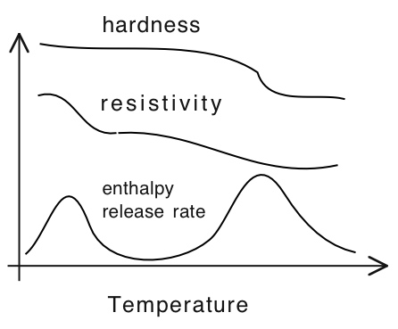

Slide 14
Part IB
Materials Science and Metallurgy
Course A: Metals & Alloys
Professor Harry Bhadeshia
Lecture 7: Recrystallisation, grain growth

Slide 15
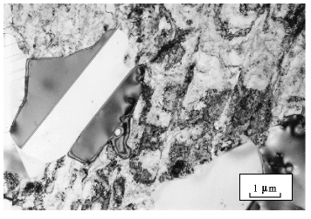

Slide 16
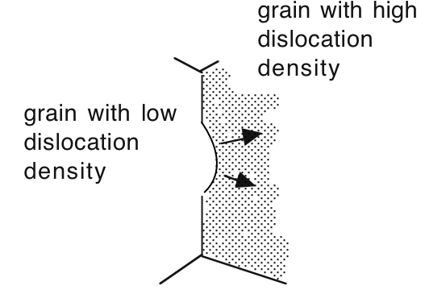

Slide 17

Ian Brough & John Humphreys
Al-0.1Mg wt% cold-rolled 50%

Slide 18
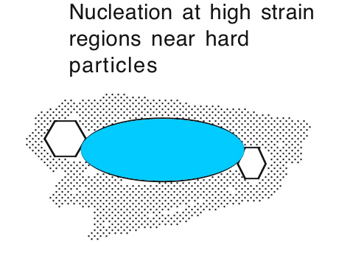

Slide 19
John Humphreys
Al-0.8Si wt% cold-rolled 60%
Acta Met. 25, 1323-1344. 1977

Slide 20
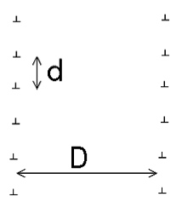





Slide 21
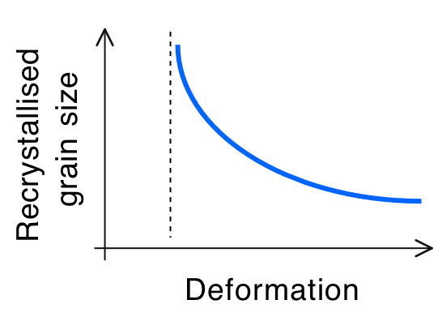

Slide 22
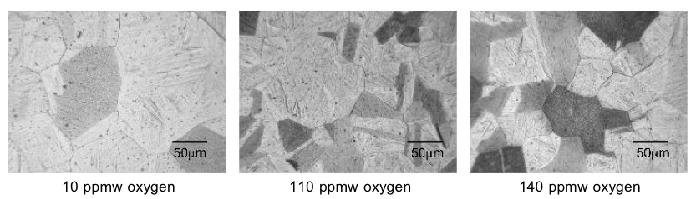
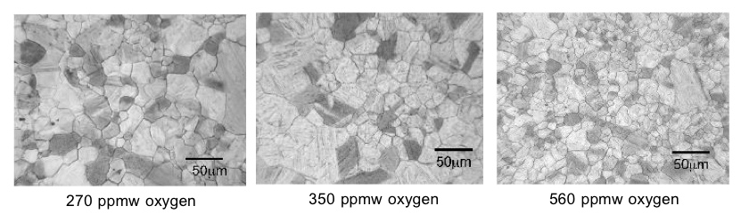
Terashima & Bhadeshia, 2006

Slide 23
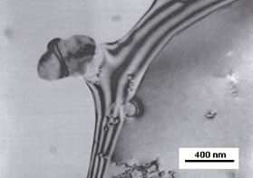

Slide 24
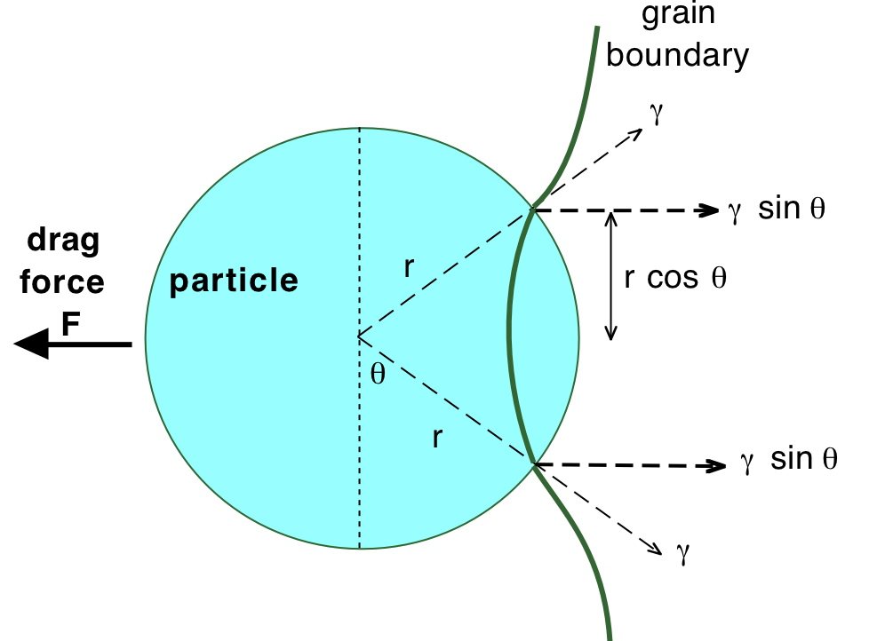

Slide 25



Slide 26
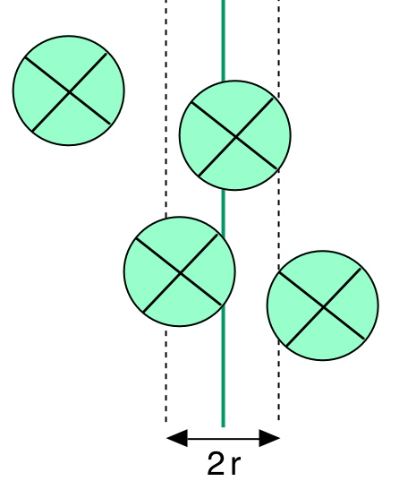



Slide 27


Slide 28
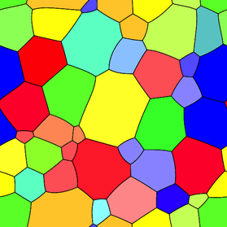




Slide 29
Grain size
Tilt boundary
Cold work
Dislocation interactions
Recovery

