Slide 1

Part IB
Materials Science and Metallurgy
Course A: Metals & Alloys
Professor Harry Bhadeshia
Lecture 8: Precipitation

Slide 2
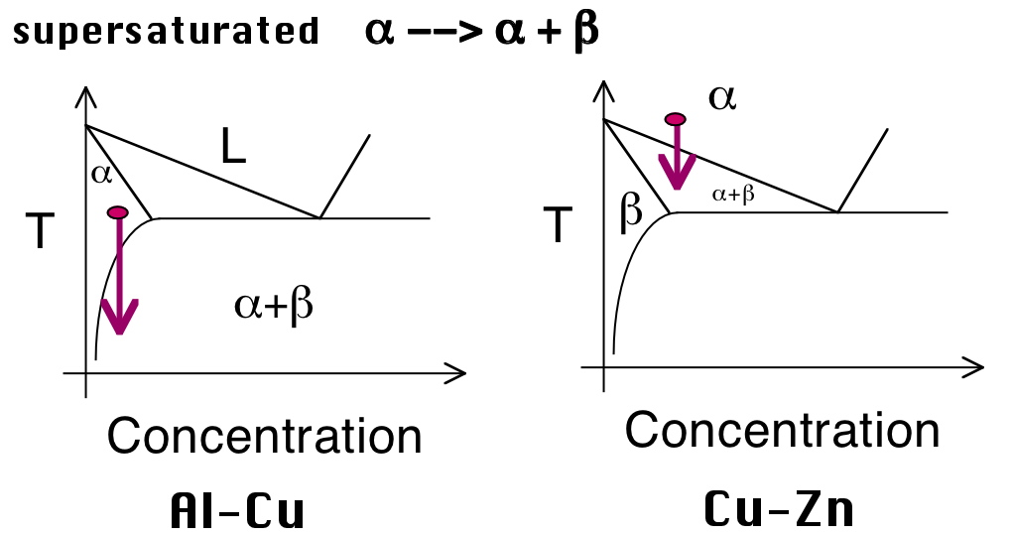

Slide 3
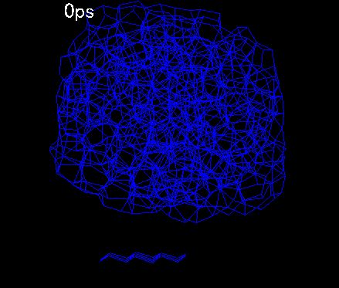
Hetrophase fluctuations
S. Maruyama, University of Tokyo

Slide 4
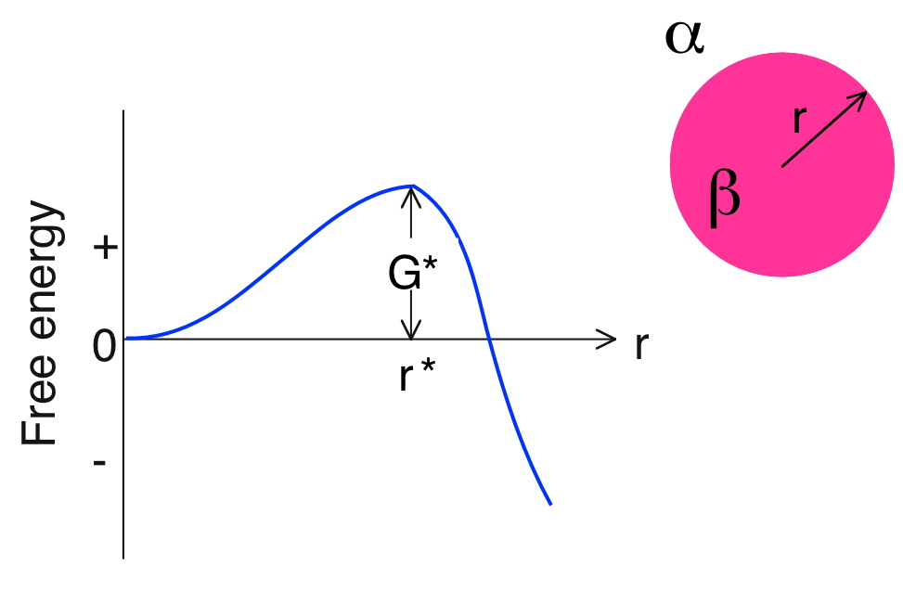



Slide 5
coherent
incoherent

Slide 6
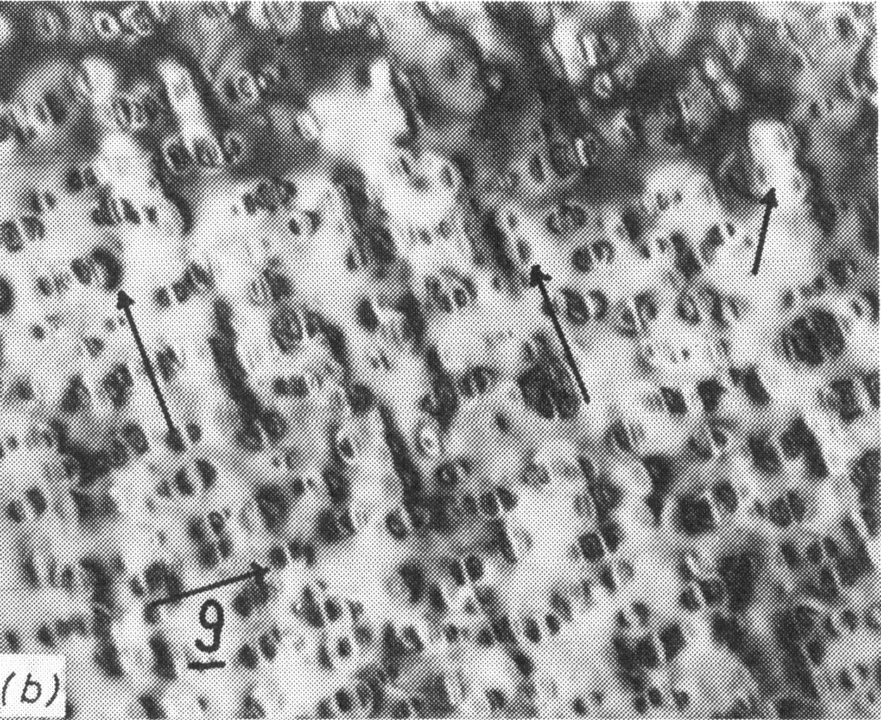
Ni-Cr-Ti-Al, Hirsch, Howie, Nicholson, Pashley, Whelan, 1977

Slide 7
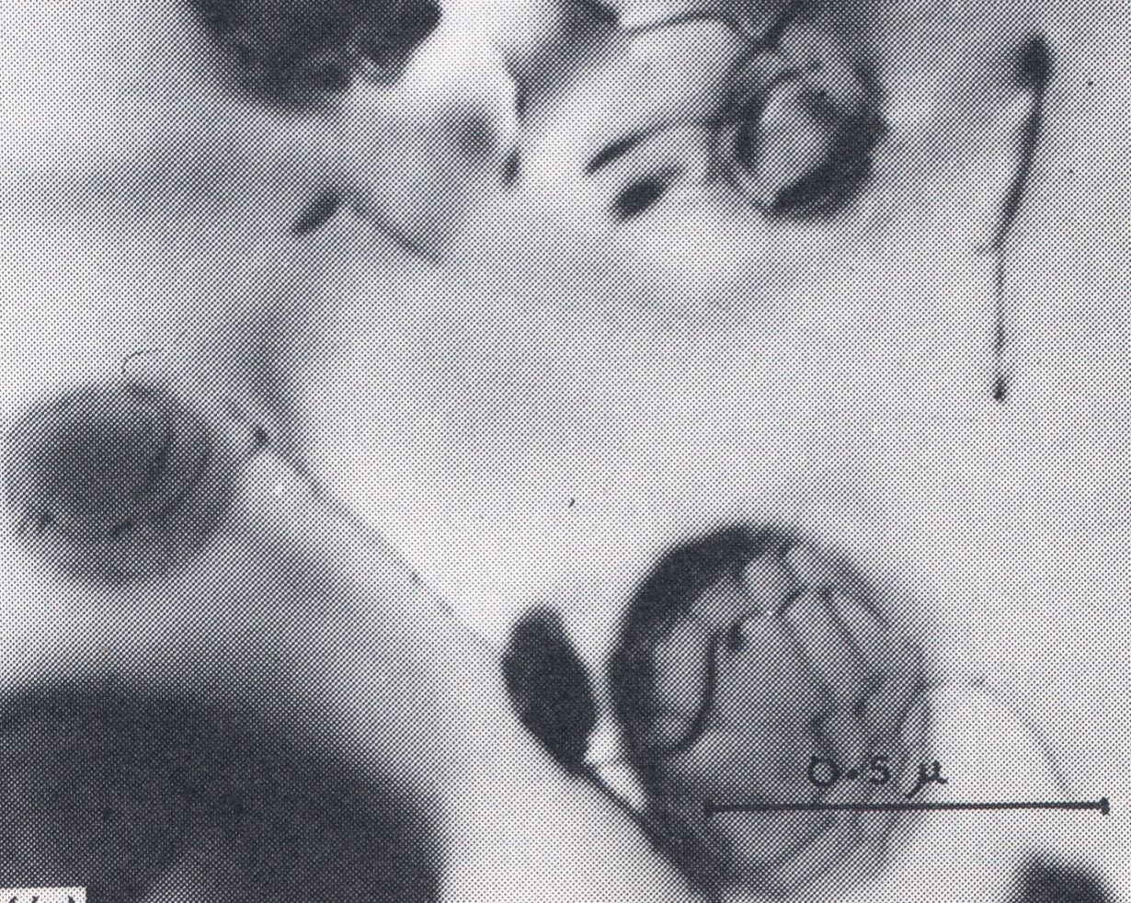
Ni-Cr-Ti-Al, Hirsch, Howie, Nicholson, Pashley, Whelan, 1977

Slide 8
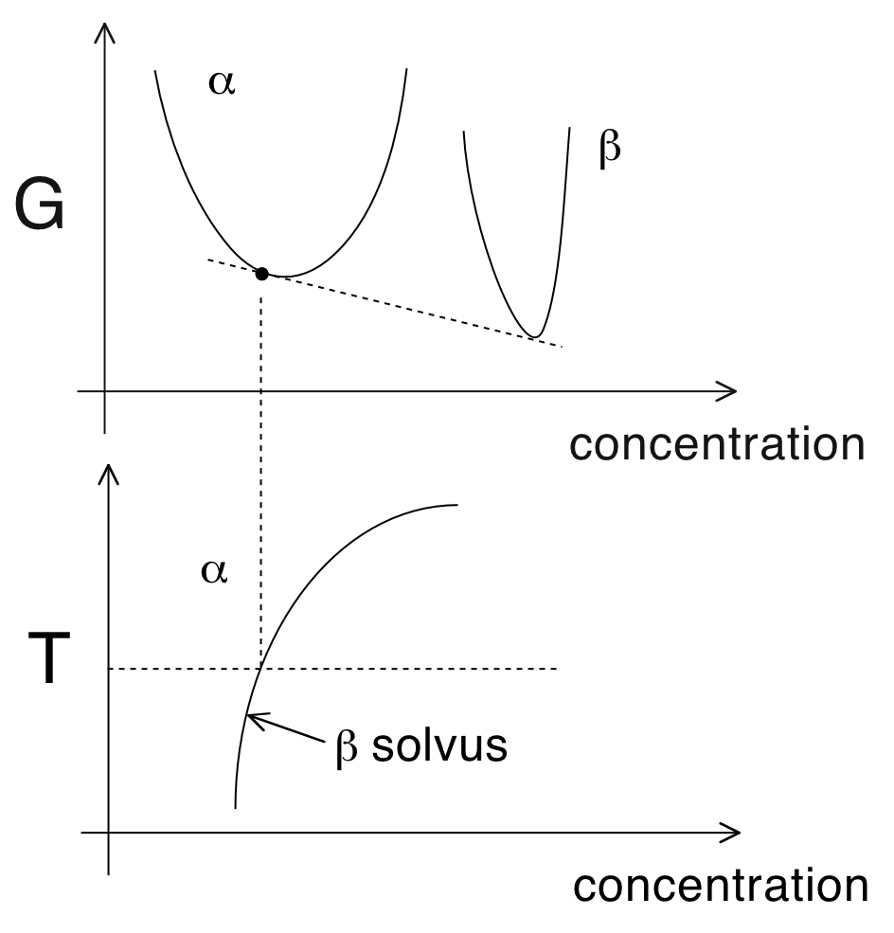

Slide 9
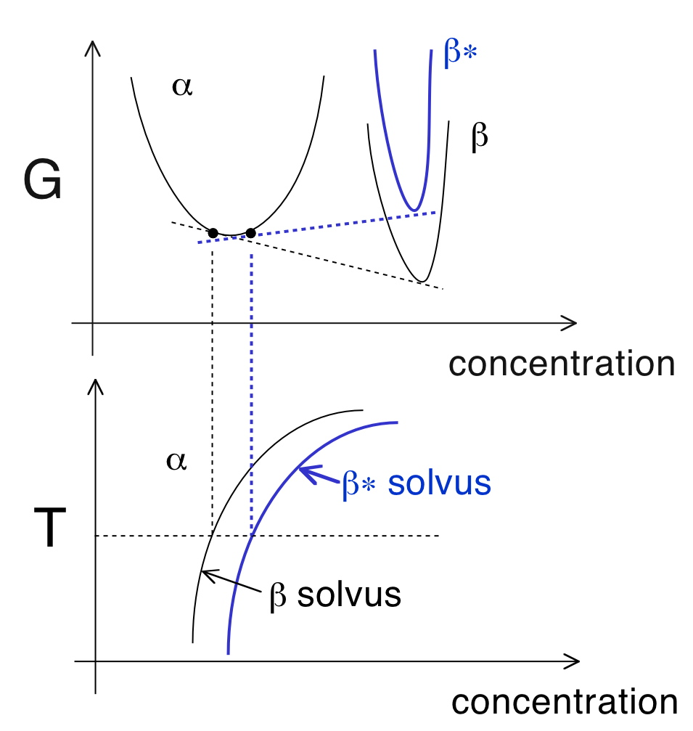

Slide 10
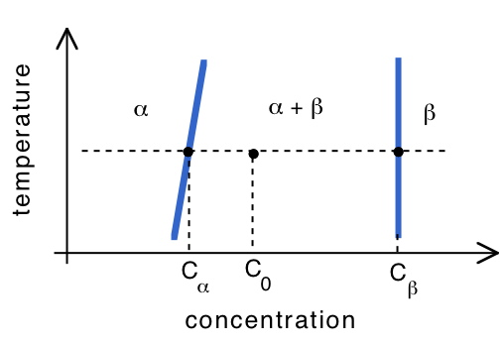
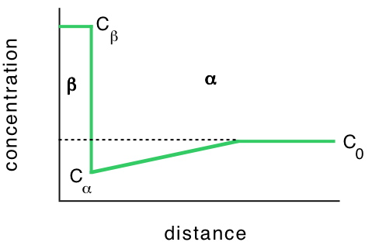

Slide 11



Slide 12
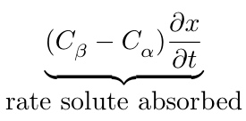
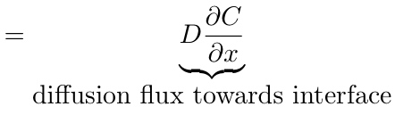
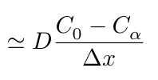

Slide 13



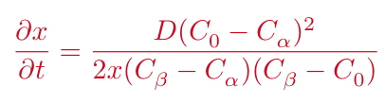

Slide 14
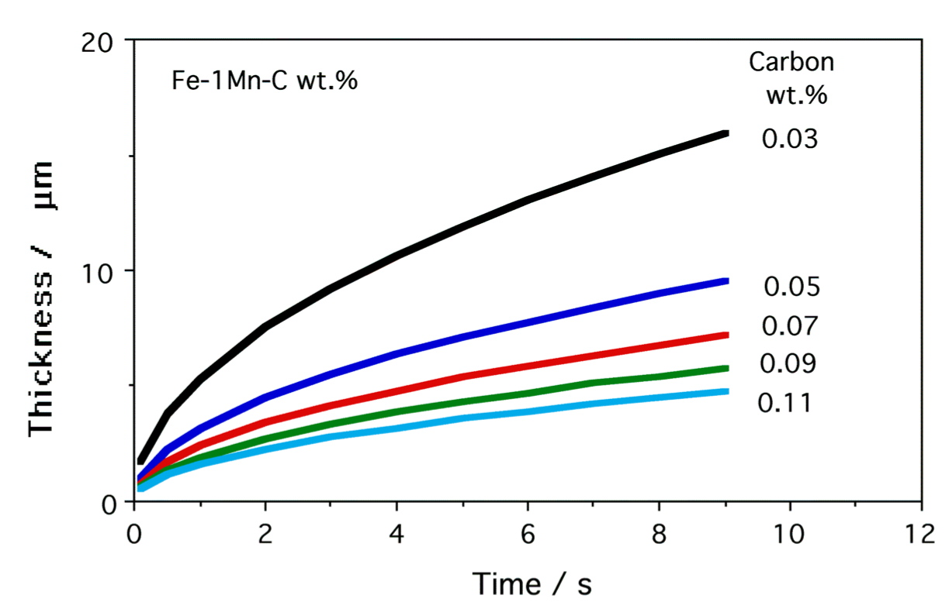
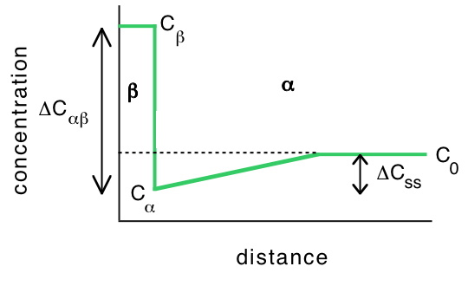

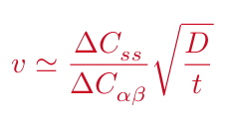

Slide 15
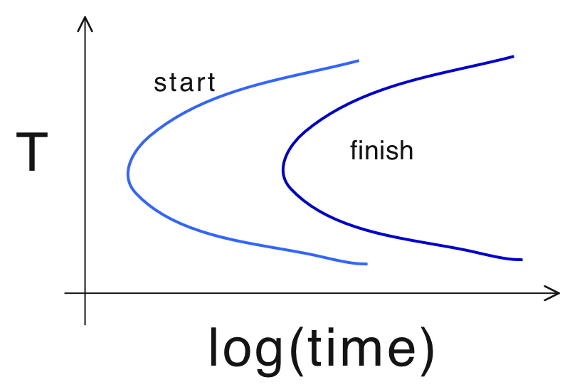

Slide 16
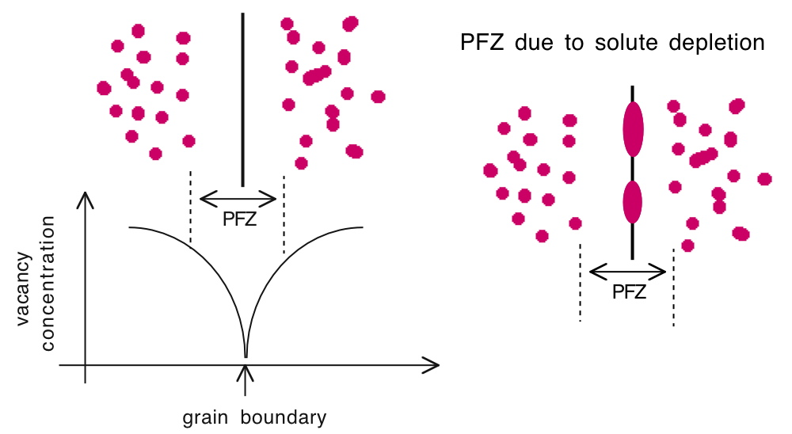

Slide 17

Precipitate-free zones:
Enhanced corrosion
Weak zones
Clad Al-Cu alloys

Slide 18
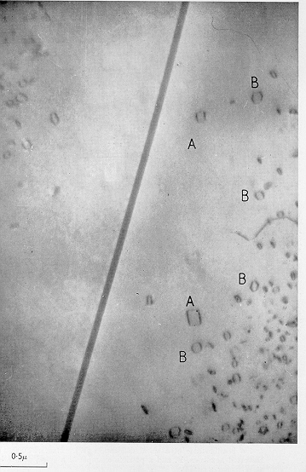
Condensed vacancy loops
Hirsch, Silcox, Smallman and Westmacott.

Slide 19
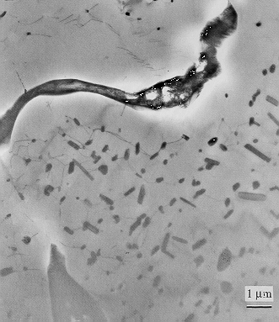
T. Takasugi

Slide 20
