Slide 1
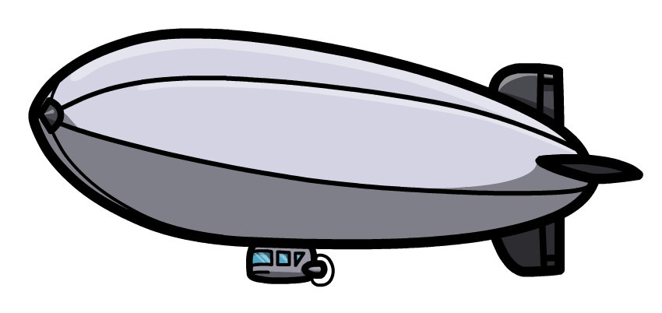
Aluminium-copper alloys
Phase transitions
Harry Bhadeshia
Haixue Yan

Slide 2
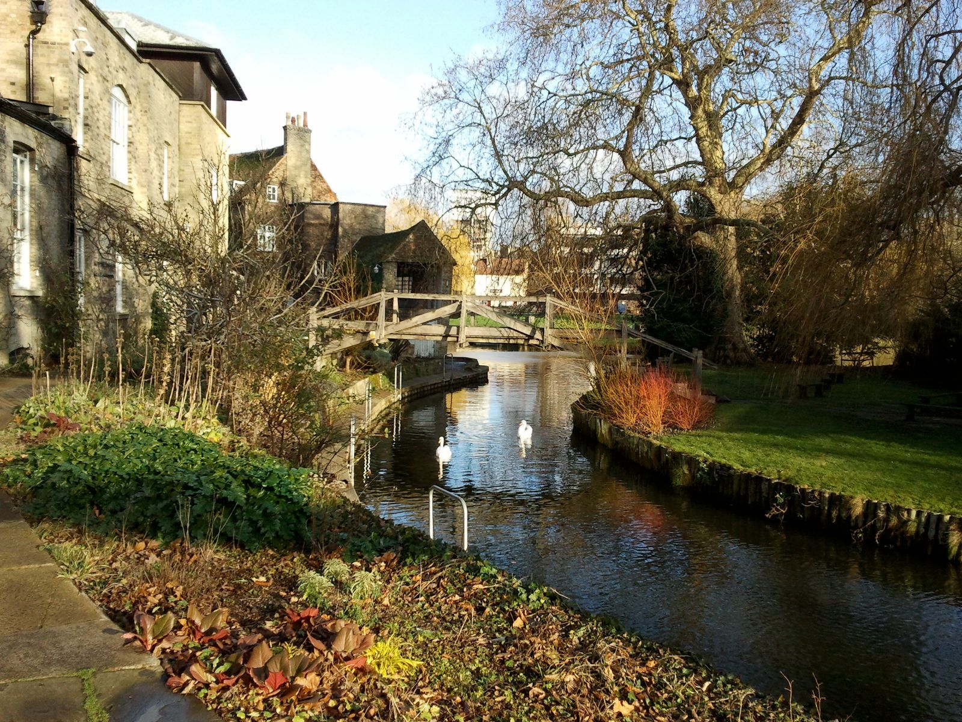
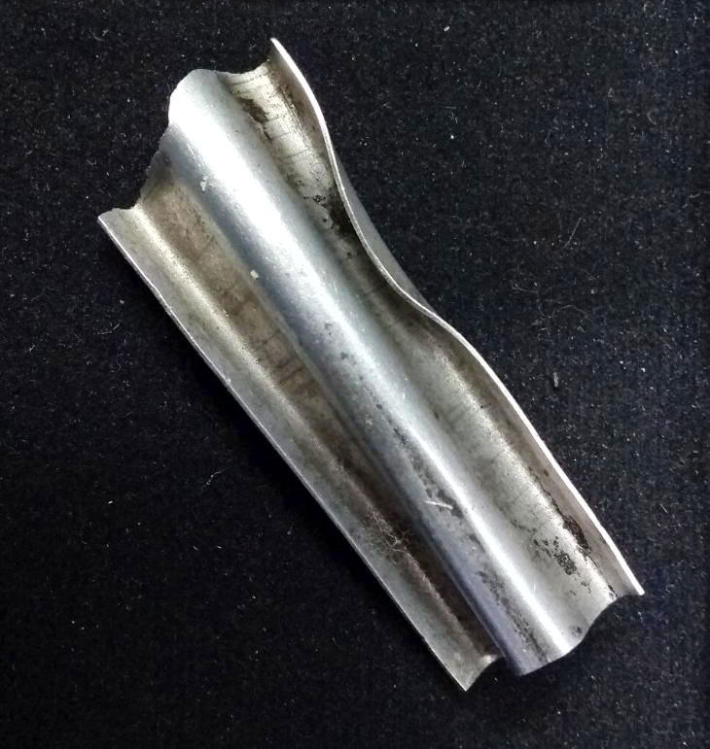
encounter with Michael Cook
about 3 cm in length
Darwin College

Slide 3
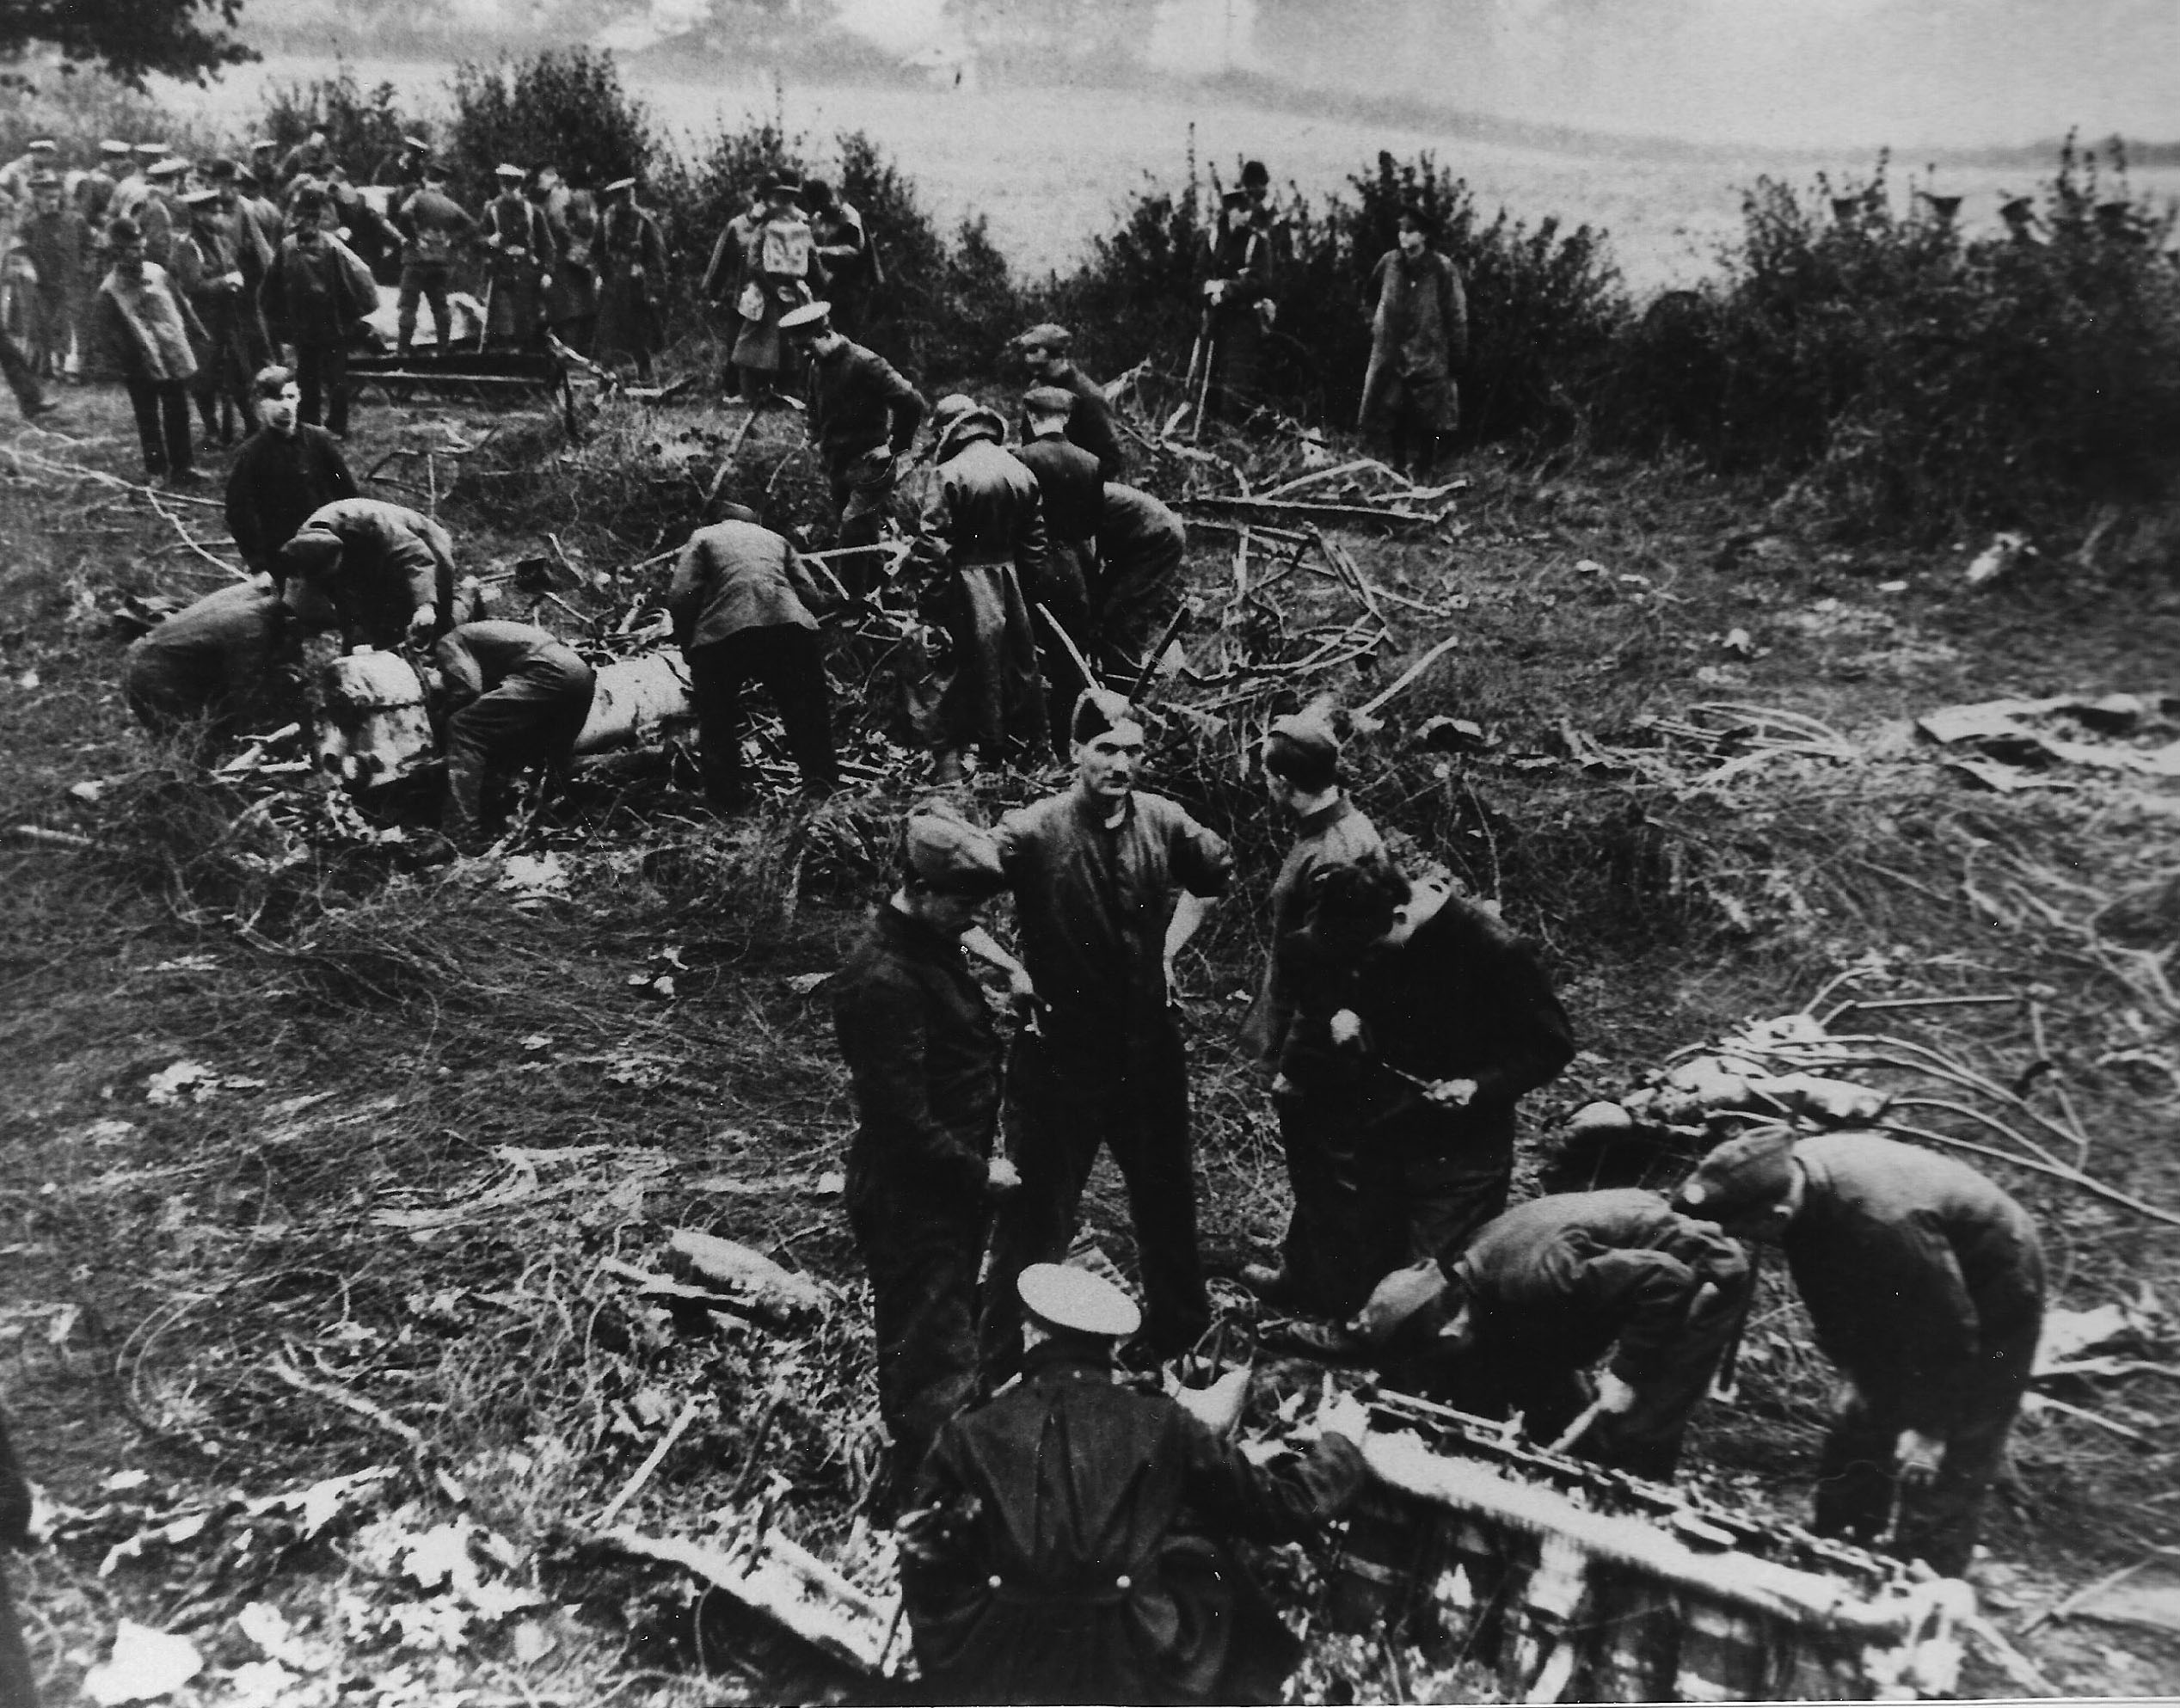
Royal Flying Corps personnel examining the debris from the
reproduced with permission of Cllr Peter Dace, Northshaw & Cuffley Parish Council
https://northawcuffleypc.org.uk/w-l-robinson-vc/

Slide 4
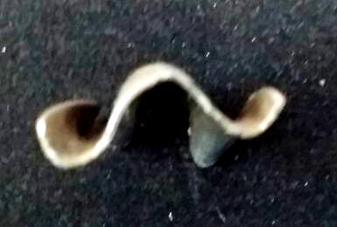
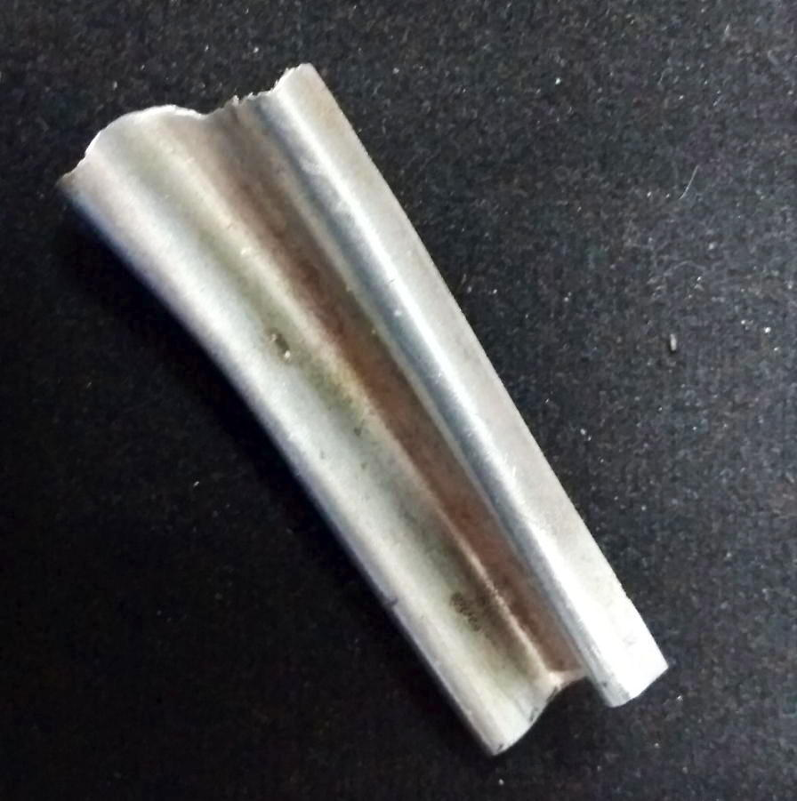
corrugated for engineered rigidity

Slide 5
Duralumin
an aluminium-(10Cu wt%...+Mg, Mn) alloy invented and patented by Alfred Wilm, a Berlin Chemist, in 1906
First produced in Düren (Prussian territory), hence, Duralumin (pronuounced douralumin)
Heat it to say 500°C, quench, leave. It hardens at room temperature over a period of days

Slide 6
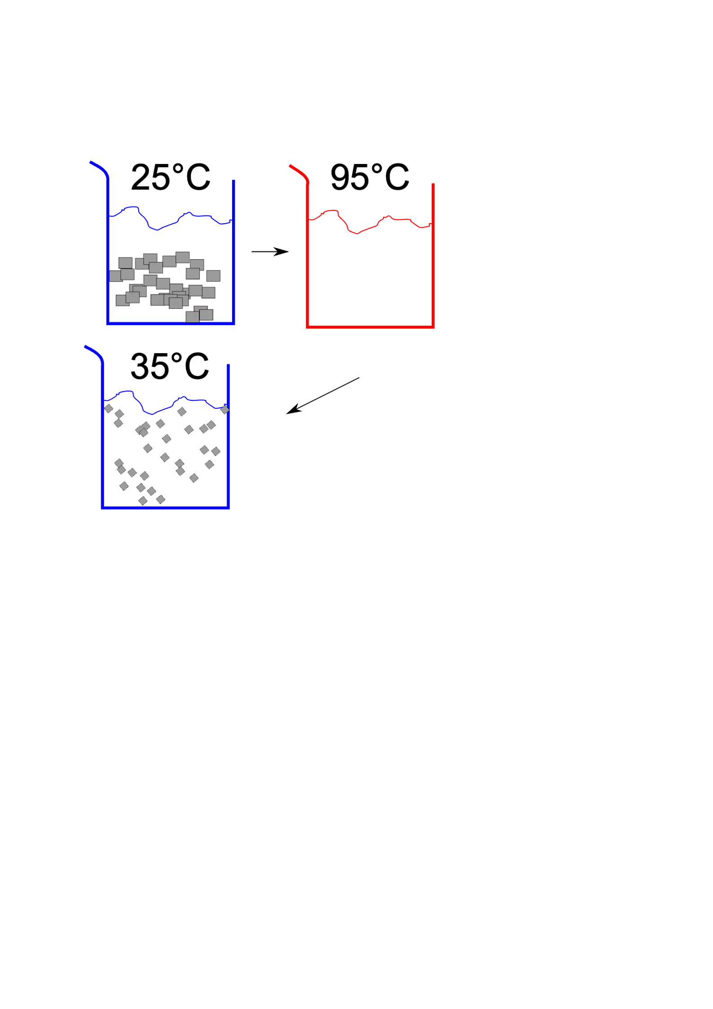
solution

Slide 7

Microscopy & microanalysis

Slide 8
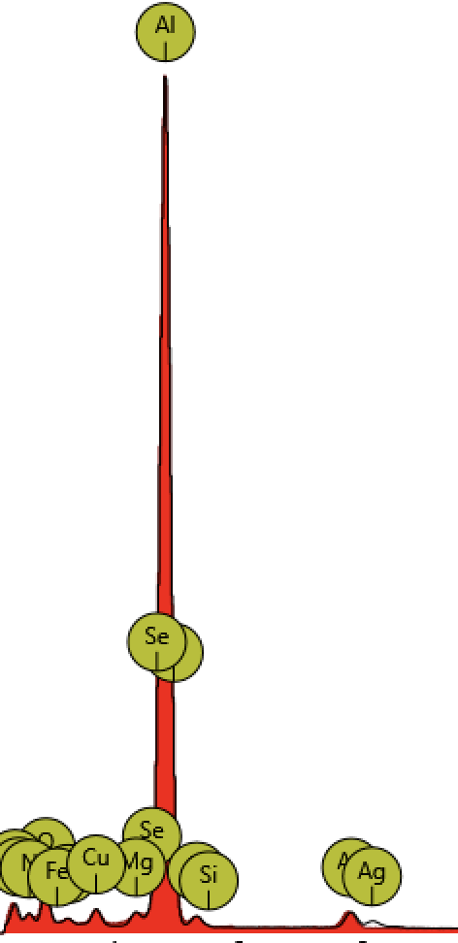
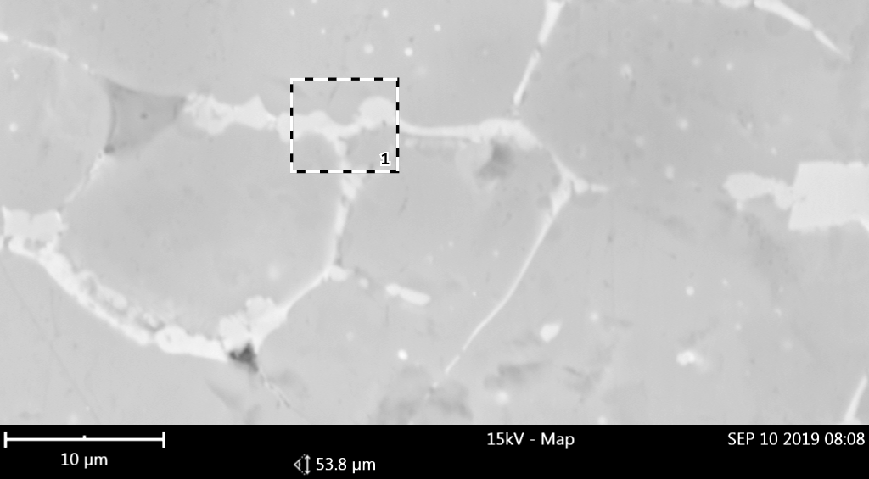
Microanalysis
Aluminium contains copper, magnesium and silver additions

Slide 9
Age hardening: fine precipitates
solution
dissolve solute
controlled heat treatment
precipitate in fine form

Slide 10
suitability for age hardening
A
B

Slide 11
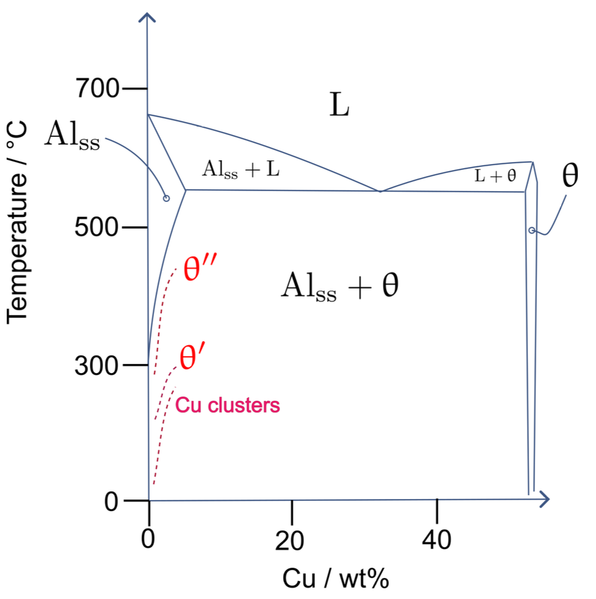
red phases metastable
meaning?
why does metastable form at all?
why does solubility change?

Slide 12
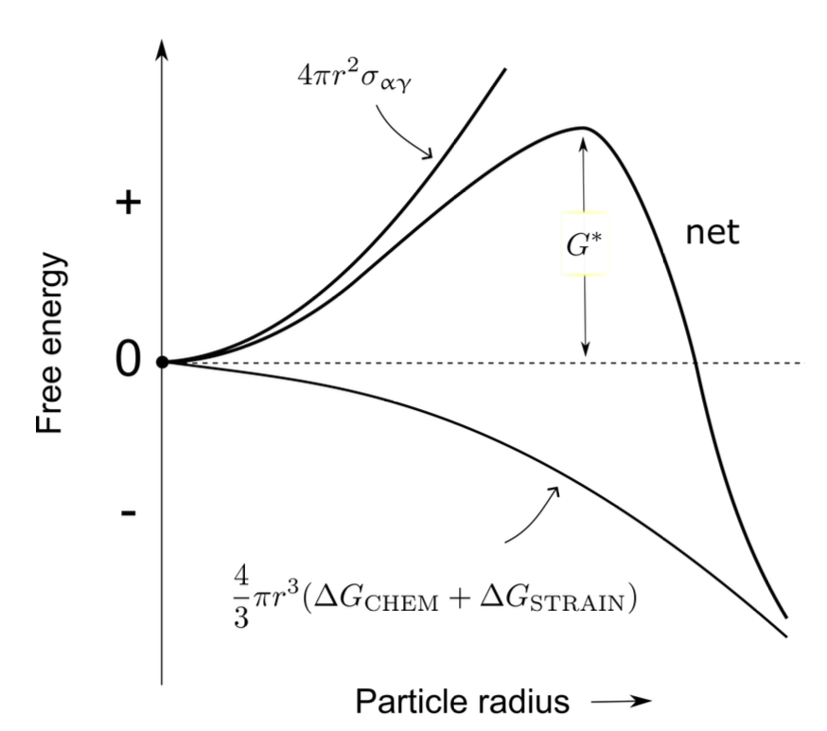
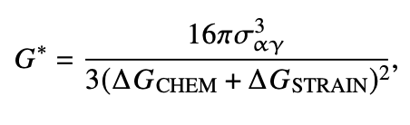

Slide 13
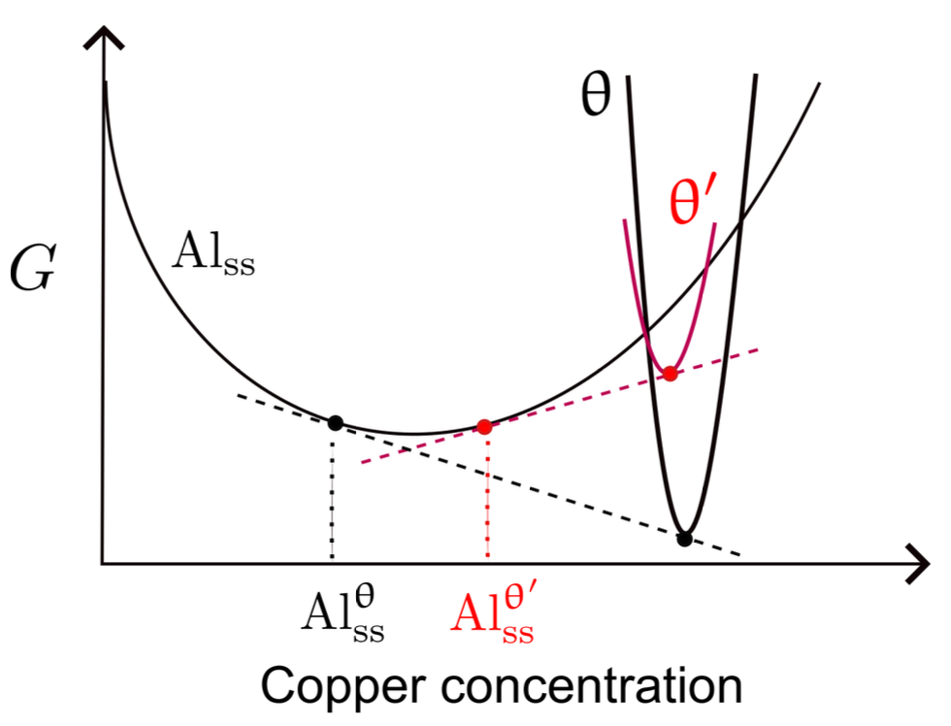

Slide 14
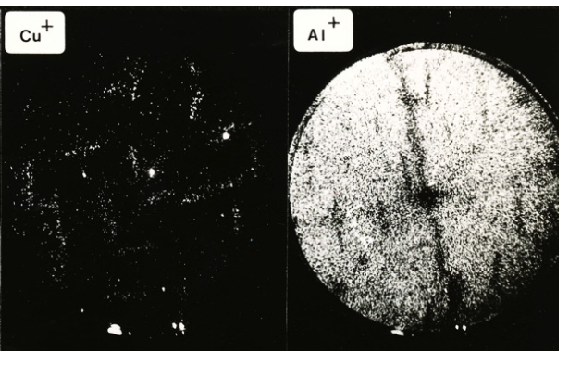
Bob Waugh

Slide 15
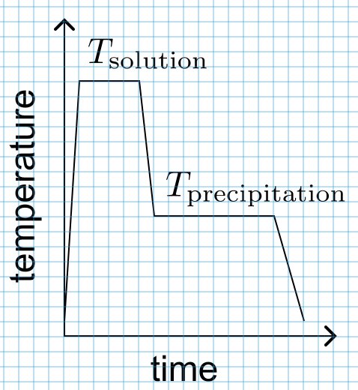

Slide 16
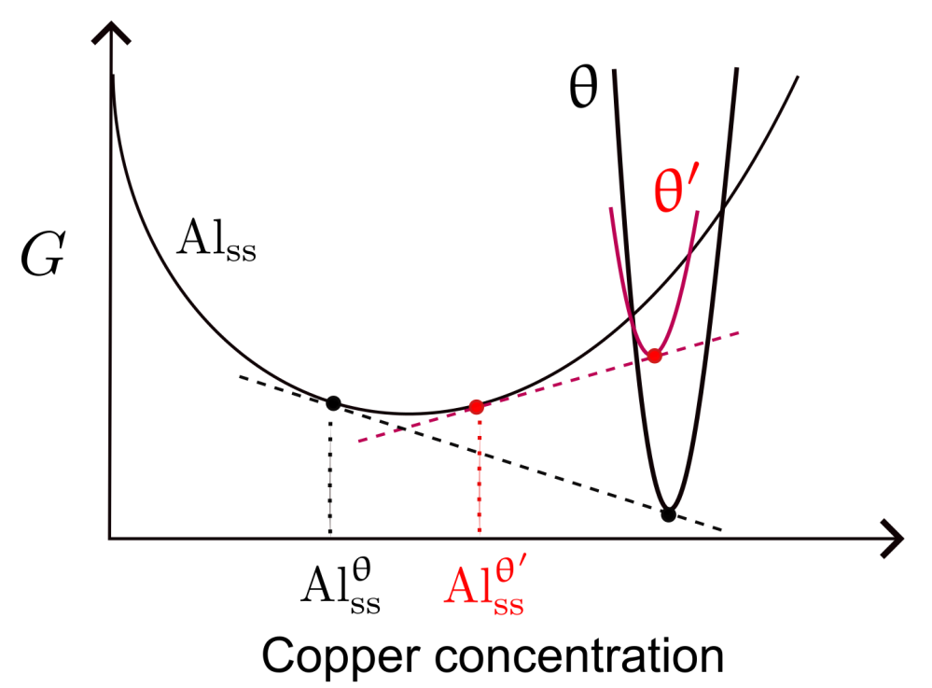
Equilibrium compositions using the common tangent construction.
Metastable precipitate has a greater free energy, than stable one.
Increased solubility of Cu in Al.

Slide 17
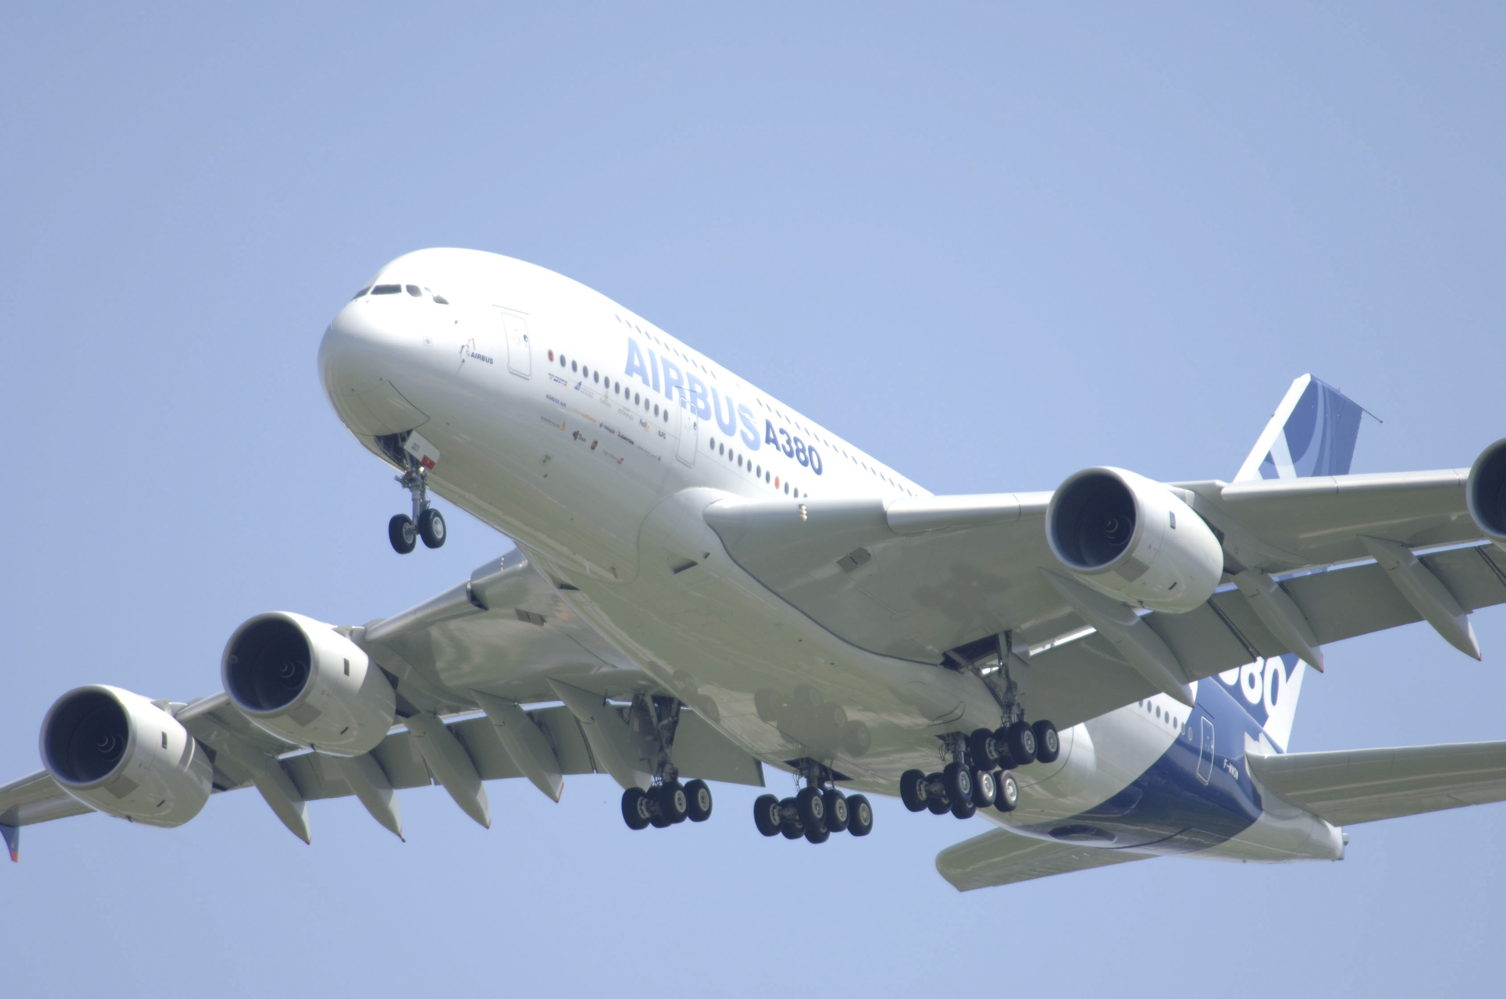

Slide 18
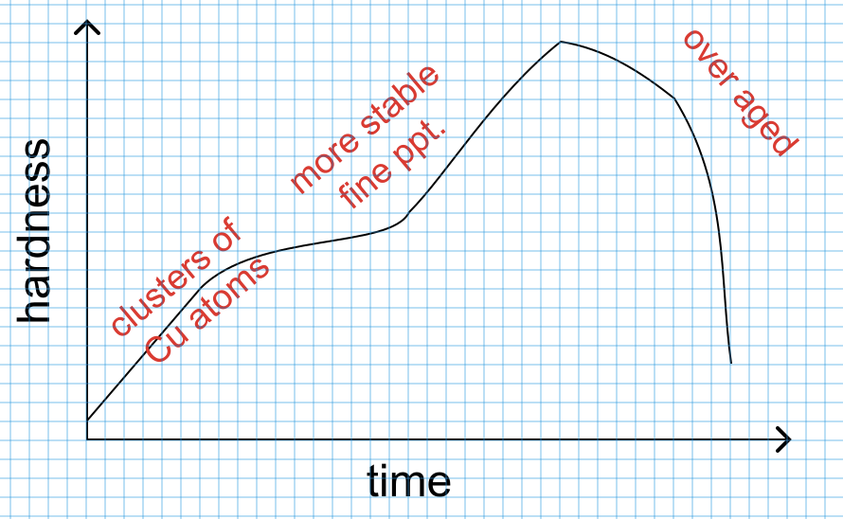

Slide 19
Crystals of liquid? bizarre!

Slide 20
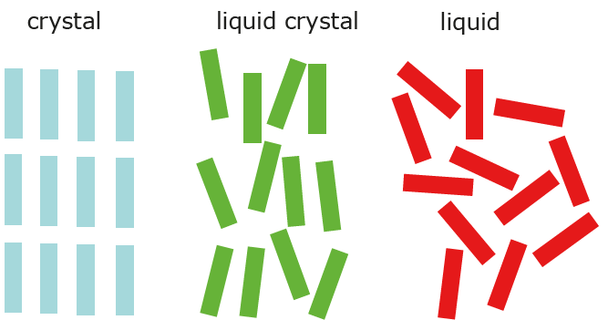
Crystals: long-range order, anisotropic.
Liquids: no long-range order, isotropic.
Liquid crystals are anisotropic liquids due to molecular shape.

Slide 21
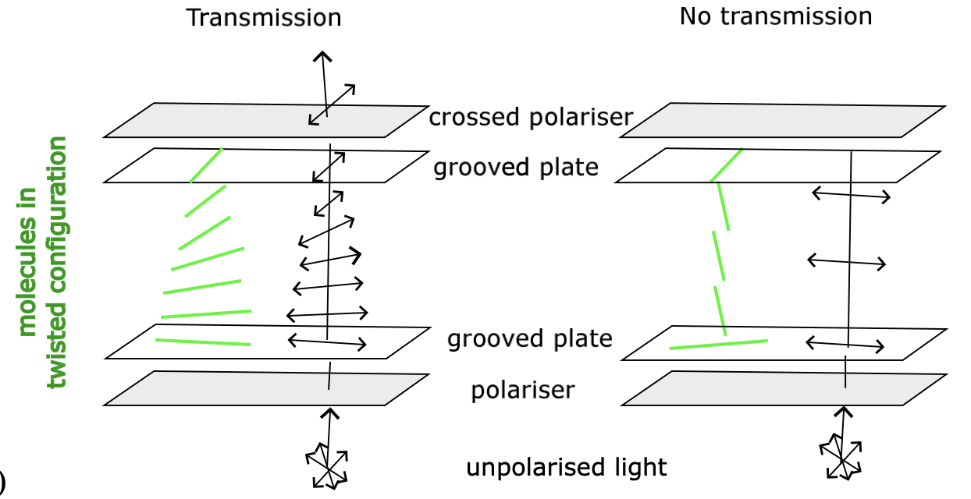

Slide 22
Example 27: cholesterol (first liquid crystal)
Solid cholesterol heated above 145 °C, forms cloudy liquid.
On reaching 170 °C, it clarifies.
This effect is reverisible.
Explain.

Slide 23
Solution 27
Liquid crystal has aligned molecules. Different regions have different orientation. Therefore, scatter light, cloudy.
At higher temperature, disorder, true liquid, so no domains to scatter light.

